Slide 1
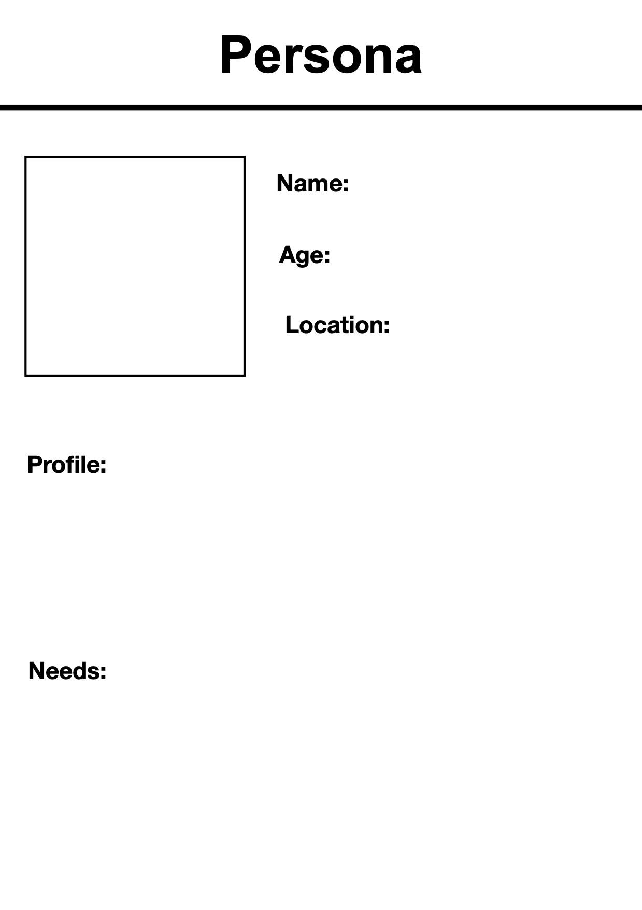
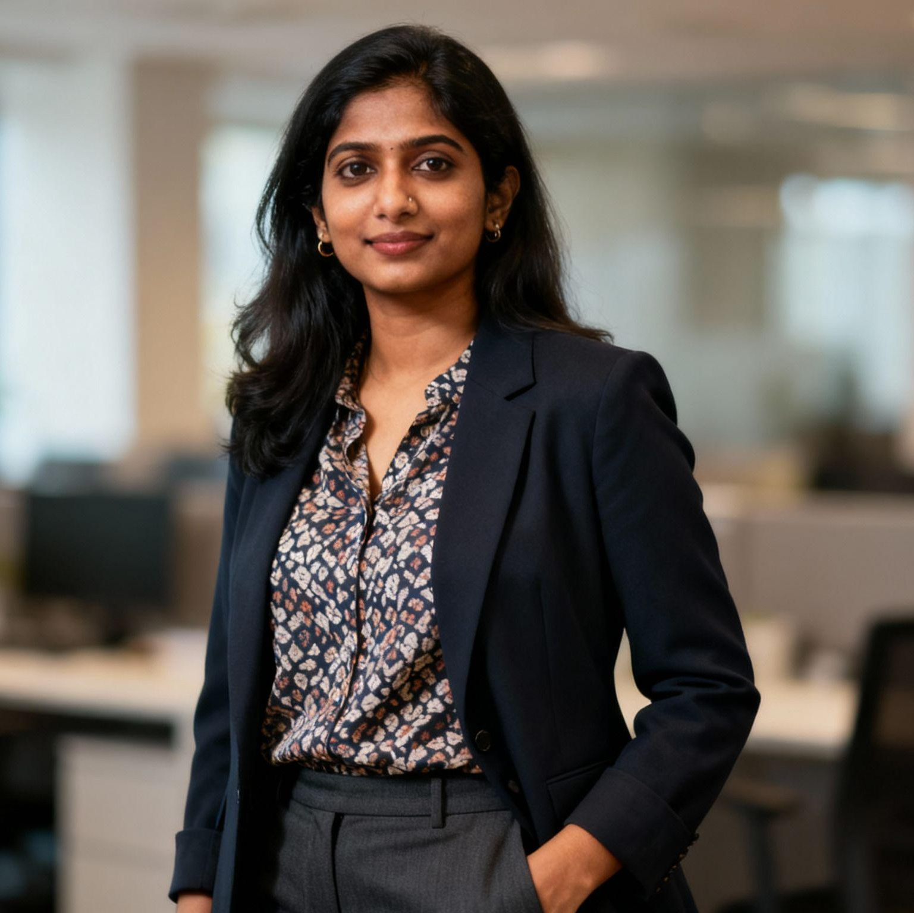
Jiya Sharma
25
Condo in Downtown
Oshawa
Jiya is a young professional working as an AI Engineer for a tech company in the GTA. She earned her Master’s in Data Science and quickly found a high-demand job that uses her AI skills. Jiya feels secure in her role, earns a good salary, and has access to training and career growth in the region’s growing tech sector.
Jiya is looking for ways to keep improving her AI skills, like advanced courses, networking, and leadership programs. She wants housing close to her workplace and support for ongoing learning, so she can stay ahead as AI evolves.

Slide 2

Chris Anderson
26
Basement suite in Ajax, Durham Region
Chris is a recent graduate working as a supervisor for a logistics company. He has a business degree, but his job is at risk as computers and robots start to handle more tasks. His pay isn’t increasing, and rising rent is making life tough. Chris worries that he might lose his job and doesn't know how to move into a safer, better-paid field.
Chris wants affordable upskilling options in AI, like basic certificates or introductory classes. He’s looking for guidance to switch careers and for financial help, so he can retrain while working and keep up with living costs.

