Slide 1
Distributed Representations for Natural Language Processing
Tomas Mikolov, Facebook
ML Prague 2016

Slide 2
Structure of this talk
Motivation
Word2vec
Architecture
Evaluation
Examples
Discussion

Slide 3
Motivation
Representation of text is very important for performance of many real-world applications: search, ads recommendation, ranking, spam filtering, …
Local representations
N-grams
1-of-N coding
Bag-of-words
Continuous representations
Latent Semantic Analysis
Latent Dirichlet Allocation
Distributed Representations

Slide 4
Motivation: example
Suppose you want to quickly build a classifier:
Input = keyword, or user query
Output = is user interested in X? (where X can be a service, ad, …)
Toy classifier: is X capital city?
Getting training examples can be difficult, costly, and time consuming
With local representations of input (1-of-N), one will need many training examples for decent performance

Slide 5
Motivation: example
Suppose we have a few training examples:
(Rome, 1)
(Turkey, 0)
(Prague, 1)
(Australia, 0)
…
Can we build a good classifier without much effort?

Slide 6
Motivation: example
Suppose we have a few training examples:
(Rome, 1)
(Turkey, 0)
(Prague, 1)
(Australia, 0)
…
Can we build a good classifier without much effort?
YES, if we use good pre-trained features.

Slide 7
Motivation: example
Pre-trained features: to leverage vast amount of unannotated text data
Local features:
Prague = (0, 1, 0, 0, ..)
Tokyo = (0, 0, 1, 0, ..)
Italy = (1, 0, 0, 0, ..)
Distributed features:
Prague = (0.2, 0.4, 0.1, ..)
Tokyo = (0.2, 0.4, 0.3, ..)
Italy = (0.5, 0.8, 0.2, ..)

Slide 8
Distributed representations
We hope to learn such representations so that Prague, Rome, Berlin, Paris etc. will be close to each other
We do not want just to cluster words: we seek representations that can capture multiple degrees of similarity: Prague is similar to Berlin in some way, and to Czech Republic in another way
Can this be even done without manually created databases like Wordnet / Knowledge graphs?

Slide 9
Word2vec
Simple neural nets can be used to obtain distributed representations of words (Hinton et al, 1986; Elman, 1991; …)
The resulting representations have interesting structure – vectors can be obtained using shallow network (Mikolov, 2007)

Slide 10
Word2vec
Deep learning for NLP (Collobert & Weston, 2008): let’s use deep neural networks! It works great!
Back to shallow nets: Word2vec toolkit (Mikolov at el, 2013) -> much more efficient than deep networks for this task

Slide 11
Word2vec
Two basic architectures:
Skip-gram
CBOW
Two training objectives:
Hierarchical softmax
Negative sampling
Plus bunch of tricks: weighting of distant words, down-sampling of frequent words

Slide 12
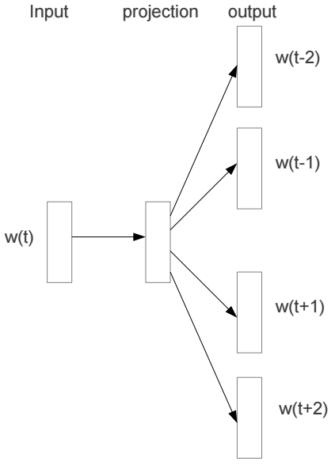
Skip-gram Architecture
Predicts the surrounding words given the current word

Slide 13
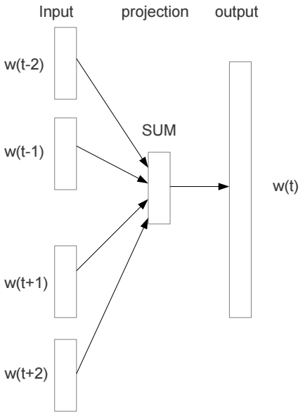
Continuous Bag-of-words Architecture
Predicts the current word given the context

Slide 14
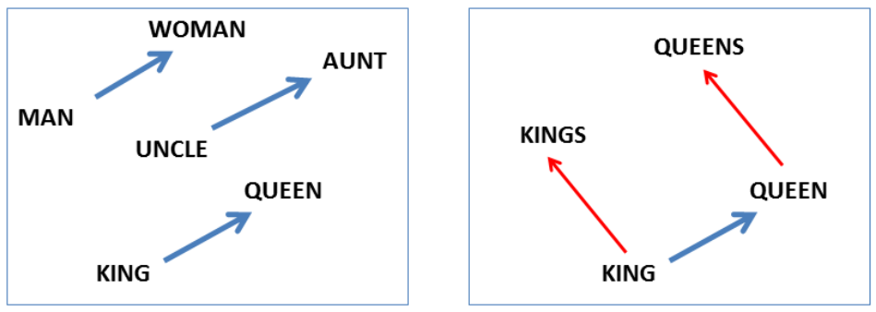
Word2vec: Linguistic Regularities
After training is finished, the weight matrix between the input and hidden layers represent the word feature vectors
The word vector space implicitly encodes many regularities among words:

Slide 15
Linguistic Regularities in Word Vector Space
The resulting distributed representations of words contain surprisingly a lot of syntactic and semantic information
There are multiple degrees of similarity among words:
KING is similar to QUEEN as MAN is similar to WOMAN
KING is similar to KINGS as MAN is similar to MEN
Simple vector operations with the word vectors provide very intuitive results (King – man + woman ~= Queen)

Slide 16
Linguistic Regularities - Evaluation
Regularity of the learned word vector space was evaluated using test set with about 20K analogy questions
The test set contains both syntactic and semantic questions
Comparison to previous state of art (pre-2013)

Slide 17
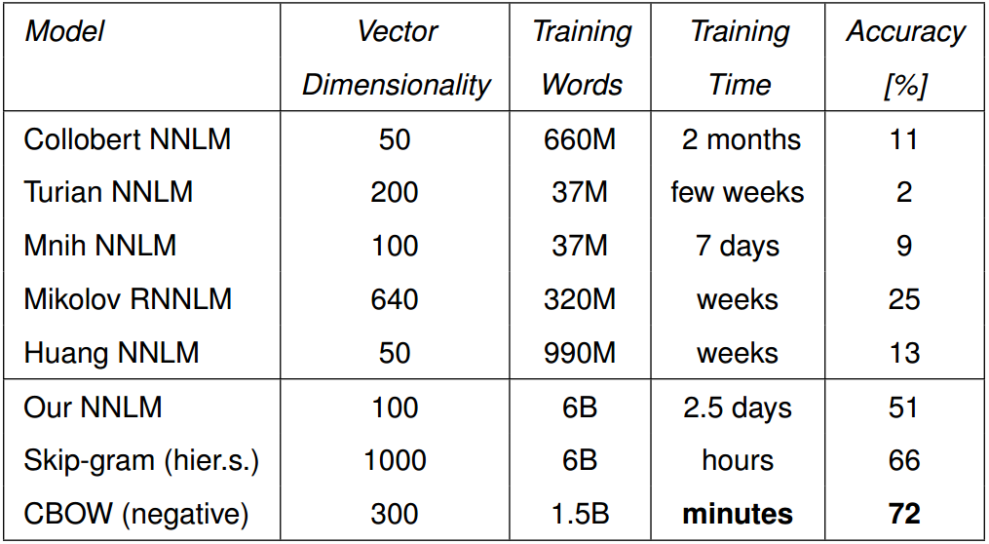
Linguistic Regularities - Evaluation

Slide 18
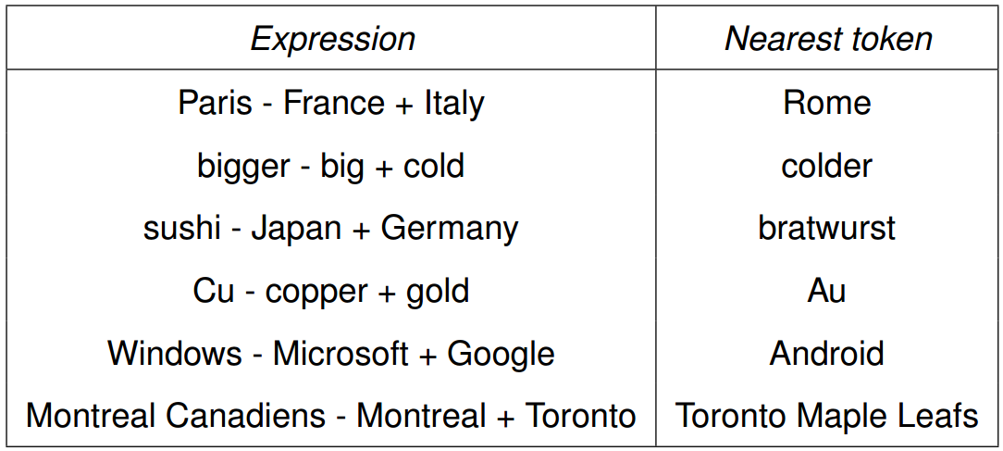
Linguistic Regularities - Examples

Slide 19
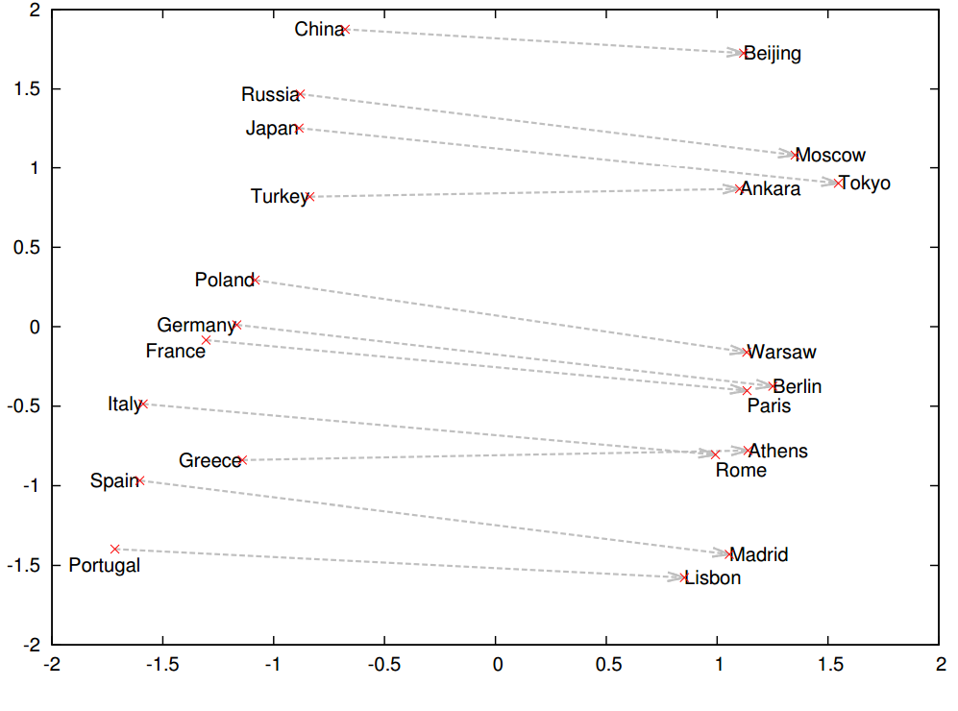
Visualization using PCA

Slide 20
Summary and discussion
Word2vec: much faster and way more accurate than previous neural net based solutions - speed up of training compared to prior state of art is more than 10 000 times! (literally from weeks to seconds)
Features derived from word2vec are now used across all big IT companies in plenty of applications (search, ads, ..)
Very popular also in research community: simple way how to boost performance in many NLP tasks
Main reasons of success: very fast, open-source, easy to use the resulting features to boost many applications (even non-NLP)

Slide 21
Follow up work
Baroni, Dinu, Kruszewski (2014): Don't count, predict! A systematic comparison of context-counting vs. context-predicting semantic vectors
Turns out neural based approaches are very close to traditional distributional semantics models
Luckily, word2vec significantly outperformed the best previous models across many tasks ☺

Slide 22
Follow up work
Pennington, Socher, Manning (2014): Glove: Global Vectors for Word Representation
Word2vec version from Stanford: almost identical, but a new name ☺
In some sense step back: word2vec counts co-occurrences and does dimensionality reduction together, Glove is two-pass algorithm

Slide 23
Follow up work
Levy, Goldberg, Dagan (2015): Improving distributional similarity with lessons learned from word embeddings
Hyper-parameter tuning is important: debunks the claims of superiority of Glove
Compares models trained on the same data (unlike Glove…), word2vec is faster & vectors better & much less memory consuming
Many others did end up with similar conclusions (Radim Rehurek, …)

Slide 24
Final notes
Word2vec is successful because it is simple, but it cannot be applied everywhere
For modeling sequences of words, consider Recurrent networks
Do not sum word vectors to obtain representations of sentences, it will not work well
Be careful about the hype, as always … the most cited papers often contain non-reproducible results

Slide 25
References
Mikolov (2007): Language Modeling for Speech Recognition in Czech
Collobert, Weston (2008): A unified architecture for natural language processing: Deep neural networks with multitask learning
Mikolov, Karafiat, Burget, Cernocky, Khudanpur (2010): Recurrent neural network based language model
Mikolov (2012): Statistical Language Models Based on Neural Networks
Mikolov, Yih, Zweig (2013): Linguistic Regularities in Continuous Space Word Representations
Mikolov, Chen, Corrado, Dean (2013): Efficient estimation of word representations in vector space
Mikolov, Sutskever, Chen, Corrado, Dean (2013): Distributed representations of words and phrases and their compositionality
Baroni, Dinu, Kruszewski (2014): Don't count, predict! A systematic comparison of context-counting vs. context-predicting semantic vectors
Pennington, Socher, Manning (2014): Glove: Global Vectors for Word Representation
Levy, Goldberg, Dagan (2015): Improving distributional similarity with lessons learned from word embeddings

