Slide 1


HW3:I am Elon ma
Notes:
Easter egg

Slide 2

Assignment Requirement:
Your program will compute how to gain profit as much as you can.
The input array contains the doge coin prices for each day, and in this task you need to select a day to buy the doge coin and another day to sell it.
( the input arrays will not be empty)
For example,
1.Input: [7,1,5,3,6] , Output: 5
2.Input: [7,6,4,3,1] , Output: 0
Abstract class:

Slide 3
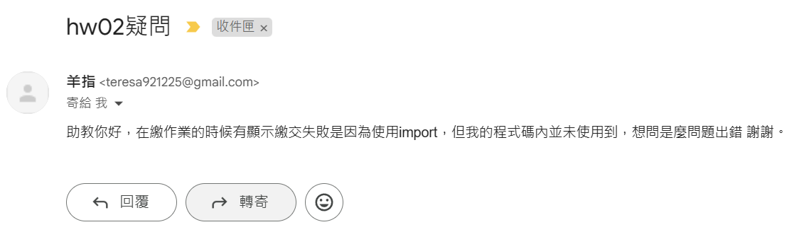

Slide 4
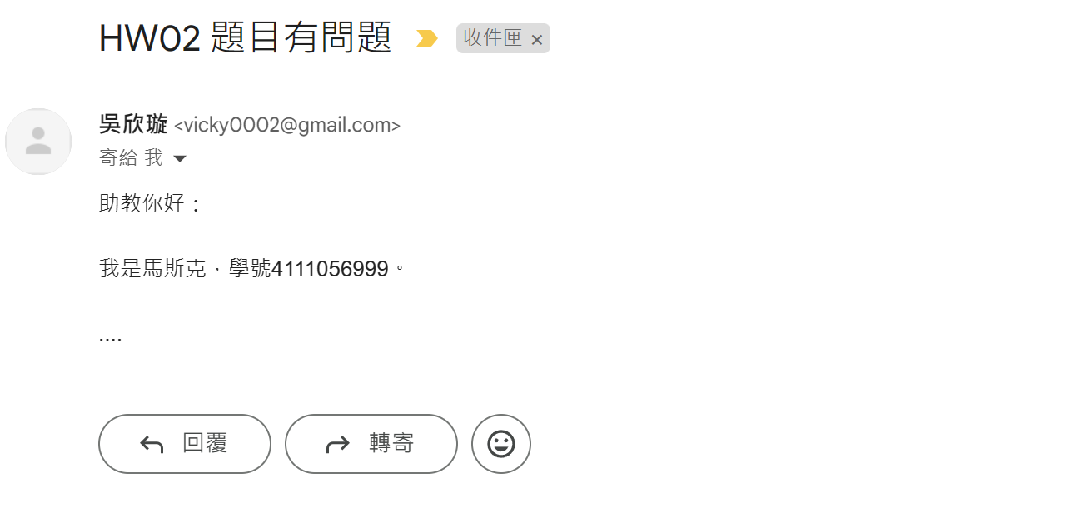
寄信規範
請大家寄信時，屬名自己的學號及姓名，方便助教幫大家處理問題。

Slide 5
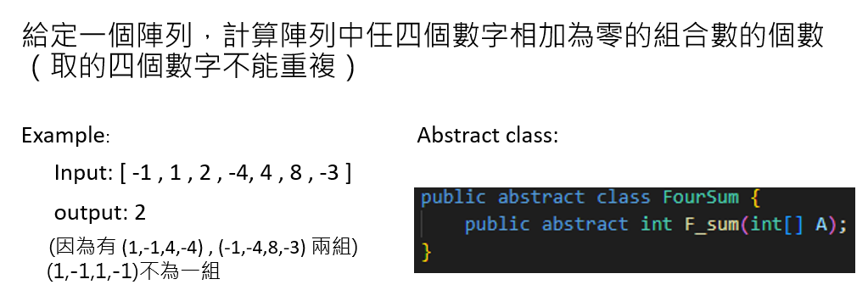
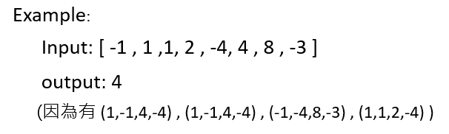
HW02 延期一周
測資全部是 unique integer
Deadline 3/27

