Slide 1

Algorithm HW6
Sorting is all you need
Due: 05/08

Slide 2
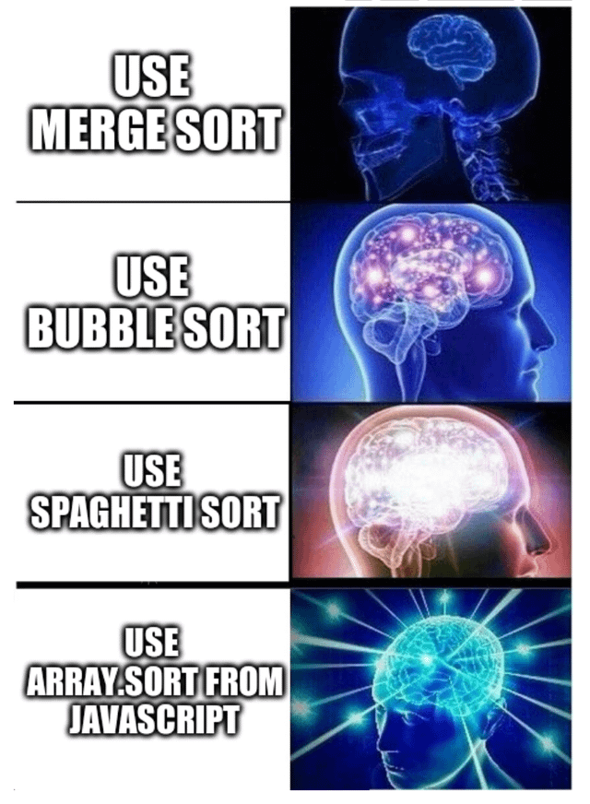
Description
In this programming assignment, you will explore the efficiency and implementation of sorting algorithms.
Given a list containing N elements, your task is to sort it in the fastest time possible using any legal method.

Slide 3
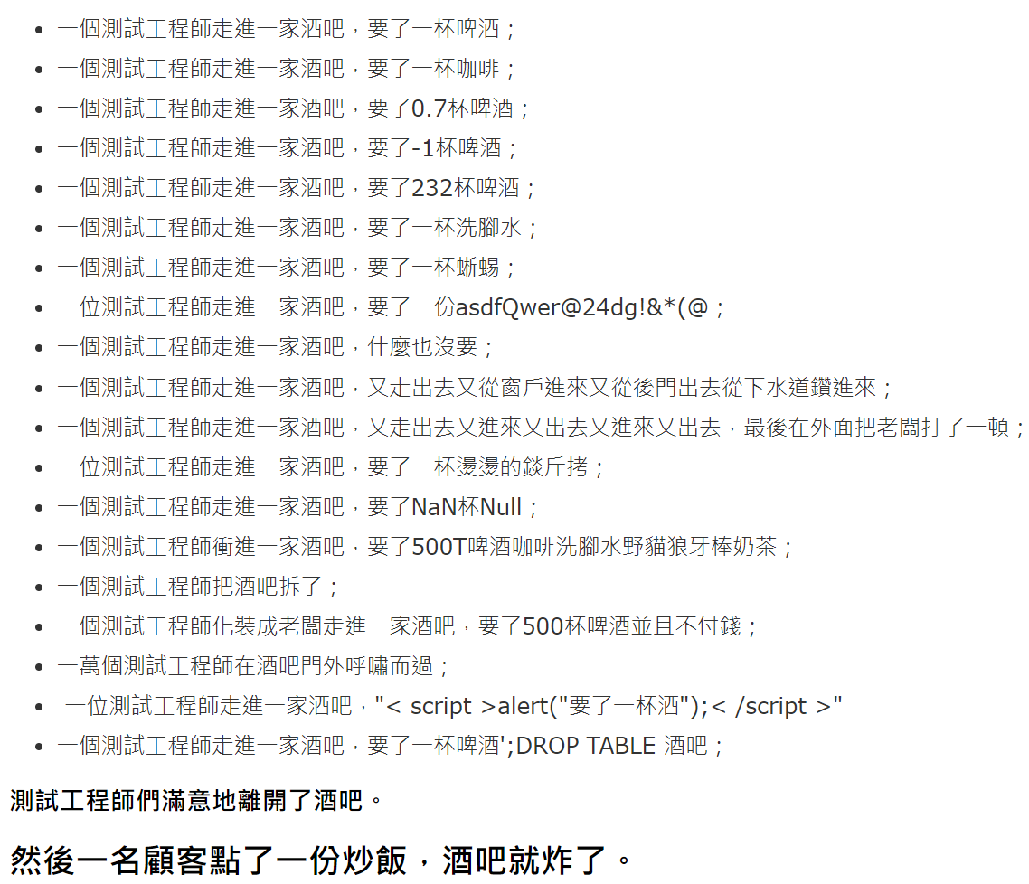
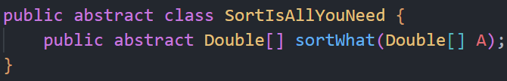
Description
Example:
[5,1,4,2,3] → [1,2,3,4,5]
[2,1,1,3,2] → [1,1,2,2,3]

Slide 4
Assignment deadline
Assignment 5 is postponed to May 8th for submission.
The submission deadline for Assignment 4 is also May 8th.

Slide 5
Check Mid Exam Score
理學大樓720 (720 Science College Building)
5/1 Web. 12:00~17:00
5/3 Fri. 12:00~17:00
5/6 Mon. 12:00~17:00

