Slide 1

Algorithm HW7
LSD: Longest Shortest Distance
Due: 05/15

Slide 2
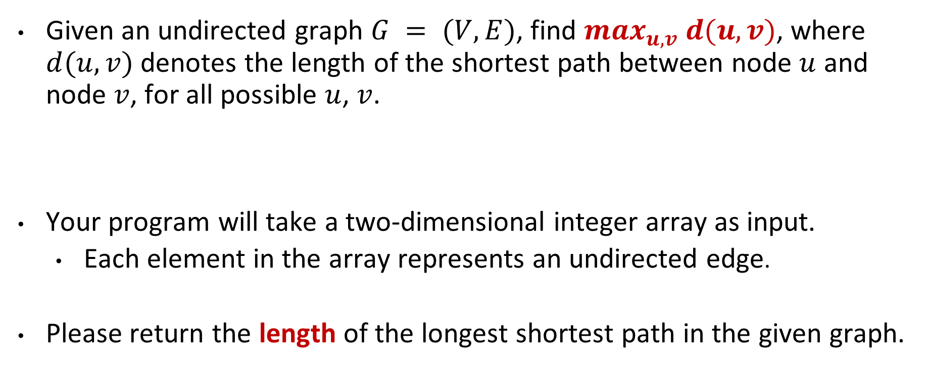
Description
Given an undirected graph $G = (V, E)$, find $max_{u,v} d(u, v)$, where $d(u,v)$ denotes the length of the shortest path between node $u$ and node $v$, for all possible $u$, $v$.
Your program will take a two-dimensional integer array as input.
Each element in the array represents an undirected edge.
Please return the length of the longest shortest path in the given graph.

Slide 3
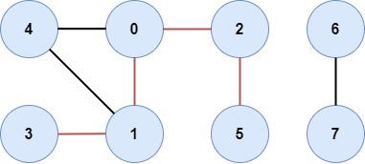

Description
Input: [[0, 1], [0, 2], [0, 4], [1, 3], [1, 4], [2, 5], [6, 7]]
Output: 4

