Slide 1
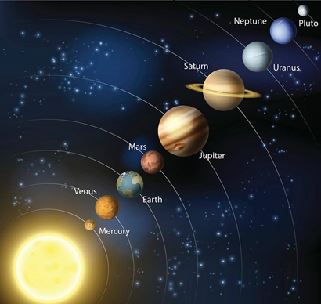
HW07 Collinearity of Galaxies
Notes:
24.137208
121.275960

Slide 2

Assignment Requirement:
Problem Description:
In astronomical observations, astronomers are studying whether the arrangement of multiple galaxies follows a certain pattern. They need to determine if the observed galaxies lie on a straight line, which is crucial for their research on the motion and distribution of galaxies.
Given a set of galaxy coordinates , each point represented by (x, y) , design an algorithm to determine if these galaxies are collinear. If all the galaxies are collinear, return True; otherwise, return False.
Example:
input: {{1,2},{1,3},{1,4}} output : True
input: {{0,0},{1,0},{1,1},{0,1}} output : False
Abstract class:
Notes:
24.137208
121.275960

