Slide 1
Flu Death Prediction with Vaccination Effect Evaluation
Yunchao Yang

Slide 2
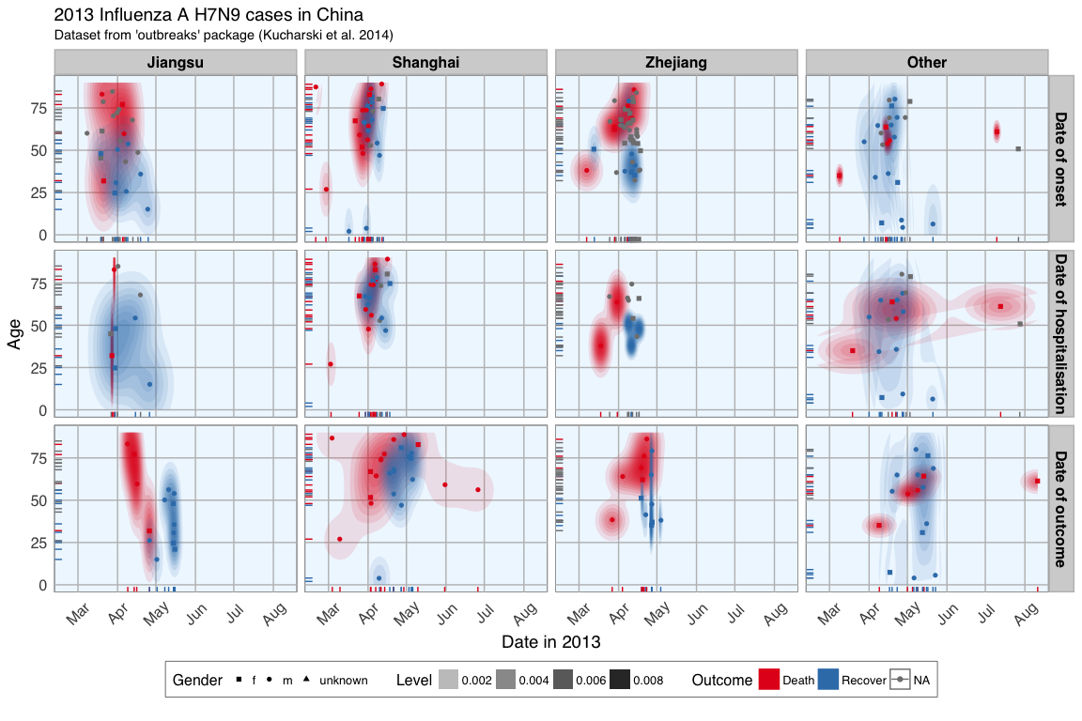
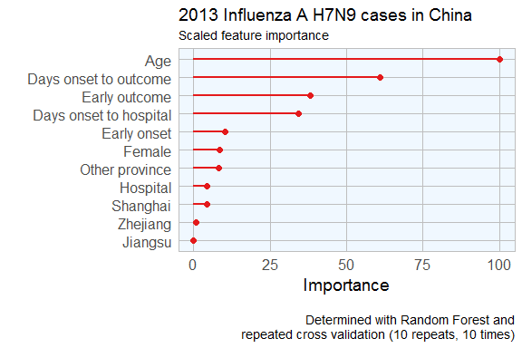
2013 Influenza H7N9 cases in China

Slide 3
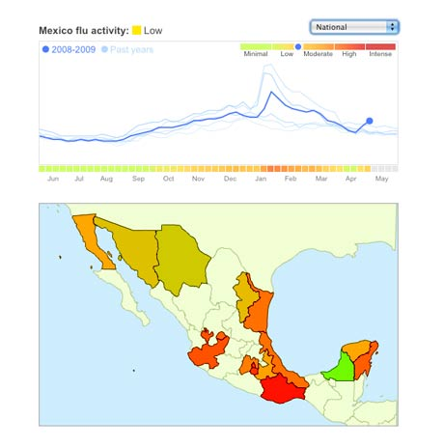
Data Science: Why all the Excitement?
Exciting new effective
applications of data analytics
e.g.,
Google Flu Trends:
Detecting outbreaks
two weeks ahead
of CDC data
New models are estimating which cities are most at risk for spread of the Ebola virus.
Prediction model is built on
Various data sources,
types and analysis.
Notes:
CDC: Centers for Disease Control

Slide 4
Flu activity level prediction
LSTM

