Slide 1

“Fast and Furious” Bike Company Analysis
By: Alexey Grabar

Slide 2
Fast And Furious Company
Chief Executive Officer
Fabiola Jackson
Manager of
Branch
Santa Cruz Bikes
Manager of Branch
Rowlett Bikes
Mireya Copeland
Manager of Branch
Baldwin Bikes
Kali Vargas
Jannette David
Employee
Employee
Employee
Employee
Genna Serrano
Virgie Wiggins
Layla Terrell
Bernardine Houston
Employee
Employee
Marcelene Boyer
Venita Daniel

Slide 3
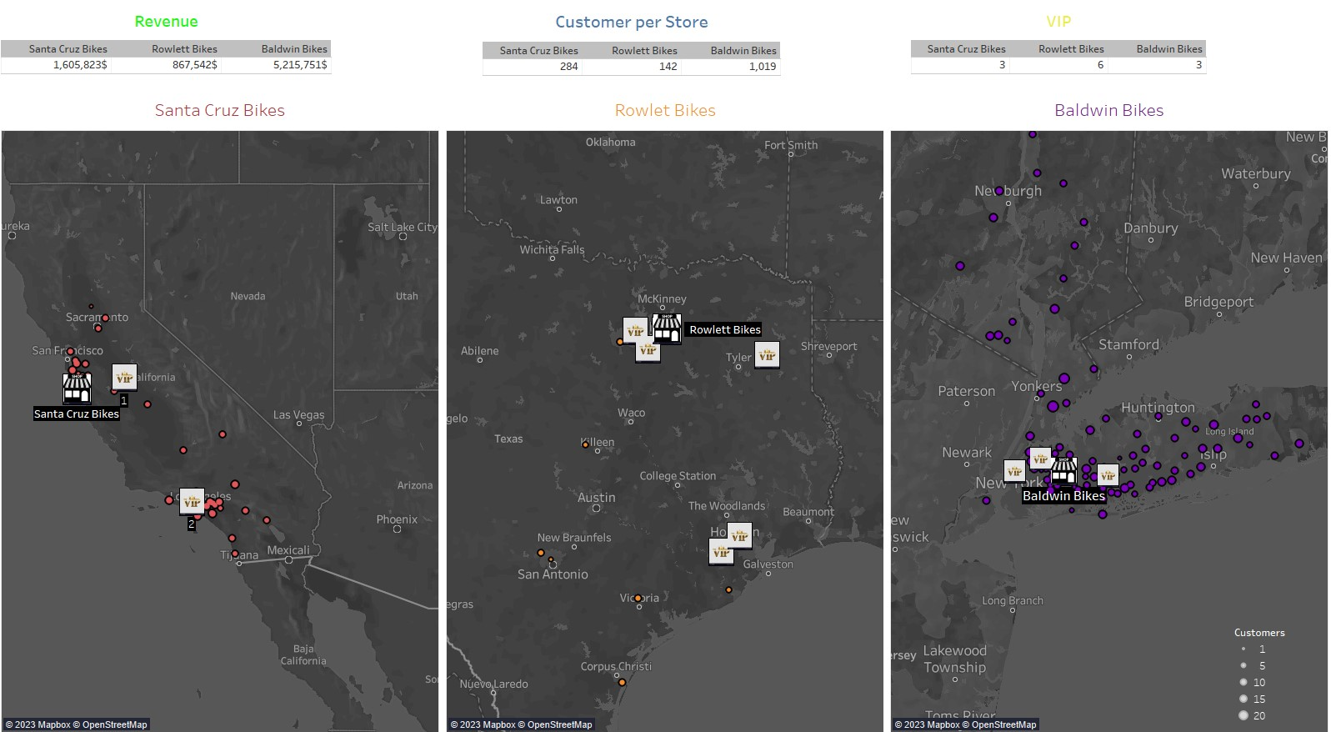

Slide 4
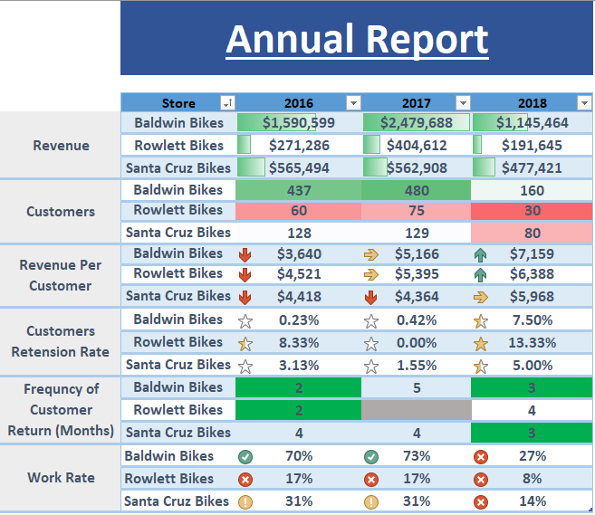

Slide 5
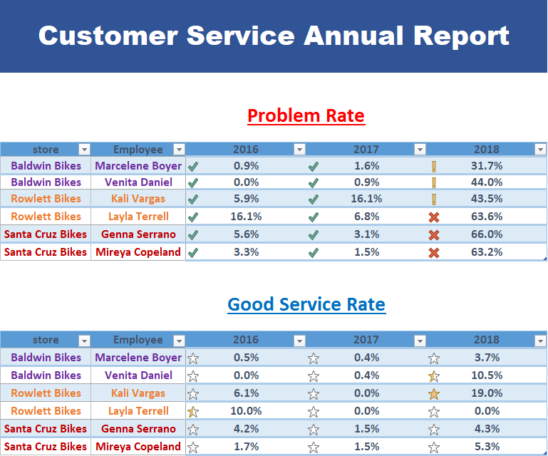

Slide 6
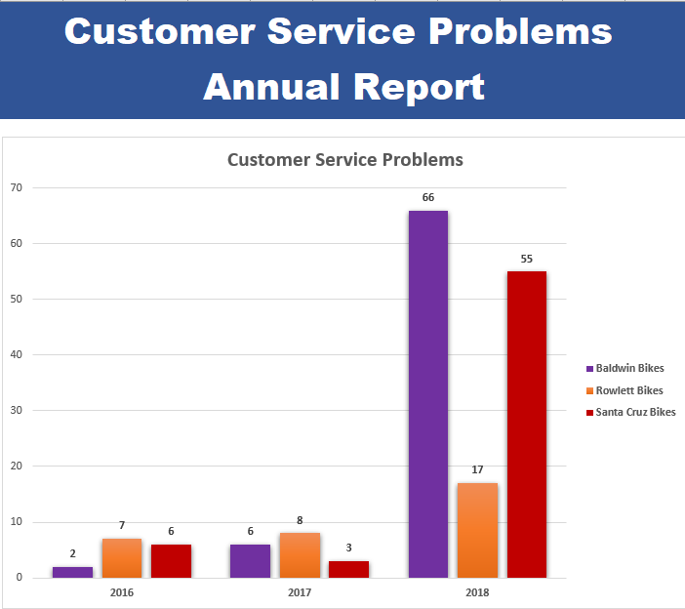

Slide 7
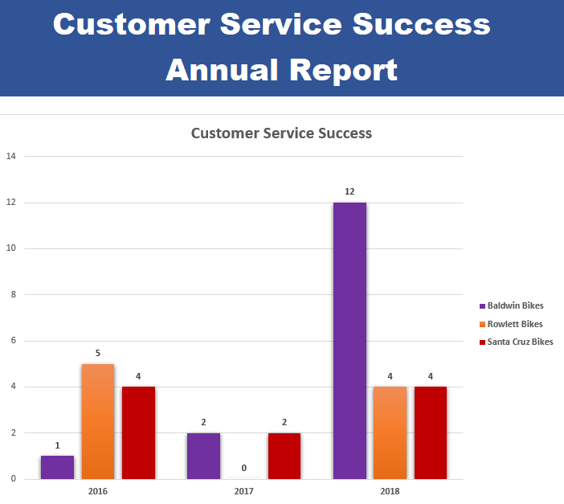

Slide 8
New Customers Per Month Report

Slide 9
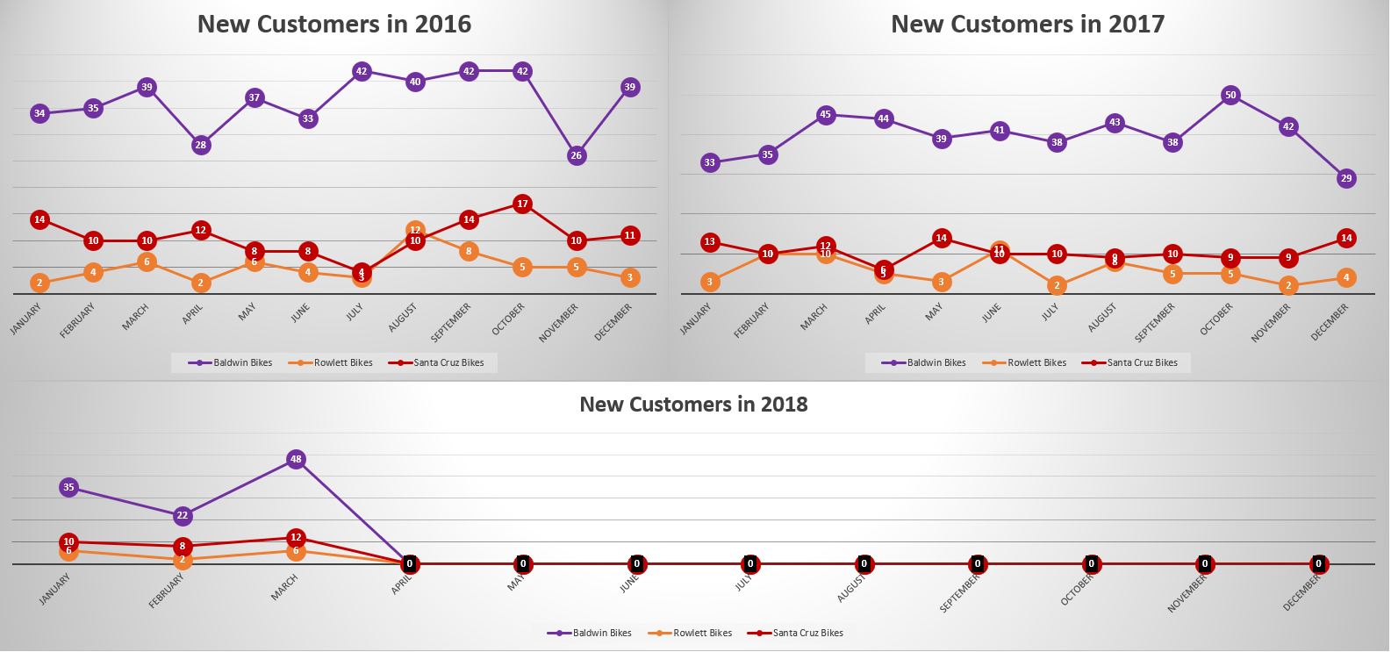

Slide 10
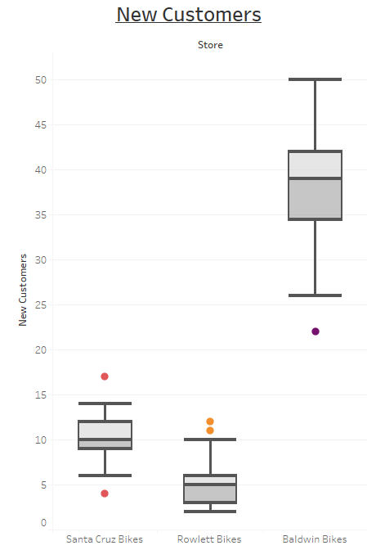
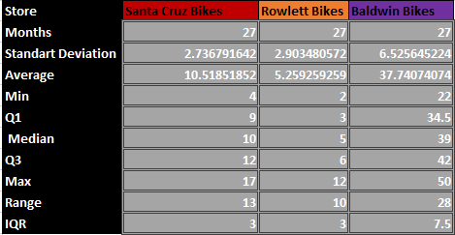

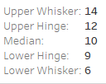
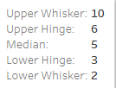
New Customers Per Month
22
17
12
11
4

Slide 11
Revenue Quantity And Discount Quarterly Report

Slide 12
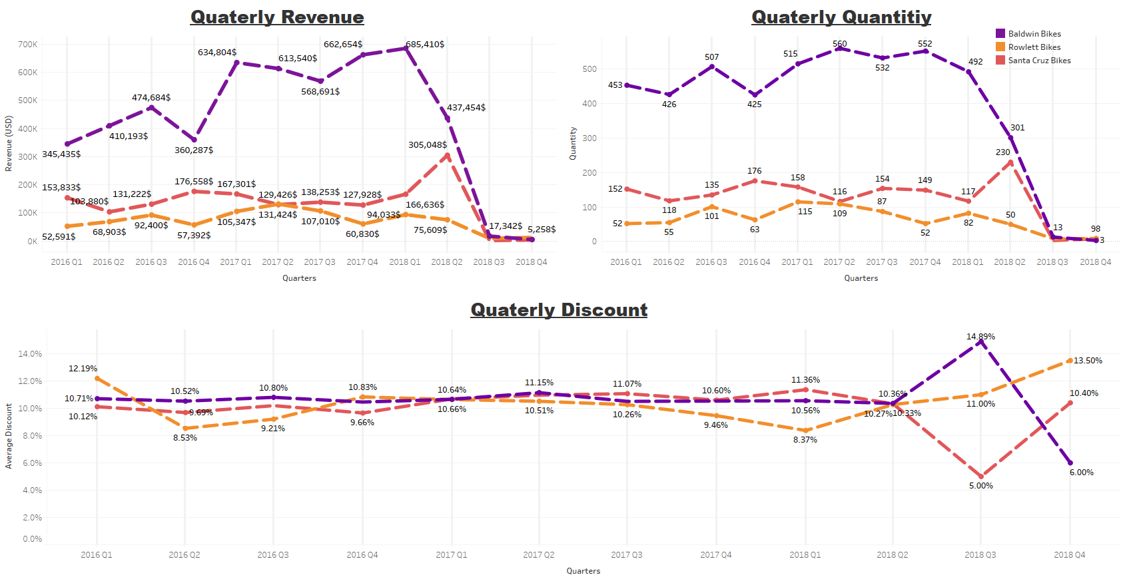

Slide 13
VIP Preferences

Slide 14
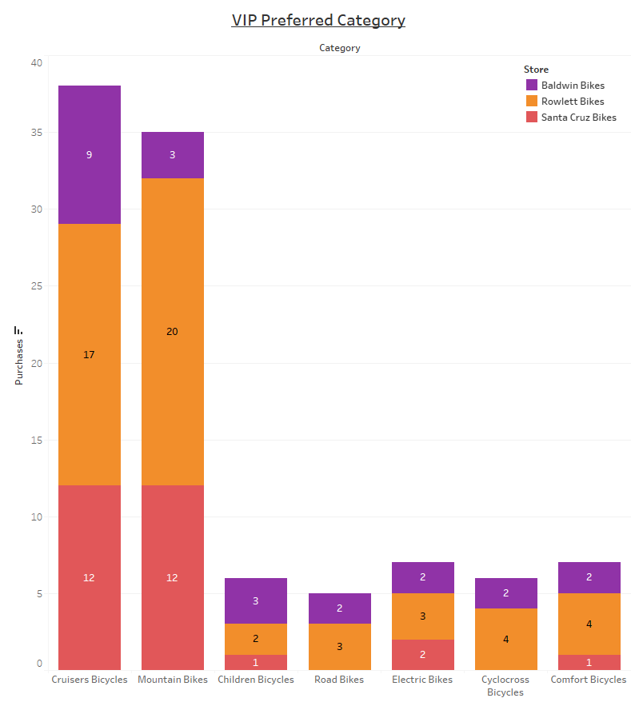

Slide 15
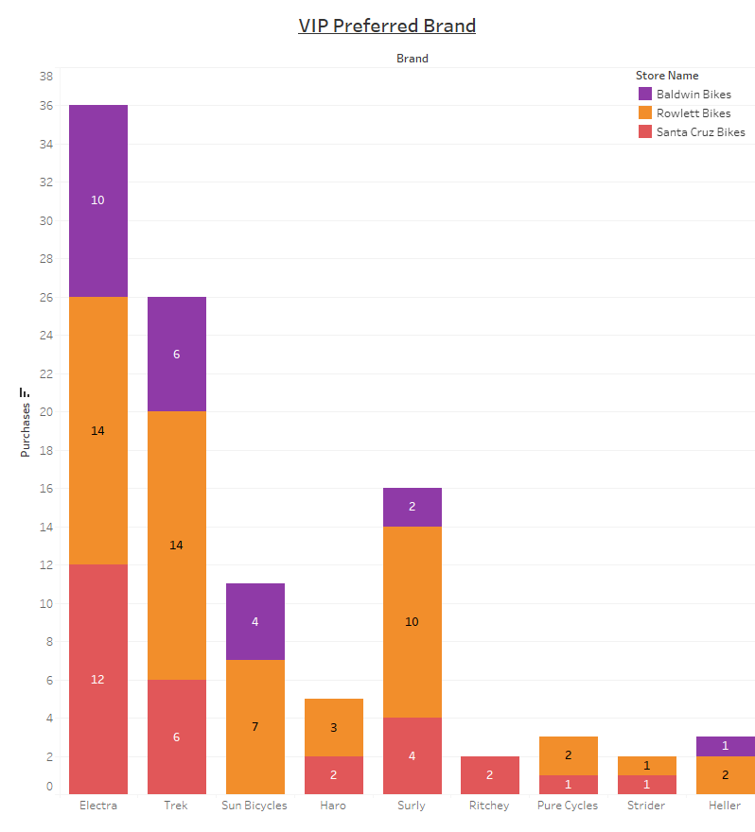

Slide 16
Thank You☺

