Slide 1
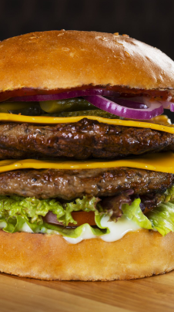
25 cites & 50 burgers

Slide 2

BackGround
The food network a reality TV network that specializes in tv series about food is interested in making a reality TV series highlighting the top burgers restaurants in several cities.
They plan on doing 25 episodes, to air weekly, each one highlighting two burger joints.
They would like to focus on the top 25 cities by population in the United States

Slide 3

Data acquisition
Data requirements
List of top 25 cites by population in the United states
Top popular burger restaurants in each of the 25 cities
Two popular attractions

Slide 4
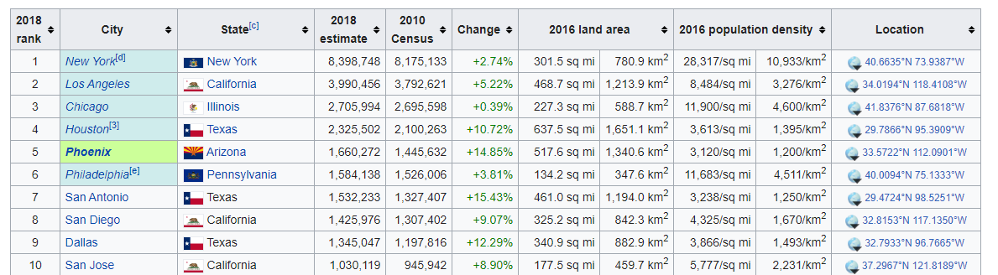
Data sources
For the population data the web site https://en.wikipedia.org/wiki/List_of_United_States_cities_by_population
was chosen to get a list of cities in the United States along with their latitude and longitude.
For determining the restaurants, and their popularity as well as top local attractions the web site https://foursquare.com/ was chosen.

Slide 5
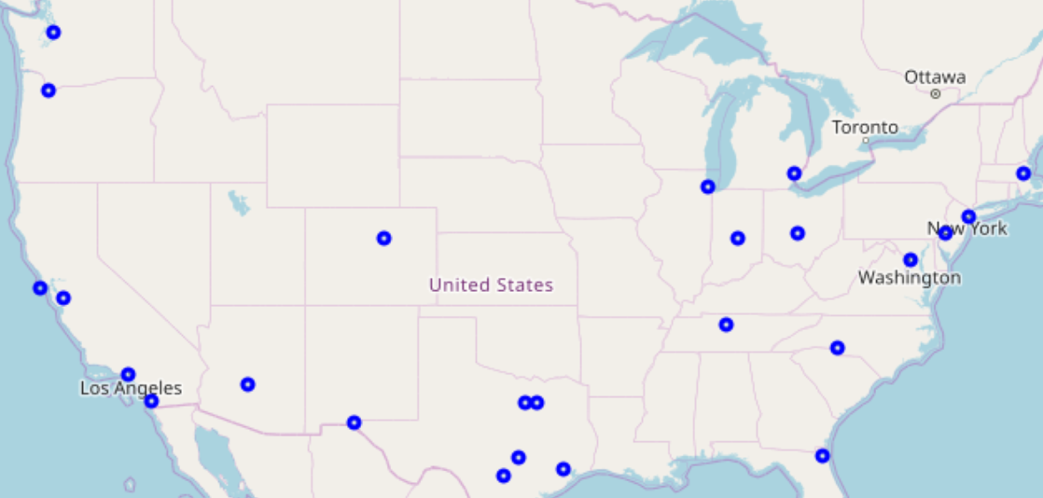
Map indicating location of top 25 cities created using Wikipedia web site.
df = pd.DataFrame(columns =["Rank", "City", "State", "Population", "latitude", "longitude"])
Rank | City | State | Population | latitude | longitude
1 | New York | New York | 8,398,748 | 40.6635 | -73.9387
2 | Los Angeles | California | 3,990,456 | 34.0194 | -118.4108
3 | Chicago | Illinois | 2,705,994 | 41.8376 | -87.6818
4 | Houston | Texas | 2,325,502 | 29.7866 | -95.3909
5 | Phoenix | Arizona | 1,660,272 | 33.5722 | -112.0901

Slide 6
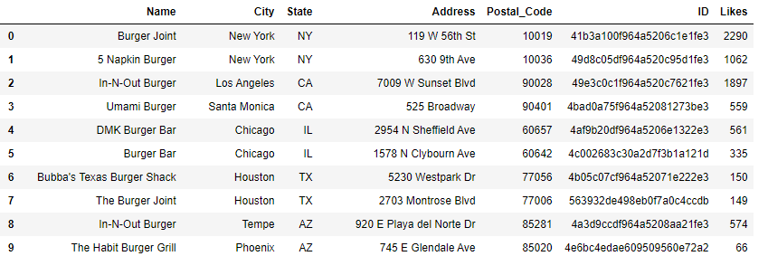
• The top burger restaurants list was derived using the latitude and longitude contained in the top 25 cites list.
• This was a two-part process. First a call was made to search using the search query word 'Burger’ for each of 25 cites.
• A second call was made using the foursquare API for each of the Burger restaurants returned on the first call. This second call was to get the number of likes for each restaurant on the list.
• The two burger restaurants with the most “likes” was then chosen for each city.

Slide 7
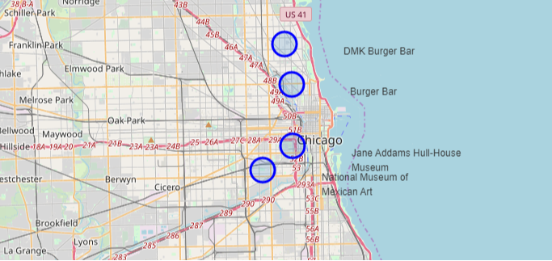
The last query to the foursquare.com database was to get two museums from each of the cites on the list. A provision was made in the code to map any particular city and show the 2 Burger restaurants as well as the museums so they could be mapped.
Name | City | State | Address
Jewish Children's Museum | Brooklyn | NY | 792 Eastern Pkwy
Brooklyn Children's Museum | New York | NY | 145 Brooklyn Ave
Museum of Jurassic Technology | Culver City | CA | 9341 Venice Blvd
Center for Land Use Interpretation | Culver City | CA | 9331 Venice Blvd
National Museum of Mexican Art | Chicago | IL | 1852 W 19th St
Jane Addams Hull-House Museum | Chicago | IL | 800 S Halsted St
Art Car Museum | Houston | TX | 140 Heights Blvd

Slide 8
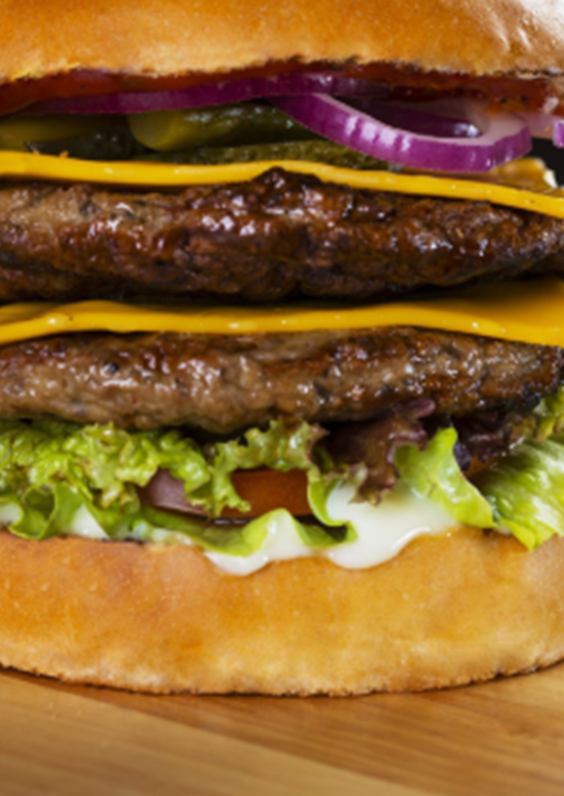
Conclusions
Although the created list only used one parameter (the number of “likes”) to determine the most popular burger restaurants in each of the cities it should provide a starting place for the show.
If the information provided so far is intriguing and a decision is made to proceed more elaborate measures of popularity could be used to determine the best burger in each of the cities this could possibly include some “engineered” measures of popularity.

Slide 9
Images used:
Image of burger, redrobin.com/menu, 2 Feb. 2020,
https://www.redrobin.com/menu.html
Food network background image, foodnetwork.com/schedule, 2 Feb. 2020,
https://watch.foodnetwork.com/schedule
City image, YouTube, Samsung 4K UHD demo video: Cityscape, 2 Feb. 2020,
Jeremy Smith, https://www.youtube.com/watch?v=6jiNS_4CEug
25 cites 50 popular burger restaurants
Richard Williams
Feb 10, 2020

