Slide 1
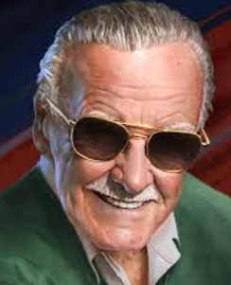
The Life of Stan Lee
Richard Abraham

Slide 2




Introduction
The project task was to explore the life of Stan Lee (Stanley Martin Lieber; Dec 28,1922 - Nov 12, 2018) who was an American comic book writer, editor and publisher. In his series called Marvel Comics he created popular fictional characters such as Spider-Man, X-Man, Iron Man, Thor, the Fantastic Four, Doctor strange, Ant-man, Avengers, Scarlet Witch and Daredevil. He also appeared in some films based on Marvel.
I have explored his popularity and people’s sentiments after his death based on Twitter data.

Slide 3
Data collection & Analysis
Data collection:
Streaming API:
Tweepy : Nov 22 - 27, 2018
Rest API
TwitterScraper: Nov 10 - 14, 2018
Data analysis:
Matplotlib, WordCloud, Seaborn, pandas (Time Series)
Textblob, NLTK, Beautiful Soup
Sklearn
feature_extraction.text.CountVectorizer
model_selection.train_test_split
naive_bayes.MultinomialNB
metrics.confusion_matrix
metrics.accuracy_score

Slide 4
Key aspects of Analysis
Explored user response immediately after Stan Lee’s death
Analyzed shift in user sentiments over time
His most popular piece of creative work
Explored his popularity based on
Date & Time
Location
Language

Slide 5
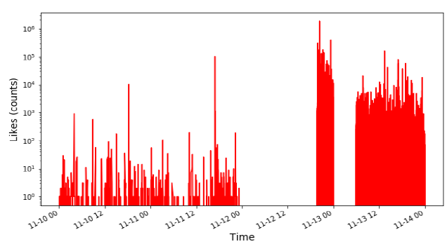


Twitters reaction to Stan Lee’s death
Most liked tweet from his official account

Slide 6
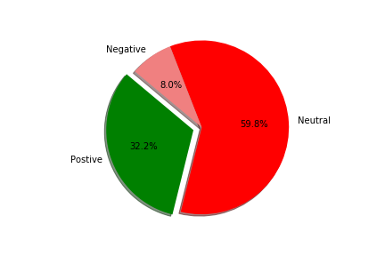
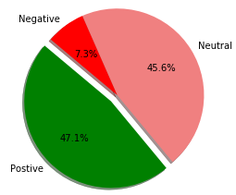
Shift in user sentiments over time
Around his death
After 10 days

Slide 7
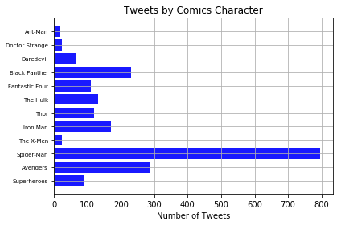


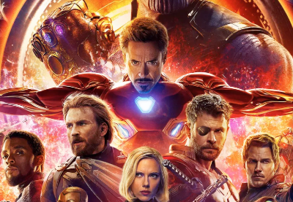
Popular piece of his creative work

Slide 8
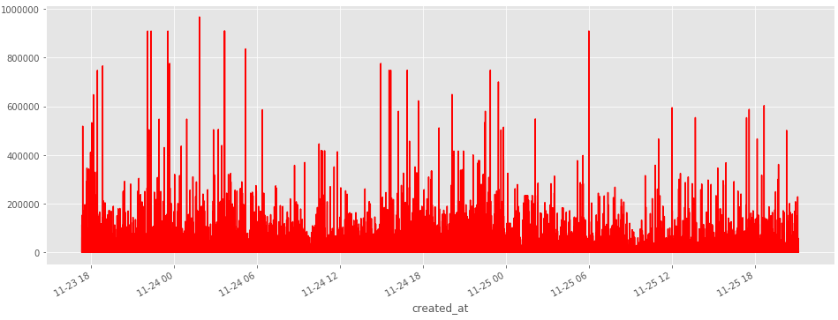
Time Series analysis of likes
967317 likes
Homenagem ao STAN LEE: ♫ "O Criador de Heróis" ♪ https://t.co/NQ68opM386 via @YouTube
Number of likes
Notes:
The tweet with 967317 likes (Homenagem ao STAN LEE: ♫ "O Criador de Heróis" ♪ https://t.co/NQ68opM386 via @YouTube) was created on the 24th of November.

Slide 9
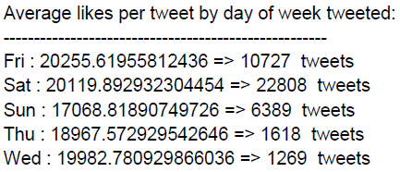


Time Series analysis of likes
Notes:
If we further bin the data by days of week, we notice average likes per tweet is significantly high on Saturday i.e 24th of November.

Slide 10
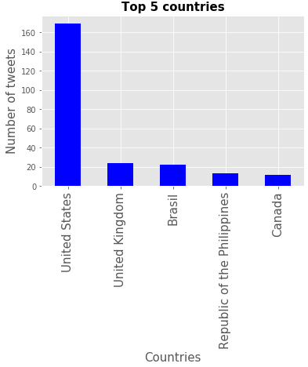
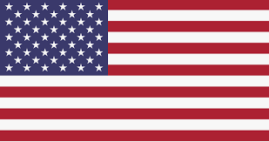

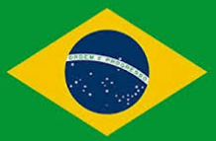
Popularity based on countries
Notes:
Majority of the tweets were sent by users living in United States.

Slide 11
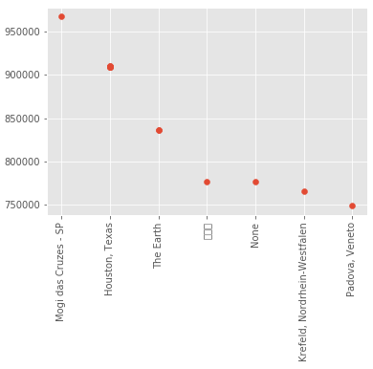

Popularity based on countries
Brazil – Sao Paulo
Number of likes
Location
Notes:
The tweet with the greatest number of likes came from a city in Brazil near Sao Paolo. This was followed by Houston, Texas in the United States.

Slide 12
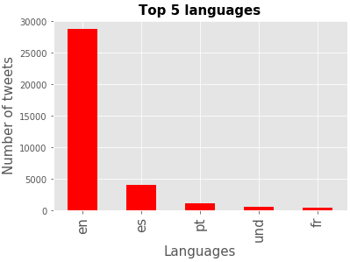
Popularity based on Language
Notes:
English seemed to be the preferred language of choice for most users when tweeting.

Slide 13

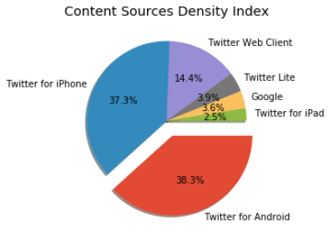

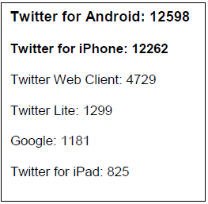




User behaviour – Creation of content sources

Slide 14
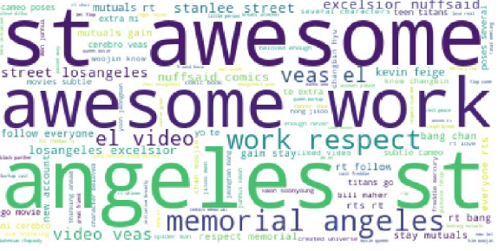
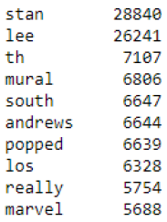
Common words - WordCloud
Words highlight positive sentiment in general

Slide 15

Model building
A model was created using Multinomial Naïve Bayes classifier for the purpose of classification.
The model achieved a prediction accuracy score of ~ 87%
Confusion Matrix - to help visually breakdown the performance of the algorithm
Notes:
After determining the general sentiments of the tweets using TextBlob, a model was created using Multinomial Naïve Bayes classifier for the purpose of classification with ~87% accuracy score.

