Slide 1
Team Project
Code Factory

Slide 2
Our Team
Maria (Team Leader)
PM Software setup (Jira), Frontend, Backend, Debugging
Martin
Frontend, Backend, Database setup, Debugging
Lesia
Design & Layout, Frontend, Responsive Design
Richard
Frontend, Backend, Debugging
Marko
Frontend, Backend, Debugging

Slide 3
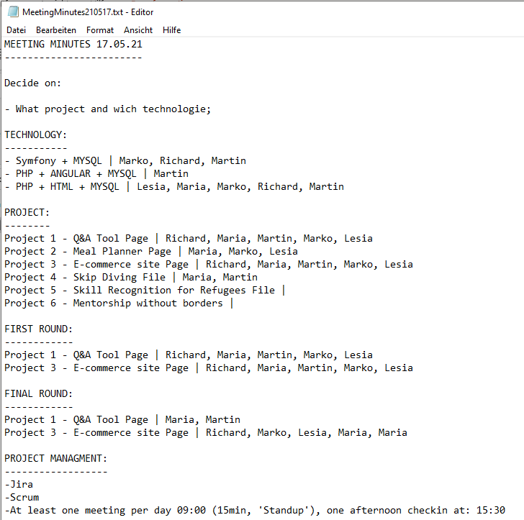
Choosen Topic:
E-commerce site
Many topics combined within the one
Commonly needed topic
Good practice
A topic everybody knows

Slide 4
Project Organisation
Tools
Jira Software
Zoom
Slack
Visual Studio Code
Notepad++
Adobe XD
Chrome, Firefox
XAMPP
cPanel
FileZilla
GitHub
Technologien
PHP
HTML
CSS
Bootstrap
JavaScript
SQL
MariaDB
Methodologies
SCRUM
Sprint Planning
Daily Standups
(Sprint Review)
Why not Symfony, Angular or SCSS?
Everybody can do everything
Training of the basics

Slide 5
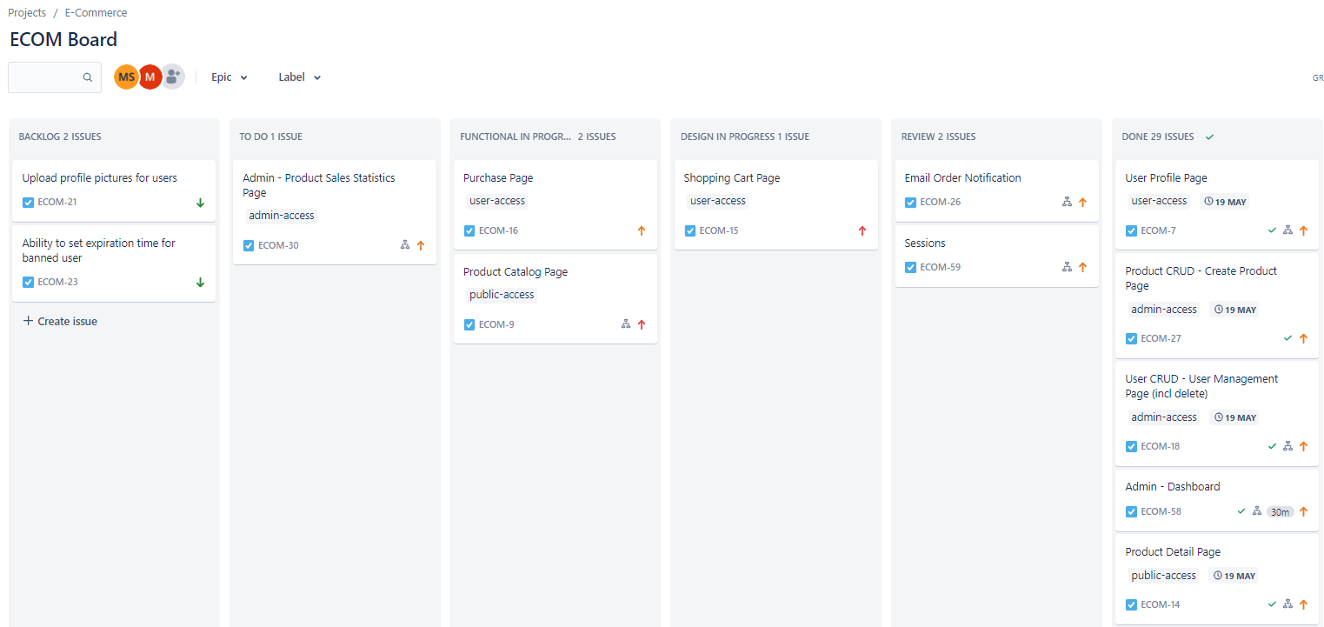
Jira Software

Slide 6
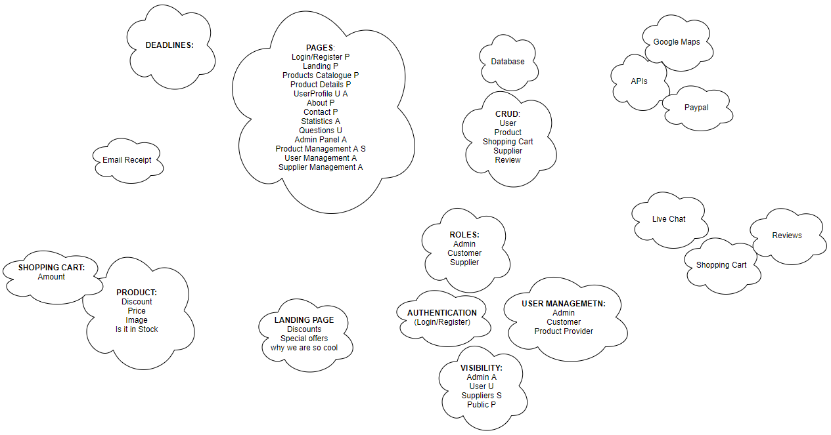
Requirement Analyses - Brainstorming

Slide 7
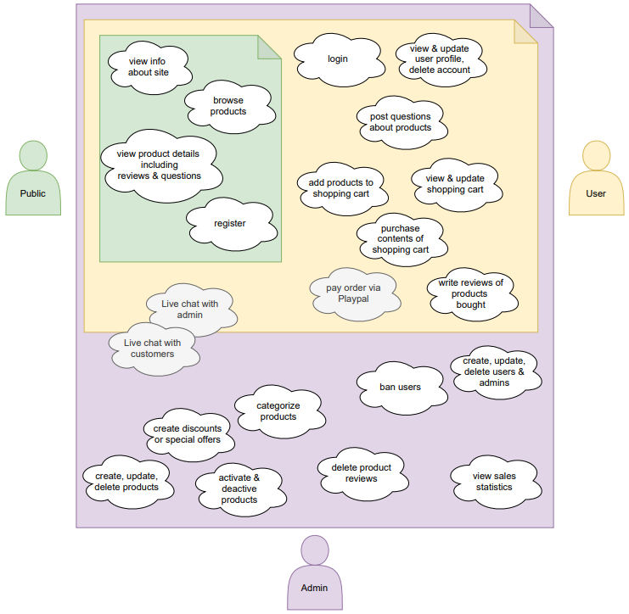
Requirement Analyses – User Story

Slide 8
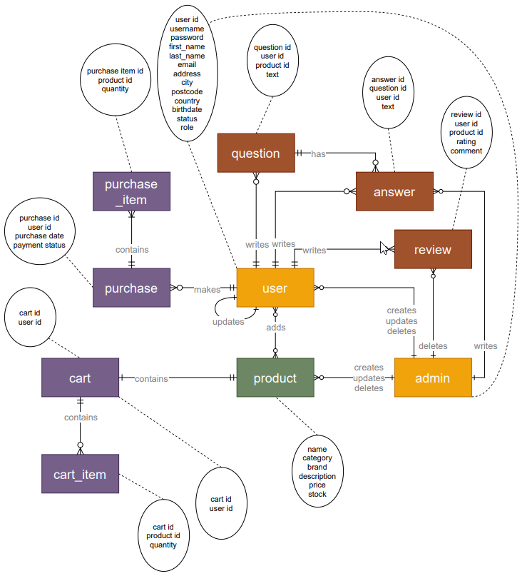
Requirement Analyses - ERD

Slide 9
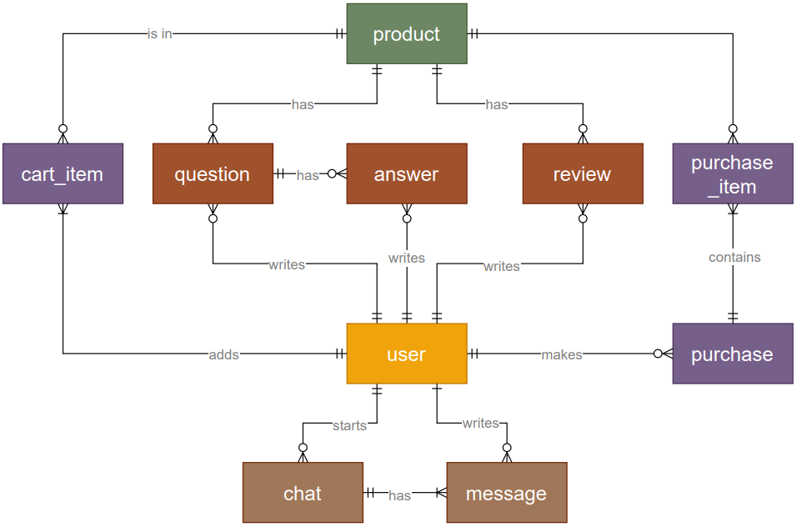
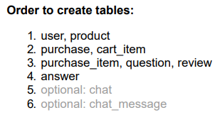
Requirement Analyses - ERD

Slide 10
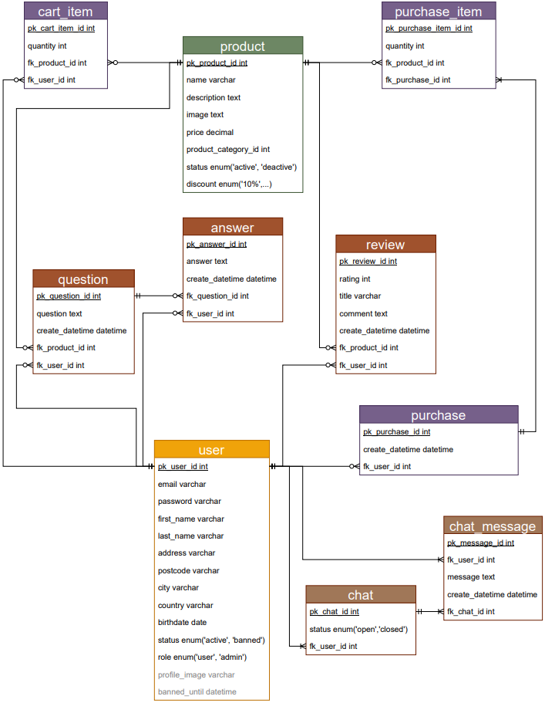
Requirement Analyses - UML

Slide 11
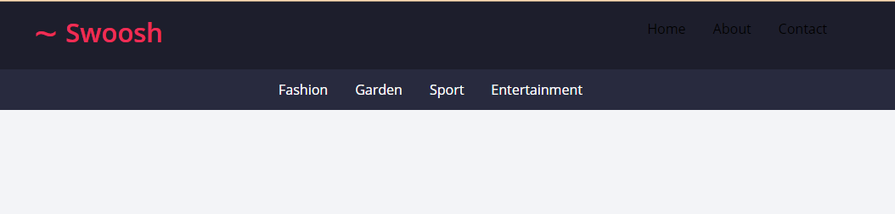

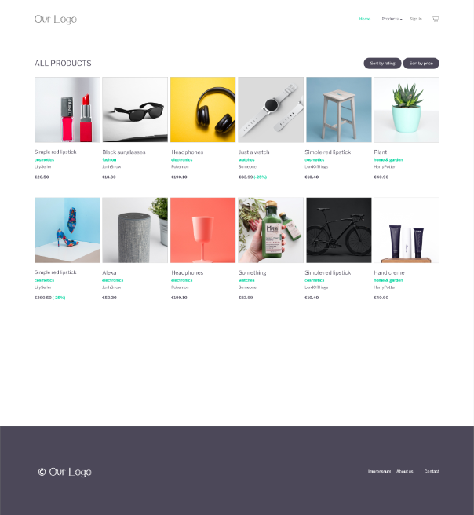
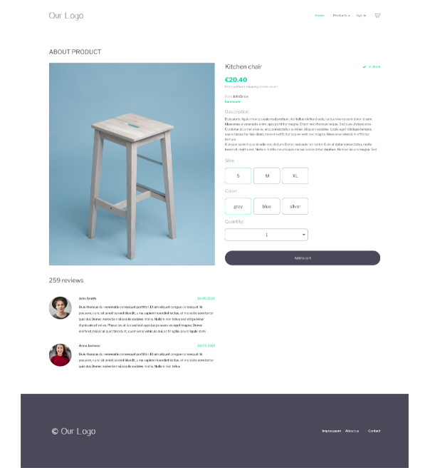
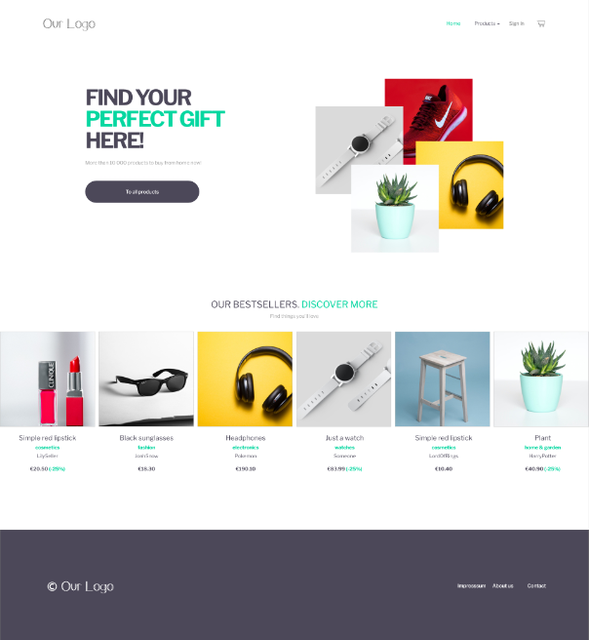
Design & Layout Mockup (Adobe XD)

Slide 12
Lessons Learned
Shopping cart
had to not only calculate once but at several locations
Better to include seperate cart table
Importance to test each others code (Blindness to own errors)
Discovered further bugs with explorative testing
Extensive usage of Slack & Jira to avoid merge conflicts
Slack
Best is address with @
Subchats are easily overlooked

Slide 13
Live Presentations
Public → Marko
Landing page
Product detail (review & questions read only, no add to cart)
Product Catalog (filter, sort, search)
Register page
Admin
Login
Header
Product overview
Review overview
Sales statistics
User overview
Ban user (Sandy)
User (Sandy)
Attempts login
(Admin Remove user ban)
User (Sandy)
User login again
User profil & update
Product detail (review, q&a, cart)
Add to cart
Checkout & order confirmation
Continue shopping
Leave review
Leave question (other product)
Responsiveness

Slide 14
Q & A

