Slide 1
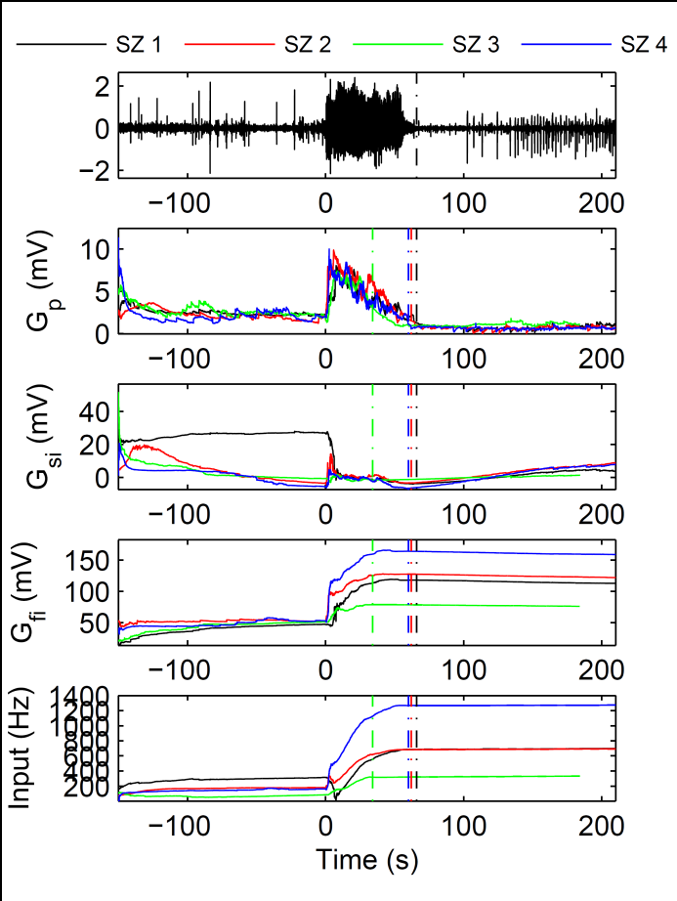
A
B
C
D
E
Figure 1. Results from the estimation of four seizures from the same animal. In Figure A the first seizure estimated is demonstrated. For this seizure, and all other seizures estimated the transition to ictal occurs at 0s, and end at the dotted line with the same colour as the estimated data. In Figure B,C and D the estimated synaptic gains for excitatory, slow inhibitory and fast inhibitory populations are demonstrated, with each colour corresponding to the results from a different seizure. Lastly, in Figure E the estimated input mean to the model cortical region is demonstrated.

Slide 2
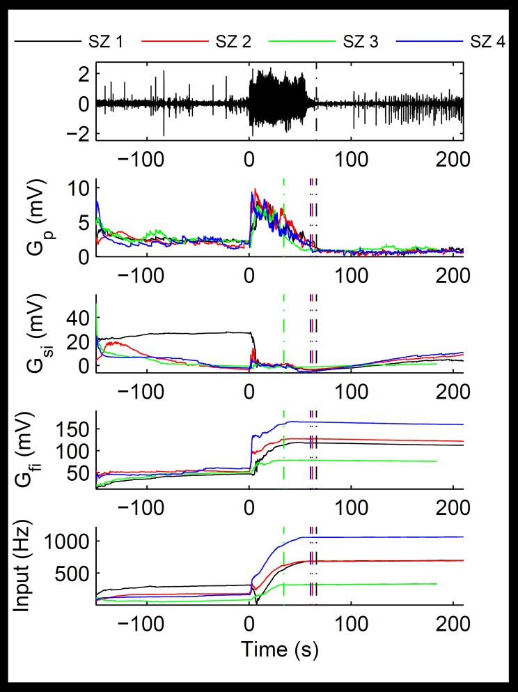
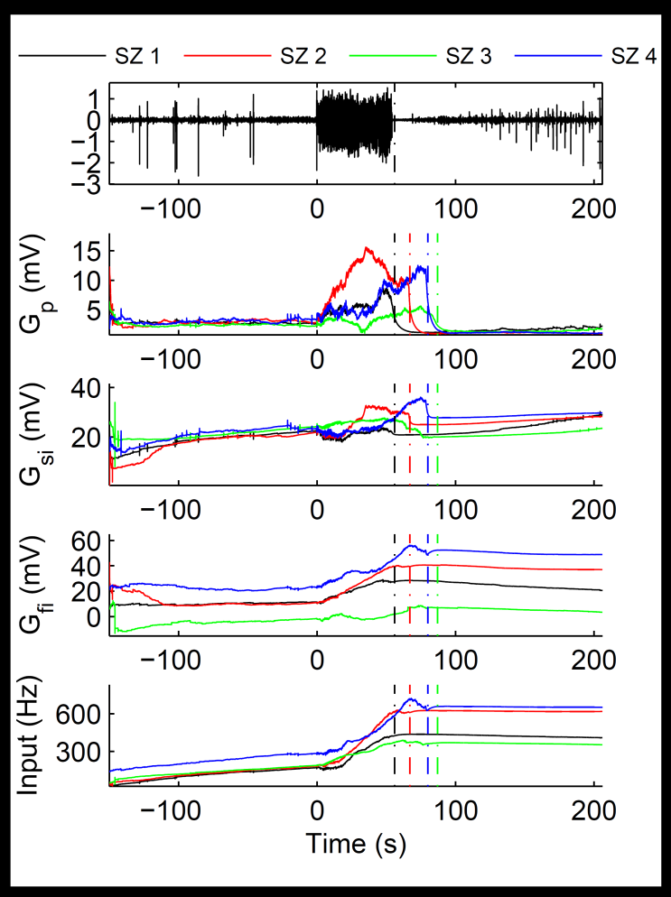
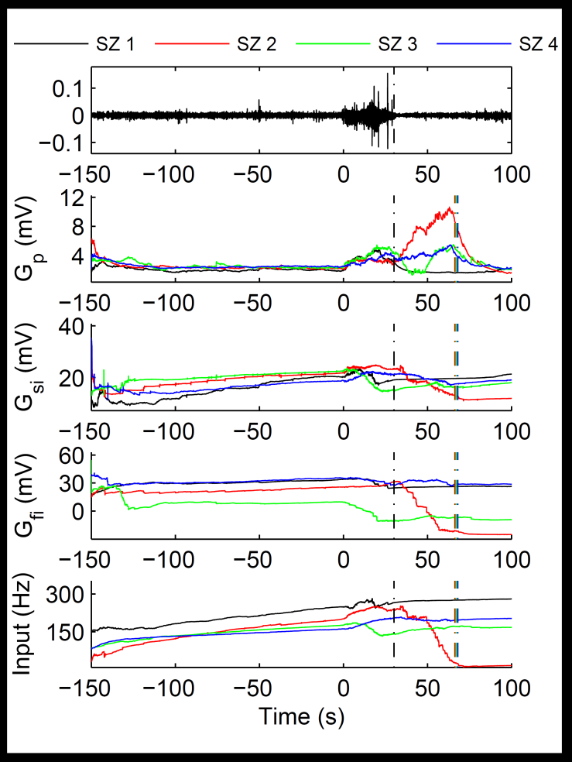
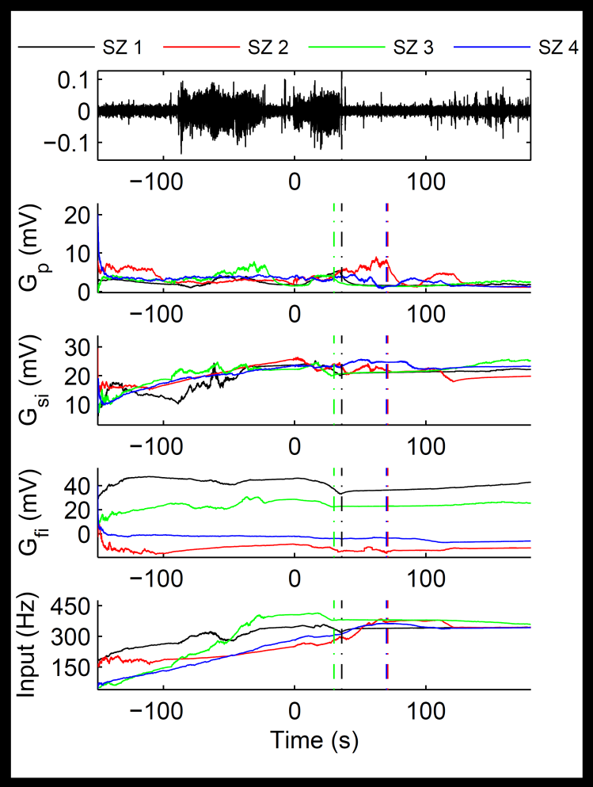
A
B
C
D

Slide 3
A
B
C
D

Slide 4
A
B
C
D
E

Slide 5
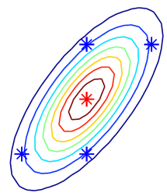
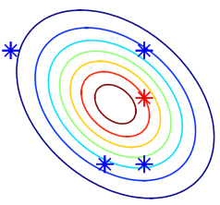
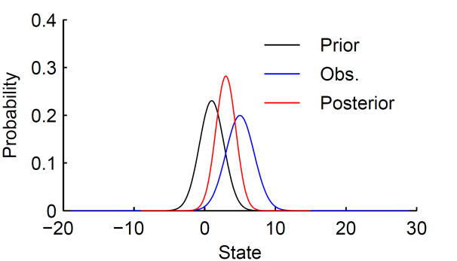
A
F(x)
f(x)
B

Slide 6
A
F(x)
f(x)
B

Slide 7
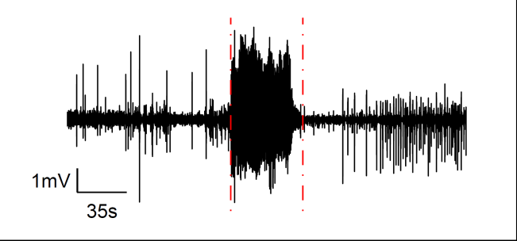
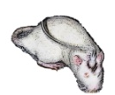
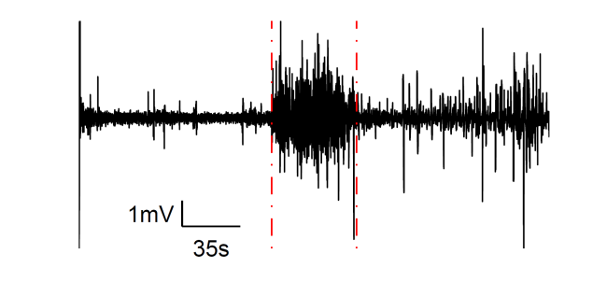
A
B

Slide 8
A
B

Slide 9
A
B

Slide 10
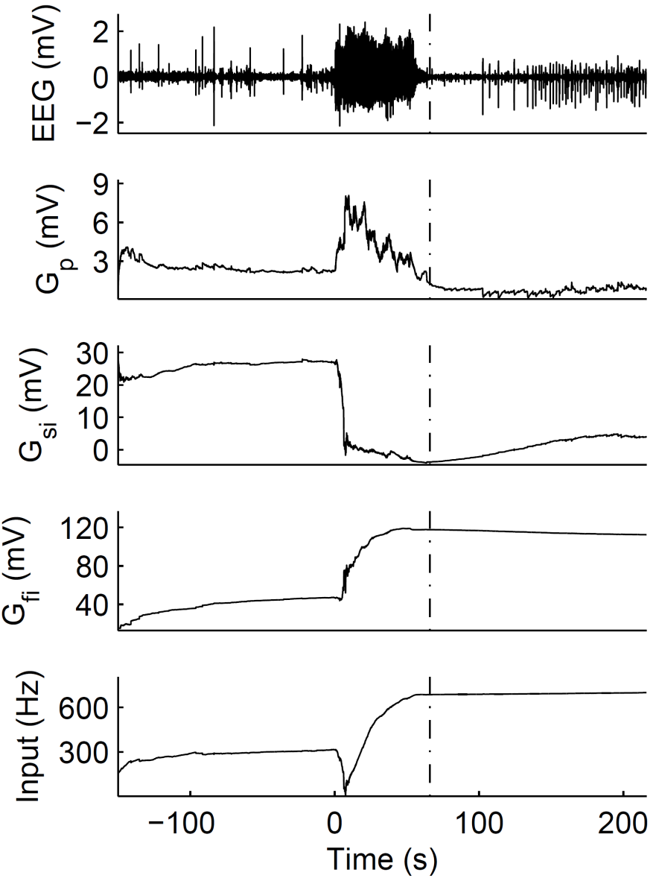

Slide 11
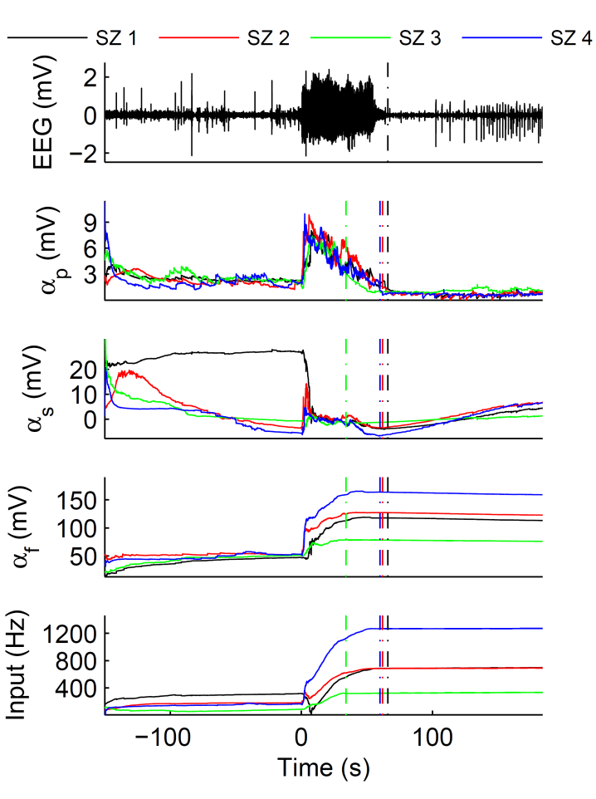
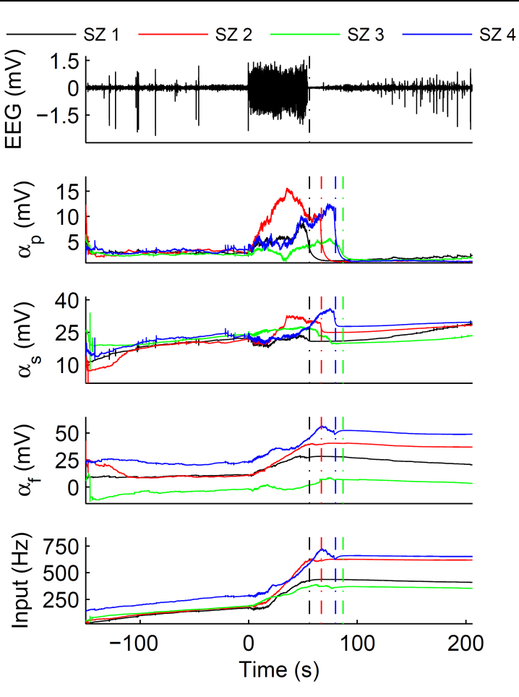
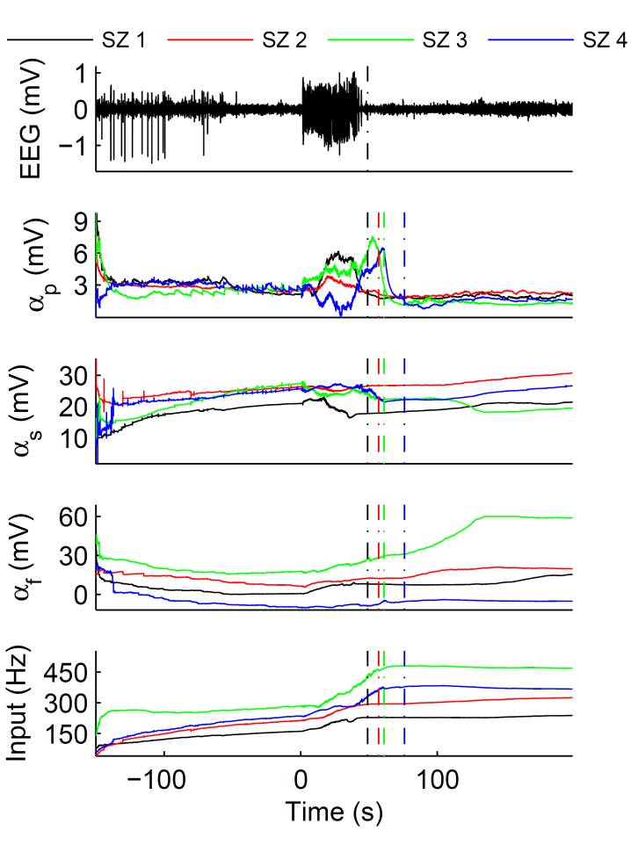
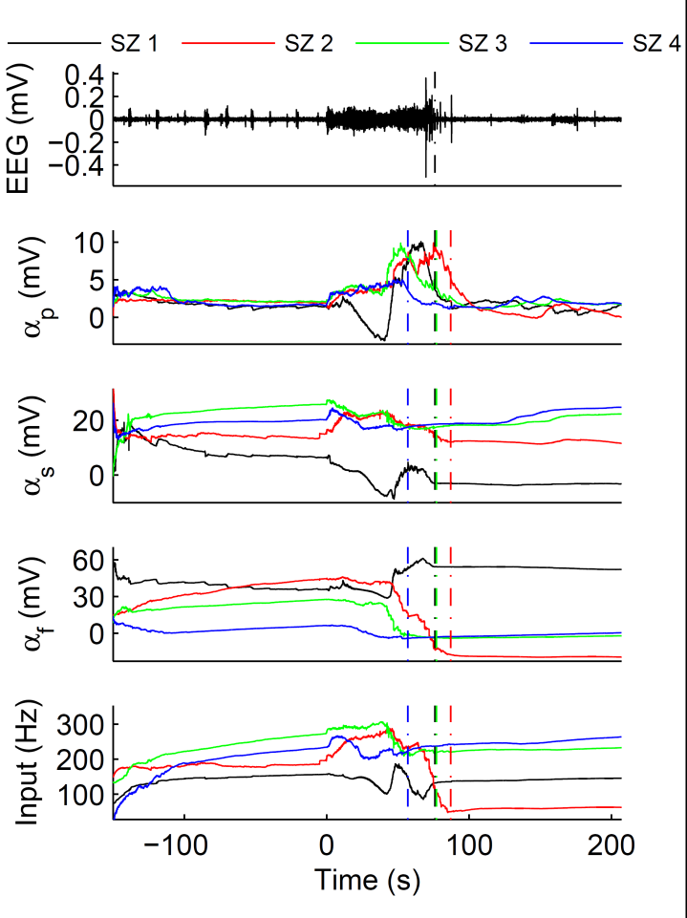
A
B
C
D

Slide 12

A
B
C
D

Slide 13
A
B
C
D

Slide 14
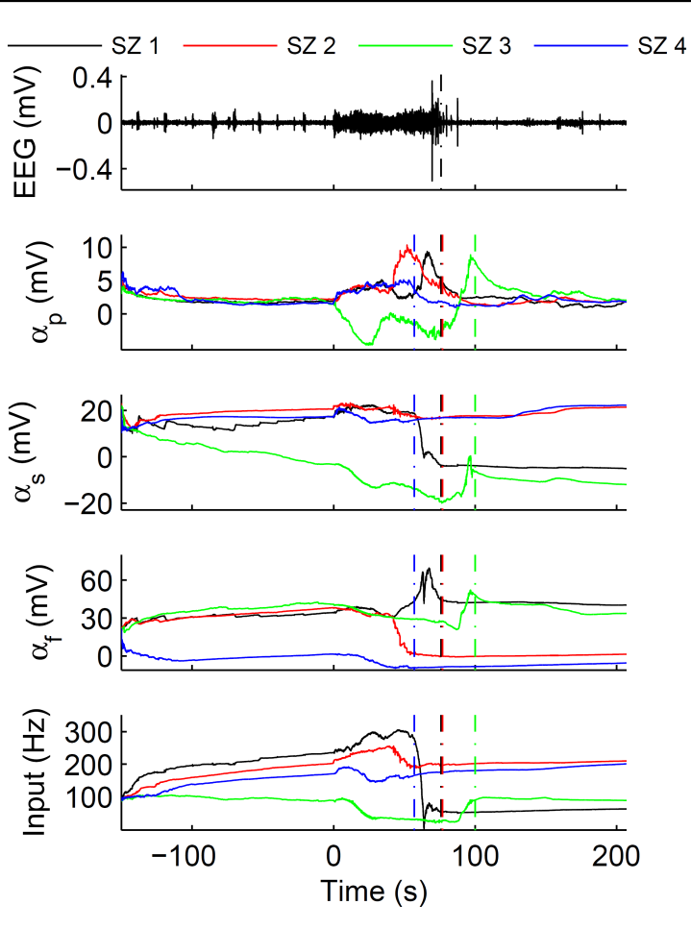
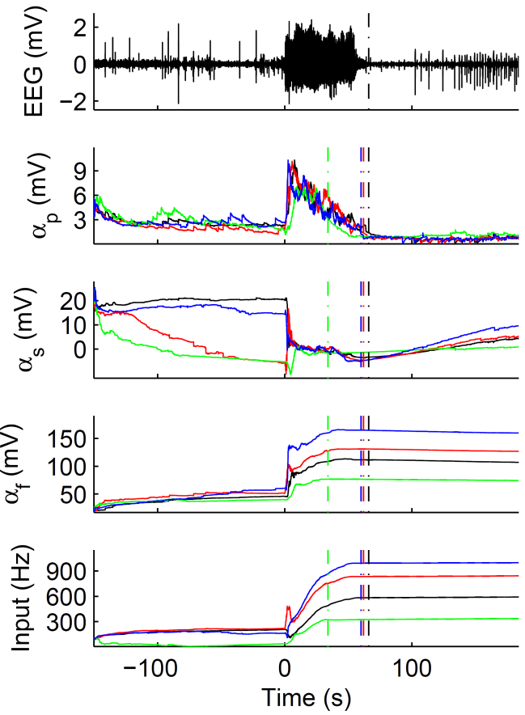
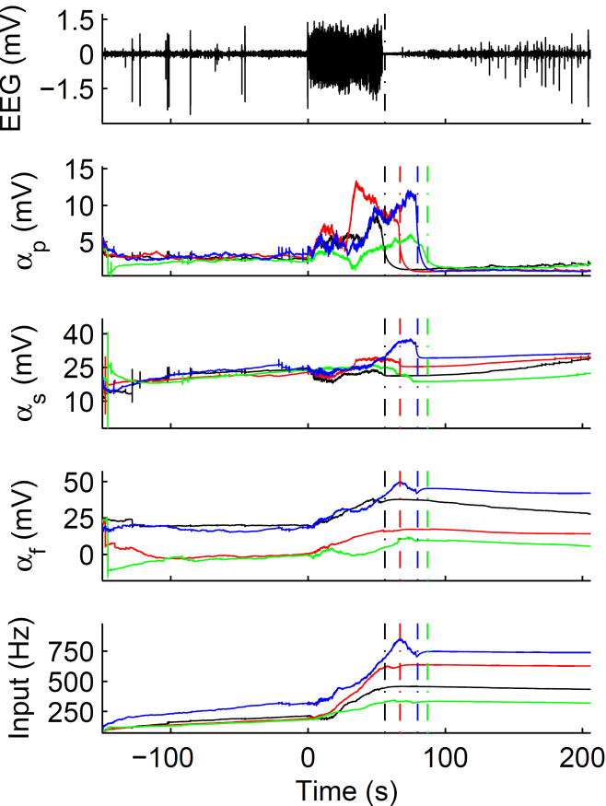
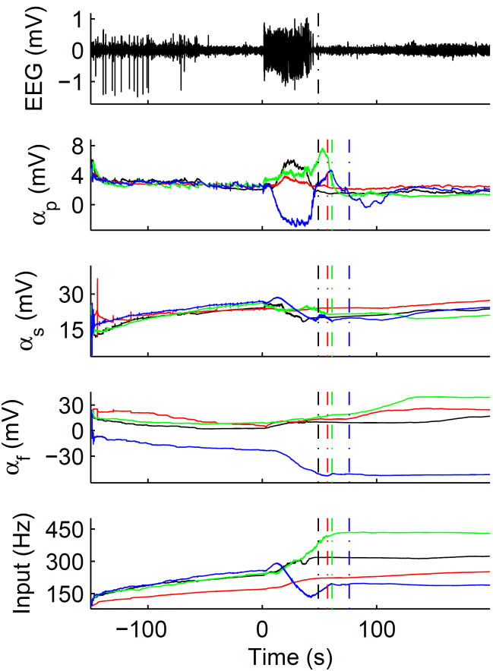

A
B
C
D

Slide 15
A
B
C
D

Slide 16

A
B

Slide 17
A
B

Slide 18
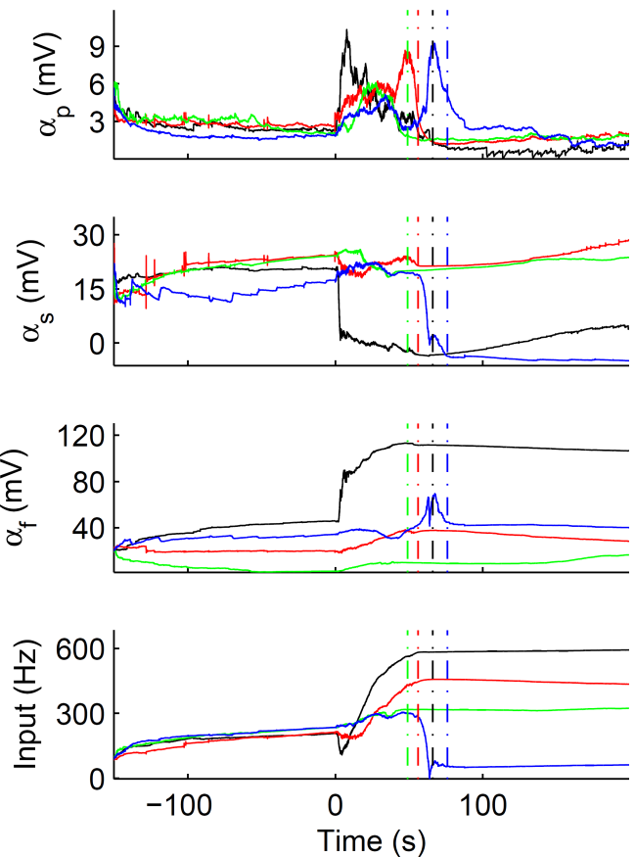
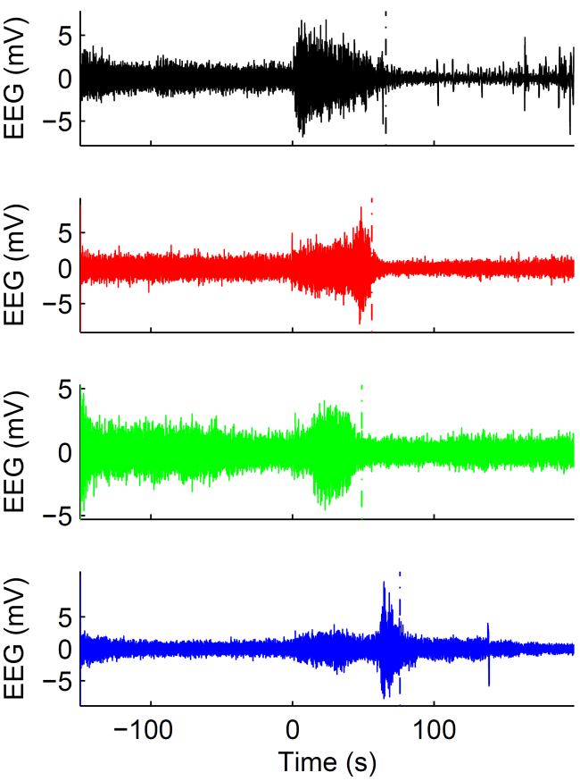
A
B

Slide 19
A
B

