Slide 1
Excitation – Strength = A
Slow Inhibition – Strength = B
Fast Inhibition – Strength = G

Slide 2
Excitation – Strength = A
Slow Inhibition – Strength = B
Fast Inhibition – Strength = G

Slide 3
Excitation – Strength = A
Slow Inhibition – Strength = B
Fast Inhibition – Strength = G

Slide 4
Excitation – Strength = A
Slow Inhibition – Strength = B
Fast Inhibition – Strength = G

Slide 5
Excitation – Strength = A
Slow Inhibition – Strength = B
Fast Inhibition – Strength = G

Slide 6
Excitation – Strength = A
Slow Inhibition – Strength = B
Fast Inhibition – Strength = G

Slide 7
A
B
C
Excitation – Strength = A
Slow Inhibition – Strength = B
Fast Inhibition – Strength = G

Slide 8
BIN
BIN
BIN
PYP
PPO
A
B
C
SSP
FIP
SIP
Excitation ( )
Slow Inhibition ( )
Fast Inhibition ( )

Slide 9
BIN
BIN
BIN
PYP
PPO
A
B
C
SSP
FIP
SIP
Excitation ( )
Slow Inhibition ( )
Fast Inhibition ( )

Slide 10
BIN
B
BIN
Input
PYP
Output
A
C
SSP
FIP
SIP
Excitation ( )
Slow Inhibition ( )
Fast Inhibition ( )

Slide 11
A
B
C
Input
Input
Input
PY
Output
SS
FI
SI
Excitation ( )
Slow Inhibition ( )
Fast Inhibition ( )

Slide 12
A
B
C
Input
Input
Input
PY
Output
SS
FI
SI
Excitation ( )
Slow Inhibition ( )
Fast Inhibition ( )

Slide 13
A
B
C
Input
Input
Input
PY
Output
SS
FI
SI
Excitation ( )
Slow Inhibition ( )
Fast Inhibition ( )

Slide 14
A
B
C
Input
Input
Input
PY
Output
SS
FI
SI
Excitation ( )
Slow Inhibition ( )
Fast Inhibition ( )

Slide 15
A
B
C
Input
Input
Input
PY
Output
SS
FI
SI
Excitation
Slow Inhibition
Fast Inhibition

Slide 16








Input
Excitation ( )
Slow Inhibition ( )
Fast Inhibition ( )

Slide 17







Input

Slide 18
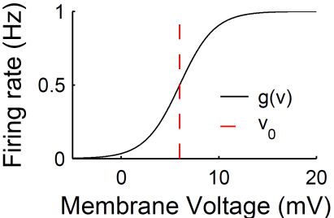
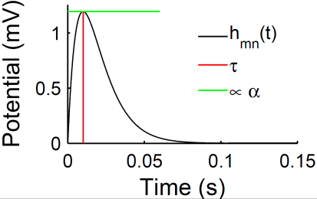
A
B
Input
C
Output

Slide 19


A
B
Input
C
Output

Slide 20
A
B
Input
C
Output

Slide 21
A
B
Input
C
Output

Slide 22
A
B
D
Input
Input
C
Output
Excitation
Slow Inhibition
Fast Inhibition

Slide 23
A
B
D
Input
Input
C
Output
Excitation
Slow Inhibition
Fast Inhibition

