Slide 1
Study Finder
Richard Blanchard, Nika Shafranov
Aubree Lytwyn, Elanor Hoak

Slide 2

Agile
Rating:
Pros: Good way to organize
Easier to plan ahead
Cons: Not great for the time we had

Slide 3

Local Server
Rating:
Pros: Great for testing/visual
Cons: Difficult to get working properly

Slide 4

Parse
Rating:
Pros: Good for hosting a cloud database - Easy to use.
Cons: You need to install a
bunch of packages, have to
get the hang of it

Slide 5

My SQL
Rating:
Pros: Easy to learn and use
Cons: Hard to connect to the rest of our project

Slide 6

Github
Rating:
Pros: Kept all our stuff together. Easy to
share code.
Cons: Occasional trouble merging

Slide 7
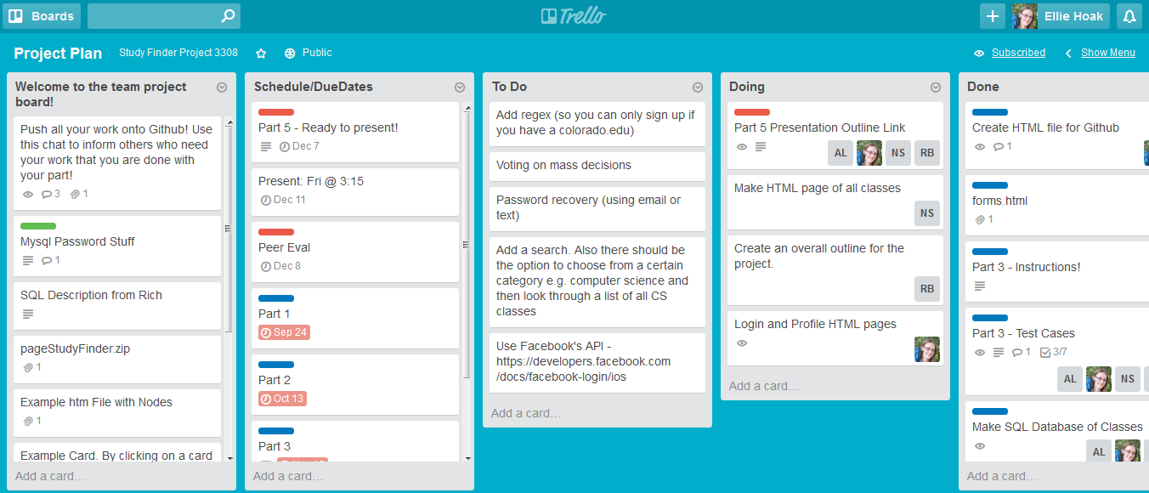
Trello
Rating:
Pros: Great for showing tasks, todo lists, and deadlines
Cons: A lot to learn all at once

Slide 8

Doxygen
Rating:
Pros: Easy to use. Useful. You don’t need to do a lot of work.
Cons: Not too useful for a small project.

Slide 9

JSON
Rating:
Pros: Very easy to use

Slide 10

Xcode
Rating:
Pros: Easy to use and implement code
Cons: Not available to everyone in the group

Slide 11

Vim
Rating:
Pros: Easy to access and use
Cons: Difficult to learn the shortcuts

Slide 12
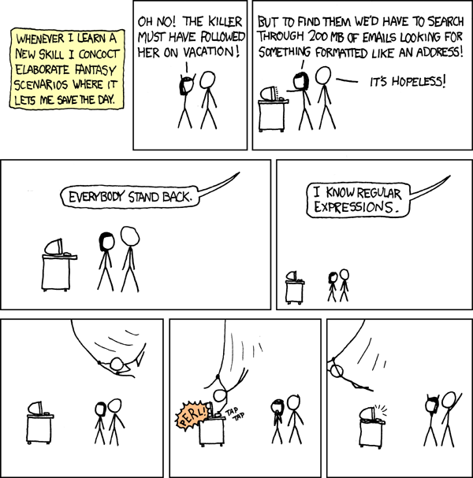
Regex
Rating:
Pros: Quick, saves time if you use it properly.
Cons: Difficult to plan for corner cases.

Slide 13

Challenges
MySQL database connecting to HTML page
Meeting Times

Slide 14
Demo Time!

