Slide 1

Optimal Restaurant Location Capstone
Richard Boulet

Slide 2
Business Problem and Stakeholders
We will be exploring the Washington D.C. area in order to assist in informing our client what the best location is for opening a high-end French restaurant.
We will identify a Census Tract in D.C. based on the amount of other French restaurants, the median income in various areas, the amount of accessible metro stations and roadways, and restaurant statistics.
Our stakeholders include not only our client, but also our customers.

Slide 3
Data Wrangling
Foursquare API
French Restaurants in D.C.
French Restaurant Metrics (likes, rating, price-tier)
Link to Foursquare API
DC Open Data API
Median Income estimates from US Census Bureau
Average Daily Traffic for roadways
Metro Entrances in D.C.
Link to Open Data DC

Slide 4
Data Cleaning
Foursquare API
Used temporary dataframes to select only columns needed from JSON returned from API call with renamed headers.
Used spatial joins to define which restaurants and statistics were located in which Census Tract (our targets used for cluster analysis).
MinMax scaling used for cluster analysis.
DC Open Data API
Found the average daily traffic located within each Census Tract using spatial joins.
Found the count of Metro entrances within each Census Tract using spatial joins.
Used the median income for each Census Tract in clustering analysis.

Slide 5
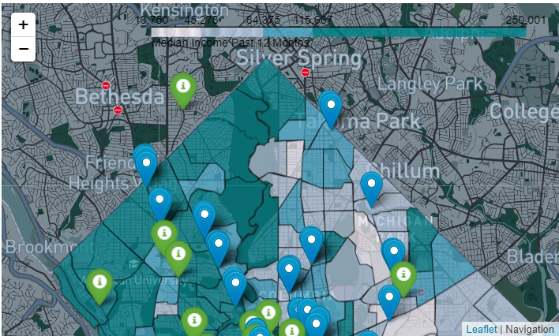
Data Exploration - Spatial Joins
Using GeoPandas package, and the .sjoin function, I was able to accurately match my restaurants, Metro entrances, and road networks to the Census Tract that they are located in.

Slide 6
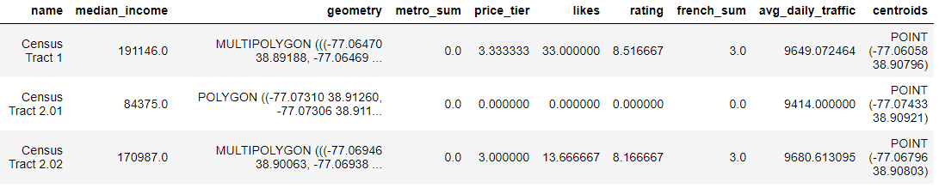
Feature Data Set
Once I had cleaned the data sets and spatially joined them, I then merged the columns I needed into a single dataframe.
MinMax scaling was used in order to convert all of the various data sets to a standard scale.

Slide 7
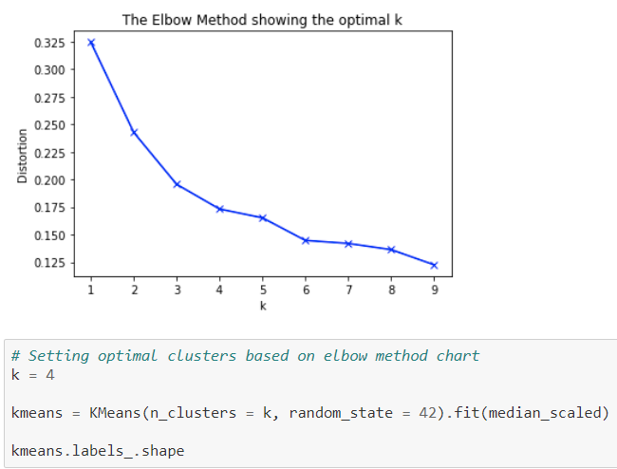
K Means Clustering – Elbow Method
After rescaling the data set, the Elbow Method was used to determine the optimal number of clusters.
In this case I chose 4 as the optimal amount of clusters.

Slide 8
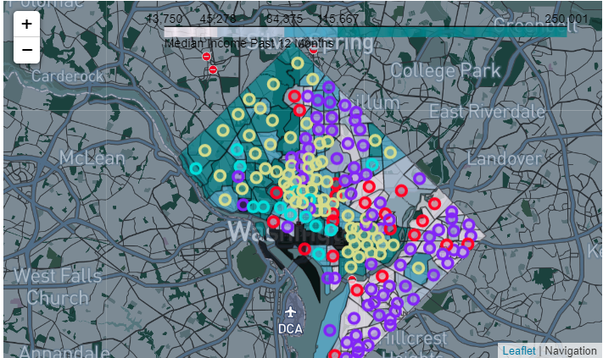
Results - Census Tract Centroids
To display the Census Tracts that we were performing a clustering analysis on, the centroids of the Census Tract polygons were found and displayed.
After K Means clustering was performed, the Census Tract’s cluster was appended to the data set.

Slide 9


Results - Discussion
Based on the clusters identified, there were two groups of clusters that may be ideal locations for our client’s French restaurant to be located in:
Cluster group 2
Cluster group 3
Cluster Group 2 Feature Averages
Cluster Group 3 Feature Averages
We can see that within these two clusters, there is far more competition in Cluster 2 Census Tracts with the sum of French restaurants in the cluster averaging two restaurants per Census Tract. However, in Cluster 2 on average there are far more metro stops and people who have liked a French restaurant in the cluster locations.
Cluster 3 could be a viable option with almost as much daily traffic as Cluster 2, thus showing accessibility to the restaurant, and an even higher average median income than Cluster 2. Additionally there is far less French restaurant competition in Cluster 3 locations than Cluster 2 locations.

Slide 10
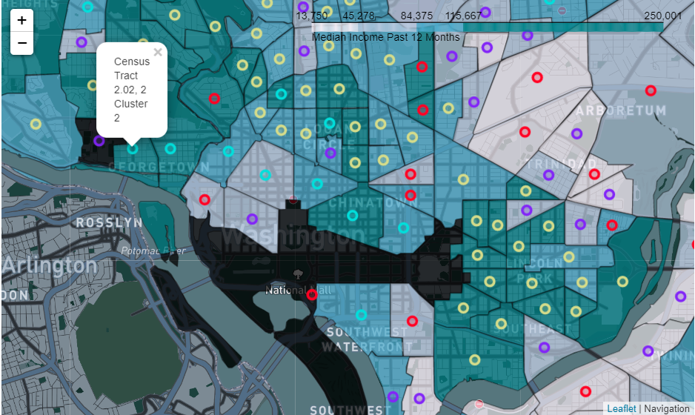
Results – Conclusion
Pros and Cons of Cluster Locations
Cluster 2 | Cluster 3
High median income | High median income
Large amount of Metro stops | Small amount of Metro stops
High amount of competition | Low amount of competition
High traffic flow | High traffic flow
I would recommend to our client that if they want to open a high-end French restaurant in D.C. the best place to do so is in Cluster 2 locations in Downtown D.C.

