Slide 1
3D Graphics Project Proposal
Richard Bruce
5th August, 2009
Notes:
Welcome.

Slide 2
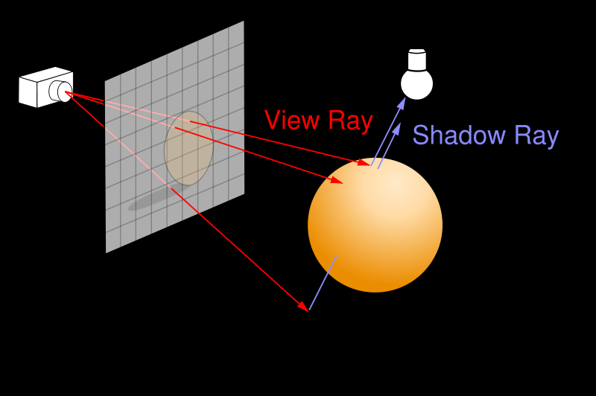
What is Ray Tracing
Shoot a “ray” through each pixel of the screen (Red lines).
If an object is hit then shoot a shadow ray to each light (Blue lines).
If the ray reaches the light then shade.
If object is reflective or transparent then recur.

Slide 3
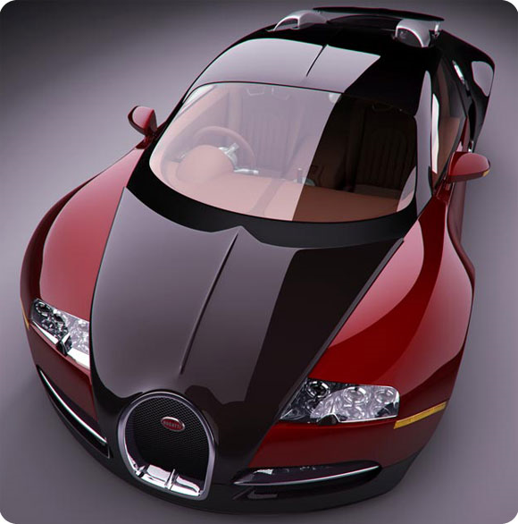
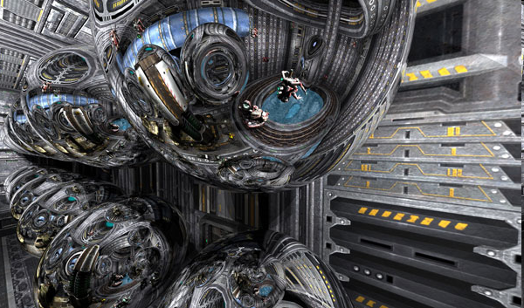
Examples
Very high detail models; 2 million triangles for the car.
Physically accurate shadows, reflections and refractions.
Generate photorealistic images.
Images generated by nVidia Quadro Plex and from http://www.pcper.com/article.php?aid=506&type=expert&pid=4
Notes:
Show reflection layers.

Slide 4
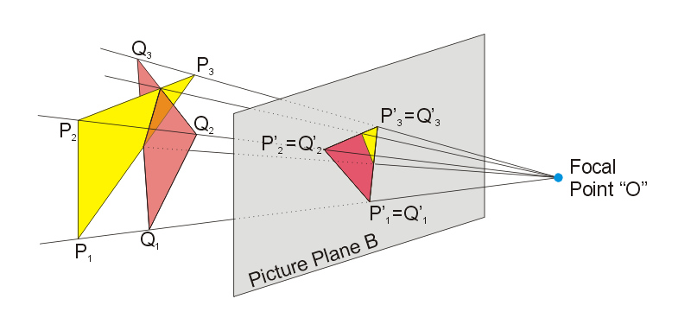
What is Rastering
Project triangles into the view plane.
Shade the triangles.
Remove occluded triangles with a z-buffer.

Slide 5
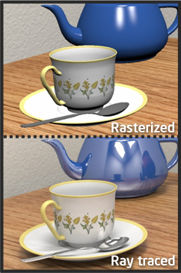
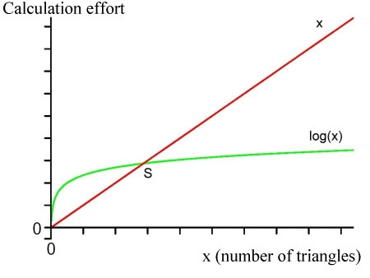
Ray Traced Vs. Rastered
Ray tracing is a potential disruptive technology.
Currently slower than rastering.
Ray tracing scales better.
Ray tracing produces better pictures.
Notes:
Naive ray tracing O(N^2), but accl. Structure make it O(nlog(n)).
Green line ray tracing.
Red line rastering.

Slide 6
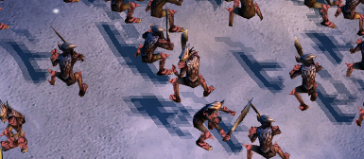
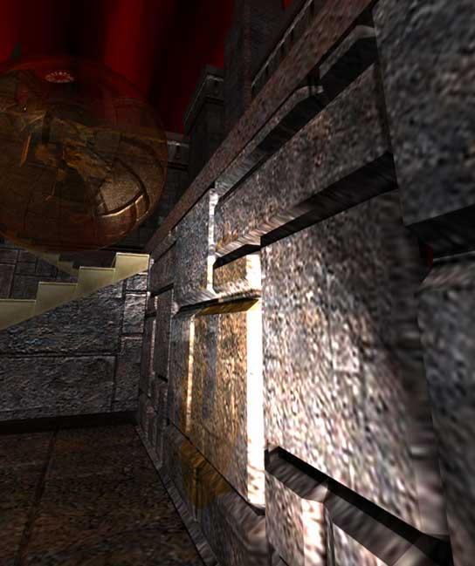

Ray Traced Vs. Rastered
Notes:
Left rastered with shadow maps. Top not updated fast enough. Bottom too lower resolution. Right ray traced.

Slide 7
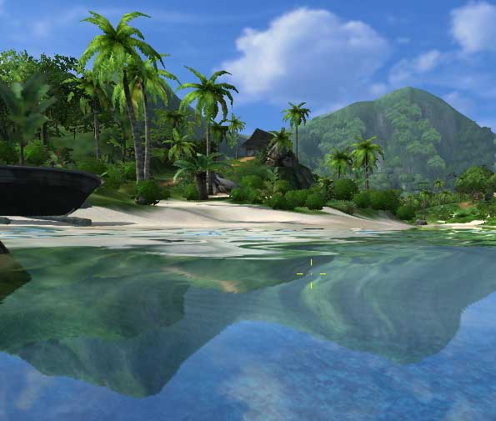
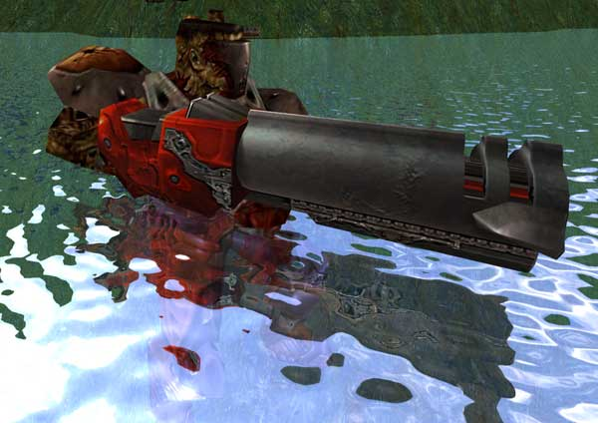
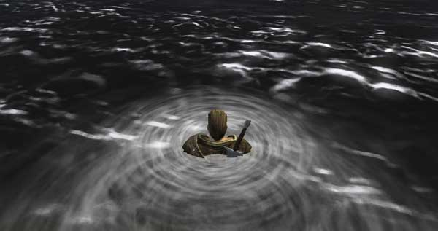
Ray Traced Vs. Rastered
Notes:
Right rastered. Top is missing detail, trees, boat brown hill. Bottom is just terrible. Left is ray tracerd.

Slide 8
This Project
Optimised ray tracer.
  Fast.
  Feature rich.
Physics engine.
  Adds animation and effects.
Hardware platform.
  Improved performance.
  Competitive pricing.
Notes:
Physics as support for the ray tracer to complete the story.
In the future it can help to improve the animation’s physics.

Slide 9
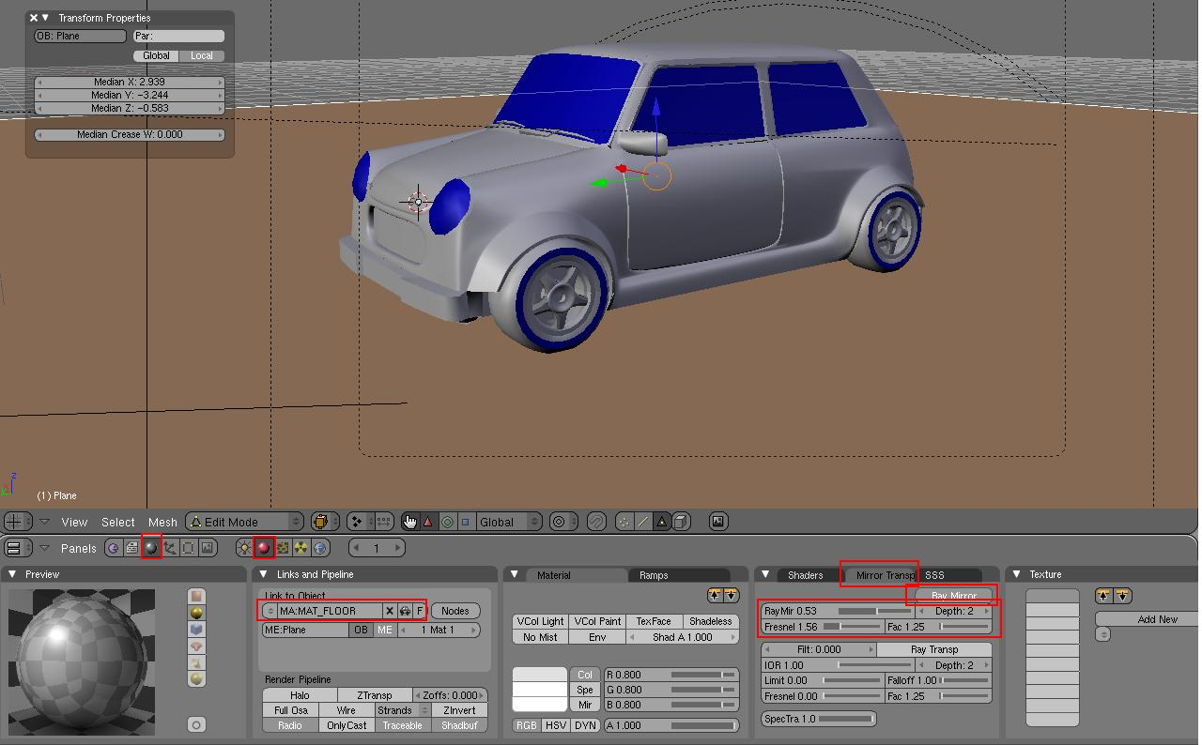
Software Product
Software to run on the PC.
Start up GUI.
SDK and drivers.

Slide 10
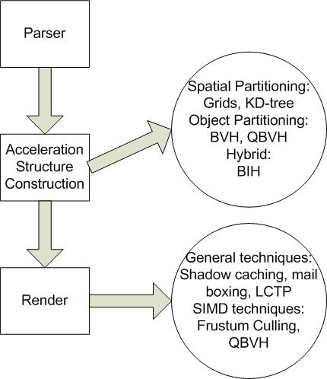
Ray Tracer
Requires an acceleration structure for O(n log (n) ) complexity.
Lots of algorithmic techniques for extra speed.

Slide 11
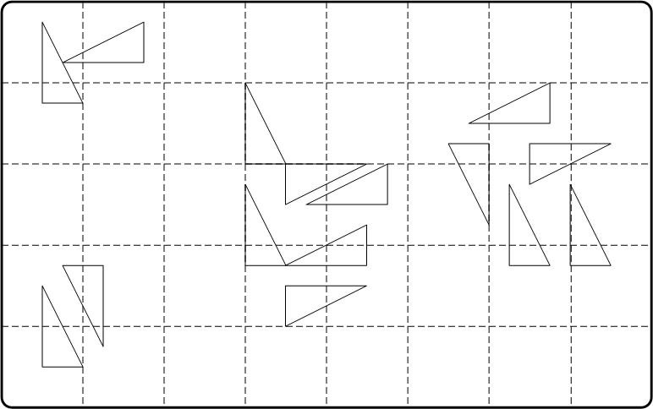
Grids
May split primitives, but not overlap in space.
Don’t adapt well to the scene.
High memory usage.
Spatial ordering allows early completion of traversal.
Long traversal times.

Slide 12
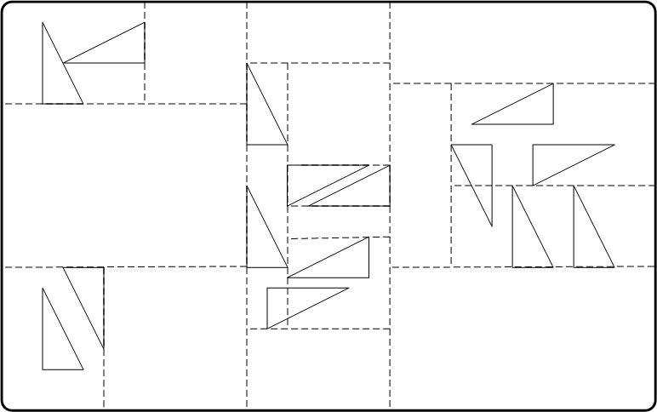
KD-Tree
May split primitives, but not overlap in space.
Adapt to the scene.
High memory usage.
Spatial ordering allows early completion of traversal.

Slide 13
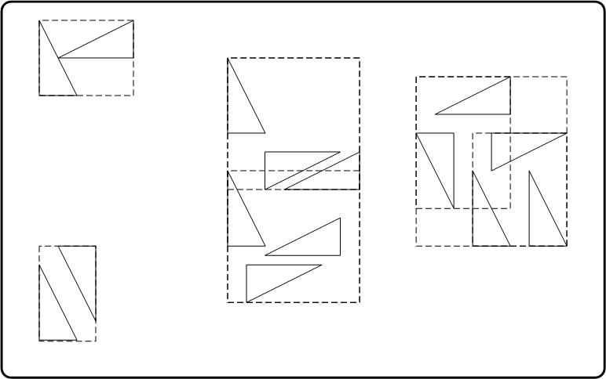
BVH (Bounding Volume Hierarchy)
May overlap in space, but not in objects.
Lower memory consumption.
No spatial ordering.

Slide 14
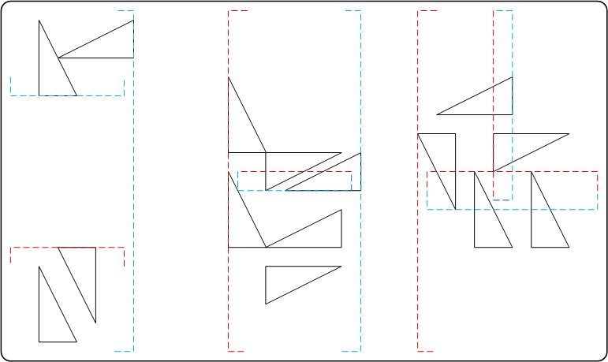
BIH (Bounding Interval Hierarchy)
May overlap in space, but not in objects.
Lower memory consumption.
Some spatial ordering retained allowing early completion of traversal.
Two splits per layer so shallower trees.

Slide 15
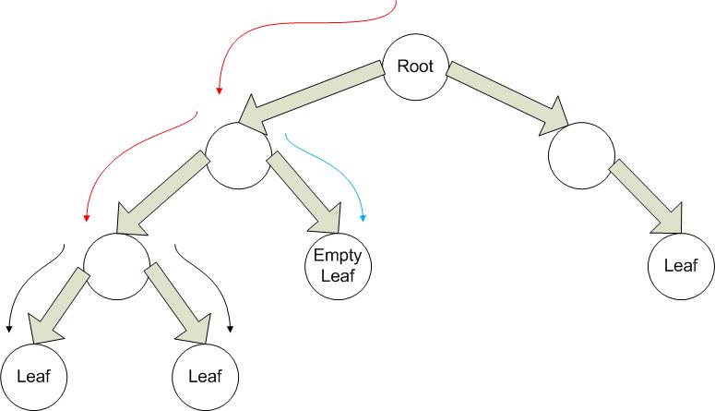
Longest Common Traversal Path
Amortize traversal between multiple rays.
Ray must take the same path to work.

Slide 16
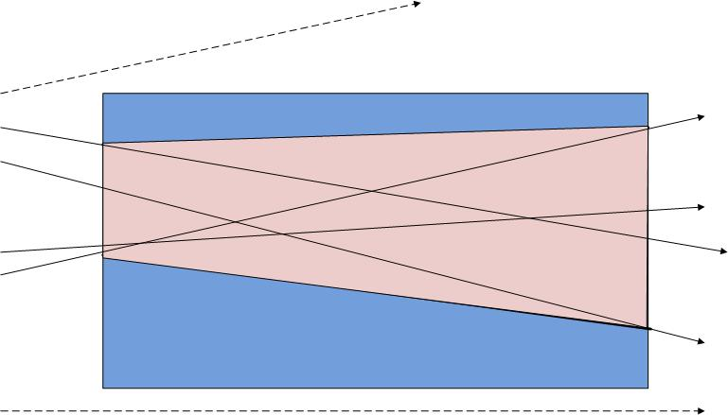
Frustum Culling
At each traversed leaf build a one off frustum for each ray packet.
Allows bigger leaves to be built
Allows larger, less coherent ray packets.

Slide 17
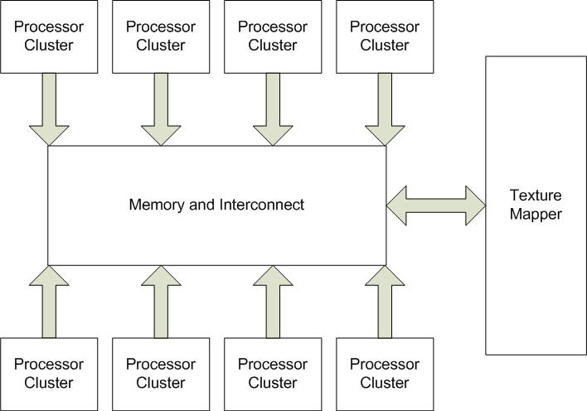
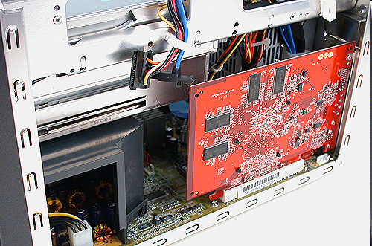
Hardware Product
PCI card to attach to a PC.
Large multi-core architecture.
Texture mapper.

Slide 18
Choice of Processor
Try to get as much performance per area as possible.
Must have:
  SIMD.
  Multi core support.
  Cache.
  OS support.
  Low area.

Slide 19
Memory and Interconnect
No overlapping write or read/write sets.
  Caching (and clever application mapping) to cut down on bandwidth requirement.
Inspiration from:
  Super computing.
  XMOS.
  Teraflop Chip.

Slide 20
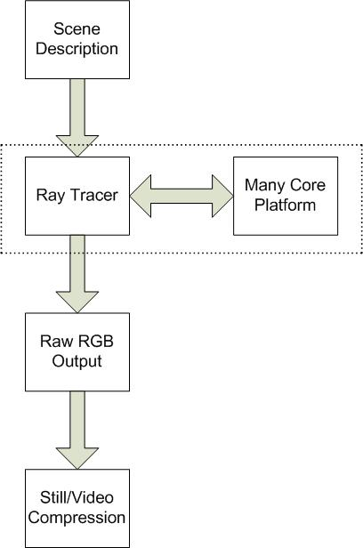
Applications
Animation.
Movie Effects.
Still Graphics.
Computer Graphics.

Slide 21
Computer Graphics Competition
nVidia, ATI, Intel.
Edging towards ray tracing, but still raster dominated.
  Speed is everything.
Some hardware accelerated physics.
Produce hardware we could use.
  Tailored for rastering not ray tracing.
  Quite expensive.
Notes:
No standard ray tracing or physics API. Mainly care about rastering.

Slide 22
Animation Competition
In-House designs for the larger companies.
Already using ray tracing.
  Use large clusters.
  Image quality is everything.
  Time isn’t so important.
  Use a lot of triangles.
Notes:
Ray traces for its better image quality.

Slide 23
Market
Market | Companies | Analysis
Console gaming | Sony, Nintendo, Microsoft. | Difficult to work with or compete with.
Desktop Gaming | NVIDIA, ATI, Intel. | Could try to compete.
Computer Animation | Pixar, Dream Works, Centro Digital, smaller studios. | Could work with the smaller studios.

Slide 24
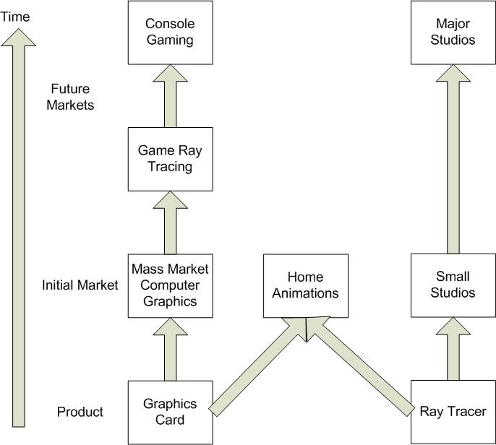
Market Strategy
Difficult to approach Sony, Pixar etc.
End user would buy from us.
Small design studios would buy from us.
Start at the bottom and work up.

Slide 25
Seed Project Timeline
Date | Y0Q1 | Y0Q2
Task
Initial Ray Tracer Design (proof of concept)
Hardware Investigation
Initial FPGA Design

Slide 26
Full Project Timeline
Date | Y0Q3 | Y0Q4 | Y1Q1 | Y1Q2 | Y1Q3 | Y1Q4
Task
Ray Tracer Optimisation
FPGA Design
Physics Engine Design

