Slide 1
RAPTor-
Ray And Photon Tracing or rastering
Richard Bruce
Erik Olsson
12th November, 2009
Notes:
Welcome.

Slide 2
Agenda
What is Quake 2.
What we did to Quake 2.
What we will do next.
Demo.
Questions.

Slide 3
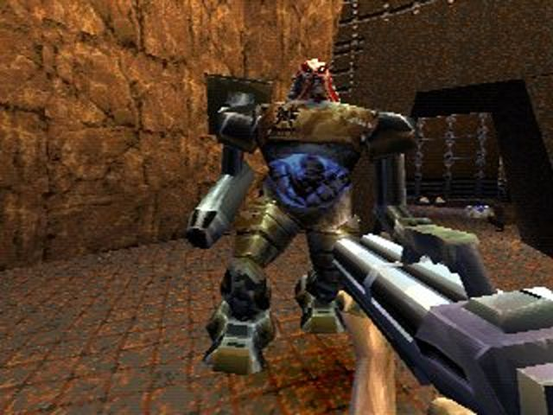
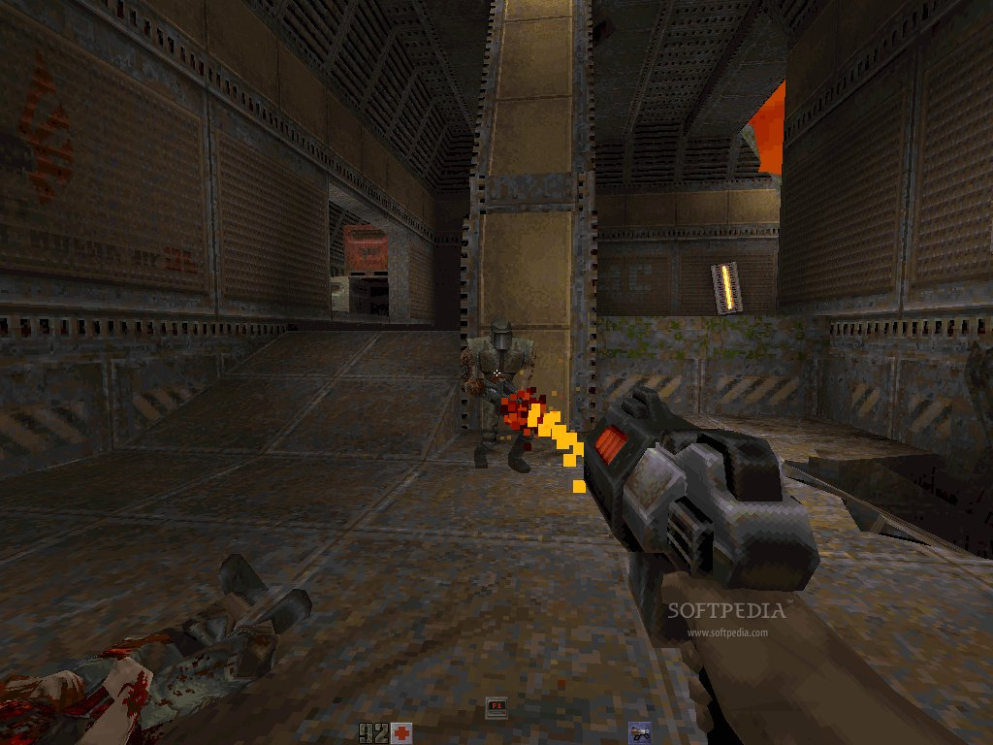
Quake 2
Developed by ID Soft.
Released on December 9, 1997.
One of the most revolutionary games of its day and the ancestor of one of today's most successful game engines.
An excellent place to learn from.

Slide 4
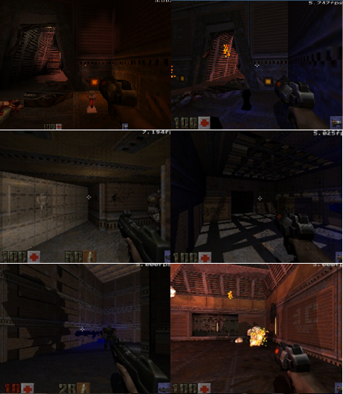
Our Contribution
What we did:
  All ray traced, except the menus.
  Added lighting effects.
  Added reflections.
What we didn’t do:
  Update any models.
  Update the game engine.

Slide 5
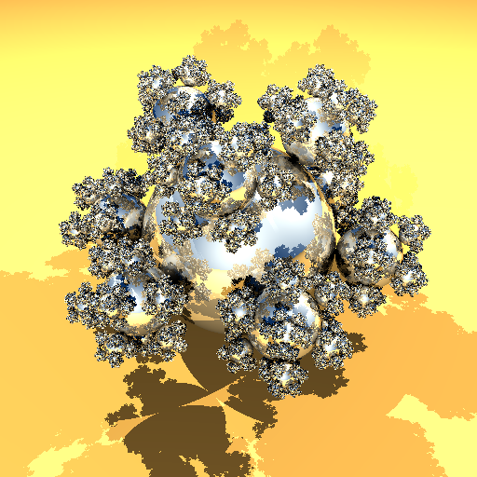
Ray Tracer
2 Acceleration structures, one for fast build, one for fast rendering.
Implements shadows, HDR lighting, reflections and refractions.
SIMD packet tracing.
Arbitrary shaders and texture mappers
  Cook-Torrence and Phong shaders.
  Texture mapping with a bilinear filter.
  Procedural texture mapping using Perlin noise.
Threaded to expand with available cores without re-compilation.

Slide 6
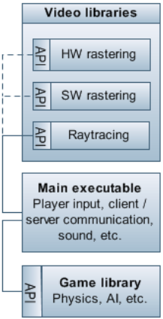
Raytracing in Quake 2
Raytracer input
  Triangles
  Textures
  Light sources
  Camera
  Skybox
8 bit palette → 24 bit colour
Effects and 2D graphics
  E.g. menus, particles, sprites, screen warp, …

Slide 7
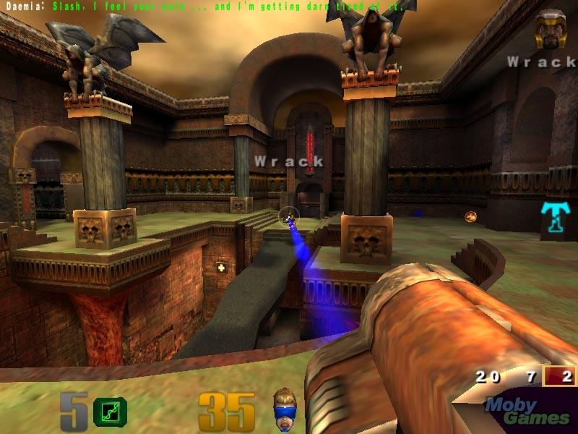
What We Will Do Next
Quake 3 (of course).
  More triangle.
  More detailed models and textures.
  Open source.
Our own physics engine.
  Rigid Body motion.
  Collision detection.

Slide 8
Seed Project
Start system modelling with PV models.
Our own game engine.
  Still suitable for animation.
  Extended rendering effects.
  Physics engine.

