Slide 1

Brand Guidelines
Security that keeps its head above water
Version 1.0 | October 2026
© Halyard. All rights reserved.

Slide 2

ABOUT THIS GUIDE
This guide shows how to present the Halyard brand consistently. It is for employees, agencies, partners, and AI design tools. The rules are fixed; creativity inside them is encouraged.
Who it is for
Marketing, sales, product, agencies, and partners producing anything with our name on it.
Where to get files
brand.halyard.example (logos, fonts, templates)
Halyard | Brand Guidelines | Introduction
2 / 41

Slide 3
Contents
01
Brand Foundation
07
Using This Guide
02
Logo
03
Color
04
Typography
05
Imagery
06
Writing Style

Slide 4
OUR MISSION
Give every security team the calm, clear signal they need to act.

Slide 5
01
Brand Foundation
Who we are, what we stand for, and how we sound.

Slide 6
BRAND FOUNDATION
VISION
Who We Are
A world where security teams spend their time deciding, not searching.
Halyard is the detection platform that turns noisy telemetry into a short, ranked list of what matters, so lean security teams act first and explain later.
BOILERPLATE | approved company description
Halyard helps security teams cut through alert noise. The Halyard platform correlates signals across cloud, identity, and endpoint to surface the handful of threats that matter, ranked and explained. Founded in 2021 and headquartered in Denver, Colorado, Halyard protects more than 400 organizations. Learn more at halyard.example.
Halyard | Brand Guidelines | Brand Foundation
6 / 41

Slide 7
BRAND FOUNDATION
Brand Pillars
Clarity
Calm
Craft
We say the useful thing first.
Security without the siren.
Built by practitioners.
Ranked, explained findings
Plain language over jargon
No dashboards for their own sake
No fear-based selling
Confident, steady tone
Evidence over adjectives
Designed with SOC analysts
Opinionated defaults
Fast to deploy
Halyard | Brand Guidelines | Brand Foundation
7 / 41

Slide 8
BRAND FOUNDATION
Over the next two years we are moving from a detection tool to the system of record for security decisions. The brand should feel more like a trusted instrument than a startup.
Where We Are Going
Our direction shapes how the brand shows up. Use it to judge whether new work moves us forward.
Halyard | Brand Guidelines | Brand Foundation
8 / 41

Slide 9
BRAND FOUNDATION
WE ARE
WE ARE NOT
Voice and Tone
Direct
Blunt or cold
We sound like the most senior analyst on the team: direct, unhurried, and specific.
Confident
Arrogant or absolute
Lead with the outcome, then the evidence
Cite a source for every number
Never use breach headlines to sell
Plainspoken
Jargon-heavy
Calm
Alarmist
Halyard | Brand Guidelines | Brand Foundation
9 / 41

Slide 10
02
Logo
Our most recognizable asset. Use only approved files, exactly as supplied.

Slide 11

LOGO
Our Logo
The Halyard logo pairs the Signal mark, a wave rising inside a circle, with our wordmark. The two always appear together in the approved relationship.
Signal mark: the circle and wave
Wordmark: custom-drawn lowercase lettering
The mark and wordmark are one lockup and are never redrawn
Halyard | Brand Guidelines | Logo
11 / 41

Slide 12


LOGO
Logo Variations
Choose the version by the background it sits on, not by taste.
Full color (preferred)
Knockout
All white
Default. White and light gray backgrounds.
Ink and other dark backgrounds.
On Halyard Blue only.
All ink
Signal mark
One-color print and engraving.
Favicons and avatars where the full logo will not fit.
Halyard | Brand Guidelines | Logo
12 / 41

Slide 13
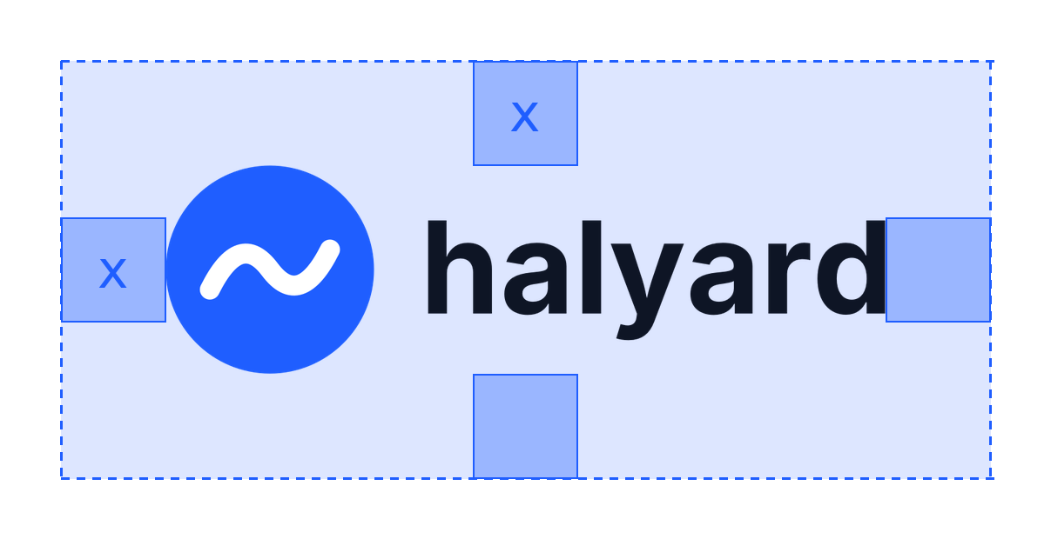
LOGO
Clear Space and Minimum Size
Keep a clear zone of x on every side of the logo, where x is half the height of the Signal mark. No text, imagery, or edges inside it.
x = half the height of the Signal mark
At favicon sizes the mark may fill up to 90% of the canvas.
PRINT
DIGITAL
MARK ONLY
1 in / 25 mm wide
120 px wide
16 px
Halyard | Brand Guidelines | Logo
13 / 41

Slide 14




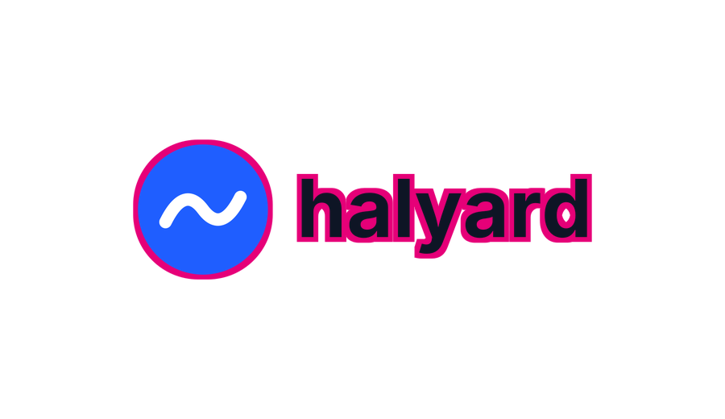



LOGO
Incorrect Logo Usage
Never alter the logo. These examples use our real logo to show what not to do.
✕
✕
✕
✕
Do not stretch or distort the logo
Do not rotate, angle, or skew the logo
Do not recolor the logo or use unapproved colors
Do not add drop shadows, glows, or other effects
✕
✕
✕
✕
Do not outline or stroke the logo
Do not place the logo on busy backgrounds or patterns
Do not use the light-mode logo on dark backgrounds
Do not crowd the logo or ignore its clear space
Halyard | Brand Guidelines | Logo
14 / 41

Slide 15
LOGO
WHERE OUR LOGO DOES NOT APPEAR
Brand-Specific Rules
On competitor-hosted or competitor-sponsored materials
On merchandise without marketing approval
Next to breach news imagery or hacker stock photos
In a partner's product UI without a signed agreement
These go beyond the generic rules above. They exist because of how our brand has actually been misused.
ALSO DO NOT
Do not use the Signal mark as a bullet point or decorative icon
Do not animate the wave without the approved motion file
Halyard | Brand Guidelines | Logo
15 / 41

Slide 16
LOGO
Partner Co-branding
PARTNER LOGO
When Halyard appears with a partner, both brands should look like equals.
Order: Halyard first in Halyard-led materials; partner first in theirs.
Balance: Match visual weight, not pixel width.
Alignment: Center-align on a shared axis.
Mode: Both logos in the same mode.
PARTNER LOGO
Minimum space between logos: 0.5 in / 48 px between logos
Halyard | Brand Guidelines | Co-branding
16 / 41

Slide 17
CO-BRANDING
Co-branding: What Not To Do
Do not convert the Halyard logo to grayscale to match a partner
✕
Do not give either logo visual dominance
✕
Do not create a combined lockup
✕
Halyard | Brand Guidelines | Co-branding
17 / 41

Slide 18
03
Color
Color is one of the fastest ways people recognize us.

Slide 19
COLOR
Primary Palette
Halyard Blue and Ink carry the brand. Use them for logo, headlines, and large color fields.
Halyard Blue
HEX #1F5EFF
RGB 31, 94, 255
CMYK 85, 63, 0, 0
PMS 2728 C
Ink
HEX #0E1525
RGB 14, 21, 37
CMYK 86, 75, 49, 72
PMS Black 6 C
White
HEX #FFFFFF
RGB 255, 255, 255
CMYK 0, 0, 0, 0
Halyard | Brand Guidelines | Color
19 / 41

Slide 20
COLOR
Accent Palette
Use sparingly for calls to action, highlights, and charts. Never as a background behind body text.
Signal Coral
HEX #FF6B4A
RGB 255, 107, 74
PMS 2028 C
CTAs and highlights
Tide
HEX #14B8A6
RGB 20, 184, 166
PMS 3268 C
Success, charts
Sky
HEX #9CC3FF
RGB 156, 195, 255
PMS 2706 C
Links on dark
Halyard | Brand Guidelines | Color
20 / 41

Slide 21
COLOR
Neutral Palette
Structure: backgrounds, borders, dividers, tables, and body copy.
Mist
HEX #F4F6FA
RGB 244, 246, 250
Fog
HEX #E3E8F0
RGB 227, 232, 240
Slate 300
HEX #B6C0D0
RGB 182, 192, 208
Slate 500
HEX #6B778C
RGB 107, 119, 140
Slate 700
HEX #3A4458
RGB 58, 68, 88
Deep
HEX #1A2335
RGB 26, 35, 53
Halyard | Brand Guidelines | Color
21 / 41

Slide 22

COLOR
Gradients
One gradient only, Halyard Blue to Ink, at 135 degrees. Use for hero backgrounds, never behind small text.
Depth #1F5EFF > #0E1525 135°
Halyard | Brand Guidelines | Color
22 / 41

Slide 23
COLOR
Light Mode and Dark Mode
The same brand on two backgrounds. Each mode has its own text, accent, and logo version.
LIGHT MODE
DARK MODE
Headline in primary text
Headline in primary text
Secondary text sits here and carries supporting detail.
Secondary text sits here and carries supporting detail.
Primary action
Text link
Primary action
Text link
Background
#FFFFFF
Surface
#F4F6FA
Text
#0E1525
Text Muted
#6B778C
Background
#0E1525
Surface
#1A2335
Text
#FFFFFF
Text Muted
#B6C0D0
Border
#E3E8F0
Accent
#1F5EFF
Link
#1F5EFF
Border
#3A4458
Accent
#1F5EFF
Link
#9CC3FF
Halyard | Brand Guidelines | Color
23 / 41

Slide 24
COLOR
Color Proportion
Roughly how much of a layout each color should occupy.
55%
25%
15%
5%
White / Mist
Space and backgrounds
Ink
Type and dark sections
Halyard Blue
Brand moments
Coral
Actions only
Halyard | Brand Guidelines | Color
24 / 41

Slide 25
COLOR
Accessible Color Pairings
WCAG 2.x contrast ratios. Body text needs 4.5:1 (AA). Large text and UI elements need 3:1. Calculated from the HEX values above.
Text \ Background | light bg #FFFFFF | light surface #F4F6FA | dark bg #0E1525 | dark surface #1A2335 | accent #1F5EFF
light text #0E1525 | Aa 18.2:1 AAA | Aa 16.8:1 AAA | Aa 1.0:1 Fail | Aa 1.2:1 Fail | Aa 3.6:1 AA Large
light text muted #6B778C | Aa 4.5:1 AA | Aa 4.2:1 AA Large | Aa 4.0:1 AA Large | Aa 3.5:1 AA Large | Aa 1.1:1 Fail
light accent #1F5EFF | Aa 5.1:1 AA | Aa 4.7:1 AA | Aa 3.6:1 AA Large | Aa 3.1:1 AA Large | Aa 1.0:1 Fail
dark text #FFFFFF | Aa 1.0:1 Fail | Aa 1.1:1 Fail | Aa 18.2:1 AAA | Aa 15.7:1 AAA | Aa 5.1:1 AA
dark text muted #B6C0D0 | Aa 1.8:1 Fail | Aa 1.7:1 Fail | Aa 9.9:1 AAA | Aa 8.6:1 AAA | Aa 2.8:1 Fail
dark link #9CC3FF | Aa 1.8:1 Fail | Aa 1.7:1 Fail | Aa 10.1:1 AAA | Aa 8.7:1 AAA | Aa 2.8:1 Fail
Halyard | Brand Guidelines | Color
25 / 41

Slide 26
COLOR
Color: What Not To Do
Do not tint or shade brand colors outside the defined neutrals
✕
Do not set body text in Signal Coral
✕
Do not place Halyard Blue text on Ink
✕
Halyard | Brand Guidelines | Color
26 / 41

Slide 27
04
Typography
Consistent type makes us recognizable before anyone reads a word.

Slide 28
HEADLINE
Aa
Inter Display
ABCDEFGHIJKLMNOPQRSTUVWXYZ
abcdefghijklmnopqrstuvwxyz
0123456789 !@#$%&*()?
Headlines and display numbers.
Source / license: Open source (SIL OFL), rsms.me/inter
Fallback when unavailable: Arial
WEIGHTS
Medium
Inter Display
Semi Bold
Inter Display
Bold
Inter Display
Halyard | Brand Guidelines | Typography
28 / 41

Slide 29
BODY
Aa
Inter
ABCDEFGHIJKLMNOPQRSTUVWXYZ
abcdefghijklmnopqrstuvwxyz
0123456789 !@#$%&*()?
Body copy, UI, tables, and captions.
Source / license: Open source (SIL OFL)
Fallback when unavailable: Arial
WEIGHTS
Regular
Inter
Italic
Inter
Medium
Inter
Semi Bold
Inter
Halyard | Brand Guidelines | Typography
29 / 41

Slide 30
TYPOGRAPHY
Type Hierarchy
EYEBROW
PRODUCT UPDATE
Inter | Semi Bold | 12px | Tracking 8% | uppercase
H1
Headline sample
Inter Display | Semi Bold | 48px | LH 1.1
H2
Headline sample
Inter Display | Semi Bold | 32px | LH 1.2
H3
Headline sample
Inter Display | Medium | 24px | LH 1.25
LEAD
The quick brown fox
Inter | Regular | 20px | LH 1.5
BODY
The quick brown fox
Inter | Regular | 16px | LH 1.6
CAPTION
The quick brown fox
Inter | Medium | 12px | LH 1.4
Halyard | Brand Guidelines | Typography
30 / 41

Slide 31
TYPOGRAPHY
Typography Rules
DO
DON'T
Sentence case for all headlines
Use more than two weights in one layout
✓
✕
Headlines in Ink, White, or Halyard Blue only
Set body copy below 14 px on screen
✓
✕
Left-align body copy; never justify
✓
Halyard | Brand Guidelines | Typography
31 / 41

Slide 32
05
Imagery
Photography, illustration, and icons that look and feel like us.

Slide 33
IMAGERY
Photography
Real practitioners at work, in natural light.
DO
DON'T
Real people: Candid, never posed.
Hooded hackers or green code rain
✓
✕
Natural light: Daylight, soft shadows.
Padlocks, shields, and stock 'cyber' clichés
✓
✕
Calm focus: Concentration, not panic.
Staged handshakes
✓
✕
Halyard | Brand Guidelines | Imagery
33 / 41

Slide 34
06
Writing Style
How we write about ourselves and our products.

Slide 35
WRITING STYLE
Company and Product Names
Halyard, never HALYARD or Halyard Labs
1
The Halyard platform on first reference, then Halyard
2
Do not add 'Halyard' in front of feature names
3
Halyard | Brand Guidelines | Writing Style
35 / 41

Slide 36
WRITING STYLE
Preferred Terms
Use | Instead of | Why / note
threat | attack (when the tactic is unknown) | Broader and more accurate
AI | AI and machine learning | Redundant together
cybersecurity | cyber security | One word
sign in | login (as a verb) | Login is a noun
Halyard | Brand Guidelines | Writing Style
36 / 41

Slide 37
WRITING STYLE
Formatting Rules
For anything not covered here, follow the AP Stylebook.
Always use the Oxford comma
Never use & or + in place of 'and' in body copy
1
2
Dates: October 28, 2026
Phone: +1-303-555-0100
3
4
Halyard | Brand Guidelines | Writing Style
37 / 41

Slide 38
07
Using This Guide

Slide 39
USING THIS GUIDE
Brand Checklist
Run through this before anything ships.
Is this the current logo file from the official source?
Are the brand typefaces (or approved fallbacks) used?
Is the logo version right for the background (light vs. dark)?
Are company and product names written correctly?
Is the logo clear space respected and above minimum size?
Does photography match the brand direction?
Are all colors from the approved palette, using exact values?
Are partner logos balanced and spaced per co-branding rules?
Do text and background pairs meet contrast guidelines?
Halyard | Brand Guidelines | Using This Guide
39 / 41

Slide 40
USING THIS GUIDE
Brand approvals
Brand team | brand@halyard.example
Questions and Resources
Logo files, fonts, and templates: brand.halyard.example (logos, fonts, templates)
When in doubt, ask before you publish.
VERSION HISTORY
1.0 October 2026 First edition
Halyard | Brand Guidelines | Using This Guide
40 / 41

Slide 41
OUR MISSION
Give every security team the calm, clear signal they need to act.

