Slide 1

Steering behaviours for autonomous agents in games
Richard Čerňanský

Slide 2
What is an autonomous agent?
An entity not controlled by a player
No global leader, no plan
Important part of the game – influencing
Three key components:
Limited ability to perceive environment
Calculating an action after processing information
No leader (optional)

Slide 3
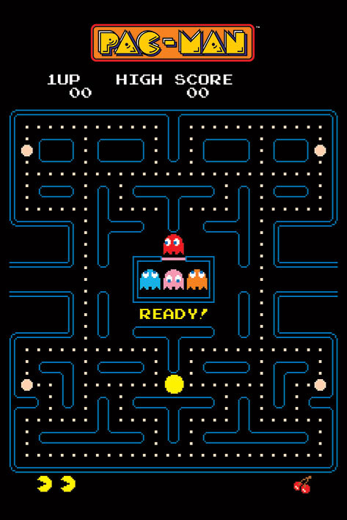
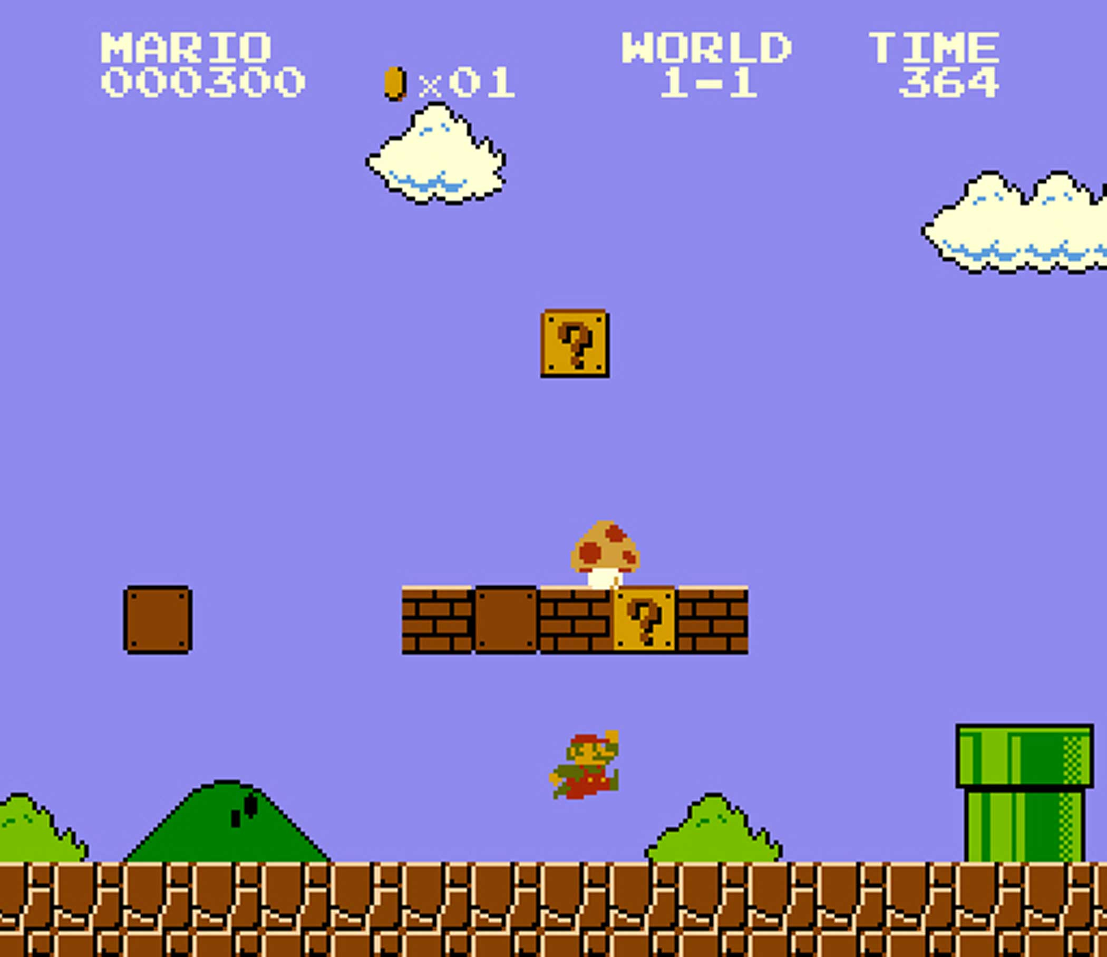
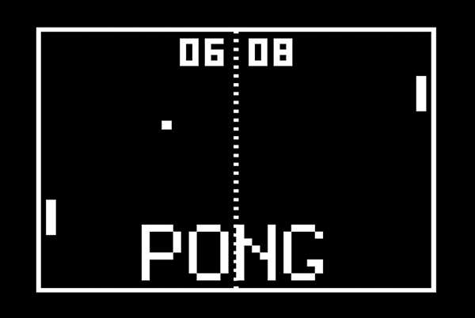
A brief History of game graphics and animation

Slide 4
Types of behaviors according to the number of objects involved
Examples:
https://www.youtube.com/watch?v=EVFGVr99ipg
https://editor.p5js.org/RichardCernansky/sketches/E0zAXshWw
Simple behavior for individuals and pairs
Combined behaviors and groups

Slide 5
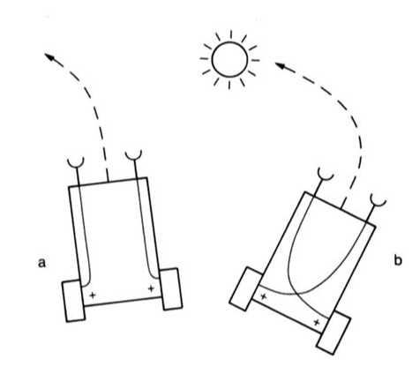
Braitenberg vehicle
Valentino Braitienberg (18 June 1926 – 9 September 2011),
neuroscientist and cyberneticist from Italy
Book Vehicles: Experiments in Synthetic Psychology
The vehicles A and B feel emotion about the object (sun), fear and attraction
Vehicle- reference to autonomous agents

Slide 6
Seek and arrive – a pursuit of a static object

Slide 7
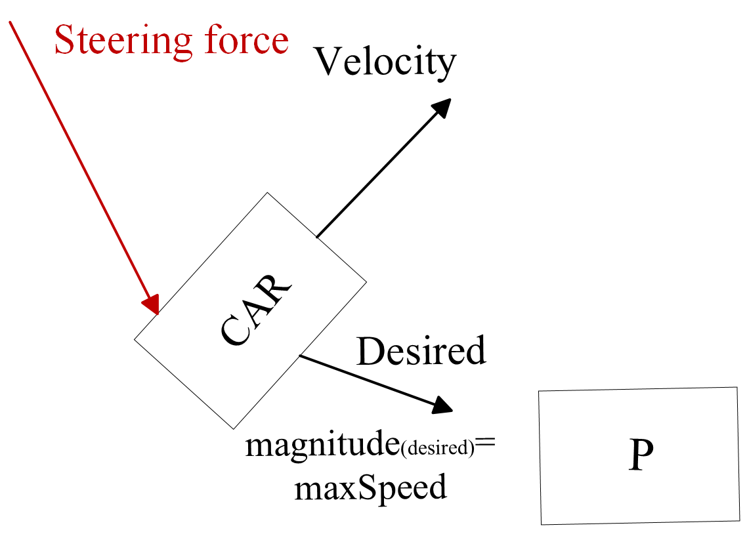
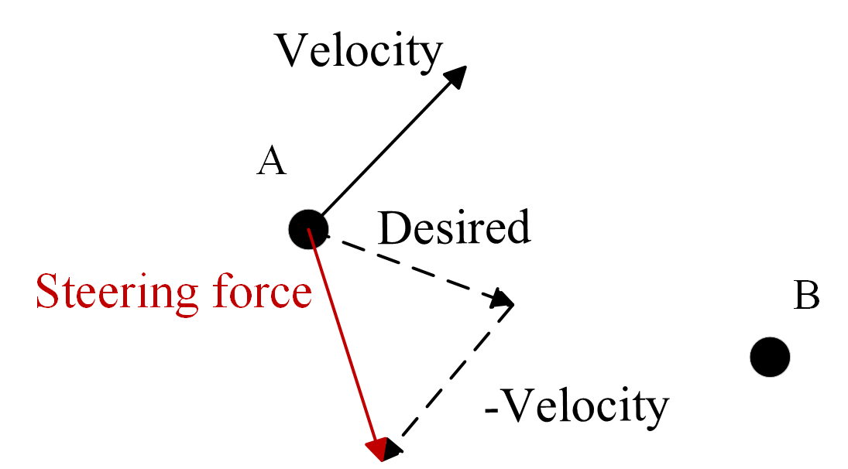

Seeking behavior
One object attracted to the target
Steers a character towards a specified position in a space
Velocity vector alingned with target’s coordinates
Calculation of the motion:

Slide 8

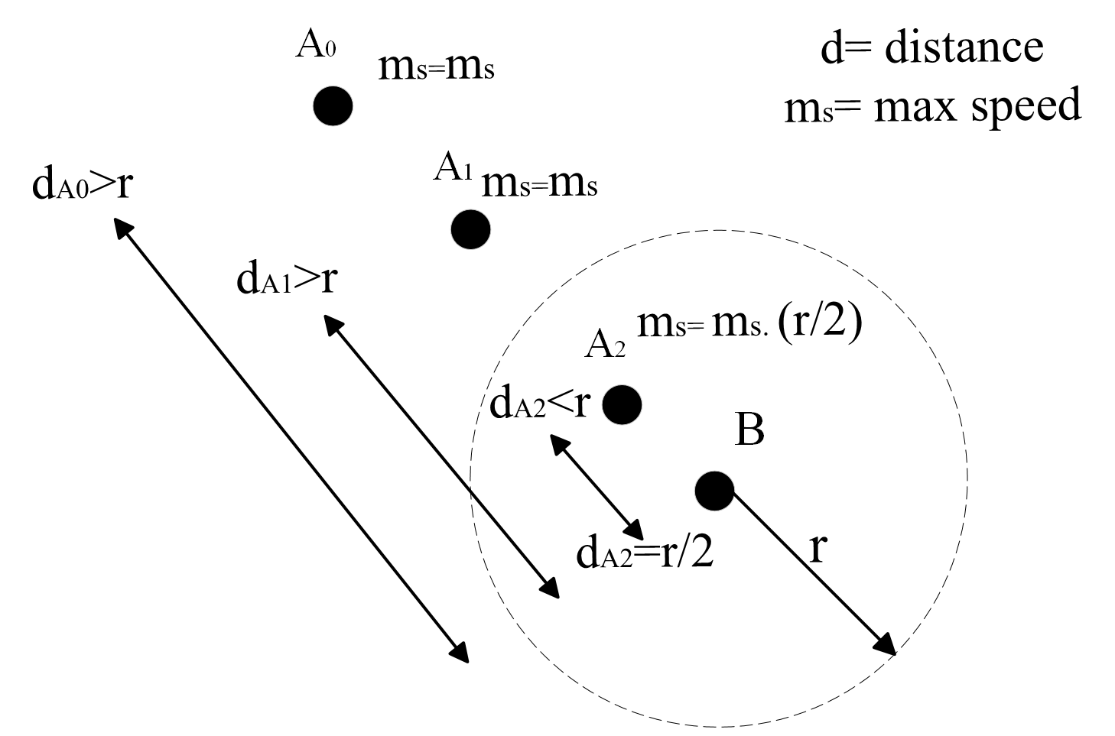
Arrive behavior
If in range - gradually decrease the speed
Eventually stop
Any idea for deriving a formula? (see the diagram)

Slide 9
Seeing the code in p5.js
https://www.youtube.com/watch?v=EVFGVr99ipg

Slide 10
Other possible steering behaviors

Slide 11
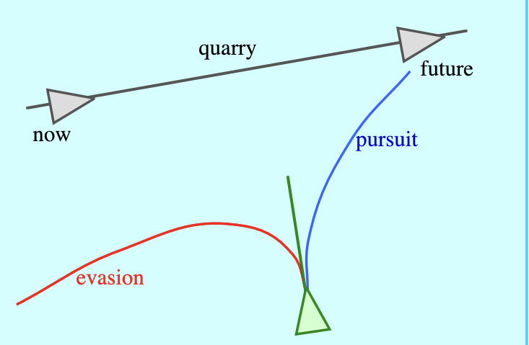
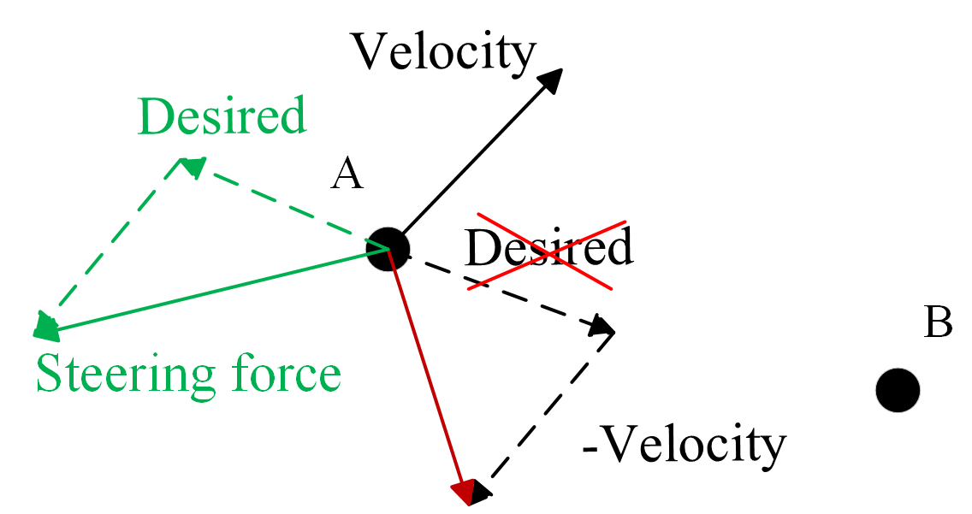
Pursuit and flee
Pursuit
Flee
Different than seeking
Target is moving in a certain direction
If the pursuer knows the direction, how can it use the information?
Similar to the seek behavior
The desired velocity is reversed

Slide 12
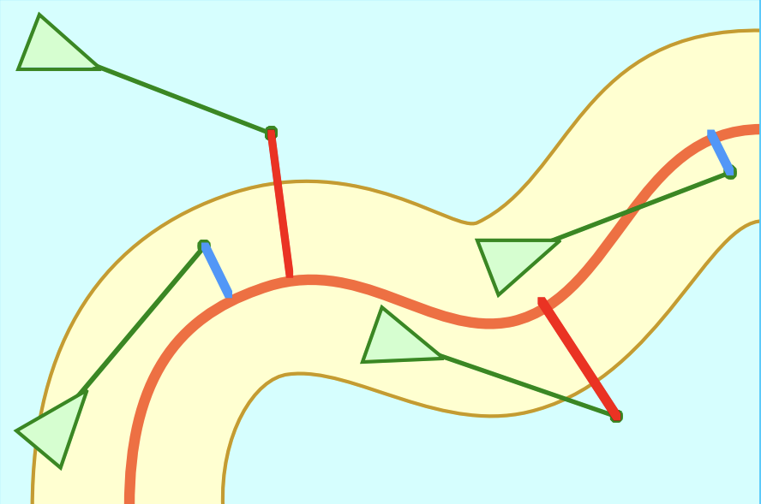
Path following
Steering along predetermined path
Vehicle not constrained rigidly to a path
vehicle’s distance from line > radius ⟹ the steering force applied

Slide 13
Thank you for your attention!

