Slide 1
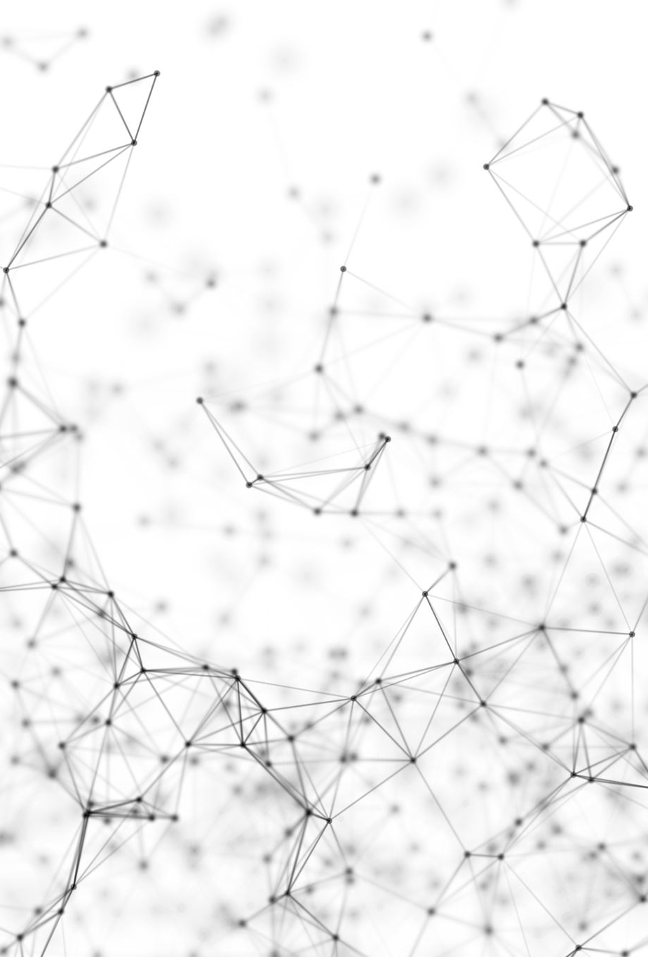
Application of vector algebra and physics in designing steering behaviours of autonomous agents for realistic display in two dimensions

