Slide 1

Application of vector algebra and physics in designing steering behaviours of autonomous agents for realistic Display in two dimensions
Richard Čerňanský

Slide 2
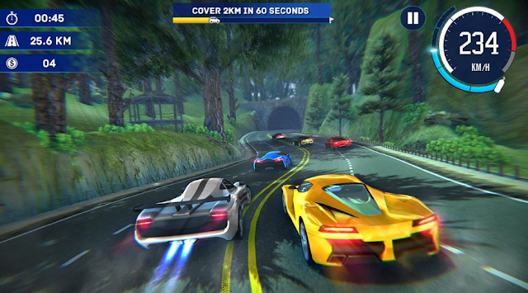
What is an autonomous agent?
An entity not controlled by a player
No global leader, no plan
Important part of the game – influencing
Three key components:
Limited ability to perceive environment
Calculating an action
No leader (optional)

Slide 3
Types of behaviors -number of objects involved
Examples:
https://www.youtube.com/watch?v=EVFGVr99ipg
https://editor.p5js.org/RichardCernansky/sketches/E0zAXshWw
Simple behavior for individuals and pairs
Combined behaviors and groups

Slide 4
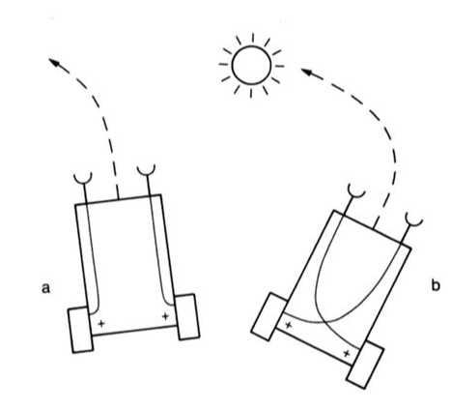
Braitenberg vehicle
Valentino Braitienberg (18 June 1926 – 9 September 2011), Italy
Neuroscientist, cyberneticist
Book Vehicles: Experiments in Synthetic Psychology
The vehicles A and B feel emotion about the object (sun), fear and attraction
Vehicle- reference to autonomous agents

Slide 5
Seek and arrive – a pursuit of a static object

Slide 6
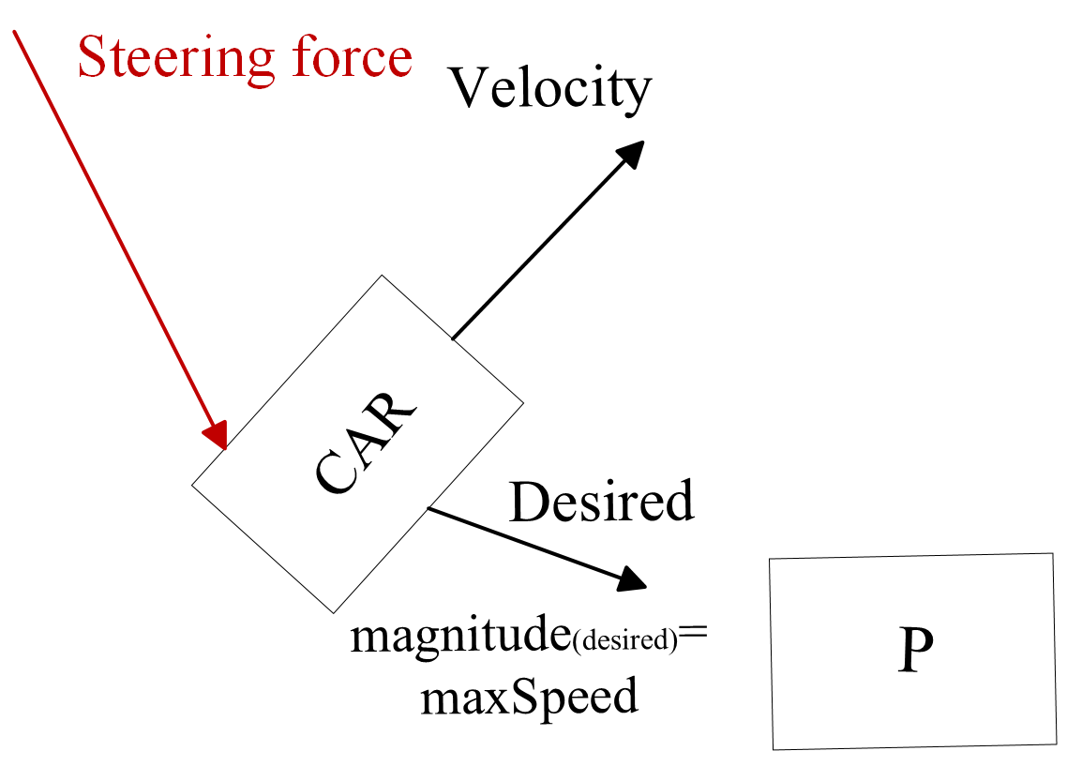
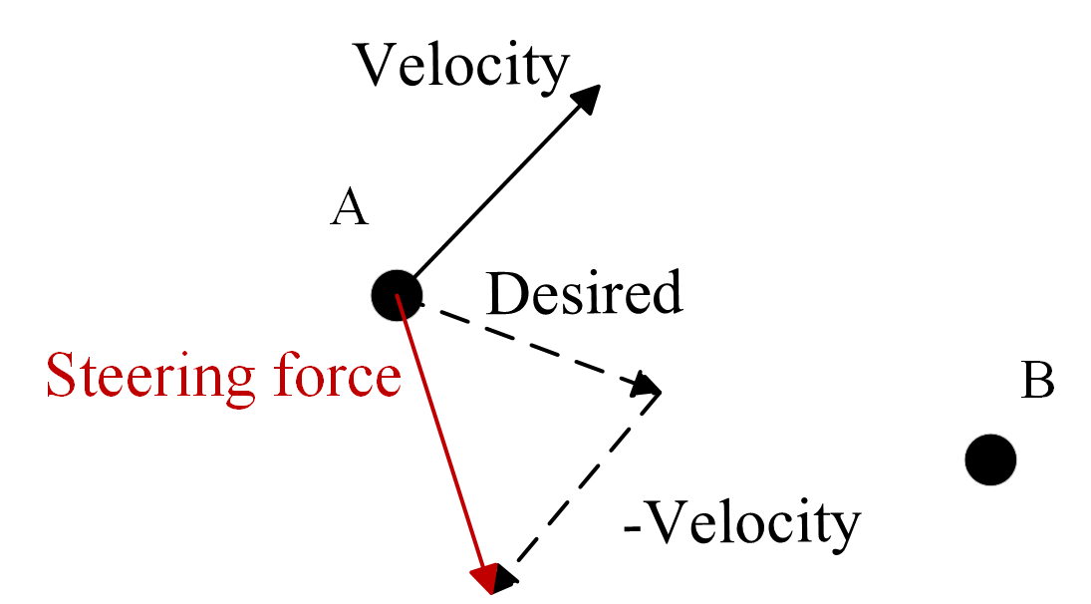

Seeking behavior
One object attracted to the target
Steers a character towards a specified position in a space
Desired velocity alingned with target’s coordinates
Calculation of the motion:

Slide 7
Moving a point using seeking

Slide 8

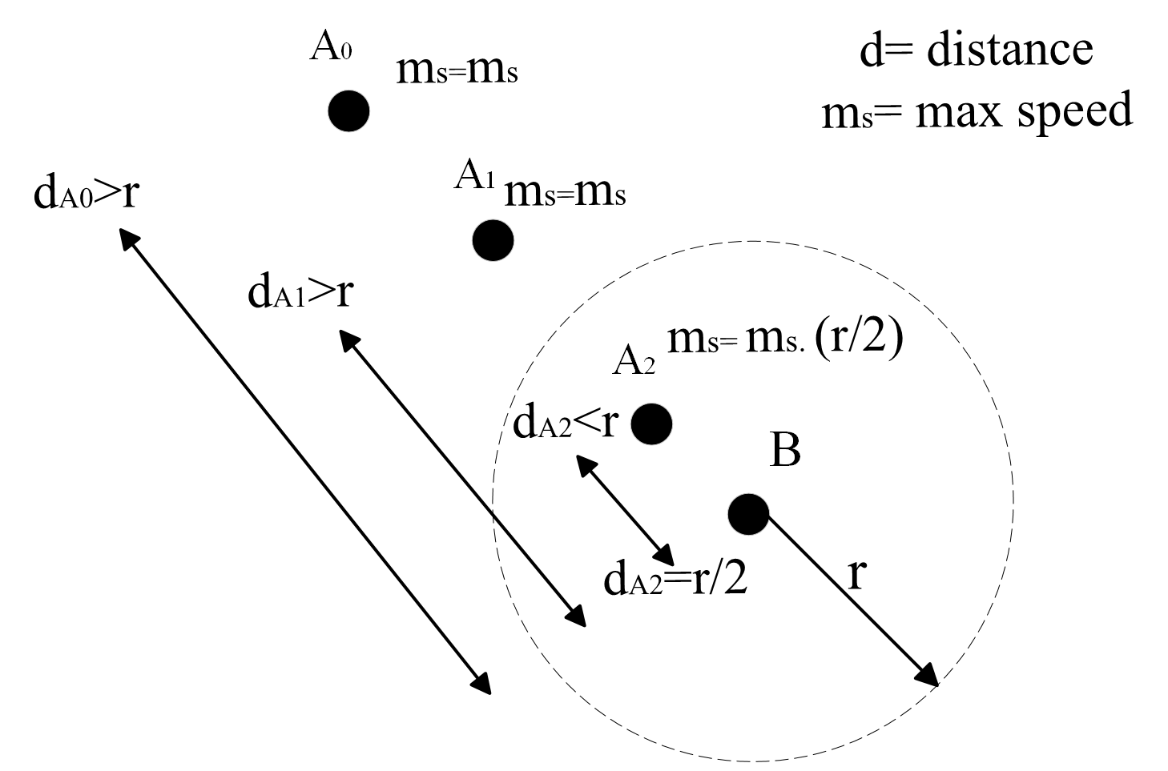
Arrive behavior
If in range - gradually decrease the speed
Eventually stop

Slide 9
Result: Animation in p5.js
https://www.youtube.com/watch?v=EVFGVr99ipg

Slide 10
Thank you for your attention!

