Slide 1
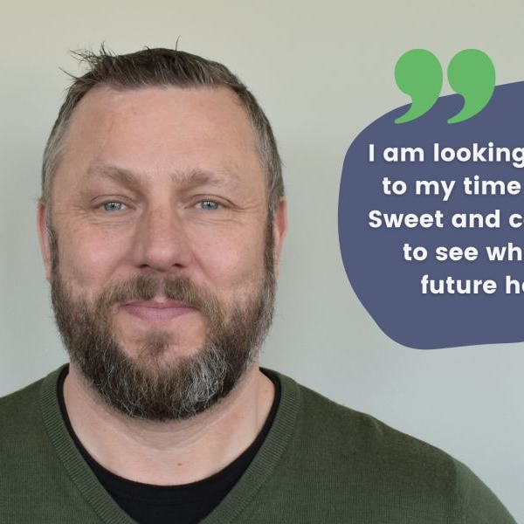

I have a passion for quality code and great UX/UI

Slide 2
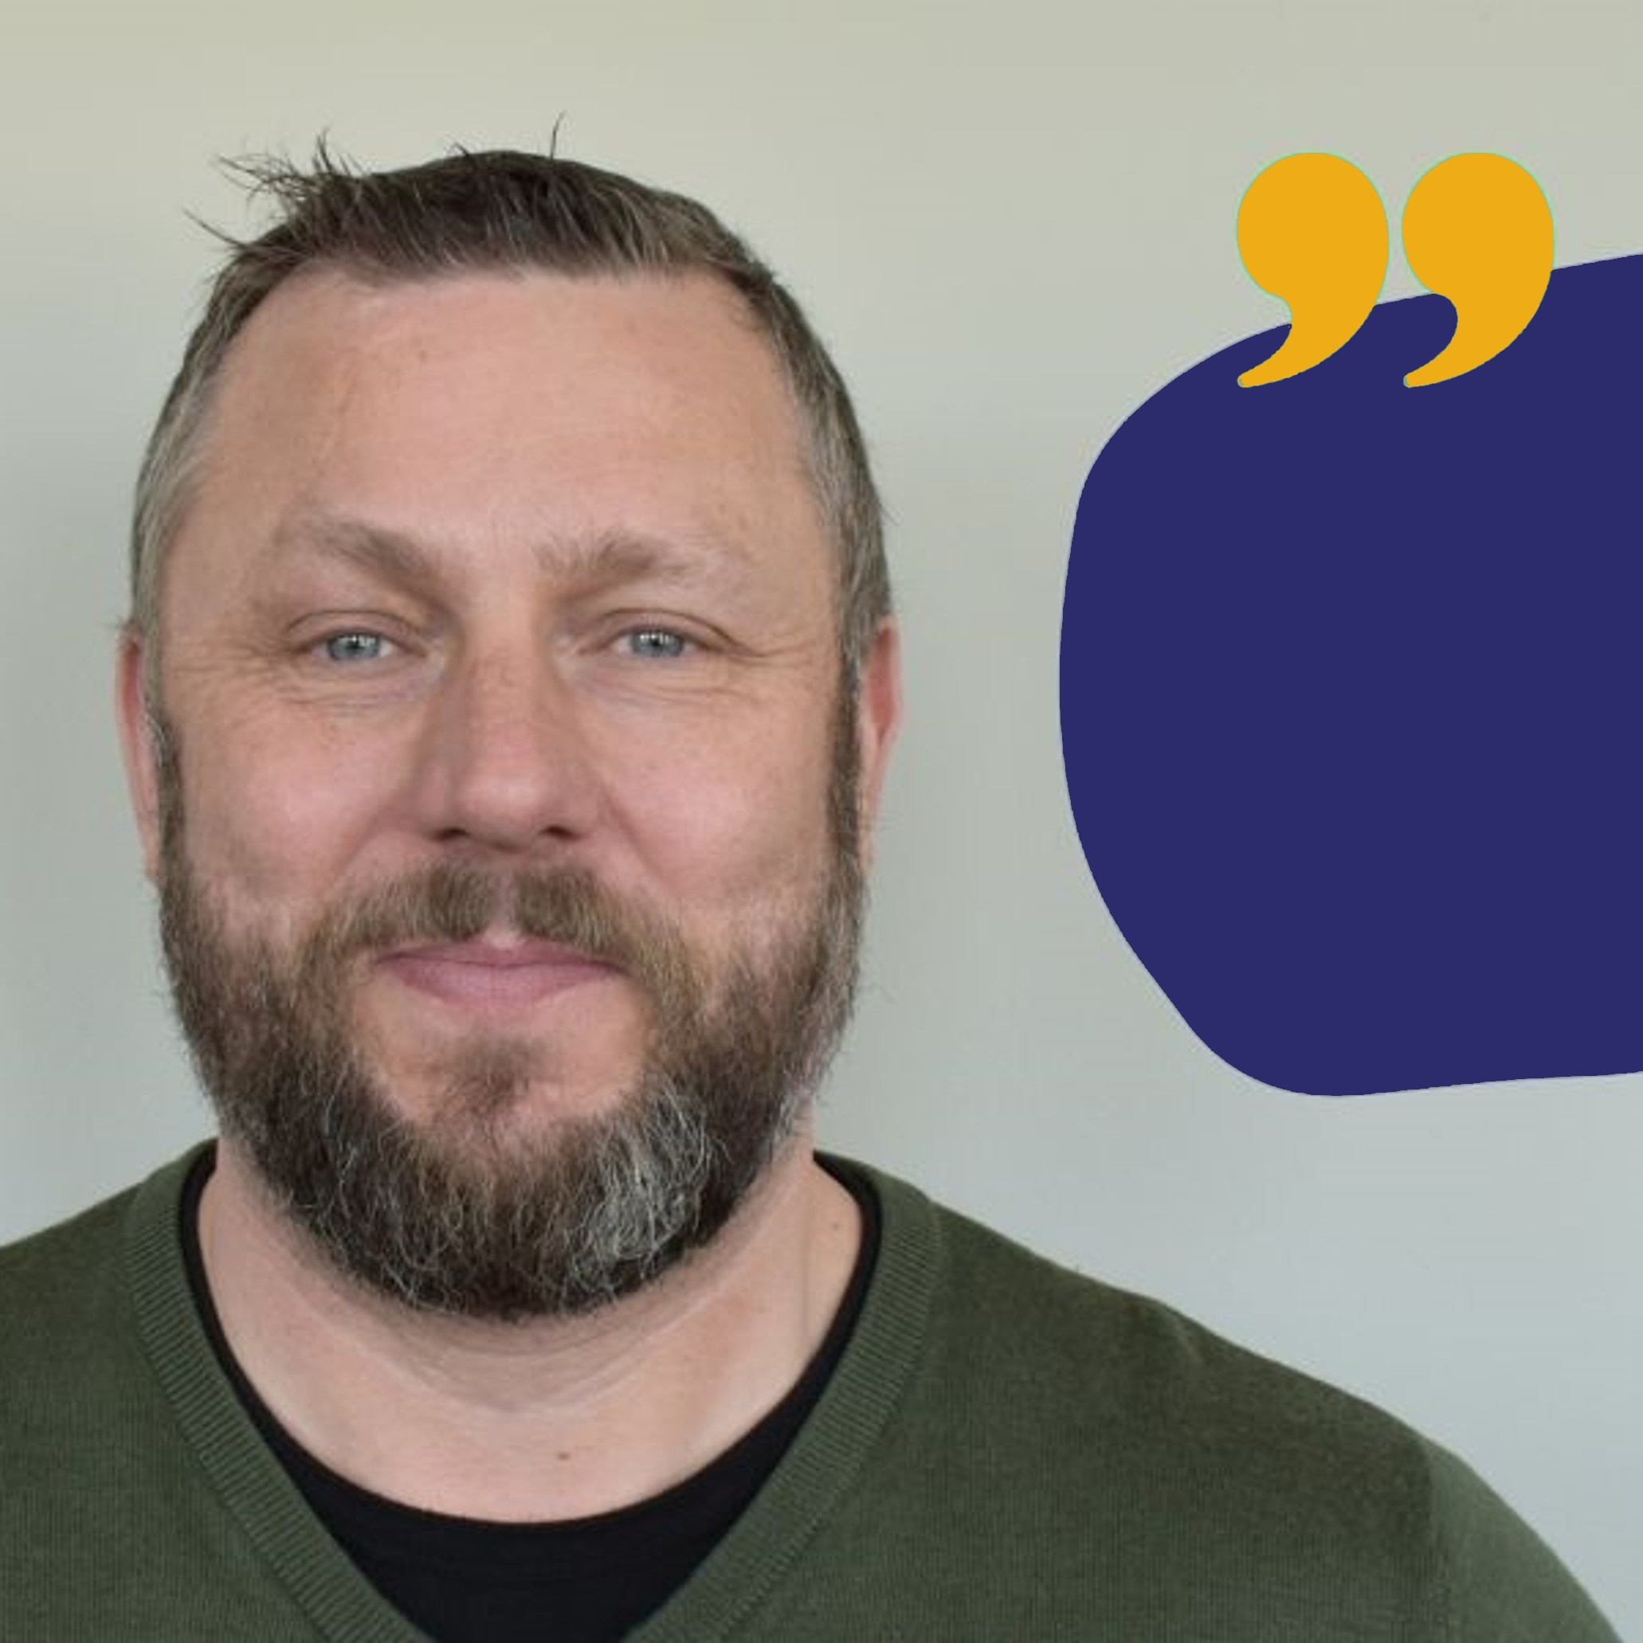
I have a passion for quality code and great UX/UI
I have a passion for quality code and great UX/UI

