Slide 1


Title: ReBoost: a retrieval-boosted sequence-to-sequence model for neural response generation
Yutao Zhu, Zhicheng Dou, Jian-Yun Nie, Ji-Rong Wen
Presented by:
Lingfeng Zhang, Ottawa University
Yu Sun, Carleton University
2020-02-03
Faculté de génie | Faculty of Engineering
uOttawa.ca

Slide 2
Abstract
2
Sequence-to-Sequence Model (Seq2Seq)
Limited input information
Seq2seq model tends to generate meaningless and trivial responses
more supplementary information
propose to utilize retrieved responses
ReBoost, incorporates retrieved results in the Seq2seq model by a hierarchical structure
Experiments on two benchmark datasets
both automatic and human evaluations
outperforms the state-of-the-art response generation models

Slide 3
Introduction
3
Conversational systems
1. Retrieval-based systems: maintain a large repository of conversation
usually fluent and grammatically correct
do not generate new responses
conversation repositories are usually limited samples of real-world conversations
2. generation-based systems
Variants of sequence-to-sequence (Seq2seq) neural network models
incorporate an encoder and a decoder
attention mechanism

Slide 4
Introduction
4
Seq2seq model is liable to generate short, trivial and meaningless replies
Because insufficient source information
In the absence of more information, trivial replies are often “safer” solutions.
Previous studies:
pre-trained external model: commonsense knowledge graph, a topic model or an emotional classifier
involving any external knowledge.

Slide 5
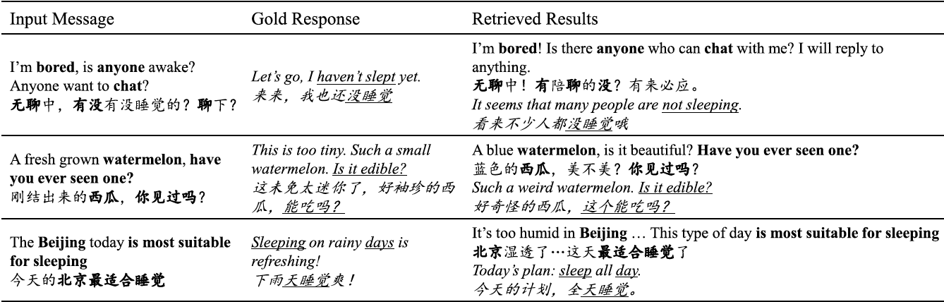
Introduction
5
retrieved results are returned by an information retrieval (IR) system on the training data
hypothesize that retrieved results can provide useful prior knowledge for generating responses

Slide 6
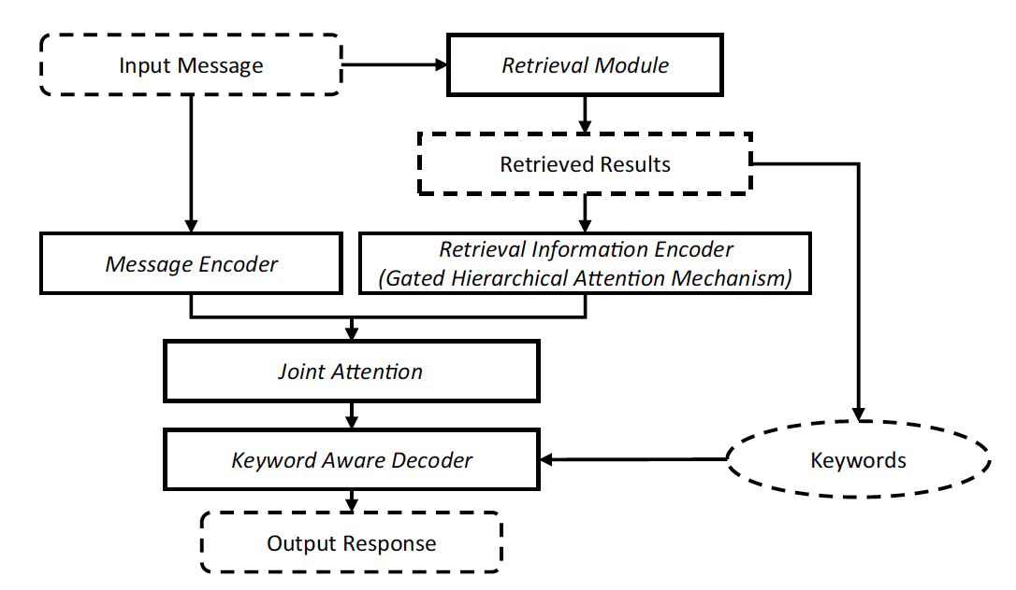
Introduction- model structure
6

Slide 7
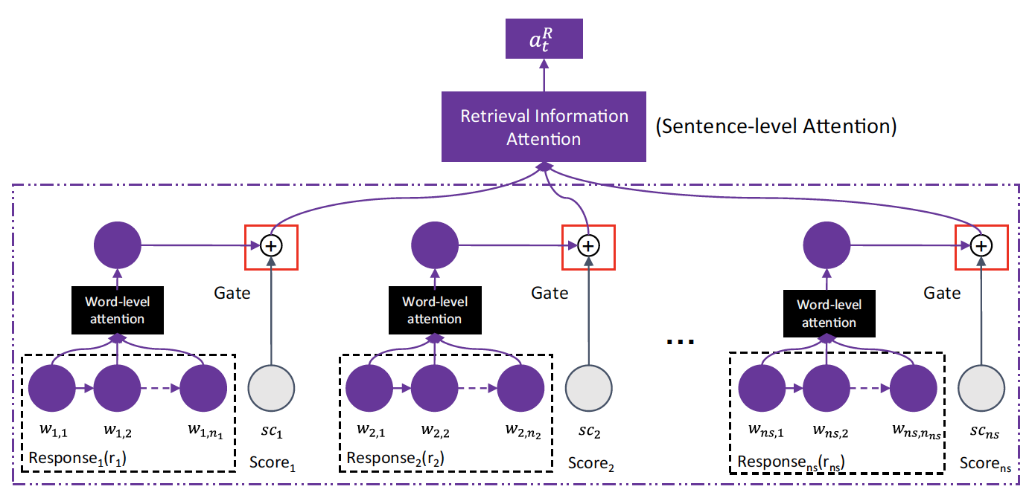
Introduction
7
the retrieval module returns some relevant responses and their relevance scores
gated hierarchical attention mechanism to integrate words, sentences and their relevance scores
word-level attention → keywords
sentence-level attention → relevance scores

Slide 8
Paper Structure
8
Abstract
Introcution
briefly describes recent works in neural response generation
details of our model
experiments and results
Analysis and discussion
conclusion

Slide 9
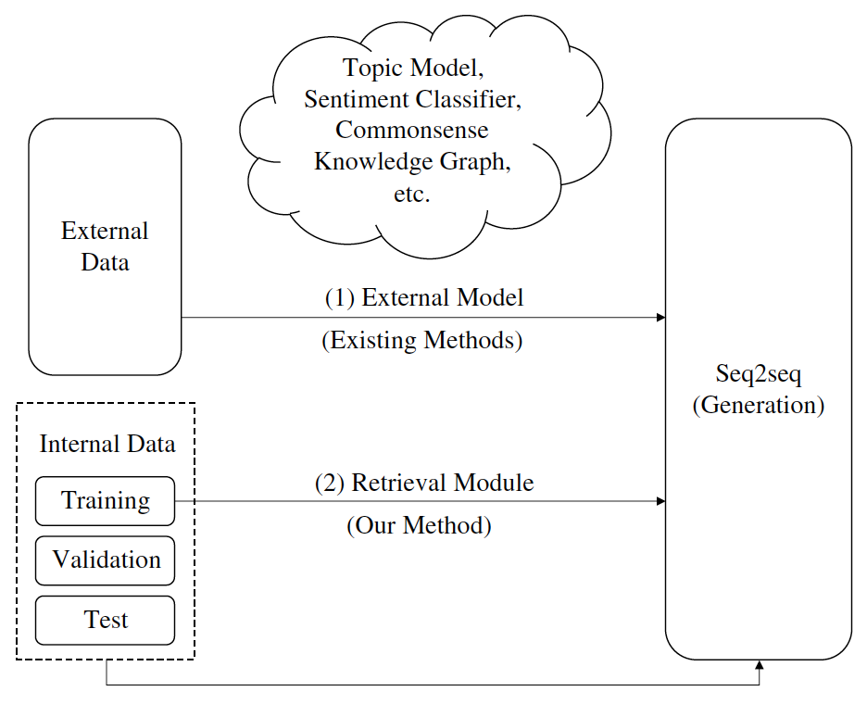
Related Work
9
Retrieval‑based system
Generation‑based system
External data → noisy sometimes

Slide 10
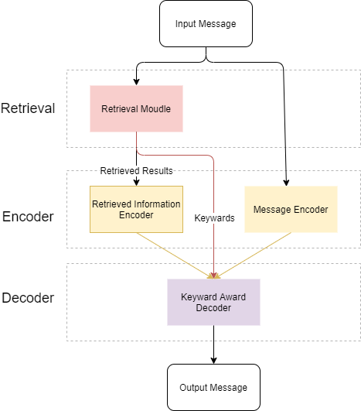
The overview of ReBoost
1.Get relevant responses and corresponding relevant scores for input message
2.Use Retrieved Information Encoder and Message Encoder to encode retrieved results and input message respectively
3.Union two encoder results and use retrieved keywords to Decoder

Slide 11
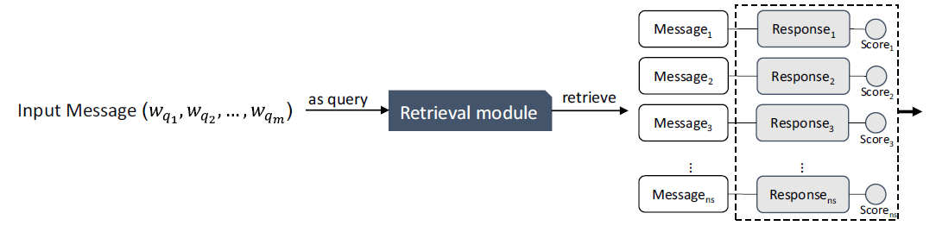
Retrieval Module
Given an input message, the retrieval would provide many message-response pairs and score them according to the semantic matching degree(BM 25).
Use Apache Solr (https//lucene.apache.org/solr/) for implementation

Slide 12
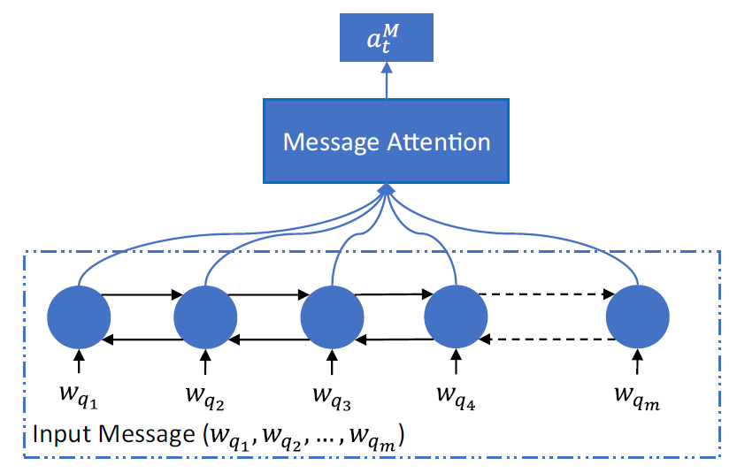
Message Encoder
Use Bi-Directional RNN and GRU as encoder to represent the input message

Slide 13

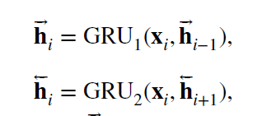
Message Encoder-Details
Hidden States
hidden state in the forward RNN
hidden state in the backward RNN

Slide 14
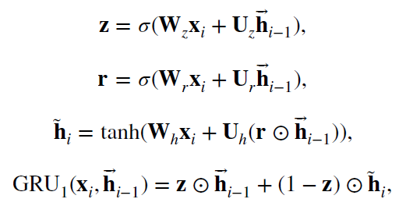
Message Encoder-Details
GRU Cell of Forward RNN
⊙ denotes element-wise product between vectors.
tanh(⋅) and σ (⋅) are the tanh and sigmoid function.

Slide 15
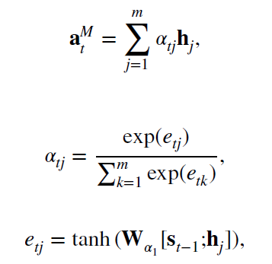
Message Encoder-Details
Attention Mechanism
summarized the input message representations into a fixed-size vector
S_{t−1} is the hidden state of the decoder in the decoding time step t − 1 ,

Slide 16
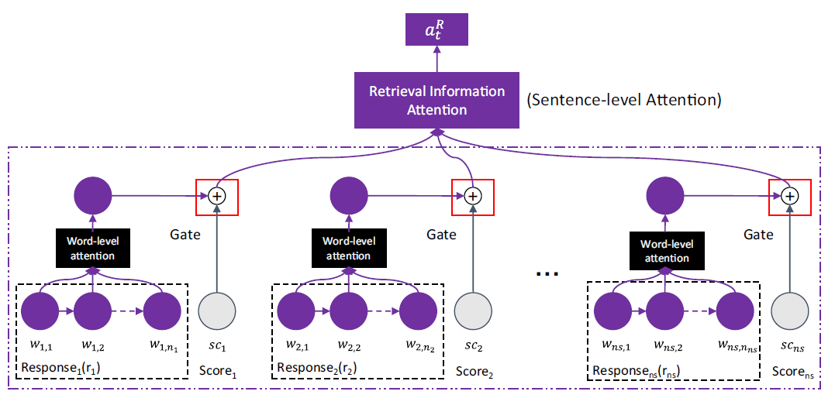
Retrieval Information Encoder
Design a gated hierarchical attention mechanism with retrieved results and relevance score

Slide 17
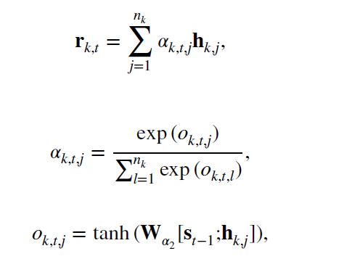
Retrieval Information Encoder-Details
Word Level Attention
Traditional Attention Mechanism
Represent Like in “Message Encoder”

Slide 18
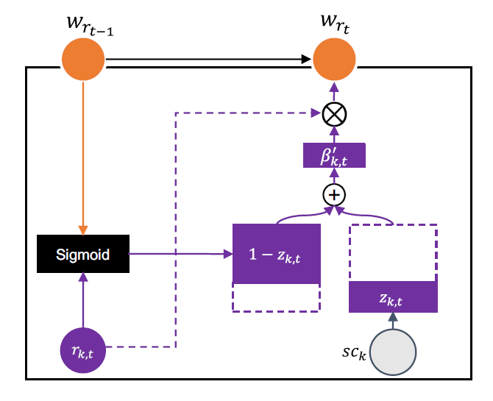
Retrieval Information Encoder-Details
Sentence Level Attention
Incorporate Retrieved Relevance Score Into the Model By Gated Mechanism

Slide 19
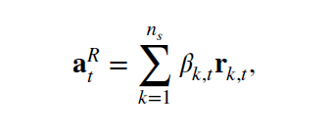


Retrieval Information Encoder-Details
Sentence Level Attention
Controls how much overall weight refers to relevance score
Remove the SoftMax Normalization

Slide 20
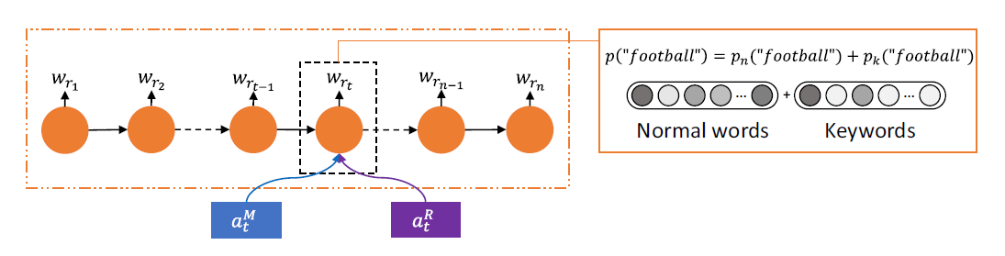

Keyword Aware Decoder
Concatenated previous two context vector
Modify the generation probability to make it biased towards some keywords
Message Context Vector
Retrieval Information Context Vector

Slide 21
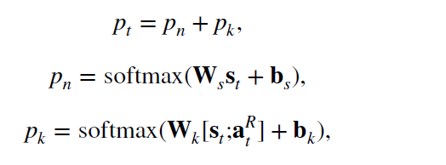
Keyword Aware Decoder-Details
Keywords select by their TF-IDF values
For a non-keyword, the generation probability is the same as that in standard Seq2seq model. But for a selected keyword, there is an extra probability term that increase its generation probability.

Slide 22
Experiments
22
Datasets: Chinese Sina Weibo dataset & NTCIR-13 STC task(English OpenSubtitles dataset)
State-of-art models as baselines:
1. S2SA: the standard Seq2seq model with an attention mechanism
2. NRM-hyb： two encoders to represent messages in local（attention） and global(final word) schemes.
3.MMI: diversity-promoting objective function, rerank
4.TA-Seq2seq: use topic model

Slide 23
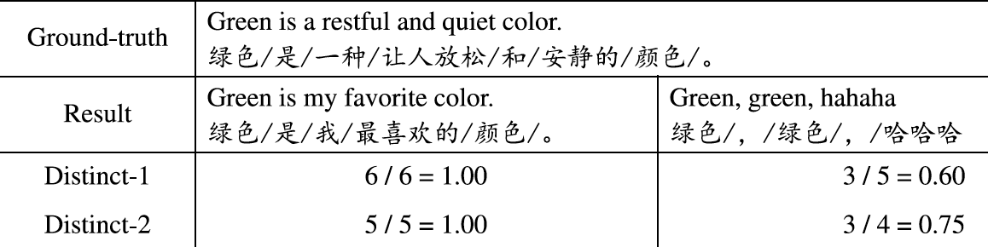
Evaluation Metrics
23
Distance-1: degree of diversity according to the ratios of distinct unigrams and bigrams
Distance-2
Higher values of these metrics indicate the replies contain more different words and more information potentially

Slide 24
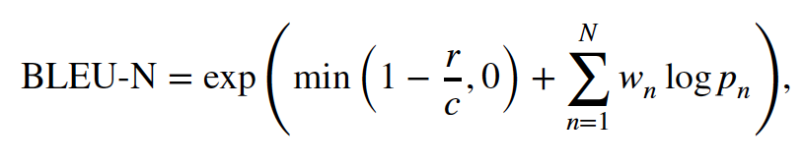
Evaluation Metrics
24
BLUE-N: BLEU-1, BLEU-2, BLEU-3 and BLEU-4
evaluates the output by using n-gram matching between the output and the reference.
where r and c are the lengths of the reference response and candidate ones respectively, p_{n} is the modified n-gram precision, and N means using n-grams up to length N and w_{n} = 1∕N

Slide 25
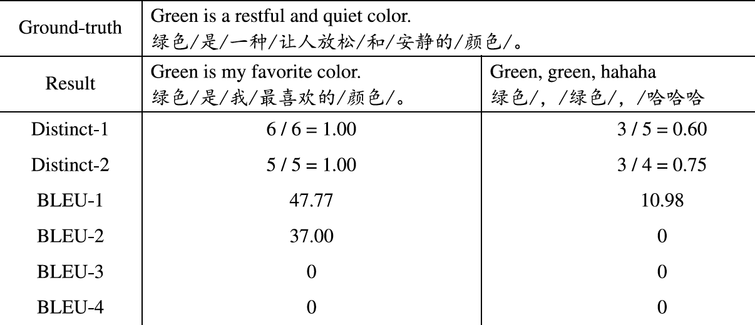
Evaluation Metrics Example
25
Higher BLEU values mean that the output response and the reference
have more sharing words and are more similar

Slide 26
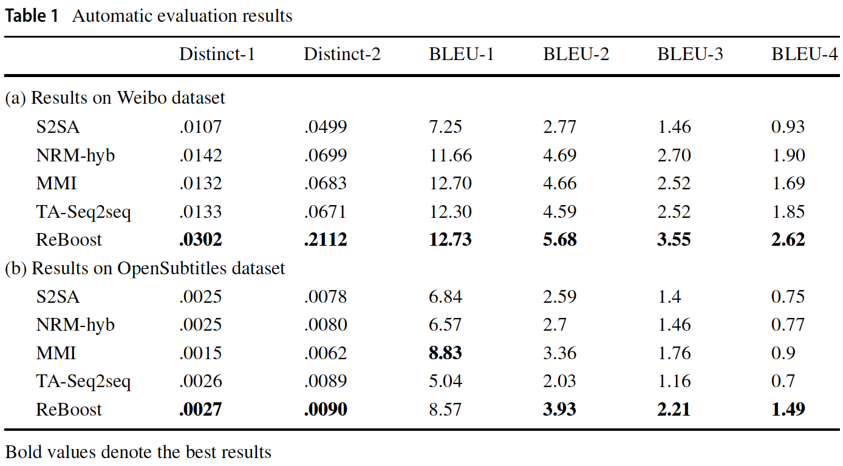
Overall Performance
26
Statistical significant difference

Slide 27
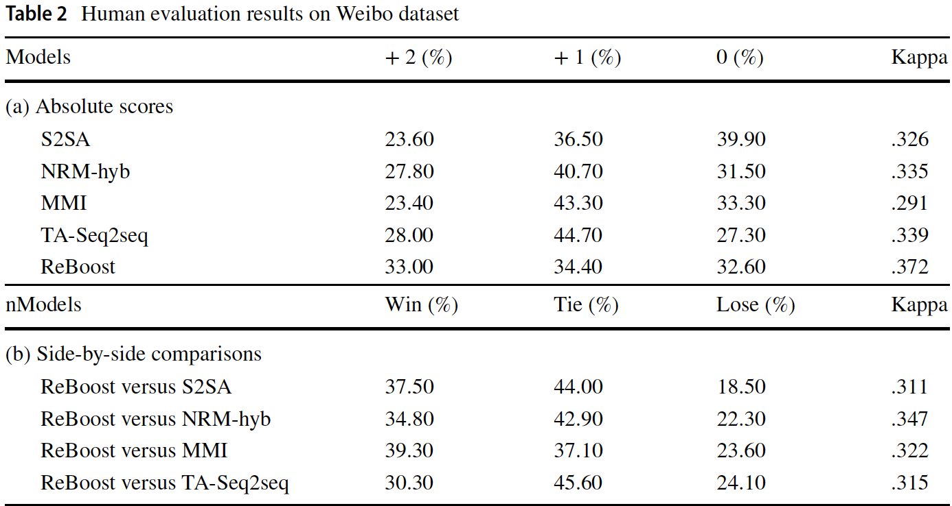
Human Evaluation
27
5 evaluators

Slide 28
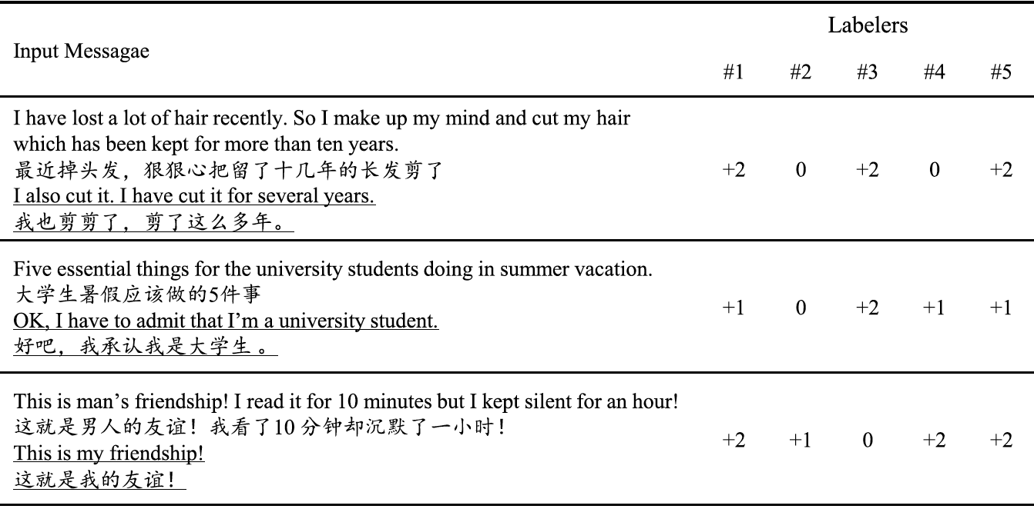
Discussion
28
Kappa is not high in the human evaluation results
it is difficult to make a gold standard in the evaluation of response generation

Slide 29
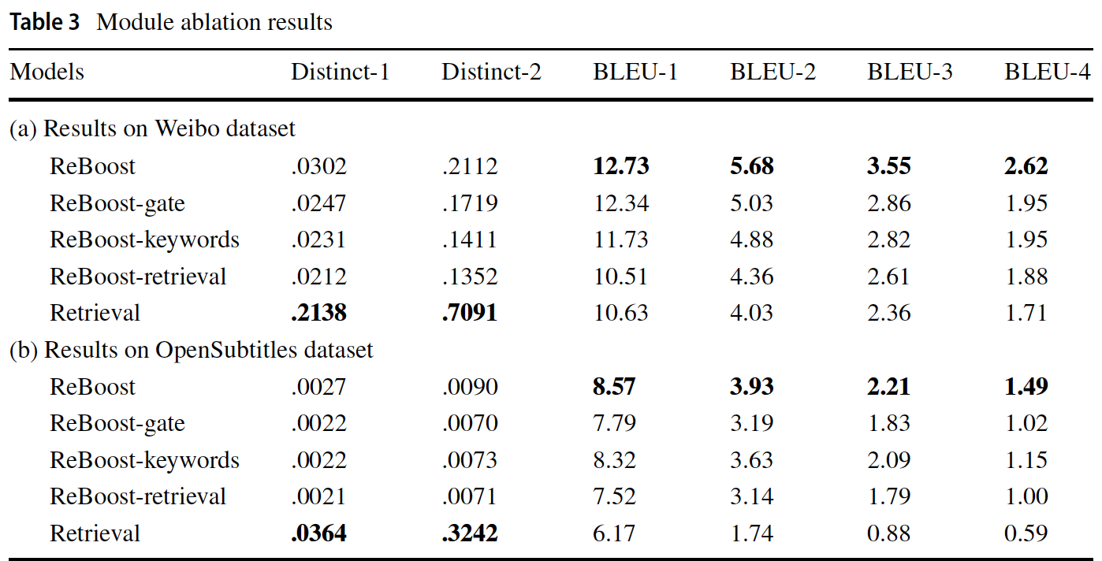
Module abalation
29
In order to investigate the effectiveness of these two strategies and the performance of the retrieval module

Slide 30
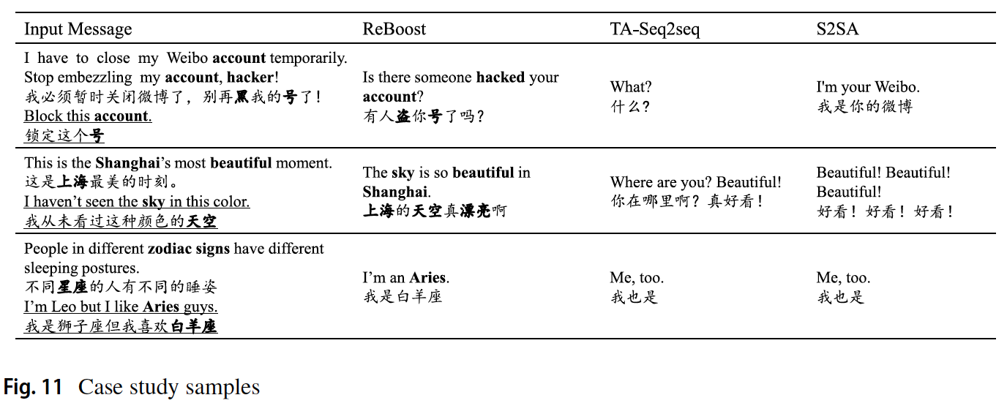
Case Study
30

Slide 31
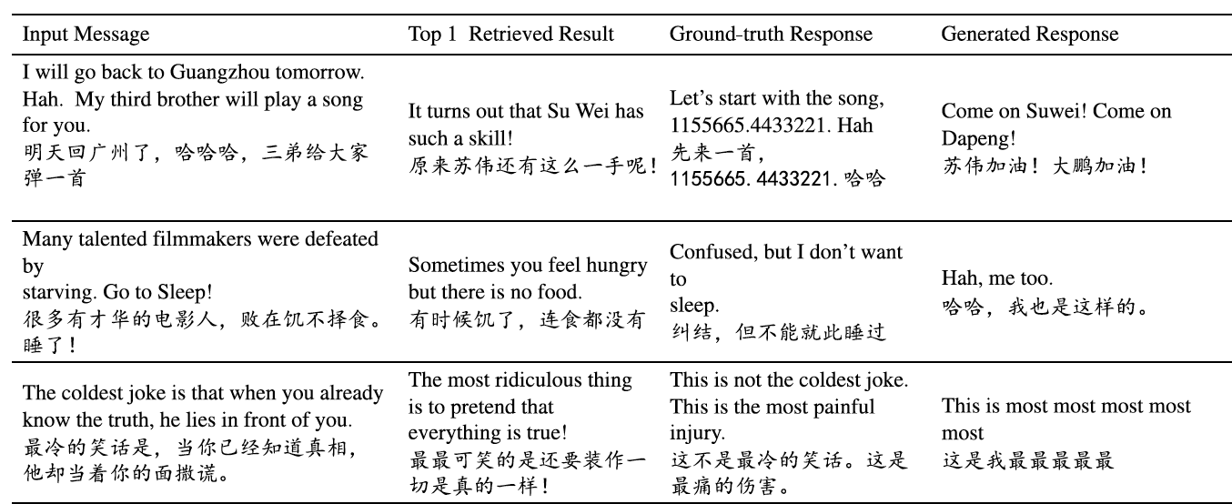
Error Analysis
31
1.irrelevant retrieved results→keyword extraction technology
2.neglecting the useful retrieved results→rerank retrivals
3.using the retrieved results incorrectly→refine keywords

Slide 32
Conclusion
32
retrieved replies to boost the Seq2seq model
gated hierarchical attention mechanism
novel way to combine the retrieval- and generation- based methods
Empirical results with both automatic and human evaluations
generate better responses than the state-of-the-art models

