Slide 1
Exploriation on “Universal” in adversarial attack
1.3 Adversarial Training and Regularization
Group #10, Meeting #9

Slide 2
PART I
Questions answerd for the last disscusion
The defination of “Universal”

Slide 3
Q1: Can A random image be classified as anything?
Yes. A FGSM demo of cnn trained on MNIST
classified as
3(61%)
6(65%)
1(19%)
FGSM attack
FGSM attack
FGSM attack
classified as
9(79%)
9(97%)
9(93%)

Slide 4
Recall the characteristics of Adversarial Attack
1. A small perturbation added to the image which is quasi-imperceptible to the human eye.
2. The small perturbation can cause natural images to be misclassified with high probability.
3. State-of-the-art deep neural networks are highly vulnerable to such perturbations.

Slide 5
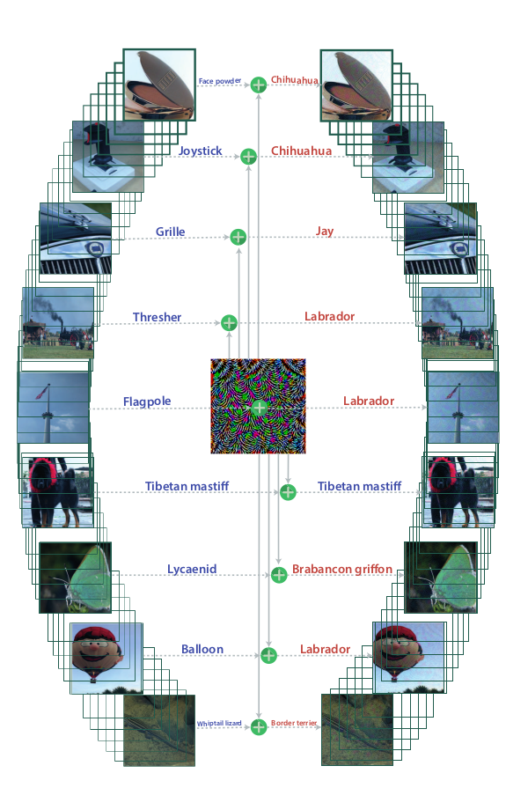
What is “Universal”
A universal perturbation should
be image-agnostic in addition to
the above common characteristics.
“we seek a single perturbation vector that fools the network on most natural images. Perturbing a new datapoint then only involves the mere addition of the universal perturbation to the image (and does not require solving an optimization problem/gradient computation).”

Slide 6
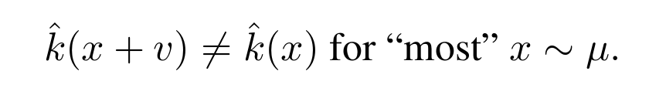
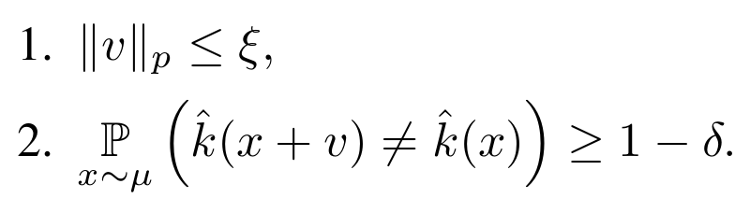
Goal & Constraint
we seek a vector v such that:
The goal is to find v that satisfies the following two constraints:

Slide 7
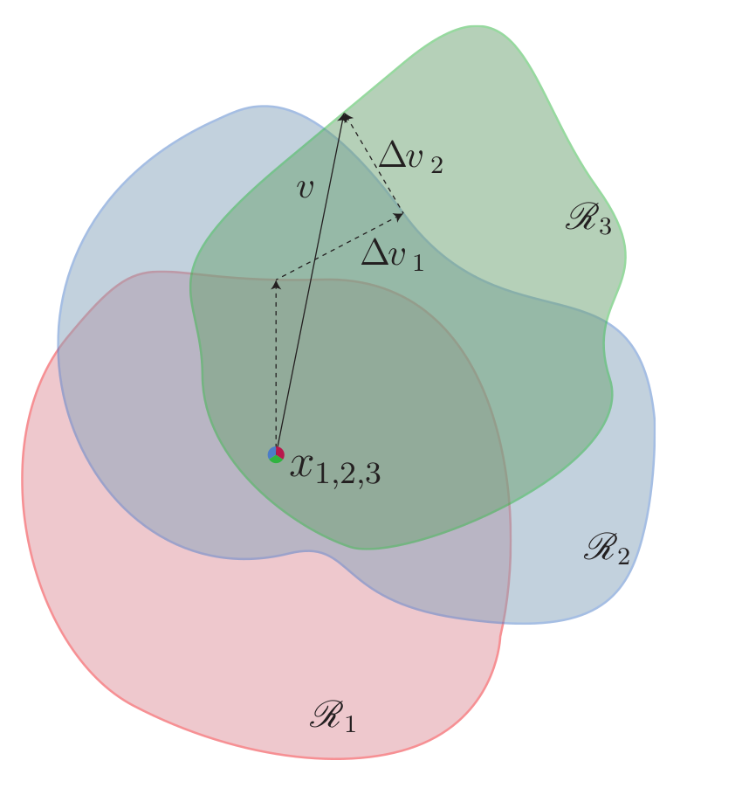
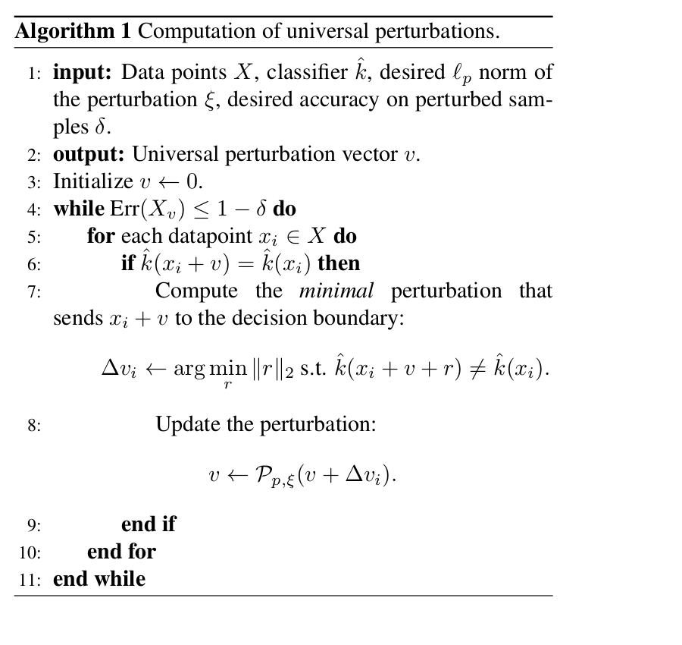




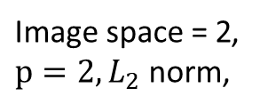


Algorithm
$\text{Image} \text{space}\text{ = 2}$,
$p=2, L_{2}$ norm,
$$∆v$$
$$∆v$$
$$v_{new}$$
$$v_{old}$$
$$v_{new}$$
$$ζ$$
Any optimization/gradient desent method

Slide 8
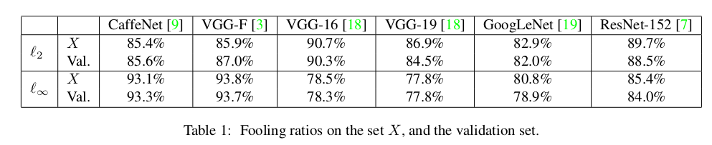
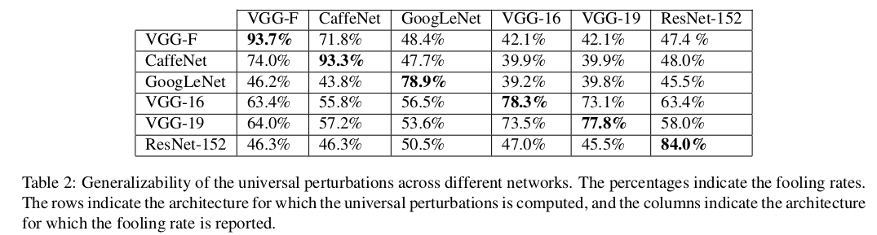
Robustness analysis

Slide 9
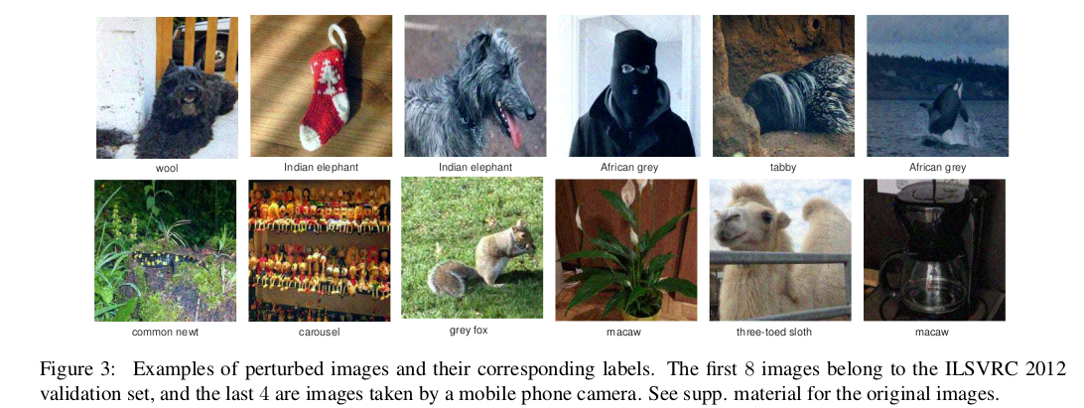
Examples

Slide 10
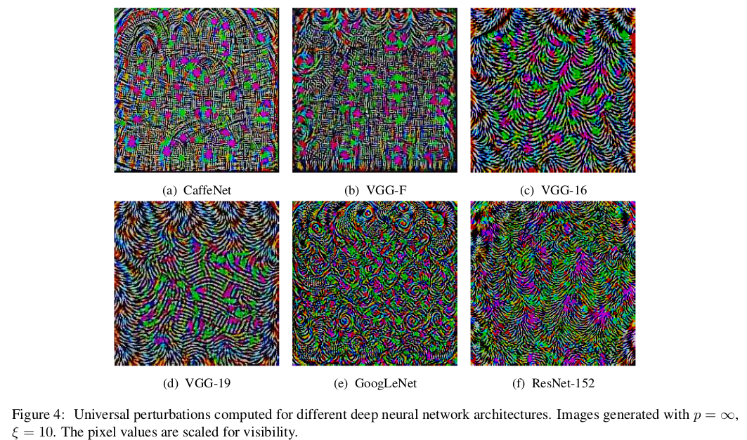
Examples

Slide 11
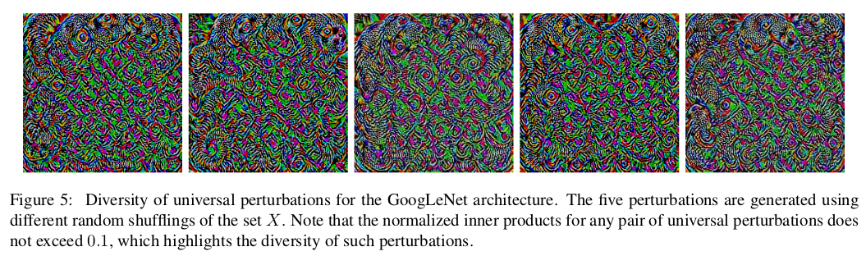
Examples

Slide 12
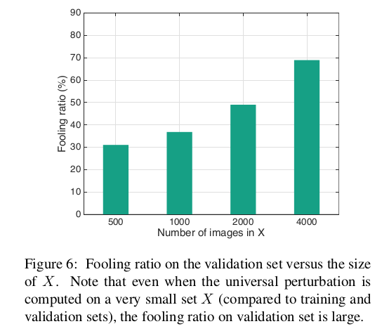
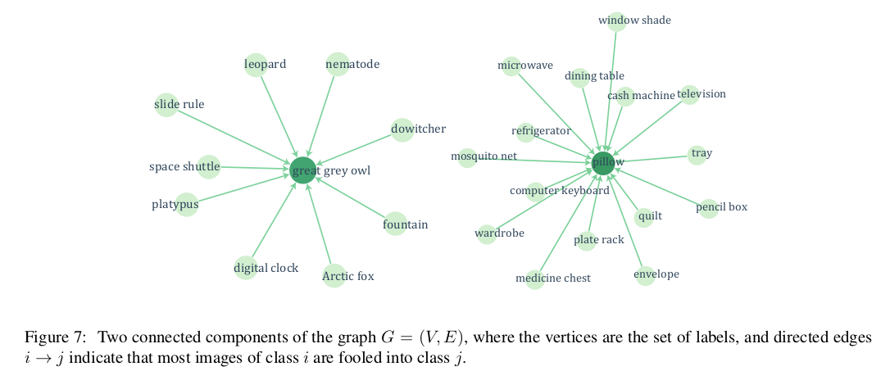
Others

Slide 13
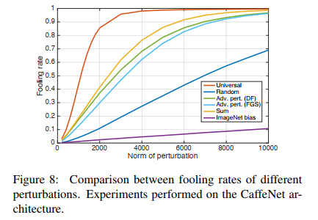
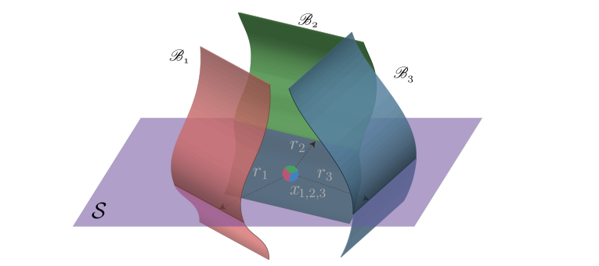
“The large difference between universal and random perturbations suggests that the universal perturbation exploits some geometric correlations between different parts of the decision boundary of the classifier. ”
Comparison shows that fool rate of universal attack is significantly higher than random noise
It suggest that there is redundancies in the geometry of the decision boundaries of DNN
The existence of universal attack suggest there may existence a subspace S that contains most normal vectors to the decision boundary (contain most of the redundant information)

Slide 14
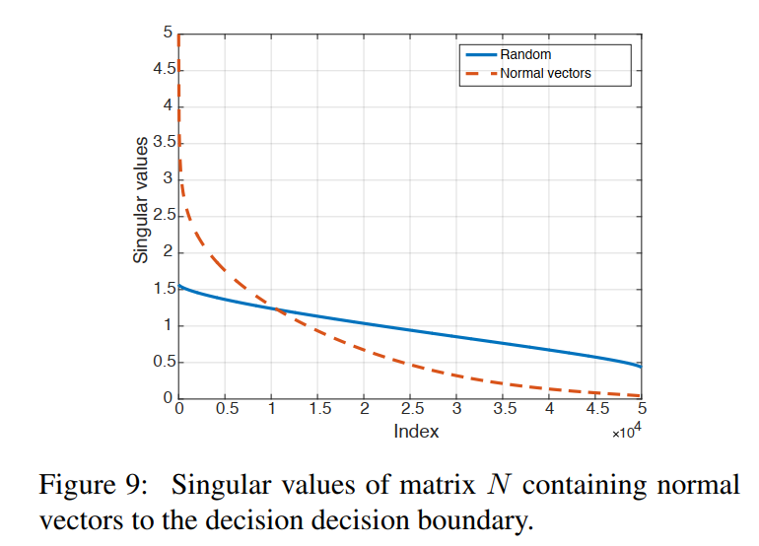
Verification:
Figure 9: SVD of adversary perturbation vectors and random vectors shows that the singular values of perturbations drop faster than the singular values of random noise → sign of redundancy among different regions of the decision boundary
random vector spanned by first 100 singular vectors in the subspace S obtained a fooling rate of 38%, much better than random noise (10%)

Slide 15
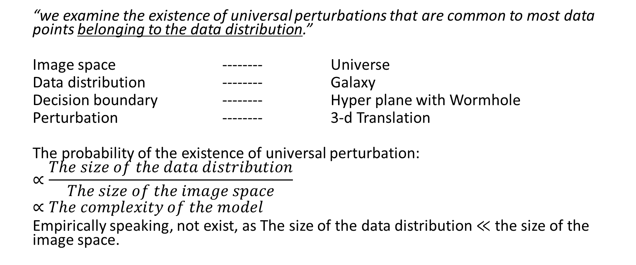
Q2: Is there a universal perturbation that can be added to any image?
“we examine the existence of universal perturbations that are common to most data points belonging to the data distribution.”
Image space -------- Universe
Data distribution -------- Galaxy
Decision boundary -------- Hyper plane with Wormhole
Perturbation -------- 3-d Translation
The probability of the existence of universal perturbation:
$$∝\frac{The size of the data distribution}{The size of the image space}$$
$$∝The complexity of the model$$
Empirically speaking, not exist, as The size of the data distribution $≪$ the size of the image space.

Slide 16
PART II
Some more exploriation on Universal

Slide 17
Traditional defination of universal attack
doubly-universal perturbations:
image-agnostic
network-agnostic
Constraints:
1. The data attacked should have the same/similar distribution as data trained.
2. The Model used to generate perturbations should work on the same task as the model attacked.
Question:
If the model attacked is (partly)unkonwn?

Slide 18
A scenario(out of lab)
As an attacker, you hope to use adversarial attack method to mislead the object detection system of an autonomous car. For simplicity, we see this as a classification problem.
Then how many classes does the classifier distinguish?
traffic lights, road signs, street signs, crosswalk...?
cars, pedestrians, cyclist, lane lines, stop lines...?
trucks, school buses, motorcycles, sports cars...?
All? or some? or something else?

Slide 19
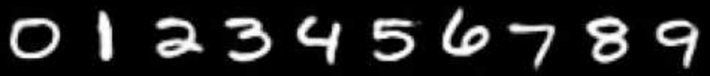

Abstract the problem
Model attacked are trained on (10 classes):
Perturbations are generated on (9 classes):
Does the perturbation still network-agnostic?
Does the perturbation works on images with different distribution?

Slide 20
Metrics
The number of the classes of the model attacked is 6.
The number of the classes of the model used to generate perturbations is from 1 to 10
The fooling rate of the 6-class attacking model is the baseline.
All models generate the same amount of perturbations.
 | 1 | 2 | 3 | 4 | 5 | 6 | 7 | 8 | 9 | 10 | 4(1) | 5(1) | 6(1) | 6(2) | 6(3)
FGSM
JSMA
CW2
DF
UAP

Slide 21
Universal perturbation affect different classes in varying degrees
Experiment steps:
1.shuffle datasets(1)shuffle randomly, (2)arrange datasets class by class, (3)arrange dataset uniformly
2.generate MNIST universal perturbation in baseline model
3.compare the (1)fool rate, (2)# images to train in different classes
4.tried on other datasets(e.g. CIFAR10,CIFAR100 divided by 10 in classes).
Intuition: (1)different fool rate in different classes.(2)datasets_2 easier to train, datasets_3 harder to train.

Slide 22
Comparing different baseline models in the generation of universal perturbation
In article, author used deepfool as baseline model
We will use deepfool, fsgm, etc. as the baseline model to generate universal perturbation
Compare their L-norm in certain fool rate.
Goal: Find better baseline model

