Slide 1
RubyFuZa 2014
The Art of Debugging
Ruby and Rails
Richard Cochrane

Slide 2
Contents
On Development Tools
Why Developers Don't Use Them
Pry
  History
  Console
  Inline Debugging
  Remote Debugging
Jazz Hands

Slide 3
How many of you actively find new tools to develop with?

Slide 4

Different Kinds
Some help write better code (eg. Linters)
Some help writing code
and tests together
(eg. Guard + Spork)
Some help finding
bugs, understanding
errors and exploring code
(eg. Better errors)

Slide 5

When I Started Developing

Slide 6

What I Now Understand

Slide 7
Contents
On Development Tools
Why Developers Don't Use Them
Pry
  History
  Console
  Inline Debugging
  Remote Debugging
Jazz Hands

Slide 8
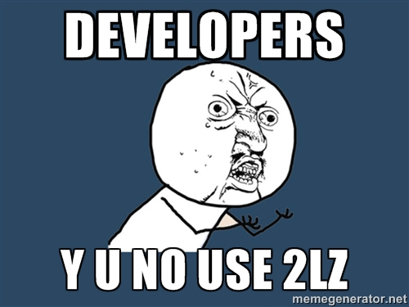

Slide 9

Takes time to learn
Inertia
Usefulness? Unconvinced...

Slide 10
Contents
On Development Tools
Why Developers Don't Use Them
Pry
  History
  Console
  Inline Debugging
  Remote Debugging
Jazz Hands

Slide 11

How many of you have used Pry?

Slide 12
Created by John Mair, Conrad Irwin and Ryan Fitzgerald.
Written for Ruby
Powerful alternative to the standard IRB shell
Runtime developer console

Slide 13

Pry and its plugins have something for everyone. Pry is not a development tool – it's a toolbox!

Slide 14
Installing Pry
To access off the command line, just gem install pry and run pry.
To add to your rails project, add 'pry' to your Gemfile:
  gem 'pry', group: :development
To replace your default console with pry, add this to the very end of your development environment file:
silence_warnings do
require 'pry'
IRB = Pry
end

Slide 15
Contents
On Development Tools
Why Developers Don't Use Them
Pry
  History
  Console
  Inline Debugging
  Remote Debugging
Jazz Hands

Slide 16
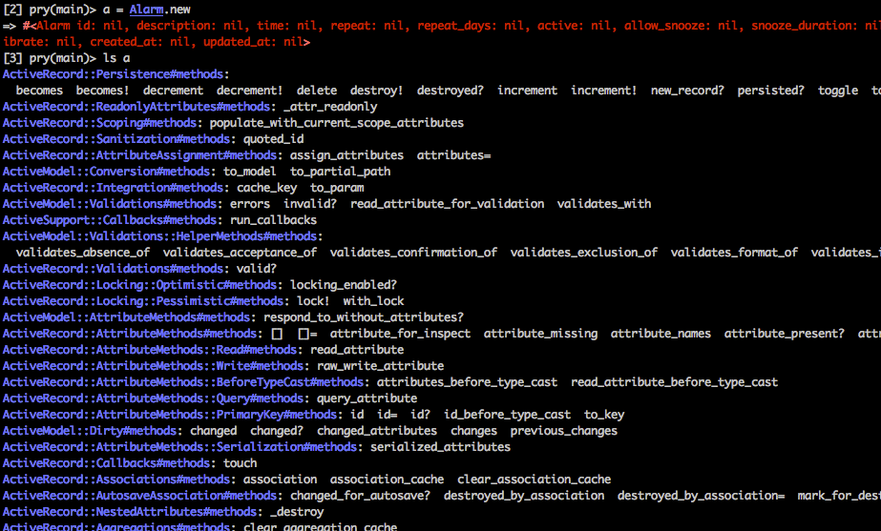
Listing Stuff
ls object will show a list of all methods, properties and instance and class variables
alarm = Alarm.new
ls alarm

Slide 17
Use filters to limit information:
  -m: public methods
  -M: class/module methods
  -q: quiet (only methods on class singleton)
  -G: grep
  -i: instance variables
  -c: constants
  -h: help
Most useful:
  ls -Mq className
  ls -mq instance

Slide 18
Scoping
You can change “self” very easily by using “cd”
cd into classes, instances, properties, rails built-in methods, ANYTHING

Slide 19
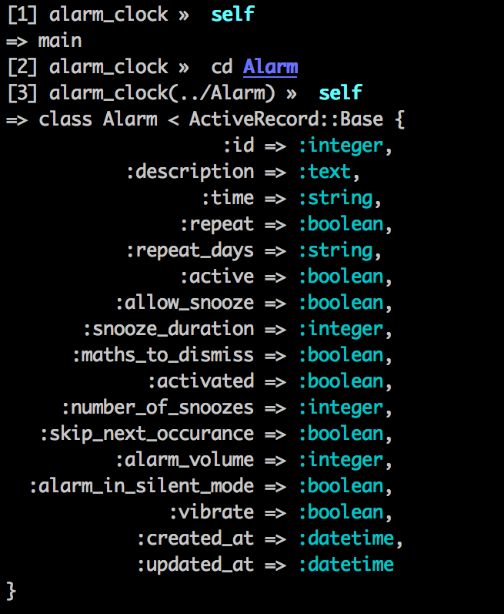
A Magical
Journey

Slide 20
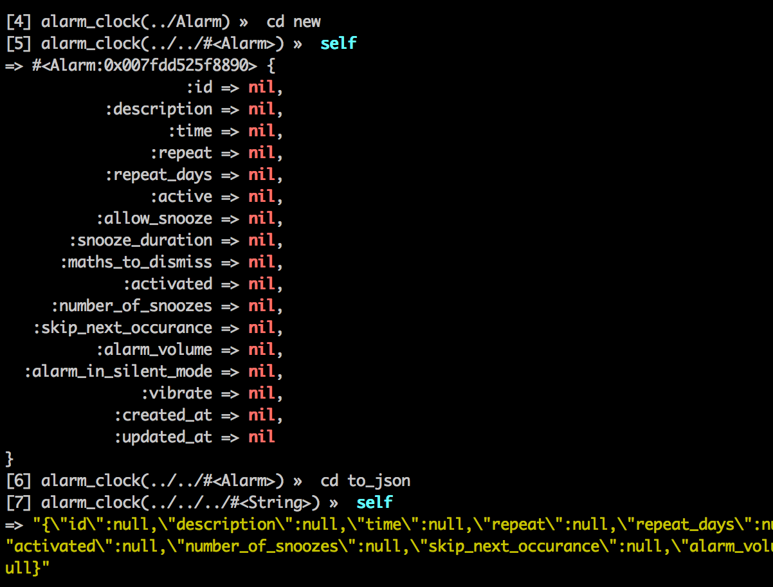

Slide 21
Some shortcuts
  cd .. (drop scope to parent level)
  cd / (drop scope to root level)
  cd - (switch scope between root and last non-root
  level)

Slide 22
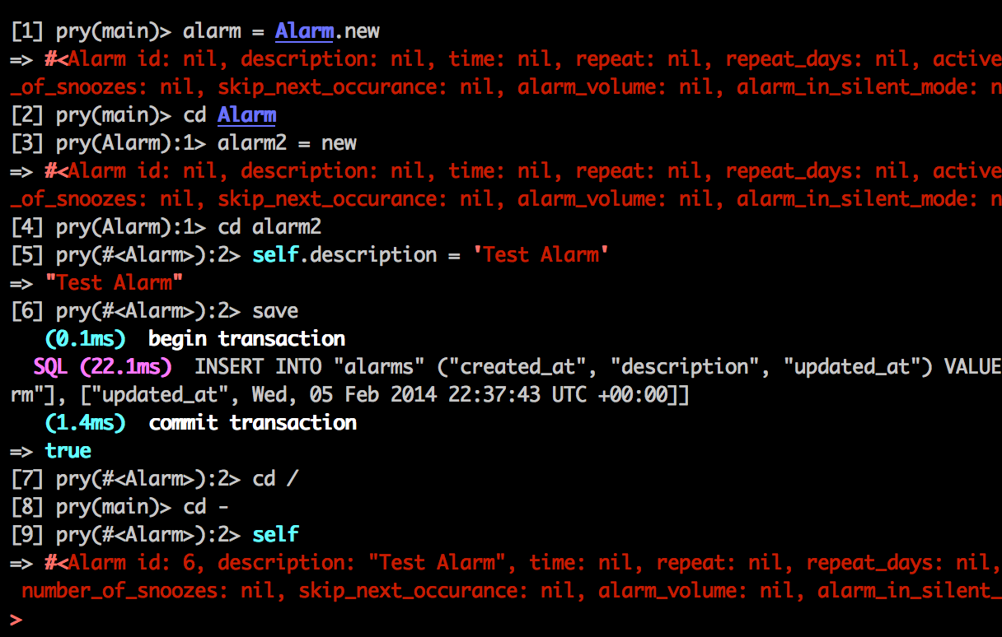
Some More Scoping FUN

Slide 23
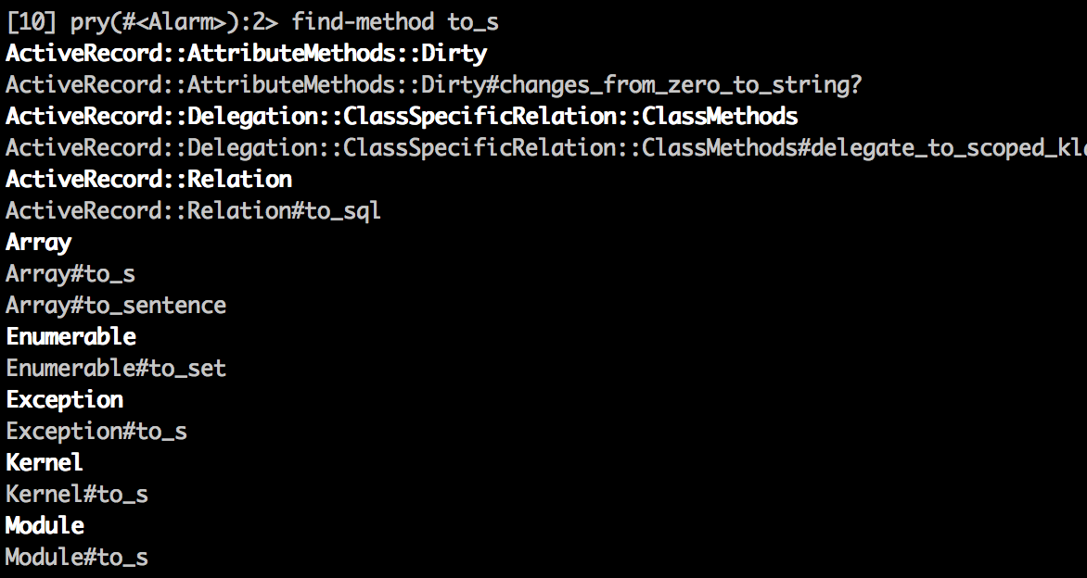
Exploring the Base
find-method string will find all methods that contain the requested string

Slide 24
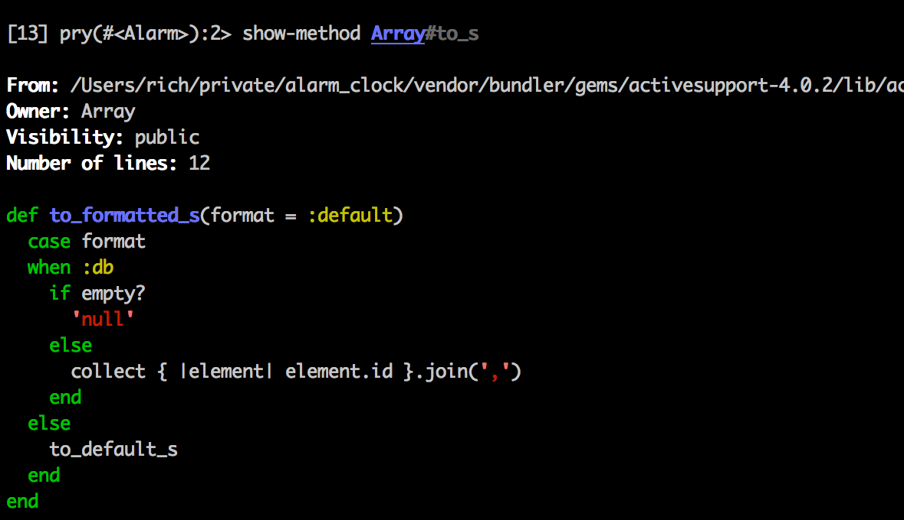
show-method method name will print out the method definition

Slide 25
Shell Commands
Any command following a dot is sent through to the shell:
  .cat filename: will display the contents of a file
  .ls -l: will list the files and folder in the current directory
  .cd app: will move you to inside the app folder
  .sudo rm -rf /: will hurt you so so bad... probably

Slide 26
Contents
On Development Tools
Why Developers Don't Use Them
Pry
  History
  Console
  Inline Debugging
  Remote Debugging
Jazz Hands

Slide 27
When you run a server (non-daemonised)
All it takes is:
binding.pry

Slide 28
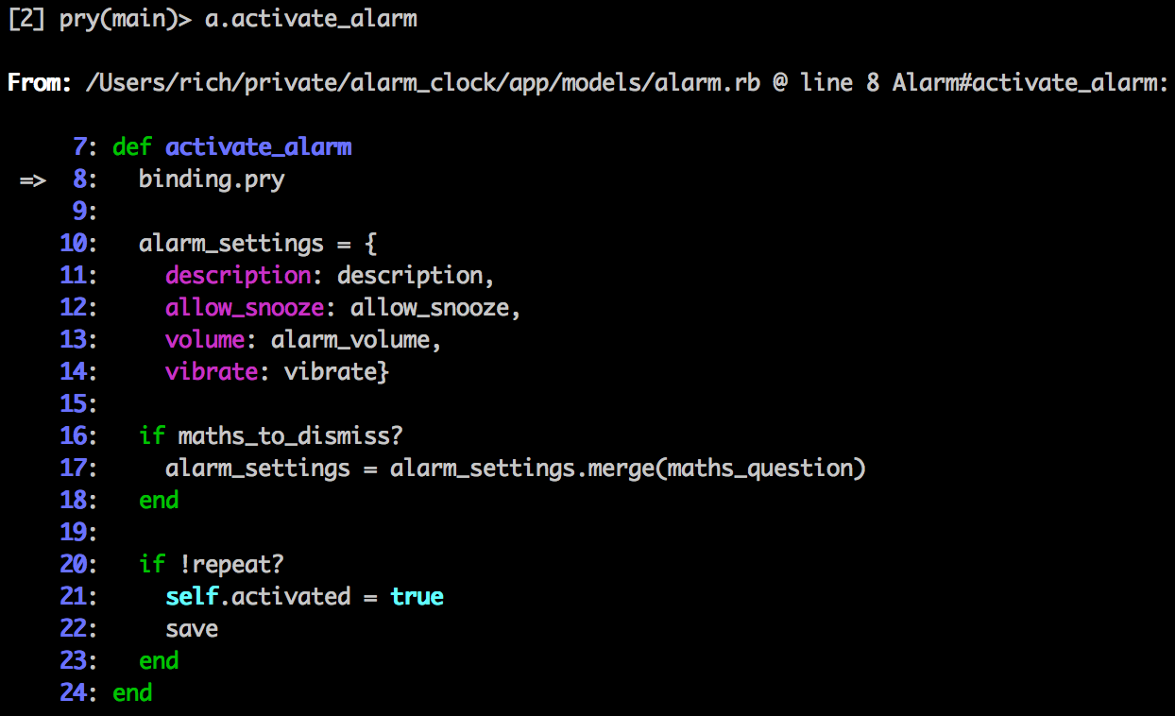
The program will halt at the point of your code:

Slide 29
Some helpful commands
  whereami: show surrounding code and current place in it
  next: next command in same frame
  step: next command in any frame
  finish: run till current frame returns
  continue: continue and end pry session

Slide 30
Contents
On Development Tools
Why Developers Don't Use Them
Pry
  History
  Console
  Inline Debugging
  Remote Debugging
Jazz Hands

Slide 31
When you run a daemonised server, like pow
All it takes is:
binding.remote_pry

Slide 32
Contents
On Development Tools
Why Developers Don't Use Them
Pry
  History
  Console
  Inline Debugging
  Remote Debugging
Jazz Hands

Slide 33
Jazz Hands
https://github.com/nixme/jazz_hands
Collection of tools to make your debugging experience awesome!
Pry | Awesome Print
Hirb | Pry Rails
Pry Doc | Pry Git
Pry Remote | Pry Debugger
Pry Stack Explorer | Coolline & CodeRay

Slide 34
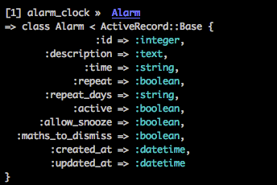
Class Presentation
IRB:
Pry:
Jazz Hands:

Slide 35

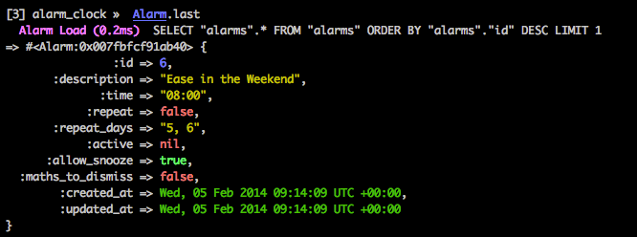
Instance Prettiness
IRB:
Pry:
Jazz Hands:

Slide 36
Colourful Syntax as You Type
IRB and Pry:
Jazz Hands:

