Slide 1

DSAI4205 Big Data Analytics
Lecture 2: The path to Parallelism
Dr. Ken FONG
Department of Data Science and Artificial Intelligence
chi-kit-ken.fong@polyu.edu.hk

Slide 2
Agenda
rationale behind parallel computing
2. dask: multi-processing library for NUMpy/ pandas
2.1. Dask Overview
2.2. Dask Data Arrays
2.3. Dask Client/Cluster and Dashboard and dask delayed
2.4. Dask DataFrames

Slide 3


Scalability
As we require more resources for computation, we simply have two options:
Scale up (Vertical Scaling)
Upgrade Hardware: Acquire higher-quality hardware to enhance system performance.
Add Resources: Introduce additional resources to an existing system or component to boost its performance.
Scale out (Horizontal Scaling)
Performance Enhancement: Increasing performance by adding more machines or workers to a system.
Capacity Expansion Enhances the system's capacity to handle greater workloads by distributing tasks across additional resources.
Scale up
Scale out

Slide 4
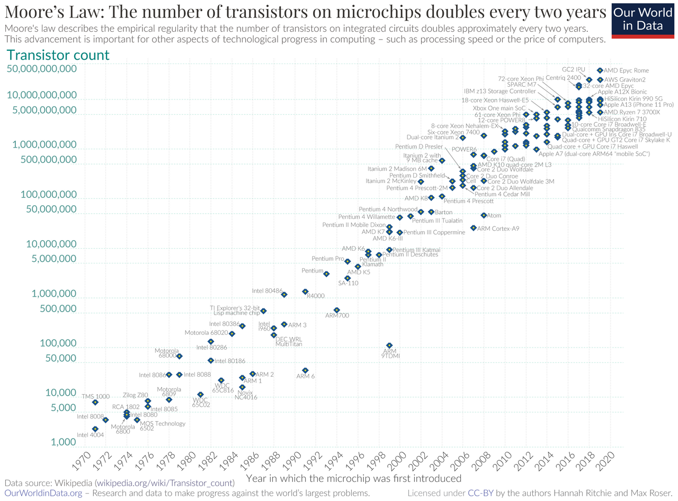
Limitation of scaling up
Why is there a focus on using multiple processors instead of just one fast processor
For many decades, we can depend on computer technology
Transistors getting smaller, and CPU gets faster with every generation.
The number of transistors in integrated circuits doubles roughly every 18-24 months

Slide 5
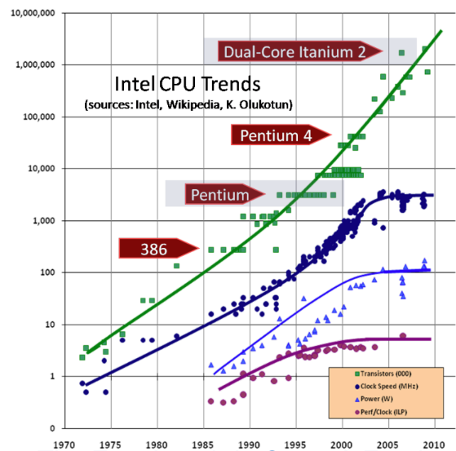
Clock Speed of Processors
Due to physical limitations of miniaturization, leading to issues like quantum tunneling and thermal constraints
It is no longer possible to make single CPU twice as faster every 18 months. (In 2005, Herb Sutter announced to the world: The Free Lunch Is Over)

Slide 6

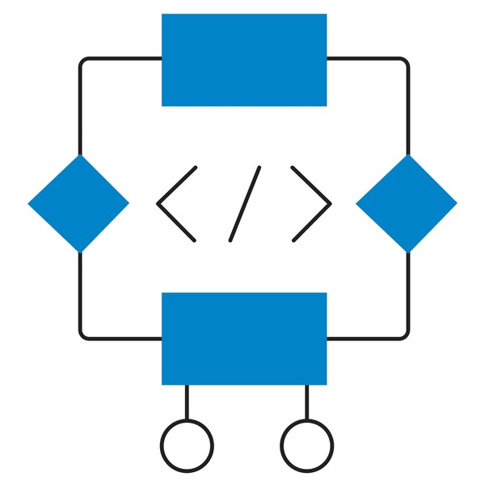
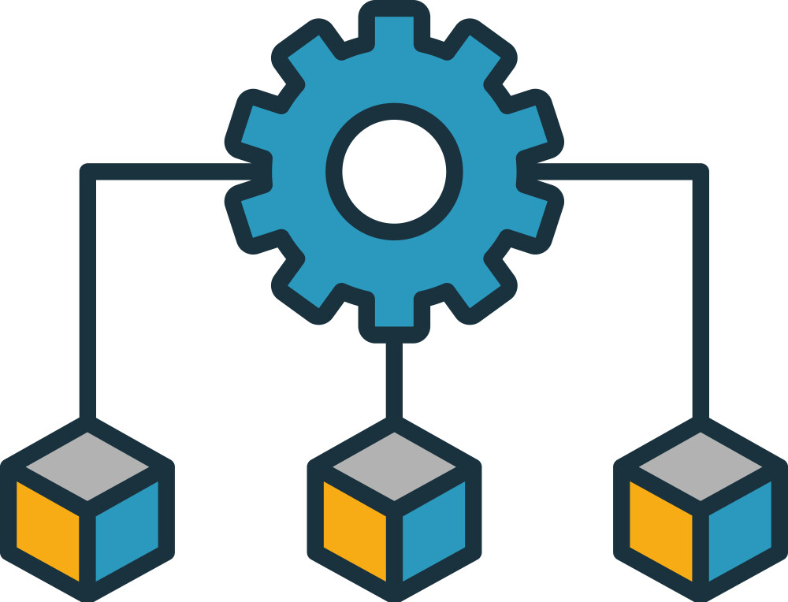
Implications
The clock speeds of microprocessors are not going to improve much in the foreseeable future
The efficiency gains in single threaded performance are going to be only moderate.
How to process Big Data (Large Volume of data) ?
Data Reduction
Efficient Algorithm and Data Structure
Allocate workload to multiple processors/workers.
Feature selection
Dimensionality reduction
Data Compression
Indexing
Tree
HashMap/HashTable
Graph

Slide 7
Possible Solutions to Big Data
The number of transistors in a microprocessor is still growing at a high rate
One of the main uses of transistors has been to increase the number of computing cores the processor has
The number of cores in a low-end workstation (as those employed in large scale datacenters) is going to keep on steadily growing
Programming models need to change to efficiently exploit all the available concurrency

Slide 8
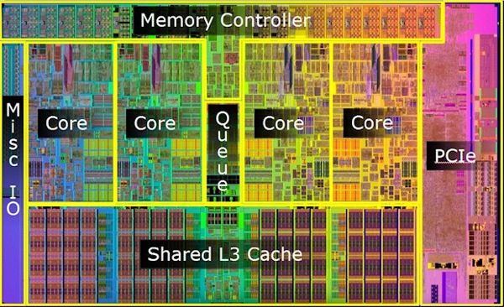
Multi-Core Processor
To address this issue, processor vendor tends to develop multi-core processor
Putting multiple CPU core on the same chip and utilize multiple cores in parallel processing
Enabled by a shared memory model in which the same address in memory points to the same data on all the cores on a chip.
These CPU cores have their own local state and run their own instruction-evaluation loop.

Slide 9


Challenge of Parallel Processing
How to write algorithm that coordinate among these different core and have them to do the work efficiently.
However, double the number of workers for a job does not ensure that the throughput will also be doubled.
There is significant overhead associated with coordination.
A team with 5 students
A team with 30 students

Slide 10

Bulk Operations
The method of managing and coordinating multiple workers is referred to as bulk operations.
The key is that we are performing the same operation
It is feasible to execute this independently across various values.
If we can carry out these tasks in an uncoordinated manner across different segments of our data, we can allocate distinct tasks to different CPU cores.
Therefore, we can scale everything in proportion to the number of computer cores.

Slide 11

Data parallelism
Data parallelism = same instructions, multiple data items
The apply function over a DataFrame or the conditional filtering can be done in parallel on different rows by different core.
Example:
A | B
1 | 3
4 | 2
2 | 3
1 | 4
A | B
4 | 2
A | B
2 | 3
4 | 2
A | B
2 | 3
df[df[‘A’] >1]

Slide 12

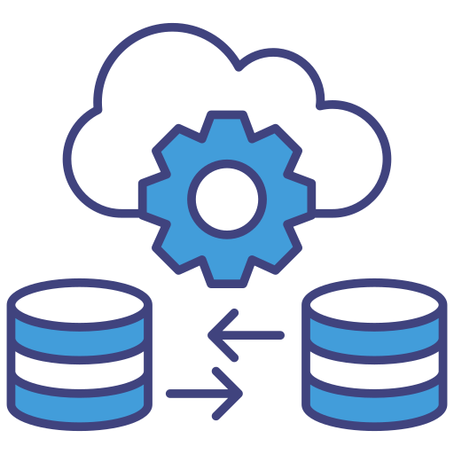
Parallelism Mechanisms
Two possible ways to overcome:
Sharding/Partitioning:
Dividing a dataset or workload into smaller, manageable subsets (partitions) that are distributed across multiple nodes or servers.
Replication:
Creating and maintaining multiple copies (replicas) of the same data or service across different nodes to ensure fault tolerance
Two issues to address :
How can data be processed in parallel?
How can we minimize communication between workers and reduce coordination overhead?

Slide 13
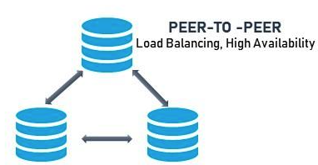
Replication
Copying data and storing it in different locations
Ensures data availability, fault tolerance, and improved performance in parallel computing environments.
Redundancy: Multiple copies of data reduce the risk of data loss if a node fails.
Scalability: Distributes data access across nodes, enabling faster read operations.
Consistency: Requires synchronization to ensure all replicas reflect the same data state.

Slide 14
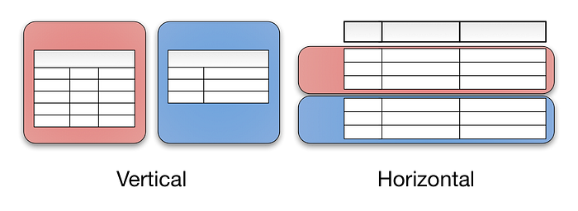
Sharding/Partitioning:
A tabular data can be split
vertically - storing different tables & columns
horizontally - storing rows of a same table in multiple nodes.

Slide 15
Example of Horizontal Partitioning
In multi-core setting, we can randomly put different rows of data on different core
Some operations work great!
fitering: df[df[‘A’] > 1]
projection: df[[‘A’, ‘B’]]
apply: df[‘A’].apply(lambda x: add_one(x))
However, this doesn’t work for everything
What about groupby(‘A’).count()?
Solution: maybe rearrange the data, such that all A’s in the same partition (to be processed by same core)
A | B | C
1 | 3 | 5
4 | 2 | 3
2 | 3 | 3
1 | 4 | 5
CPU 0
CPU 1
CPU 0
CPU 1

Slide 16
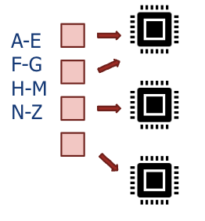
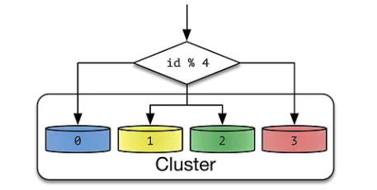
How to shard the data
Utilize an index as a key to associate with a specific core.
Assuming we have multiple cores, we can create a mapping from a range of keys to their corresponding core IDs.
Subsequently, we will direct all tuples that match the key to the designated core.
Hashing: takes a value (“a hash key”) and returns a large integer
If we have n cores, we typically put the data for key k at node:
h(k) % n

Slide 17
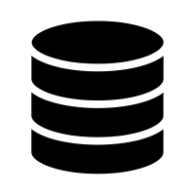

Fault Tolerance
Data
…
Partition 1
Partition 2
Partition N-1
Partition N
What if your server crashes?
Happens all the time when you have 1000s of machines…

Slide 18
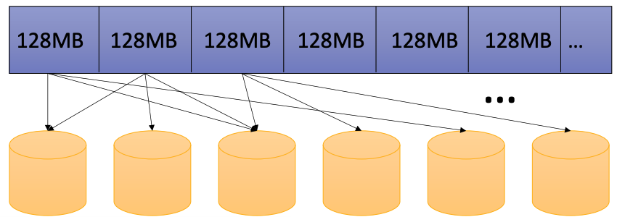
Hadoop Distributed File System (HDFS)
The most widely used distributed file system
Fixed-sized partitioning
3-way replication
Write-once read-many

Slide 19

Replication Mechanism
A
B
C
D
E
A
B
D
D
E
C
C
A
B
E
D
C
A
D
A
B
C
A
D
B
B
Node 1
Node 2
Node 3
Node 4
Node 5
Input File

Slide 20

Dask: Open-Source Parallel Computing Library

Slide 21
Dask
Complex data structures enable data science in Python
E.g. Numpy Array, Pandas series and dataframes, etc.
But datasets are getting larger all the time.
What if my dataset is too big to fit into the memory of the computer.
What if the analysis is too long to complete.
Dask is an open-source Python library:
Enable us to perform parallel computing
Scales Python packages such as Numpy, Pandas, etc.
From one machine to thousand core machine such as HPC clusters.

Slide 22




Why Dask?
Provides interface which are similar to Numpy and Pandas API.
Provides ways to parallelize Pandas, Numpy workflows with minimal code rewriting.
Familiar Interface
Scale from single machine to thousand-node HPC clusters or the cloud.
Allow users to use their existing hardware or add more machine as needed.
Scalability
Provides several tools that integrate with HPC resources managers, schedulers, etc.
E.g. You can wrap your function in dask.delayed to make it run in parallel mode.
Flexibility
Provide a live dashboard that give responsive feedback on how the computation is progressing
This would be helpful to identify potential bottlenecks/issues.
Diagnostic Tools

Slide 23
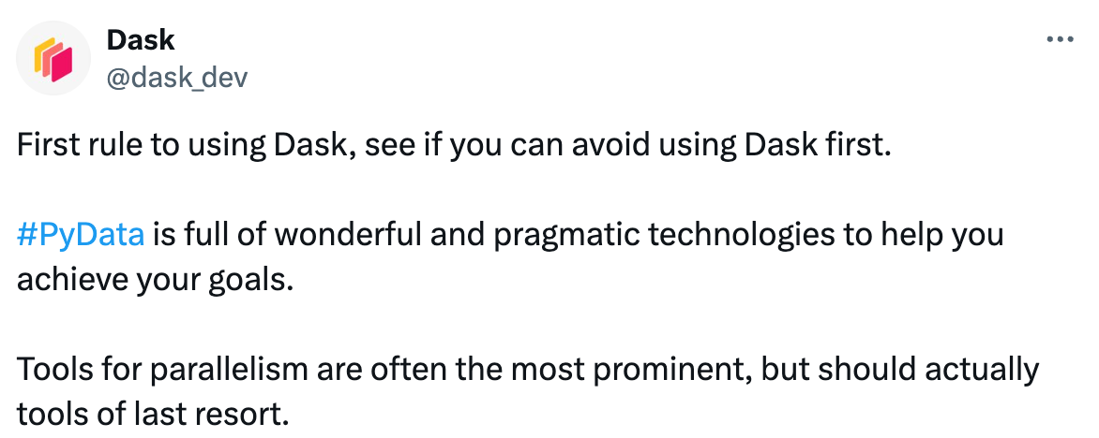

First rule of Dask
Its not always the best solution for all problems
Parallel computing add another layer of complexity/overhead to your problem.
Think about how much time you can gain by using parallel computing compared to standalone applications.
May require extra time for debugging and maximize the workflow.
When to use Dask?
When you have large data that cannot fit in the main memory.
If you have smaller dataset, it wouldn’t be beneficial
When you want to do parallel computation, such as Big Data Analysis.

Slide 24
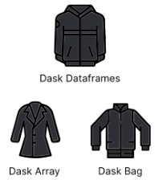
Dask Collections
Dask Collections
User interfaces that enable us to perform parallel computing.
Two-level collections: High-level collection/Low-level collection
High Level Collection: (Imagine as the parallelized version of numpy/pandas.)
Dask Arrays, Dask DataFrames, and Dask Bags
Similar to NumPy array, pandas dataframe, and lists
Can operate in parallel on datasets that cannot fit into memory.
Collection | Serial Execution | Dask
Arrays | numpy.array | dask.array.from_array
Dataframes | pandas.read_csv | dask.dataframe.read_csv
Unstructured | [1,2,3] | dask.bag.from_sequence([1,2,3])

Slide 25

Dask Collections
Low Level Collection:
Enable user to perform customized things and customized workflow.
Two low-level collection types:
delayed: run any arbitrary Python function in a parallel way (similar as looped function call)
futures: similar to delayed but allows for concurrent commands in the client script (similar as backgrounded processes)

Slide 26
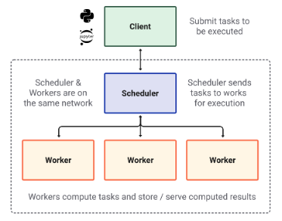
Dynamic Task Scheduling (Dask Scheduler)
When a computation is submitted:
The work will be split into different segment.
Different segments will be sent to different workers.
They coordinate the workers and send the tasks to the workers.
They organize everything.
High level Interface to the scheduler
Perform coordination between workers
Perform the computation and sent the results back to the scheduler.

Slide 27
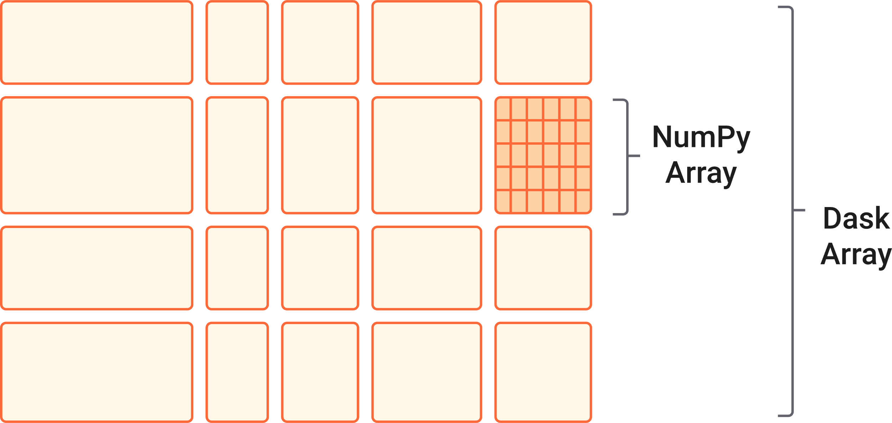
Dask Arrays
It only use whatever it needs !
Dask is Lazy:
The operations on Dask array are evaluated just in time when the results are needed!
Parallelized version of NumPy arrays for processing data sets that cannot fit in the memory.
Used as a replacement for NumPy arrays,
With a similar API as a subset of NumPy functions.
Effectively reduces the memory of large array computations
Split the arrays into smaller pieces (called chunks)
Able to fit into memory and stream the data from disk.

Slide 28
Block Algorithms
The algorithm splits large computation into smaller segment which operate on subsets of the data (chunks)
The workers only focus the computation on the assigned smaller piece of data.
import numpy as np
import dask.array as da
data = np.array([
[1,2,3,4],
[5,6,7,8],
[9,10,11,12],
[13,14,15,16]
])
dask_arr = da.from_array(data, chunks=(2,2))
1 | 2 | 3 | 4
5 | 6 | 7 | 8
9 | 10 | 11 | 12
13 | 14 | 15 | 16

Slide 29
Block Algorithms
Suppose we would like to compute the sum of this array using dask_arr.sum() which is similar to numpy.
When we take the sum of the dask_arr:
First compute the sum of each chunk
Take the sum of the results from each chunk
1 | 2
5 | 6
3 | 4
7 | 8
14
22
136
9 | 10
13 | 14
11 | 12
15 | 16
46
54

Slide 30
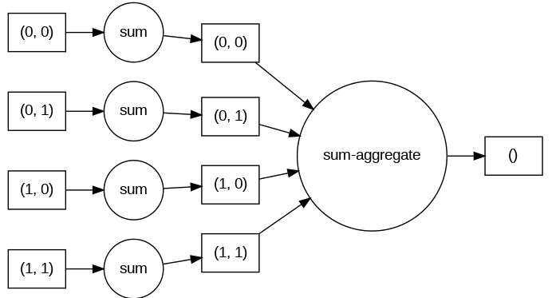
Task Graph
dask_arr.sum().visualize(rankdir="LR")
Instructs Graphviz to arrange the nodes in the graph from left to right instead.
Symbolic representation of the computations that are needed.
The task graph defines:
(1) The relationships between tasks
(2) The order in which they should be executed.
Each node in a graph represents a task
Each line represent the dependencies/relationships between tasks

Slide 31

Task Graph
This is called a low-level task graph
However, with larger dataset, the task graphs overwhelming rapidly.
Instead, we can switch to high level of task graph:
The task graph only display the high-level steps instead.
dask_arr.sum().dask.visualize(rankdir="LR")

Slide 32
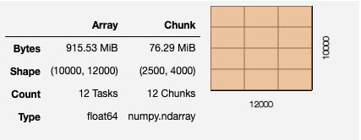
Large data example
Now try a with a larger array.
data = np.ones((10000, 12000))
data
array([[1., 1., 1., ..., 1., 1., 1.],
[1., 1., 1., ..., 1., 1., 1.],
[1., 1., 1., ..., 1., 1., 1.],
...,
[1., 1., 1., ..., 1., 1., 1.],
[1., 1., 1., ..., 1., 1., 1.],
[1., 1., 1., ..., 1., 1., 1.]])
dask_data = da.ones((10000, 12000))
dask_data

Slide 33
Splitting Chunks
Notice that the way that arrays are chunked can significantly affect total performance.
Make use the chunks argument when creating the dask.array
Be careful: chunk argument represent the shape of the chunk, not the number of chunks.
E.g. if you put 1 in chunks argument, it means one element in each of the chunk

Slide 34
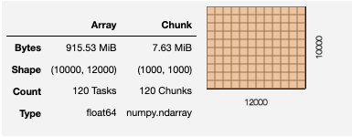

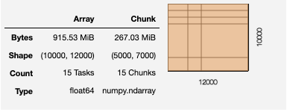
Splitting Chunks
There are several ways to define chunks:
We can have same size of chunks
A chunk size like 1000, meaning chunks of size 1000 in each dimension.
We can have different size of chunks
A chunk shape like (1000, 2000), meaning chunks of size 1000 in the first axis, 2000 in the second axis
A dictionary specifying chunk size per dimension like {0: 1000, 1: 2000}
Fully explicit sizes of all blocks for all dimensions, like ((1000,1000,1000,5000,2000),(3000,2000,7000))

Slide 35
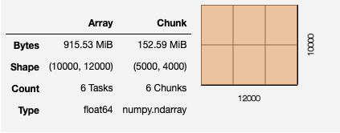
Splitting Chunks
Suppose we would like to split the data into 6 chunks
da.ones((10000, 12000,chunks=(5000,4000))

Slide 36

Performance comparison
So far, we just construct the representation (task graph), but no computation yet
data.mean()
mean_of_1 = dask_data.mean()
CPU times: user 62.9 ms, sys: 45.3 ms, total: 108 ms
Wall time: 105 ms
CPU times: user 3.47 ms, sys: 55 µs, total: 3.52 ms
Wall time: 3.51 ms
array([[1., 1., 1., ..., 1., 1., 1.],
[1., 1., 1., ..., 1., 1., 1.],
[1., 1., 1., ..., 1., 1., 1.],
...,
[1., 1., 1., ..., 1., 1., 1.],
[1., 1., 1., ..., 1., 1., 1.],
[1., 1., 1., ..., 1., 1., 1.]])
mean_of_1.compute()
we need to call the compute to trigger the computation!
CPU times: user 49.5 ms, sys: 5.98 ms, total: 55.5 ms
Wall time: 29.9 ms
compute():convert the dask array to the numpy array

Slide 37
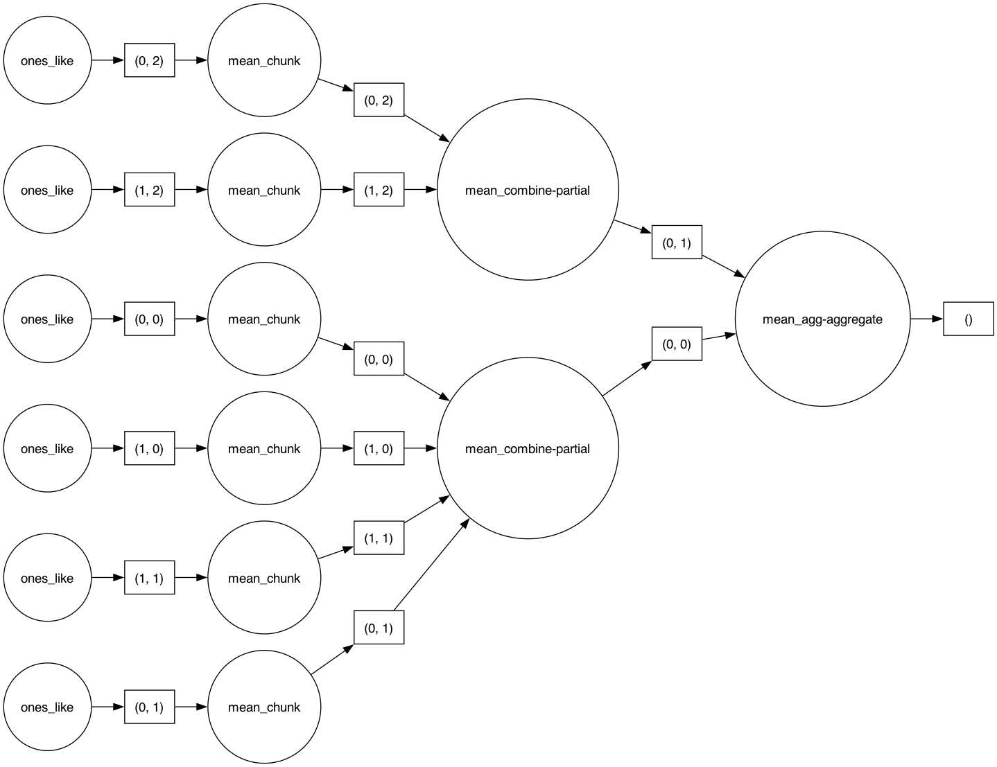
Task Graph
When working with large Dask arrays, we want to avoid generate the data right away by compute function
We should perform some computations that reduce the data size
E.g. compute statistics like the mean or standard deviation

Slide 38
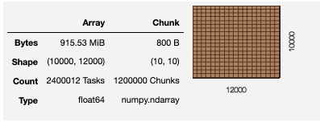
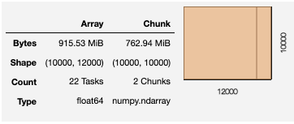
Rechunking Arrays
Change the chunking after the creation of a Dask array.
Note that: Rechunking Dask arrays can be expensive
dask_data.rechunk(10,10)
dask_data.rechunk(10000,10000)
CPU times: user 5min 22s, sys: 1min 29s, total: 6min 52s
Wall time: 7min 13s
CPU times: user 183 ms, sys: 12.8 ms, total: 196 ms
Wall time: 86.2 ms
Consider on Chunk Size:
Too small: will be bad because introducing too much overhead
Too large: may not fit well in main memory
Chunk size recommended in Dask Guideline: 100MB to 1GB

Slide 39



Dask Client/Cluster and Dashboard

Slide 40
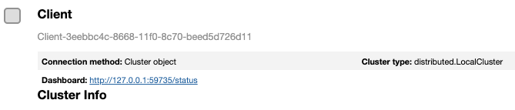
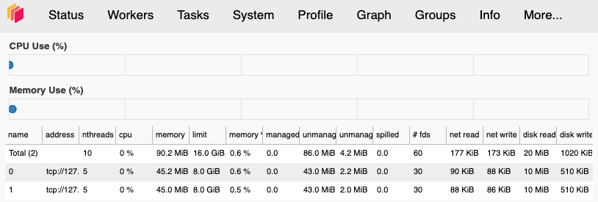
Create workers (Start our cluster)
from dask.distributed import Client
client = Client(n_workers=2)
client
To create a set of workers on your computer.
This cluster is running only on your own computer
it would work on a cloud cluster where these workers live on other computers.

Slide 41
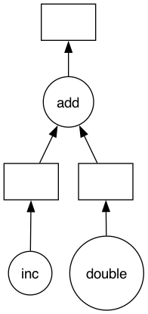
Dask Delayed
to parallelize computations and build complex workflows in Python.
Consider the following Python Program
@dask.delayed
def inc(x):
return x + 1
def double(x):
return x * 2
def add(x, y):
return x + y
output = []
x = 5
a = inc(x)
b = double(x)
c = add(a, b)
c
@dask.delayed
@dask.delayed
Delayed('add-84c361fe-7381-4cb3-ae48-02be99f73111')
To define tasks lazily:
computations are not executed until explicitly requested.

Slide 42
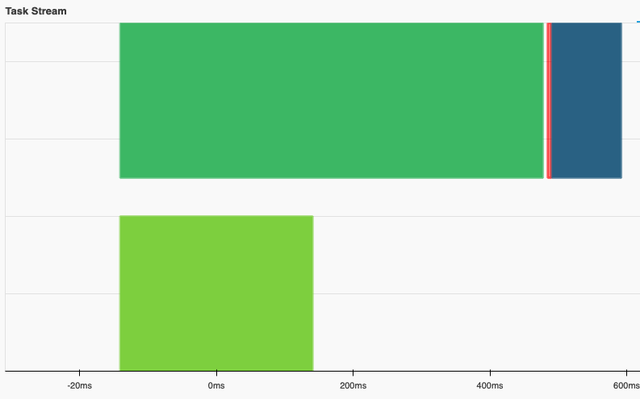
Dask Delayed
import dask
import time
import random
@dask.delayed
def inc(x):
time.sleep(random.random())
return x + 1
@dask.delayed
def double(x):
time.sleep(random.random())
return x * 2
@dask.delayed
def add(x, y):
time.sleep(random.random())
return x + y
x = 5
a = inc(x)
b = double(x)
c = add(a, b)
c.compute()
transfer-add
inc()
add()
double()

Slide 43
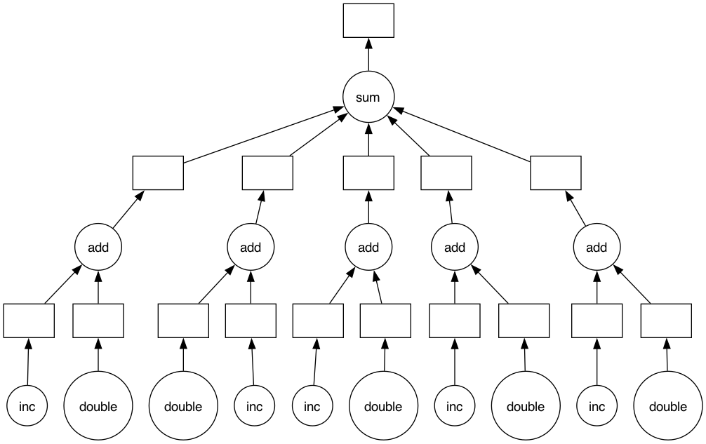
Dask Delayed
import dask
import time
import random
@dask.delayed
def inc(x):
time.sleep(random.random())
return x + 1
@dask.delayed
def double(x):
time.sleep(random.random())
return x * 2
@dask.delayed
def add(x, y):
time.sleep(random.random())
return x + y
for i in range(5):
x = random.random()
a = inc(x)
b = double(x)
c = add(a, b)
output.append(c)
total = dask.delayed(sum)(output)

Slide 44
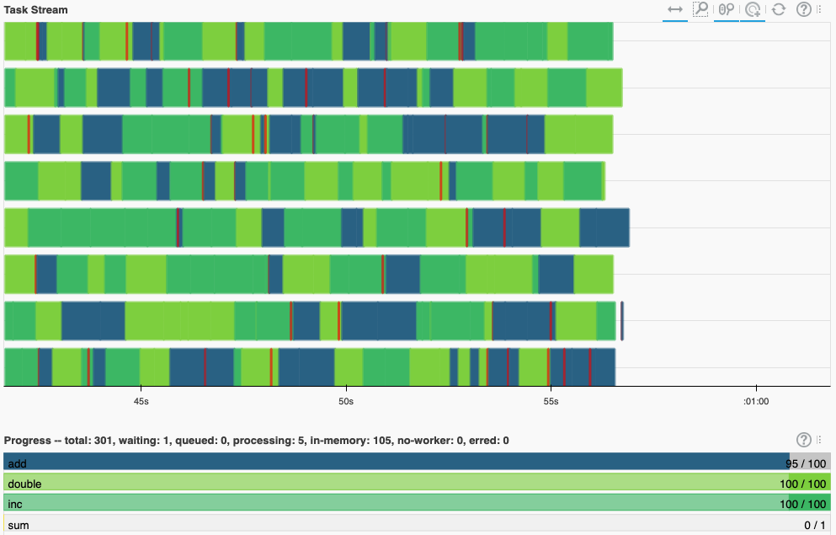
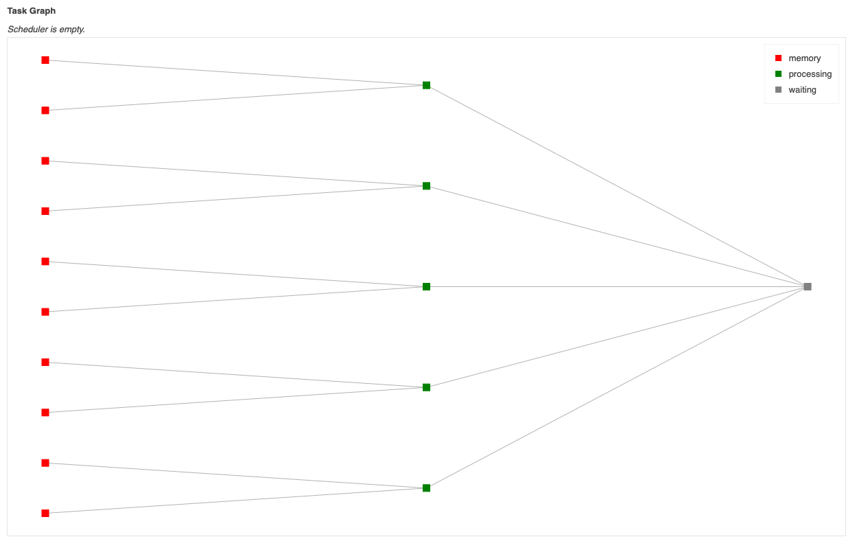
Dask Delayed
import dask
import time
import random
@dask.delayed
def inc(x):
time.sleep(random.random())
return x + 1
@dask.delayed
def double(x):
time.sleep(random.random())
return x * 2
@dask.delayed
def add(x, y):
time.sleep(random.random())
return x + y
for i in range(100):
x = random.random()
a = inc(x)
b = double(x)
c = add(a, b)
output.append(c)
total = dask.delayed(sum)(output)
c.compute()

Slide 45
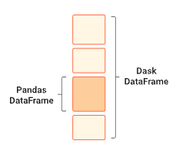
Dask DataFrame

Slide 46
Dask DataFrame
Pandas is popular to deal with tabular datasets
But the datasets need to be fit into the memory
Pandas operates best with smaller dataset.
If you have a large dataset, you will receive an out of memory error using pandas.
The practice:
To have 5-10 times as much main memory as the size of your dataset.
Dask DataFrame can be used to solve Pandas performance issue.

Slide 47
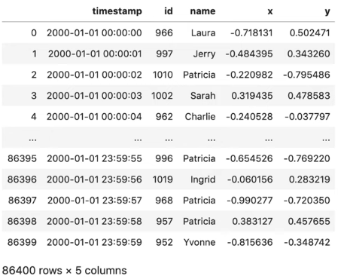
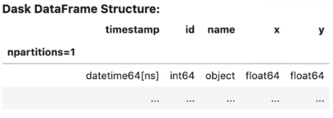
Dask DataFrame
import pandas as pd
df = pd.read_csv(‘data/2000-01-01.csv’, parse_dates=‘timestamp’)
df
Lazy output
import dask.dataframe as dd
df = dd.read_csv(‘data.csv’, pares_dates=‘timestamp’)
df

Slide 48
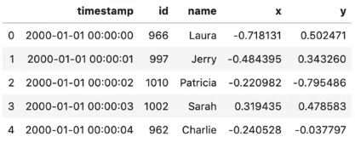
Dask DataFrame
df.head()
df.x.mean()
Lazy result: the file is not yet loaded into memory
Dask will only load that memory when we ask for a result.
dd.Scalar<series-…, dtype=float64>
df.x.mean().compute()
0.0017233805619337674

Slide 49
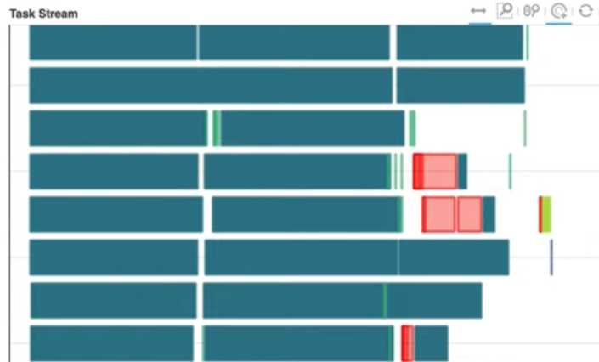
Dask DataFrame
Unlike Pandas, Dask DataFrame can read multiple files at once.
import dask.dataframe as dd
df = dd.read_csv(‘data/*.csv’, parse_dates=‘timestamp’)
df.groupby(‘name’).x.std().compute()
name
Alice 0.577489
Bob 0.576694
Charlie 0.577403
Dan 0.577112
Edith 0.577661
Frank 0.576977
George 0.579063
Hannah 0.577351
Ingrid 0.576857
Jerry 0.577186
Kevin 0.577374
Laura 0.578591
Dask will reread through all the CSV files and compute the result.

Slide 50
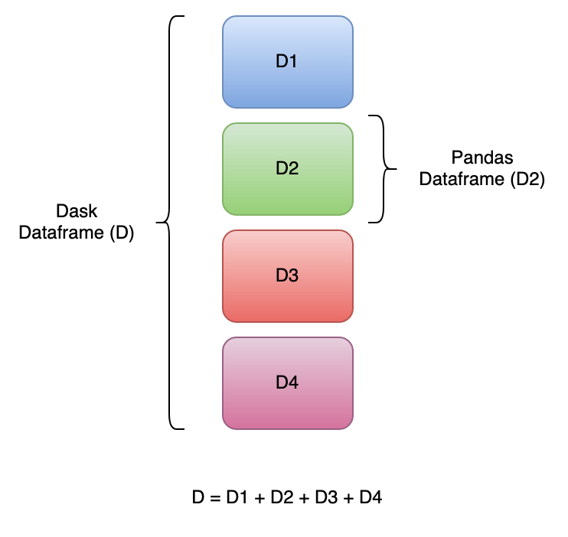
Dask DataFrame
Dask DataFrame is composed of many pandas' data frame. (partitions)
The partitions will be:
Loaded lazily.
Operations on Dask DataFrames are not computed until you explicitly request them
Processed in parallel across multiple cores.

Slide 51
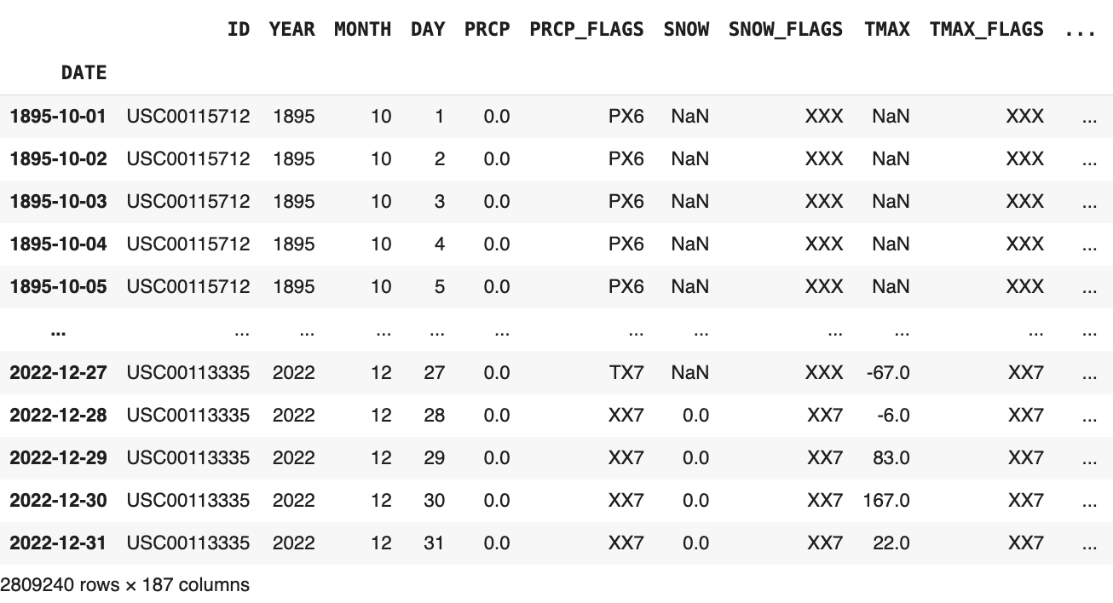
Dask DataFrame
Suppose we have a large DataFrame from multiple files.

Slide 52
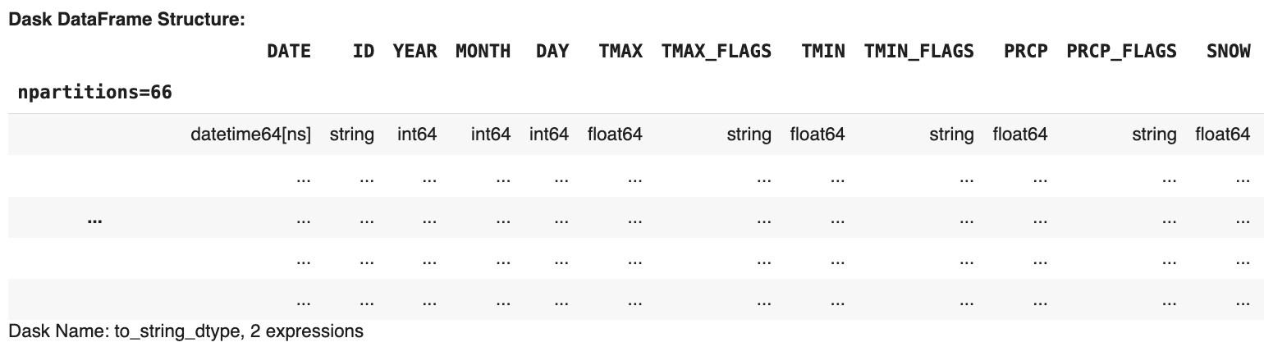
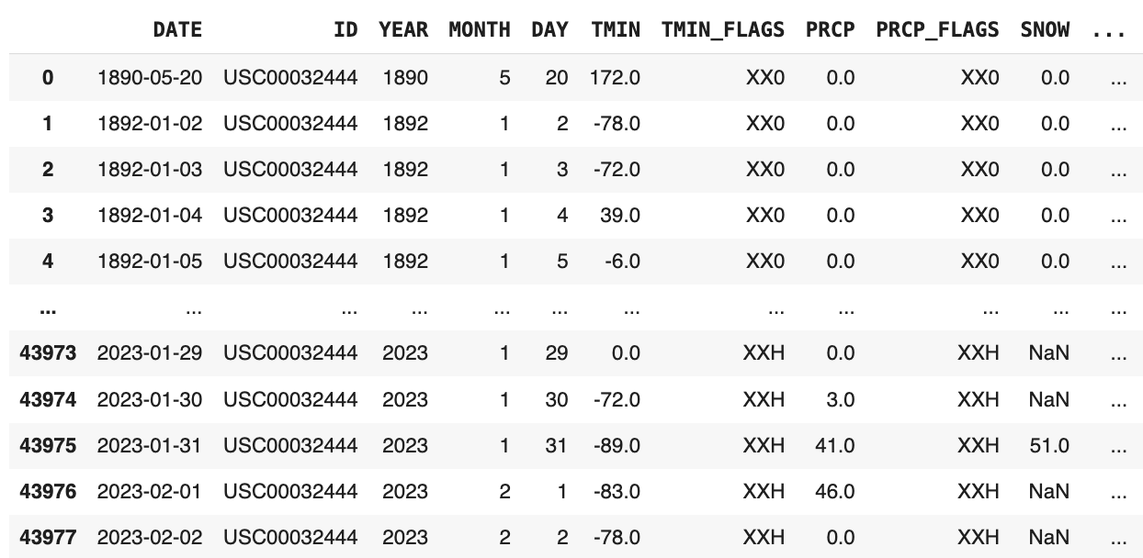
Dask DataFrame
import dask
import dask.dataframe as dd
ddf = dd.read_csv('*.csv', parse_dates=['DATE'], blocksize='64MB’)
ddf
ddf.partitions[5].compute()

Slide 53
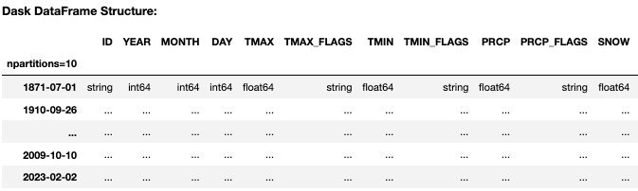
Dask DataFrame
We can also use dd.from_pandas function to convert Pandas DataFrame to Dask DataFrame
import dask
import dask.dataframe as dd
ddf = dd.from_pandas(df, npartitions=10)
ddf
ddf.map_partitions(len).compute()
0 280908
1 280909
2 280910
3 280960
4 280915
5 280891
6 280926
7 280957
8 280883
9 280981

Slide 54
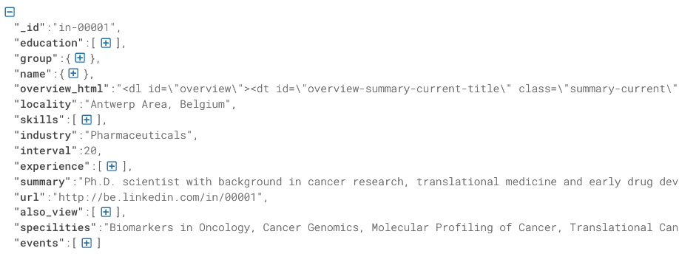
LinkedIn Dataset Example
Suppose we obtain 100k records from LinkedIn in JSON format.
Convert to the DataFrame.
data = open(‘linkedin.json.txt’)
people = [] for line in data:
person = json.loads(line)
people.append(person)
df = pd.DataFrame(people)

Slide 55

LinkedIn Dataset Example
LinkedIn DataFrame
['_id', 'name', 'locality', 'skills', 'industry', 'summary', 'url',
'also_view', 'education', 'group', 'overview_html', 'interval’,
'experience', 'specilities', 'events', 'interests', 'homepage’, 'honors']
['_id', 'name', 'locality', 'industry', 'summary', 'url',
'also_view', 'group', 'overview_html', 'interval’,
'specilities', 'events', 'interests', 'homepage’']
skills
education
experience
honors
skills_df = people_df[['_id','skills']].explode('skills')
education_df = people_df[['_id','education']].explode('education')
experience_df = people_df[['_id','experience']]
honors_df = people_df[['_id', 'honors']]

Slide 56
LinkedIn Dataset Example
linkedin_df
experience_df
skills_df
honors_df
education_df
linkedin_df.merge(experience_df, on='_id').merge(skills_df, on='_id').merge(honors_df, on='_id').merge(education_df, on='_id')
CPU times: user 5.34 s, sys: 1.6 s, total: 6.94 s Wall time: 6.95 s

Slide 57
LinkedIn Dataset Example
linkedin_ddf
experience_ddf
skills_ddf
honors_ddf
education_ddf
linkedin_ddf = dd.from_pandas(linkedin_df,npartitions=100)
skills_ddf = dd.from_pandas(skills_df,npartitions=100)
experience_ddf = dd.from_pandas(experience_df,npartitions=100)
education_ddf = dd.from_pandas(education_df,npartitions=100)
honors_ddf = dd.from_pandas(honors_df, npartitions=100)
linkedin_ddf.merge(experience_ddf, on='_id').merge(skills_ddf, on='_id').merge(honors_ddf, on='_id').merge(education_ddf, on='_id')
CPU times: user 49.2 ms, sys: 0 ns, total: 49.2 ms Wall time: 50.4 ms
linkedin_ddf.merge(experience_ddf, on='_id').merge(skills_ddf, on='_id').merge(honors_ddf, on='_id').merge(education_ddf, on='_id')
CPU times: user 3.81 s, sys: 181 ms, total: 3.99 s Wall time: 4.06 s

Slide 58
When to use Dask DataFrame
Same question, when to use Dask DataFrame?
Answer: when we require parallelizable computations.
For example:
Element-wise operations such as df.x + df.y
Row-wise filtering such as df[df.x>0]
Common aggregations such as df.x.max()
Dropping duplicates such as df.x.drop_duplicate()
Dask is not great for operations that requires shuffling or re-indexing.
Set index: df.set_index(df.x)

Slide 59

Any Questions?

