Slide 1



DSAI4205 Big Data Analytics
Lecture 4: Exploring Hive, Shark, and SparkSQL in Big Data Systems
Dr. Ken FONG
Department of Data Science and Artificial Intelligence
chi-kit-ken.fong@polyu.edu.hk

Slide 2
Agenda
Recall map reduce and explore its challenge for programmers
Structured data with hive and shark
intro to sparksql
3.1 DataFrame api
3.2 DataFrame operations with examples
3.3 extend rdds with relational operations
3.4 load data from external source: CSV, JSON, Parquet

Slide 3
Recall: Map Reduce Example
Map
Shuffle
Reduce
(did1, v1)
(did1, v2)
...
(did2, v1)
(did2, v2)
...
(w1,1)
(w2,1)
(w3,1)
…
(w1,1)
(w2,1)
…
(w1, (1,1,1,…1))
(w2, (1,1,…))
(w3, (1,…))
(w1,25)
(w2,77)
(w3,12)
…

Slide 4
Recall: Map Reduce Example
I often repeat repeat myself
I often repeat repeat
I don’t don’t know why know why
I simply know that I I I
am am inclined to say to say
a lot a lot this way this way
I often repeat repeat myself
I often repeat repeat
Mapper1
I: 1, often: 1, repeat: 1, repeat: 1, myself: 1, I: 1, often: 1, repeat: 1, repeat: 1, I: 1, don’t: 1, don’t: 1, know: 1, why: 1, know: 1, why: 1
I often repeat repeat myself
I often repeat repeat
I don’t don’t know why know why
Mapper2
I simply know that I I I
am am inclined to say to say
a lot a lot this way this way
I: 1, simply: 1, know: 1, that: 1, I: 1, I: 1, I: 1, am: 1, am: 1, inclined: 1, to: 1, say: 1, to: 1, say: 1, a: 1, lot: 1, a: 1, lot: 1, this: 1, way: 1, this: 1, way: 1
Mapper3
I often repeat repeat myself
I often repeat repeat
I: 1, often: 1, repeat: 1, repeat: 1, myself: 1, I: 1, often: 1, repeat: 1, repeat: 1

Slide 5
Recall: Map Reduce Example
Reducer 1
I: 1, often: 1, repeat: 1, repeat: 1, myself: 1, I: 1, often: 1, repeat: 1, repeat: 1, I: 1, don’t: 1, don’t: 1, know: 1, why: 1, know: 1, why: 1
a: [1,1]
am: [1,1]
don’t: [1,1]
I: [1,1,1,1,1,1,1,1,1]
inclined: [1]
know: [1,1,1]
lot: [1,1]
myself: [1,1]
often: [1,1,1,1]
repeat: [1,1,1,1,1,1,1,1]
say: [1, 1]
simply: [1]
that: [1]
this: [1,1]
to: [1,1]
way: [1,1]
why: [1,1]
a: 2
am: 2
don’t: 2
I: 9
inclined: 1
know: 3
a: 2
am: 2
don’t: 2
I: 9
inclined: 1
know: 3
lot: 2
myself: 2
often: 4
repeat: 8
say: 2
simply: 1
that: 1
this: 2
to: 2
way: 2
why: 2
Reducer 2
I: 1, simply: 1, know: 1, that: 1, I: 1, I: 1, I: 1, am: 1, am: 1, inclined: 1, to: 1, say: 1, to: 1, say: 1, a: 1, lot: 1, a: 1, lot: 1, this: 1, way: 1, this: 1, way: 1
lot: 2
myself: 2
often: 4
repeat: 8
say: 2
simply: 1
Reducer 3
I: 1, often: 1, repeat: 1, repeat: 1, myself: 1, I: 1, often: 1, repeat: 1, repeat: 1
that: 1
this: 2
to: 2
way: 2
why: 2

Slide 6
Problem with MapReduce
Many queries/computations require multiple Map Reduce jobs
2-stage (Mapper and Reducer) computation too rigid
For example, if we want to find the top 2 most visited pages in each category
Visits
UrlInfo
User | Url | Time
Amy | amazon.com | 8:00
Amy | facebook.com | 10:00
Amy | twitter.com | 10:05
Fred | amazon.com | 12:00
Kenneth | espn.com | 21:00
Janice | twitter.com | 08:44
Url | Category | PageRank
amazon.com | Ecommerce | 0.9
facebook.com | Social Network | 0.8
twitter.com | facebook.com | 0.7
espn.com | Sports | 0.9

Slide 7
Phase 1 - Join Visits with URLInfo and Compute Visit Counts per URL
Mapper 1
Input: (User, URL, Time)
for each record:
emit key: URL
emit value: ("visit", 1)
(Amy, amazon.com, 8:00) → key: amazon.com, value: ("visit", 1)
(Amy, facebook.com, 10:00) → key: facebook.com, value: ("visit", 1)
(Amy, twitter.com, 10:05) → key: twitter.com, value: ("visit", 1)
(Fred, amazon.com, 12:00) → key: amazon.com, value: ("visit", 1)
(Kenneth, espn.com, 21:00) → key: espn.com, value: ("visit", 1) (
Janice, twitter.com, 08:44) → key: twitter.com, value: ("visit", 1)
Mapper 2
Input: (URL, Category, PageRank)
for each record:
emit key: URL
emit value: (”info", category)
(amazon.com, Ecommerce, 0.9) →
key: amazon.com, value: ("info", Ecommerce)
(facebook.com, Social Network, 0.8) →
key: facebook.com, value: ("info", Social Network)
(twitter.com, Social Network, 0.7) →
key: twitter.com, value: ("info", Social Network)
(espn.com, Sports, 0.6) →
key: espn.com, value: ("info", Sports)

Slide 8
Phase 1 - Join Visits with URLInfo and Compute Visit Counts per URL
MapReduce groups by key (URL), so the reducer receives:
amazon.com: [("visit", 1), ("visit", 1), ("info", Ecommerce)]
facebook.com: [("visit", 1), ("info", Social Network)]
twitter.com: [("visit", 1), ("visit", 1), ("info", Social Network)]
espn.com: [("visit", 1), ("info", Sports)]
Initialize visit_count = 0
Initialize category = null
For each value in values:
If value.type == "visit":
visit_count += value.count
For each value in values:
If value.type == "info":
// Set category (assume one per URL)
category = value.category
If category != null and visit_count > 0:
Emit key: URL
Emit value: (category, visit_count)
(Ecommerce, (amazon.com, 2))
(Social Network, (facebook.com, 1)) (Social Network, (twitter.com, 2)) (Sports, (espn.com, 1))
←Process Visits records
←Process URLInfo records
← Emit joined results

Slide 9
Phase 2: Find Top 2 URLs per Category
(Ecommerce, (amazon.com, 2))
(Social Network, (facebook.com, 1)) (Social Network, (twitter.com, 2)) (Sports, (espn.com, 1))
Mapper:
Input: (category, (URL, visit_count))
Output:
for each record:
emit key: category
emit value: (URL, visit_count)
)
(Ecommerce, (amazon.com, 2)) →
key: Ecommerce, value: (amazon.com, 2)
(Social Network, (facebook.com, 1)) →
key: Social Network, value: (facebook.com, 1) (Social Network, (twitter.com, 2)) →
key: Social Network, value: (twitter.com, 2) (Sports, (espn.com, 1)) →
key: Sports, value: (espn.com, 1)

Slide 10
Phase 2: Find Top 2 URLs per Category
MapReduce groups by key (category), so the reducer receives:
Ecommerce: [(amazon.com, 2)]
Social Network: [(facebook.com, 1), (twitter.com, 2)] Sports: [(espn.com, 1)]
Reducer:
Input: key = category, values = list of (URL, visit_count) Output:
Collect all (URL, visit_count) into a list
Sort the list in descending order by visit_count
Select the top 2 entries
For each of the top 2 (in order):
Emit key: (category, rank)
Emit value: (URL, visit_count)
((Ecommerce, 1), (amazon.com, 2))
((Social Network, 1), (twitter.com, 2))
((Social Network, 2), (facebook.com, 1))
((Sports, 1), (espn.com, 1))
For Ecommerce: [(amazon.com, 2)] → top 2:
[(amazon.com, 2)] (only 1 URL)
Emit: (Ecommerce, 1), (amazon.com, 2)
For Social Network: [(facebook.com, 1), (twitter.com, 2)] →
sort by visit count: [(twitter.com, 2), (facebook.com, 1)] →
top 2: Emit: (Social Network, 1), (twitter.com, 2)
Emit: (Social Network, 2), (facebook.com, 1)
For Sports: [(espn.com, 1)] →
top 2: [(espn.com, 1)] (only 1 URL)
Emit: (Sports, 1), (espn.com, 1)

Slide 11
The Map Reduce API is too low-level
User | Url | Time
Amy | amazon.com | 8:00
Amy | facebook.com | 10:00
Amy | twitter.com | 10:05
Fred | amazon.com | 12:00
Kenneth | espn.com | 21:00
Janice | twitter.com | 08:44
Url | Category | PageRank
amazon.com | Ecommerce | 0.9
facebook.com | Social Network | 0.8
twitter.com | facebook.com | 0.7
espn.com | Sports | 0.9
Map Reduce Job 1:
Group by URL, compute the count, and join with URLInfo Table
Common Operations are coded manually:
join
selects
projection,
aggregates
sorting
distinct
Map Reduce Job 2:
Group by category and compute the count
((Ecommerce, 1), (amazon.com, 2))
((Social Network, 1), (twitter.com, 2))
((Social Network, 2), (facebook.com, 1))
((Sports, 1), (espn.com, 1))

Slide 12
High Level Language
Programmers are unfamiliar with map and reduce functions.
They prefer using operations like joins, filters, groupBy, and select all.
Solution:
High-level languages/systems that compile to Map Reduce with HDFS.
Initially Developed by Facebook
Put structure/schema onto HDFS data
Compile HiveQL queries into MapReduce jobs
Popular: more than 90% of Facebook MapReduce jobs generated by Hive

Slide 13
HiveQL Queries
SELECT category, url, visit_count, rank FROM
(
SELECT u.category, v.url, COUNT(*) as visit_count, RANK() OVER
(PARTITION BY u.category ORDER BY COUNT(*) DESC, v.url ASC) as rank
FROM Visits v JOIN URLInfo u ON v.url = u.url
GROUP BY u.category, v.url
) ranked
WHERE rank <= 2
ORDER BY category, rank;
HIVE provides a limited version of SQL.
Data Definition Language (DDL)
Table Operations: Create, Drop, Alter
Database Operations: Create, Drop
View Operations: Create, Drop
Querying Data:
SELECT / FROM / WHERE / GROUP BY /
HAVING / ORDER BY / LIMIT
Joins
INNER JOIN, LEFT JOIN, RIGHT JOIN,
FULL OUTER JOIN
Functions:
Aggregate Functions / String Functions /
Date Functions /Window Functions
Partitioning and Bucketing
PARTITIONED BY: Defines partitions for a table during creation
CLUSTERED BY: Defines bucketing for a table during creation
Data Manipulation Language (DML)
Operations: INSERT, SELECT, UPDATE, DELETE
Load Data: Load data from local or HDFS storage into a table

Slide 14
HiveQL Commands
The difference between HiveQL and SQL can be found here.
http://hortonworks.com/wp-content/uploads/2016/05/Hortonworks.CheatSheet.SQLtoHive.pdf
Load data from local file system
Delete previous data from that table
LOAD Data Local INPath ‘./textData.txt’ OVERWRITE INTO TABLE textData
LOAD DATA INPATH ‘/tmp/textData.txt’ INTO TABLE partitioned_sample PARTITION (ds=‘2025-09-16’);
Load data from HDFS
loading or inserting data into an existing table
If the table is partitioned, you must specify the partition(s) where the data should be loaded, as shown in your original command.

Slide 15
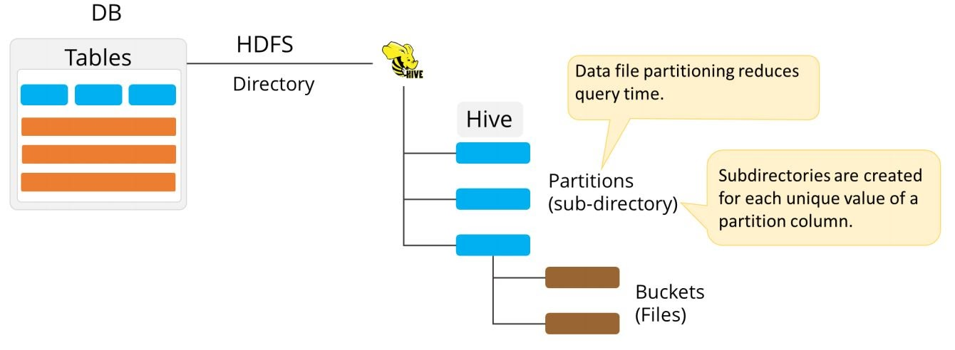
Data Model for Hive
Hive deals with Structured Data of different types in THREE levels:

Slide 16
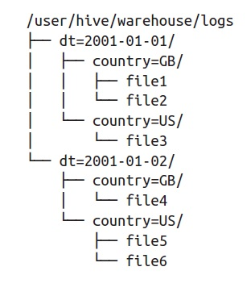
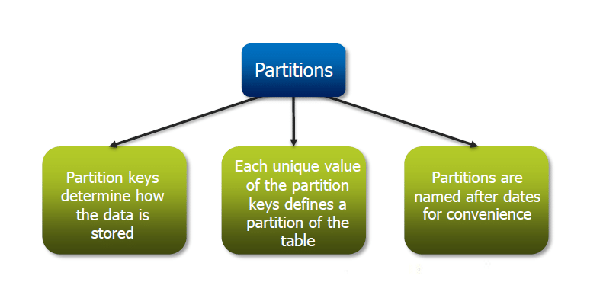
Data Model for Hive
Hive deals with Structured Data of different types in THREE levels:
Table:
Typed columns (int, float, string, Boolean)
Similar to Tables in RDBMS
Each table has a corresponding directory in HDFS
Data serialized and stored as files within that directory
Supports the map data type, which allows users to store JSON-like data structure
Partitions:
To determine the distribution of data within a Table
E.g. range-partition tables by date
Each partition is a sub-directory of the main directory in HDFS
Converting an object or data structure into a format that can be easily stored or transmitted and then reconstructed later.

Slide 17
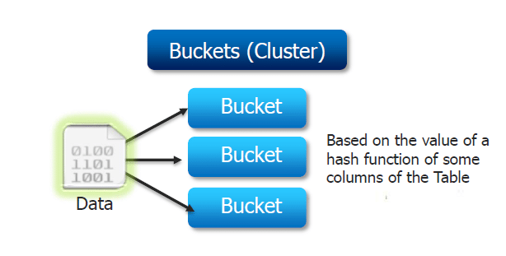
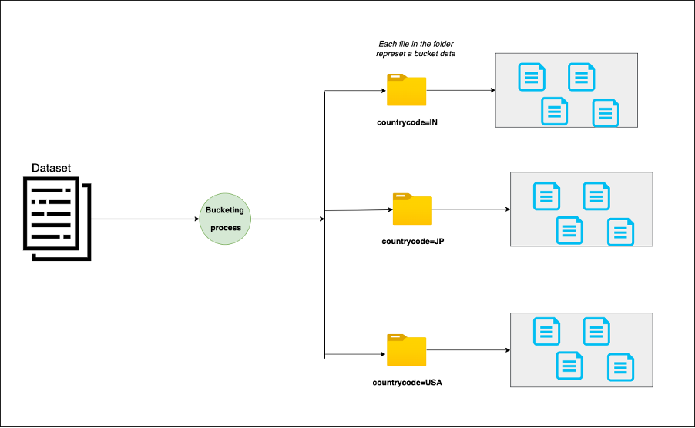
Data Model for Hive
Bucket:
Partitions can be subdivided into buckets.
Each bucket is saved as a file within the directory.
For example, to split the partitions into 𝑛 buckets, create 𝑛 files in each of your partition directories.

Slide 18
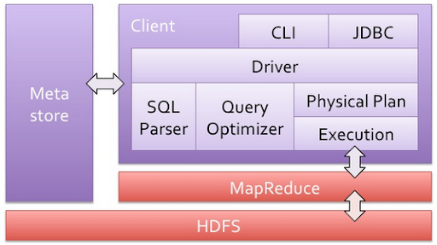
Hive Architecture
Managing the lifecycle of a HiveQL query, from parsing to execution
Stores metadata about Hive tables, including their schema, location, partitioning information, and other propertie
Takes HiveQL statements as input and generates a parse tree.
Executing the optimized query plan. It translates the execution plan into MapReduce that run on the Hadoop cluster.

Slide 19






Steps in compilation of Hive Programs
The HiveQL statement is parsed to
- check for syntax errors.
- generate a parse tree which represents the structure of the query.
HiveQL
Parser
The parse tree undergoes semantic analysis to
Retrieve the schema
Validate the query's logic
This step checks for the existence of tables, columns, and data types, ensuring that the query is semantically correct.
Execution !
Semantic Analysis
Logical Plan Generator
Optimizer
Physical Plan Generator
A logical plan is created from the validated HiveQL statement.
The logical plan is optimized to improve performance.
The logical plan is converted into a physical plan (DAG of Map Reduce Jobs)

Slide 20
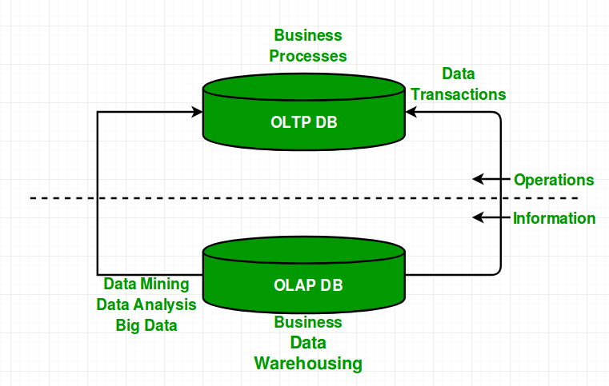
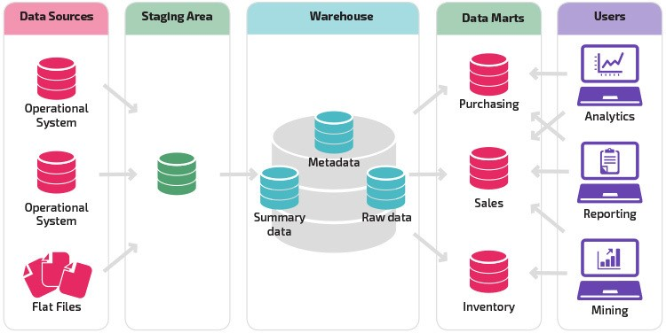
Key Principles of Hive
Hive is an open source peta-byte scale data warehousing framework based on MapReduce and HDFS.
Hive is NOT for Online Transaction Processing (OLTP)
Focuses on scalability and extensibility for data warehouses / online analytical processing (OLAP)
Run as a client library on top of MapReduce with HDFS:
It is fault-tolerant
Massively scale-out on commodity hardware
Able to handle petabyte of data
Flexible and Extensible
Support for nested data
Allow user define functions easily
Allow users to write custom mapper and reducer to use it with HiveQL
Serialize/Deserialize: Convert inputs into structured format.

Slide 21
Key Principles of Hive
Define SQL-Like Query Language: HiveQL
Data Warehousing Infrastructure
Allow programmers to plug-in custom mapper and reducers
Provide tools to enable easy data ETL (Extract, Transform, Load)

Slide 22
Limitations of Hive
High Latency:
Hive uses MapReduce, resulting in high latency for query execution, often taking minutes for small queries.
Limited Support for Interactive Analytics
Hive is optimized for batch processing, not interactive or ad-hoc queries
Complex Query Performance
Complex queries with multiple joins or subqueries are slow due to MapReduce’s disk-based processing.
No Native Support for Advanced Analytics
Hive lacks built-in support for machine learning or iterative algorithms.

Slide 23
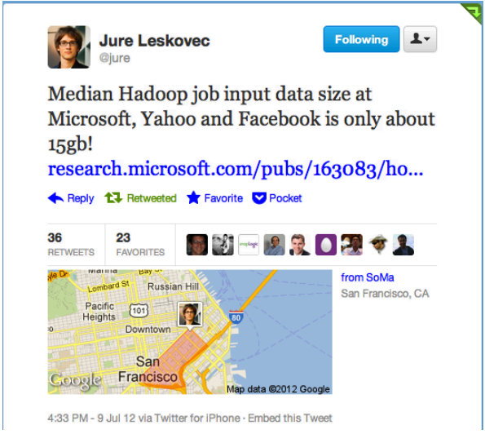
Shark Motivation
Can in-memory computation be beneficial for Hive in the context of managing petabyte-scale data warehouses?
How do you fit a petabyte into memory?
Most of their queries don't operate on the petabyte warehouse directly. Instead, they target smaller, specific data windows, such as daily visit logs.

Slide 24
Shark Motivation
data or resources recently accessed are likely to be accessed again in the near future.
Data warehouses exhibit a huge amount of temporal locality
90% of Facebook queries could be served in Main Memory
The next question is whether we can:
Keep the benefits of Hive (Scalability and Extensibility)
Leverage the temporal locality ?
Swap out the physical plan generation execution engine
Adding a cache manager and made tweaks to the query optimizer as part of its architecture to improve performance over Hive
Replace Hive's MapReduce-based physical planning and execution with Spark's RDD-based execution engine for faster in-memory processing.
Cache Manager
Spark

Slide 25
Shark
Data warehouse system compatible with Hive
Supports HiveQL, UDFs, Serialize/Deserialize, scripts, type.
However, Shark not support:
Bucketing: does not support hash-based bucketing for tables, limiting efficient sampling and joins.
Heterogeneous Partition Formats: All partitions must use the same input format.
Result File Merging: No merging of small output files, potentially causing HDFS fragmentation.
Automatic Join Optimization: Lacks auto-conversion to map-side joins; requires manual tuning.

Slide 26
Engine Extensions and Features in Shark
In-Memory Table Caching
Allow caching data in a cluster’s memory
Create a table cached in a cluster’s memory using RDD.cache()
Optimization throughout the query execution process
Data Co-partitioning
Ensuring that records with the same join key are placed in the same partition for faster joins in subsequent queries.
Cost Based Query Optimizer
Utilizes a cost-based optimizer that considers various execution strategies and estimates their costs.
To choose better join orders or execution strategies, to generate the initial execution plan.
Partial DAG Execution
Columnar Memory Store
…
CREATE TABLE mytable_cached AS SELECT * FROM mytable where count > 10

Slide 27
Partial DAG Execution
To support dynamic query optimization in a distributed setting, allows dynamic alteration of query plans based on data statistics collected at run-time
Mechanism:
Step 1: gathers customizable statistics at global and per-partition granularities while generating map outputs.
Step 2: allows the DAG to be altered based on these statistics, either by choosing different operators or altering their parameters
Statistics:
Partition sizes and record counts, which can be used to detect skew.
Lists of “heavy hitters,” i.e., items that occur frequently in the dataset.
Approximate histograms, which can be used to estimate partitions’ data distributions.
These statistics are sent by each worker to the master, where they are aggregated and presented to the optimizer
The master can then use these statistics to perform various run-time optimizations

Slide 28
Partial DAG Execution
Consider the scenario:
Analyzing e-commerce data:
joining a large orders table (millions of rows) with a customers table on customer_id,
filtering high-value orders (> $1000), and
aggregating total spend per region.
Initial DAG Construction:
Scan orders and apply filter (amount > 1000). This is a narrow transformation (no shuffle).
Collect runtime statistics
Data size per key (e.g., heavy hitters in customer_id).
Skewness (e.g., 80% of filtered orders in "US" region).
Approximate histograms for join keys.
Join on customer_id, assuming broadcast join if customers table is small.
Group by region and aggregate sum.
SELECT c.region, SUM(o.amount) AS total_spend FROM orders o JOIN customers c ON o.customer_id = c.customer_id WHERE o.amount > 1000 GROUP BY c.region;
Shark executes Stage 1 across the cluster.
After completion: Shark's optimizer re-evaluates the remaining DAG using collected stats.

Slide 29
Partial DAG Execution
Examples of optimizations:
Join algorithm selection: whether to run a shuffle join or broadcast join
Degree of parallelism: use individual partitions’ sizes to determine the number of reducers at run-time
Too few reducers may overload reducers’ network connections and exhaust their memories
Too many may prolong the job due to scheduling overhead
Skew handling
Identify popular keys and treat them specially
Popular partitions can go to a single reduce task, while other buckets might be coalesced to form larger tasks.
hashing both collections of records across the network based on their key
sending a copy of the smaller table to all nodes with data from the larger one

Slide 30
Efficient In-Memory Storage
Efficiency in analytical queries is often tied to how data is stored and accessed
Shark can work with column-oriented storage formats.
Array of primitive types
1 | Kennth | 4.1
1 | 2 | 3
2 | Sarah | 3.7
Kenneth | Sarah | Joseph
3 | Joseph | 2.7
4.1 | 3.7 | 2.7
Row storage
Column storage

Slide 31
Example
user_id | name | age
1 | Alice | 25
2 | Bob | 30
3 | Carol | 28
In a row-oriented storage system, the data is stored as:
A query like SELECT AVG(age) would require reading the entire table, including user_id and name, even though they’re not needed.
In a column-oriented storage system, the data is stored as:
For the same query (SELECT AVG(age)), Shark only reads the age column [25, 30, 28], reducing I/O and speeding up the computation.
[1, Alice, 25], [2, Bob, 30], [3, Carol, 28]
user_id: [1, 2, 3]
name: [Alice, Bob, Carol]
age: [25, 30, 28]

Slide 32
Efficient In-Memory Storage
Performance benefits:
CPU-efficient Compression
Compact Storage (5X less space footprint) Columnar formats like Parquet use advanced compression techniques (e.g. dictionary encoding, run-length encoding) that reduce storage size and improve query speed, which Shark leverages for faster execution
For columns with a limited set of distinct values (e.g., states or product types), a dictionary maps unique values to compact codes, reducing storage needs.
If a column has repeated values, RLE can store these as a single value with a count, drastically reducing space.
Selective Column Access
JVM garbage collection friendly.
Analytical queries often access only a subset of columns (e.g., summing sales amounts without touching customer names). In a column-oriented format, only the relevant columns are read from disk, reducing I/O and memory usage.
uses large, contiguous memory blocks for columns, reducing object allocations and fragmentation. This minimizes the number of objects the JVM tracks, leading to fewer, faster GC cycles compared to row-oriented storage with many small row objects.

Slide 33

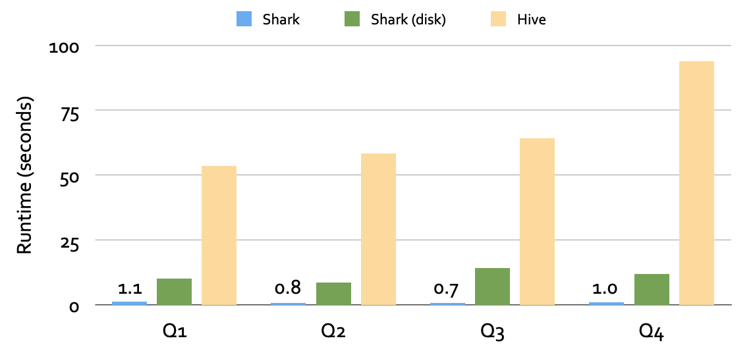
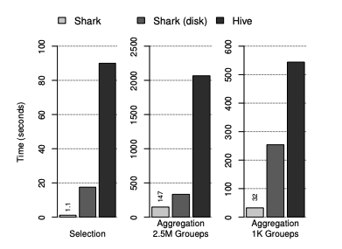
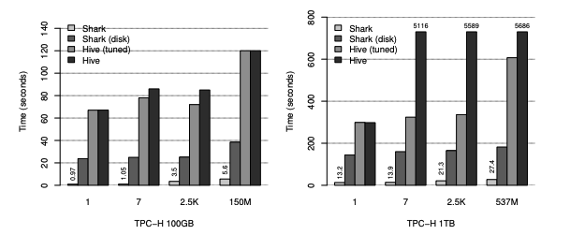
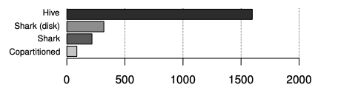
Benchmarks
Conviva Warehouse Queries (1.7 TB)
Selection and aggregation query runtimes
Pavlo et al. Benchmarks
Join query runtime (seconds) from Pavlo benchmark
Experiment with 100GB and 1TB Data

Slide 34
Shark was short-lived (2011-2014)
Limitations of SHARK
Data Querying:
Limited to querying external data stored solely within the Hive MetaStore.
Unable to execute SQL queries on data processed natively within Spark applications (e.g., in-memory RDD transformations).
Inconvenient Invocation:
Required invocation from Spark programs via SQL string.
Increasing error potential compared to a rich programmatic API.
Hive optimizer for MapReduce:
Shark inherited its logical query optimizer from Hive.
This optimizer was originally designed for the MapReduce execution model, making it inflexible and difficult to extend with new performance-enhancing features
As a result, the development of Shark was stopped in 2014, with the developers pivoting their efforts toward Spark SQL.

Slide 35

SQL
is about more than SQL.

Slide 36
Spark SQL (2014)
Part of the core distribution since Spark 1.0
Runs SQL / HiveQL queries, optionally alongside or replacing existing Hive deployments
S
Spark Core
Spark SQL
Spark Streaming
MLlib
GraphX

Slide 37

Improvement upon Existing Art
The spark engine does not understand the structure of the data in RDD
Limited optimization
Can only be used to query external data in Hive MetaStore
Limited Data Source
Can only be invoked via SQL string from Spark
Hive optimizer tailored for MapReduce

Slide 38
Challenges with Spark’s Functional API
Hidden Semantics and Arbitrary Code Blocks
The core Spark API, based on Resilient Distributed Datasets (RDDs) as low-level abstraction.
Requires developers to define transformations and actions (e.g., map, filter, reduce).
The RDD API allows developers to pass arbitrary functions to transformations like map or filter. (e.g., lambdas or functions).
These functions are treated as black boxes by the Spark engine
The engine cannot inspect or optimize the logic inside them
Limited engine visibility into operation semantics due to general-purpose code.
Restricts Spark optimizer (Catalyst) from creating efficient execution plans.

Slide 39
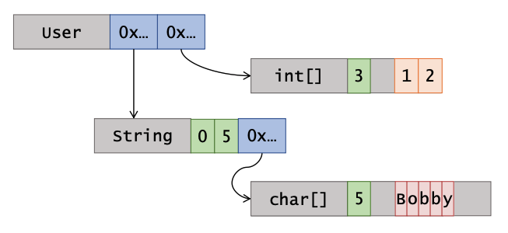
Challenges with Spark: Data Representation
Data stored is arbitrary Java/Python objects
Java/Python objects often many times larger than data
class User: def __init__(self, name: str, friends: list[int]): self.name = name
self.friends = friends
user = User("Bobby", [1, 2])

Slide 40
RDD vs DataFrames
Functional transformation on Spark RDDs uses pure, immutable functions like map or filter to generate new datasets from opaque objects, ensuring efficient, fault-tolerant processing with immutability and laziness.
Spark + RDD:
Data within RDDs can be unstructured or semi-structured, with no predefined schema.
Enable functional transformations (e.g., map, filter, reduce) on partitioned collections of Opaque Objects.
SQL + DataFrames (SchemaRDDs)
Declarative transformations on Partitioned Collections of Tuples
User
User
User
User
Spark doesn't inherently know the internal details (e.g., fields or types) of these objects
User
Name
Age
Height
declarative transformation lets you specify what you want (e.g., a filtered result) using SQL or DataFrame APIs on structured tuples, with Spark's optimizer handling the how.
Name
Age
Height
Name
Age
Height
Name
Age
Height
Name
Age
Height

Slide 41
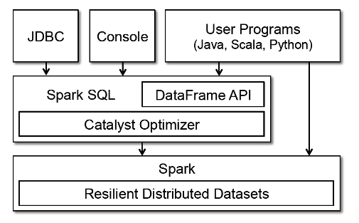
SparkSQL Architecture
Spark SQL was introduced as a module in Apache Spark to provide a SQL-like interface for querying structured and semi-structured data.
It is built directly on top of Spark’s core engine, leveraging Spark’s distributed computing capabilities (RDDs under the hood) to process data at scale.
Added Two features:
DataFrames:
Spark SQL introduced the DataFrame API, which allows developers to perform relational operations
Extensible Optimizer (Catalyst): Spark SQL includes the Catalyst optimizer, a query optimization framework that transforms logical query plans into efficient physical execution plans.

Slide 42

DataFrame
A DataFrame is a Dataset organized into named columns.
It is conceptually equivalent to a table in a relational database or a data frame in Python, but with richer optimizations under the hood.
Data frame can be constructed from a wide array of sources such as:
structured data files, tables in Hive, external databases, or existing RDDs.
The DataFrame API is available in many programming languages (e.g., Python, Scala, Java and R).
In the Python API, DataFrame is simply a type alias of Dataset[Row], users can use Dataset<Row> to represent a DataFrame.
Spark DataFrames are Lazy:
Each DataFrame object represents a logical plan to compute a dataset.
But no execution occurs until the user call a special “output operation”
E.g. count(), save(), show(), etc.

Slide 43
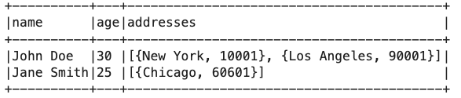
Data Model for DataFrame
Spark DataFrame support Nested Data Model.
spark = SparkSession.builder.appName("Nested DataFrame").getOrCreate()
# Define schema with nested structure
schema = StructType([
StructField("name", StringType(), True),
StructField("age", IntegerType(), True),
StructField("addresses", ArrayType(StructType([
StructField("city", StringType(), True),
StructField("zip", StringType(), True)
])), True)
])
# Create DataFrame
data = [
("John Doe", 30, [{"city": "New York", "zip": "10001"}, {"city": "Los Angeles", "zip": "90001"}]),
("Jane Smith", 25, [{"city": "Chicago", "zip": "60601"}])
]
df = spark.createDataFrame(data, schema)
# Show DataFrame
df.show(truncate=False)

Slide 44
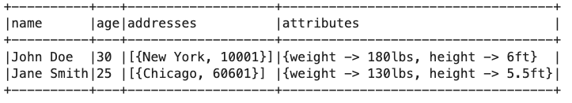
Data Model for DataFrame
Spark DataFrame Supports:
primitive SQL types: boolean, integer, double, decimal, string, data, timestamp
Complex types: structs, arrays, maps, and unions
User defined types
Full integration of complex data types:
data = [
("John Doe", 30, [{"city": "New York", "zip": "10001"}], {"height": "6ft", "weight": "180lbs"}),
("Jane Smith", 25, [{"city": "Chicago", "zip": "60601"}], {"height": "5.5ft", "weight": "130lbs"})
]
schema = StructType([
StructField("name", StringType(), True),
StructField("age", IntegerType(), True),
StructField("addresses", ArrayType(StructType([
StructField("city", StringType(), True),
StructField("zip", StringType(), True)
])), True),
StructField("attributes", MapType(StringType(), StringType()), True)
])

Slide 45
RDD vs DataFrame
In RDD
In SparkSQL
Python/Java/Scala
Transformation (e.g. map or filter)
DataFrame API or SQL queries
Logical Plan
Catalyst Optimizer
JVM backend
Physical Execution

Slide 46
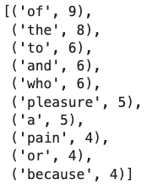
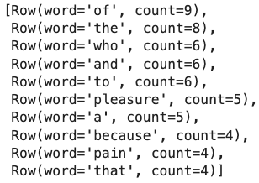
RDD vs DataFrame
Text Data:
But I must explain to you how all this mistaken idea of denouncing pleasure and praising pain was born and I will give you a complete account of the system, and expound the actual teachings of the great explorer of the truth, the master-builder of human happiness. No one rejects, dislikes, or avoids pleasure itself, …
spark = SparkSession.builder.appName(‘DataFrame-Demo’).getOrCreate()
sc = spark.sparkContext
rdd = sc.textFile(”/tmp/data.txt”)
result_rdd = rdd.flatMap(lambda line: line.split(“ ”)) \
.map(lambda word: (word, 1)) \
.reduceByKey(lambda a, b: a+b)\
.sortBy(lambda x: x[1], ascending=False)
result_rdd.take(10)
from pyspark.sql.functions import desc
df = spark.read.text(“/tmp/data.txt”)
result_df = df.selectExpr(“explode(split(value, ‘ ’)) as word”) \
.groupby(“word”).count().orderBy(desc(“count”))
result_df.take(10)
DataFrame is user-friendly and optimized approach for structured data in Apache Spark !

Slide 47
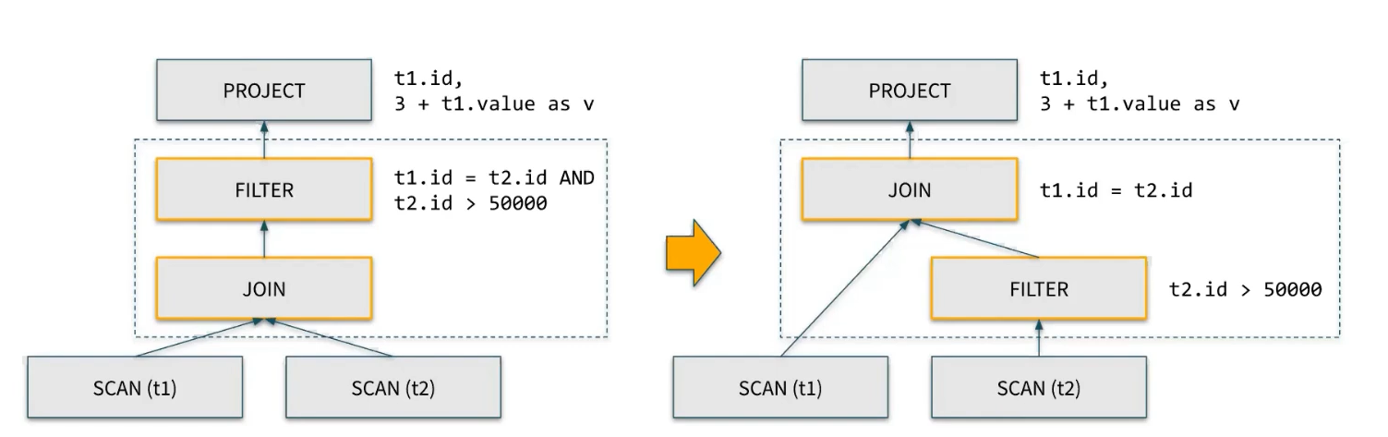
Advantage of DataFrame over RDDs
Optimization Execution
Schema information enables query optimization and predicate pushdowns.
Faster and more efficient data processing
SELECT sum(v)
FROM (
SELECT t1.id, 1+2+t1.value as v
FROM t1 JOIN t2
WHERE t1.id = t2.id AND t2.id > 50000) tmp

Slide 48
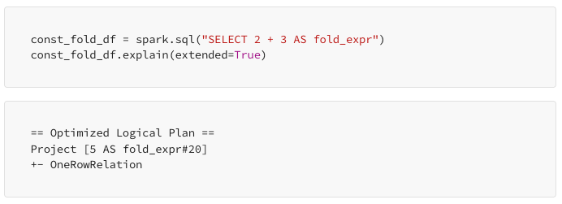
Advantage of DataFrame over RDDs
Built-in Optimization:
Leverage Spark’s Catalyst optimizer for advance optimizations
Predictive pushdowns, constant folding, loop unrolling.
compiler optimization that evaluates constant expressions at compile time instead of runtime.
Transforms a loop that iterates over a dataset (e.g., rows or columns) into a sequence of explicit operations, reducing the overhead of loop control structures like condition checks and increments
for (int i = 0; i < numRows; i++) {
if (data[i].age > 30) { output.append(data[i].name);
}
}
if (data[0].age > 30) output.append(data[0].name);
if (data[1].age > 30) output.append(data[1].name);
if (data[2].age > 30) output.append(data[2].name);
if (data[3].age > 30) output.append(data[3].name);

Slide 49
Advantage of DataFrame over RDDs
Compact binary representation:
Columnar, compressed storage for disk-based data; compact, row-based in-memory caching
Optimization across operators (join reordering, predicate pushdown, etc)
Runtime code generation
Ease of use:
High-level, SQL-like interface for data interaction
Simplified compared to complex RDD transformations.
Integrated with the rest of Spark
Integration with Spark’s ecosystem (Spark SQL, MLlib, GraphX)
ML library takes DataFrames as input/output
Easily convert RDDs ↔ DataFrames
Interoperability:
Easily convert to/from other data formats (e.g. Pandas DataFrames, CSV, JSON, Parquet)
Rearranges the order of join operations in a query to improve performance

Slide 50
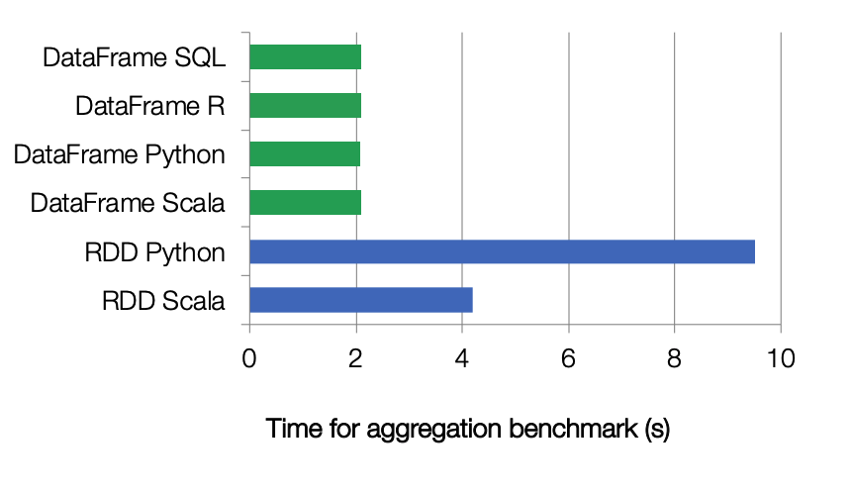
Performance

Slide 51
DataFrame operations with examples
SQL

Slide 52
DataFrame Operations
Allow to perform relational operations on DataFrame using a Domain Specify Language (DSL) similar to R data frames and Python Pandas.
Support all common relational operators
Projection: (select)
Filter (where)
Join
Aggregation (groupBy)
These operators take expression objects
For example:
Operators build up an abstract syntax tree (AST), which is then optimized by Catalyst
Expressions describe operations without executing them
employees.join(dept, employees.deptId == dept.id) # Join condition .where(employees.gender == "female") # Filter condition .groupBy(dept.id, dept.name) # Group by .agg(count("name").alias("employee_count"))
employees is a DataFrame
employees.deptId is the expression represent the deptId column

Slide 53
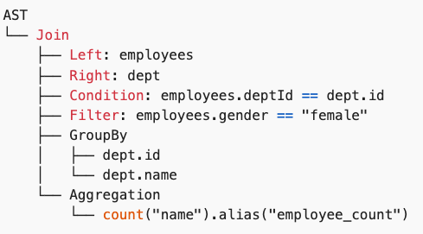
DataFrame Operations
Operators build up an abstract syntax tree (AST), which is then optimized by Catalyst
This structure helps Spark understand the operations to perform, their order, and how to optimize the execution plan for the query.
employees.join(dept, employees.deptId == dept.id) # Join condition .where(employees.gender == "female") # Filter condition .groupBy(dept.id, dept.name) # Group by .agg(count("name").alias("employee_count"))

Slide 54
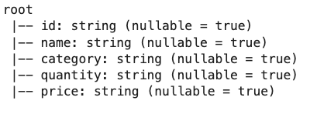
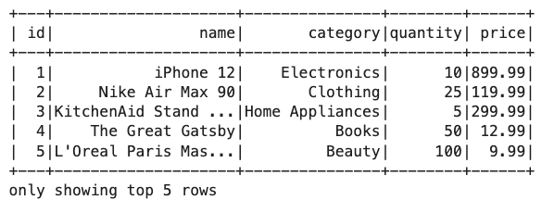
DataFrame Creation
id,name,category,quantity,price
1,iPhone,Electronics,10,899.99
2,Macbook,Electronics,5,1299.99
3,iPad,Electronics,15,499.99
…
We can create DataFrame by reading a .csv file
from pyspark.sql import SparkSession
spark = SparkSession.builder.appName("Create-DataFrame").getOrCreate()
csv_file_path = "./data/products.csv"
df = spark.read.csv(csv_file_path, header=True)
# Display schema of DataFrame
df.printSchema()
# Display content of DataFrame
df.show(5)
In DataFrame, data are stored in column. We can view the columns using .columns
# Display columns
df.columns

Slide 55
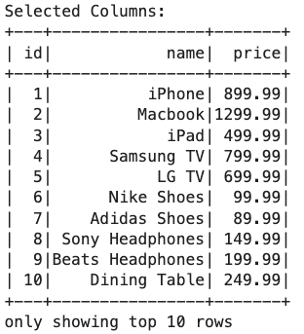
DataFrame Operations
Selecting columns: to choose specific columns
# Select specific columns
selected_columns = df.select("id", "name", "price")
print("Selected Columns:")
selected_columns.show(10)

Slide 56
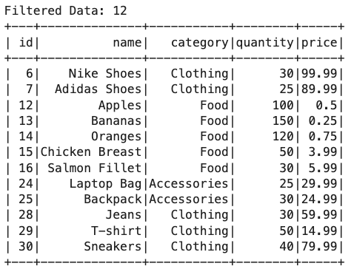
DataFrame Operations
Apply conditions to filter rows
# Filter rows based on a condition
filtered_data = df.filter(df.quantity > 20)
print("Filtered Data:", filtered_data.count())
filtered_data.show()

Slide 57
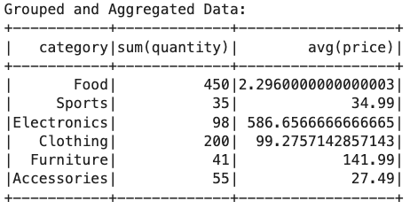
DataFrame Operations
PySpark provides many built-in standard Aggregate functions (e.g., sum, mean).
Aggregate functions operate on a group of rows and calculate a single return value for every group. For example, max, min, sum, mean.
# GroupBy and Aggregations
grouped_data = df.groupBy("category").agg({"quantity": "sum", "price": "avg"})
print("Grouped and Aggregated Data:")
grouped_data.show()

Slide 58
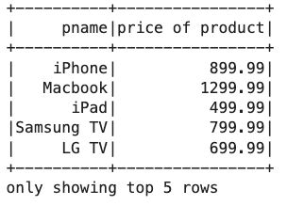
DataFrame Creation
We can create a new DataFrame from existing DataFrame using toDF() and display the results using show()
df.select('name', 'price').toDF('pname', 'price of product').show(5)

Slide 59
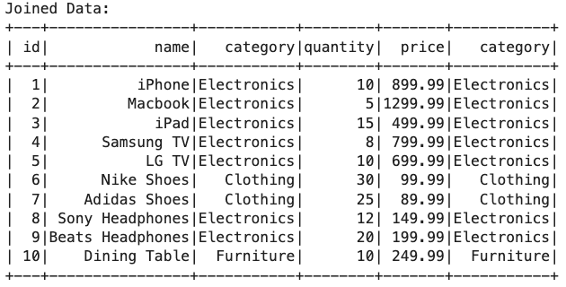
DataFrame Operations
Join: Combine multiple DataFrames based on specified columns.¶
# Join with another DataFrame
df2 = df.select("id", "category").limit(10)
joined_data = df.join(df2, "id", "inner")
print("Joined Data:")
joined_data.show()

Slide 60
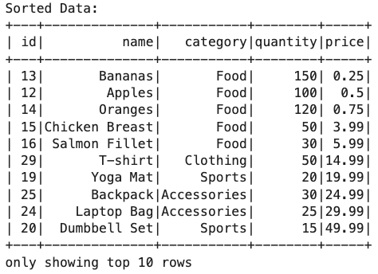
DataFrame Operations
Sort: Arrange rows based on one or more columns.
# Sort by a column
sorted_data = df.orderBy("price")
print("Sorted Data:")
sorted_data.show(10)

Slide 61
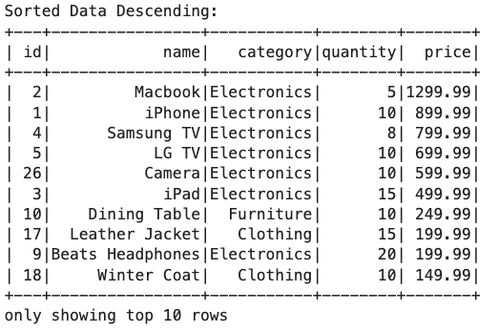
DataFrame Operations
Sort: Arrange rows based on one or more columns.
# Sort by a column desc
from pyspark.sql.functions import col, desc
sorted_data = df.orderBy(col("price").desc(), col("id").desc())
print("Sorted Data Descending:")
sorted_data.show(10)

Slide 62
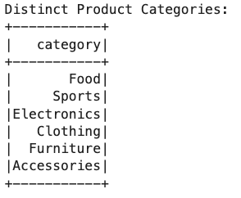
DataFrame Operations
Distinct: Get unique rows.
# Get distinct product category
distinct_rows = df.select("category").distinct()
print("Distinct Product Categories:")
distinct_rows.show()

Slide 63
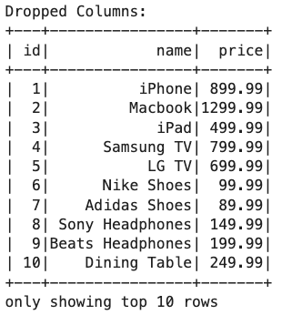
DataFrame Operations
Drop: Remove specified columns.
# Drop columns
dropped_columns = df.drop("quantity", "category")
print("Dropped Columns:")
dropped_columns.show(10)

Slide 64
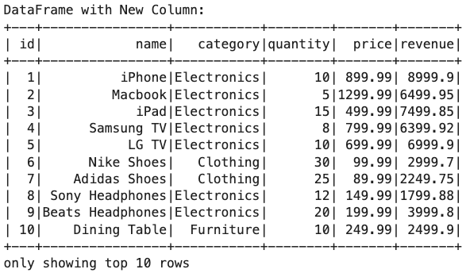
DataFrame Operations
WithColumn: Add new calculated columns.
# Add a new calculated column
df_with_new_column = df.withColumn("revenue", df.quantity * df.price)
print("DataFrame with New Column:")
df_with_new_column.show(10)

Slide 65
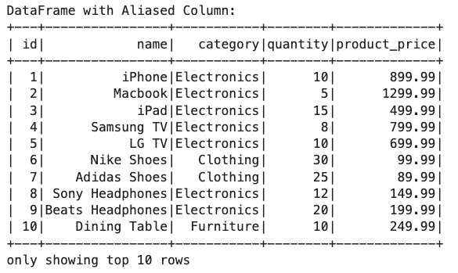
DataFrame Operations
Alias: Rename columns for better readability.
# Rename columns using alias
df_with_alias = df.withColumnRenamed("price", "product_price")
print("DataFrame with Aliased Column:")
df_with_alias.show(10)

Slide 66
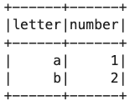
DataFrame Creation
We can also create DataFrame from Python object (e.g., list)
my_list = [['a', 1], ['b', 2]]
df = spark.createDataFrame(my_list, ['letter', 'number'])
df.show()

Slide 67
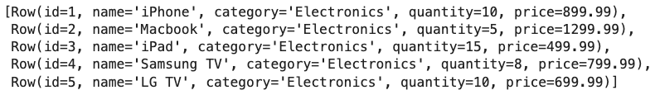
DataFrame to RDD
To execute data processing in a distributed manner, it is necessary to convert the DataFrame into an RDD.
This can be done by calling the pyspark.sql.DataFrame.rdd()
Each element in the returned RDD is an pyspark.sql.Row object.
An Row is a list of key-value pairs.
data_file_path = "./data/stocks.txt"
df = spark.read.csv(data_file_path, header=True, inferSchema=True)
df_rdds = df.rdd
df_rdds.take(5)

Slide 68
RDD Examples: map() and mapValue()
With an RDD object, we can apply a set of mapping functions, such as map()and mapValue()
map()applies a function to each elements of the RDD.
Each element has to be a valid input to the function.
The returned RDD has the function outputs as its new elements
The mapValues()function requires that each element in the RDD has a key/value pair structure.
For example, a tuple of 2 items, or a list of 2 items.
The mapValues() applies a function to each of the element values. The element key will remain unchanged

Slide 69
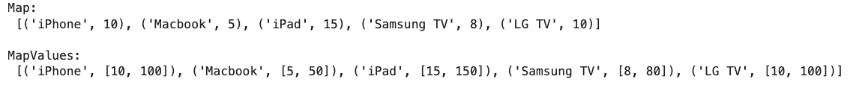
RDD Examples: map() and mapValue()
# retrieve the 'name' and 'quantity' columns from df
df_rdds_map = df_rdds.map(lambda x: (x['name'], x['quantity']))
print('Map: \n', df_rdds_map.take(5), '\n')
# multiply each value in 'quantity' by 10
df_rdds_mapvalues = df_rdds_map.mapValues(lambda x: [x, x*10])
print(‘MapValues: \n', df_rdds_mapvalues.take(5), '\n')

Slide 70
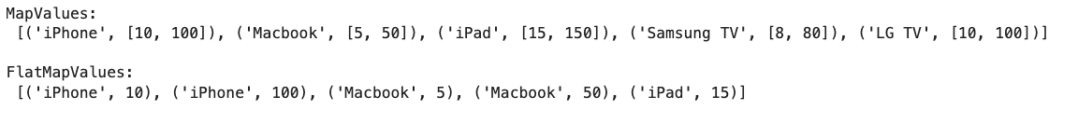
flatMapValues()
Sometimes we want to flatten multiple output elements for each input elements. The operation to do this is called flatMapValues()
map()will not flatten the results. Hence, there will have multiple output.
In contrast, flatMap()flatten the output, so there always have 1 output.
# multiply each value in 'quantity' by 10
df_rdds_mapvalues = df_rdds_map.mapValues(lambda x: [x, x*10])
print('MapValues: \n', df_rdds_mapvalues.take(5), '\n')
df_rdds_mapvalues = df_rdds_map.flatMapValues(lambda x: [x, x*10])
print('FlatMapValues: \n', df_rdds_mapvalues.take(5), '\n')

Slide 71
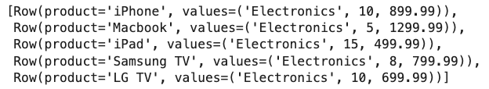
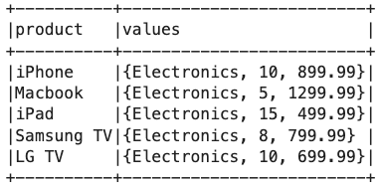
Merge Columns
Sometimes we need to merge multiple columns in a Dataframe into one column, or split a column into multiple columns
We can easily achieve this by converting a DataFrame to RDD, applying map() functions to manipulate elements, and then converting the RDD back to a DataFrame
from pyspark.sql import Row
df_rdds_map = df_rdds.map(lambda x: Row(product=x[1], values=x[2:]))
df_rdds_map.take(5)
df2 = spark.createDataFrame(df_rdds_map)
df2.show(5, truncate=False)

Slide 72
Extend RDD with Relational Operations
SQL

Slide 73
Spark SQL
Spark SQL
Allow to construct DataFrames directly from an RDD that contains data in the form of objects defined in your programming language (like Python, Scala, or Java).
Spark SQL can automatically infer the schema of these objects
In Python, Spark SQL samples the dataset to perform schema inference due to the dynamic type system.
Enable querying of structured and semi-structured data using SQL commands
DataFrames can be registered as temporary tables in the system catalog and queried using SQL.
Extend Spark’s capabilities to handle structured data effectively.
Supports inline definition of UDFs, without the complicated packaging and registration process found

Slide 74
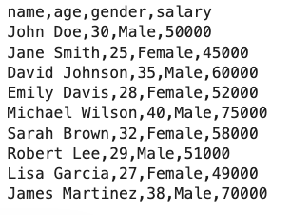
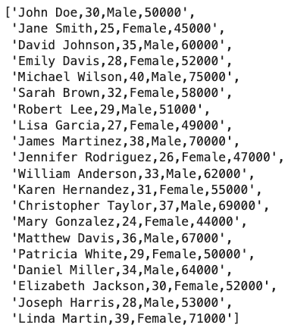
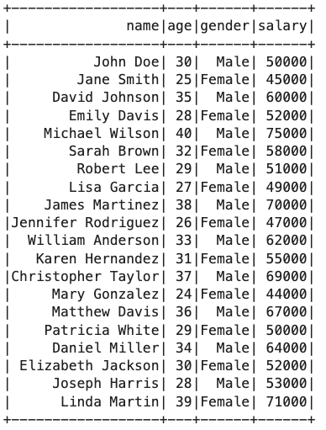
DataFrame Creation from Text File
A text file filled with user’s names, ages, gender, and salary:
lines = spark.sparkContext.textFile("/tmp/persons.txt").zipWithIndex()
lines_without_first_row = lines.filter(lambda x: x[1] > 0).map(lambda x: x[0])
lines_without_first_row.collect()
from pyspark.sql import Row
parts = lines_without_first_row.map(lambda x: x.split(','))
parts.collect()
people = parts.map(lambda x: Row(name=x[0], age=int(x[1]), \
gender=x[2], salary=int(x[3]))).toDF()
people.show()

Slide 75
Temporary tables
DataFrames can be registered as temporary tables in the system catalog and queried using SQL.
Example:
SQL sometimes convenient for computing multiple aggregates concisely.
The DataFrames registered in the catalog are still unmaterialized (non-cached) view, so that optimizations can happen across SQL and the original DataFrame expressions.
people.createOrReplaceTempView('user’)

Slide 76
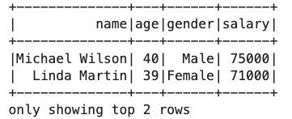
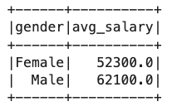
Perform SQL-like Queries
spark.sql('select * from user order by age DESC').show(n=2)
avg_salary_by_gender = spark.sql("SELECT gender, AVG(salary) as avg_salary FROM user GROUP BY gender")
avg_salary_by_gender.show()

Slide 77
Creating and managing temporary view
To work with DataFrames using SQL-like syntax
Use createOrReplaceTempView method to register the DataFrame
Once a temporary view is created, we can query it using SQL-like syntax with the spark.sql method.
We can also check if a temporary view exists using ‘spark.catalog.tableExists’ method
We can drop a temporary view/table.
people.createOrReplaceTempView(”user")
result = spark.sql("SELECT * FROM user WHERE age > 25")
result.show()
view_exists = spark.catalog.tableExists(”user")
view_exists
spark.catalog.dropTempView(”user")

Slide 78
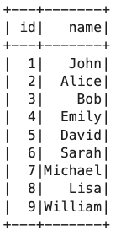
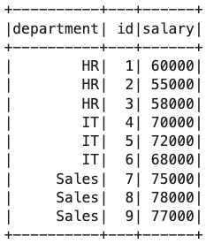
Sub-queries
employee_data = [
(1, "John"), (2, "Alice"), (3, "Bob"), (4, "Emily"),
(5, "David"), (6, "Sarah"), (7, "Michael"), (8, "Lisa"),
(9, "William")
]
employees = spark.createDataFrame(employee_data, ["id", "name"])
salary_data = [
("HR", 1, 60000), ("HR", 2, 55000), ("HR", 3, 58000),
("IT", 4, 70000), ("IT", 5, 72000), ("IT", 6, 68000),
("Sales", 7, 75000), ("Sales", 8, 78000), ("Sales", 9, 77000)
]
salaries = spark.createDataFrame(salary_data, ["department", "id", "salary"])
employees.show()
salaries.show()

Slide 79
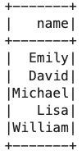
Sub-queries
employee.createOrReplaceTempView("employees")
salaries.createOrReplaceTempView(”salaries")
# Subquery to find employees with salaries above average
result = spark.sql("""
SELECT name
FROM employees
WHERE id IN (
SELECT id
FROM salaries
WHERE salary > (SELECT AVG(salary) FROM salaries)
)
""")
result.show()

Slide 80


Window Functions
employee_salary = spark.sql("""
select salaries.*, employees.name
from salaries
left join employees on salaries.id = employees.id
""")
employee_salary.show()
window_spec = Window.partitionBy("department").orderBy(F.desc("salary"))
employee_salary.withColumn("rank", F.rank().over(window_spec)).show()

Slide 81

User-Defined Functions (UDFs)
Easy extension of limited operations supported.
Allows inline registration of UDFs
Can be defined on simple data types or entire tables.
UDFs available to other interfaces after registration
from pyspark.sql.functions import udf
from pyspark.sql.types import IntegerType
def round_float_down(x):
return int(x)
round_float_down_udf = udf(round_float_down, IntegerType())
df.select(round_float_down_udf('price')).show()

Slide 82


Parquet Compatibility
Native support for reading data in Parquet
Columnar storage avoids reading unneeded data
RDDs can be written to Parquet files, preserving the schema
Convert other slower formats into Parquet for repeated querying
df.write.parquet('./parquet_output')
df2 = spark.read.parquet('./parquet_output')

Slide 83


Read CSV with an explicit schema definition
from pyspark.sql.types import StructType, StructField, StringType, IntegerType, DoubleType
schema = StructType([
StructField(name="id", dataType=IntegerType(), nullable=True),
StructField(name="name", dataType=StringType(), nullable=True),
StructField(name="category", dataType=StringType(), nullable=True),
StructField(name="quantity", dataType=IntegerType(), nullable=True),
StructField(name="price", dataType=DoubleType(), nullable=True)
])
csv_file_path = "./data/products.csv"
df = spark.read.csv(csv_file_path, header=True, schema=schema)
# Display schema of DataFrame
df.printSchema()
# Display content of DataFrame
df.show(5)

Slide 84
Read CSV with inferSchema
csv_file_path = "./data/products.csv"
df = spark.read.csv(csv_file_path, header=True, inferSchema=True)
# Display schema of DataFrame
df.printSchema()
# Display content of DataFrame
df.show(5)

Slide 85



Read JSON file (Single Line)
head -10 data/products_singleline.json
# Each row is a JSON record, records are separated by new line
json_file_path = "./data/products_singleline.json"
df = spark.read.json(json_file_path)
# Display schema of DataFrame
df.printSchema()
# Display content of DataFrame
df.show(5)

Slide 86

Read JSON file (Multi Line)
head -10 data/products_singleline.json
# Each row is a JSON record, records are separated by new line
json_file_path = "./data/products_multiline.json"
df = spark.read.json(json_file_path, multiLine=True)
# Display schema of DataFrame
df.printSchema()
# Display content of DataFrame
df.show(5)

Slide 87

Any Questions?

