Slide 1

DSAI4205 Big Data Analytics
Lecture 7: Link Analysis
Dr. Ken FONG
Department of Data Science and Artificial Intelligence
chi-kit-ken.fong@polyu.edu.hk

Slide 2
Agenda
1. web as a graph
2. challenges of web search
3. page rank (The ”flow” formulation)
4. problems of PageRank
5. Solution: Teleports
6. how to compute PageRank efficiently

Slide 3

World Wide Web (WWW)
1989 Tim Berners-Lee invents the World Wide Web at the CERN research institute in Geneva, Switzerland.
Berners-Lee created its three fundamental components:
Markup language (HTML):
A system of instructions and formatting codes embedded in text.
HTTP system for linking sites:
A means for embedding links to documents, images, and other elements in text.
URL:
The address system, the address that contains information about the location of the webpage.

Slide 4
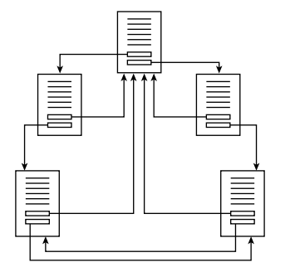
World Wide Web (WWW)
Links let the reader view the online information in small doses.
The reader can choose whether to link to another page for additional information.
HTML documents can be assembled into unified systems of pages and links.

Slide 5
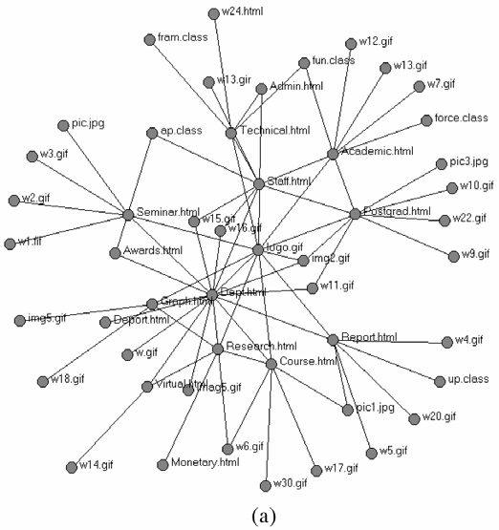
Web as a Graph
Nodes: Web pages
Edges: Hyperlinks

Slide 6
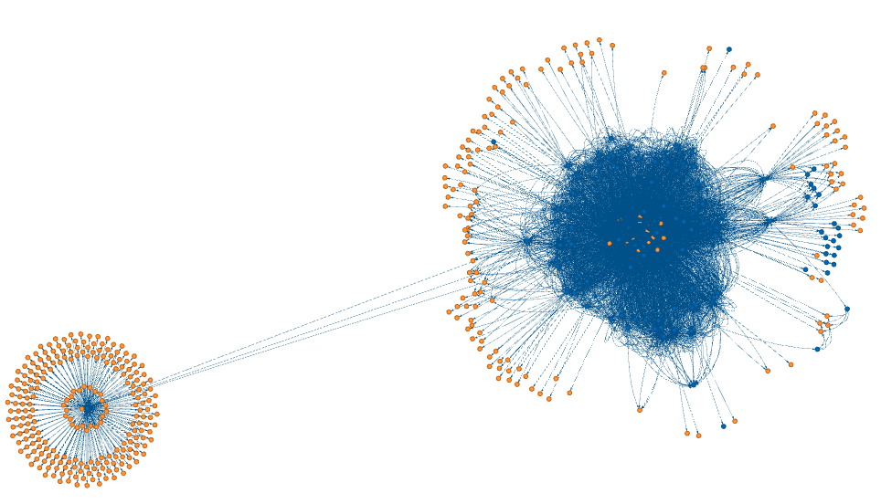
Web as a Graph
If we analyze our department webpage:
https://www.polyu.edu.hk/dsai/
> python3 site_graph.py https://www.polyu.edu.hk/dsai/
Visiting https://www.polyu.edu.hk/dsai/ from None Visiting https://www.polyu.edu.hk/dsai/Sitemap from https://www.polyu.edu.hk/dsai/ Visiting https://www.polyu.edu.hk/dsai/News-and-Events/News/2025/20250703-Welcome-Prof-Yang-Xingyi from https://www.polyu.edu.hk/dsai/ Visiting https://www.polyu.edu.hk/dsai/News-and-Events/News/2025/20250624-IEEE-Best-Paper-Award from https://www.polyu.edu.hk/dsai/News-and-Events/News/2025/20250703-Welcome-Prof-Yang-Xingyi …
You can try this: https://github.com/tomlinsonk/site-graph

Slide 7


Broad Questions
How to organize the web?
First try: Human curated web directories (1994)
Yahoo DMOZ, LookSmart, …
Second try: Web Search (late 1990s - early 2000s)
Information retrieval investigates:
Find relevant docs in a small and trusted set
E.g. Newspaper articles, Patents, etc.
But web is huge, full of untrusted documents, random things, web spam, etc.

Slide 8
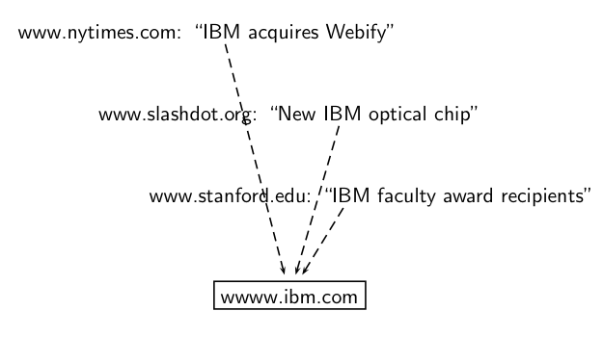
Challenges of Web Search
TWO challenges of web search:
(1) Web contains many source of information.
Who to “trust”?
(2) What is the ”best” answer to query ”IBM” ?
No single right answer.
Matches IBM’s copyright page
Matches many spam pages
Matches IBM Wikipedia article
May not match IBM home page!
… if IBM home page is mostly graphics

Slide 9
Example: Good/Bad/Unknown
The Good, The Bad and The Unknown
Good nodes won’t point to Bad nodes
All other combinations plausible
?
Good
?
?
Bad
?

Slide 10
Links are everywhere
Powerful sources of authenticity and authority
Host quality – which hosts are “Bad”?
The Good, The Bad and The Unknown
?
Good
?
?
Bad
?

Slide 11
Simple iterative logics
Good nodes won’t point to Bad nodes
If you point to a Bad node, you’re Bad
If a Good node points to you, you’re Good
?
Good
Good
Good
?
?
?
Bad
Bad
Bad
?
?

Slide 12
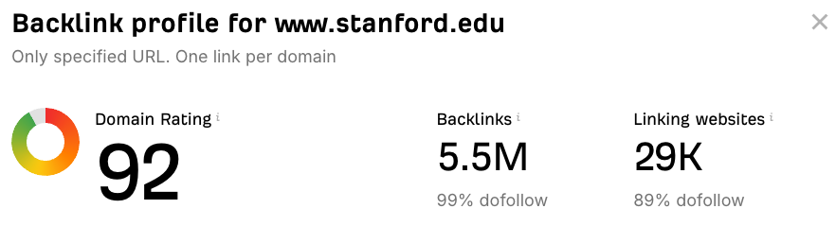
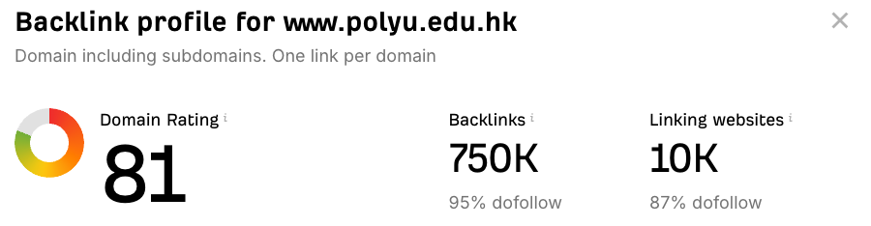
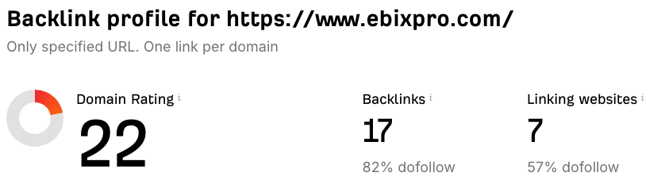
Links as Votes
Idea: Links as votes
Page is more important if it has more links
Should we consider in-coming links or out-going links?
Think of in-links as votes:

Slide 13
Links as Votes
Are all incoming links equal ?
Links from important pages count more
This is a recursive question.
My importance depends on my friends’ importance.
My friends’ importance depends on their friends’ importance.
…

Slide 14
Example: PageRank Score
B
38.4
C
34.3
A
3.3
D
3.9
E
8.1
F
3.9
1.6
1.6
1.6
1.6
1.6

Slide 15
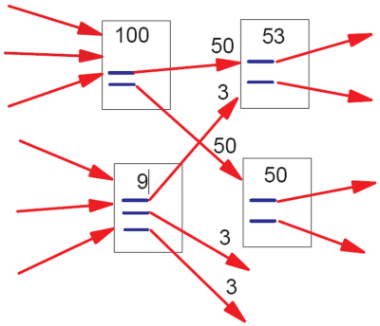
PageRank: The “Flow” Formulation

Slide 16





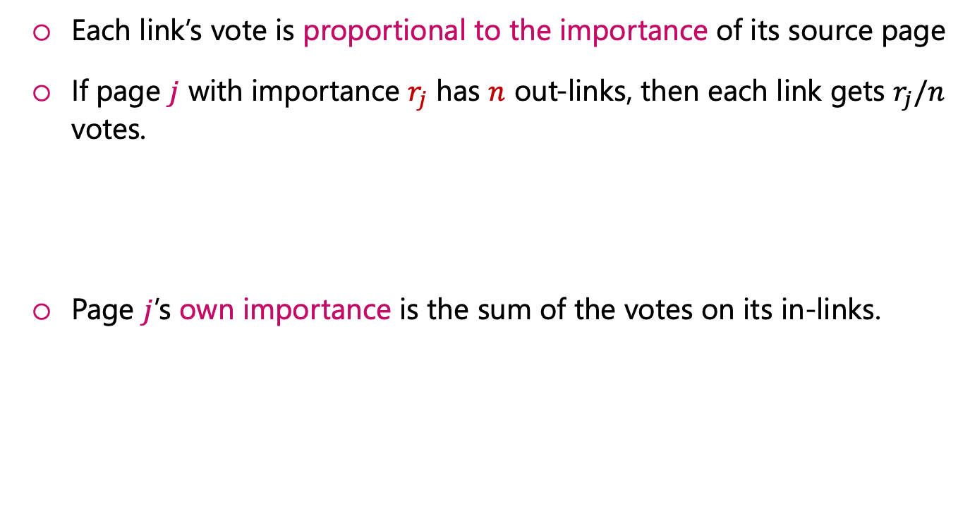






Simple Recursive Formulation
Each link’s vote is proportional to the importance of its source page
If page $j$ with importance $r_{j}$ has $n$ out-links, then each link gets $r_{j}/n$ votes.
Page $j$’s own importance is the sum of the votes on its in-links.
$$r_{j} ×\frac{1}{N}$$
$$r_{j}$$
$$r_{j} ×\frac{1}{N}$$
…
$$r_{j} ×\frac{1}{N}$$
$$r_{i}$$
$$r_{j} ×\frac{1}{N}$$
$$r_{j}$$
$$r_{j} ×\frac{1}{N}$$
…
$$r_{j} ×\frac{1}{N}$$
$$r_{k}$$
$$r_{j}=r_{i}/3 + r_{k}/4$$

Slide 17
Toy example
A
0.1
1/2
?
1/2
1/3
B
0.9
?
1/3
1/3
?
C

Slide 18
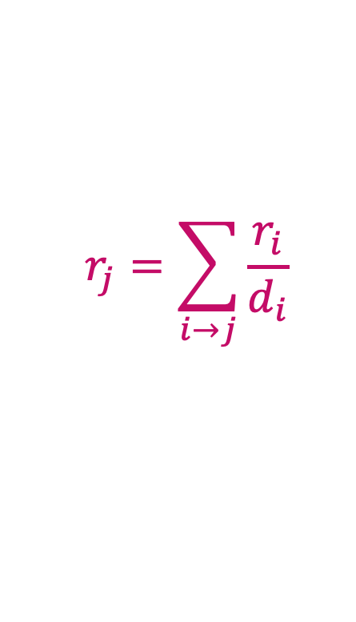



PageRank: The “Flow” Model
A ”vote” from an important page is worth more
A page is important if it is pointed by other important pages.
Define a “rank” $r_{j}$ for page $j$
$$r_{j}=\sum_{i→j}{\frac{r_{i}}{d_{i}}}$$
$d_{i}$: out degree of node $i$
Flow equations:
$$r_{a} = r_{m} + r_{y}/2$$
$$r_{y} = r_{a}/2 + r_{y}/2$$
$$r_{m} = r_{a}/2$$

Slide 19
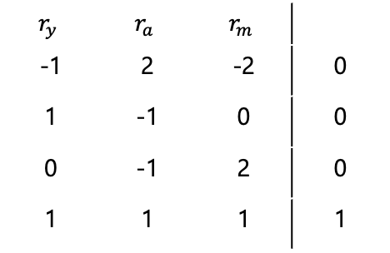
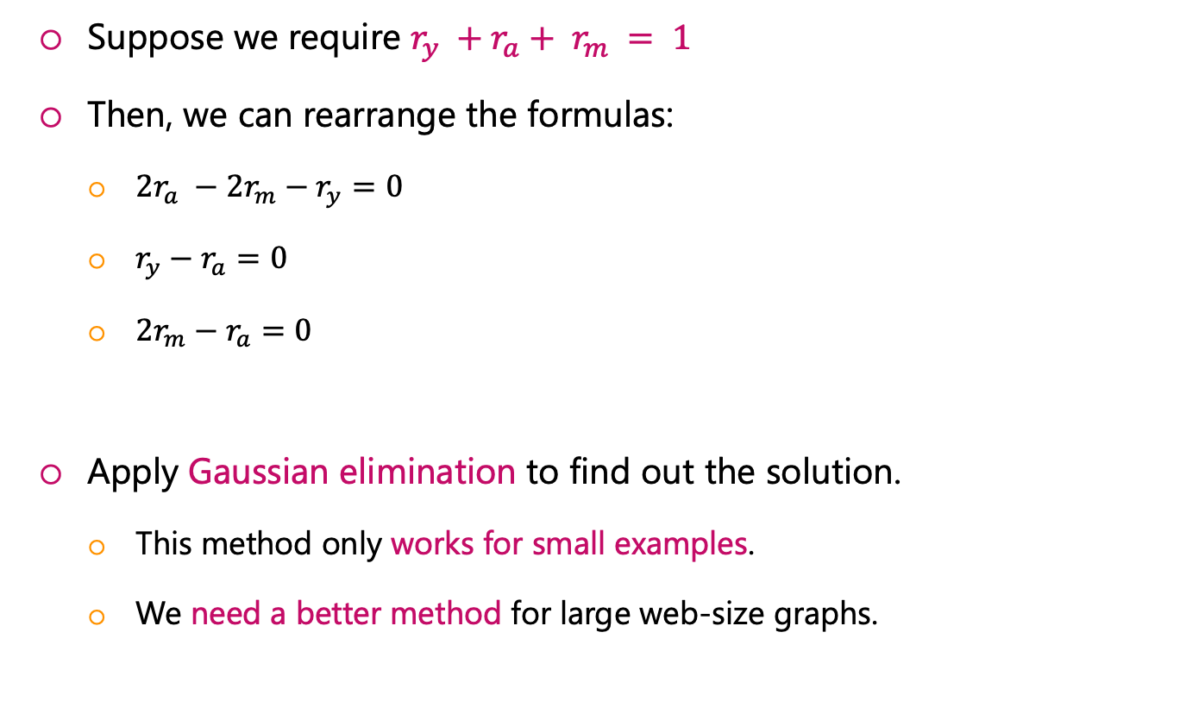
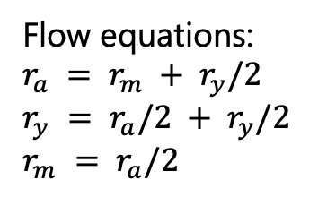
Solving the Flow Equations
Flow equations:
$$r_{a} = r_{m} + r_{y}/2$$
$$r_{y} = r_{a}/2 + r_{y}/2$$
$$r_{m} = r_{a}/2$$
Suppose we require $r_{y} +r_{a}+ r_{m} = 1$
Then, we can rearrange the formulas:
${2r}_{a} −{2r}_{m}−r_{y}=0$
$r_{y}−r_{a}=0$
${2r}_{m}−r_{a}=0$
Apply Gaussian elimination to find out the solution.
This method only works for small examples.
We need a better method for large web-size graphs.
$$r_{y}$$ | $$r_{a}$$ | $$r_{m}$$
-1 | 2 | -2 | 0
1 | -1 | 0 | 0
0 | -1 | 2 | 0
1 | 1 | 1 | 1

Slide 20
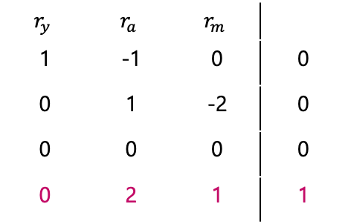

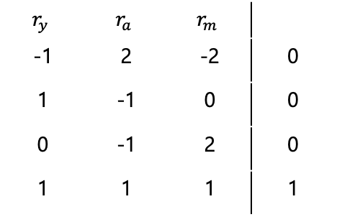

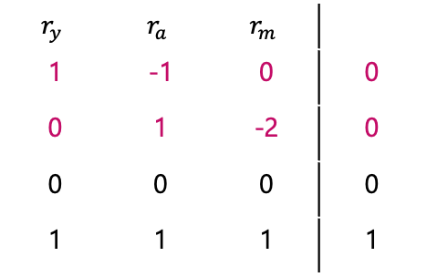
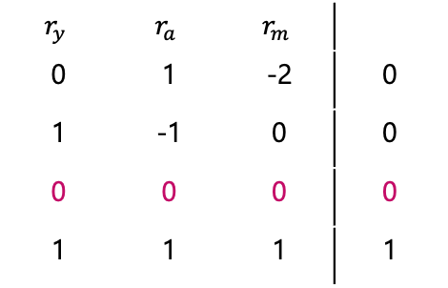


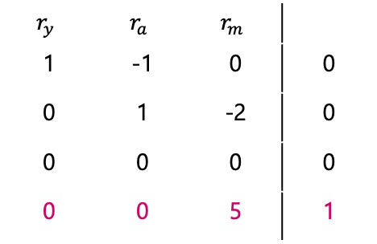
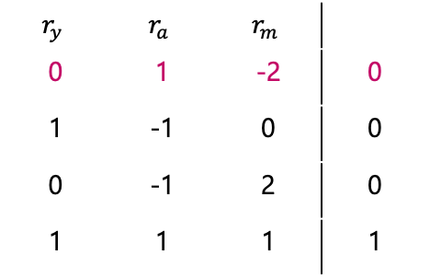

Solving the Flow Equations
Row 1 and Row 2
$$[−1,2,−2,0]+[1,−1,0,0]=[0,1,−2,0]$$
Row 1 and Row 3
$$[0,−1,2,0]+[0,1,−2,0]=[0,0,0,0]$$
$$r_{y}$$ | $$r_{a}$$ | $$r_{m}$$
-1 | 2 | -2 | 0
1 | -1 | 0 | 0
0 | -1 | 2 | 0
1 | 1 | 1 | 1
$$r_{y}$$ | $$r_{a}$$ | $$r_{m}$$
0 | 1 | -2 | 0
1 | -1 | 0 | 0
0 | -1 | 2 | 0
1 | 1 | 1 | 1
$$r_{y}$$ | $$r_{a}$$ | $$r_{m}$$
0 | 1 | -2 | 0
1 | -1 | 0 | 0
0 | 0 | 0 | 0
1 | 1 | 1 | 1
$$r_{y}$$ | $$r_{a}$$ | $$r_{m}$$
1 | -1 | 0 | 0
0 | 1 | -2 | 0
0 | 0 | 0 | 0
0 | 0 | 5 | 1
$$r_{y}$$ | $$r_{a}$$ | $$r_{m}$$
1 | -1 | 0 | 0
0 | 1 | -2 | 0
0 | 0 | 0 | 0
0 | 2 | 1 | 1
$$r_{y}$$ | $$r_{a}$$ | $$r_{m}$$
1 | -1 | 0 | 0
0 | 1 | -2 | 0
0 | 0 | 0 | 0
1 | 1 | 1 | 1
Row 2 and Row 4
$$\left[0,2,1,1\right]−2 ×\left[0,1,−2,0\right]=[0,0,5,1]$$
Row 1 and Row 4
$$[1,1,1,1]+[1,−1,0,0]=[0,2,1,1]$$
Swap Row 1 and Row 2
$$r_{m}=\frac{1}{5}, r_{a}=2r_{m}=\frac{2}{5}, r_{y}=r_{a}=\frac{2}{5}$$

Slide 21

PageRank: Matrix Formulation
Stochastic adjacency matrix 𝑴
Assume page $i$ has $d_{i}$ outgoing links
If $i → j$, then $M_{ji} = 1/d_{i}$.
Otherwise, $M_{ji}=0$.
M is a column stochastic matrix
Columns sum to 1.
y
a
m
Source
 | y | a | m
y | ½ | ½ | 0
a | ½ | 0 | 1
m | 0 | ½ | 0
Destination

Slide 22




Rank Vector
Rank vector $r$: vector with an entry per page
$r_{i}$ is the importance score of page $i$
$\sum_{i}{r_{i}}=1$
Recall the flow equation: $r_{j}=\sum_{i→j}{\frac{r_{i}}{d_{i}}}$
i
j
$$r_{j}$$
.
=
$$r_{i}$$
1/3
$$M$$
r
r

Slide 23
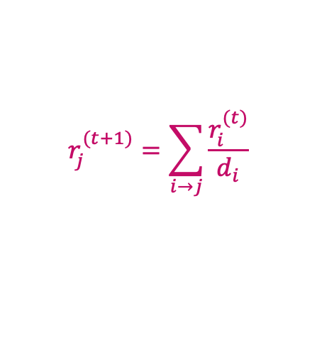
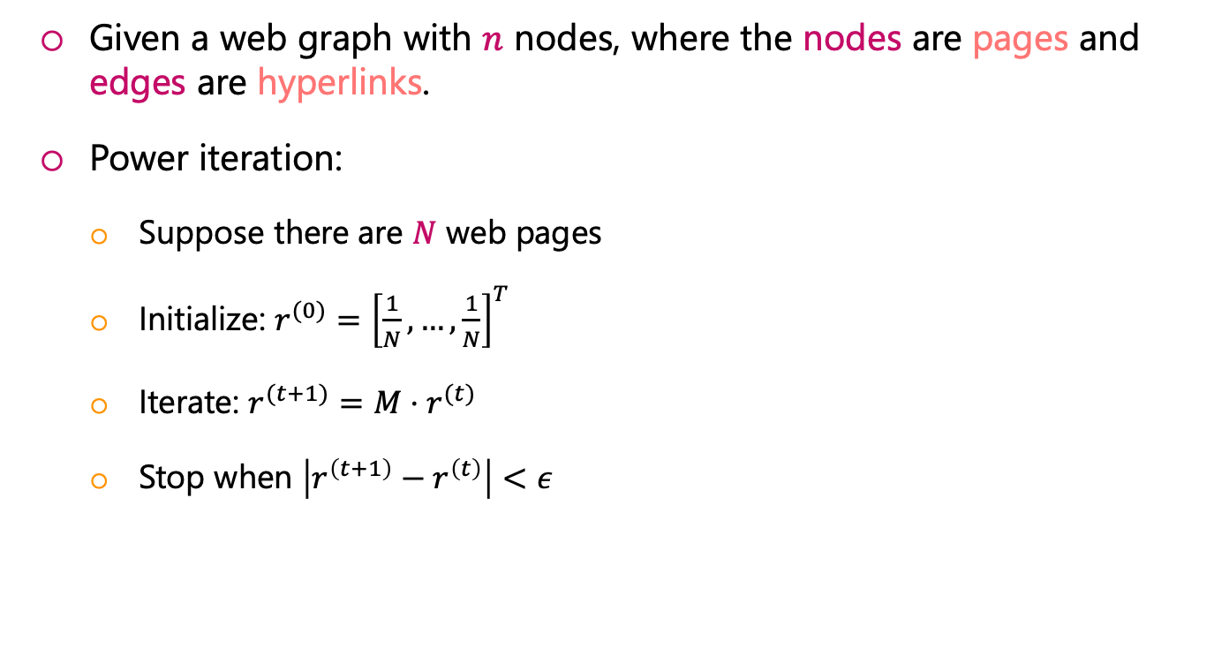
Power Iteration Method
Given a web graph with $n$ nodes, where the nodes are pages and edges are hyperlinks.
Power iteration:
Suppose there are $N$ web pages
Initialize: $r^{(0)}={\left[\frac{1}{N}, …,\frac{1}{N}\right]}^{T}$
Iterate: $r^{(t+1)}=M⋅r^{(t)}$
Stop when $\left|r^{\left(t+1\right)}−r^{\left(t\right)}\right|<ε$
$$r_{j}^{(t+1)}=\sum_{i→j}{\frac{r_{i}^{(t)}}{d_{i}}}$$

Slide 24
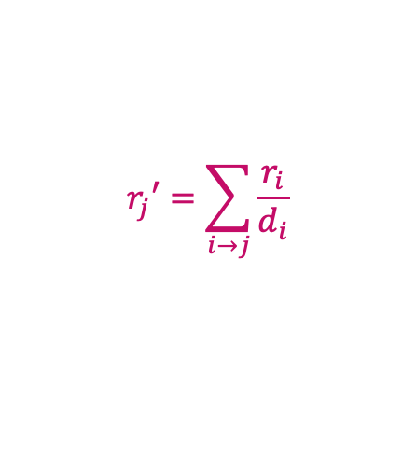


Solving by Power Iteration
Power Iteration:
Set
$Step 2: r=r′$
Goto Step 1
y
$$r_{j}′=\sum_{i→j}{\frac{r_{i}}{d_{i}}}$$
(for each page in the rank vector r)
a
m
 | y | a | m
y | ½ | ½ | 0
a | ½ | 0 | 1
m | 0 | ½ | 0
$$\left({\begin{aligned}r_{y} \\ r_{a}\end{aligned} \atop r_{m}}\right)=$$
1/3
1/3
1/3
1/3
3/6
1/6
5/12
1/3
3/12
9/24
11/24
1/6
 | 6/15
… | 6/15
 | 3/15

Slide 25
Power Iteration Algorithm
Initialize: r[0] = [1/N, ..., 1/N] r[-1] = [0, ..., 0] while (error_norm(r[t], r[t-1])>min_error): r[t+1] = M.r[t] t+=1 solution = r[t]

Slide 26
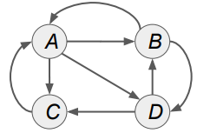
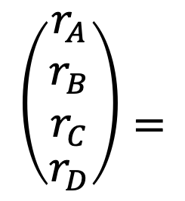
Another Example
 | A | B | C | D
A | 0 | 1/2 | 1 | 0
B | 1/3 | 0 | 0 | 1/2
C | 1/3 | 0 | 0 | 1/2
D | 1/3 | 1/2 | 0 | 0
$$\left({\begin{aligned}r_{A} \\ r_{B} \\ r_{C}\end{aligned} \atop r_{D}}\right)=$$
1/4
1/4
1/4
1/4
3/8
5/24
5/24
5/24
15/48
11/48
11/48
11/48
11/32
7/32
7/32
7/32
… | 171/512
… | 341/1536
… | 341/1536
… | 341/1536

Slide 27
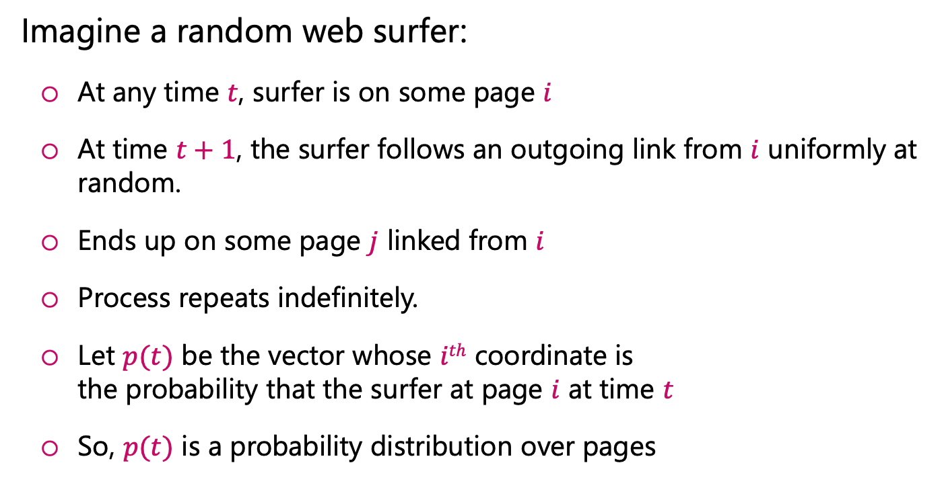
Random Walk Interpretation
Imagine a random web surfer:
At any time $t$, surfer is on some page $i$
At time $t+1$, the surfer follows an outgoing link from $i$ uniformly at random.
Ends up on some page $j$ linked from $i$
Process repeats indefinitely.
Let $p(t)$ be the vector whose $ith$ coordinate is the probability that the surfer at page $i$ at time $t$
So, $p(t)$ is a probability distribution over pages
i₁
i₂
i₃
j

Slide 28

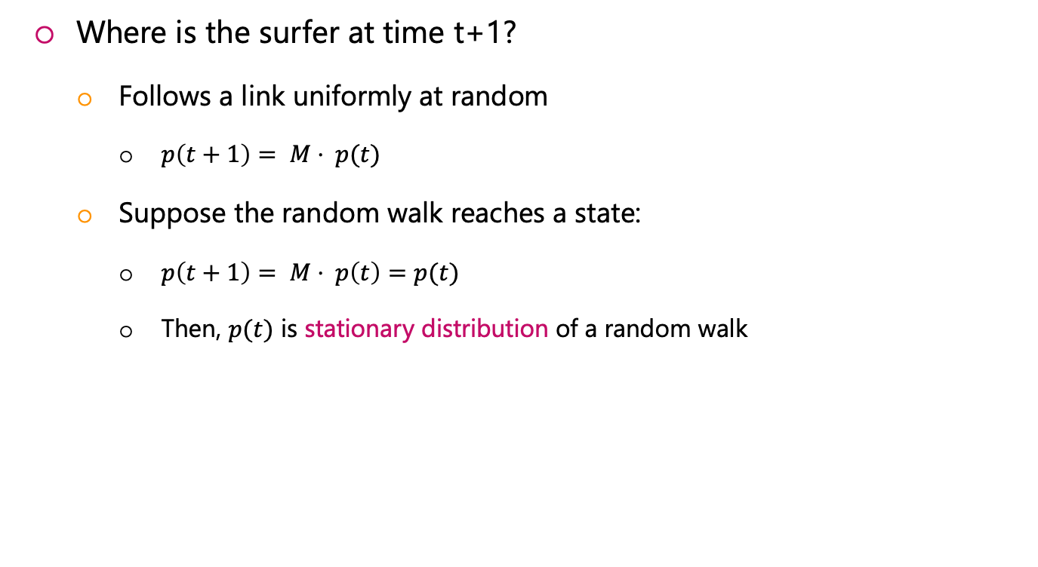
The Stationary Distribution
Where is the surfer at time t+1?
Follows a link uniformly at random
$p\left(t+1\right)= M⋅ p(t)$
Suppose the random walk reaches a state:
$p\left(t+1\right)= M⋅ p\left(t\right)=p(t)$
Then, $p(t)$ is stationary distribution of a random walk
i₁
i₂
i₃
j
$$p\left(t+1\right)= M⋅p(t)$$

Slide 29
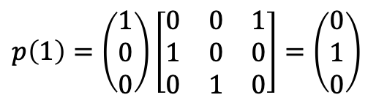
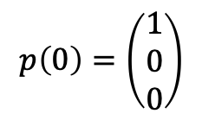
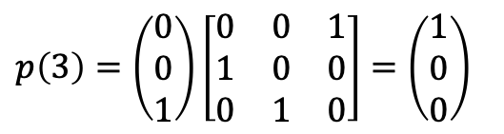
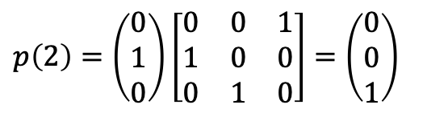
Simple Example
$$p\left(0\right)=\left(\begin{aligned}1 \\ 0 \\ 0\end{aligned}\right)$$
a
b
$p\left(1\right)=\left(\begin{aligned}1 \\ 0 \\ 0\end{aligned}\right)\left[\begin{matrix}0 & 0 & 1 \\ 1 & 0 & 0 \\ 0 & 1 & 0\end{matrix}\right]=$ $\left(\begin{aligned}0 \\ 1 \\ 0\end{aligned}\right)$
c
$p\left(2\right)=\left(\begin{aligned}0 \\ 1 \\ 0\end{aligned}\right)\left[\begin{matrix}0 & 0 & 1 \\ 1 & 0 & 0 \\ 0 & 1 & 0\end{matrix}\right]=$ $\left(\begin{aligned}0 \\ 0 \\ 1\end{aligned}\right)$
 | A | B | C
A | 0 | 0 | 1
B | 1 | 0 | 0
C | 0 | 1 | 0
$p\left(3\right)=\left(\begin{aligned}0 \\ 0 \\ 1\end{aligned}\right)\left[\begin{matrix}0 & 0 & 1 \\ 1 & 0 & 0 \\ 0 & 1 & 0\end{matrix}\right]=$ $\left(\begin{aligned}1 \\ 0 \\ 0\end{aligned}\right)$

Slide 30
Existence and Uniqueness
According to the theory of random walks (a.k.a. Markov processes):
For graphs that satisfy certain conditions, the stationary distribution is unique and eventually will be reached no matter what the initial probability distribution at time t = 0

Slide 31

PageRank: The Google Formulation

Slide 32

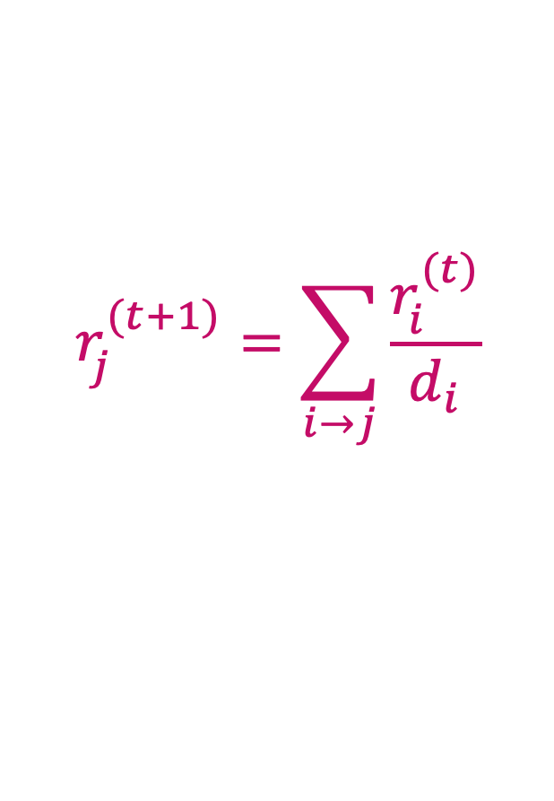
Questions of PageRank
$$r_{j}^{(t+1)}=\sum_{i→j}{\frac{r_{i}^{(t)}}{d_{i}}}$$
OR equivalently
$$r = M⋅ r$$
(1) Does this converge?
(2) Does it converge to what we want?
(3) Are results reasonable?

Slide 33


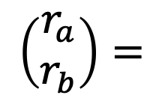
Does this converge?
$$a$$
$$b$$
 | A | B
A | 0 | 1
B | 1 | 0
$$\left(\begin{aligned}r_{a} \\ r_{b}\end{aligned}\right)=$$
1
0
0
1
1
0
0
1
…
…

Slide 34
Does it converge to what you want ?
$$a$$
$$b$$
 | A | B
A | 0 | 0
B | 1 | 0
$$\left(\begin{aligned}r_{a} \\ r_{b}\end{aligned}\right)=$$
1
0
0
1
0
0
0
0
…
…

Slide 35
Problems of PageRank
Problem 1: Some pages are dead ends (have no outgoing links)
Random walk has “no where” to go …
Such page cause importance to “leak out”
Problem 2: Spider traps
All outgoing links are within the group
Random walked get ”stuck” in a trap
Eventually, spider traps absorb all importance
Dead end
Spider trap

Slide 36


Spider Traps Problem
Power Iteration:
Set
$Step 2: r=r′$
Goto Step 1
y
$$r_{j}′=\sum_{i→j}{\frac{r_{i}}{d_{i}}}$$
(for each page in the rank vector r)
a
m
m is a spider trap
$$\left({\begin{aligned}r_{y} \\ r_{a}\end{aligned} \atop r_{m}}\right)=$$
 | y | a | m
y | 1/2 | 1/2 | 0
a | 1/2 | 0 | 0
m | 0 | 1/2 | 1
1/3
1/3
1/3
2/6
1/6
3/6
3/12
2/12
7/12
5/24
3/24
16/24
 | 0
… | 0
 | 1

Slide 37
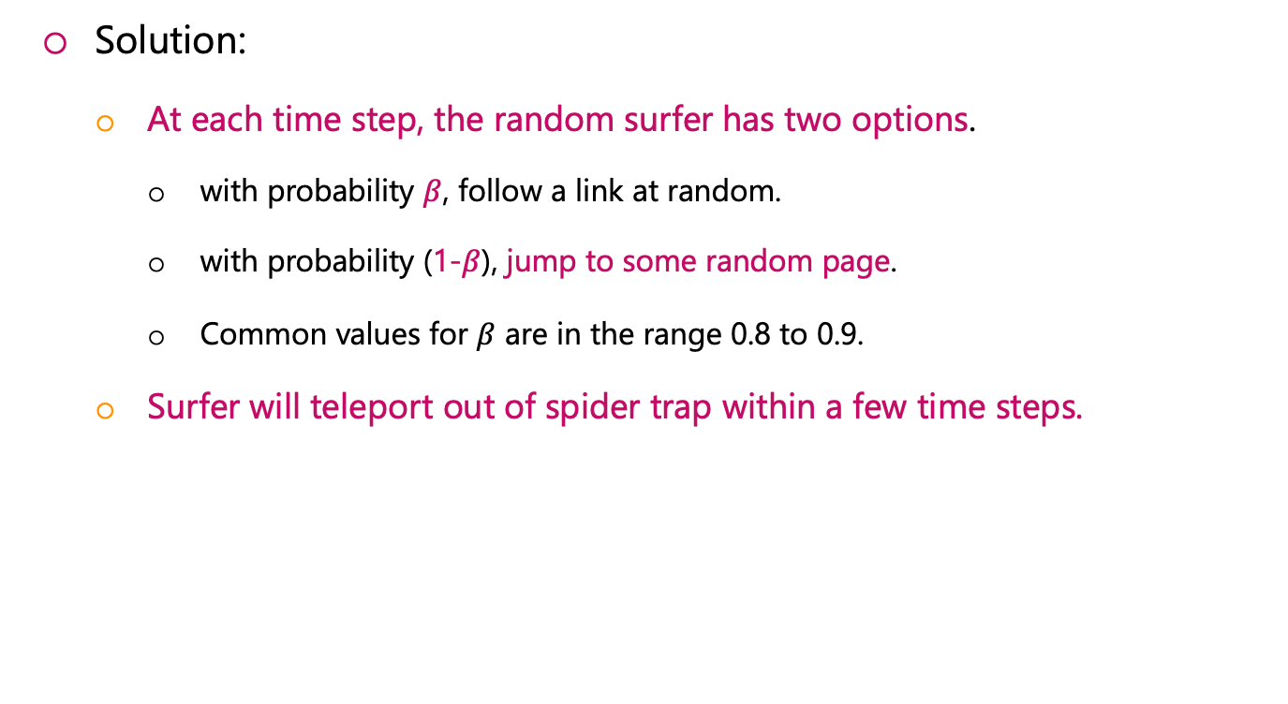
Solution: Teleports
Solution:
At each time step, the random surfer has two options.
with probability $β$, follow a link at random.
with probability (1-$β$), jump to some random page.
Common values for $β$ are in the range 0.8 to 0.9.
Surfer will teleport out of spider trap within a few time steps.
y
y
a
m
a
m

Slide 38
Dead Ends Problem
Power Iteration:
Set
$Step 2: r=r′$
Goto Step 1
y
$$r_{j}′=\sum_{i→j}{\frac{r_{i}}{d_{i}}}$$
(for each page in the rank vector r)
a
m
m is a dead-end
$$\left({\begin{aligned}r_{y} \\ r_{a}\end{aligned} \atop r_{m}}\right)=$$
 | y | a | m
y | 1/2 | 1/2 | 0
a | 1/2 | 0 | 0
m | 0 | 1/2 | 0
1/3
1/3
1/3
2/6
1/6
1/6
3/12
2/12
1/12
5/24
3/24
2/24
 | 0
… | 0
 | 0

Slide 39
Solution: Teleport again !
Teleports: Follow random teleport links with probability 1.0 from dead-ends.
Adjust matrix accordingly
y
y
a
m
a
m
 | y | a | m
y | ½ | ½ | 0
a | ½ | 0 | 0
m | 0 | ½ | 0
 | y | a | m
y | ½ | ½ | ⅓
a | ½ | 0 | ⅓
m | 0 | ½ | ⅓

Slide 40
Why Teleports solve the problems?
Why do teleports solve both problems?
Spider-traps are not a problem.
But with traps, PageRank scores are NOT what we want.
Solution: Never get stuck in a spider trap by teleporting out of it in a finite number of steps.
Dead-ends are a problem.
The matrix is not column stochastic, so our initial assumptions are not met.
Solution: Make matrix column stochastic by always teleporting when there is nowhere else to go
 | y | a | m
y | ½ | ½ | 0
a | ½ | 0 | 0
m | 0 | ½ | 0

Slide 41
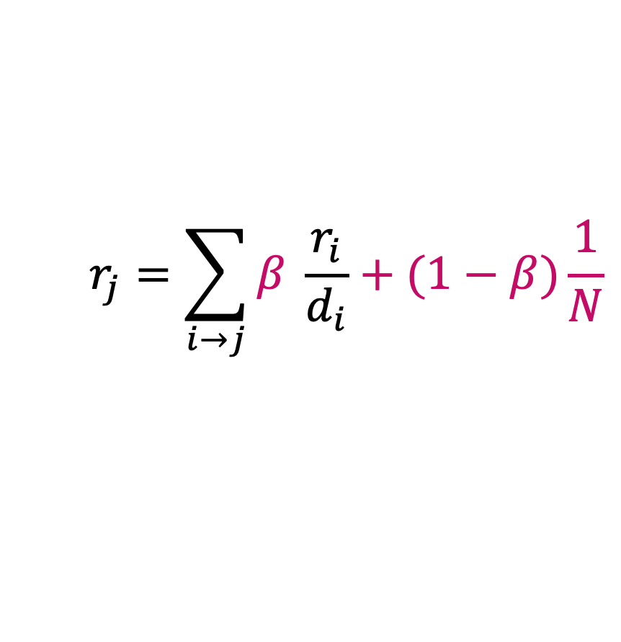

Solution: Random Teleports
At each step, random surfer has two options:
With probability $β$, follow a link at random
With probability $1−β$, jump to some random page
PageRank equation [Brin-Page, 98]
$$r_{j}=\sum_{i→j}{β \frac{r_{i}}{d_{i}}}+(1−β)\frac{1}{N}$$

Slide 42
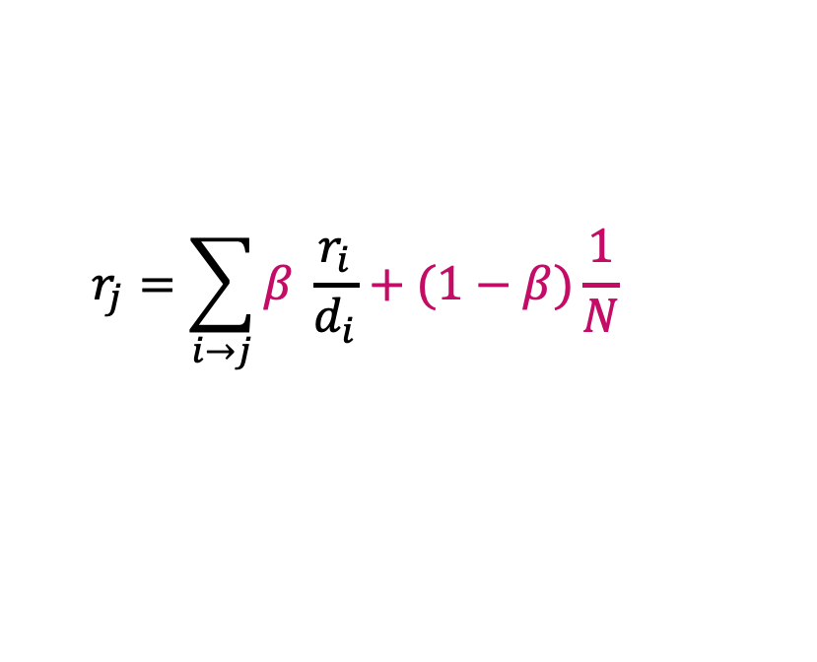

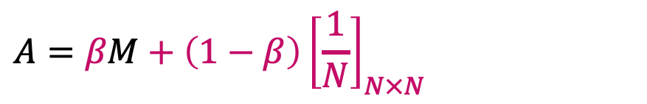
The Google Matrix
PageRank equation [Brin-Page, 98]
The Google Matrix A:
Our recursive problem become $r = A⋅ r$
And the Power method still work.
What is $β$?
In practice, $β=0.8, 0.9$
$$r_{j}=\sum_{i→j}{β \frac{r_{i}}{d_{i}}}+(1−β)\frac{1}{N}$$
$$A=βM+\left(1−β\right){\left[\frac{1}{N}\right]}_{N×N}$$

Slide 43
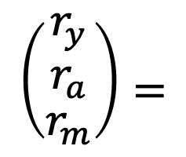

Random Teleport ($β$ = 0.8)
M
[1/N]_{NxN}
7/15
y
 | y | a | m
y | 1/2 | 1/2 | 0
a | 1/2 | 0 | 0
m | 0 | 1/2 | 1
 | y | a | m
y | 1/3 | 1/3 | 1/3
a | 1/3 | 1/3 | 1/3
m | 1/3 | 1/3 | 1/3
0.8
+ 0.2
7/15
1/15
7/15
1/15
13/15
 | y | a | m
y | 7/15 | 7/15 | 1/15
a | 7/15 | 1/15 | 1/15
m | 1/15 | 7/15 | 13/15
a
7/15
m
1/15
1/15
A
$$\left({\begin{aligned}r_{y} \\ r_{a}\end{aligned} \atop r_{m}}\right)=$$
1/3
1/3
1/3
0.33
0.20
0.46
0.28
0.20
0.52
0.26
0.18
0.56
 | 7/33
… | 5/33
 | 21/33

Slide 44

How do we compute the PageRank?

Slide 45

MapReduce Program for PageRank
Key step is matrix-vector multiplication
$r^{new} = A ∙ r^{old}$
It is easy if we have enough main memory to hold A, r^{new} and r^{old}
If N = 1 billion pages
If we need 4 bytes for each entry:
2 billion entries for vectors (r^{new} and r^{old}), approx. 8GB
Matrix A has $N^{2}$ entries: ${10}^{18}$ which is a large number!
A = β∙M + (1-β) [1/N]_{NxN}
 | y | a | m
y | 1/2 | 1/2 | 0
a | 1/2 | 0 | 0
m | 0 | 1/2 | 1
 | y | a | m
y | 1/3 | 1/3 | 1/3
a | 1/3 | 1/3 | 1/3
m | 1/3 | 1/3 | 1/3
A=0.8
+0.2
 | y | a | m
y | 7/15 | 7/15 | 1/15
a | 7/15 | 1/15 | 1/15
m | 1/15 | 7/15 | 13/15
=

Slide 46

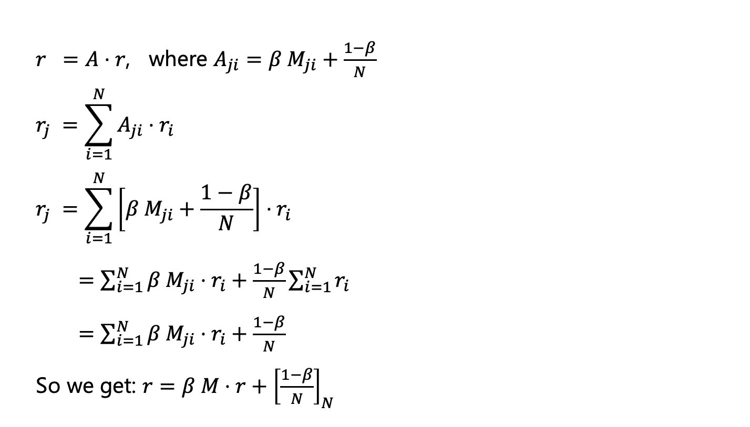
Rearranging the Equation
$r =A⋅r$, where $A_{ji}=β{ M}_{ji}+\frac{1−β}{N}$
$$r_{j} =\sum_{i=1}^{N}{A_{ji}⋅r_{i}}$$
$$r_{j} =\sum_{i=1}^{N}{\left[β{ M}_{ji}+\frac{1−β}{N}\right]⋅r_{i}}$$
$=\sum_{i=1}^{N}{β{ M}_{ji}⋅r_{i}+\frac{1−β}{N}}\sum_{i=1}^{N}{r_{i}}$
$=\sum_{i=1}^{N}{β{ M}_{ji}⋅r_{i}+\frac{1−β}{N}}$
So we get: $r=β M⋅r+{\left[\frac{1−β}{N}\right]}_{N}$
since $∑r_{i}=1$

Slide 47
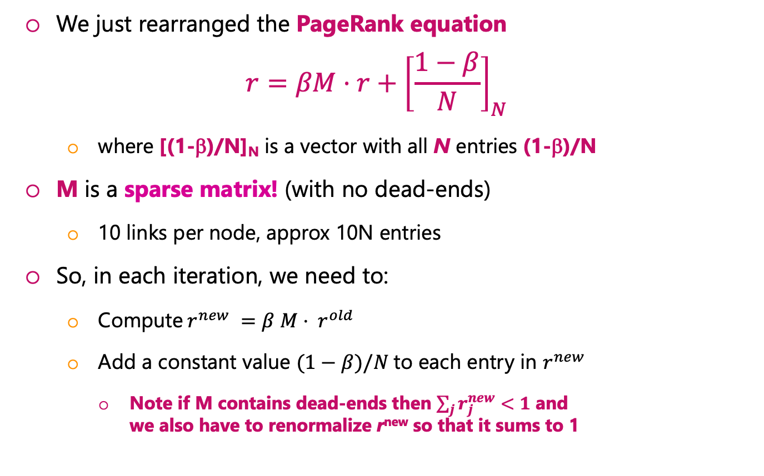
Sparse Matrix Formulation
We just rearranged the PageRank equation
$$r=βM⋅r+{\left[\frac{1−β}{N}\right]}_{N}$$
where [(1-β)/N]_{N} is a vector with all N entries (1-β)/N
M is a sparse matrix! (with no dead-ends)
10 links per node, approx 10N entries
So, in each iteration, we need to:
Compute$r^{new} =β M⋅ r^{old}$
Add a constant value $(1−β)/N$to each entry in $r^{new}$
Note if M contains dead-ends then $\sum_{j}{r_{j}^{new}}<1$ and we also have to renormalize r^{new} so that it sums to 1

Slide 48



The complete algorithm
Input: Graph $G$ and parameter $β$
Directed graph $G$ (can have spider traps and dead ends)
Parameter $β$
Output: PageRank vector $r^{new}$
Set $r_{j}^{old} =1/N$
while $\sum_{j}{\left|r_{j}^{new}−r_{j}^{old}\right|>ε}$:
$r^{old} = {r′}^{old}$
for all j:
if in-degree of j > 0:
${r′}_{j}^{new}=\sum_{i→j}{β {r_{i}^{old}}/{d_{i}}}$ else:
${r′}_{j}^{new}=0$
#re-insert the leaked PageRank
for all j:
$r_{j}^{new}={r^{′}}_{j}^{new}+\frac{1−S}{N}$
$r’^{old} = r^{new}$
If the graph has no dead-ends, then the amount of leaked PageRank is 1-β
where: $S=\sum_{j}{{r′}_{j}^{new}}$

Slide 49





Dead-end Example
$$\left(\begin{aligned}r_{a} \\ r_{b}\end{aligned}\right)=$$
1/2
1/2
0.2875
0.7125
0.3778125
0.6221875
0.33942969 | …
0.66057031 | …
b
a
$$r_{a}^{1}=\frac{1}{2}×0+\frac{1}{2}×0=0$$
$$r_{b}^{1}=\frac{1}{2}×1+\frac{1}{2}×0=\frac{1}{2}$$
$$r_{a}^{1}=r_{a}^{1}+\frac{1−s}{N}=0.2875$$
$$r_{b}^{1}=r_{b}^{1}+\frac{1−s}{N}=0.425+0.2875=0.7125$$
 | a | b
a | 0 | 0
b | 1 | 0
$$βr_{a}^{1}=0$$
$βr_{b}^{1}=\frac{1}{2}×0.85=$ 0.425
$$s=0.425,\frac{1−s}{N}=\frac{0.575}{2}=0.2875$$

Slide 50



Spider Trap Example
$$\left(\begin{aligned}r_{a} \\ r_{b} \\ r_{c}\end{aligned}\right)=$$
1/3
1/3
1/3
0.05
0.6167
0.3333
… | 0.05
… | 0.4865
… | 0.4635
 | a | b | c
a | 0 | 0 | 0
b | 1 | 0 | 1
c | 0 | 1 | 0
c
$$r_{a}^{1}=\frac{1}{3}×0+\frac{1}{3}×0+\frac{1}{3}×0=0, βr_{a}^{1}=0$$
$$r_{b}^{1}=\frac{1}{3}×1+\frac{1}{3}×0+\frac{1}{3}×1=\frac{2}{3},βr_{b}^{1}=\frac{2}{3}∗0.85=0.5667$$
$r_{c}^{1}=\frac{1}{3}×0+\frac{1}{3}×1+\frac{1}{3}×0=\frac{1}{3}$, $βr_{c}^{1}=\frac{1}{3}∗0.85=0.2833$
b
a
$$r_{a}^{1}=r_{a}^{1}+\frac{1−β}{N}=0.05$$
$$r_{b}^{1}=r_{b}^{1}+\frac{1−β}{N}=0.5667+0.05=0.6167$$
$$r_{c}^{1}=r_{c}^{1}+\frac{1−β}{N}=0.2833+0.05=0.3333$$

Slide 51

MapReduce Program for PageRank
A B C D
B A D
C A B
D B C
A 1
B 1
C 1
D 1
B 1/3
C 1/3
D 1/3
A 1/2
A 1/2
Map
A 1/2
D 1/2
B 1/3
B 1/2
B 1/2
Links.txt
Initial PageRank
Reduce
A 1/2
B 1/2
C 1/3
C 1/2
B 1/2
C 1/2
D 1/3
D 1/2

Slide 52

MapReduce Program for PageRank
Map(key, value){
//key: a page
//value: PageRank of the page
for each page in Adj[key]:
emit(page, PR(key)/sizeof(Adj[key])
}
Reduce(key, values){
//key: a page
//values: a list of page ranks from all its incoming pages
PR(key) = $(1−β)/N$
for each pagerank in values:
PR(key) = PR(key) + $β$*pagerank
emit(key, PR(key))
}

Slide 53

Any Questions?

