Slide 1
Universal Description, Discovery, and Integration (UDDI)
Web Services Jakub Klímek
This work is licensed under a Creative Commons Attribution 4.0 International License. Contains examples and images from the UDDI specification.

Slide 2
SOAP reminder
<?xml version="1.0" encoding="utf-8" ?> <soap:Envelope xmlns:soap="http://schemas.xmlsoap.org/soap/envelope/" xmlns:xsi="http://www.w3.org/2001/XMLSchema-instance" xmlns:xsd="http://www.w3.org/2001/XMLSchema"> <soap:Header> <RequesterCredentials xmlns="urn:ebay:api:PayPalAPI"> <Credentials xmlns="urn:ebay:apis:eBLBaseComponents"> <Username>paypal_1206382697_biz_api1.paypal.com</Username> <Password>5CX9UDFSF2ZK7UYW</Password> <Signature>AFcWxV3C7fdsdfsSFDS2342l31ApeELK3f4pOMPrCWOWerIYKvXni9</Signature> </Credentials> </RequesterCredentials> </soap:Header>
<soap:Body> <DoDirectPaymentReq xmlns="urn:ebay:api:PayPalAPI"> <DoDirectPaymentRequest> <Version xmlns="urn:ebay:apis:eBLBaseComponents">57.0</Version> <DoDirectPaymentRequestDetails xmlns="urn:ebay:apis:eBLBaseComponents"> <PaymentAction>Sale</PaymentAction> <PaymentDetails> <OrderTotal currencyID="USD">212.07</OrderTotal> <ItemTotal currencyID="USD">198.39</ItemTotal>
Notes:
We had SOAP for
message syntax - evelope contains headers (extensibilty mechanism) an body (application data payload)
message processing - SOAP message path, SOAP intermediaries, SOAP faults
SOAP abstracts from a specific message transport mechanism (HTTP, SMTP, JMS, …)
SOAP does not interfere with application data payload in body

Slide 3
WSDL 1.1 reminder
<?xml version="1.0" encoding="utf-8" ?>
<definitions xmlns="http://schemas.xmlsoap.org/wsdl/">
<documentation> ... </documentation>
<!-- types (0,1) --> <types> ... </types>
<!-- messages (0,*) --> <message> ... </message>
<!-- port types (0,*) --> <portType> ... </portType>
<!-- bindings (0,*) --> <binding> ... </binding>
<!-- services (0,*) --> <service> ... </service>
</definitions>
Notes:
We had WSDL for
specification of a WS Interface - abstract and concrete
XML elements used in messages, operations consisting of messages, port types/interfaces consisting of operations
binding to specific message transport protocols
ability to generate a client just based on WSDL (e.g. in SoapUI, but also in Java, C#, etc.)
again extensibility mechanism - you can add protocol specific parts to WSDL

Slide 4
Universal Description, Discovery and Integration
UDDI 3.0.2
OASIS 2004
Group of Web Services and APIs for WS information (data and metadata)
publishing
retrieving
managing
For public and private deployments
v1.0 - 2000
v2.0 - 2001, ratified 2003 as a standard
v3.0 - 2004, ratified 2005 as a standard

Slide 5
UDDI scenarios - design-time and run-time
Find WS implementations based on common abstract interface definition
Find WS providers classified according to known classification scheme
Determine the security and transport protocols supported by given WS
Issue search for services based on general keyword
Cache technical information about WS and update that information at run-time
Notes:
e.g. I have an abstract WSDL and I am searching for WS implementing it
e.g. I search for all WS providers (companies) which deal with, e.g. domain registration services

Slide 6
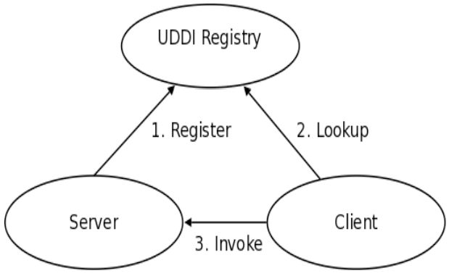
UDDI overview
Notes:
In the context of UDDI
a Web Service is registered in the UDDI Registry
a client searches for the web service in the UDDI Registry
When the client finds the service, they also discover, how to use (invoke) the web service.

Slide 7
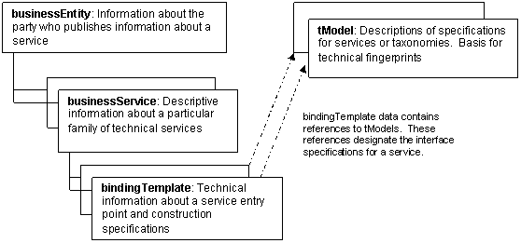
UDDI data model overview
Notes:
businessEntity - e.g. Charles University or Department of Software Engineering - a real world entity
businessService - e.g. Manage course schedule, Manage topic of theses
bindingTemplate - e.g. a SOAP-based, WSDL-described web service implementing course schedule management
tModel - e.g. “uses SOAP”, “uses HTTP” - typical web service described by a set of tModels (set of tModels ~ technical fingerprint)

Slide 8
UDDI - overview - Data Model
businessEntity
organization that published the service
businessService
service’s business function
bindingTemplate
service’s technical details
tModels
other metadata
publisherAssertion
relationships among entities in the registry
subscription
requests to track changes to a list of entities
Notes:
businessEntity - e.g. Charles University or Department of Software Engineering - a real world entity
businessService - e.g. Manage course schedule, Manage topic of theses
bindingTemplate - e.g. a SOAP-based, WSDL-described web service implementing course schedule management
tModel - e.g. “uses SOAP over HTTP” - typical web service described by a set of tModels (set of tModels ~ technical fingerprint)

Slide 9
UDDI - Basic construct: Keys
Keys are unique identifiers
All core data structures get keys
by publisher or
by UDDI node
UDDI v2 key: uddi:4CD7E4BC-648B-426D-9936-443EAAC8AE23
UUID based URN
UDDI v3 key: uddi:tempuri.com
Domain name based URN
In both cases the key is structured using semi-colons ":" into partitions

Slide 10
UDDI - Focuses on: Taxonomic Classification
UDDI focuses on entity classification
Every entity can be classified within UDDI
Multiple taxonomies can be used on one entity
Entities can be precisely searched for using different classification schemes
using Inquiry API
Value sets
classification systems and identification systems
checked or unchecked
checked are inspected for conformance with requirements of the value set
Notes:
classification by classification schemes (codelists)
e.g. type of department (Accounting, HR, Marketing, …)
checked - there is a validation service attached to the classification scheme

Slide 11
UDDI - Focuses on: Internationalization
UDDI = universal description, discovery and integration
Multi-regional businesses
Time zones
Operations across international of inter-region units
Internationalization of UDDI data and services
XML, Unicode Character Set
e.g. Postal address
list of addressLine elements
each addressLine element has attributes for structure and meaning
Language-specific sort orders
Unicode Normalization Form C for search
Notes:
Universal in the name refers to internationalization
Flexible formats of addresses
Native support for time zones, languages, sort orders
UNF (Unicode Normalization From) C refers to the fact that one unicode symbol can be represented in multiple ways, which is bad for search. UNF C is like XML Canonicalization - establishes one normal form for all the possibilities of writing the same symbol - eases search

Slide 12
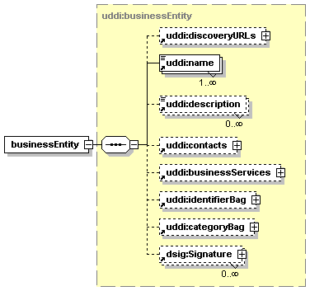
UDDI - businessEntity - “white pages”
businessEntity - any service provider, e.g. department, application, server. Basic business information and links to business services:
Names and descriptions
multiple languages
Contact information
personName. phone, email, address
Classification information
Identifier bag
other identifiers, e.g. VAT number
Category bag
business categories
industry
product
geographic region
Notes:
White pages - list of businesses and their structure, contact information
A discoveryURL is a URL that points to Web addressable (via HTTP GET) discovery documents. The expected return document is not defined.
Each individual discoveryURL MAY be adorned with a useType attribute that designates the name of the convention that the referenced document follows.
Reserved useType value for discoveryURL is "homepage". Adorning a discoveryURL with this value signifies that a business’s homepage can be discovered at that URL.

Slide 13
UDDI - businessEntity example
<uddi3:businessEntity xmlns:uddi3="urn:uddi-org:api_v3" businessKey="uddi:juddi.apache.org:node1"> <uddi3:discoveryURLs> <uddi3:discoveryURL useType="homepage"> http://localhost:8080/juddiv3 </uddi3:discoveryURL> </uddi3:discoveryURLs> <uddi3:name xml:lang="en">An Apache jUDDI Node</uddi3:name> <uddi3:description xml:lang="en"> This is a UDDI registry node as implemented by Apache jUDDI. </uddi3:description> <uddi3:businessServices/> <uddi3:categoryBag> <uddi3:keyedReference tModelKey="uddi:uddi.org:categorization:nodes" keyName="uddi.org:categorization:nodes" keyValue="node"/> </uddi3:categoryBag> </uddi3:businessEntity>
Notes:
Apache jUDDI is a UDDI implementation we will use in tutorials. The UDDI registry itself and its web services are registered in the UDDI registry.

Slide 14
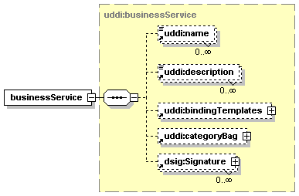
UDDI - businessService - “yellow pages”
Child of exactly one businessEntity
Logical grouping of Web services
No technical information
Basic information
names and descriptions
classification
e.g. a set of Purchase Order Web services
(submission, confirmation, notification)
Notes:
Yellow pages - what the businesses actually do (which services they provide)

Slide 15
UDDI - businessService example
<uddi3:businessService xmlns:uddi3="urn:uddi-org:api_v3" serviceKey="uddi:www.dneonline.com:service_calculator" businessKey="uddi:www.dneonline.com:business_myfirst"> <uddi3:name xml:lang="en">Calculator</uddi3:name> <uddi3:description xml:lang="en"> Default service description… </uddi3:description> <uddi3:bindingTemplates> … </uddi3:bindingTemplates> <uddi3:categoryBag> <uddi3:keyedReference tModelKey="uddi:uddi.org:xml:namespace" keyName="uddi-org:xml:namespace" keyValue="http://tempuri.org/"/> <uddi3:keyedReference tModelKey="uddi:uddi.org:wsdl:types" keyName="uddi-org:wsdl:types" keyValue="service"/> <uddi3:keyedReference tModelKey="uddi:uddi.org:xml:localname" keyName="uddi-org:xml:localName" keyValue="Calculator"/> </uddi3:categoryBag> </uddi3:businessService>
Notes:
We can see the calculator service registered in UDDI as a businessService, i.e. no technical details

Slide 16
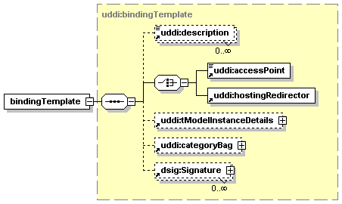
UDDI - bindingTemplate - “green pages”
represents an individual Web service
child of exactly one businessService
Technical information needed by applications to bind and interact with the WS
Must contain accessPoint. UseType:
endPoint
actual endpoint
bindingTemplate
points to another bindingTemplate
hostingRedirector
points to another UDDI registry
wsdlDeployment
WSDL with endpoint already specified
Notes:
Green pages - technical specifications

Slide 17
UDDI - bindingTemplate example
<uddi3:bindingTemplate xmlns:uddi3="urn:uddi-org:api_v3" bindingKey="uddi:www.dneonline.com:binding_www.dneonline.com_calculator_calculatorsoap12_80" serviceKey="uddi:www.dneonline.com:service_calculator"> <uddi3:description xml:lang="en">Default binding description … </uddi3:description> <uddi3:accessPoint useType="endPoint">http://www.dneonline.com/calculator.asmx</uddi3:accessPoint> <uddi3:tModelInstanceDetails> <uddi3:tModelInstanceInfo tModelKey="uddi:www.dneonline.com:calculatorsoap12"> <uddi3:description xml:lang="en">The wsdl:binding that … </uddi3:description> <uddi3:instanceDetails> <uddi3:instanceParms>CalculatorSoap12</uddi3:instanceParms> </uddi3:instanceDetails> </uddi3:tModelInstanceInfo> <uddi3:tModelInstanceInfo tModelKey="uddi:www.dneonline.com:calculatorsoap"> <uddi3:description xml:lang="en">The wsdl:portType that … </uddi3:description> </uddi3:tModelInstanceInfo> <uddi3:tModelInstanceInfo tModelKey="uddi:uddi.org:protocol:soap"/> <uddi3:tModelInstanceInfo tModelKey="uddi:uddi.org:transport:http"/> </uddi3:tModelInstanceDetails> <uddi3:categoryBag> <uddi3:keyedReference tModelKey="uddi:uddi.org:categorization:types" keyName="uddi-org:types:wsdl" keyValue="wsdlDeployment"/> </uddi3:categoryBag> </uddi3:bindingTemplate>
Notes:
This is the registration of our Calculator web service. We can see
the endpoint URL
WSDL binding of the registered WS (as tModel) - here it is the SOAP 1.2 one (remember that the service also contains a SOAP 1.1 binding)
WSDL port type (as tModel)
it uses SOAP protocol and HTTP transport (as tModels)
it is categorized by a type “wsdlDeployment”

Slide 18
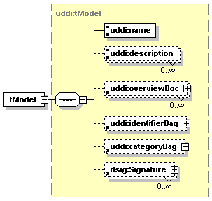
UDDI - Technical Models (tModels) - “green pages”
unique concepts or constructs
allow re-use
exist outside of parent-child relationships
businessEntity, businessService, bindingTemplates
based on WSDL, XSD
and other documents that specify contract and behavior (interface) that a WS may choose to comply with
bindingTemplate references a set of tModels representing these concepts
tModel contains URLs of represented technical documents and metadata about them
Notes:
Green pages - technical specifications

Slide 19
UDDI - tModel example
<uddi3:tModel tModelKey="uddi:uddi.org:transport:http" xmlns:uddi3="urn:uddi-org:api_v3" deleted="false"> <uddi3:name>uddi-org:http</uddi3:name> <uddi3:description>A Web service that uses HTTP transport</uddi3:description> <uddi3:overviewDoc> <uddi3:overviewURL useType="text"> http://uddi.org/pubs/uddi_v3.htm#overHTTP </uddi3:overviewURL> </uddi3:overviewDoc> <uddi3:categoryBag> <uddi3:keyedReference tModelKey="uddi:uddi.org:categorization:types" keyName="uddi-org:types:transport" keyValue="transport"/> </uddi3:categoryBag> </uddi3:tModel>

Slide 20
UDDI - Technical Models (tModels)
tModel name is URN
xml:lang attribute should not be used
technical fingerprint
bindingTemplates referring to precisely the same set of tModels have the same technical fingerprint and are of the same type
example: system of values, e.g. Postal address formats
within identifierBag and categoryBag, address and publisherAssertion
example: find qualifier
modify behavior of APIs
specify, e.g. sort orders
more examples
Transport and protocol definitions such as HTTP and SMTP
Types of resources referred to by a URI reference

Slide 21
UDDI - Technical Models (tModels) - Types usage
<tModel
tModelKey="uddi:uddi.org:findqualifier:approximatematch">
…
<categoryBag>
<keyedReference keyName="uddi-org:types:categorization"
keyValue="findQualifier"
tModelKey="uddi:uddi.org:categorization:types"/>
</categoryBag>
</tModel>
Key of this tModel
the value
Optional name for the classification
Key of the “types” tModel
Notes:
This tModel is used to modify a search - say it should be performed as approximate.
This tModel is categorized (in its categoryBag) by a reference to the “types” categorization (that is also a tModel: uddi:uddi.org:categorization:types)
In the “types” categorization, a.k.a. uddi-org:types:categorization, this tModel is categorized as findQualifier

Slide 22
UDDI Types: uddi:uddi.org:categorization:types 1/2
ID | Parent ID | Allowed | Description
tModel |  | No | These types are used for tModels
valueSet | tModel | Yes | Value set
identifier | valueSet | Yes | Identifier system
namespace | valueSet | Yes | Namespace
categorization | valueSet | Yes | Categorization system
postalAddress | categorization | Yes | Postal address system
categorizationGroup | tModel | Yes | Category group system
relationship | tModel | Yes | Relationship type system
specification | tModel | Yes | Specification for a Web service
xmlSpec | specification | Yes | Specification for a Web service using XML messages
soapSpec | xmlSpec | Yes | Specification for interaction with a Web service using SOAP messages
wsdlSpec | specification | Yes | Specification for a Web service described in WSDL
protocol | tModel | Yes | Protocol
transport | protocol | Yes | Wire/transport protocol
Notes:
This is the whole uddi:uddi.org:categorization:types tModel (it is a hierarchical categorization)
We have seen some of them before:
transport

Slide 23
UDDI Types: uddi:uddi.org:categorization:types 2/2
ID | Parent ID | Allowed | Description
signatureComponent | tModel | Yes | Signature component
unvalidatable | tModel | Yes | Prevents a checked value set from being used
checked | tModel | Yes | Checked value set
unchecked | tModel | Yes | Unchecked value set
cacheable | tModel | Yes | Cacheable checked value set
uncacheable | tModel | Yes | Uncacheable checked value set
keyGenerator | tModel | Yes | Key generator
findQualifier | tModel | Yes | Find qualifier
sortOrder | findQualifier | Yes | Sort order
useTypeDesignator | tModel | Yes | Designates a kind of usage for the pieces of data with which it is associated
bindingTemplate |  | No | These types are used for bindingTemplates
wsdlDeployment | bindingTemplate | Yes | bindingTemplate represents the WSDL deployment of a Web service
Notes:
This is the whole uddi:uddi.org:categorization:types tModel (it is a hierarchical categorization)
We have seen some of them before:
checked
findQualifier
wsdlDeployment

Slide 24
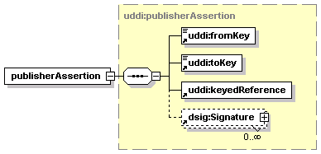
UDDI - Publisher assertion
Business relationship
to be used for searching
e.g. corporation with a variety of subsidiaries
keyedReference
tModel describing relationship type system
keyValue designate relationship type within this value set
<publisherAssertion> <fromKey>BK1</fromKey> <toKey>BK2</toKey> <keyedReference tModelKey="uddi:uddi.org:relationships" keyName="Holding Company" keyValue="parent-child" /> </publisherAssertion>

Slide 25
UDDI APIs

Slide 26
UDDI - overview - APIs (UDDI Web services)
What you would expect
Publishing information about a service to a registry
UDDI_Publication_PortType
Searching a UDDI registry for information about a service
UDDI_Inquiry_PortType
but also
Replication, transferring custody of data about a service
UDDI_Replication_PortType
UDDI_CustodyTransfer_PortType
Security and authorization, registration key generation and management
UDDI_Security_PortType
Registration subscription API set
UDDI_Subscription_PortType
UDDI_SubscriptionListener_PortType
Value sets
UDDI_ValueSetValidation_PortType
UDDI_ValueSetCaching_PortType

Slide 27
UDDI Inquiry API and findQualifiers
find_xx APIs
find_business
find_service
find_binding
find_tModel
find_relatedBusinesses
get_xx APIs
get_bindingDetail
get_businessDetail
get_operationalInfo
get_serviceDetail
get_tModelDetail
some of the find qualifiers (tModels) for find_xx APIs
andAllKeys, orAllKeys
approximateMatch, exactMatch
binarySort
caseInsensitiveSort, caseSensitiveSort
caseInsensitiveMatch, caseSensitiveMatch
diacriticInsensitiveMatch, diacriticSensitiveMatch
signaturePresent
sortByNameAsc, sortByNameDesc
sortByDateAsc, sortByDateDesc

Slide 28
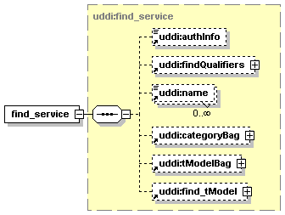
UDDI Inquiry API - find_service example request
<soapenv:Envelope xmlns:soapenv="http://schemas.xmlsoap.org/soap/envelope/" xmlns:urn="urn:uddi-org:api_v3"> <soapenv:Header/> <soapenv:Body> <urn:find_service> <urn:name xml:lang="en">Calculator</urn:name> </urn:find_service> </soapenv:Body> </soapenv:Envelope>
http://localhost:8080/juddiv3/services/inquiry
Notes:
This is a SOAP message to the UDDI Inquiry API
It is a “find_service” request, searching for the Calculator web service by name

Slide 29
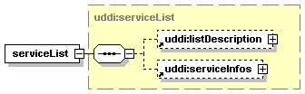
UDDI Inquiry API - find_service example response
<soap:Envelope xmlns:soap="http://schemas.xmlsoap.org/soap/envelope/"> <soap:Body> <ns2:serviceList truncated="false" xmlns:ns2="urn:uddi-org:api_v3"> <ns2:listDescription> <ns2:includeCount>1</ns2:includeCount> <ns2:actualCount>1</ns2:actualCount> <ns2:listHead>1</ns2:listHead> </ns2:listDescription> <ns2:serviceInfos> <ns2:serviceInfo serviceKey="uddi:www.dneonline.com:service_calculator" businessKey="uddi:www.dneonline.com:business_myfirst"> <ns2:name xml:lang="en">Calculator</ns2:ame> </ns2:serviceInfo> </ns2:serviceInfos> </ns2:serviceList> </soap:Body> </soap:Envelope>
Notes:
This is a SOAP response with the response to the search for the Calculator service
1 was found
Its key is in the response. This key can be then used by the get_xx API to get more information

Slide 30
UDDI Publication API
save_business, delete_business
save_service, delete_service
save_binding, delete_binding
save_tModel, delete_tModel
add_publisherAssertions, delete_publisherAssertions
get_publisherAssertions, set_publisherAssertions
get_registeredInfo
Used to request an abbreviated list of businesses and tModels currently managed by a given publisher.

Slide 31
UDDI - Key Generator tModel
Special tModel, “keyGenerator” at the end of its key
Owner of this tModel is authorized to generate keys in key partition
Key | keyGeneratorKey
uddi:tempuri.com | uddi:tempuri.com:keygenerator
uddi:tempuri.com:keygenerator | <none>
uddi:tempuri.com:xxx:keygenerator | uddi:tempuri.com:keygenerator
uddi:tempuri.com:xxx | uddi:tempuri.com:keygenerator
uddi:tempuri.com:xxx:yyy | uddi:tempuri.com:xxx:keygenerator
Notes:
Everything in UDDI has a Key, in UDDIv3 the key is not a UUID, but based on domain names.
There is an authorization mechanism in place in the UDDI registry so that only authorized users can create keys in partitions.
Examples: In order to create a key in the “Key” column, you must own the keyGenerator identified by the “keyGeneratorKey” column.

Slide 32
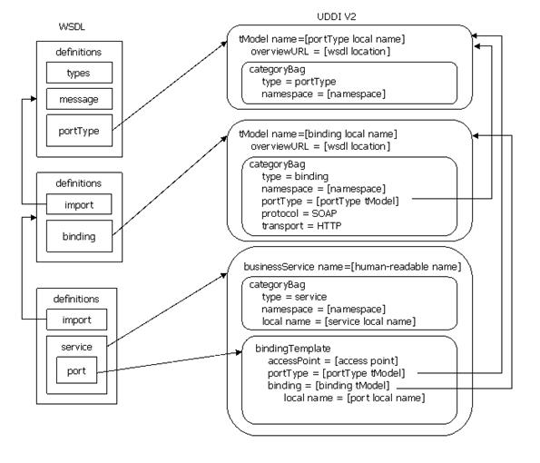
WSDL services in UDDI
This diagrams shows how a WSDL based Web service is registered in UDDIv2/UDDIv3.
tModels are created from
portType
binding
port
service

Slide 33
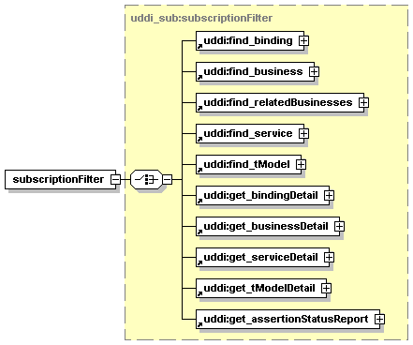
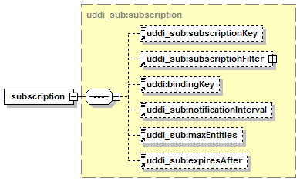
UDDI - Subscription API
To easily detect changes to a UDDI Node
save_subscription, delete_subscription
get_subscriptions, get_subscriptionResults
notify_subscriptionListener
implemented by the subscriber
referred to in the bindingKey

Slide 34
UDDI Nodes and Registries
node
minimum set of functionality
member of exactly one registry
registry
one or more nodes
complete set of functionality
affiliated registries
individual registries
policy-based sharing of information among them
common namespace for UDDI keys which identify records
Notes:
UDDI has various levels of complexity of implementation
UDDI natively supports entire ecosystems of UDDI registries (e.g. custody transfer)

Slide 35
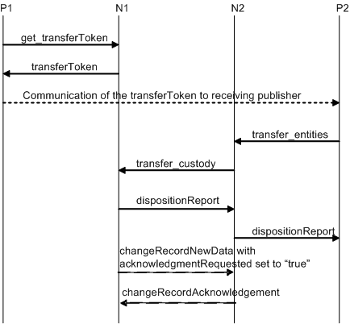
UDDI - Custody transfer API
Used to change custody of a UDDI record from one UDDI registry to another
Business A creates a transfer token
Business A sends the token to Business B’s representative (email)
Business B accepts the token and transfers the ownership

