Slide 1

Pac-Man — Search vs Reinforcement Learning
CS 520 Final Project — how do search and reinforcement-learning agents play Pac-Man?
Team
Michael Liu
Ruiding Feng
Zhichun Xiao
Lead Designer / Project Guide
Principal Implementer / Eval Study
Report Writer
What's in this deck
• Problem setup and how we measure agents.
• Four agent families: static A*, replanning A*, risk-aware A*, and tabular Q-learning.
• Score, survival, and risk-vs-reward results across 11 agents and 50 paired seeds.
• Cognitive-science angle: planning vs habit-learning.
• Takeaways and future work.
Code · github.com/RichardFeng000/cs520-project

Slide 2
Problem Setup: Pac-Man as a Dynamic Grid
Pac-Man with 4 ghosts on a fixed maze. Eat every pellet before losing all 3 lives.
MAZE
PELLETS
GHOSTS
LIVES / CAP
EPISODES
AGENTS
28 × 36
244 + 4 energizers
4 (mobile)
3 / 900 steps
50 paired seeds
11 configs
How the maze maps to our problem
How we score the agents
• Open / blocked tiles → walkable / wall tiles
• Goal → eat every pellet to clear the level
• Hazard tiles → ghost tiles + the 4 squares around them
• Random spread → ghosts move uniformly over legal directions
• Risk weight λ → cost = path length + λ × expected ghost risk
• Episode ends on the 3rd life lost, a level clear, or 900 steps.
• Score = highest score the agent reached.
• Time-to-failure = steps before the first death.
• Hazard exposure = total steps spent within 2 tiles of a ghost.
• Clear rate = fraction of episodes that ate every pellet.
Every agent runs on the same 50 seeds {1000…1049}, so all comparisons are on identical starting conditions.

Slide 3
Agent Lineup — Four Families
f(n) = g(n) + h(n) + λ · E[risk(n)] · Q(s,a) ← Q(s,a) + α · [r + γ · maxₐ' Q(s',a') − Q(s,a)]
Static A*
Replanning A*
• Plans a path once at the start of the episode.
• Only replans if the path becomes blocked or the target is eaten.
• Doesn't react to ghosts. Our baseline search agent.
• Recomputes the path every step.
• Treats ghost tiles and the 4 squares around them as walls.
• Falls back to a greedy step toward the nearest pellet if no path exists.
Risk-Aware A*
Tabular Q-learning — 3 death policies
• Like Replanning A*, but each tile pays an extra cost for expected ghost risk.
• Risk is estimated from one step of random ghost movement.
• We swept λ over {0.5, 1, 2, 5}.
• 10-feature state. α = 0.18, γ = 0.95, ε from 0.12 with decay.
• Trained for many episodes per model.
• Three death penalties: Model 1 keep score · Model 2 zero on death · Model 3 ratcheting penalty.
Two extra baselines (random and a hand-coded heuristic) run alongside the four families above.

Slide 4
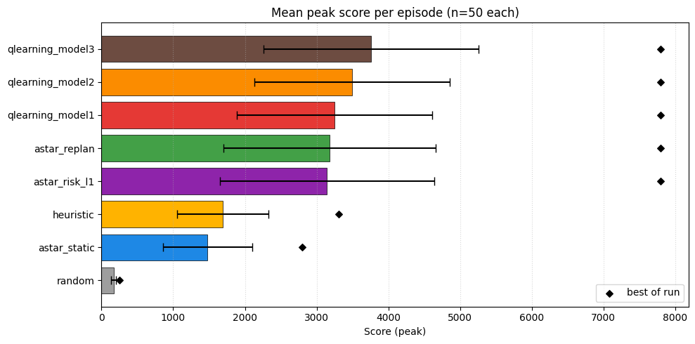
Score Comparison (Figure 1)
Read-outs
• All three Q-learning agents top the planners on score: model 3 (3,757) > model 2 (3,494) > model 1 (3,249).
• Planners cluster just behind at ≈3,150 (replan / risk-aware tied).
• Heuristic (1,695) and astar_static (1,479) form the middle pack.
• Random sanity floor: 167 ± 31.
Mean peak score per episode (n=50). Black diamonds = single best run.
Take-away — Q-learning beats the planners across the board; heavier death penalty (model 1 → model 3) yields an even stronger policy.
Best single run: 7,800 (level cleared) — every Q-learning model and every planner reaches it on at least one seed.

Slide 5
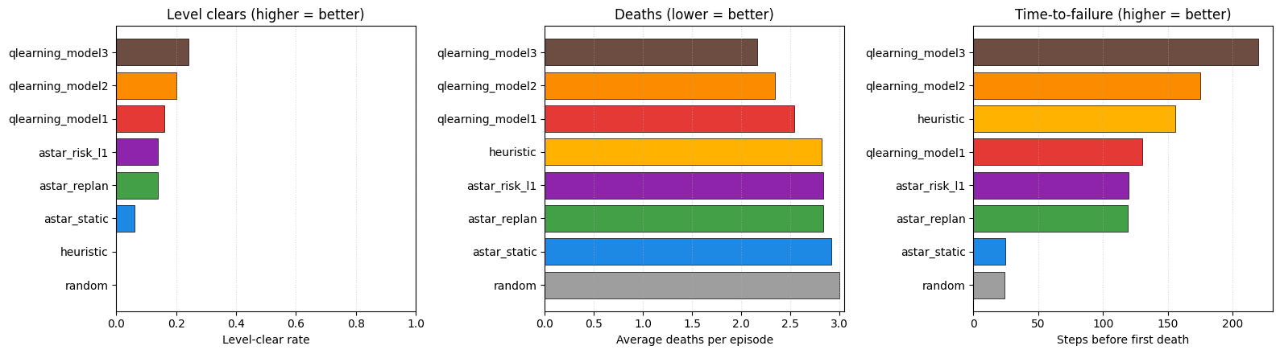
Survival: Clear Rate, Deaths, Time-to-Failure (Figure 3)
Three views across all 11 agents (50 paired seeds each).
Clear rate
Deaths per episode
Time-to-failure
• Q-learning model 3 leads at 24%, model 2 at 20%, model 1 at 16%.
• Replan / Risk-aware: 14%.
• Static A*: 6% · Heuristic and Random never clear.
• Static A* and Random lose all 3 lives every episode.
• Planners + Heuristic ≈ 2.8.
• Q-learning: model 1 (2.55) → model 2 (2.35) → model 3 (2.15).
• Q-learning: model 3 (220) > model 2 (175) > model 1 (130).
• Heuristic ≈ 156 · Replan / Risk-aware ≈ 119.
• Static A* dies at step 24 — walks into the first ghost it sees.
Take-away — Q-learning leads on every survival metric. Heavier death penalty produces a more cautious and longer-lived policy.

Slide 6
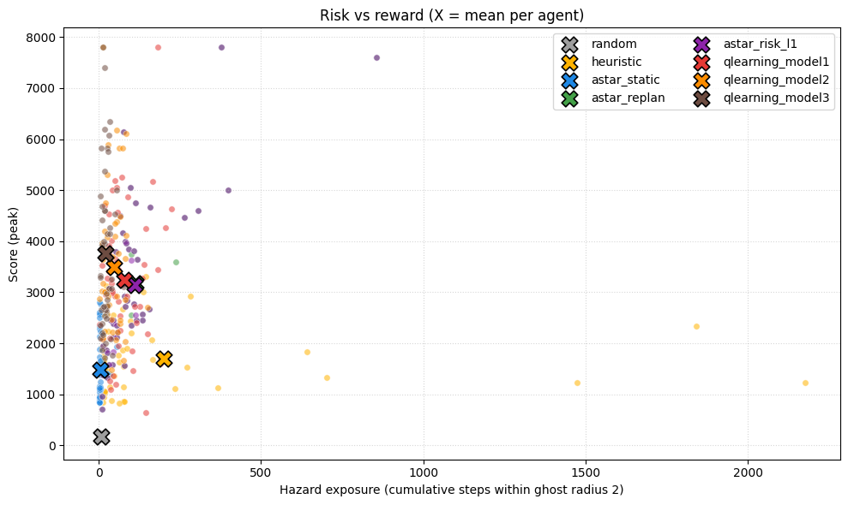
Risk vs Reward — The Central Finding (Figure 5)
Three clusters
• Q-learners → upper-left corner: score 3,249–3,757 with hazard 22–78.
• Planners (replan / risk-aware) → middle: score ≈ 3,150, hazard ≈ 110.
• Heuristic → far right: hazard 201, score 1,695.
Why this is the central finding
• Q-learning has learned a value function that already includes ghost-avoidance.
• All three variants beat the planners on score AND on hazard exposure.
• Model 3 (3,757 / hazard 22) Pareto-dominates every other agent in the field.
• This sets up the cognitive-science slide next.
Top-left = high score with low risk (the best place to be). Bold X = each agent's mean.
Hazard exposure = total steps with a ghost within 2 tiles.

Slide 7
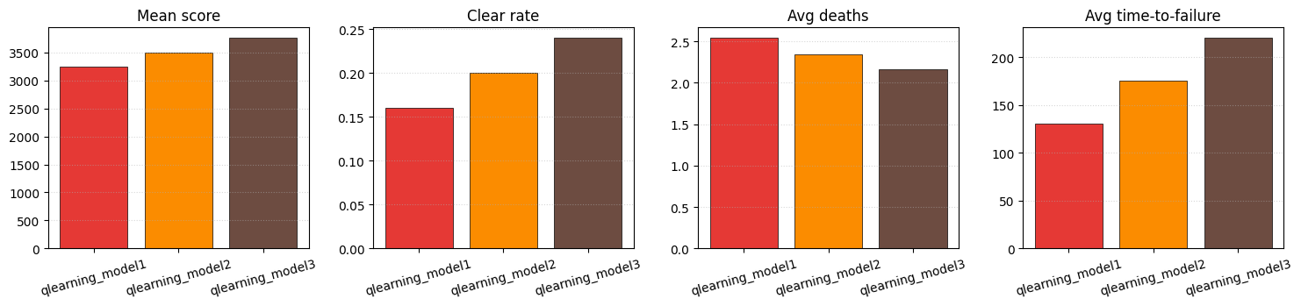
Q-learning: Death-Policy Ablation (Figure 7)
Mean score · clear rate · avg deaths · avg time-to-failure for the three death-penalty variants.
Model 1 — keep score on death
Model 2 — zero score on death
Model 3 — scaled + ratcheting penalty
• Lowest of the three (3,249 mean) but still tops every planner.
• Hazard 78 · time-to-failure 130 · 15.1% level clears.
• No death cost → policy is the riskiest of the three, but the value function still avoids ghosts well enough to win.
• Middle score (3,494), hazard cut to 46.
• Time-to-failure 175 steps · 19.7% level clears.
• A balanced spot: chases score, but really tries not to die.
• Best agent in the field (3,757 mean) and the safest.
• Hazard 22 (about 1/5 of the planners) · time-to-failure 220 · 24.8% level clears.
• Strong death penalty teaches the agent to survive — and surviving = more pellets.
Take-away — every variant beats the planners; heavier death penalty (1 → 3) makes the gap larger on every metric.

Slide 8
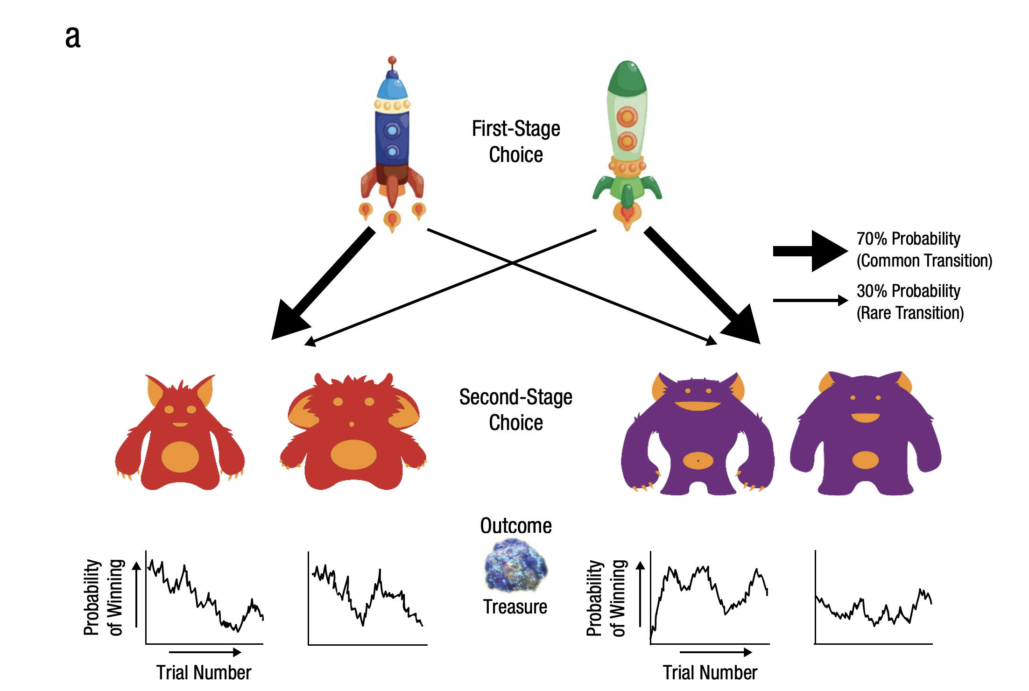
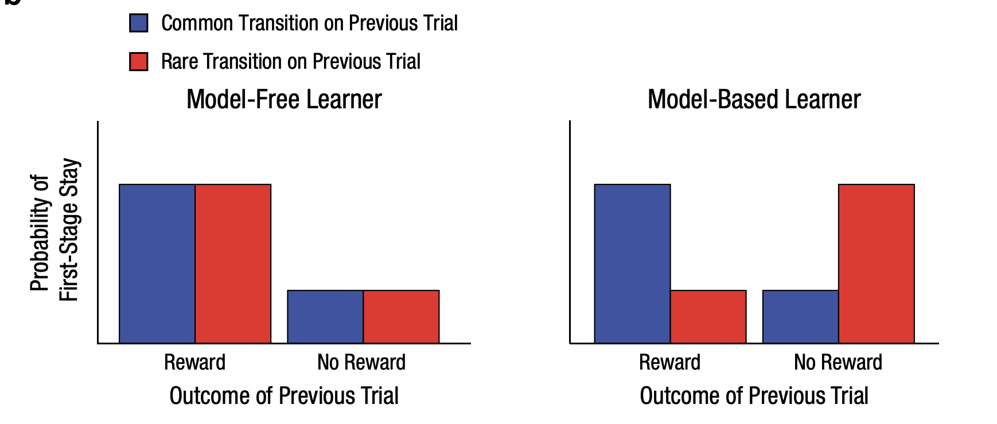
Cognitive Science: Planning vs Habit-Learning
Decker, Otto, Daw & Hartley (2016) — "From Creatures of Habit to Goal-Directed Learners", Psychological Science.
Echo 2 — Habits and planning live side by side
Their idea ↔ Our agents
• Their data: habits never disappear — they blend with planning.
• Our run: Q-learning beats the planners on score AND spends 1.4–5× less time near ghosts.
• Cached value can specialise for safety in ways a 1-step planner can't — both routes are useful.
• Fig. 5 shows the same trade-off.
• Habit-style learning (no simulation) → qlearning_model{1,2,3}
• Planning (simulate, then act) → astar_replan & astar_risk_l*
• Planning that uses risk estimates → risk-aware A*
• Two-stage MDP probe → 50-seed Monte Carlo on the maze

Slide 9
Conclusions & Future Work
6 agents · 50 paired seeds · 28×36 Pac-Man — what we learned.
1. Replanning is what makes A* work
2. Risk-Aware A* ≈ Replanning A* here
• Static A* loses to every replanning agent on every metric.
• 5× longer survival and ~2× higher score, just by replanning every step.
• Treating ghost squares as walls already removes most of the risk, so the λ·E[risk] term has little extra to do.
• Risk-aware A* would shine in a sparser maze with fewer escape routes.
3. Q-learning beats planning on this maze
4. The heuristic survives longest but takes the most risk
• All three Q-learning models top the planners on score AND on hazard exposure.
• Heavier death penalty → stronger policy: model 1 (3,249 / haz 78) → model 3 (3,757 / haz 22).
• Survives 156 steps (longest of all agents) but hazard 201 (highest of all).
• Useful contrast for the planner-vs-learner trade-off.
Future work — soften the ghost obstacles · plan further ahead · DQN from raw maze · learn the ghost movement model.
Code · github.com/RichardFeng000/cs520-project

