Slide 1


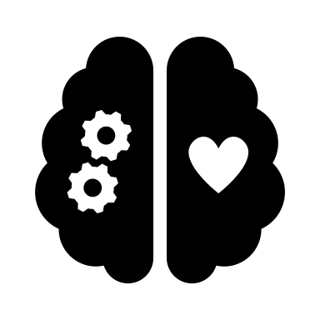

Human-AI Decision Making
Human-AI Decision Making
Across high-stakes domains (e.g., financial and medical domains)
Human factors matter
Cognitive
Bias
Knowledge
Mindset
Picture from https://enterprisetalk.com/featured/can-ai-eliminate-bias-from-decision-making/
Notes:
This is Day 4 at CHI, and at this stage I am guessing all of you have heard a lot about human-ai decision-making. So I won’t go too deep into it!
In recent years, researchers and practitioners have started to adopt AI systems to support human decision makers in critical domains (like financial and medical domains).
In such a collaborative decision process, human factors like knowledge, mindset, cognitive bias are important for trust in the AI system and for human reliance on the system.

Slide 2

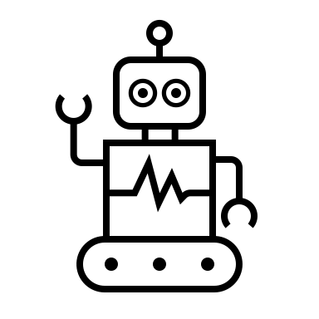
Complementary Human-AI Collaboration
+
>
How? ➔ Appropriate reliance
Notes:
With the wish of complementary team performance, we hope human-AI team performs better than AI alone.
But how it happens? The answer is appropriate reliance
Appropriate reliance means human decision makers rely on an AI system when it is more accurate than humans and do not rely on it when the system is inaccurate.

Slide 3
Is human-AI team better than AI alone?
+
>
?
Not Always
Notes:
Then the question comes: Is human-AI team performs better than AI alone?
The answer is: not always.

Slide 4
Suboptimal Human-AI Teaming
+
<
Over-reliance and under-reliance
Why?
Notes:
With recent empirical studies in human-AI decision making, results show that human-AI team more often show worse performance than AI alone.
This is inconsistent with our expectation.
The reason for such phenomenon is suboptimal reliance --- under-reliance and over-reliance.
But why over-reliance and under-reliance happens, up to now, we still have no clear conclusions.

Slide 5

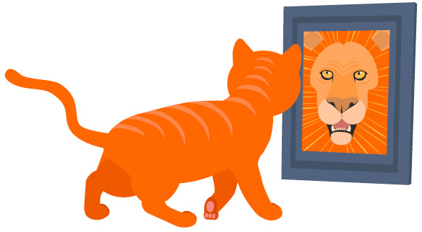




Knowing About Knowing: An Illusion Of Human Competence Can Hinder Appropriate Reliance On AI Systems
Gaole He, Lucie Kuiper, Ujwal Gadiraju
Notes:
Hello everyone! I’m Gaole He, a second-year PhD candidate from TU Delft.
Today I will show you our recent work of the meta-cognitive bias --- Dunning-Kruger Effect in a human-AI decision making context.
This is a collaboration with Lucie Kuiper and Dr. Ujwal Gadiraju.
First, I will show you the background and motivation of our work.

Slide 6
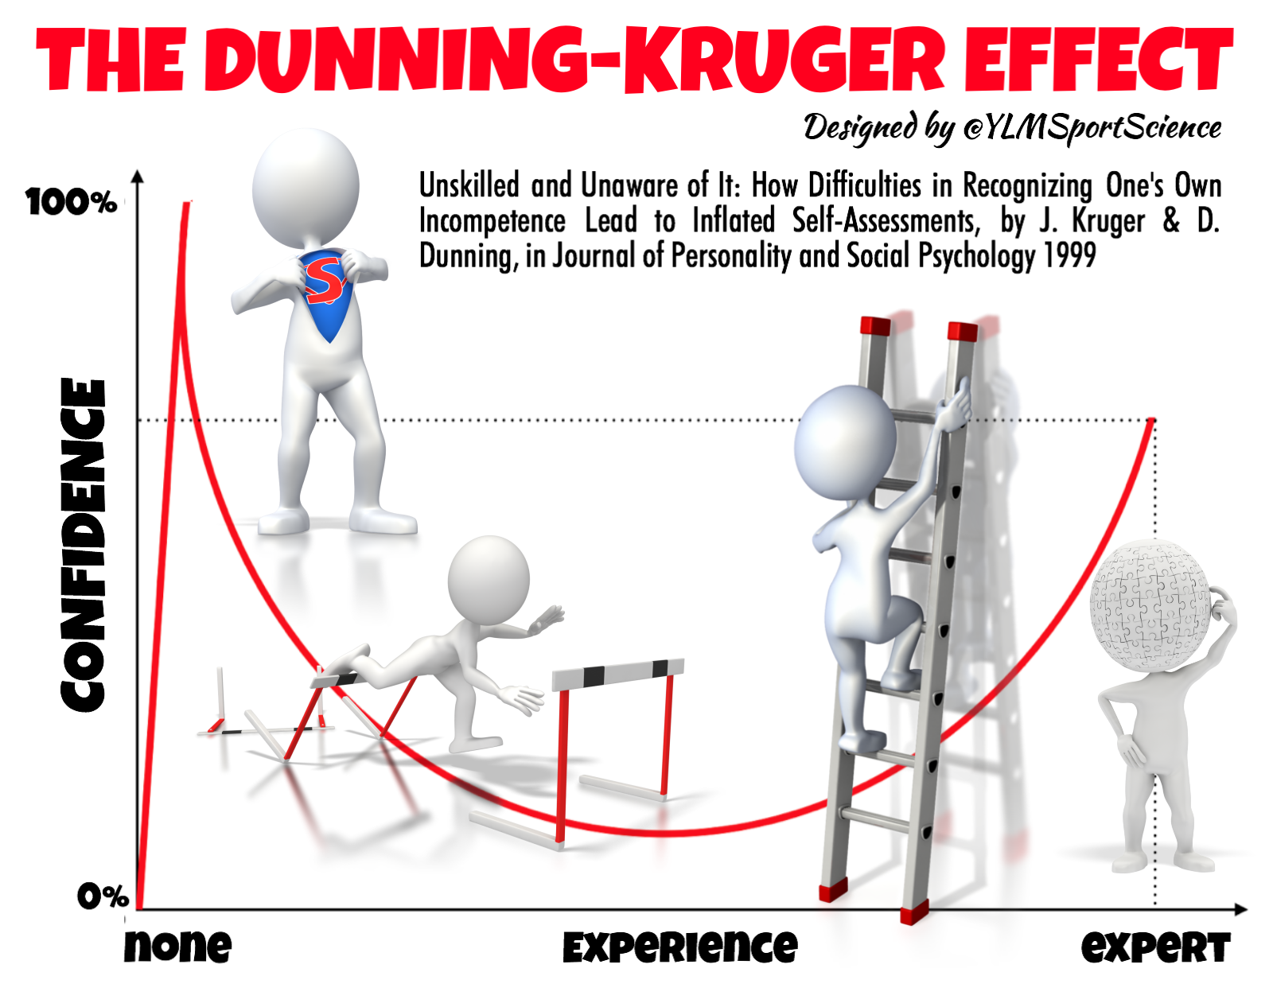
Dunning-Kruger Effect
Human cognitive bias may affect their interaction with AI system
Our Focus: Dunning-Kruger Effect
Meta Cognitive Bias
less-competent individuals overestimate their own skill and performance
DKE found across multiple domains
Unskilled and unaware of it: how difficulties in recognizing one’s own incompetence lead to inflated self-assessments. 1999
I can do better than your AI: expertise and explanations. IUI’19
Notes:
As pointed out by existing literature, human cognitive bias may affect their interaction with AI system
In this work, we mainly focused on whether Dunning-Kruger effect (DKE) affects user reliance on AI systems.
Dunning-Kruger effect is a metacognitive bias due to which individuals overestimate their competence and performance.
And this bias is also widely replicable across multiple domains, like medicine and economics

Slide 7

Motivation
It is still unclear how Dunning-Kruger effect (DKE) affects user reliance on AI systems
DKE may cloud human behavior in their interaction with AI systems
DKE is closely related to user confidence in decision making
To achieve appropriate reliance, users are expected to adequately calibrate their self-confidence and their confidence in the AI system
Notes:
The motivation of analyzing Dunning-Kruger effect in the context of human-AI decision making are four-fold:
Firstly, in the context of human-AI decision making, it is still unclear how Dunning-Kruger effect affects user reliance on AI systems.
Meanwhile, according to the existing literature, we can infer that Dunning-Kruger effect can cloud human behavior in their interaction with AI systems.
Furthermore, Dunning-Kruger effect is closely related to user confidence in decision making.
To achieve the goal of appropriate reliance, users are expected to adequately calibrate their self-confidence and their confidence in the AI system.

Slide 8
Research Questions
RQ1
RQ1: How does the Dunning-Kruger Effect shape reliance on AI systems?
RQ2
RQ2: How can the Dunning-Kruger Effect be mitigated in human-AI decision making tasks?
Our work
Empirical Study (n = 249)
Tutorial intervention
Notes:
To analyze the impact of Dunning-Kruger effect on user reliance on AI systems, we aim to find answers for the following two research questions:
First, How does the Dunning-Kruger Effect shape reliance on AI systems?
Second. How can the Dunning-Kruger Effect be mitigated in human-AI decision making tasks?
To answer them, we conducted empirical study to analyze the effect of DKE on reliance,
And designed tutorial intervention to help users calibrate self-assessment of their performance and mitigate Dunning-Kruger Effect.
Next, I will show you the task and hypothesis for our work.

Slide 9
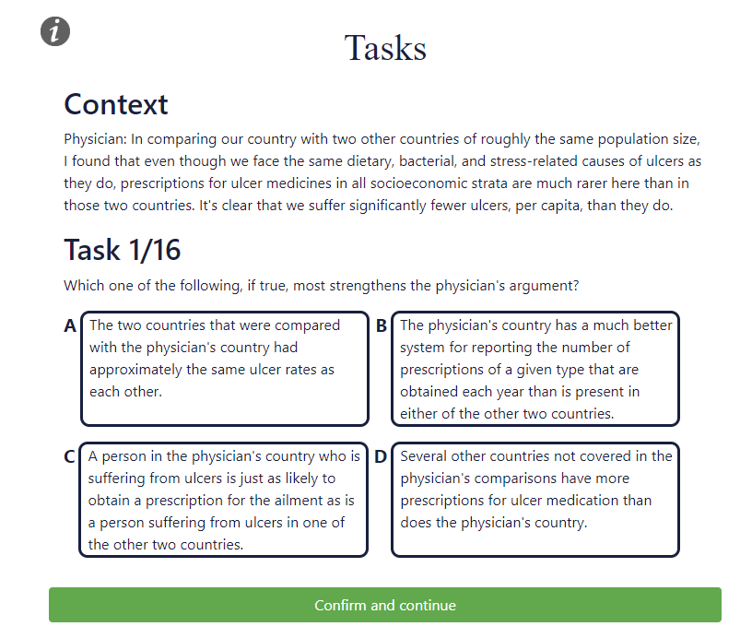
Task Selection
Logical question answering with four candidates and context paragraph
Why this task?
Adopted by existing work for empirical study of Human-AI Decision Making
To systematically study DKE
Two-stage decision making
Figure 1. Screenshot of first page of decision making.
https://whyu.me/reclor/
Notes:
We selected logical question answering task for our study.
In this task, users will answer a logical question based on one context paragraph and four answer candidates.
This task was chosen as a realistic scenario for human-AI collaboration, where most laypeople can work with but still benefit from introducing AI assistant.
Meanwhile, according to existing literature, Dunning-Kruger effect can be triggered in the context of logical reasoning.
In our experiment, for each decision making task, we adopted a two-stage decision making setup.
In the first stage, only task information was provided, and participants were asked to make decisions themselves.

Slide 10
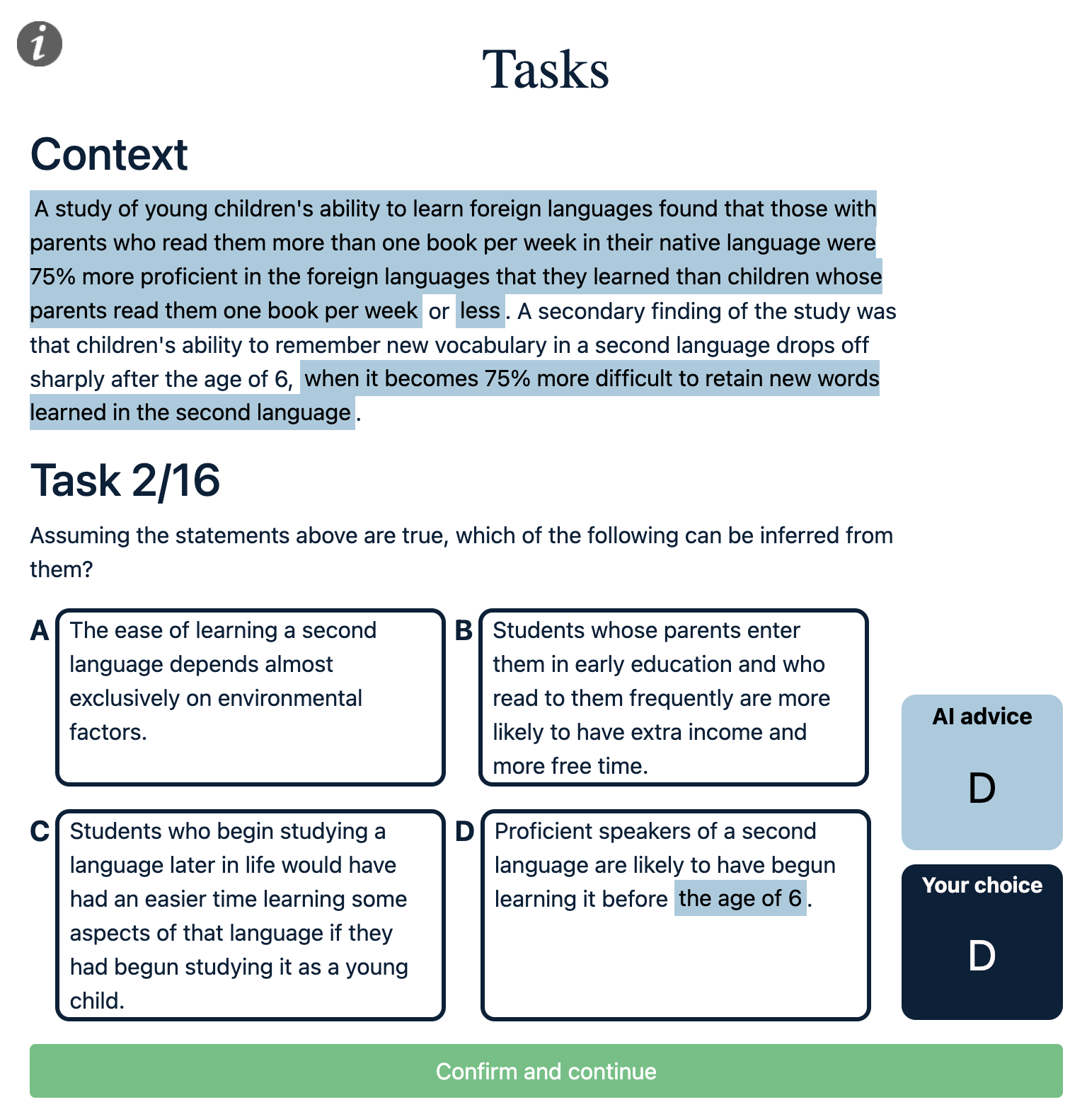
XAI Intervention
Two-stage Decision Making Setup
Logic units-based explanations
Logic units (light blue highlight), obtained from the attention weight of Transformer network
Figure 2. Screenshot of second stage of decision making with logic units-based explanations.
Logiformer: A Two-branch Graph Transformer Network for Interpretable Logical Reasoning (SIGIR 2022)
Notes:
After that, we showed the same task with AI advice (and explanations depending on the experimental condition) and provided an opportunity for the participants to alter their initial choice.
One example is shown at the left panel.
With the recent work of interpretable logical reasoning with logic units, we adopted logic units-based explanations as XAI intervention in our study.
In the left panel, the top-5 text spans are highlighted to help participants interpret the AI advice.

Slide 11
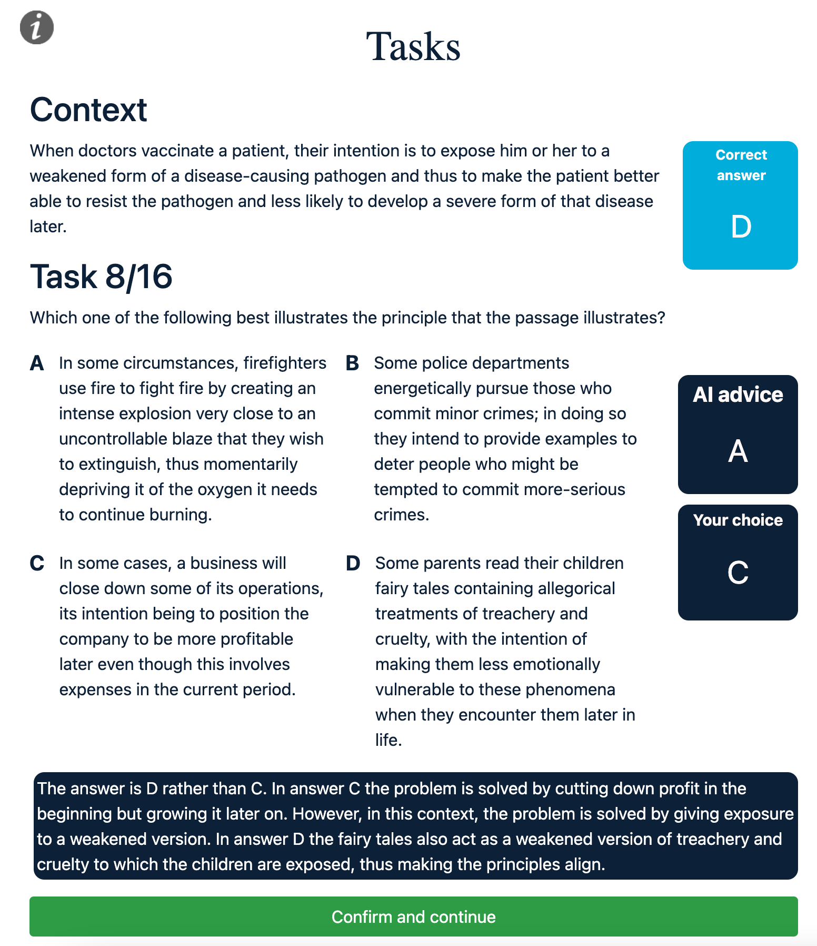
Tutorial Intervention
Performance feedback + contrastive explanations
Performance feedback
Point out the mistakes in user choice
Contrastive explanation
Manual curated contrastive explanations to clarify users’ mistakes
Figure 3. Screenshot of tutorial intervention.
Notes:
Inspired by existing work to mitigate different kinds of cognitive biases through revealing such biases to users, we decided to adopt a tutorial to help users calibrate their skills through self-assessment on logical reasoning tasks.
To this end, we designed a tutorial with the aim of revealing to users that they may not be as capable in such tasks as they may believe.
Furthermore, to ensure the effectiveness of revealing their mistakes, we designed contrastive explanations for users.
For example, here we explained that why the correct answer is option D instead of user choice C.

Slide 12




Hypothesis
Overestimated self-assessment as an indicator of DKE
H1: Users overestimating their own performance will demonstrate relatively less reliance on AI systems than users demonstrating accurate self-assessment.
H2: Making users aware of their miscalibrated self-assessment will help them improve their self-assessment.
H3: Making users aware of their miscalibrated self-assessment will result in relatively more appropriate reliance on AI systems.
H4: Providing performance feedback and meaningful explanations can facilitate appropriate reliance on the AI system.
Notes:
Informed by prior work, we consider overestimated self-assessment in the context of human-AI decision making as an indicator of the DKE and explore it further
To answer our research questions, and based on existing literature, we proposed four hypotheses considering:
first, the effect of the overestimation of performance on (appropriate) reliance,
Then, the effect of the tutorial intervention on self-assessment calibration and (appropriate) reliance,
Finally, the effect of logic units-based explanations and tutorial intervention on reliance and team performance.
Next, I will show you our study design and experimental results

Slide 13
Experimental Design
Four conditions (2 × 2):
XAI × Tutorial
Two batches of tasks with equivalent difficulty
Participants: Crowd workers from Prolific
63 (× Tutorial,× XAI)
62 (✓ Tutorial,× XAI)
62 (× Tutorial,✓ XAI)
62 (✓ Tutorial,✓ XAI)
Figure 4. This flow chart describes the experimental condition ✓ Tutorial,✓ XAI. Blue boxes represent the questionnaire phase, orange boxes represent the task phase.
Notes:
In our study, we considered a two by two factorial design with four experimental conditions.
The figure at the left panel illustrate the procedure participants worked in our study.
First, they read the basic instructions, and fill in some pre-task questionnaire for collecting user properties.
Then based on different experimental conditions, they will go through two task sessions and one tutorial session.
In conditions without tutorial, participants will work on four tasks without any feedback.
The number of participants also get balanced across the four conditions. After each task batch, participants will be asked to indicate their self-assessment of performance, subject trust in AI system. And the helpfulness of explanations are assessed if they are provided with logic units-based explanations.

Slide 14


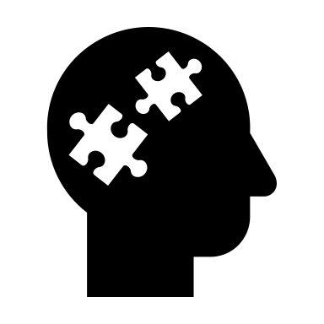
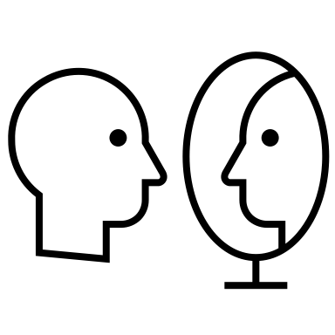
Dependent Variables
Performance
Accuracy
Reliance
Agreement Fraction
Switch Fraction
Appropriate Reliance
RAIR, RSR
Accuracy with initial disagreement
Assessment
Degree of miscalibration
…
Notes:
To verify our hypothesis, we considered mainly four types of dependent variables.
First, user performance, which is mainly assessed by accuracy.
Second, user reliance and appropriate reliance, which is measured by agreement fraction, switch fraction, RAIR, RSR and accuracy with initial disagreement
Third, user self-assessment of their performance on each batch of tasks, and the extent of miscalibration of such assessment.
For more details of our study design, please refer to our paper

Slide 15
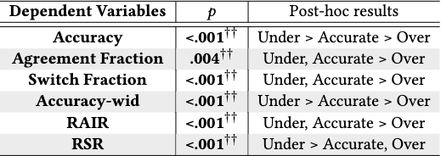
Main Results – H1
H1: Users overestimating their own performance will demonstrate relatively less reliance on AI systems than users demonstrating accurate self-assessment.
Overall, Under > Accurate > Over exist for performance metric Accuracy, Accuracy-wid and RSR
H1 is supported by our experimental results.
Table 2. Kruskal-Wallis H-test results for inflated self-assessments (H1) on reliance-based dependent variables.
Notes:
To verify hypothesis one, we compared participants’ reliance on the AI system with regard to different self-assessment on the first batch of tasks
Overall, the results indicate that participants who overestimated their performance tend to rely less on the AI system, and showed worse performance as well as appropriate reliance.
Thus, hypothesis one is supported by our experimental results.

Slide 16
Main Results – H2 & H3
H2: Making users aware of their miscalibrated self-assessment will help them improve their self-assessment.
participants’ perception of human-AI team performance improves
H3: Making users aware of their miscalibrated self-assessment will result in relatively more appropriate reliance on AI systems.
Participants with initial overestimation showed improved appropriate reliance;
Participants with initial underestimation showed worse appropriate reliance and accuracy
H2 is supported, H3 is partially supported
Notes:
To verify hypothesis 2 and hypothesis 3, we compared the self-assessment and reliance measures before and after the tutorial intervention.
The results show that, after providing the performance feedback, participants’ perception of team performance get calibrated, which is in support of our hypothesis two.
Meanwhile, we found that the tutorial intervention showed different impact on participants with different initial self-assessment.
For participants who initially overestimated their own performance, they showed better appropriate reliance after the tutorial intervention.
While participants with initial underestimation, showed worse appropriate reliance and accuracy.
Thus, hypothesis three is only partially supported.

Slide 17
Experimental Results: Summary
Hypothesis | Conclusion
H1: Users overestimating their own performance will demonstrate relatively less reliance on AI systems than users demonstrating accurate self-assessment. | Supported
H2: Making users aware of their miscalibrated self-assessment, will help them improve their self-assessment. | Supported
H3: Making users aware of their miscalibrated self-assessment will result in relatively more appropriate reliance on AI systems. | Partially supported
H4: Providing performance feedback and meaningful explanations can facilitate appropriate reliance on the AI system. | Not supported
Notes:
In summary, our hypothesis 1, 2, 3 are supported by the experimental results; while no support for hypothesis 4.

Slide 18
Main Takeaways
Users who overestimate their performance tend to exhibit under-reliance on AI systems, which hinders optimal team performance
The designed tutorial intervention can help users calibrate their self-assessment and facilitate appropriate reliance among participants with DKE; but it can also hurt the appropriate reliance of participants with underestimated self-assessment
A more effective tutorial to promote appropriate reliance can be one that helps users understand both themselves and AI systems, and not only revealing the weakness but also showing the strengths of each.
Notes:
In this work, we have three main takeaways:
First, Users who overestimate their performance tend to exhibit under-reliance on AI systems, which hinders optimal team performance
Second, The designed tutorial intervention can help users calibrate their self-assessment and facilitate appropriate reliance among participants with DKE; but it can also hurt the appropriate reliance of participants with underestimated self-assessment
Third, A more effective tutorial to promote appropriate reliance can be one that helps users understand both themselves and AI systems, and not only revealing the weakness but also showing the strengths of each.

Slide 19



Q & A
Code and data available:
https://github.com/RichardHGL/CHI2023_DKE
Thanks for listening!
See more of our related work:
Contact: g.he@tudelft.nl
Notes:
Thanks for your time and listening! Any questions? Please contact me with email

Slide 20
Human-AI Decision Making
Human-AI Decision Making
Across high-stakes domains (e.g., financial and medical domains)
Human factors matter
Goal: Appropriate Reliance (AR)
Complementary team performance
Over-reliance and Under-reliance
Interventions to facilitate AR (e.g., Explainable AI)
Picture from https://enterprisetalk.com/featured/can-ai-eliminate-bias-from-decision-making/
Notes:
In recent years, attracted by the predictive capability of AI systems, researchers and practitioners have started to adopt such systems to support human decision makers in critical domains (like financial and medical domains).
In such a collaborative decision process, human factors like knowledge, mindset, cognitive bias are important for trust in the AI system and for human reliance on the system.
With the wish of complementary team performance, one goal of such human-AI collaboration is appropriate reliance: which means human decision makers rely on an AI system when it is more accurate than humans and do not rely on it when the system is inaccurate.
However, users typically don’t know when they should rely on the AI system, which results in under-reliance and over-reliance. To mitigate these unexpected reliance behaviors, researchers proposed multiple interventions to facilitate appropriate reliance. For example, explainable AI.

Slide 21
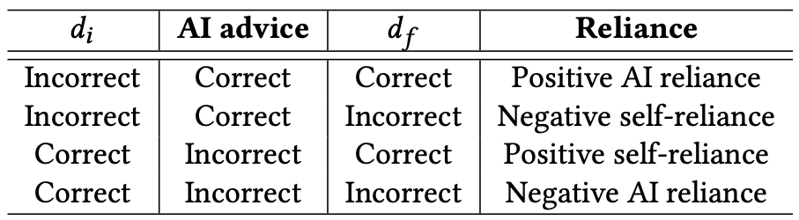
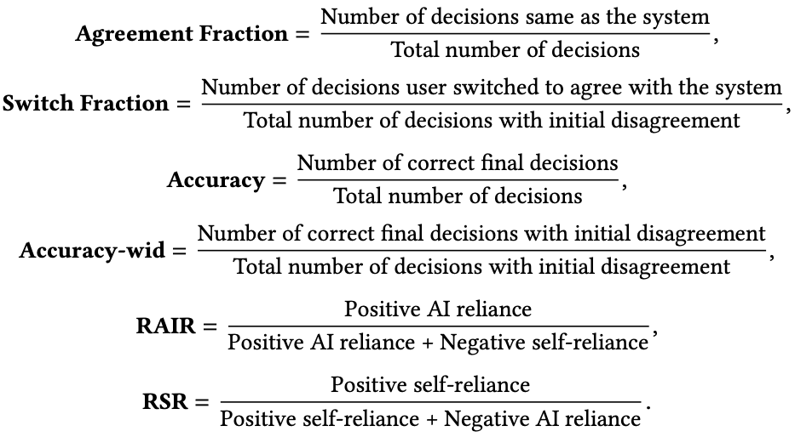

Variables
Simplify slides
Table 1. Reliance Patterns. $d_{i}$ is initial human decision, while $d_{f}$ is the final decision after AI advice.
Performance
Accuracy
Reliance
Agreement Fraction
Switch Fraction
Appropriate Reliance
RAIR, RSR
Accuracy with initial disagreement
Assessment
Degree of miscalibration
…
Notes:
To verify our hypothesis, we considered mainly four types of dependent variables.
First, user performance, which is mainly assessed by accuracy.
Second, user reliance and appropriate reliance, which is measured by agreement fraction, switch fraction, RAIR, RSR and accuracy with initial disagreement
Third, user self-assessment of their performance on each batch of tasks, and the extent of miscalibration of such assessment.
For more details of our study design, please refer to our paper

Slide 22
Main Results – H4
H4: Providing performance feedback and meaningful explanations can facilitate appropriate reliance on the AI system.
Two-way ANOVA to compare the performance and (appropriate) reliance measures of participants, only the second batch of tasks are considered
No significant effect is found -> H4 is not supported
Explanation for H4 results:
The effect of tutorial on participants who under-estimated themselves and over-estimated themselves get cancelled
The logic units-based explanations does not show any effect in reliving DKE or facilitating appropriate reliance
Notes:
To verify hypo 4, we conducted two-way ANOVA to compare the performance and (appropriate) reliance measures of participants.
As the tutorial intervention is after the first batch of tasks, only the second batch of tasks are considered
Here, we found no significant effect with each intervention and their interaction effect.
Combined with the findings from H1 – H3, we can explain such findings:
First, the effect of tutorial intervention on participants with underestimation and overestimation of their own performance get cancelled.
As we see in H3 results, participants who initially under-estimated their performance showed worse appropriate reliance and performance after receiving the tutorial intervention.
While participants who over-estimated their performance

