Slide 1








Plan-Then-Execute: An Empirical Study of User Trust and Team Performance When Using LLM Agents As A Daily Assistant
Gaole He, Gianluca Demartini, Ujwal Gadiraju
Notes:
Hello, everyone!
Today, I will show you our recent work – an empirical study about user trust and team performance when using LLM agents as a daily assistant.

Slide 2
Background & Motivation
Notes:
To begin with, we introduce the background and motivation of this work

Slide 3
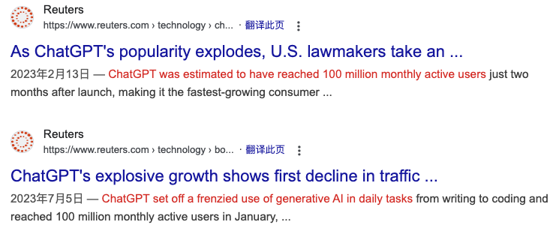
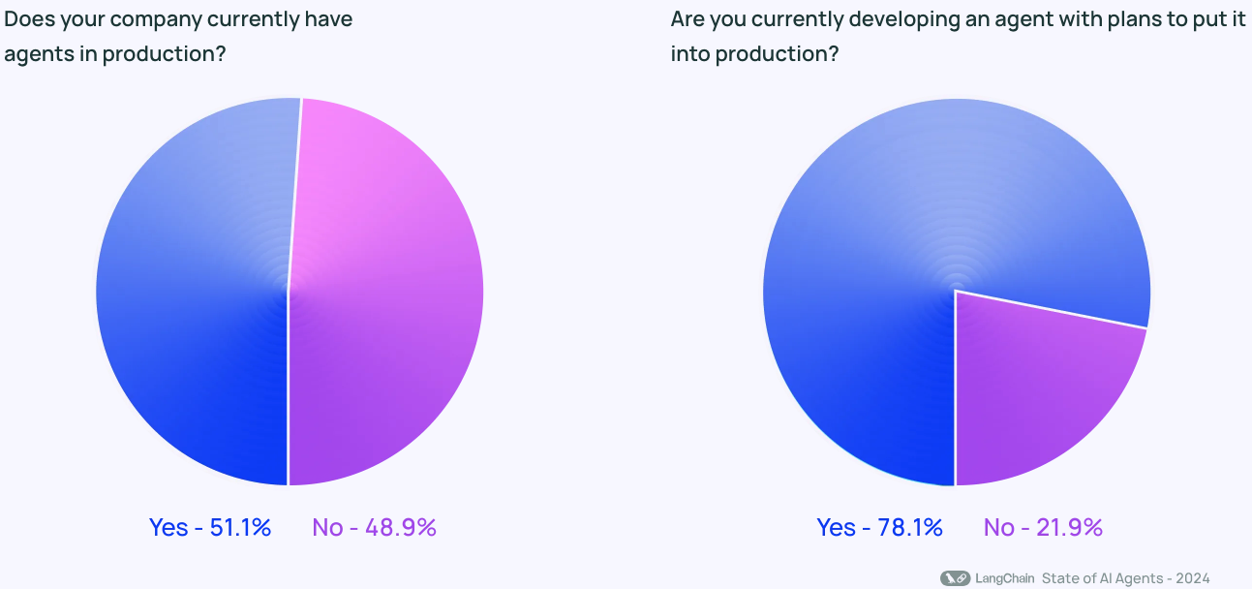
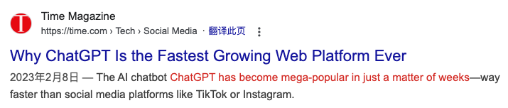
Rise of LLMs and LLM Agents
Background | Motivation | Method | Results
Notes:
Since the explosion in popularity of ChatGPT, LLMs have continuously impact our daily life.
Equipped with external tools, LLM agents have shown increasing capabilities to assist humans in their daily work.
According to Langchain survey in 2024, more than half survey participants are developing or consider to develop and use AI agent in production.

Slide 4






Our focus: plan-then-execute LLM agents
I have a task for you. Can you …?
User
1
Planning
Executable Plan
Sure. I followed three steps to work on it:
xxx (2) yyy (3) zzz.
Finally, the outcome is …
LLM Agent
Execution
Action Sequence
2
Background | Motivation | Method | Results
Notes:
In our work, we adopted plan-then-execute workflow for LLM agents.
Here is one example of how plan-then-execute LLM agent works.
First, after users send a task request, the LLM agent generates a step-wise plan formulated with a hierarchical structure.
Then, the LLM agent executes the generated plan by transforming it into a sequence of actions.
The benefits of such a plan-then-execute framing are three-fold:
First, Compared to a dynamic process where planning and execution are bound closely, separating planning and execution into two stages provides more task clarity to the users.
Second, with planning at the beginning of the task, users can develop a global understanding of how the LLM agents will execute the task.
Third, Planning and execution are representative abstractions of how LLM agents work.
The findings of such an empirical study can be generalized to human-AI collaboration with other kinds of LLM agents

Slide 5



LLM Agents as Daily Assistants
Flight Ticket Booking
Credit Card Payment
Itinerary Planning
Why LLM agents as daily assistants
Step-wise planning, easy for humans to understand
Reduced manual efforts, e.g., information seeking and information filtering
Real-time execution with action sequences, users can delegate or involve
Background | Motivation | Method | Results
Notes:
Compared to existing deep learning and LLM-based methods, LLM agents provide more flexibility in task solving and user interaction, which makes them suitable for daily assistance.
This is primarily due to three reasons.
First, the LLM agents can generate a step-wise plan according to user request, which can be easily understood by humans.
Second, when interacting with LLM agents, users don’t need to control the toolkits directly.
Instead, they follows a more natural conversation to communicate with LLM agents, which reduced manual efforts.
For example, LLM agents can complete time-consuming jobs like information seeking and information filtering.
For example in booking a flight ticket, the searching process can be time-consuming.
Third, the final outcomes of LLM agents can be generated with execution of action sequences, which facilitated both user involvement and task delegation.

Slide 6
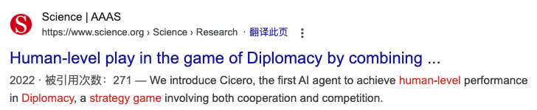

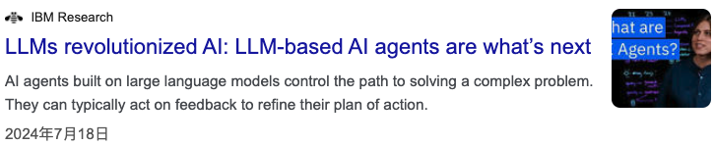
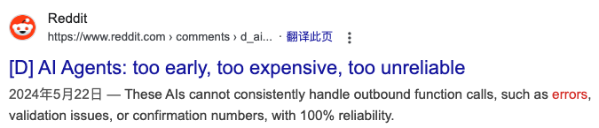
Challenges in Automating LLM Agents
Background | Motivation | Method | Results
Notes:
Existing work on automated task completion has revealed that LLM agents can handle complex tasks like playing games and answering complex questions.
However, such agents are still far from perfect.
There is much uncertainty in automating LLM agents
Thus, people raise concerns about their reliability.

Slide 7
Challenges in Automating LLM Agents
RQ1: How does human involvement in the high-level planning and real-time execution shape their trust in an AI system powered by LLM agents?
RQ2: How does human involvement in the high-level planning and real-time execution of tasks with an AI system powered by LLM agents affect the overall task performance?
User Involvement can address these concerns
Function | Challenges | Benefits of Human-AI Collaboration
Planning
Execution
LLMs’ ability to generate executable plans autonomously is rather limited
Reduce human efforts in generating a reliable plan from scratch
Probabilistic nature of LLMs
Potential errors leads to unintended or unexpected consequences
User control over the real-time execution process
Background | Motivation | Method | Results
Notes:
Based on our focus, we figured out potential challenges in the planning and execution stages of LLM agents.
According to previous work, planning experts found that “LLMs’ ability to generate executable plans autonomously is rather limited”.
Meanwhile, there is much uncertainty in automating LLM agents for tasks with high risks attached.
Potential errors in these scenarios can cause unintended or unexpected consequences.
Human-AI collaboration may address such concerns.
For example, humans can potentially be a good planner who can work in conjunction and optimize plans drafted by LLMs.
Such human-AI collaboration can reduce human efforts in generating a reliable plan from scratch.
At the same time, with necessary user involvement in the execution stage, users can control over the execution process, which can fix potential errors
Thus, in this paper, we proposed to analyzed the impact of user involvement in the planning and the execution stages on user trust and overall task performance.

Slide 8
Method
Notes:
Then, I will show you the designed user involvement within plan-then-execute LLM agents and our study design

Slide 9

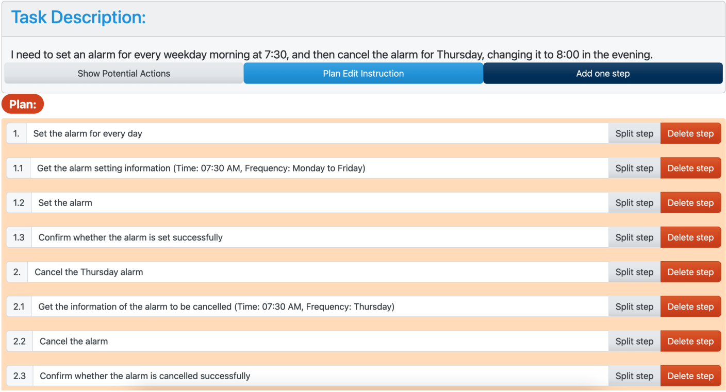
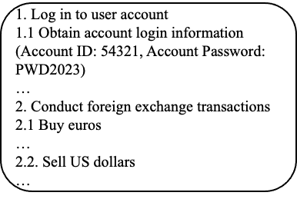
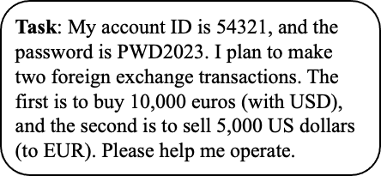

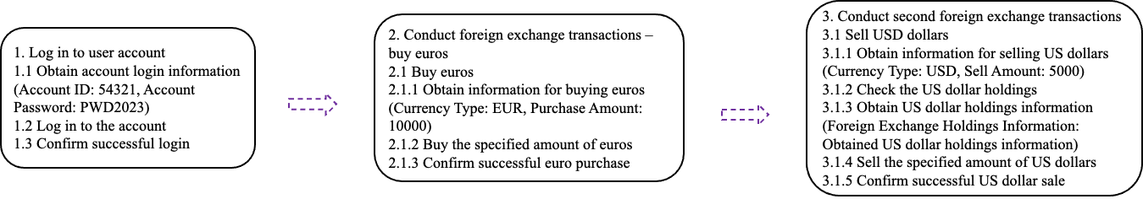
User-involved Planning
LLM Planning
Plan Edit
Background | Motivation | Method | Results
Notes:
After users send a task request, the LLM agent first generates a step-wise plan with LLMs.
Then users will base on the draft plan to edit it and improve it.
To help users edit the step-wise plan, we allow users to add step, delete step, edit step, and split step.
After that, we can get a step-wise plan as input for the execution stage.

Slide 10
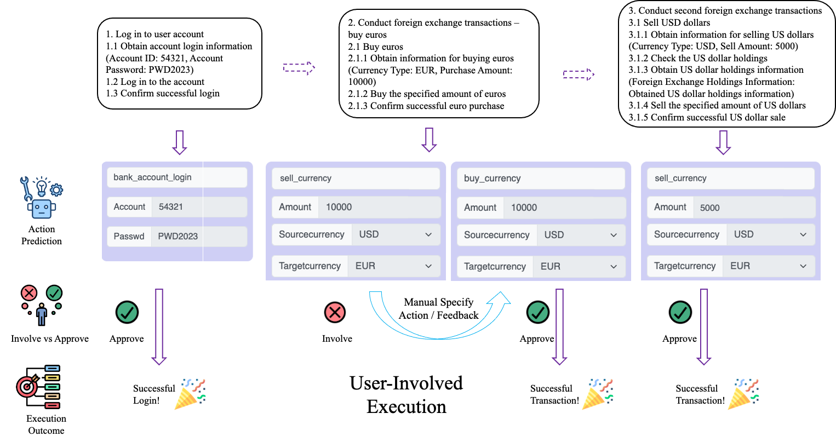
User-involved Execution
Background | Motivation | Method | Results
Notes:
In the execution stage, the LLM agent executes the outcome of the planning stage in a step-by-step manner.
In each step, the LLM agent translates a single step of the plan into one action, which is implemented with an API call in the backend.
Here, LLM agent predict the bank account login as the action to execute.
It is correct, and the user approved it.

Slide 11
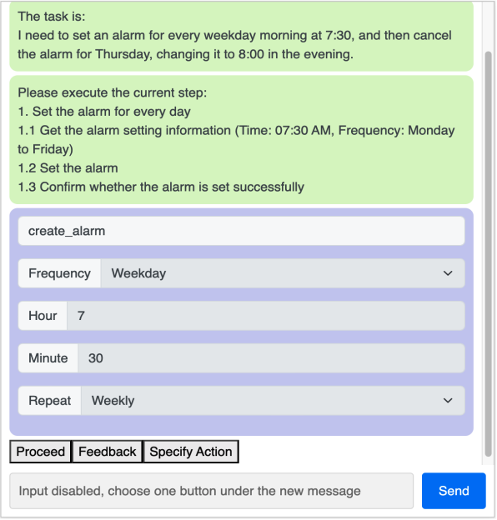
User-involved Execution
Background | Motivation | Method | Results
Notes:
However, it is also possible that, users find the action to execute mismatch the task description.
Then he can choose to involve.
In the second step of the example, the users found that it should be ‘buy currecy instead of sell currecy.
Then he chooses to involve.
In our study, users can choose to give text feedback to LLM agent or manually specify one action to execute.
They’re implemented as feedback button and ‘specify action’ button in the interface.
If users click proceed, the LLM agent will directly execute the current predicted action.

Slide 12
User-involved Execution
Background | Motivation | Method | Results
Notes:
After the whole plan is executed, we obtained a sequence of actions.
And use it as evidence to evaluate the task outcomes.

Slide 13
Study Design & Hypothesis
H1: Compared to automatic planning, user-involved planning will result in a higher calibrated trust in the plan.
H2: Compared to automatic planning, user-involved planning will result in better overall task performance.
H3: Compared to automatic execution, user-involved execution will result in a higher calibrated trust in execution outcome.
H4: Compared to automatic execution, user-involved execution will result in better overall task performance.
2 × 2 factorial design
Automatic planning (AP) vs User-involved planning (UP)
Automatic execution (AE) vs User-involved execution (UE)
Prolific Participants (N =248)
AP-AE (63)
AP-UE (64)
UP-AE (61)
UP-UE (60)
Background | Motivation | Method | Results
Notes:
In our study, we adopted a two by two factorial design which mainly considers the user involvement in the planning stage and user involvement in the execution stage.
To answer our research questions, we considered automatic and user-involved version in each factor.
As we mentioned earlier, user involvement in the planning and execution provides users a potential chance to fix imperfect plan steps and actions.
As a result, users may calibrate their trust in the LLM agent and contribute to the overall task performance.
Thus, in all hypothesis, we assume that the user involvement will be beneficial to both calibrated trust and task performance.

Slide 14



Tasks
Data source: UltraTool benchmark
Perceived risk (based on pilot study): 3 high-risk tasks, 3 low-risk tasks
Task Domain: six life daily tasks covering five domains
Task Complexity: number of actions to execute + number of concepts in task description
Correctness of generated plans: imperfect plan vs correct plan
Credit Card Payment
Currency Transaction
Alarm setting
Flight Ticket Booking
Itinerary Planning
Repair Appointment
Background | Motivation | Method | Results
Notes:
To analyze how LLM agents can serve as daily assistants, we adopted tasks from a planning dataset designed for LLM agents — UltraTool.
Finally, we obtained tasks which are balanced concerning perceived risk, task complexity and correctness of generated plans.
The selected tasks cover daily scenarios including credit card payment, currency transaction, alarm setting, flight ticket booking, trip planning, and repair service appointments.

Slide 15




Procedure
Informed
Consent
Pre-task
Questionnaire
Onboarding
Tutorial
Task Phase
Post-task
Questionnaire
LLM Expertise
Automatic Assistant Expertise
Introduction
LLM agent tutorial
Example task with explanation
plan-then-execute workflows
Trust, confidence, risk perception
Trust-in-automation
NASA-TLX
Open feedback (planning, execution, other)
Background | Motivation | Method | Results
Notes:
This flow chart illustrates the procedure of our study.
First, participants will be asked to check the informed consent for data collection and the study’s purpose.
Next, they were asked to complete a pre-task questionnaire to measure their expertise in LLMs and automatic assistants.
With an onboarding tutorial, we showcased the necessary interactions that participants were expected to perform in the planning and execution stages.
An example task was used to help participants understand how to work with the plan-then-execute LLM agent.
After that, participants worked on the selected tasks.
Finally, we collected trust-in-automation questionnaire, NASA-TLX questionnaire, and open feedback to gather general trust, cognitive load, and user opinion towards our system
For more details about our study design, please refer to our paper.

Slide 16
Results & Interpretation
Notes:
Then, we show the main results and our interpretation

Slide 17
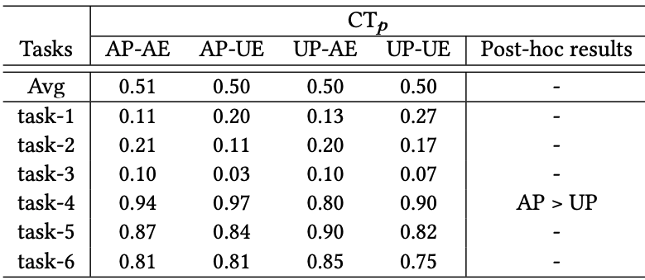
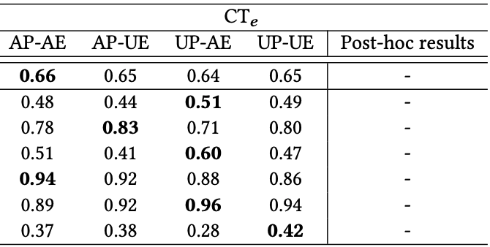
Impact of User Involvement on Calibrated Trust
Table. 2 Task-specific evaluation results for user-involvement in planning on calibrated trust in planning (CT$p$)
Table. 3 Task-specific evaluation results for user-involvement in execution on calibrated trust in execution (CT$e$)
User involvement in planning can hurt calibrated trust in planning
User involvement not necessarily help calibrate user trust (H1 and H3 are not supported)
Overall, users tend to trust the plan (to be correct) no matter whether the plan is correct
Background | Motivation | Method | Results
Notes:
We analyzed the impact of user involvement on calibrated trust for planning and execution stages.
Only in task-4, we found user involvement in planning will have a negative impact on calibrated trust in planning.
Thus, H1 and H3 are not supported.
We noticed that the calibrated trust in planning is quite low in the high-risk tasks where all initial plans are imperfect.
This indicates that many users across all conditions consider the generated plan trustworthy.

Slide 18
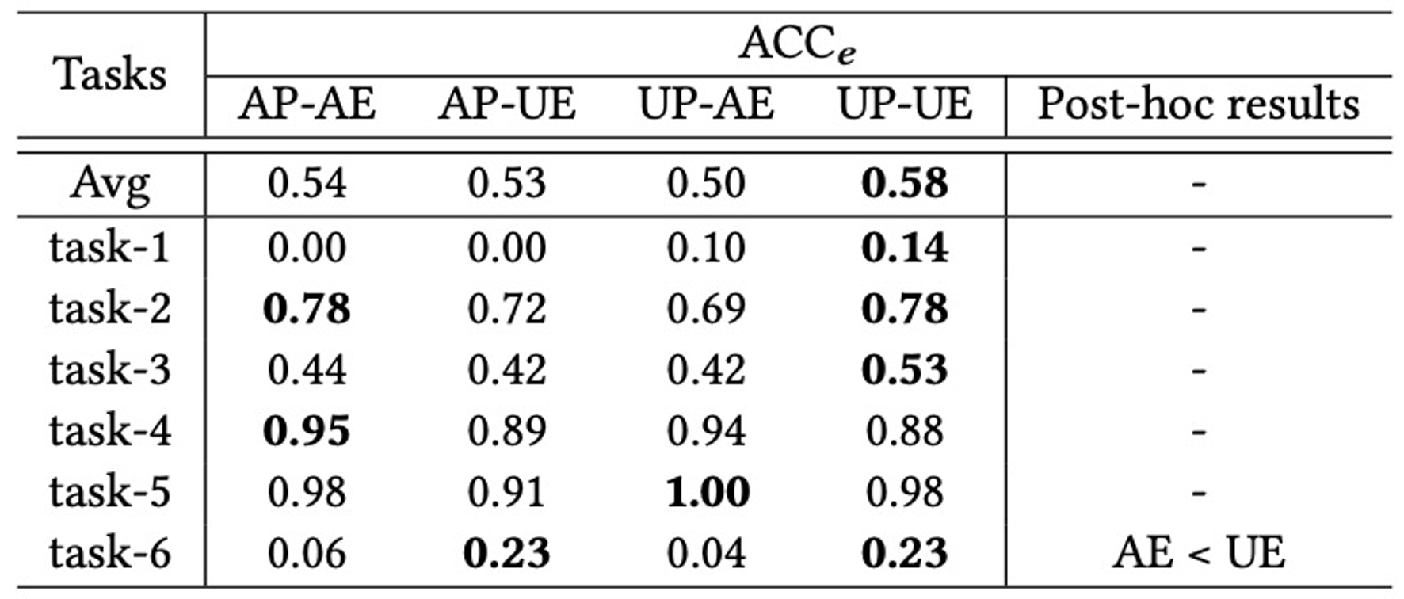
Impact of User Involvement in Execution on Task Performance
Participants who involved in the execution stage obtained the better task outcomes
Correcting potential flawed actions
Significant on task-6
As the results are not consistent across all tasks. These results are not enough to strictly support H4
Table. Task-specific evaluation results for user-involvement in planning on execution accuracy
Background | Motivation | Method | Results
Notes:
We also analyzed the impact of user involvement on overall task performance.
Compared to the user involvement in the planning stage, user involvement in the execution stage provides more stable positive impact on task performance
As we can see, participants in condition user-involved planning and user-involved execution shows the best execution accuracy in more tasks.
And it’s significant in task-6
However, the results are not consistent across all tasks.
Thus, it is not enough to strictly support Hypothesis four.

Slide 19
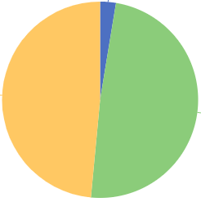
Failure Analysis
Wrong Action Name
2.6%
Plan Quality | Execution Accuracy
1 - 2 | 1.8%
3-4 | 59%
5 | 66.7%
Invalid
Action
48.5%
Wrong Parameter 48.9%
Table. Execution accuracy with varying plan quality.
Figure. Failure analysis on tasks with a high-quality plan
Background | Motivation | Method | Results
Notes:
To understand why the failures in tasks, we mainly analyzed the plan quality and error types.
We calculated the average execution accuracy on different plan quality.
We found plan quality substantially affected task execution accuracy.
On tasks with a poor plan quality, the execution accuracy is extremely low.
To control the impact of plan quality, we only checked the error types on tasks with a high-quality plan.
In these cases, the LLM agent mainly fail due to wrong parameter prediction and invalid action prediction.

Slide 20
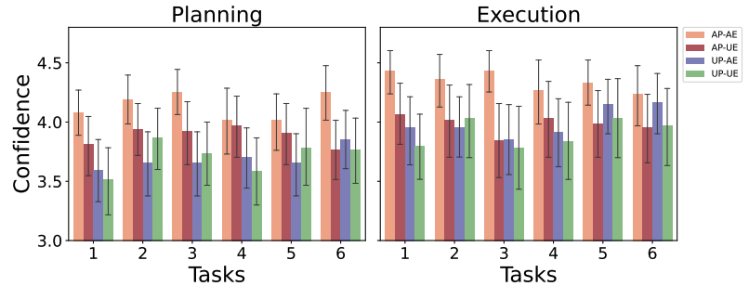
Impact of User Involvement on User Confidence
Figure. Bar plot for confidence dynamics, the x-axis denotes the task ordering index
User Involvement will decrease user confidence, but increase cognitive load
User confidence in planning: AP-AE > UP-AE,UP-UE
User confidence in execution: AP-AE > AP-UE, UP-UE
Background | Motivation | Method | Results
Notes:
With an exploratory analysis about user confidence, we found that user involvement in both planning and execution stages lead to significantly lower user confidence.
But at the same time, we also observe the user involvement will pose a higher cognitive load on users.

Slide 21



Key Findings
Positive
findings
User involvement can fix imperfect plan
User involvement can benefit task performance
Negative
findings
User involvement may hurt high-quality plans
User involvement fails to calibrate user trust
User involvement may cause higher cognitive load and lower user confidence
Other
findings
Some user factors may cause miscalibrated trust and reduced risk perception
Users often trust LLM outcomes despite flaws, hindering trust calibration.
Background | Motivation | Method | Results
Notes:
To summarize, we found that the user involvement can fix imperfect plans and benefit task performance.
However, user involvement may also hurt high-quality plans.
And in our study, user involvement fails to calibrate user trust.
Furthermore, too much user involvement can pose high cognitive load on users and negatively affect user confidence
Besides them, we also find some user factors like LLM expertise may cause miscalibrated trust and reduce risk perception
Meanwhile, user often trust LLM outcomes despite its correctness, which hinders trust calibration

Slide 22

Implications
Necessity of
User Involvement
Human Oversight and Designing Flexible Collaborative Workflows
01
03
User involvement can be necessary to achieve reliable outcomes, e.g., fix imperfect plan and prevent risky actions.
We may need a more flexible collaborative workflow where humans can fix planning and execution simultaneously
04
02
Impact of Convincingly Wrong Content
User Involvement Trade-off
Convincingly wrong content can bias user trust and reliance towards the extremes.
Too much human involvement in collaboration with plan-then-execute LLM agents can be undesirable.
Background | Motivation | Method | Results
Notes:
Based on our findings, we provide four main implications.
First, user involvement can be necessary to ensure the reliability of task outcomes
Second, user involvement may pose a high cognitive load on users and negatively impact user confidence.
Thus, too much user involvement may be undesirable.
Third, we may need a more flexible collaborative workflow to facilitate user involvement
And lastly, convincingly wrong content may bias user trust and reliance towards extremes.

Slide 23


Q & A
Code and data available:
https://github.com/RichardHGL/CHI2025_Plan-then-Execute_LLMAgent
Take-aways
LLM agents can provide plausible text plans to cover task requirements, which can be convincingly wrong
Plan quality substantially affects the subsequent execution accuracy
User involvement in planning may harm task plan quality where the original plan is good
User involvement in execution brings a more stable positive impact on task performance
User involvement in the LLM agent workflow can be important in ensuring reliable task outcomes
For your interest about conversational XAI interface, readers can refer to our recent paper:
Gaole He, Nilay Aishwarya, Ujwal Gadiraju. (2025). Is Conversational XAI All You Need? Human-AI Decision Making With a Conversational XAI Assistant. IUI 2025
Background | Motivation | Method | Results
Notes:
That’s it. Thanks for your time and listening!
The code and data can be found in Github.
If you’re also interested in conversational XAI interface, you can refer to our recent paper in IUI.

