Slide 1
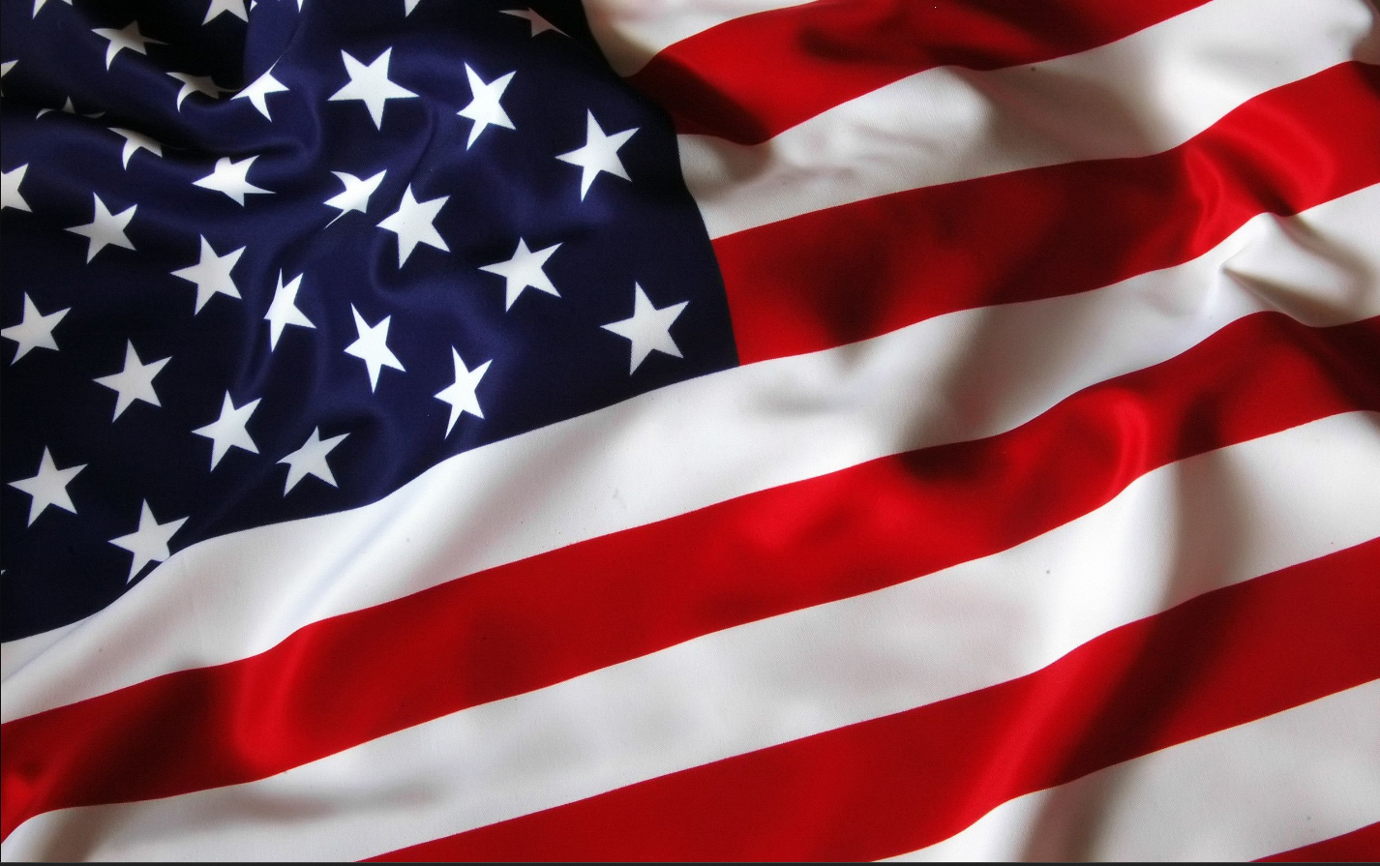
Patty Hamilton Candidate For the 12th District State Representative

Slide 2
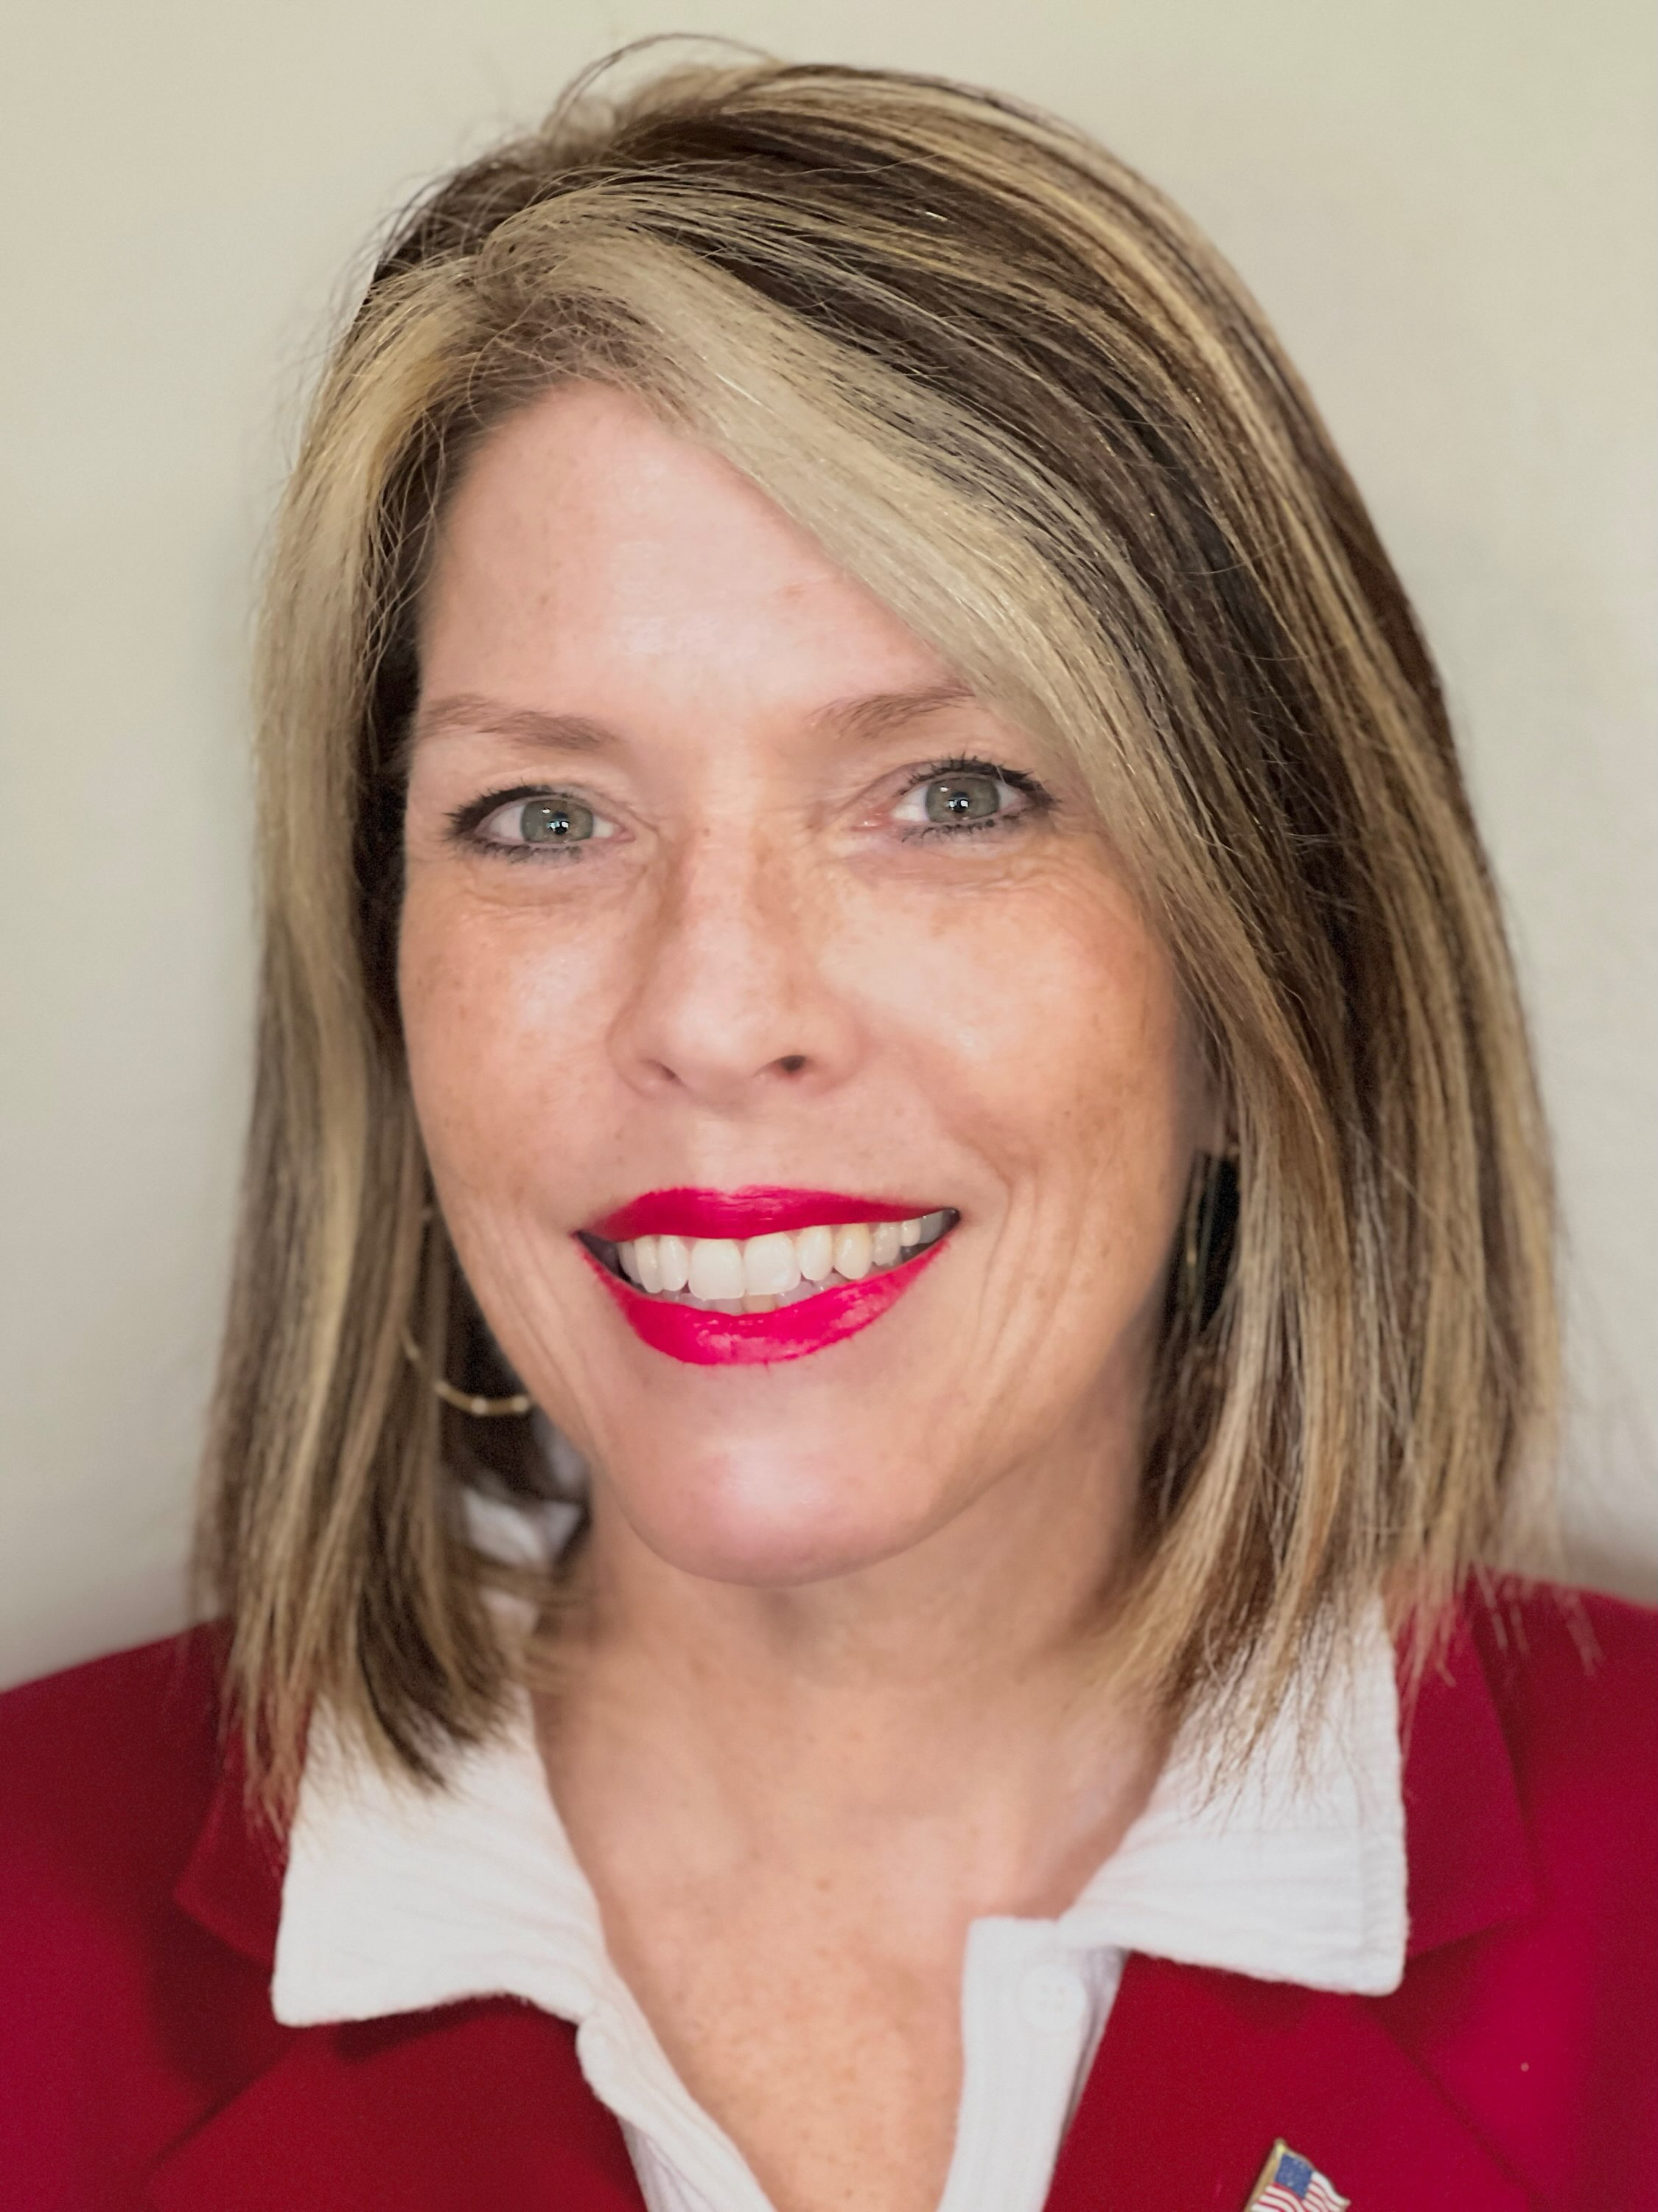

Slide 3
WHO I AM
I am Patty Hamilton, and I am a Republican running in upcoming Republican Primary which will take place on
March 19, 2024, to become the State Representative for the 12th District, and to serve in the Ohio House of
Representatives. My district covers all of Madison County, Pickaway County, and lower Franklin County.
I am currently a landlord of 10 high quality rental houses of which my husband and I,
along with our 3 sons, have renovated.
I am member of the Pickaway County Republican Central Committee, for the past two years,
and am the secretary. I am a member of the America First Now (AFN) group, Ohio Farm Bureau member,
and the Pickaway County Agricultural Society. I am a 4 year member of the Soldier’s Monumental
Association (SMA) and am currently serving as the Treasurer and Corresponding Secretary.
I am very knowledgeable on various guns, have my Concealed Carry Weapon (CCW) permit, and am an
NRA member. I am a lifetime member of the Veterans of Foreign Wars (VFW) and a member of the Pickaway
County Sportsman Club.

Slide 4
Biographical Summary
I served for 30 years in the Army Reserves as a Military Police Officer; I am a retired Lieutenant Colonel
with Combat tours of duty in both Iraq and Afghanistan. In Iraq during the Operation Iraqi Freedom (OIF),
as the Theater Detainee Reporting Center Chief. In Afghanistan during Operation Enduring Freedom (OEF),
as the Provost Marshal for Kandahar Airfield and Customs Clearance AOfficer in Charge of all of Afghanistan.
I worked one year at the Pentagon, as the National Detainee Reporting Center Operations Officer.
My last assignment was two years as the Battalion Commander of a Military Police Training Battalion.
While in the Army, I earned the Legion of Merit Medal, Bronze Star Medal, Defense Meritorious Service Medal,
Meritorious Service Medal and many other awards and decorations.
My Military Training Consists of Basic Combat Training, Military Police School, Officers Basic Course,
Airlift Planners Course, Air Movement Course, Hazardous Materials, Adjutant General School,
Officers Advanced Course, Mobilization Planners Course, Hand-to-hand Combat Training,
Drug Demand Reduction Course, Commander’s Course, Army Master Fitness Course,
Combined Arms and Services Staff School (CAS3),
Command and General Staff College (CGSS) / Intermediate Level Education (ILE).

Slide 5
Biographical Summary
page 2
I had many different civilian jobs because my husband was an Active duty Command Sergeant Major for
over 29 years. Therefore, I changed civilian jobs every time we moved from state to state and to different countries.
Some of my work experience includes: being a Community Based Outpatient Clinic (CBOC) Manager
at the Department of Veterans Affairs in Lancaster and as the Transition Patient Advocate for OIF/OEF Veterans
at the Chillicothe VA Hospital, a school teacher in NC, SC, GA, a tax preparer,
a nursing home certified medical technician, a Law Office legal assistant, a Police Officer in the Marshall Islands,
an exchange detective for Army Air Force Exchange Service (AFFES), an Inventory Management Auditor,
a Raytheon accounting collections Manager.
My civilian education consists of a Master’s of Science Degree in Education from Walden University, MN;
a Bachelor of Science degree from Central Missouri State University, in Criminal Justice;
a Teaching Certificate from Armstrong Atlantic State University, GA.

Slide 6
What I stand for and why I am running:
Always maintain the highest level of integrity
Duty to uphold our constitutional freedoms
Ensure Parent’s Rights to Protect their Children and Defend Biological Girls in High School Sports
Stand for Rights of Farmers and Small Businesses while keeping efficient, honest government
Lower Taxes and ensure Ohio is energy Independent
I am running because I believe the people of District 12 need a person who will listen and uphold their values along with being present in the counties represented in the district.
Ohioans deserve to be informed by their representative on a regular basis of the legislation and share their thoughts on the important legislation for their communities.

