Slide 1
Cloud Trading
A Trading Bot and AWS
Richard Hill

Slide 2
‘Eh?’
Interested
Time Consuming
Profitable
Skills
How does it all work?
Notes:
Interested : Around 2008 first time in Spread Betting and CFDs. Fascination with investing some money and making some out of pretty much thin air.
Trading : Its time consuming – when you are in the markets you cannot be complacent. If you are holding long term Spread Bet positions you need a cautious attitude and be watching the markets. There are ways to mitigate this. If you want to hold positions out side of the core trading hours of 8am -> 5pm – then expect to have to stay up through the night if things are getting volatile.
You ‘could’ make money from doing this as what they call a ‘Retail Trader’ – but its hard. And contrary to popular belief that you need a hedge fund of billions and low latency systems – you can still make money at trading.
Explain about Spreadbetting, Contracts for Difference, Options, Shares as examples. Talk about how in the end its just glorified gambling.
How do the financial markets work? Essentially they are driven by the key economic process of Supply and Demand. Think of the house market – huge demand – poor supply – pushes up prices. Think about Milk huge demaned and massive supply creates competition which drives down prices.
Why I wanted to create a cloud based trading bot ? Was driven by a set or group of interests coming together that I felt would be of a real benefit to me. I’d learn about trading a little more, I’d understand AWS better and idealy I’d make some money.
How does it all work?
DEMO IG.
Show the main UI
Show the DAX on Spread Betting.
Show a position going Long
Show a position going Short
Show a position with Stop and Not having a Stop.

Slide 3
Requirements
What should it actually do ?
Automatically ‘trade’ Mon-> Fri every minute between 8am and 5pm in specified market aiming at 75% profitability using a provided trading pattern.
How does this manifest ?
Notes:
All trades a performed in specified markets (personal focus on Indexes – FTSE 100, German DAX, Wall Street etc
We aim to take £20 profit per position.
If we loose £20 in a day we cease trading an assume volatility is high, stop losses are too tight – or general strategy isn’t working – so review
A stop loss is set per market – ie If the position trades ‘against’ us – and they often do – we allow for a certain amount of ‘swing’ before we say that the position just hasn’t worked.
Get used to the idea that we are not ‘always’ right.

Slide 4
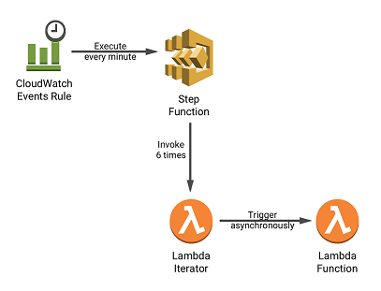
What does it ‘look like’
Notes:
We’ll create a cloud infrastructure that will log into our trading account – asses the current ‘situation’ and decide to -:
Lets create the infrastructure….
Its not possible to get a lambda to be executed at any more than a minute interval – CloudWatch events
Place a position
Close a position (if it doesn’t have a stop loss).

Slide 5
How do we operate?
Trade?
Login
No
Yes
Notes:
Lets now ADD the code that will do this and see Big Mig trade!

Slide 6
Lets do a trade!
Lets get BigMig to TRADE! ☺

Slide 7
What Next?
Cost
Allow for different patterns to be tried?
Back testing of ideas and implementing?
Allow for a URL to another Lambda that acts as the decision maker.
GO LIVE……
Notes:
State some hard facts on invocation costs….

