Slide 1
Web API 後端開發
黃麒昌
202003

Slide 2
參考
https://blog.kevinyang.net/2019/05/04/nestjs-getting-start/
https://ithelp.ithome.com.tw/articles/10190659
https://docs.nestjs.com/
本講義以上網址內容, 賅要講解。

Slide 3
架構
Client端
Application/EXE
Client/server
雲端
DB
前端
APP, WEB
HTTP
後端
API

Slide 4
學習目標
HTTP 基礎: Method, Status
實作: TS, 寫入/ 讀出/ 更新 資料

Slide 5
大綱
http概念
Nestjs 架構/實作

Slide 6
Http
https://zhuanlan.zhihu.com/p/77373945
https://data-sci.info/2015/10/24/%E5%B8%B8%E8%A6%8B%E7%9A%84http-method%E7%9A%84%E4%B8%8D%E5%90%8C%E6%80%A7%E8%B3%AA%E5%88%86%E6%9E%90%EF%BC%9Agetpost%E5%92%8C%E5%85%B6%E4%BB%964%E7%A8%AEmethod%E7%9A%84%E5%B7%AE%E5%88%A5/
Method
Get, post, put, delete, head, option
Status
1xx, 2xx, 3xx, 4xx, 5xx
https://developer.mozilla.org/zh-TW/docs/Web/HTTP/Methods
https://developer.mozilla.org/zh-TW/docs/Web/HTTP/Status

Slide 7
指令
npm i -g @nestjs/cli
nest new <project-name >
nest g module xxx
nest g control xxx
nest g service xxx
執行:
npm install
npm start

Slide 8
Decorator 裝飾詞
@Module, @Controller, @Injectable
@Get, @Post, @Put, @Delete
@Res, @Req
@Param, @Body, @Query
Url Param, Query

Slide 9
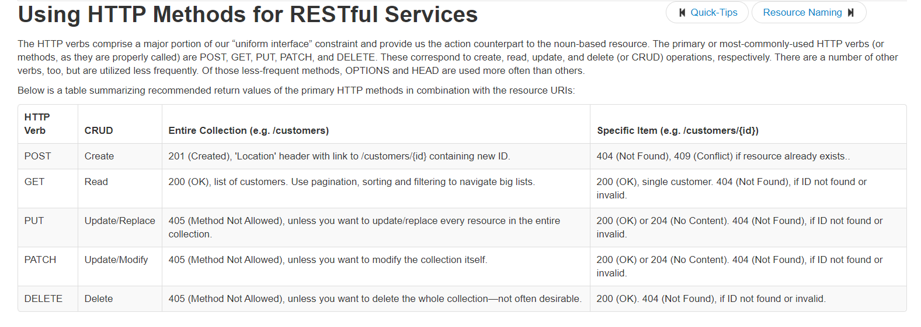
CRUD , HTTP METHOD
https://www.restapitutorial.com/lessons/httpmethods.html

Slide 10
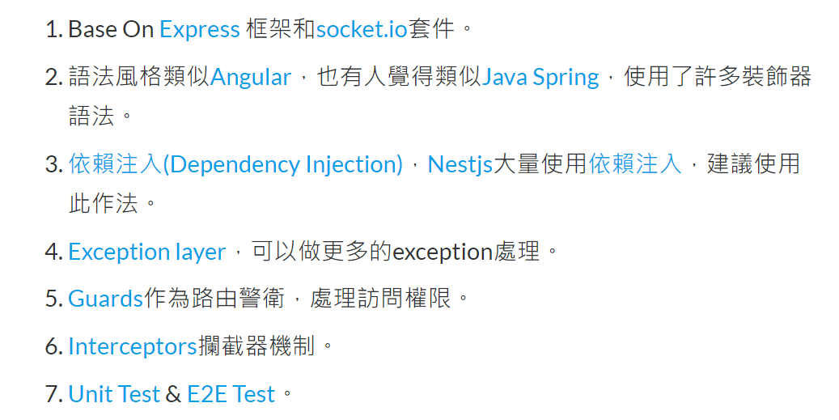
Nestjs 特點
https://ithelp.ithome.com.tw/articles/10190659

Slide 11
Nestjs Overview
Project
Module
Controller
Provider, Service, Component
資料庫串接

Slide 12
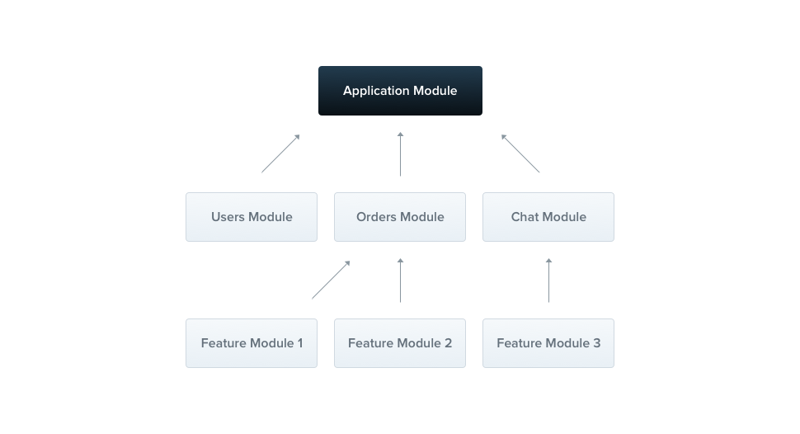
Module
A module is a class annotated with a @Module() decorator.
The @Module() decorator provides metadata that Nest makes use of to organize the application structure.
https://docs.nestjs.com/modules

Slide 13
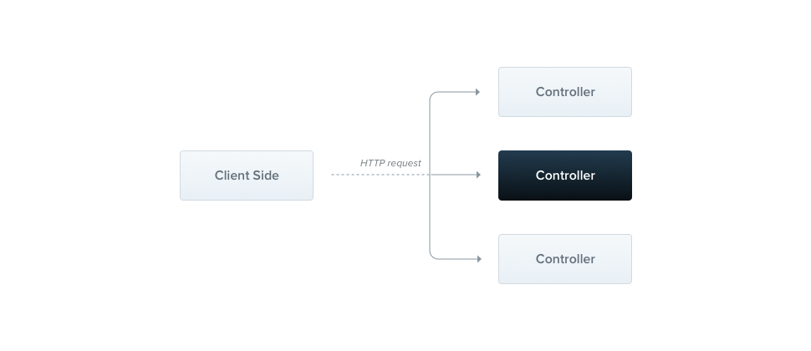
Controller
Controllers are responsible for handling incoming requests and returning responses to the client
https://docs.nestjs.com/controllers

Slide 14
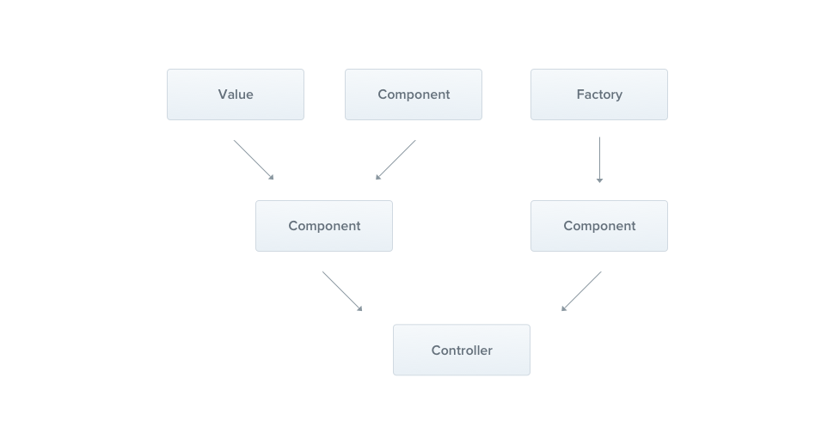
Provider, Service, Component
Providers are a fundamental concept in Nest.
Many of the basic Nest classes may be treated as a provider – services, repositories, factories, helpers, and so on.
The main idea of a provider is that it can inject dependencies;
this means objects can create various relationships with each other, and the function of "wiring up" instances of objects can largely be delegated to the Nest runtime system. A provider is simply a class annotated with an @Injectable() decorator.
https://docs.nestjs.com/providers

Slide 15
資料庫串接
TypeORM
SQL: 直接CRUD
Lession2 的專案

