Slide 1
Angular 開發教學
202003

Slide 2
參考
HTML 基礎 https://developer.mozilla.org/zh-TW/docs/Learn/Getting_started_with_the_web/HTML_basics
HTML教學 http://www.pcnet.idv.tw/pcnet/html/html.htm
CSS 基本
Angular
https://developer.mozilla.org/zh-TW/docs/Learn/Getting_started_with_the_web/CSS_basics
https://s.itho.me/modernweb/2016/trackb/%E5%BF%AB%E5%BF%AB%E6%A8%82%E6%A8%82%E5%AD%B8%E6%9C%83%20Angular%202%20%E7%B6%B2%E7%AB%99%E9%96%8B%E7%99%BC%E6%A1%86%E6%9E%B6.pdf

Slide 3
學習目標
HTML + CSS 概念
Angular
開發環境建置
認識檔案結構/組成
前後資料繫結, Say Hello
Library開發
實作網站
佈建分發

Slide 4
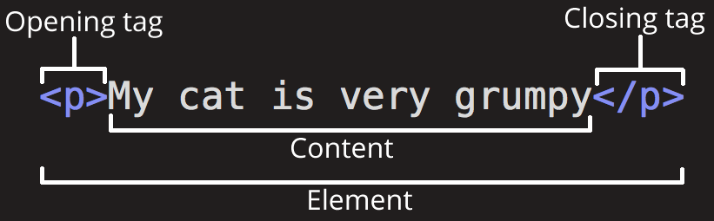
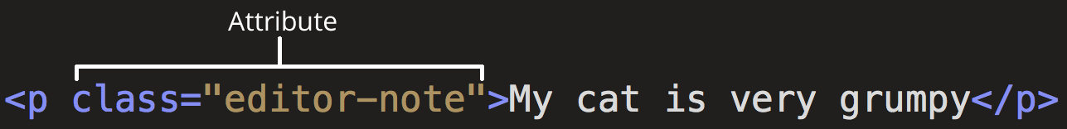
HTML
從 XML 衍生
是一種標記語言（markup language），而非一般熟知的程式設計語言；它會告訴瀏覽器該如何呈現你的網頁。
包含了一系列的元素（elements）
而元素包含了標籤（tags），屬性(atrributes)與內容（content），我們用標籤來控制內容的呈現樣貌，例如字體大小、斜體粗體、在文字或圖片設置超連結等。
https://developer.mozilla.org/zh-TW/docs/Learn/Getting_started_with_the_web/HTML_basics

Slide 5

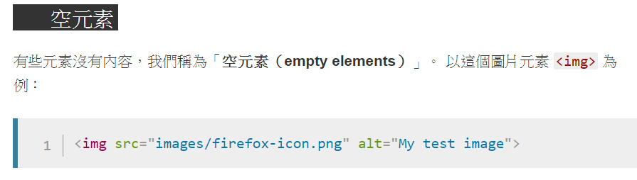
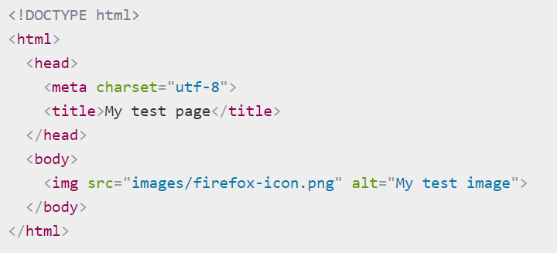
HTML 特性
巢狀
空元素, <img> <br>
架構
https://developer.mozilla.org/zh-TW/docs/Learn/Getting_started_with_the_web/HTML_basics

Slide 6
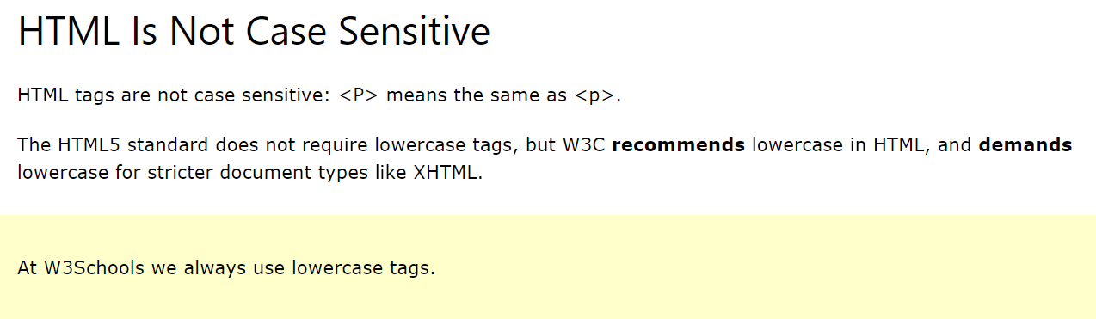
大小寫?
不分, 但小寫是慣例。
https://www.w3schools.com/html/html_elements.asp

Slide 7
HTML BASIC
Headings , <hX>
Paragraphs, <p>
Links, <a>
Images, <img>
Buttons, <button>
Lists, <ul> <ol> <li>
Tables,<table> <tr> <td>
Block, <div>
Inline, <span>
iframe, <iframe> 顯示網頁
Form,
<form><fieldset><legend>
<input><select><textarea>
<button><label>
Input type,
Canvas, <canvas> 畫布
SVG, <svg> 向量圖
Media
<!-- 註解 -->
https://www.w3schools.com/html/html_basic.asp

Slide 8
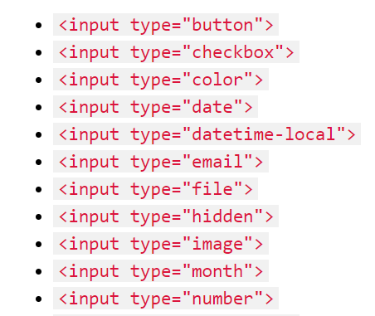
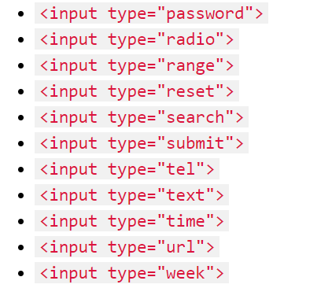
Form Input Type
https://www.w3schools.com/html/html_form_input_types.asp

Slide 9
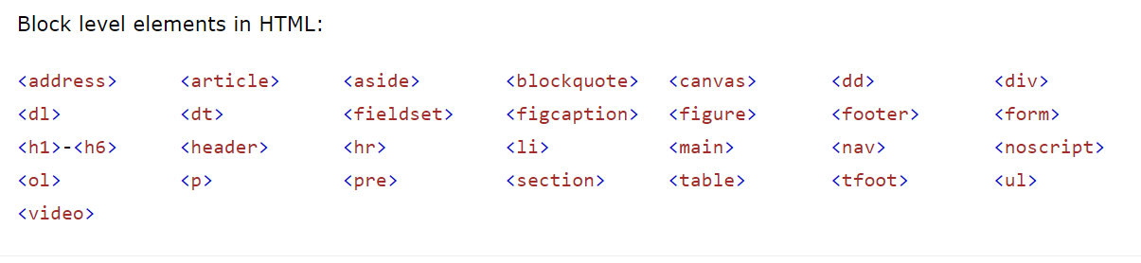
Block / inline
Block, <div>
Inline, <span>
https://www.w3schools.com/html/html_blocks.asp

Slide 10

HTML Style attribute
語法:
Color: background, Text
Text: Size, Font, Alignment, formatting
Formatting
<b> - Bold text
<strong> - Important text
<i> - Italic text
<em> - Emphasized text
<mark> - Marked text
<small> - Small text
<del> - Deleted text
<ins> - Inserted text
<sub> - Subscript text
<sup> - Superscript text
https://www.w3schools.com/html/html_styles.asp

Slide 11
CSS

Slide 12
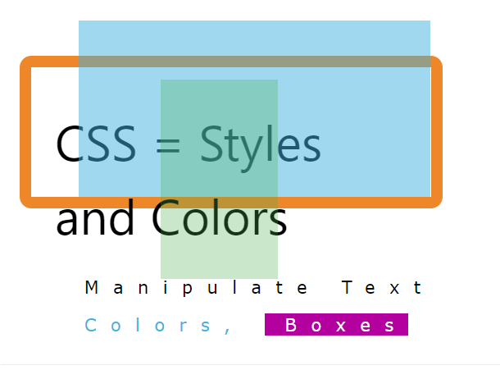
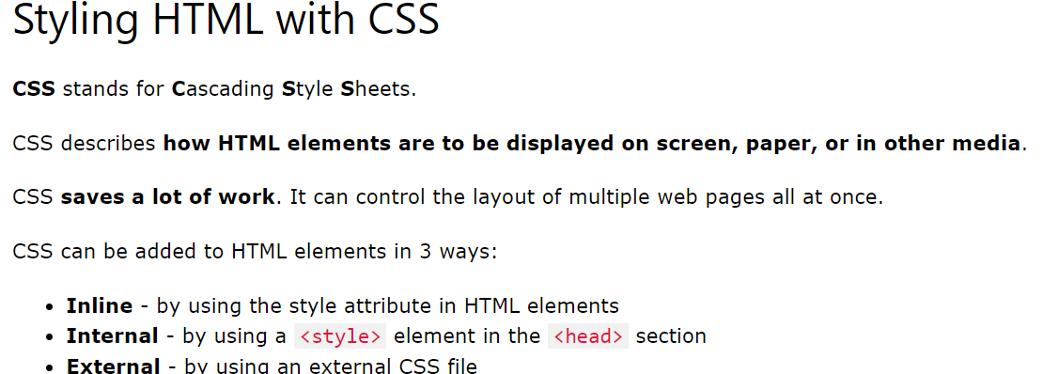
CSS/SASS/SCSS
Css = styles and Colors
https://www.w3schools.com/html/html_css.asp

Slide 13
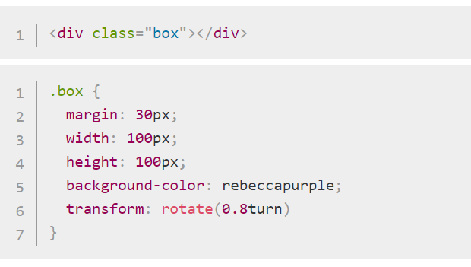
CSS 結構
Selector, property, value, function
Selector 選擇器
EX: .box
沒有修飾時等於
HTML TAG
Value 值
EX: 30px
單位: px, em, rem, %
Property 屬性
EX: height
Function 功能
EX: rotate

Slide 14
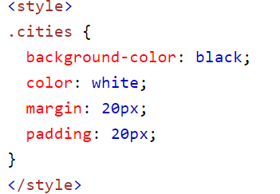
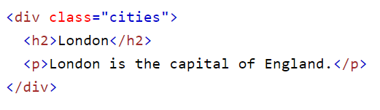
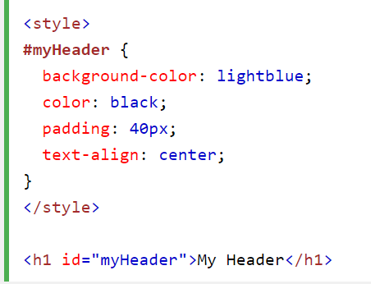
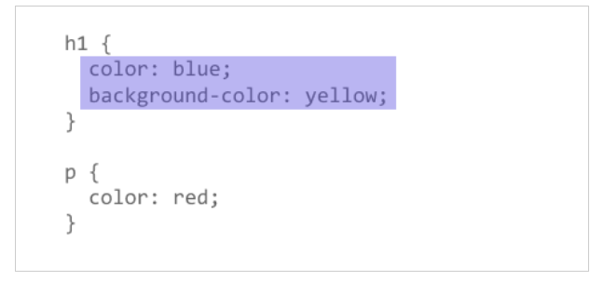
Class/id
. (dot) class
# (sharp) id
無修飾相同於
HTML TAG
https://www.w3schools.com/html/html_classes.asp
https://www.w3schools.com/html/html_id.asp

Slide 15
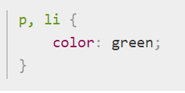
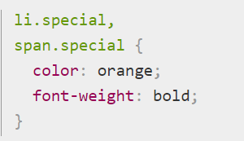
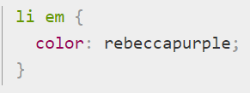
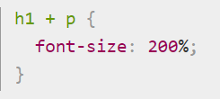
CSS 基礎-1
,(comma) 指向多個
.(dot) selector along with class
空格(space) 在巢狀內的
+ (adjacent slibling combinator), 接著
https://developer.mozilla.org/en-US/docs/Learn/CSS/First_steps/Getting_started

Slide 16
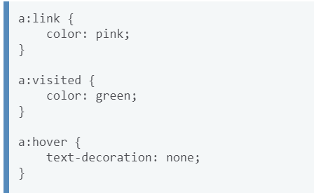
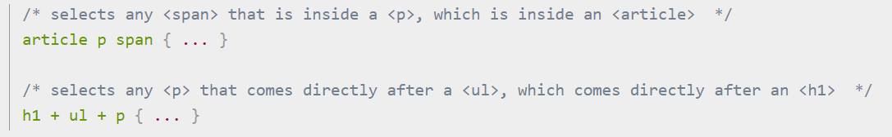
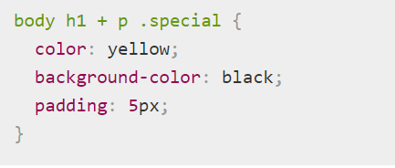
CSS 基礎-2
: (state) 狀態
Styling things based on state
在body中的 h1 下面緊接的 p 的 special class
https://developer.mozilla.org/en-US/docs/Learn/CSS/First_steps/Getting_started

Slide 17
CSS: @rule
body {
background-color: pink;
}
@media (min-width: 30em) {
body {
background-color: blue;
}
}
@import, 引入另一個 css
@media, 從 browser取得 viewport
https://developer.mozilla.org/en-US/docs/Learn/CSS/First_steps/How_CSS_is_structured#rules

Slide 18
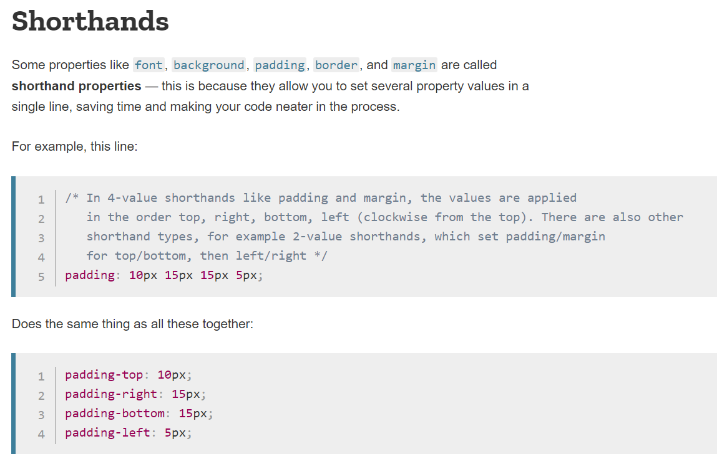
縮寫/速記

Slide 19
Angular 本番
參考
新手指南
https://angular.io/docs,
https://angular.tw/start
Heroku: https://djangogirlstaipei.herokuapp.com/tutorials/deploy-to-heroku/?os=windows
Playground: https://stackblitz.com/
範本: https://angular.tw/generated/live-examples/getting-started-v0/stackblitz.html

Slide 20
Angular 架構
Angular 8
xml/HTML /CSS/ TS
ASSET: 圖片/文檔pdf
網址, route, Query Parameter
template: html
style: css/scss
TS:

Slide 21
實作
npm install -g @angular/cli
ng new my-app
npm start/ ng serve –open
ng generate comp
file structure
https://angular.io/guide/file-structure

Slide 22
module
main module:
share module
feature module

Slide 23
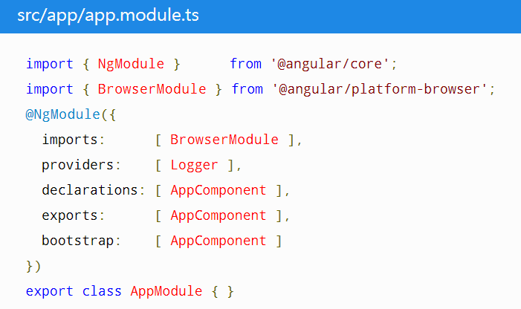
main module:
imports browserModule
bootstrap appcomponent
imports 所需module,
declares 元件(component/directive/pipe)
provides 服務(service, 有@injectable的)
Exports 元件

Slide 24
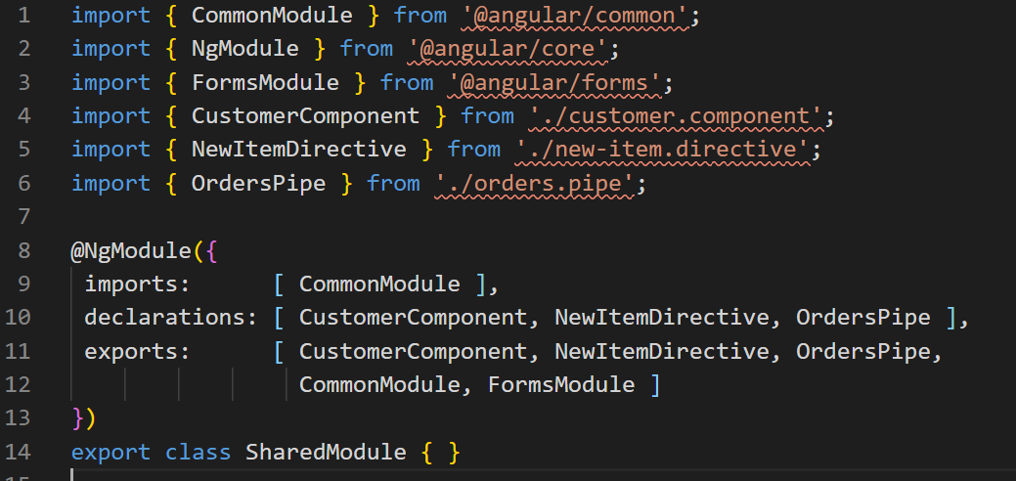
share module
Creating shared modules allows you to organize and streamline your code.
imports commonModule,
declares 元件(component/directive/pipe)
provides 服務(service, 有@injectable的)
exports 要對外的

Slide 25
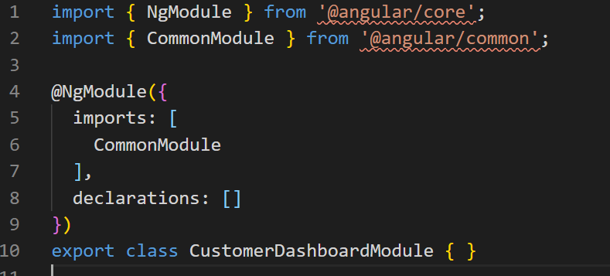
feature module
一般專案所需的功能模組
import commonModule

Slide 26
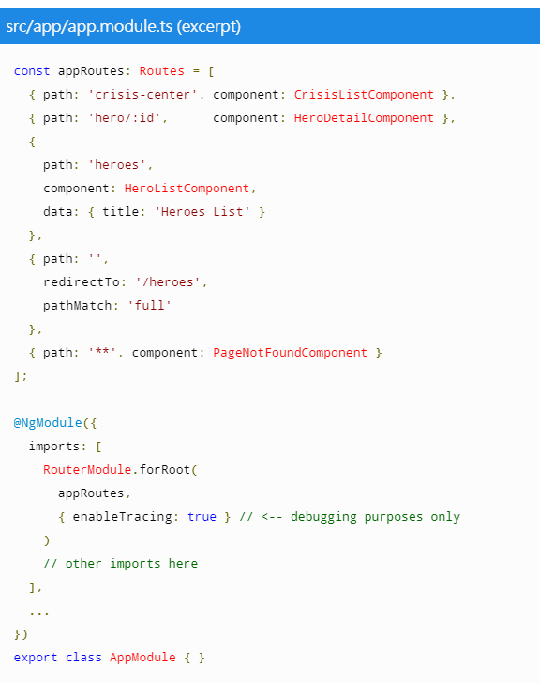
route
Path,
Route param , EX: hero/:id
**
Component
redirectTo, 轉址
https://angular.tw/guide/router

Slide 27
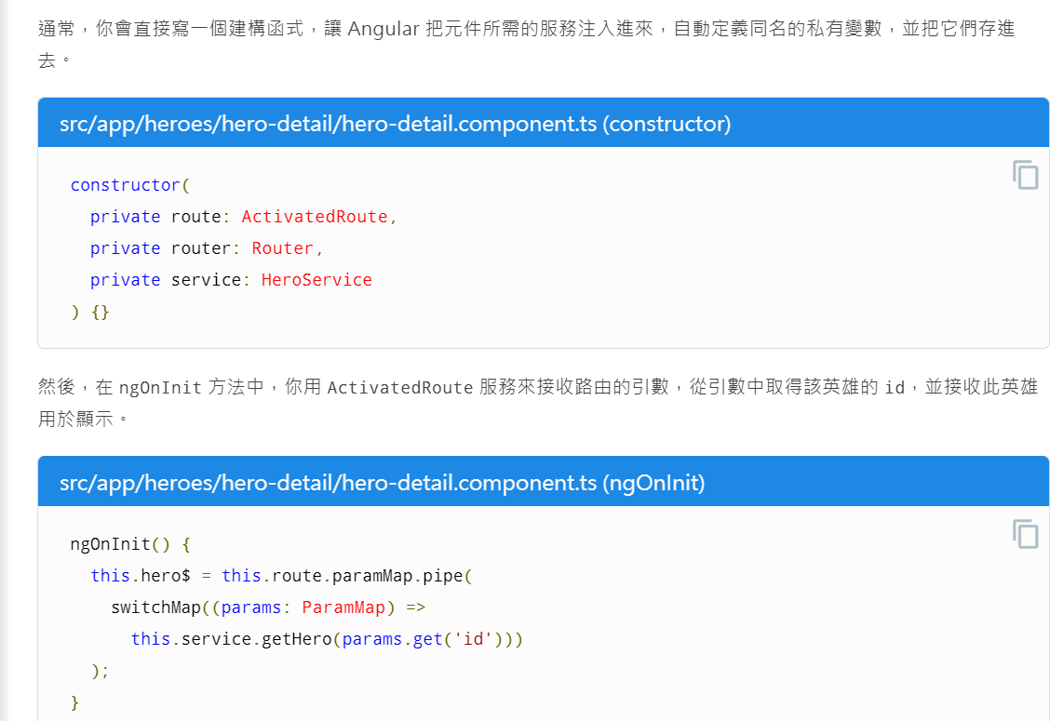
Route Param
activedRoute
paramMap

Slide 28
component
@input
in Html
<p [appHighlight]="color">Highlight me!</p>
比較
<p appHighlight="red">Highlight me!</p>
→ 傳入常數(red) VS 變數(color)
in TS
@Input('appHighlight') highlightColor: string;
@output
in Html
<p (selectedValueChange)="selectedValueChange($event)">{{item.set}}</p>
in TS
@Output() selectedValueChange = new EventEmitter<number>();

Slide 29
Directive
EX: <p appHighlight>Highlight me!</p>
Components: directives with a template.
attribute Directives: change the appearance or behavior of an element, component, or another directive.
structural Directives: change the DOM layout by adding and removing DOM elements.
*ngIf
*ngFor: 注意: let hero of heros 是用 of
*ngSwitch
https://angular.tw/guide/architecture-components#directives

Slide 30
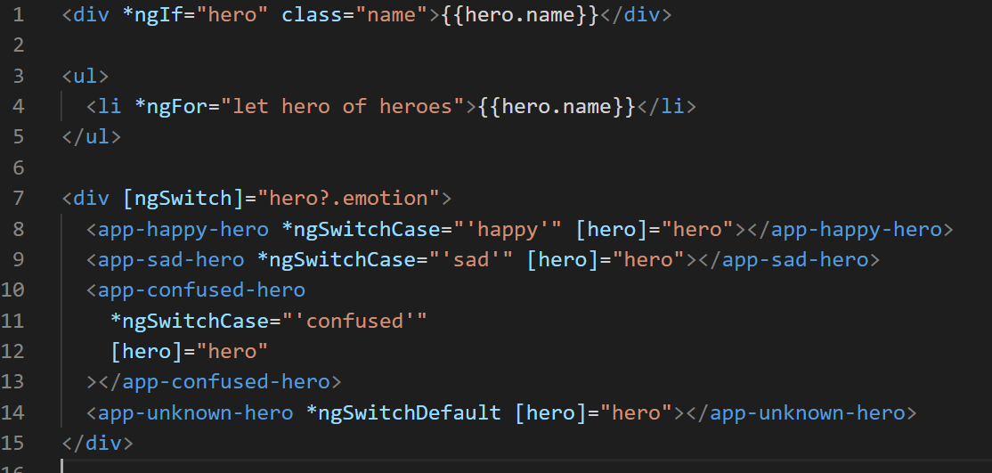
EX: ngIf, ngFor, ngSwitch

Slide 31
Pipe
pipe
providers/service/ DI (Dependency Injection)
https://angular.io/guide/pipes

Slide 32
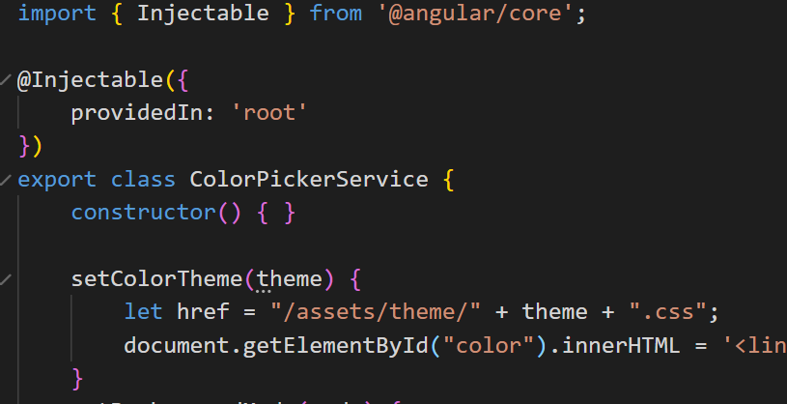
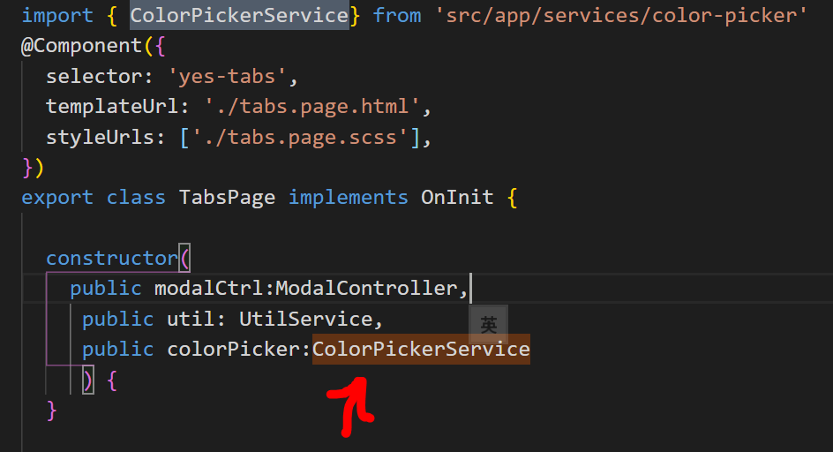
Service
@injectable

Slide 33
UI 套件
primeNG: https://primefaces.org/primeng

Slide 34
實作
npm install -g @angular/cli
ng new my-app
npm start/ ng serve –open
ng generate comp
file structure
https://angular.io/guide/file-structure

Slide 35
Library Project
ng new my-workspace --create-application=false
cd my-workspace
ng generate application my-first-app
ng generate library my-lib
https://angular.io/guide/creating-libraries

Slide 36
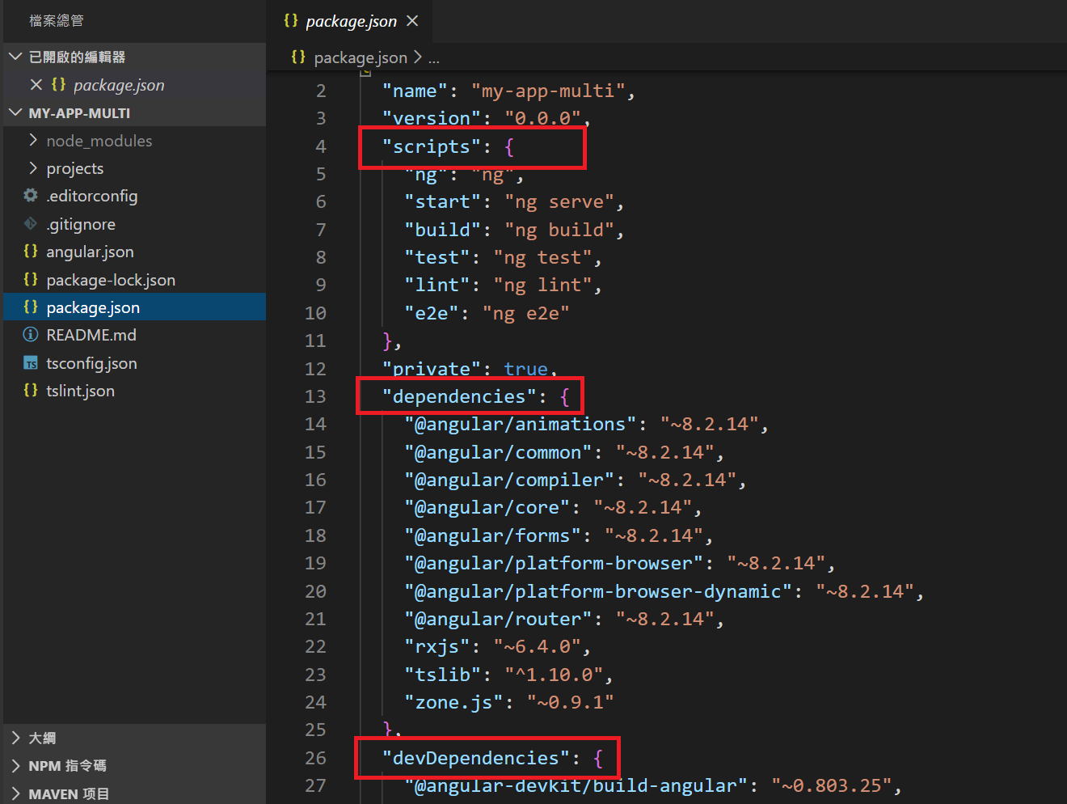
Package.json
Script
Dependencies
devDependencies

Slide 37
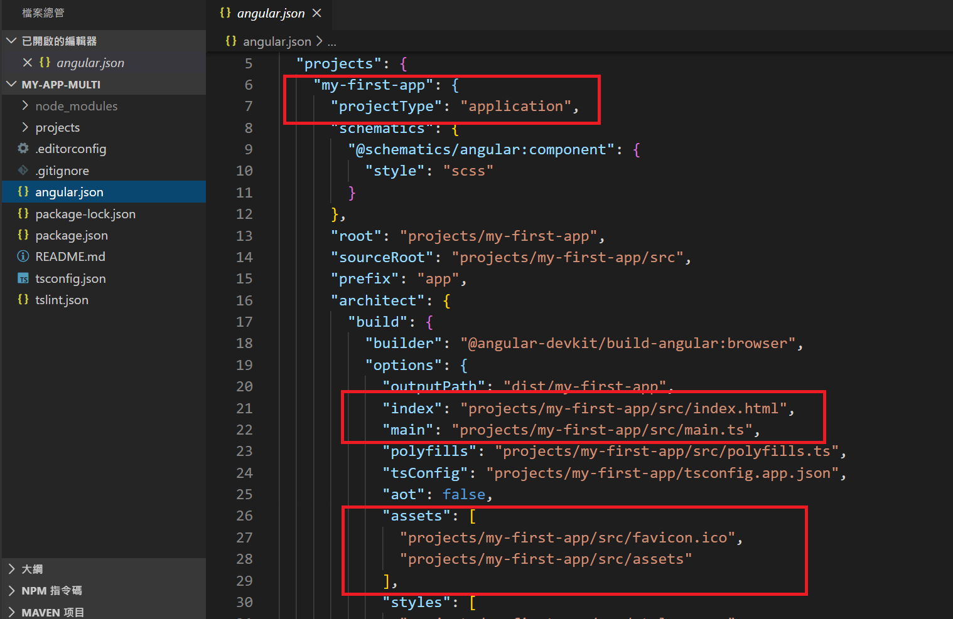
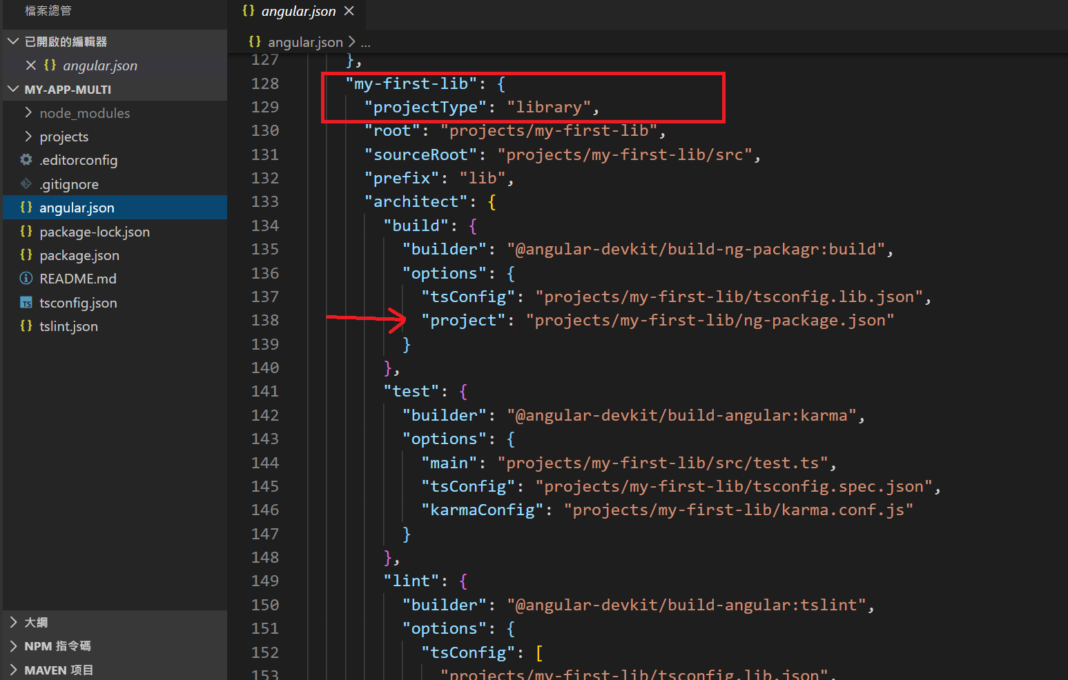
angular.json

Slide 38
main.ts
import { AppModule } from './app/app.module';
index.html: <app-root></app-root>
app.component.html: <router-outlet></router-outlet>
app.module.ts

Slide 39
view
html <-> scss <-> ts
<style></style>
class/style
{{ xxxx }}
one-way data binding : [abc] 輸入 , (clickevent) 輸出
Two-way : [( XXX )] , EX: [(ngModel)]

Slide 40
實作
ng new my-app-multi --createApplication="false"
cd my-app-multi
ng generate application my-first-app
ng generate library my-first-lib
code .
npm start
ng g component my-comp1 --project=my-first-app
ng g component my-comp-in-lib --project=my-first-lib
ng build my-first-lib

Slide 41
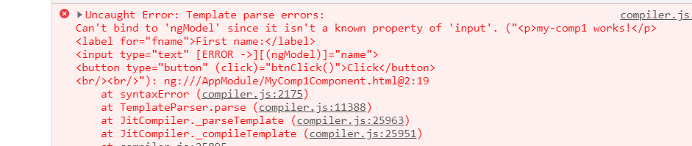
上傳heroku
執行時, 出現錯誤:

Slide 42
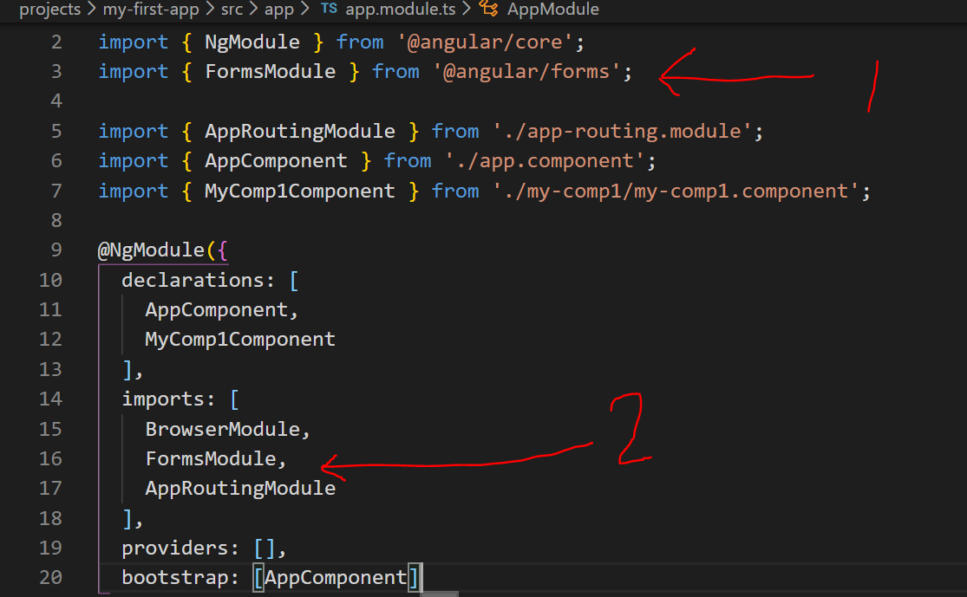
my-com1.component.html
<p>my-comp1 works!</p>
<label for="fname">First name:</label>
<input type="text" [(ngModel)]="name">
<button type="button" (click)="btnClick()">Click</button>
<br/><br/>
加入 FormsModule

Slide 43
Library Project 測試
npm link
npm build my-lib --watch
到第2個APP, 使用
ng new my-app1
npm i
ng serve --port 4201
PS:
要取消link
cd library的folder
npm uninstall # Delete global symlink
或是直接 npm unlink library-name

Slide 44
分發
ng build my-lib --prod
cd dist/my-lib
npm publish

Slide 45
Heroku 佈建
產生分發版
$ npm run build:prod
使用 ng build
加入參數:
--aot
--prod
--base-href = /專案名稱/
此案比較特殊, 有LIB, 所以要先 build lib
在 package.json中
"prebuild:prod": "npm run build:lib",
"build:prod": "ng build --aot --prod --base-href=/my-first-app/",
"build:lib": "ng build my-first-lib",

Slide 46
參考: https://djangogirlstaipei.herokuapp.com/tutorials/deploy-to-heroku/?os=windows
Signup: https://signup.heroku.com/
Login 後,
https://dashboard.heroku.com/apps
到 dashboard -> new -> new app
產生好後, 到deploy頁面, 參考 Deploy using Heroku Git https://devcenter.heroku.com/articles/git

Slide 47

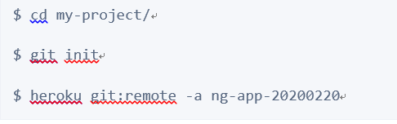
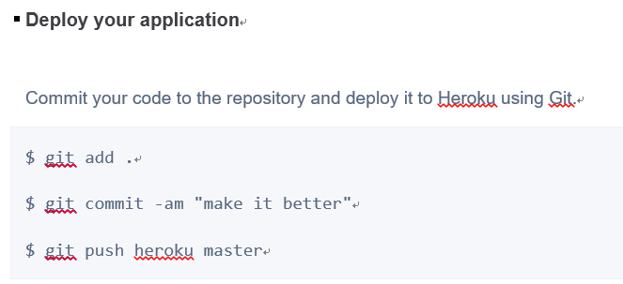
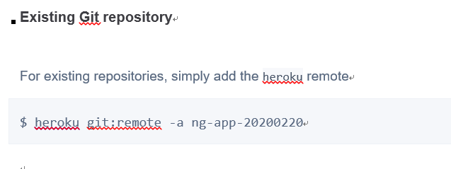
New/Update git repository

Slide 48
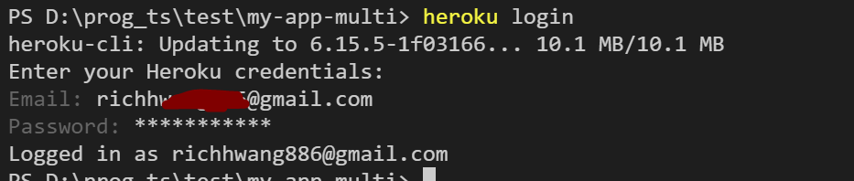
實際操作
heroku login
輸入 email / password
git init
heroku git:remote –a ng-app-20200220
git add *
git commit –m “init”
git push heroku master

