Slide 1

Decentralized Artificial Intelligence
Ernest Duarte

Slide 2
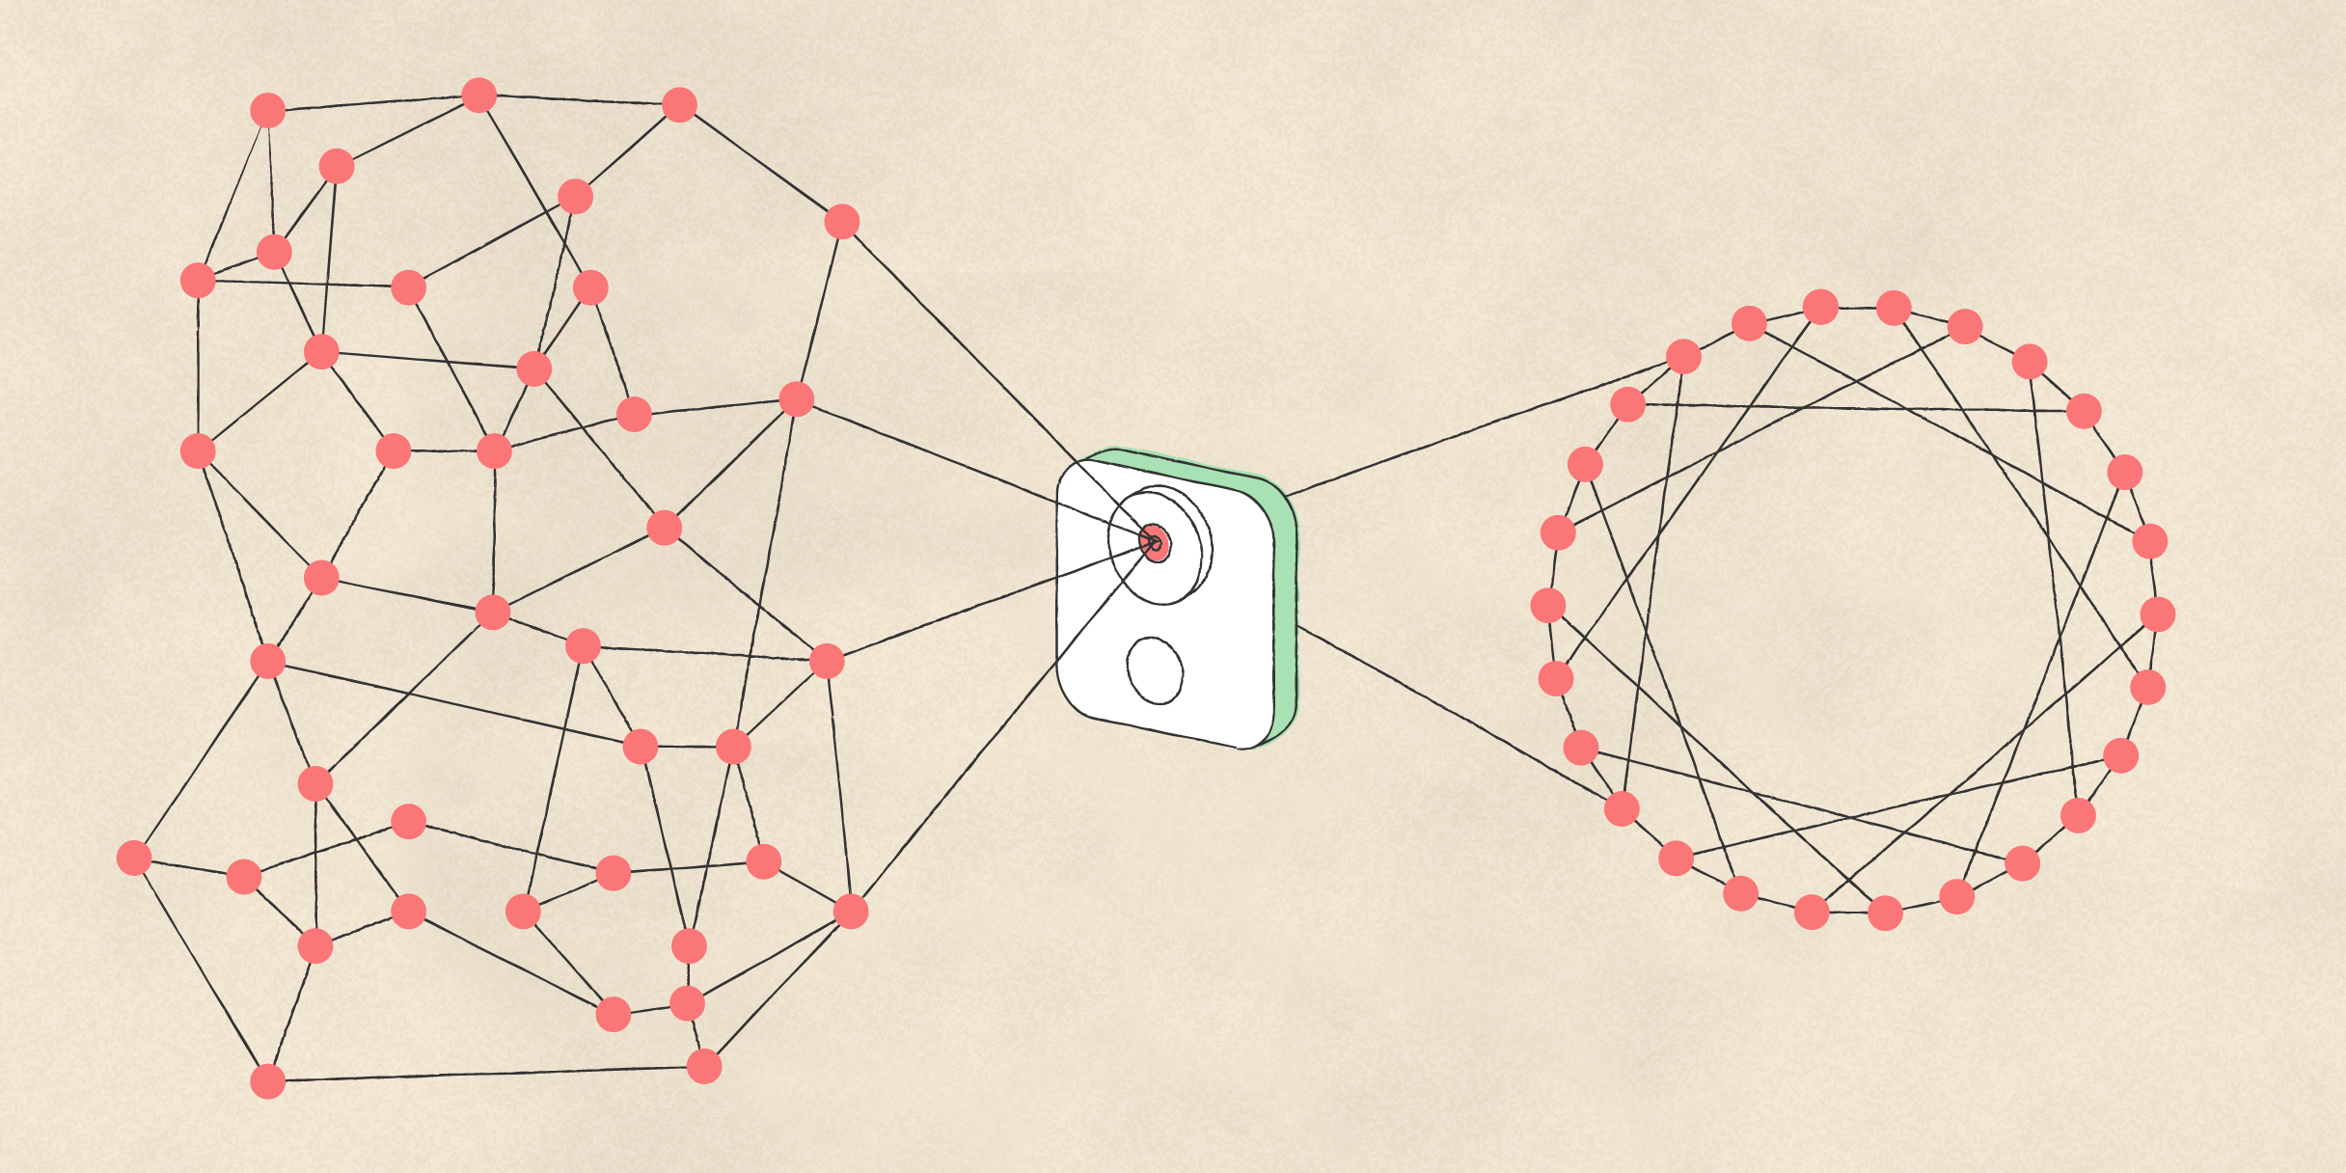
Introduction
DLT – Blockchain : Distributed ledger

Slide 3
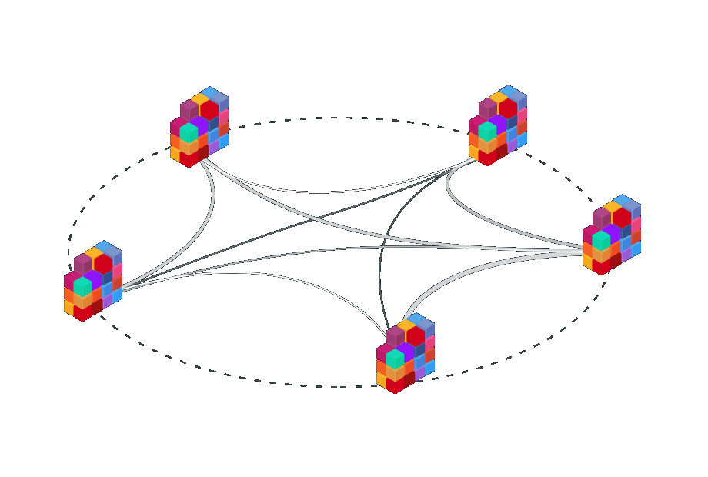
Introduction
DLT – Blockchain : Decentralized Systems

Slide 4





Introduction Blockchain
Decentralized Disintermediation Systems
MarketPlaces
DAO Decentralized Autonomous Organization

Slide 5
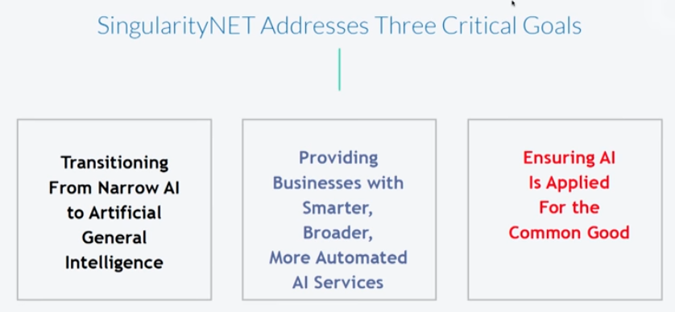
A.I. and Blockchain Combination
Artificial Intelligence, Robotics & #Blockchain: Dr. Ben Goertzel & Sophia The Robot
https://www.youtube.com/watch?v=1rrBBfVBx2Q

Slide 6
SingularityNET: The first decentralised AI marketplace
SingularityNET intends to make AI accessible as a global commons for all.
A.I. marketplace where companies can buy and sell A.I. algorithms, machine learning tools and data sets on a global scale, facilitating growth of the industry.
Blockchain has the potential to democratize A.I.
https://medium.com/the-ethical-blockchain/a-i-and-blockchain-the-ultimate-combination-290224db485

Slide 7

A.I. and Blockchain Combination
https://www.cortexlabs.ai/
MATRIX AI Network
https://www.matrix.io/
https://holochain.org/

Slide 8
Conclusion combination AI + DLT
Decentralized AI
Democratized AI
Control Supervised AI
Operational automation and decision automation
Humans take on ethical responsibility

Slide 9
References
https://medium.com/the-ethical-blockchain/a-i-and-blockchain-the-ultimate-combination-290224db485
https://www.youtube.com/watch?v=1rrBBfVBx2Q
https://www.neurochaintech.io/blockchain-artificial-intelligence/
https://www-forbes-com.cdn.ampproject.org/c/s/www.forbes.com/sites/bernardmarr/2018/03/02/artificial-intelligence-and-blockchain-3-major-benefits-of-combining-these-two-mega-trends/amp/

Slide 10
References
https://emerj.com/ai-sector-overviews/ai-in-blockchain/
https://www.matrix.io/
https://medium.com/outlier-ventures-io/what-does-artificial-intelligence-have-to-do-with-blockchains-cc8b3f8afc4b
https://www.youtube.com/watch?v=1rrBBfVBx2Q
https://medium.com/bica-labs/how-blockchain-relates-to-artificial-intelligence-f0111f39afc9
Blockchain and Artificial Intelligence : https://arxiv.org/ftp/arxiv/papers/1802/1802.04451.pdf
https://nvlpubs.nist.gov/nistpubs/ir/2018/NIST.IR.8202.pdf

