Slide 1
CADB Multi-label Positional Encoding Comparison (6 Models)
Weekly experiment comparison deck generated from existing run artifacts
ViT No Pos
ViT Baseline
ViT Row-wise
ViT Column-wise
Report scope
Comparison scenario: Multi-run comparison
Reference run: ViT No Pos
Compared runs: 6
Shared training metrics: Test ACC, Val ACC, Test Loss
Generated 2026-07-01 13:27
Report name: cadb_elements_positional_6models_report

Slide 2
Run Setup
Experiment Setup and Run Context
Keep the first --run as the reference baseline for meeting comparisons.
ViT No Pos
ViT Baseline
Run ID: no_pos_cadb_elements_seed42
Model / device: ViT No Pos / cuda
Epochs completed: 70
Family / variant: ViT / No Pos
Position / init: None / From scratch
Batch / LR / WD: 128 / 0.0003 / 0.05
Run ID: baseline_cadb_elements_seed42
Model / device: ViT Baseline / cuda
Epochs completed: 43
Family / variant: ViT / Baseline
Position / init: Absolute / From scratch
Batch / LR / WD: 128 / 0.0003 / 0.05
ViT Row-wise
ViT Column-wise
Run ID: row_cadb_elements_seed42
Model / device: ViT Row-wise Sinusoidal / cuda
Epochs completed: 54
Family / variant: ViT / Row-wise Sinusoidal
Position / init: Row-wise Sinusoidal / From scratch
Batch / LR / WD: 128 / 0.0003 / 0.05
Run ID: col_cadb_elements_seed42
Model / device: ViT Column-wise Sinusoidal / cuda
Epochs completed: 50
Family / variant: ViT / Column-wise Sinusoidal
Position / init: Column-wise Sinusoidal / From scratch
Batch / LR / WD: 128 / 0.0003 / 0.05
Run cards surface the main hyperparameters and monitoring settings without crowding a table.
Page group 1

Slide 3
Run Setup
Experiment Setup and Run Context
Keep the first --run as the reference baseline for meeting comparisons.
ViT Additive
ViT Additive Shifted
Run ID: additive_cadb_elements_seed42
Model / device: ViT Additive Sinusoidal / cuda
Epochs completed: 46
Family / variant: ViT / Additive Sinusoidal
Position / init: Additive Sinusoidal / From scratch
Batch / LR / WD: 128 / 0.0003 / 0.05
Run ID: additive_shifted_cadb_elements_seed42
Model / device: ViT Additive Sinusoidal Shifted / cuda
Epochs completed: 50
Family / variant: ViT / Additive Sinusoidal Shifted
Position / init: Additive Sinusoidal Shifted / From scratch
Batch / LR / WD: 128 / 0.0003 / 0.05
Run cards surface the main hyperparameters and monitoring settings without crowding a table.
Page group 2

Slide 4
Overview
Results Overview
Headline findings are phrased for direct use in a weekly update.
Primary comparison metric: Test ACC. Best final result is ViT No Pos with 79.48%.
Largest train-to-test accuracy gap appears in ViT Additive Shifted (22.83 pp), worth calling out during generalization discussion.
Early stopping summary: ViT No Pos: stopped early; ViT Baseline: stopped early; ViT Row-wise: stopped early
Best primary metric
Test ACC
ViT No Pos
79.48%
Runs compared
Metrics tracked
6
14
This slide replaces generic 'key takeaways' text with meeting-ready comparison statements.

Slide 5
Comparison Table
Model Comparison
This page is keyed off model family, variant, position encoding, and initialization rather than off raw run names.
Run | Model | Family | Variant | Position Encoding | Initialization | Batch / LR / WD
ViT No Pos | ViT No Pos | ViT | No Pos | None | From scratch | 128 / 0.0003 / 0.05
ViT Baseline | ViT Baseline | ViT | Baseline | Absolute | From scratch | 128 / 0.0003 / 0.05
ViT Row-wise | ViT Row-wise Sinusoidal | ViT | Row-wise Sinusoidal | Row-wise Sinusoidal | From scratch | 128 / 0.0003 / 0.05
ViT Column-wise | ViT Column-wise Sinusoidal | ViT | Column-wise Sinusoidal | Column-wise Sinusoidal | From scratch | 128 / 0.0003 / 0.05
ViT Additive | ViT Additive Sinusoidal | ViT | Additive Sinusoidal | Additive Sinusoidal | From scratch | 128 / 0.0003 / 0.05
ViT Additive Shifted | ViT Additive Sinusoidal Shifted | ViT | Additive Sinusoidal Shifted | Additive Sinusoidal Shifted | From scratch | 128 / 0.0003 / 0.05
Use this page to frame baseline vs RoPE, ViT vs CNN, or scratch vs pretrained before discussing metrics.

Slide 6
Comparison Table
Result Snapshot
Compact overview of the most important final metrics and selected checkpoint epoch.
Run | Model | Variant | Epochs | Selected Epoch | Test ACC | Val ACC | Test Loss
ViT No Pos | ViT No Pos | No Pos | 70 | 55 | 79.48% | 79.50% | 0.9451
ViT Baseline | ViT Baseline | Baseline | 43 | 28 | 78.97% | 78.07% | 0.9462
ViT Row-wise | ViT Row-wise Sinusoidal | Row-wise Sinusoidal | 54 | 39 | 78.62% | 80.15% | 0.9471
ViT Column-wise | ViT Column-wise Sinusoidal | Column-wise Sinusoidal | 50 | 35 | 77.41% | 79.66% | 0.9386
ViT Additive | ViT Additive Sinusoidal | Additive Sinusoidal | 46 | 31 | 77.06% | 76.19% | 0.9168
ViT Additive Shifted | ViT Additive Sinusoidal Shifted | Additive Sinusoidal Shifted | 50 | 35 | 77.12% | 77.23% | 0.9734
This table is intentionally compact so it remains readable on projected slides.

Slide 7
Comparison Table
Main Metrics Comparison (1/4)
Each row is a meeting-friendly metric statement rather than a raw logger dump.
Metric | Direction | ViT No Pos | ViT Baseline | ViT Row-wise | ViT Column-wise
Final Test ACC | Higher | 79.48% | 78.97% | 78.62% | 77.41%
Final Val ACC | Higher | 79.50% | 78.07% | 80.15% | 79.66%
Final Test Loss | Lower | 0.9451 | 0.9462 | 0.9471 | 0.9386
Final Val Loss | Lower | 0.9655 | 0.9890 | 0.8844 | 0.8815
Final Train ACC | Higher | 99.96% | 99.94% | 99.96% | 99.90%
Final Train Loss | Lower | 0.0072 | 0.0095 | 0.0086 | 0.0130
Final Val Macro F1 | Higher | 33.93% | 32.17% | 36.55% | 35.01%
Final Test Macro F1 | Higher | 33.50% | 33.43% | 32.08% | 32.61%
Direction indicates whether higher or lower values are preferable.

Slide 8
Comparison Table
Main Metrics Comparison (2/4)
Each row is a meeting-friendly metric statement rather than a raw logger dump.
Metric | Direction | ViT Additive | ViT Additive Shifted | Best Run
Final Test ACC | Higher | 77.06% | 77.12% | ViT No Pos
Final Val ACC | Higher | 76.19% | 77.23% | ViT Row-wise
Final Test Loss | Lower | 0.9168 | 0.9734 | ViT Additive
Final Val Loss | Lower | 0.9212 | 0.9839 | ViT Column-wise
Final Train ACC | Higher | 99.87% | 99.95% | ViT Row-wise
Final Train Loss | Lower | 0.0204 | 0.0113 | ViT No Pos
Final Val Macro F1 | Higher | 29.71% | 32.80% | ViT Row-wise
Final Test Macro F1 | Higher | 30.06% | 31.55% | ViT No Pos
Direction indicates whether higher or lower values are preferable.

Slide 9
Comparison Table
Main Metrics Comparison (3/4)
Each row is a meeting-friendly metric statement rather than a raw logger dump.
Metric | Direction | ViT No Pos | ViT Baseline | ViT Row-wise | ViT Column-wise
Selected Test Macro Precision | Higher | 36.25% | 34.08% | 34.92% | 36.84%
Selected Test Macro Recall | Higher | 32.74% | 34.80% | 31.82% | 34.18%
Selected Val Macro Precision | Higher | 38.34% | 34.43% | 39.89% | 39.48%
Selected Val Macro Recall | Higher | 34.64% | 34.51% | 36.45% | 36.45%
Selected Test Subset Accuracy | Higher | 30.98% | 27.15% | 28.30% | 27.92%
Selected Val Subset Accuracy | Higher | 30.80% | 27.49% | 32.55% | 30.60%
Direction indicates whether higher or lower values are preferable.

Slide 10
Comparison Table
Main Metrics Comparison (4/4)
Each row is a meeting-friendly metric statement rather than a raw logger dump.
Metric | Direction | ViT Additive | ViT Additive Shifted | Best Run
Selected Test Macro Precision | Higher | 36.63% | 35.89% | ViT Column-wise
Selected Test Macro Recall | Higher | 33.69% | 30.28% | ViT Baseline
Selected Val Macro Precision | Higher | 32.34% | 39.99% | ViT Additive Shifted
Selected Val Macro Recall | Higher | 32.14% | 32.43% | ViT Column-wise
Selected Test Subset Accuracy | Higher | 28.49% | 27.53% | ViT No Pos
Selected Val Subset Accuracy | Higher | 26.71% | 29.04% | ViT Row-wise
Direction indicates whether higher or lower values are preferable.

Slide 11
Comparison Table
Macro Metrics Table (1/2)
Exact selected-checkpoint macro metrics for precision, recall, and F1.
Macro Metric | Direction | ViT No Pos | ViT Baseline | ViT Row-wise | ViT Column-wise
Final Test Macro F1 | Higher | 33.50% | 33.43% | 32.08% | 32.61%
Selected Test Macro Precision | Higher | 36.25% | 34.08% | 34.92% | 36.84%
Selected Test Macro Recall | Higher | 32.74% | 34.80% | 31.82% | 34.18%
Final Val Macro F1 | Higher | 33.93% | 32.17% | 36.55% | 35.01%
Selected Val Macro Precision | Higher | 38.34% | 34.43% | 39.89% | 39.48%
Selected Val Macro Recall | Higher | 34.64% | 34.51% | 36.45% | 36.45%
This table complements the macro bar chart on the next page.

Slide 12
Comparison Table
Macro Metrics Table (2/2)
Exact selected-checkpoint macro metrics for precision, recall, and F1.
Macro Metric | Direction | ViT Additive | ViT Additive Shifted | Best Run
Final Test Macro F1 | Higher | 30.06% | 31.55% | ViT No Pos
Selected Test Macro Precision | Higher | 36.63% | 35.89% | ViT Column-wise
Selected Test Macro Recall | Higher | 33.69% | 30.28% | ViT Baseline
Final Val Macro F1 | Higher | 29.71% | 32.80% | ViT Row-wise
Selected Val Macro Precision | Higher | 32.34% | 39.99% | ViT Additive Shifted
Selected Val Macro Recall | Higher | 32.14% | 32.43% | ViT Column-wise
This table complements the macro bar chart on the next page.

Slide 13
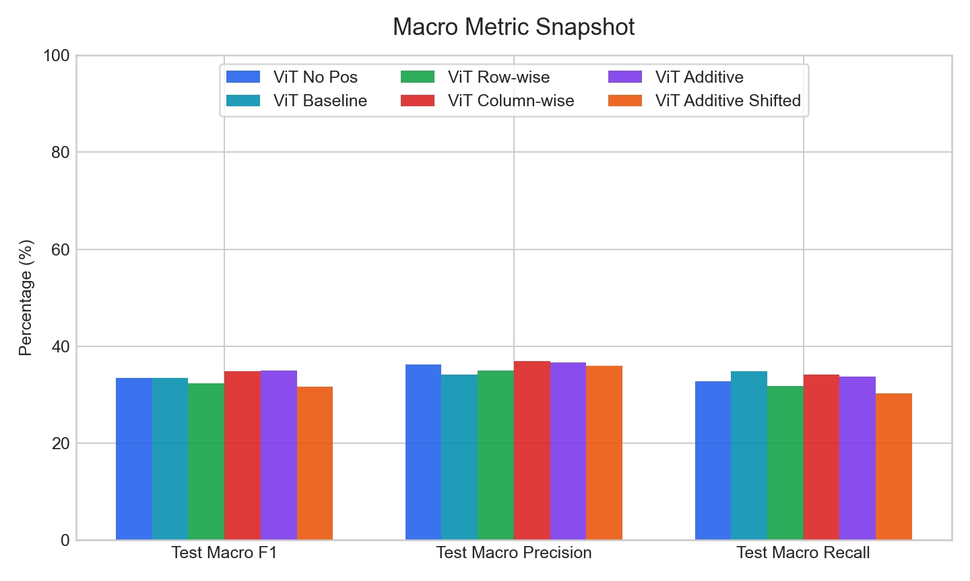
Macro Metrics
Macro Metrics
Macro F1, precision, and recall are grouped here for quick meeting discussion.
Macro readout
Best Test Macro F1 snapshot: ViT Additive (34.95%).
Best selected Test Macro Precision: ViT Column-wise (36.84%).
Best selected Test Macro Recall: ViT Baseline (34.80%).
Macro metrics help when accuracy alone hides uneven class performance.

Slide 14
Comparison Table
Config Differences (1/2)
Showing the top 2 differing settings for experiment traceability.
Config | ViT No Pos | ViT Baseline | ViT Row-wise | ViT Column-wise
command | train_cifar10_experiment.py --model... | train_cifar10_experiment.py --model... | train_cifar10_experiment.py --model... | train_cifar10_experiment.py --model...
outputs.run_name | no_pos_cadb_elements_seed42 | baseline_cadb_elements_seed42 | row_cadb_elements_seed42 | col_cadb_elements_seed42
Long config lists are paginated automatically to avoid overflow and tiny fonts.

Slide 15
Comparison Table
Config Differences (2/2)
Showing the top 2 differing settings for experiment traceability.
Config | ViT Additive | ViT Additive Shifted
command | train_cifar10_experiment.py --model... | train_cifar10_experiment.py --model...
outputs.run_name | additive_cadb_elements_seed42 | additive_shifted_cadb_elements_seed42
Long config lists are paginated automatically to avoid overflow and tiny fonts.

Slide 16
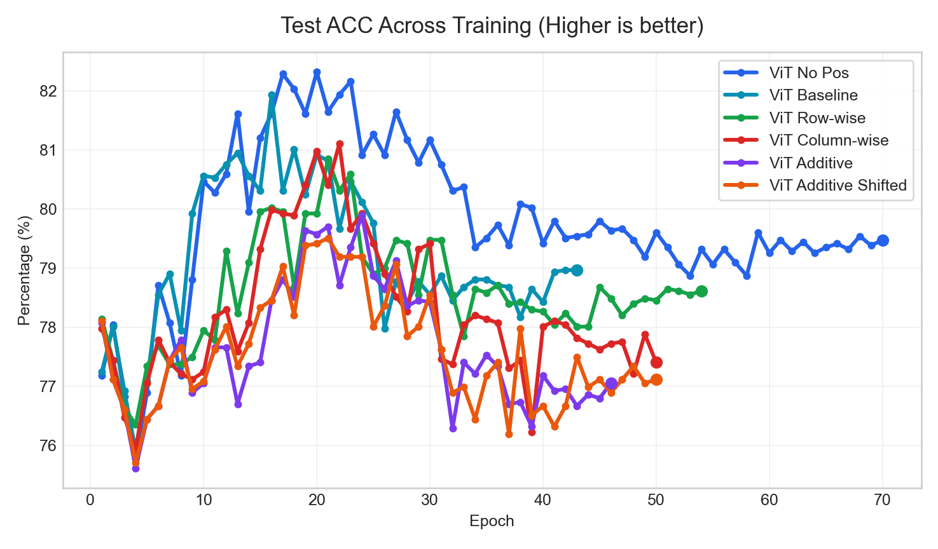
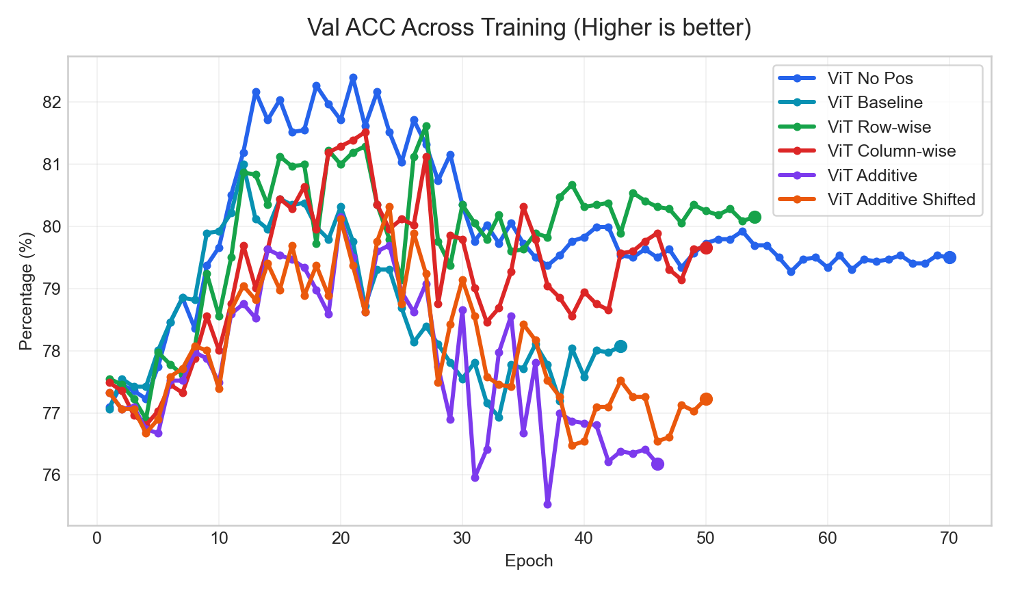
Curves
Training Curves (1/4)
Curves use a consistent title pattern and highlight the final operating point.
Test ACC
Val ACC
Best final value: ViT No Pos (79.48%)
Best final value: ViT Row-wise (80.15%)
Use these pages for trend discussion; use tables for exact values.

Slide 17
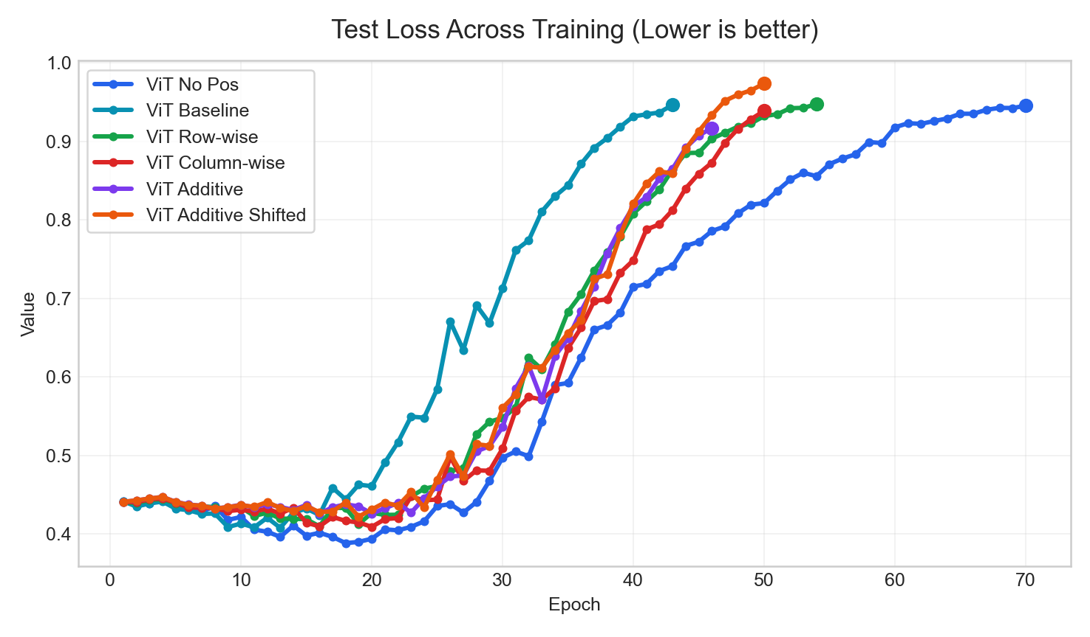
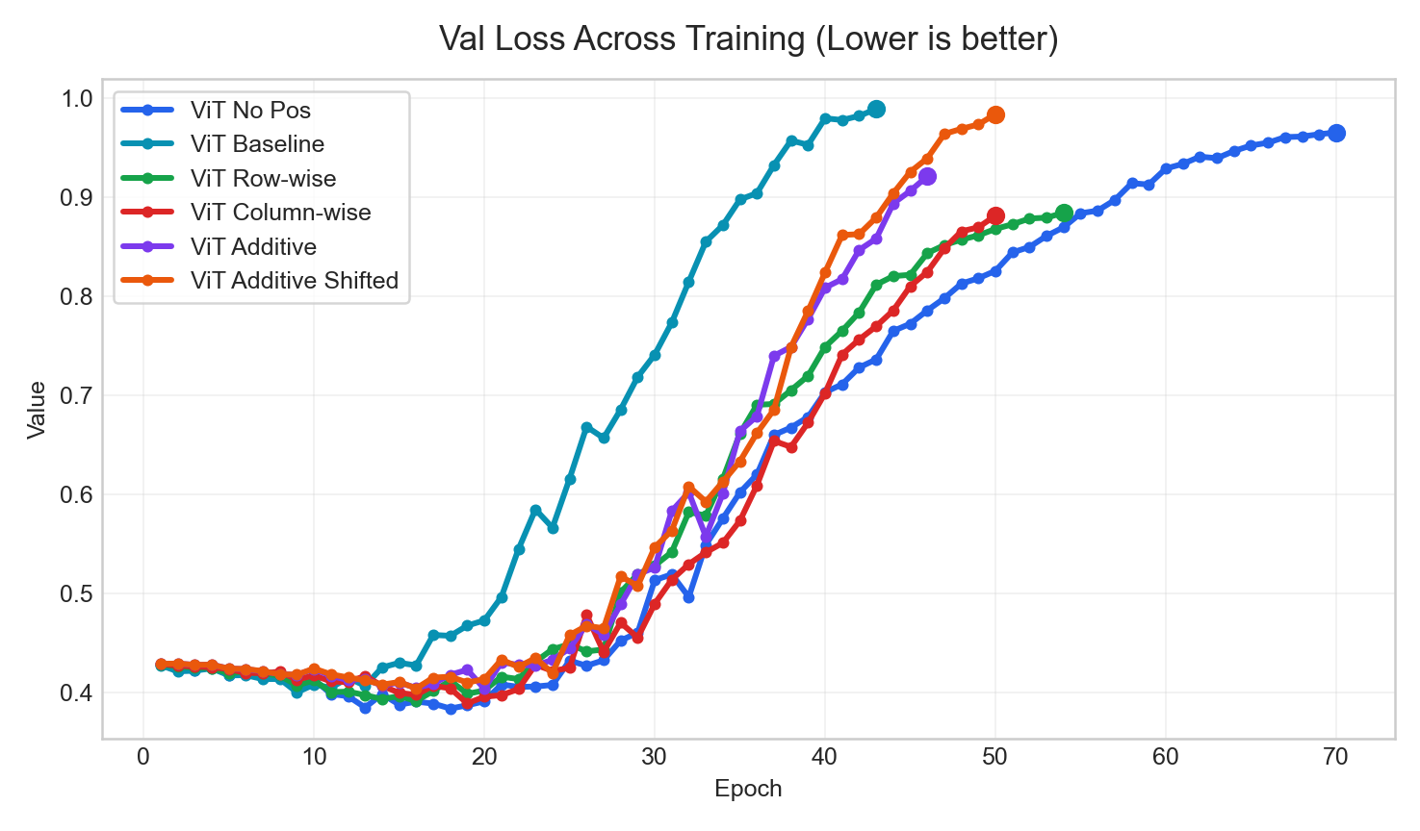
Curves
Training Curves (2/4)
Curves use a consistent title pattern and highlight the final operating point.
Test Loss
Val Loss
Best final value: ViT Additive (0.9168)
Best final value: ViT Column-wise (0.8815)
Use these pages for trend discussion; use tables for exact values.

Slide 18
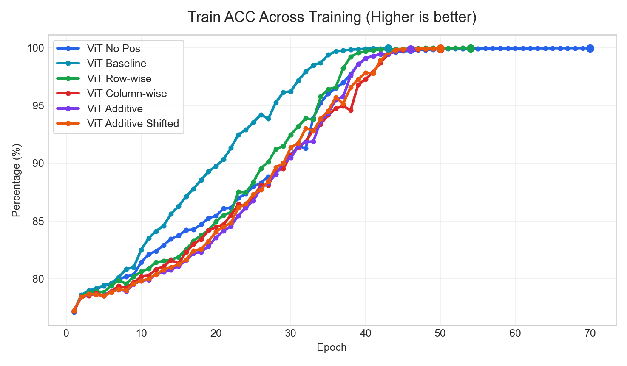
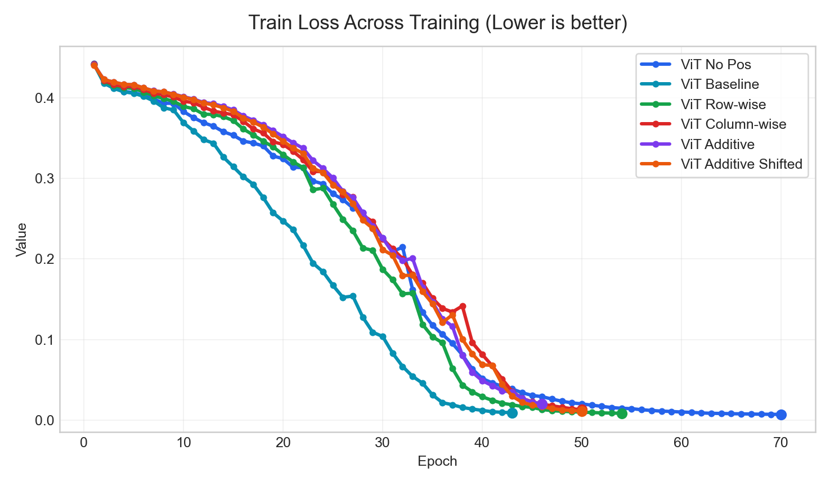
Curves
Training Curves (3/4)
Curves use a consistent title pattern and highlight the final operating point.
Train ACC
Train Loss
Best final value: ViT Row-wise (99.96%)
Best final value: ViT No Pos (0.0072)
Use these pages for trend discussion; use tables for exact values.

Slide 19
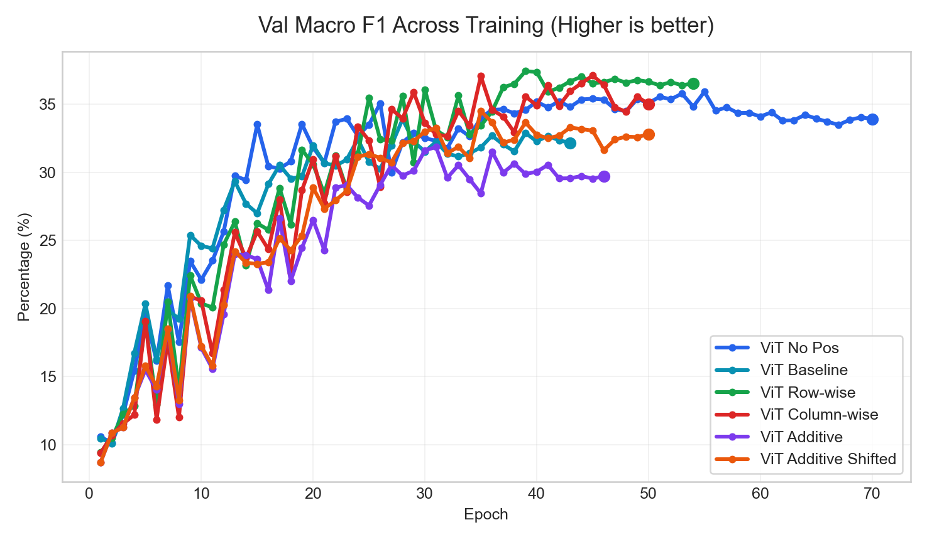
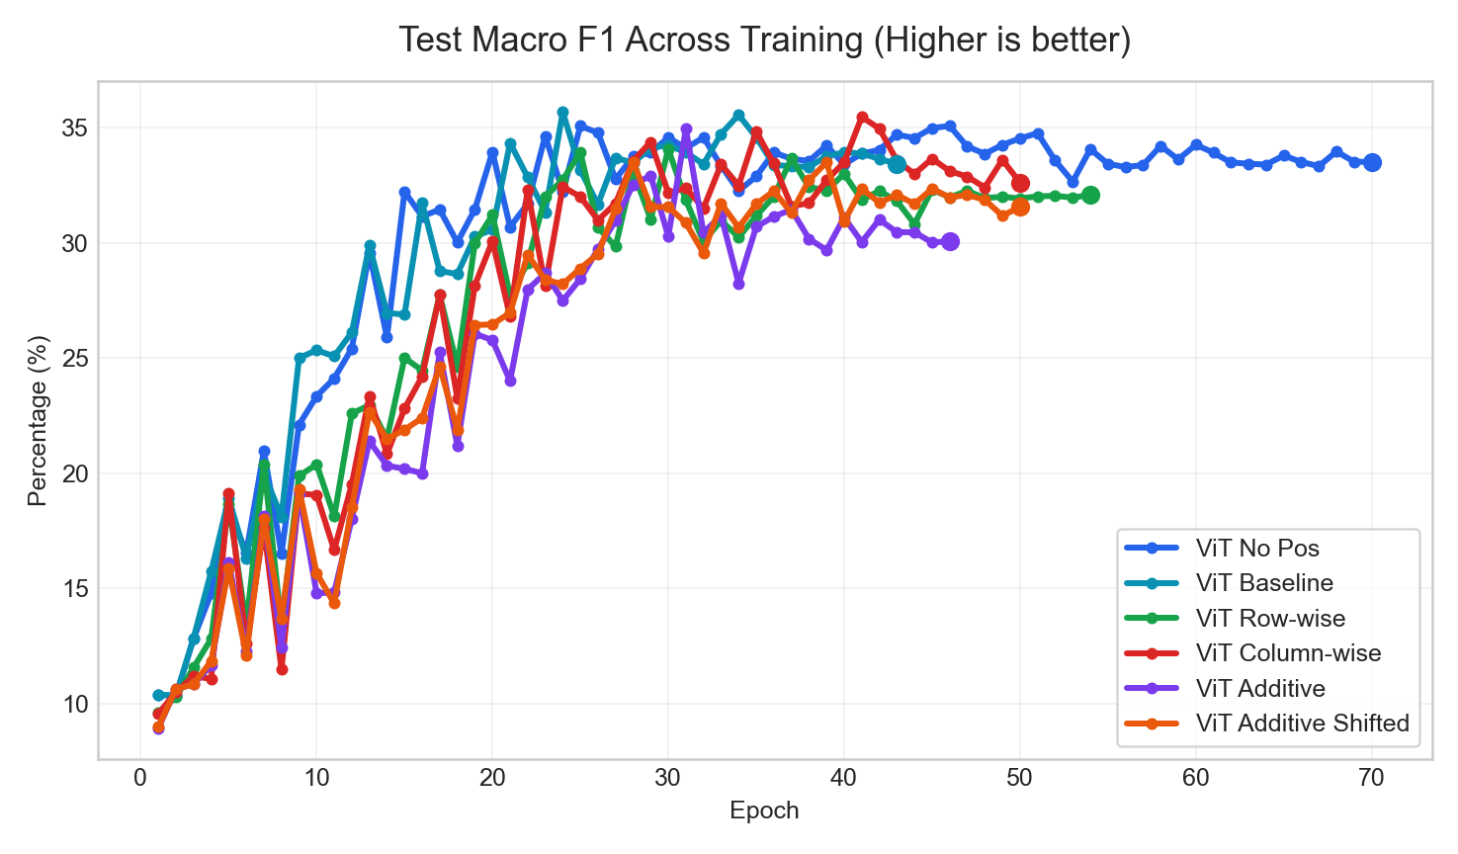
Curves
Training Curves (4/4)
Curves use a consistent title pattern and highlight the final operating point.
Val Macro F1
Test Macro F1
Best final value: ViT Row-wise (36.55%)
Best final value: ViT No Pos (33.50%)
Use these pages for trend discussion; use tables for exact values.

Slide 20
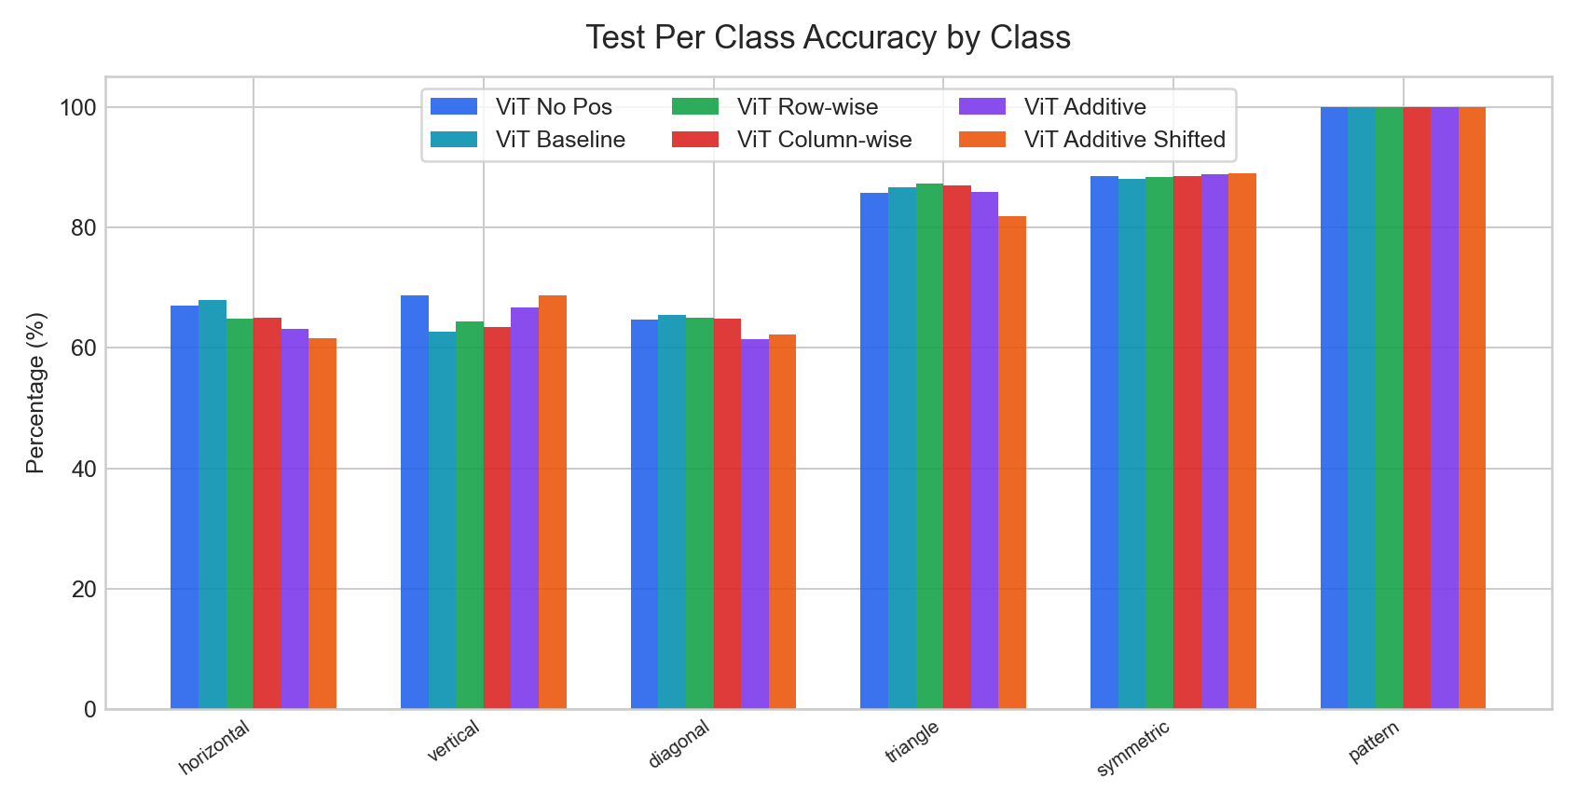
Per-Class
Per-Class Analysis | Test Per Class Accuracy
Classwise selected-checkpoint metrics are grouped across runs for easier error analysis.
Key readout
Highest mean Test Per Class Accuracy: ViT No Pos (79.06%).
Largest cross-run spread appears on class 'horizontal' (6.31 pp).
Use this page to explain which classes move together and which remain difficult.

Slide 21
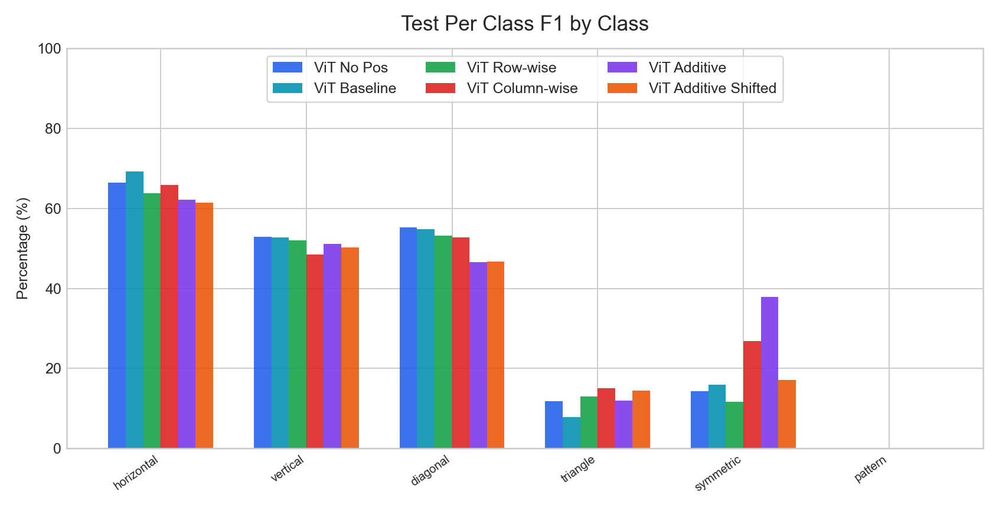
Per-Class
Per-Class Analysis | Test Per Class F1
Classwise selected-checkpoint metrics are grouped across runs for easier error analysis.
Key readout
Highest mean Test Per Class F1: ViT Additive (34.95%).
Largest cross-run spread appears on class 'symmetric' (26.30 pp).
Use this page to explain which classes move together and which remain difficult.

Slide 22
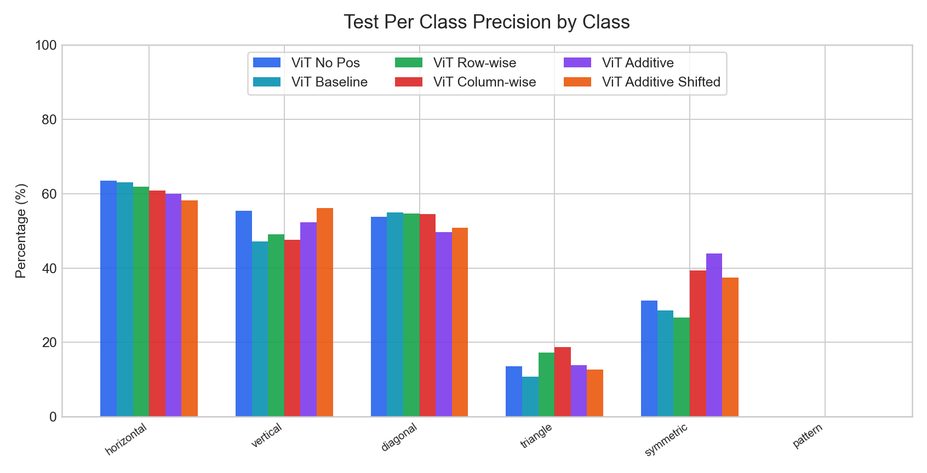
Per-Class
Per-Class Analysis | Test Per Class Precision
Classwise selected-checkpoint metrics are grouped across runs for easier error analysis.
Key readout
Highest mean Test Per Class Precision: ViT Column-wise (36.84%).
Largest cross-run spread appears on class 'symmetric' (17.24 pp).
Use this page to explain which classes move together and which remain difficult.

Slide 23
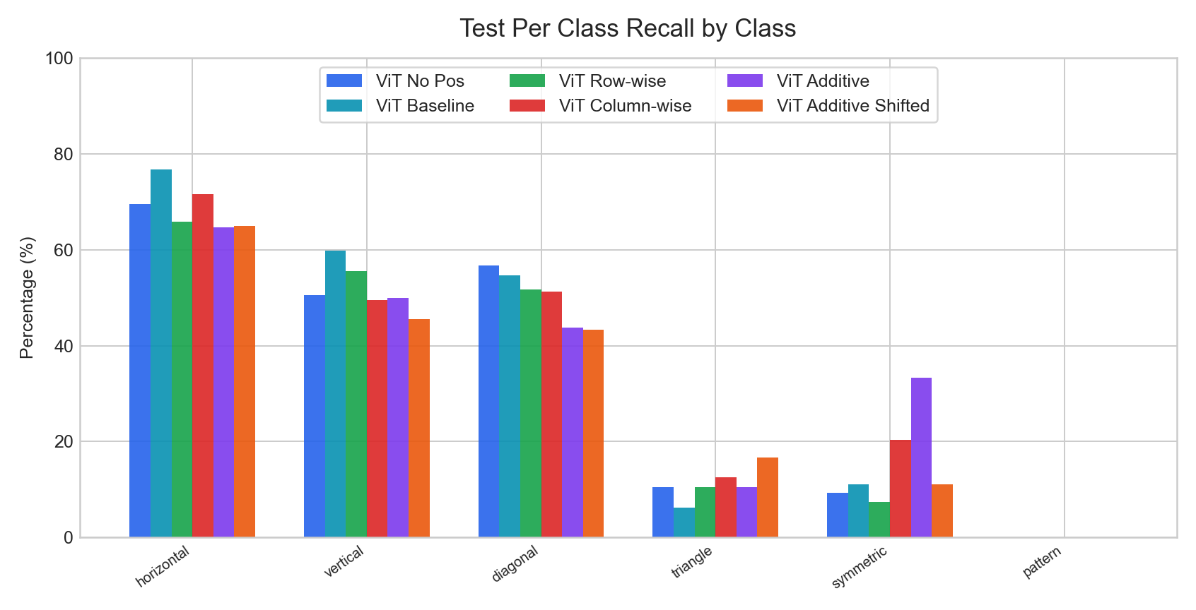
Per-Class
Per-Class Analysis | Test Per Class Recall
Classwise selected-checkpoint metrics are grouped across runs for easier error analysis.
Key readout
Highest mean Test Per Class Recall: ViT Baseline (34.80%).
Largest cross-run spread appears on class 'symmetric' (25.93 pp).
Use this page to explain which classes move together and which remain difficult.

Slide 24
Close
Conclusion
Short, reusable wrap-up slide for weekly meetings.
Current headline result: ViT No Pos leads on Test ACC with 79.48%.
When presenting baseline vs comparison, use ViT No Pos as reference and report ViT Baseline at -0.51 pp on Test ACC.
Per-class pages are now included when selected-checkpoint classwise metrics exist, so class imbalance or hard classes can be discussed directly in meetings.
The deck is now organized for weekly reporting: setup, overview, key metrics, curves, error analysis, and a conclusion slide instead of raw log-style export.
Recommended next use
Keep the baseline run first in the command line.
Append new runs with readable labels.
Reuse this deck directly for group meetings.
The goal is to export a presentable deck, not a raw artifact dump.

