Slide 1
CIFAR-10 Positional Encoding Comparison
Weekly experiment comparison deck generated from existing run artifacts
ViT Baseline (No Pos)
ViT Learnable Position
ViT Row-wise Sinusoidal
ViT Column-wise Sinusoidal
Report scope
Comparison scenario: Multi-run comparison
Reference run: ViT Baseline (No Pos)
Compared runs: 8
Shared training metrics: Test ACC, Val ACC, Test Loss
Generated 2026-07-04 15:12
Report name: cifar10_positional_8models_report

Slide 2
Run Setup
Experiment Setup and Run Context
Keep the first --run as the reference baseline for meeting comparisons.
ViT Baseline (No Pos)
ViT Learnable Position
Run ID: vit_baseline_cifar10_seed42
Model / device: ViT Baseline (No Pos) / cuda
Epochs completed: 59
Family / variant: ViT / Baseline (No Pos)
Position / init: None / From scratch
Batch / LR / WD: 128 / 0.0003 / 0.05
Run ID: vit_learnable_position_cifar10_seed42
Model / device: ViT Learnable Position / cuda
Epochs completed: 66
Family / variant: ViT / Learnable Position
Position / init: Absolute / From scratch
Batch / LR / WD: 128 / 0.0003 / 0.05
ViT Row-wise Sinusoidal
ViT Column-wise Sinusoidal
Run ID: vit_row_cifar10_seed42
Model / device: ViT Row-wise Sinusoidal / cuda
Epochs completed: 61
Family / variant: ViT / Row-wise Sinusoidal
Position / init: Row-wise Sinusoidal / From scratch
Batch / LR / WD: 128 / 0.0003 / 0.05
Run ID: vit_col_cifar10_seed42
Model / device: ViT Column-wise Sinusoidal / cuda
Epochs completed: 50
Family / variant: ViT / Column-wise Sinusoidal
Position / init: Column-wise Sinusoidal / From scratch
Batch / LR / WD: 128 / 0.0003 / 0.05
Run cards surface the main hyperparameters and monitoring settings without crowding a table.
Page group 1

Slide 3
Run Setup
Experiment Setup and Run Context
Keep the first --run as the reference baseline for meeting comparisons.
ViT Additive Sinusoidal
ViT Additive Sinusoidal Shifted
Run ID: vit_additive_cifar10_seed42
Model / device: ViT Additive Sinusoidal / cuda
Epochs completed: 70
Family / variant: ViT / Additive Sinusoidal
Position / init: Additive Sinusoidal / From scratch
Batch / LR / WD: 128 / 0.0003 / 0.05
Run ID: vit_additive_shifted_cifar10_seed42
Model / device: ViT Additive Sinusoidal Shifted / cuda
Epochs completed: 67
Family / variant: ViT / Additive Sinusoidal Shifted
Position / init: Additive Sinusoidal Shifted / From scratch
Batch / LR / WD: 128 / 0.0003 / 0.05
ViT Multiplicative Sinusoidal
ViT Multiplicative Sinusoidal Shifted
Run ID: vit_multi_cifar10_seed42
Model / device: ViT Multiplicative Sinusoidal / cuda
Epochs completed: 48
Family / variant: ViT / Multiplicative Sinusoidal
Position / init: Multiplicative Sinusoidal / From scratch
Batch / LR / WD: 128 / 0.0003 / 0.05
Run ID: vit_multi_shifted_cifar10_seed42
Model / device: ViT Multiplicative Sinusoidal Shifted / cuda
Epochs completed: 70
Family / variant: ViT / Multiplicative Sinusoidal Shifted
Position / init: Multiplicative Sinusoidal Shifted / From scratch
Batch / LR / WD: 128 / 0.0003 / 0.05
Run cards surface the main hyperparameters and monitoring settings without crowding a table.
Page group 2

Slide 4
Overview
Results Overview
Headline findings are phrased for direct use in a weekly update.
Primary comparison metric: Test ACC. Best final result is ViT Learnable Position with 78.03%.
Against reference run ViT Baseline (No Pos), ViT Learnable Position changes Test ACC by +6.61 pp.
Largest train-to-test accuracy gap appears in ViT Baseline (No Pos) (23.58 pp), worth calling out during generalization discussion.
Early stopping summary: ViT Baseline (No Pos): stopped early; ViT Learnable Position: stopped early; ViT Row-wise Sinusoidal: stopped early
Best primary metric
Test ACC
ViT Learnable Position
78.03%
Runs compared
Metrics tracked
8
12
This slide replaces generic 'key takeaways' text with meeting-ready comparison statements.

Slide 5
Comparison Table
Model Comparison (1/2)
This page is keyed off model family, variant, position encoding, and initialization rather than off raw run names.
Run | Model | Family | Variant | Position Encoding | Initialization | Batch / LR / WD
ViT Baseline (No Pos) | ViT Baseline (No Pos) | ViT | Baseline (No Pos) | None | From scratch | 128 / 0.0003 / 0.05
ViT Learnable Position | ViT Learnable Position | ViT | Learnable Position | Absolute | From scratch | 128 / 0.0003 / 0.05
ViT Row-wise Sinusoidal | ViT Row-wise Sinusoidal | ViT | Row-wise Sinusoidal | Row-wise Sinusoidal | From scratch | 128 / 0.0003 / 0.05
ViT Column-wise Sinusoidal | ViT Column-wise Sinusoidal | ViT | Column-wise Sinusoidal | Column-wise Sinusoidal | From scratch | 128 / 0.0003 / 0.05
ViT Additive Sinusoidal | ViT Additive Sinusoidal | ViT | Additive Sinusoidal | Additive Sinusoidal | From scratch | 128 / 0.0003 / 0.05
ViT Additive Sinusoidal Shifted | ViT Additive Sinusoidal Shifted | ViT | Additive Sinusoidal Shifted | Additive Sinusoidal Shifted | From scratch | 128 / 0.0003 / 0.05
ViT Multiplicative Sinusoidal | ViT Multiplicative Sinusoidal | ViT | Multiplicative Sinusoidal | Multiplicative Sinusoidal | From scratch | 128 / 0.0003 / 0.05
Use this page to frame baseline vs RoPE, ViT vs CNN, or scratch vs pretrained before discussing metrics.

Slide 6
Comparison Table
Model Comparison (2/2)
This page is keyed off model family, variant, position encoding, and initialization rather than off raw run names.
Run | Model | Family | Variant | Position Encoding | Initialization | Batch / LR / WD
ViT Multiplicative Sinusoidal Shifted | ViT Multiplicative Sinusoidal Shifted | ViT | Multiplicative Sinusoidal Shifted | Multiplicative Sinusoidal Shifted | From scratch | 128 / 0.0003 / 0.05
Use this page to frame baseline vs RoPE, ViT vs CNN, or scratch vs pretrained before discussing metrics.

Slide 7
Comparison Table
Result Snapshot (1/2)
Compact overview of the most important final metrics and selected checkpoint epoch.
Run | Model | Variant | Epochs | Selected Epoch | Test ACC | Val ACC | Test Loss
ViT Baseline (No Pos) | ViT Baseline (No Pos) | Baseline (No Pos) | 59 | 49 | 71.42% | 71.36% | 1.1672
ViT Learnable Position | ViT Learnable Position | Learnable Position | 66 | 56 | 78.03% | 78.88% | 0.9615
ViT Row-wise Sinusoidal | ViT Row-wise Sinusoidal | Row-wise Sinusoidal | 61 | 51 | 74.62% | 74.92% | 1.1507
ViT Column-wise Sinusoidal | ViT Column-wise Sinusoidal | Column-wise Sinusoidal | 50 | 40 | 74.21% | 74.78% | 0.8657
ViT Additive Sinusoidal | ViT Additive Sinusoidal | Additive Sinusoidal | 70 | 60 | 76.05% | 77.14% | 0.8797
ViT Additive Sinusoidal Shifted | ViT Additive Sinusoidal Shifted | Additive Sinusoidal Shifted | 67 | 57 | 77.19% | 77.58% | 0.8616
ViT Multiplicative Sinusoidal | ViT Multiplicative Sinusoidal | Multiplicative Sinusoidal | 48 | 38 | 76.18% | 77.14% | 0.7343
This table is intentionally compact so it remains readable on projected slides.

Slide 8
Comparison Table
Result Snapshot (2/2)
Compact overview of the most important final metrics and selected checkpoint epoch.
Run | Model | Variant | Epochs | Selected Epoch | Test ACC | Val ACC | Test Loss
ViT Multiplicative Sinusoidal Shifted | ViT Multiplicative Sinusoidal Shifted | Multiplicative Sinusoidal Shifted | 70 | 60 | 77.56% | 78.48% | 0.8706
This table is intentionally compact so it remains readable on projected slides.

Slide 9
Comparison Table
Main Metrics Comparison (1/6)
Each row is a meeting-friendly metric statement rather than a raw logger dump.
Metric | Direction | ViT Baseline (No Pos) | ViT Learnable Position | ViT Row-wise Sinusoidal | ViT Column-wise Sinusoidal
Final Test ACC | Higher | 71.42% | 78.03% | 74.62% | 74.21%
Final Val ACC | Higher | 71.36% | 78.88% | 74.92% | 74.78%
Final Test Loss | Lower | 1.1672 | 0.9615 | 1.1507 | 0.8657
Final Val Loss | Lower | 1.1645 | 0.9667 | 1.1300 | 0.8380
Final Train ACC | Higher | 95.00% | 97.74% | 97.86% | 88.85%
Final Train Loss | Lower | 0.1457 | 0.0658 | 0.0695 | 0.3096
Final Val Macro F1 | Higher | 71.24% | 78.85% | 74.80% | 74.51%
Final Test Macro F1 | Higher | 71.35% | 78.05% | 74.58% | 74.05%
Direction indicates whether higher or lower values are preferable.

Slide 10
Comparison Table
Main Metrics Comparison (2/6)
Each row is a meeting-friendly metric statement rather than a raw logger dump.
Metric | Direction | ViT Additive Sinusoidal | ViT Additive Sinusoidal Shifted | ViT Multiplicative Sinusoidal | ViT Multiplicative Sinusoidal Shifted
Final Test ACC | Higher | 76.05% | 77.19% | 76.18% | 77.56%
Final Val ACC | Higher | 77.14% | 77.58% | 77.14% | 78.48%
Final Test Loss | Lower | 0.8797 | 0.8616 | 0.7343 | 0.8706
Final Val Loss | Lower | 0.8371 | 0.8473 | 0.7078 | 0.8236
Final Train ACC | Higher | 92.24% | 94.49% | 85.94% | 95.65%
Final Train Loss | Lower | 0.2163 | 0.1572 | 0.3934 | 0.1241
Final Val Macro F1 | Higher | 76.71% | 77.50% | 76.79% | 78.39%
Final Test Macro F1 | Higher | 75.77% | 77.25% | 75.90% | 77.54%
Direction indicates whether higher or lower values are preferable.

Slide 11
Comparison Table
Main Metrics Comparison (3/6)
Each row is a meeting-friendly metric statement rather than a raw logger dump.
Metric | Direction | Best Run
Final Test ACC | Higher | ViT Learnable Position
Final Val ACC | Higher | ViT Learnable Position
Final Test Loss | Lower | ViT Multiplicative Sinusoidal
Final Val Loss | Lower | ViT Multiplicative Sinusoidal
Final Train ACC | Higher | ViT Row-wise Sinusoidal
Final Train Loss | Lower | ViT Learnable Position
Final Val Macro F1 | Higher | ViT Learnable Position
Final Test Macro F1 | Higher | ViT Learnable Position
Direction indicates whether higher or lower values are preferable.

Slide 12
Comparison Table
Main Metrics Comparison (4/6)
Each row is a meeting-friendly metric statement rather than a raw logger dump.
Metric | Direction | ViT Baseline (No Pos) | ViT Learnable Position | ViT Row-wise Sinusoidal | ViT Column-wise Sinusoidal
Selected Test Macro Precision | Higher | 70.96% | 78.79% | 74.96% | 74.30%
Selected Test Macro Recall | Higher | 71.04% | 78.88% | 74.79% | 74.33%
Selected Val Macro Precision | Higher | 71.71% | 79.03% | 75.25% | 75.49%
Selected Val Macro Recall | Higher | 71.63% | 78.98% | 75.03% | 75.32%
Direction indicates whether higher or lower values are preferable.

Slide 13
Comparison Table
Main Metrics Comparison (5/6)
Each row is a meeting-friendly metric statement rather than a raw logger dump.
Metric | Direction | ViT Additive Sinusoidal | ViT Additive Sinusoidal Shifted | ViT Multiplicative Sinusoidal | ViT Multiplicative Sinusoidal Shifted
Selected Test Macro Precision | Higher | 77.04% | 77.11% | 76.62% | 77.72%
Selected Test Macro Recall | Higher | 77.01% | 76.92% | 76.61% | 77.78%
Selected Val Macro Precision | Higher | 77.65% | 77.81% | 77.51% | 78.99%
Selected Val Macro Recall | Higher | 77.49% | 77.66% | 77.37% | 78.94%
Direction indicates whether higher or lower values are preferable.

Slide 14
Comparison Table
Main Metrics Comparison (6/6)
Each row is a meeting-friendly metric statement rather than a raw logger dump.
Metric | Direction | Best Run
Selected Test Macro Precision | Higher | ViT Learnable Position
Selected Test Macro Recall | Higher | ViT Learnable Position
Selected Val Macro Precision | Higher | ViT Learnable Position
Selected Val Macro Recall | Higher | ViT Learnable Position
Direction indicates whether higher or lower values are preferable.

Slide 15
Comparison Table
Macro Metrics Table (1/3)
Exact selected-checkpoint macro metrics for precision, recall, and F1.
Macro Metric | Direction | ViT Baseline (No Pos) | ViT Learnable Position | ViT Row-wise Sinusoidal | ViT Column-wise Sinusoidal
Final Test Macro F1 | Higher | 71.35% | 78.05% | 74.58% | 74.05%
Selected Test Macro Precision | Higher | 70.96% | 78.79% | 74.96% | 74.30%
Selected Test Macro Recall | Higher | 71.04% | 78.88% | 74.79% | 74.33%
Final Val Macro F1 | Higher | 71.24% | 78.85% | 74.80% | 74.51%
Selected Val Macro Precision | Higher | 71.71% | 79.03% | 75.25% | 75.49%
Selected Val Macro Recall | Higher | 71.63% | 78.98% | 75.03% | 75.32%
This table complements the macro bar chart on the next page.

Slide 16
Comparison Table
Macro Metrics Table (2/3)
Exact selected-checkpoint macro metrics for precision, recall, and F1.
Macro Metric | Direction | ViT Additive Sinusoidal | ViT Additive Sinusoidal Shifted | ViT Multiplicative Sinusoidal | ViT Multiplicative Sinusoidal Shifted
Final Test Macro F1 | Higher | 75.77% | 77.25% | 75.90% | 77.54%
Selected Test Macro Precision | Higher | 77.04% | 77.11% | 76.62% | 77.72%
Selected Test Macro Recall | Higher | 77.01% | 76.92% | 76.61% | 77.78%
Final Val Macro F1 | Higher | 76.71% | 77.50% | 76.79% | 78.39%
Selected Val Macro Precision | Higher | 77.65% | 77.81% | 77.51% | 78.99%
Selected Val Macro Recall | Higher | 77.49% | 77.66% | 77.37% | 78.94%
This table complements the macro bar chart on the next page.

Slide 17
Comparison Table
Macro Metrics Table (3/3)
Exact selected-checkpoint macro metrics for precision, recall, and F1.
Macro Metric | Direction | Best Run
Final Test Macro F1 | Higher | ViT Learnable Position
Selected Test Macro Precision | Higher | ViT Learnable Position
Selected Test Macro Recall | Higher | ViT Learnable Position
Final Val Macro F1 | Higher | ViT Learnable Position
Selected Val Macro Precision | Higher | ViT Learnable Position
Selected Val Macro Recall | Higher | ViT Learnable Position
This table complements the macro bar chart on the next page.

Slide 18
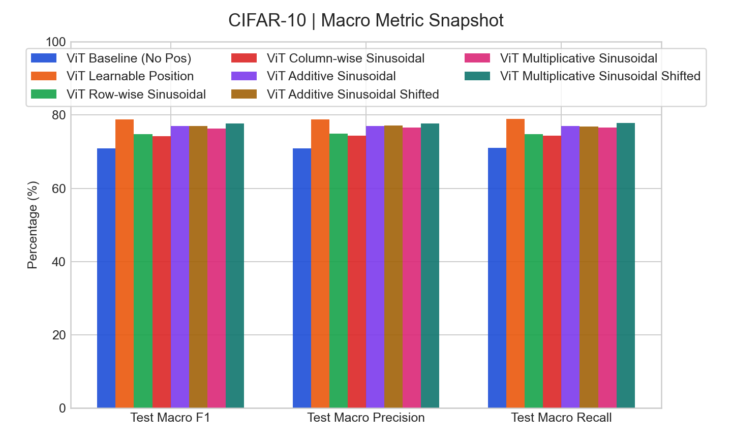
Macro Metrics
Macro Metrics
Macro F1, precision, and recall are grouped here for quick meeting discussion.
Macro readout
Best Test Macro F1 snapshot: ViT Learnable Position (78.79%).
Best selected Test Macro Precision: ViT Learnable Position (78.79%).
Best selected Test Macro Recall: ViT Learnable Position (78.88%).
Macro metrics help when accuracy alone hides uneven class performance.

Slide 19
Comparison Table
Config Differences (1/2)
Showing the top 2 differing settings for experiment traceability.
Config | ViT Baseline (No Pos) | ViT Learnable Position | ViT Row-wise Sinusoidal | ViT Column-wise Sinusoidal
command | train_cifar10_experiment.py --model... | train_cifar10_experiment.py --model... | train_cifar10_experiment.py --model... | train_cifar10_experiment.py --model...
outputs.run_name | vit_baseline_cifar10_seed42 | vit_learnable_position_cifar10_seed42 | vit_row_cifar10_seed42 | vit_col_cifar10_seed42
Long config lists are paginated automatically to avoid overflow and tiny fonts.

Slide 20
Comparison Table
Config Differences (2/2)
Showing the top 2 differing settings for experiment traceability.
Config | ViT Additive Sinusoidal | ViT Additive Sinusoidal Shifted | ViT Multiplicative Sinusoidal | ViT Multiplicative Sinusoidal Shifted
command | train_cifar10_experiment.py --model... | train_cifar10_experiment.py --model... | train_cifar10_experiment.py --model... | train_cifar10_experiment.py --model...
outputs.run_name | vit_additive_cifar10_seed42 | vit_additive_shifted_cifar10_seed42 | vit_multi_cifar10_seed42 | vit_multi_shifted_cifar10_seed42
Long config lists are paginated automatically to avoid overflow and tiny fonts.

Slide 21
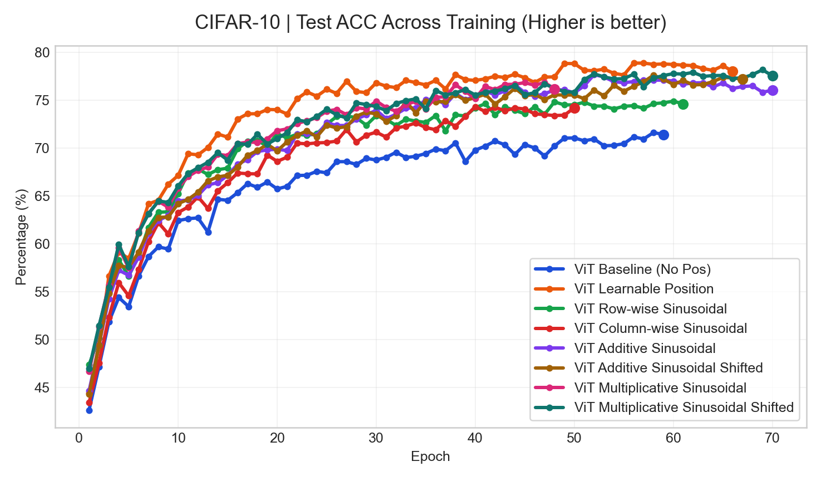
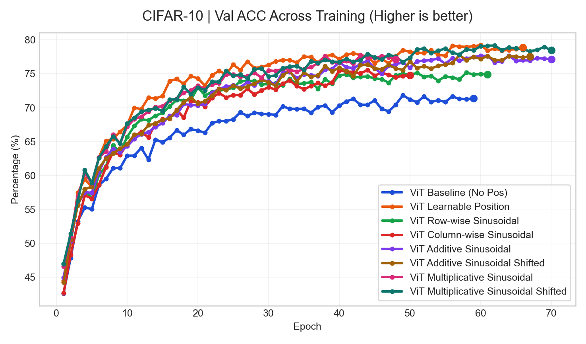
Curves
Training Curves (1/4)
Curves use a consistent title pattern and highlight the final operating point.
Test ACC
Val ACC
Best final value: ViT Learnable Position (78.03%)
Best final value: ViT Learnable Position (78.88%)
Use these pages for trend discussion; use tables for exact values.

Slide 22
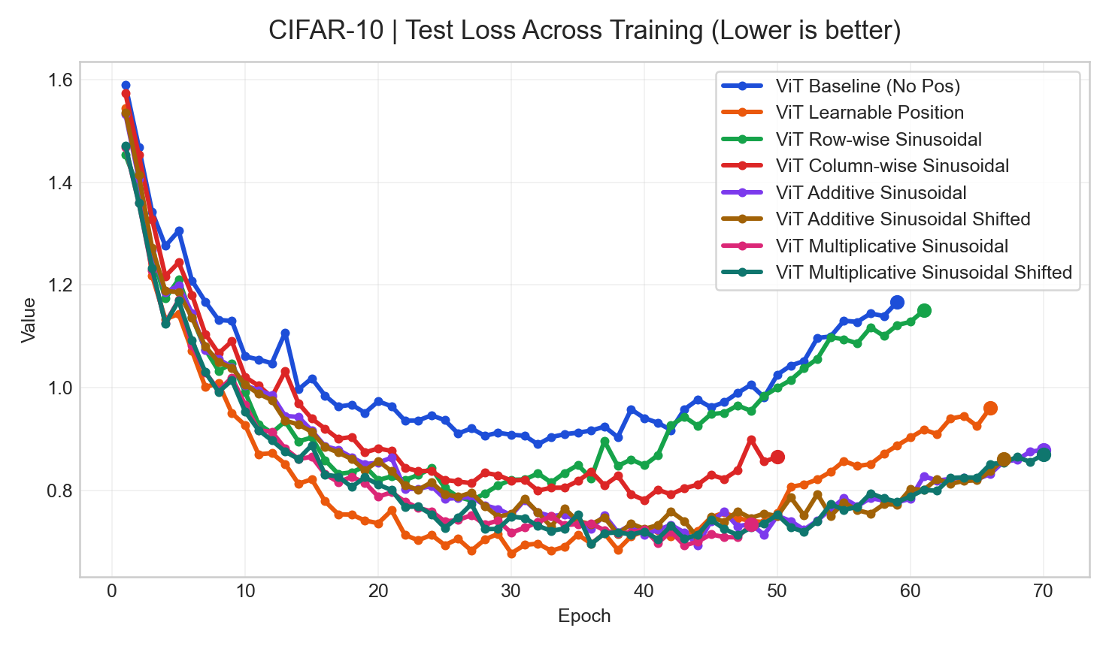
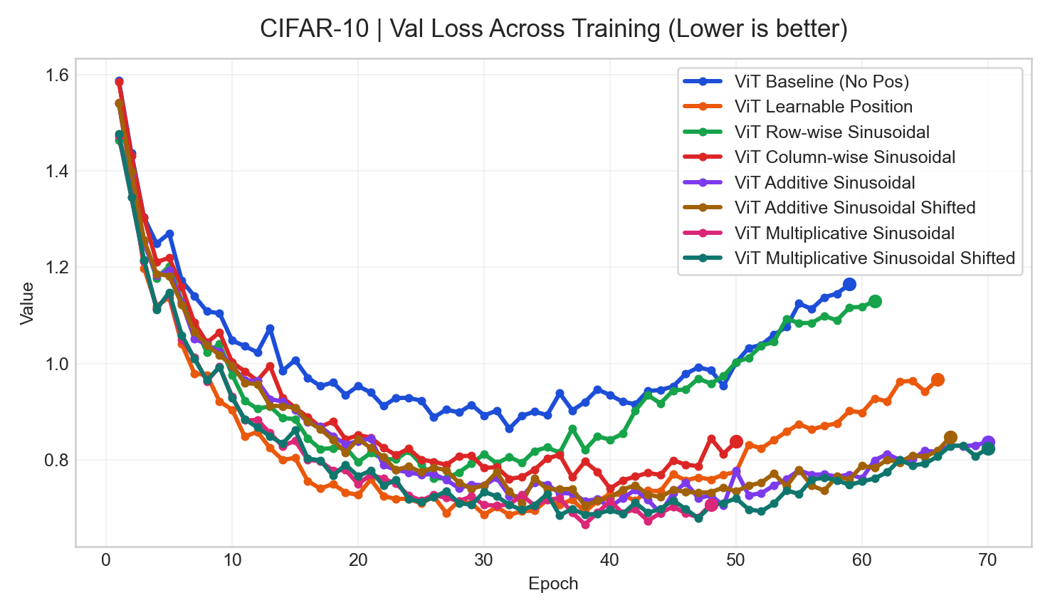
Curves
Training Curves (2/4)
Curves use a consistent title pattern and highlight the final operating point.
Test Loss
Val Loss
Best final value: ViT Multiplicative Sinusoidal (0.7343)
Best final value: ViT Multiplicative Sinusoidal (0.7078)
Use these pages for trend discussion; use tables for exact values.

Slide 23
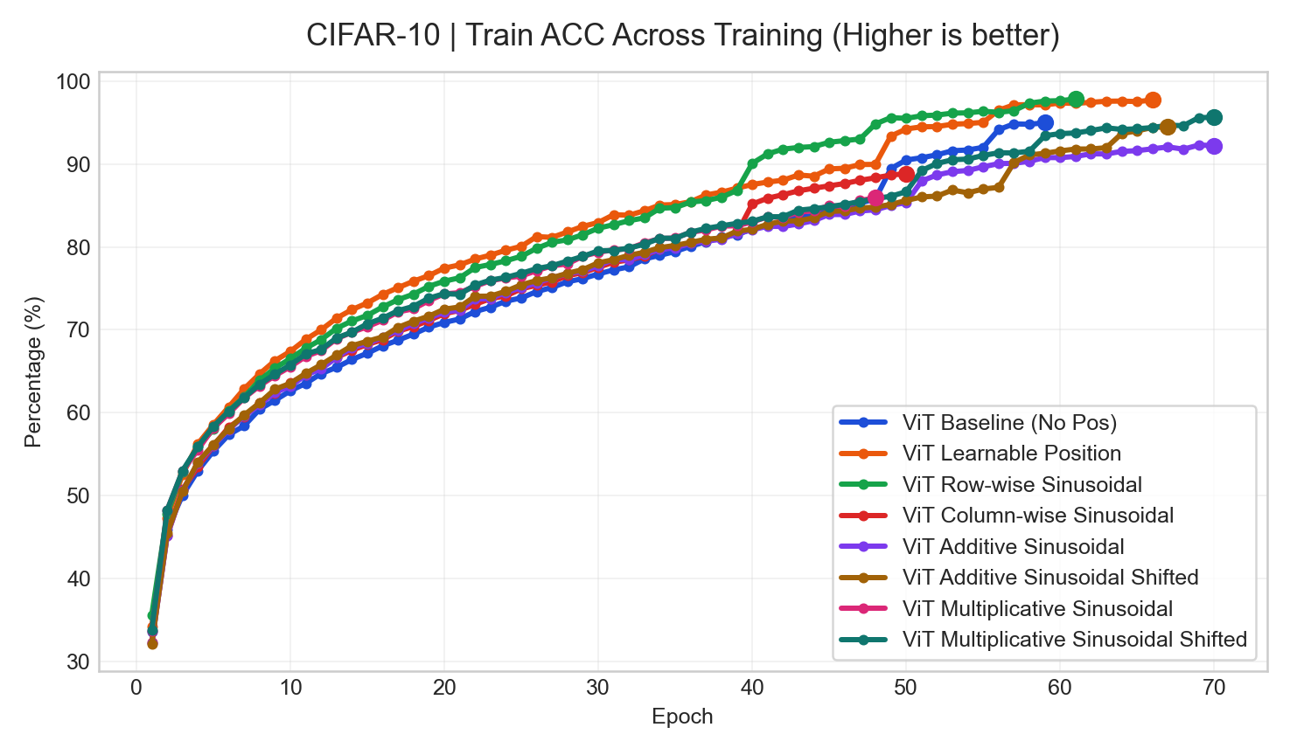
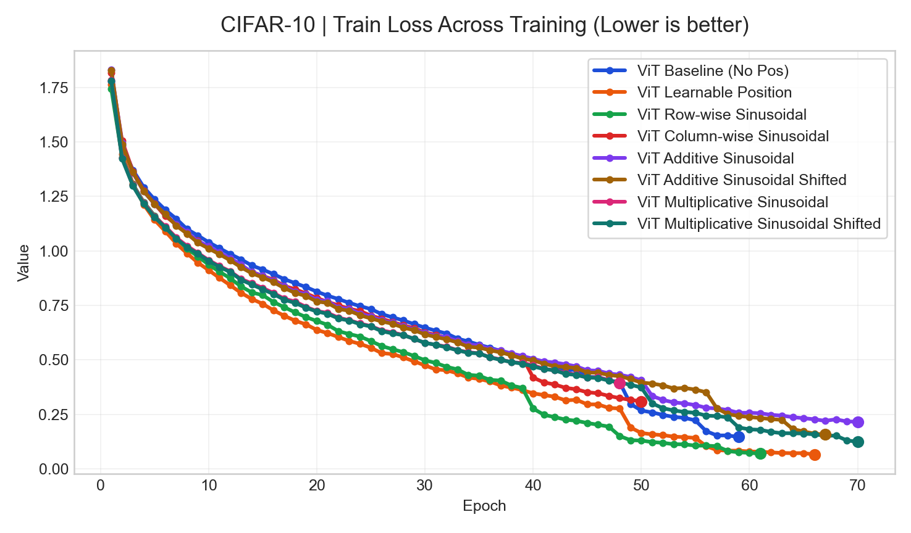
Curves
Training Curves (3/4)
Curves use a consistent title pattern and highlight the final operating point.
Train ACC
Train Loss
Best final value: ViT Row-wise Sinusoidal (97.86%)
Best final value: ViT Learnable Position (0.0658)
Use these pages for trend discussion; use tables for exact values.

Slide 24
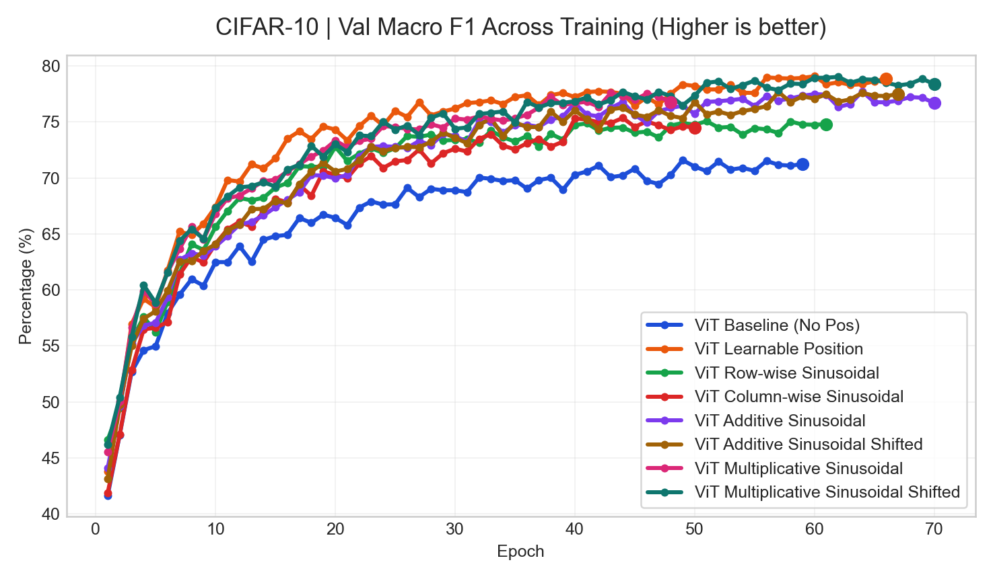
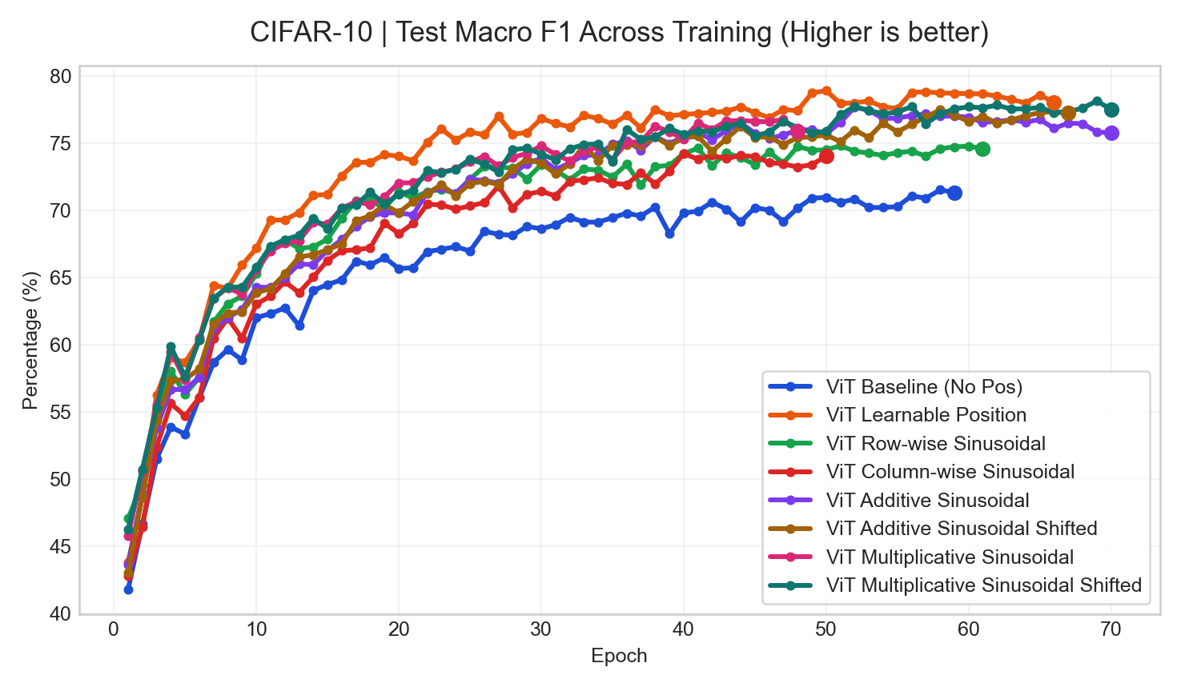
Curves
Training Curves (4/4)
Curves use a consistent title pattern and highlight the final operating point.
Val Macro F1
Test Macro F1
Best final value: ViT Learnable Position (78.85%)
Best final value: ViT Learnable Position (78.05%)
Use these pages for trend discussion; use tables for exact values.

Slide 25
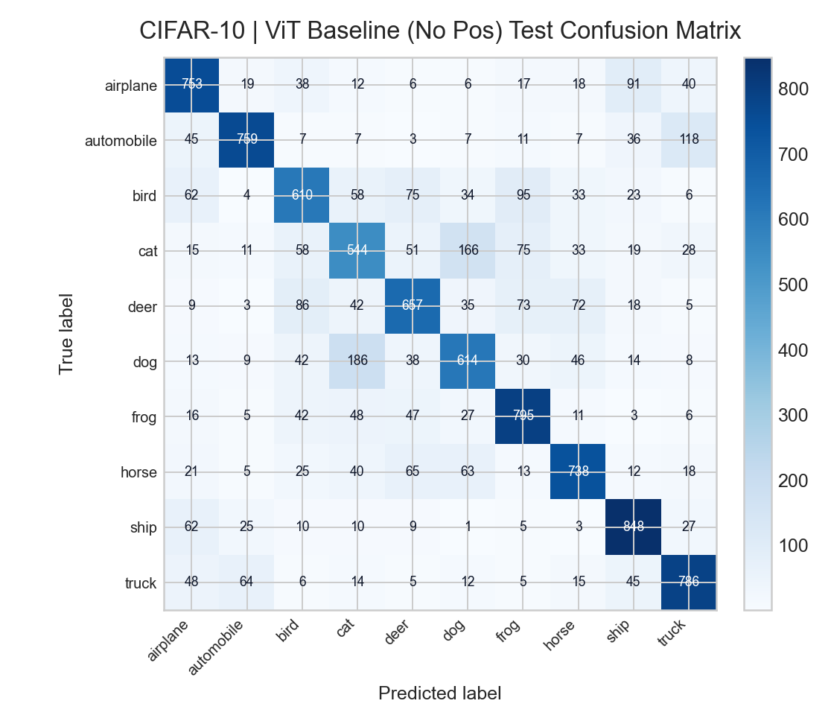
Error Analysis
Confusion Matrix | ViT Baseline (No Pos)
Selected-checkpoint error analysis pulled from existing evaluation outputs.
Reading notes
Selected checkpoint epoch: 49
Selected test accuracy: 71.04%
Selected test macro F1: 70.91%
Top confusion: true dog predicted as cat (186 samples).
Top confusion: true cat predicted as dog (166 samples).
This page gives a direct bridge from aggregate metrics to class-level failure modes.

Slide 26
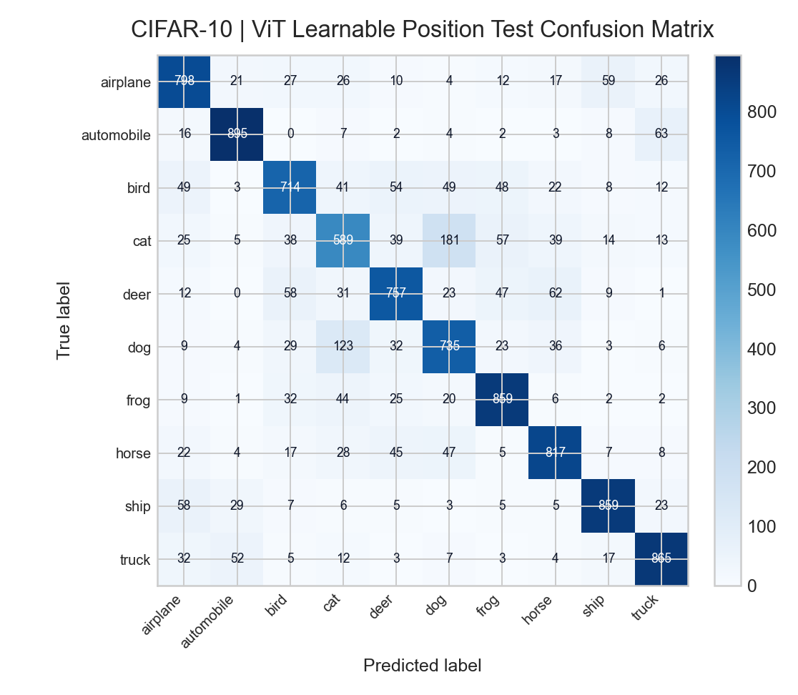
Error Analysis
Confusion Matrix | ViT Learnable Position
Selected-checkpoint error analysis pulled from existing evaluation outputs.
Reading notes
Selected checkpoint epoch: 56
Selected test accuracy: 78.88%
Selected test macro F1: 78.79%
Top confusion: true cat predicted as dog (181 samples).
Top confusion: true dog predicted as cat (123 samples).
This page gives a direct bridge from aggregate metrics to class-level failure modes.

Slide 27

Error Analysis
Confusion Matrix | ViT Row-wise Sinusoidal
Selected-checkpoint error analysis pulled from existing evaluation outputs.
Reading notes
Selected checkpoint epoch: 51
Selected test accuracy: 74.79%
Selected test macro F1: 74.82%
Top confusion: true dog predicted as cat (208 samples).
Top confusion: true cat predicted as dog (158 samples).
This page gives a direct bridge from aggregate metrics to class-level failure modes.

Slide 28

Error Analysis
Confusion Matrix | ViT Column-wise Sinusoidal
Selected-checkpoint error analysis pulled from existing evaluation outputs.
Reading notes
Selected checkpoint epoch: 40
Selected test accuracy: 74.33%
Selected test macro F1: 74.23%
Top confusion: true cat predicted as dog (179 samples).
Top confusion: true dog predicted as cat (132 samples).
This page gives a direct bridge from aggregate metrics to class-level failure modes.

Slide 29

Error Analysis
Confusion Matrix | ViT Additive Sinusoidal
Selected-checkpoint error analysis pulled from existing evaluation outputs.
Reading notes
Selected checkpoint epoch: 60
Selected test accuracy: 77.01%
Selected test macro F1: 76.94%
Top confusion: true cat predicted as dog (186 samples).
Top confusion: true dog predicted as cat (141 samples).
This page gives a direct bridge from aggregate metrics to class-level failure modes.

Slide 30

Error Analysis
Confusion Matrix | ViT Additive Sinusoidal Shifted
Selected-checkpoint error analysis pulled from existing evaluation outputs.
Reading notes
Selected checkpoint epoch: 57
Selected test accuracy: 76.92%
Selected test macro F1: 76.96%
Top confusion: true dog predicted as cat (182 samples).
Top confusion: true cat predicted as dog (136 samples).
This page gives a direct bridge from aggregate metrics to class-level failure modes.

Slide 31
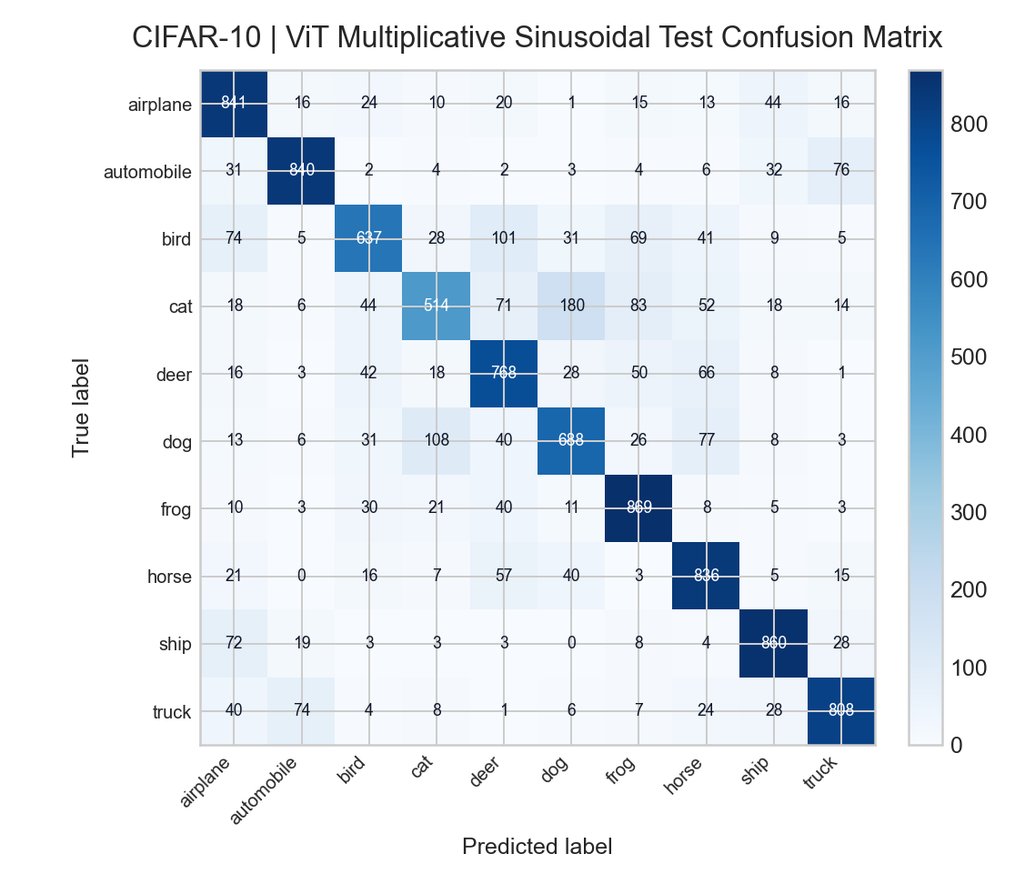
Error Analysis
Confusion Matrix | ViT Multiplicative Sinusoidal
Selected-checkpoint error analysis pulled from existing evaluation outputs.
Reading notes
Selected checkpoint epoch: 38
Selected test accuracy: 76.61%
Selected test macro F1: 76.28%
Top confusion: true cat predicted as dog (180 samples).
Top confusion: true dog predicted as cat (108 samples).
This page gives a direct bridge from aggregate metrics to class-level failure modes.

Slide 32

Error Analysis
Confusion Matrix | ViT Multiplicative Sinusoidal Shifted
Selected-checkpoint error analysis pulled from existing evaluation outputs.
Reading notes
Selected checkpoint epoch: 60
Selected test accuracy: 77.78%
Selected test macro F1: 77.72%
Top confusion: true cat predicted as dog (152 samples).
Top confusion: true dog predicted as cat (141 samples).
This page gives a direct bridge from aggregate metrics to class-level failure modes.

Slide 33
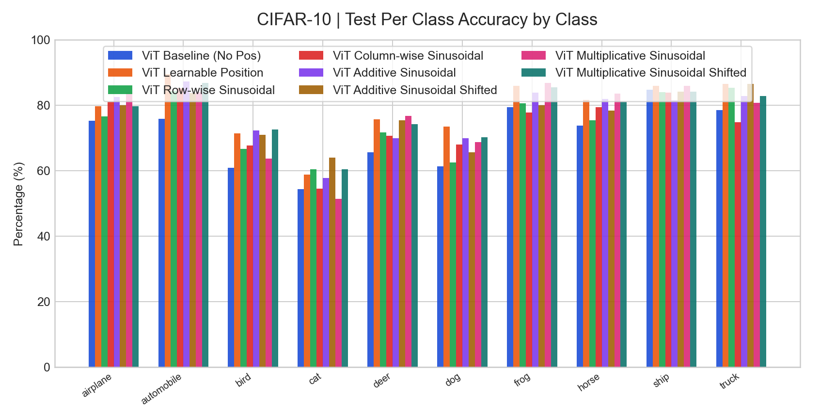
Per-Class
Per-Class Analysis | Test Per Class Accuracy
Classwise selected-checkpoint metrics are grouped across runs for easier error analysis.
Key readout
Highest mean Test Per Class Accuracy: ViT Learnable Position (78.88%).
Largest cross-run spread appears on class 'automobile' (13.60 pp).
Use this page to explain which classes move together and which remain difficult.

Slide 34
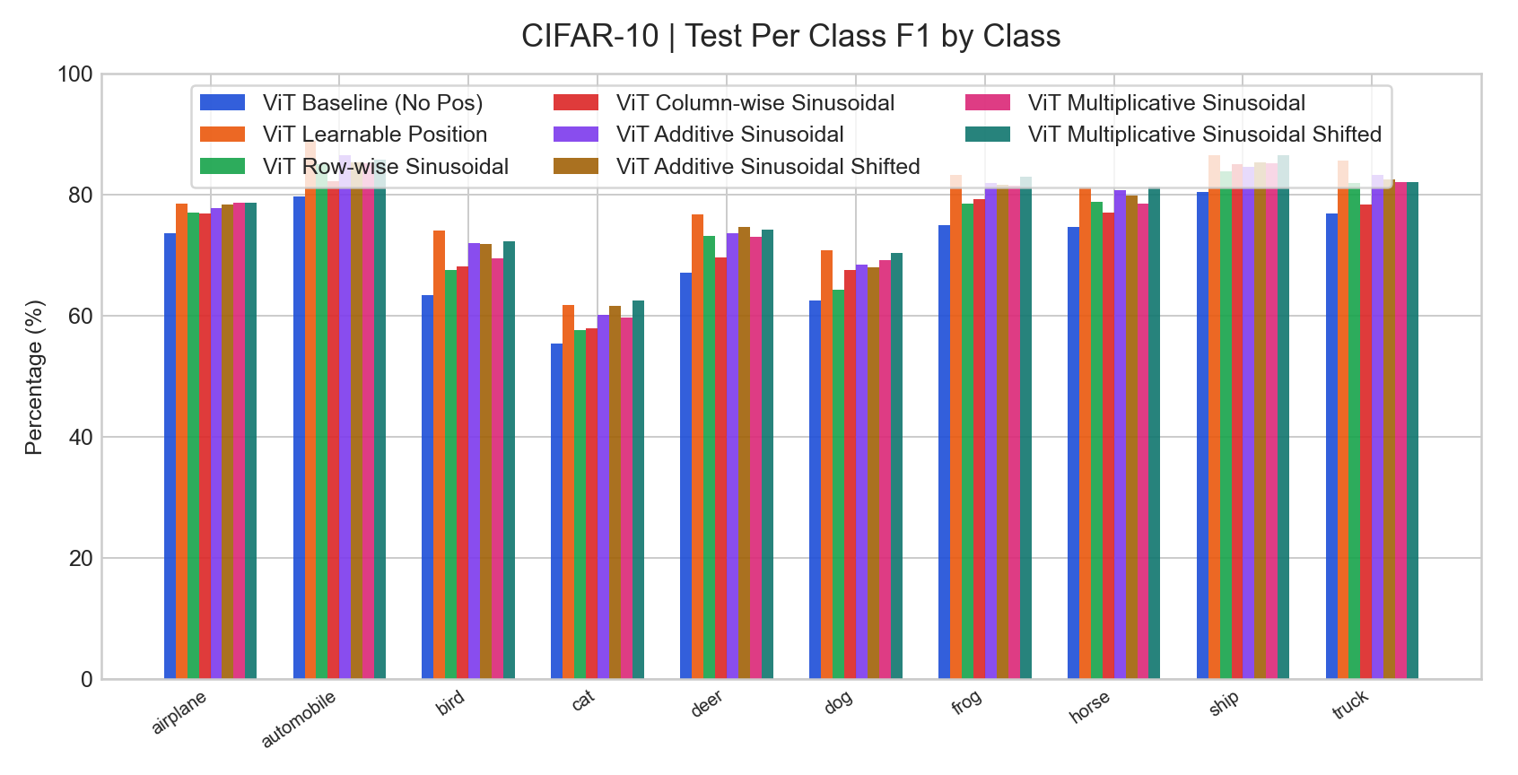
Per-Class
Per-Class Analysis | Test Per Class F1
Classwise selected-checkpoint metrics are grouped across runs for easier error analysis.
Key readout
Highest mean Test Per Class F1: ViT Learnable Position (78.79%).
Largest cross-run spread appears on class 'bird' (10.70 pp).
Use this page to explain which classes move together and which remain difficult.

Slide 35
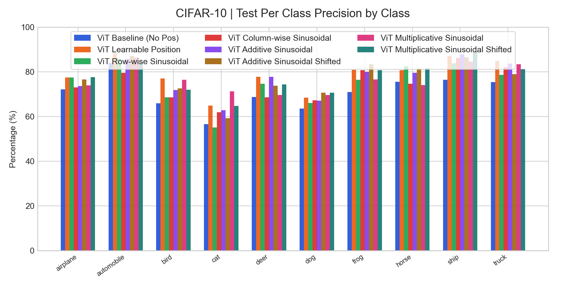
Per-Class
Per-Class Analysis | Test Per Class Precision
Classwise selected-checkpoint metrics are grouped across runs for easier error analysis.
Key readout
Highest mean Test Per Class Precision: ViT Learnable Position (78.79%).
Largest cross-run spread appears on class 'cat' (16.14 pp).
Use this page to explain which classes move together and which remain difficult.

Slide 36

Per-Class
Per-Class Analysis | Test Per Class Recall
Classwise selected-checkpoint metrics are grouped across runs for easier error analysis.
Key readout
Highest mean Test Per Class Recall: ViT Learnable Position (78.88%).
Largest cross-run spread appears on class 'automobile' (13.60 pp).
Use this page to explain which classes move together and which remain difficult.

Slide 37
Close
Conclusion
Short, reusable wrap-up slide for weekly meetings.
Current headline result: ViT Learnable Position leads on Test ACC with 78.03%.
When presenting baseline vs comparison, use ViT Baseline (No Pos) as reference and report ViT Learnable Position at +6.61 pp on Test ACC.
Per-class pages are now included when selected-checkpoint classwise metrics exist, so class imbalance or hard classes can be discussed directly in meetings.
The deck is now organized for weekly reporting: setup, overview, key metrics, curves, error analysis, and a conclusion slide instead of raw log-style export.
Recommended next use
Keep the baseline run first in the command line.
Append new runs with readable labels.
Reuse this deck directly for group meetings.
The goal is to export a presentable deck, not a raw artifact dump.

