Slide 1
Experiment Comparison: ViT Baseline vs ViT Row-wise vs ViT Column-wise
Weekly experiment comparison deck generated from existing run artifacts
ViT Baseline
ViT Row-wise
ViT Column-wise
Report scope
Comparison scenario: Multi-run comparison
Reference run: ViT Baseline
Compared runs: 3
Shared training metrics: Test ACC, Val ACC, Test Loss
Generated 2026-06-15 13:54
Report name: cadb_orientation_compare_noes

Slide 2
Run Setup
Experiment Setup and Run Context
Keep the first --run as the reference baseline for meeting comparisons.
ViT Baseline
ViT Row-wise
Run ID: baseline_cadb_seed42_noes
Model / device: ViT Baseline / cuda
Epochs completed: 20
Family / variant: ViT / Baseline
Position / init: Absolute / From scratch
Batch / LR / WD: 128 / 0.0003 / 0.05
Run ID: row_cadb_seed42_noes
Model / device: ViT Row-wise Sinusoidal / cuda
Epochs completed: 20
Family / variant: ViT / Row-wise Sinusoidal
Position / init: Row-wise Sinusoidal / From scratch
Batch / LR / WD: 128 / 0.0003 / 0.05
ViT Column-wise
Run ID: col_cadb_seed42_noes
Model / device: ViT Column-wise Sinusoidal / cuda
Epochs completed: 20
Family / variant: ViT / Column-wise Sinusoidal
Position / init: Column-wise Sinusoidal / From scratch
Batch / LR / WD: 128 / 0.0003 / 0.05
Run cards surface the main hyperparameters and monitoring settings without crowding a table.
Page group 1

Slide 3
Overview
Results Overview
Headline findings are phrased for direct use in a weekly update.
Primary comparison metric: Test ACC. Best final result is ViT Row-wise with 76.23%.
Against reference run ViT Baseline, ViT Row-wise changes Test ACC by +6.56 pp.
Largest train-to-test accuracy gap appears in ViT Baseline (22.72 pp), worth calling out during generalization discussion.
Best primary metric
Test ACC
ViT Row-wise
76.23%
Runs compared
Metrics tracked
3
12
This slide replaces generic 'key takeaways' text with meeting-ready comparison statements.

Slide 4
Comparison Table
Model Comparison
This page is keyed off model family, variant, position encoding, and initialization rather than off raw run names.
Run | Model | Family | Variant | Position Encoding | Initialization | Batch / LR / WD
ViT Baseline | ViT Baseline | ViT | Baseline | Absolute | From scratch | 128 / 0.0003 / 0.05
ViT Row-wise | ViT Row-wise Sinusoidal | ViT | Row-wise Sinusoidal | Row-wise Sinusoidal | From scratch | 128 / 0.0003 / 0.05
ViT Column-wise | ViT Column-wise Sinusoidal | ViT | Column-wise Sinusoidal | Column-wise Sinusoidal | From scratch | 128 / 0.0003 / 0.05
Use this page to frame baseline vs RoPE, ViT vs CNN, or scratch vs pretrained before discussing metrics.

Slide 5
Comparison Table
Result Snapshot
Compact overview of the most important final metrics and selected checkpoint epoch.
Run | Model | Variant | Epochs | Selected Epoch | Test ACC | Val ACC | Test Loss
ViT Baseline | ViT Baseline | Baseline | 20 | 11 | 69.67% | 75.09% | 1.0030
ViT Row-wise | ViT Row-wise Sinusoidal | Row-wise Sinusoidal | 20 | 11 | 76.23% | 76.53% | 0.5436
ViT Column-wise | ViT Column-wise Sinusoidal | Column-wise Sinusoidal | 20 | 15 | 75.00% | 80.51% | 0.5457
This table is intentionally compact so it remains readable on projected slides.

Slide 6
Comparison Table
Main Metrics Comparison (1/2)
Each row is a meeting-friendly metric statement rather than a raw logger dump.
Metric | Direction | ViT Baseline | ViT Row-wise | ViT Column-wise | Best Run
Final Test ACC | Higher | 69.67% | 76.23% | 75.00% | ViT Row-wise
Final Val ACC | Higher | 75.09% | 76.53% | 80.51% | ViT Column-wise
Final Test Loss | Lower | 1.0030 | 0.5436 | 0.5457 | ViT Row-wise
Final Val Loss | Lower | 0.8395 | 0.4771 | 0.4516 | ViT Column-wise
Final Train ACC | Higher | 92.40% | 85.27% | 83.75% | ViT Baseline
Final Train Loss | Lower | 0.1752 | 0.3179 | 0.3337 | ViT Baseline
Selected Test Macro F1 | Higher | 70.96% | 64.99% | 70.99% | ViT Column-wise
Selected Val Macro F1 | Higher | 74.86% | 73.58% | 76.33% | ViT Column-wise
Direction indicates whether higher or lower values are preferable.

Slide 7
Comparison Table
Main Metrics Comparison (2/2)
Each row is a meeting-friendly metric statement rather than a raw logger dump.
Metric | Direction | ViT Baseline | ViT Row-wise | ViT Column-wise | Best Run
Selected Test Macro Precision | Higher | 74.35% | 71.96% | 73.36% | ViT Baseline
Selected Test Macro Recall | Higher | 70.04% | 64.67% | 70.17% | ViT Column-wise
Selected Val Macro Precision | Higher | 74.96% | 80.41% | 79.19% | ViT Row-wise
Selected Val Macro Recall | Higher | 74.77% | 71.21% | 74.69% | ViT Baseline
Direction indicates whether higher or lower values are preferable.

Slide 8
Comparison Table
Macro Metrics Table
Exact selected-checkpoint macro metrics for precision, recall, and F1.
Macro Metric | Direction | ViT Baseline | ViT Row-wise | ViT Column-wise | Best Run
Selected Test Macro Precision | Higher | 74.35% | 71.96% | 73.36% | ViT Baseline
Selected Test Macro Recall | Higher | 70.04% | 64.67% | 70.17% | ViT Column-wise
Selected Test Macro F1 | Higher | 70.96% | 64.99% | 70.99% | ViT Column-wise
Selected Val Macro Precision | Higher | 74.96% | 80.41% | 79.19% | ViT Row-wise
Selected Val Macro Recall | Higher | 74.77% | 71.21% | 74.69% | ViT Baseline
Selected Val Macro F1 | Higher | 74.86% | 73.58% | 76.33% | ViT Column-wise
This table complements the macro bar chart on the next page.

Slide 9
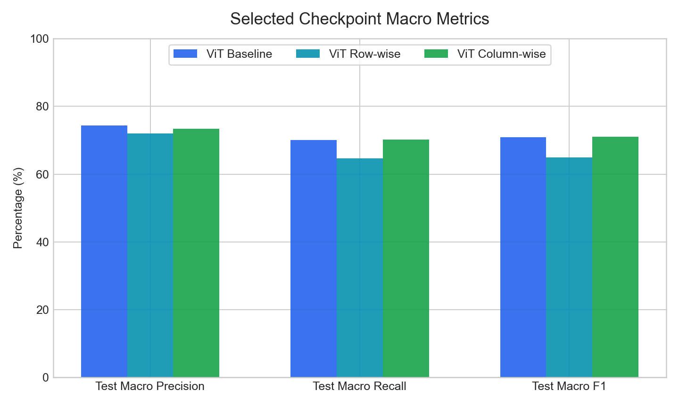
Macro Metrics
Macro Metrics
Selected-checkpoint macro precision, recall, and F1 are grouped here for quick meeting discussion.
Macro readout
Best selected Test Macro F1: ViT Column-wise (70.99%).
Best selected Test Macro Precision: ViT Baseline (74.35%).
Best selected Test Macro Recall: ViT Column-wise (70.17%).
Macro metrics help when accuracy alone hides uneven class performance.

Slide 10
Comparison Table
Config Differences
Showing the top 2 differing settings for experiment traceability.
Config | ViT Baseline | ViT Row-wise | ViT Column-wise
command | train_cifar10_experiment.py --model... | train_cifar10_experiment.py --model... | train_cifar10_experiment.py --model...
outputs.run_name | baseline_cadb_seed42_noes | row_cadb_seed42_noes | col_cadb_seed42_noes
Long config lists are paginated automatically to avoid overflow and tiny fonts.

Slide 11
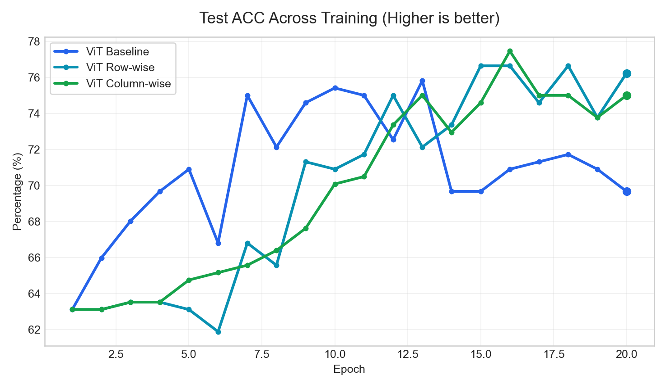
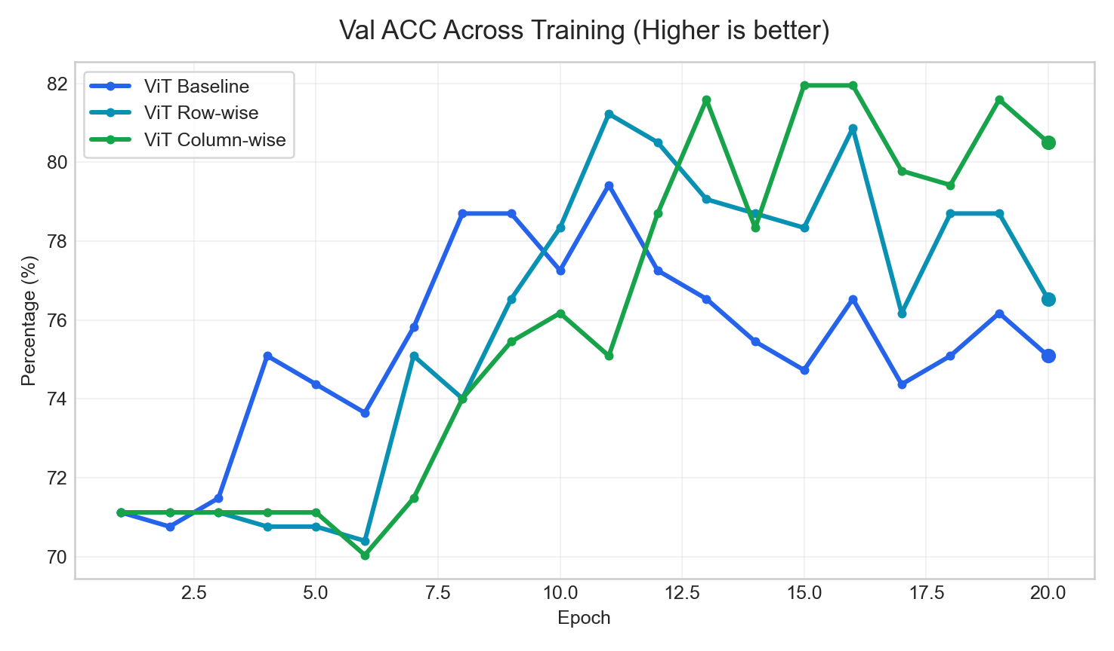
Curves
Training Curves (1/3)
Curves use a consistent title pattern and highlight the final operating point.
Test ACC
Val ACC
Best final value: ViT Row-wise (76.23%)
Best final value: ViT Column-wise (80.51%)
Use these pages for trend discussion; use tables for exact values.

Slide 12
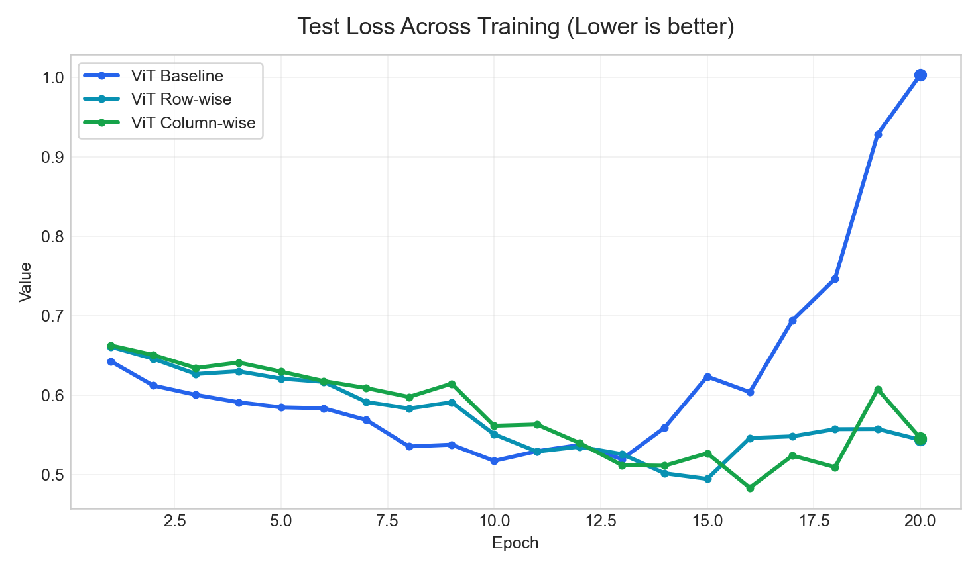
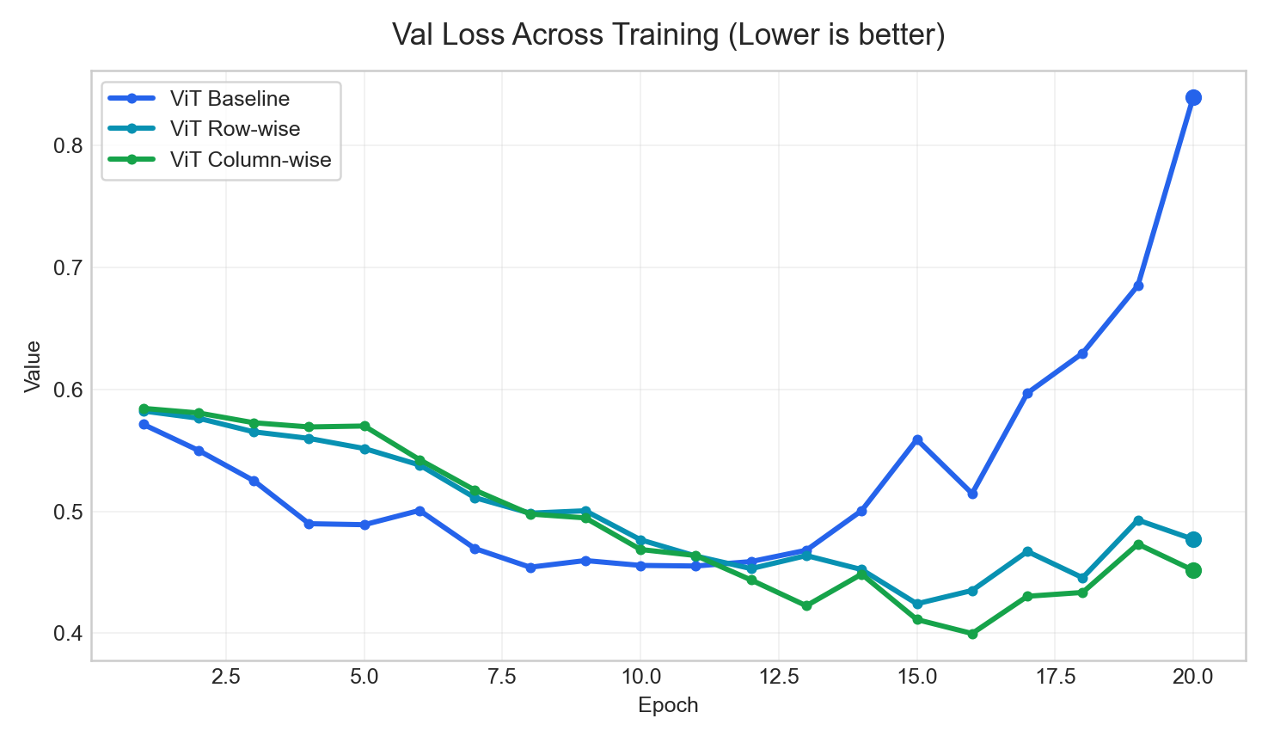
Curves
Training Curves (2/3)
Curves use a consistent title pattern and highlight the final operating point.
Test Loss
Val Loss
Best final value: ViT Row-wise (0.5436)
Best final value: ViT Column-wise (0.4516)
Use these pages for trend discussion; use tables for exact values.

Slide 13
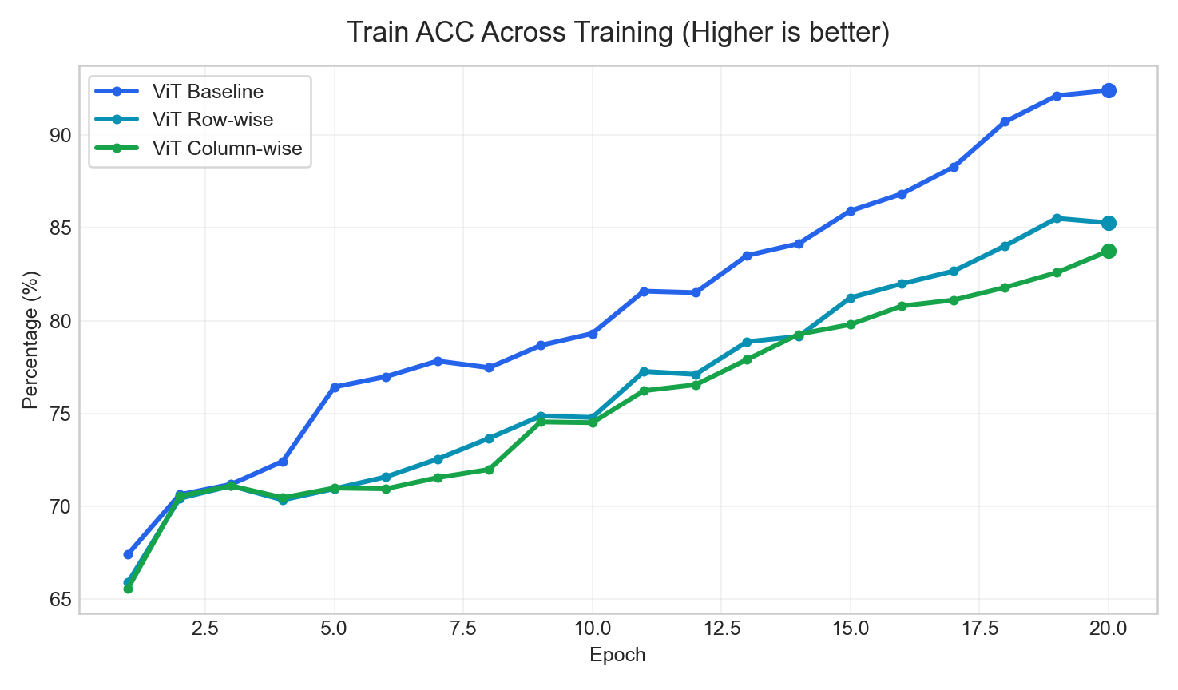
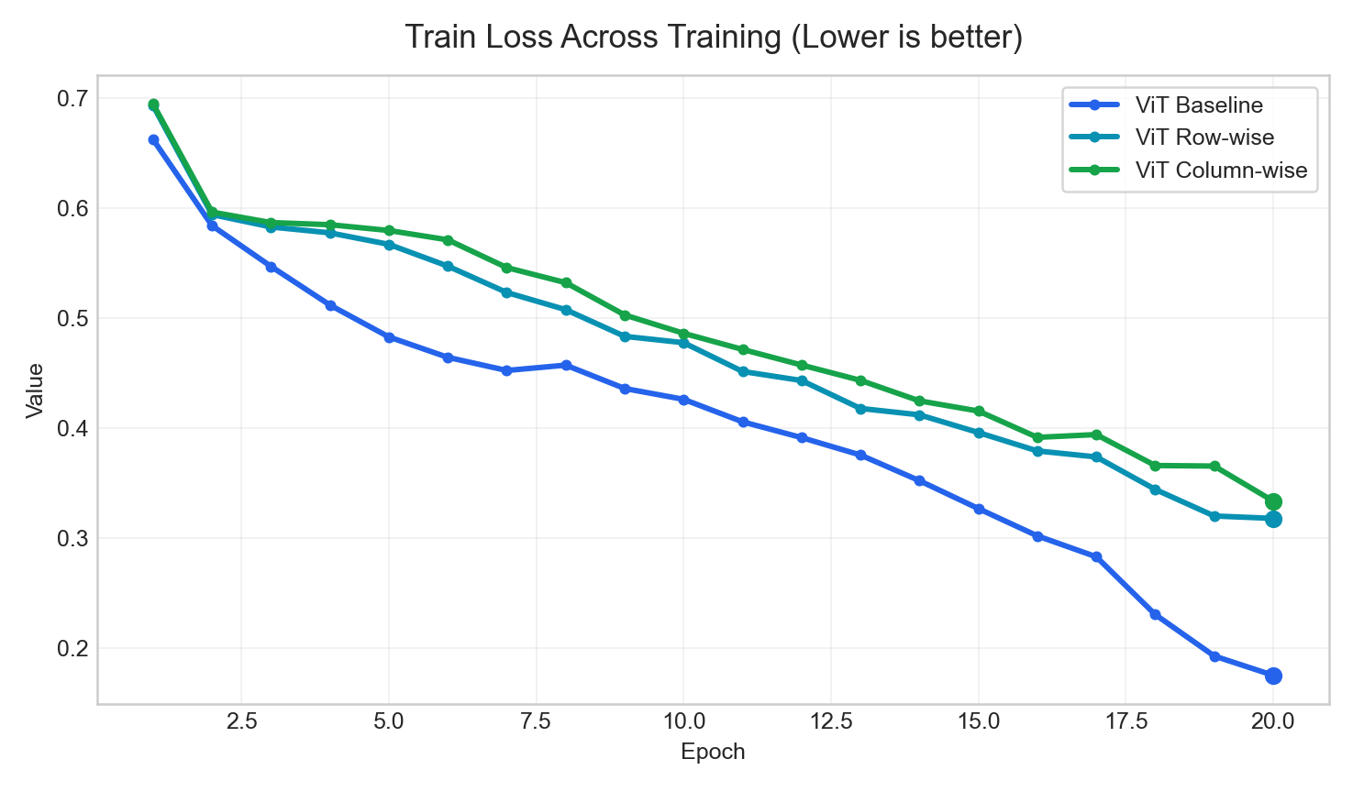
Curves
Training Curves (3/3)
Curves use a consistent title pattern and highlight the final operating point.
Train ACC
Train Loss
Best final value: ViT Baseline (92.40%)
Best final value: ViT Baseline (0.1752)
Use these pages for trend discussion; use tables for exact values.

Slide 14
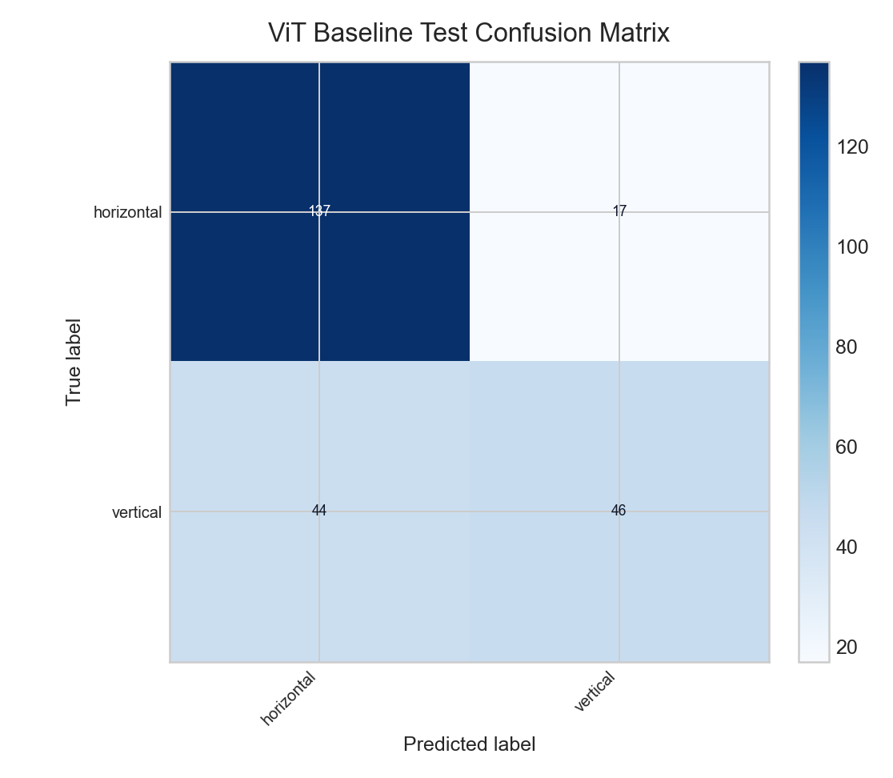
Error Analysis
Confusion Matrix | ViT Baseline
Selected-checkpoint error analysis pulled from existing evaluation outputs.
Reading notes
Selected checkpoint epoch: 11
Selected test accuracy: 75.00%
Selected test macro F1: 70.96%
Top confusion: true vertical predicted as horizontal (44 samples).
Top confusion: true horizontal predicted as vertical (17 samples).
This page gives a direct bridge from aggregate metrics to class-level failure modes.

Slide 15
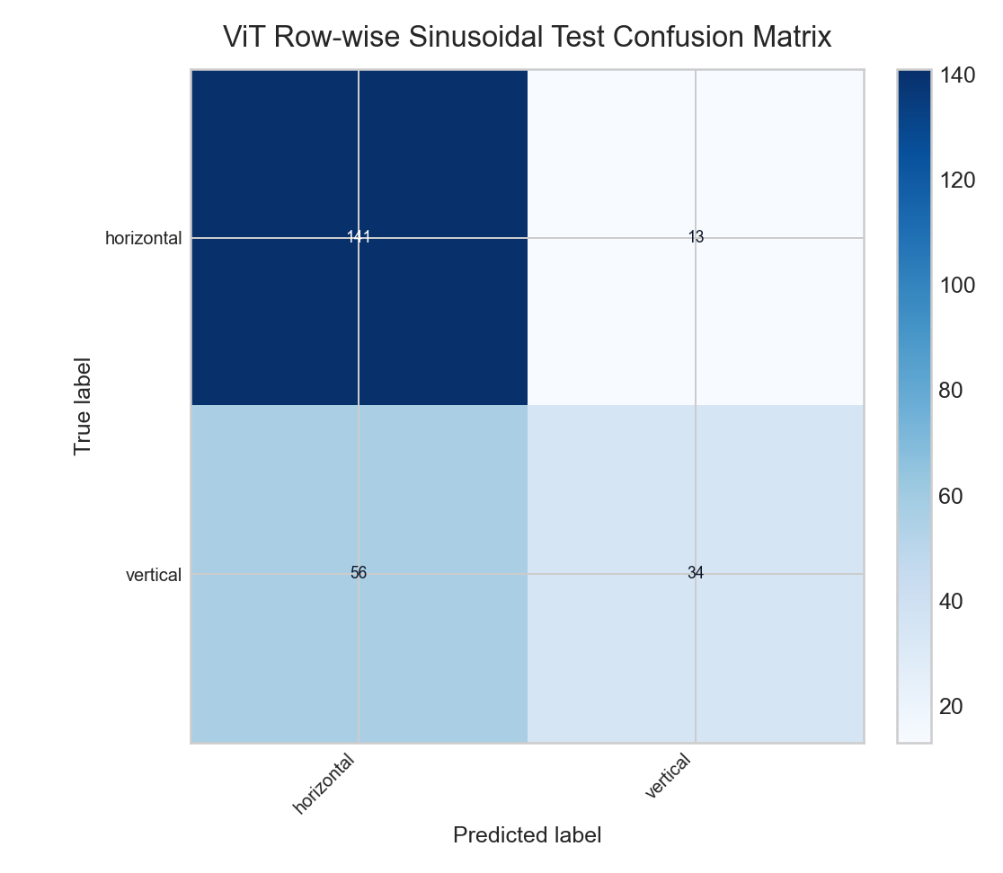
Error Analysis
Confusion Matrix | ViT Row-wise Sinusoidal
Selected-checkpoint error analysis pulled from existing evaluation outputs.
Reading notes
Selected checkpoint epoch: 11
Selected test accuracy: 71.72%
Selected test macro F1: 64.99%
Top confusion: true vertical predicted as horizontal (56 samples).
Top confusion: true horizontal predicted as vertical (13 samples).
This page gives a direct bridge from aggregate metrics to class-level failure modes.

Slide 16
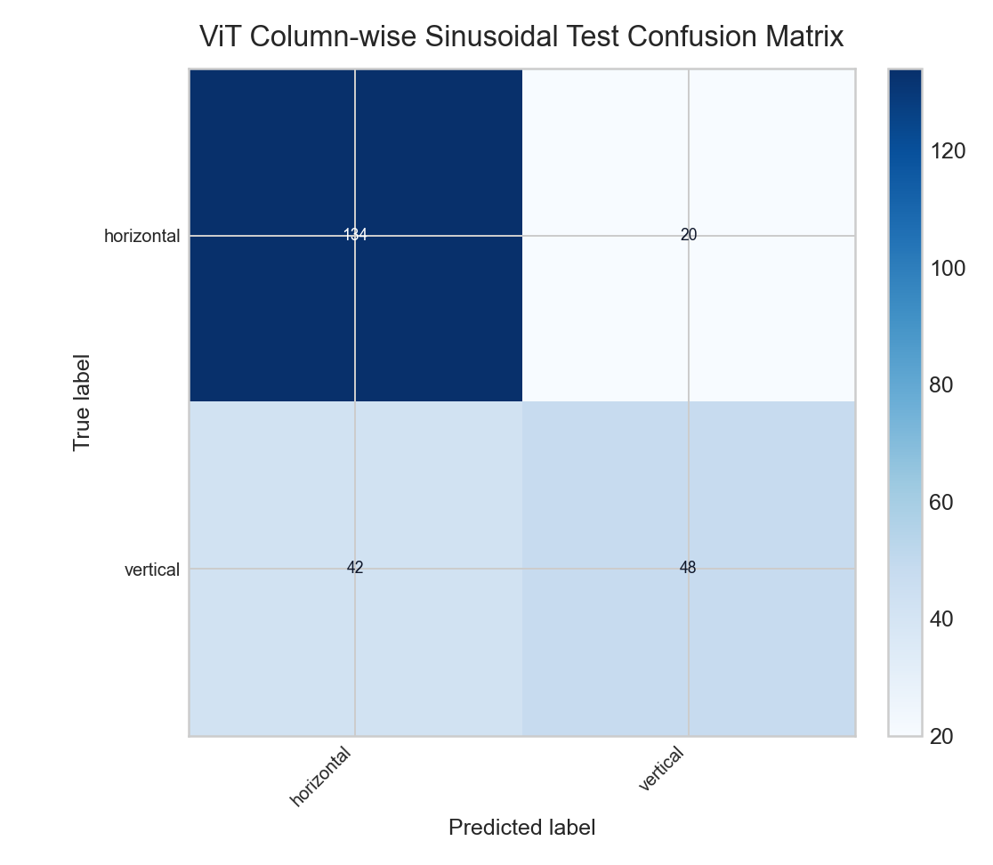
Error Analysis
Confusion Matrix | ViT Column-wise Sinusoidal
Selected-checkpoint error analysis pulled from existing evaluation outputs.
Reading notes
Selected checkpoint epoch: 15
Selected test accuracy: 74.59%
Selected test macro F1: 70.99%
Top confusion: true vertical predicted as horizontal (42 samples).
Top confusion: true horizontal predicted as vertical (20 samples).
This page gives a direct bridge from aggregate metrics to class-level failure modes.

Slide 17
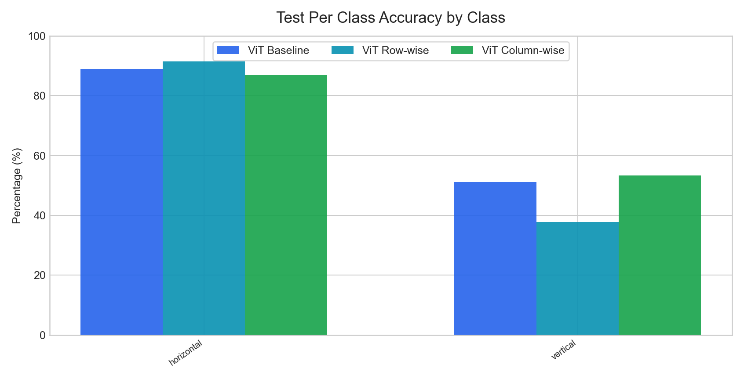
Per-Class
Per-Class Analysis | Test Per Class Accuracy
Classwise selected-checkpoint metrics are grouped across runs for easier error analysis.
Key readout
Highest mean Test Per Class Accuracy: ViT Column-wise (70.17%).
Largest cross-run spread appears on class 'vertical' (15.56 pp).
Use this page to explain which classes move together and which remain difficult.

Slide 18
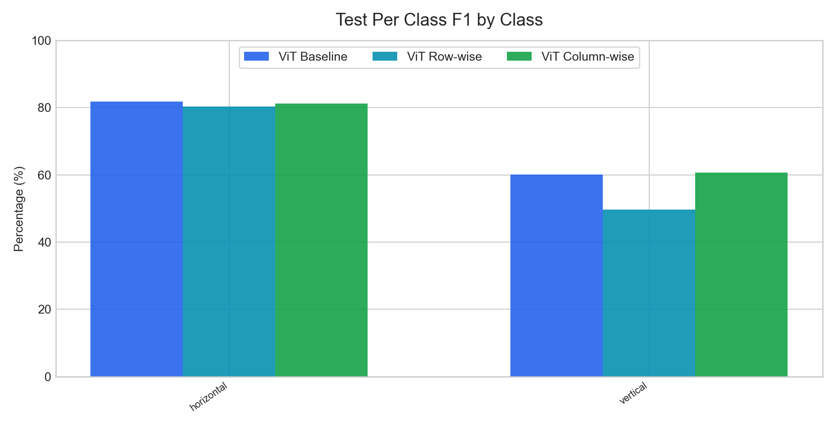
Per-Class
Per-Class Analysis | Test Per Class F1
Classwise selected-checkpoint metrics are grouped across runs for easier error analysis.
Key readout
Highest mean Test Per Class F1: ViT Column-wise (70.99%).
Largest cross-run spread appears on class 'vertical' (11.12 pp).
Use this page to explain which classes move together and which remain difficult.

Slide 19
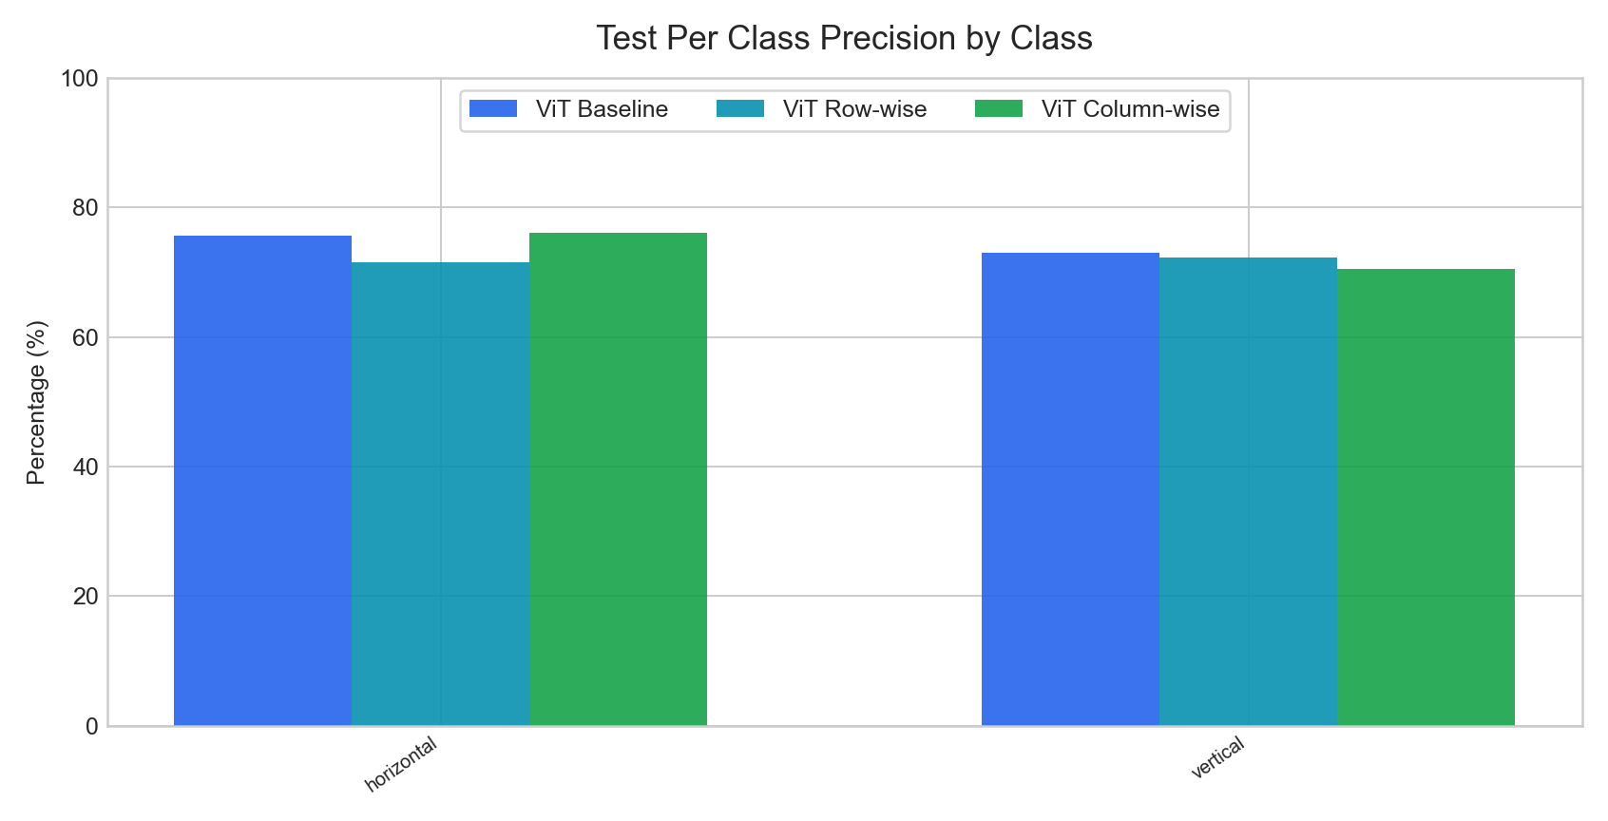
Per-Class
Per-Class Analysis | Test Per Class Precision
Classwise selected-checkpoint metrics are grouped across runs for easier error analysis.
Key readout
Highest mean Test Per Class Precision: ViT Baseline (74.35%).
Largest cross-run spread appears on class 'horizontal' (4.56 pp).
Use this page to explain which classes move together and which remain difficult.

Slide 20

Per-Class
Per-Class Analysis | Test Per Class Recall
Classwise selected-checkpoint metrics are grouped across runs for easier error analysis.
Key readout
Highest mean Test Per Class Recall: ViT Column-wise (70.17%).
Largest cross-run spread appears on class 'vertical' (15.56 pp).
Use this page to explain which classes move together and which remain difficult.

Slide 21
Close
Conclusion
Short, reusable wrap-up slide for weekly meetings.
Current headline result: ViT Row-wise leads on Test ACC with 76.23%.
When presenting baseline vs comparison, use ViT Baseline as reference and report ViT Row-wise at +6.56 pp on Test ACC.
Per-class pages are now included when selected-checkpoint classwise metrics exist, so class imbalance or hard classes can be discussed directly in meetings.
The deck is now organized for weekly reporting: setup, overview, key metrics, curves, error analysis, and a conclusion slide instead of raw log-style export.
Recommended next use
Keep the baseline run first in the command line.
Append new runs with readable labels.
Reuse this deck directly for group meetings.
The goal is to export a presentable deck, not a raw artifact dump.

