Slide 1
Weekly Comparison: CNN Baseline vs ViT Dropout 0.1
Weekly experiment comparison deck generated from existing run artifacts
CNN Baseline
ViT Dropout 0.1
Report scope
Reference run: CNN Baseline
Compared runs: 2
Shared training metrics: Test ACC, Test Loss, Train ACC, Train Loss
Generated 2026-05-27 22:33
Report name: weekly_cnn_vs_vit_baseline

Slide 2
Run Setup
Experiment Setup and Run Context
Keep the first --run as the reference baseline for meeting comparisons.
CNN Baseline
ViT Dropout 0.1
Run ID: cnn_resnet18_baseline
Model / device: resnet18 / cuda
Epochs completed: 20
Batch / LR / WD: 64 / 0.0001 / 0.01
Script: train_cnn_cifar10.py
model.architecture: resnet18
model.image_size: 224
Run ID: vit_dropout_01
Model / device: vit / cuda
Epochs completed: 20
Batch / LR / WD: 128 / 0.0003 / 0.05
Script: train_cifar10.py
model.attention_dropout: 0.1
model.embed_dim: 128
Run cards surface the main hyperparameters and monitoring settings without crowding a table.
Page group 1

Slide 3
Overview
Results Overview
Headline findings are phrased for direct use in a weekly update.
Primary comparison metric: Test ACC. Best final result is CNN Baseline with 94.92%.
Largest train-to-test accuracy gap appears in CNN Baseline (4.58 pp), worth calling out during generalization discussion.
Best primary metric
Test ACC
CNN Baseline
94.92%
Runs compared
Metrics tracked
2
4
This slide replaces generic 'key takeaways' text with meeting-ready comparison statements.

Slide 4
Comparison Table
Result Snapshot
Compact overview of the most important final metrics and selected checkpoint epoch.
Run | Model | Epochs | Selected Epoch | Test ACC | Test Loss | Train ACC
CNN Baseline | resnet18 | 20 | n/a | 94.92% | 0.2116 | 99.50%
ViT Dropout 0.1 | vit | 20 | n/a | 73.40% | 0.7734 | 71.49%
This table is intentionally compact so it remains readable on projected slides.

Slide 5
Comparison Table
Main Metrics Comparison
Each row is a meeting-friendly metric statement rather than a raw logger dump.
Metric | Direction | CNN Baseline | ViT Dropout 0.1 | Best Run
Final Test ACC | Higher | 94.92% | 73.40% | CNN Baseline
Final Test Loss | Lower | 0.2116 | 0.7734 | CNN Baseline
Final Train ACC | Higher | 99.50% | 71.49% | CNN Baseline
Final Train Loss | Lower | 0.0145 | 0.7968 | CNN Baseline
Direction indicates whether higher or lower values are preferable.

Slide 6
Comparison Table
Config Differences (1/3)
Showing the top 18 differing settings for experiment traceability.
Config | CNN Baseline | ViT Dropout 0.1
model.architecture | resnet18 | None
model.attention_dropout | None | 0.1
model.embed_dim | None | 128
model.embedding_dropout | None | 0.1
model.image_size | 224 | None
model.img_size | None | 32
model.in_channels | None | 3
Long config lists are paginated automatically to avoid overflow and tiny fonts.

Slide 7
Comparison Table
Config Differences (2/3)
Showing the top 18 differing settings for experiment traceability.
Config | CNN Baseline | ViT Dropout 0.1
model.mlp_dropout | None | 0.1
model.mlp_hidden_dim | None | 512
model.num_blocks | None | 4
model.num_heads | None | 4
model.patch_size | None | 4
model.projection_dropout | None | 0.1
model.weights | imagenet | None
Long config lists are paginated automatically to avoid overflow and tiny fonts.

Slide 8
Comparison Table
Config Differences (3/3)
Showing the top 18 differing settings for experiment traceability.
Config | CNN Baseline | ViT Dropout 0.1
training.batch_size | 64 | 128
training.lr | 0.0001 | 0.0003
training.weight_decay | 0.01 | 0.05
command | train_cnn_cifar10.py --epochs 20... | train_cifar10.py --epochs 20 --run-...
Long config lists are paginated automatically to avoid overflow and tiny fonts.

Slide 9
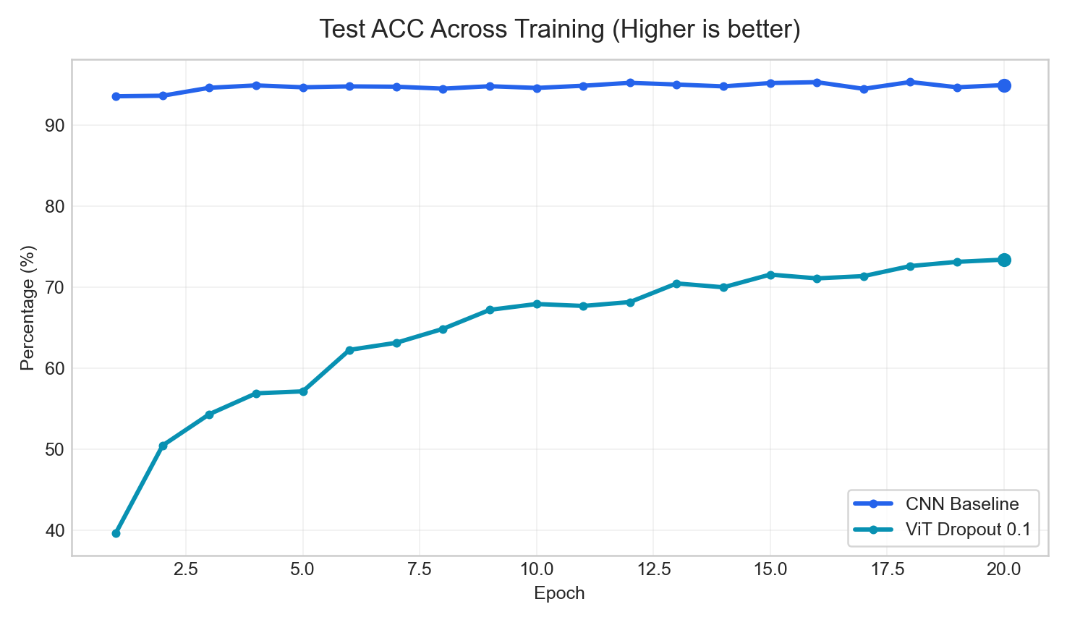
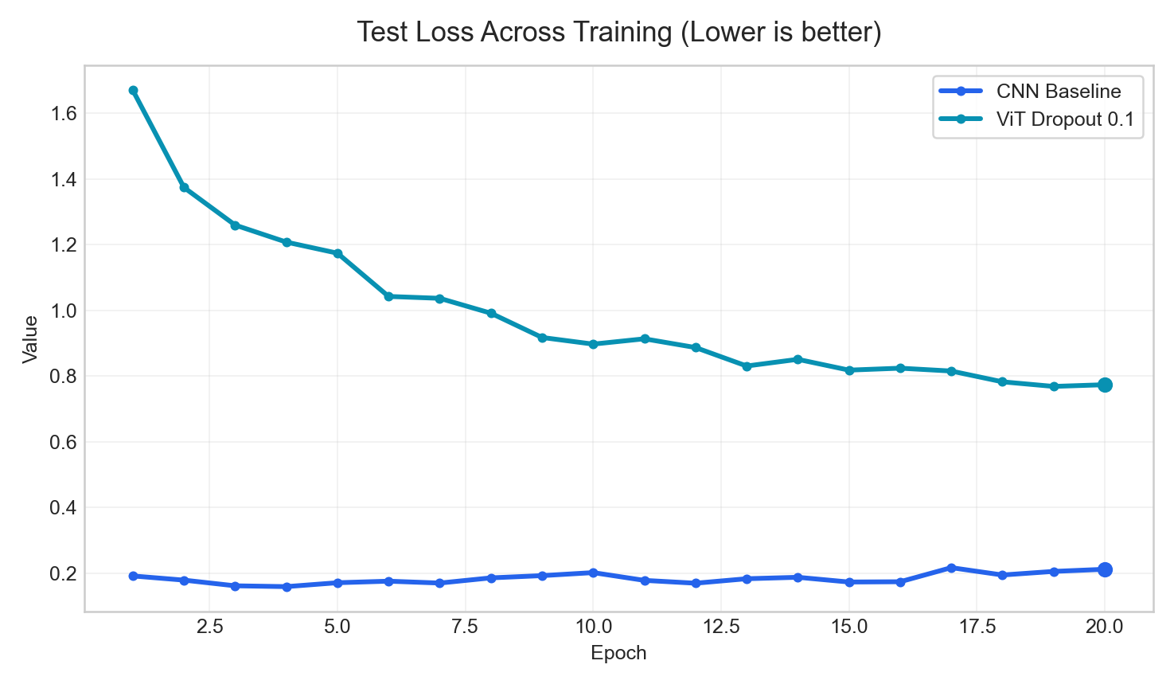
Curves
Training Curves (1/2)
Curves use a consistent title pattern and highlight the final operating point.
Test ACC
Test Loss
Best final value: CNN Baseline (94.92%)
Best final value: CNN Baseline (0.2116)
Use these pages for trend discussion; use tables for exact values.

Slide 10
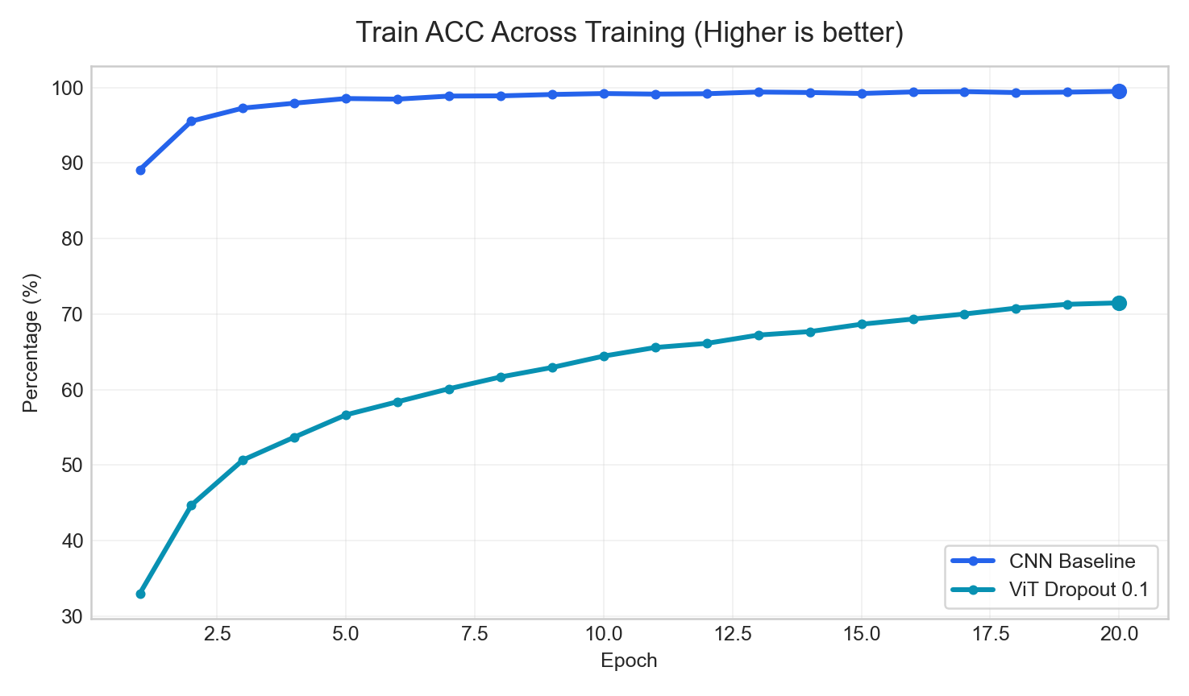
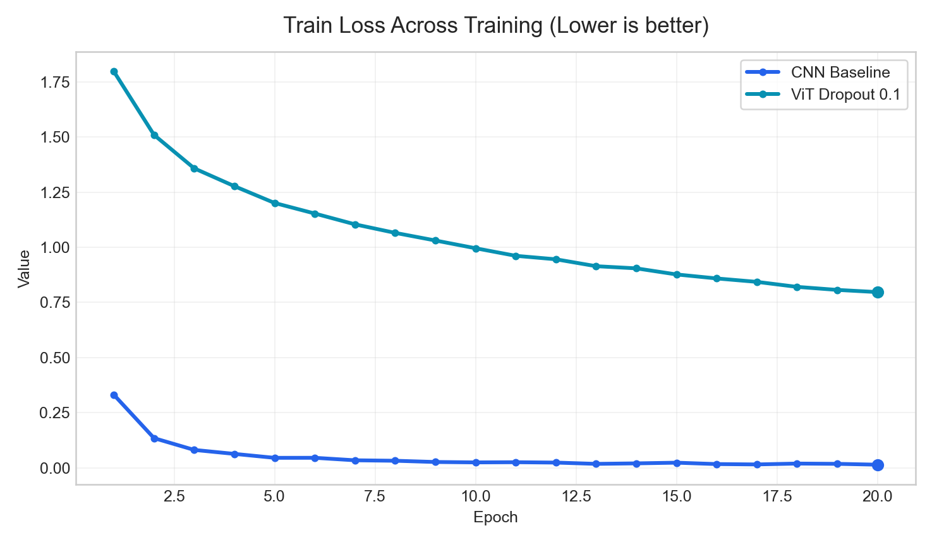
Curves
Training Curves (2/2)
Curves use a consistent title pattern and highlight the final operating point.
Train ACC
Train Loss
Best final value: CNN Baseline (99.50%)
Best final value: CNN Baseline (0.0145)
Use these pages for trend discussion; use tables for exact values.

Slide 11
Close
Conclusion
Short, reusable wrap-up slide for weekly meetings.
Current headline result: CNN Baseline leads on Test ACC with 94.92%.
When presenting baseline vs comparison, use CNN Baseline as reference and report ViT Dropout 0.1 at -21.52 pp on Test ACC.
The deck is now organized for weekly reporting: setup, overview, key metrics, curves, error analysis, and a conclusion slide instead of raw log-style export.
Recommended next use
Keep the baseline run first in the command line.
Append new runs with readable labels.
Reuse this deck directly for group meetings.
The goal is to export a presentable deck, not a raw artifact dump.

