Slide 1
Dynamical Decoupling of Nitrogen-Vacancy Electron Spins in Diamond and Nanodiamond
Defense of the Bachelor thesis
by Richard Kullmann
26.02.2017

Slide 2
Contents
Motivation
Theory
Setup
Measurements
Conclusion and Outlook

Slide 3
Motivation
magnetic field imaging: idea of single spins as sensors on the nanoscale
quantum system used for this purpose ideally meets these criteria:
stable
controllable
can be easily prepared and read out

Slide 4
Motivation
NV center meets these conditions
High sensitivity requires long coherence times
NV spin has to be decoupled from unwanted interactions with the environment
Dynamical decoupling techniques

Slide 5
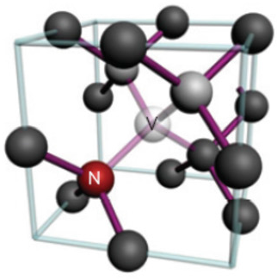
NV center
Theory
Vacancy (V) next to substitu-
tional nitrogen (N) atom in
diamond lattice
optically stable
long coherence times even
at room temperature
single photon fluorescence

Slide 6
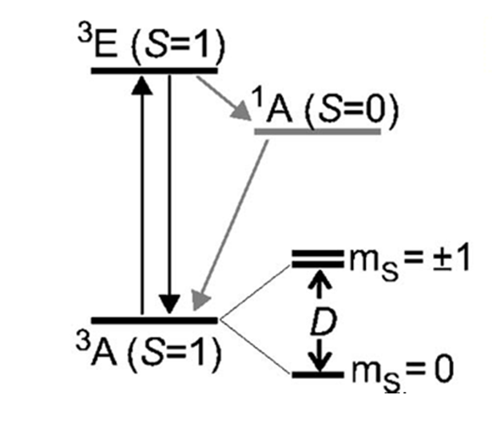
NV center
Theory
description with 3 level system
GS m_{S}=0 and m_{S}=±1 separated by D=2.87 GHz
relaxation ES→GS:
luminescence with ZPL
at 637nm
highest fluorescence
at m_{S}=0
optical initialization
NV Hamiltonian:

Slide 7
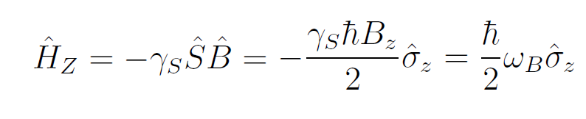

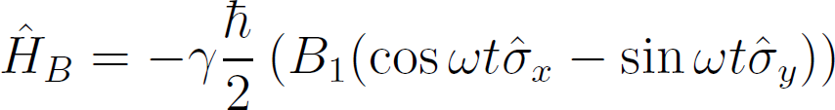
Rabi oscillations
Theory
single electronic spin (2 level system) in B-field → Zeeman splitting:
adding oscillating field
→

Slide 8
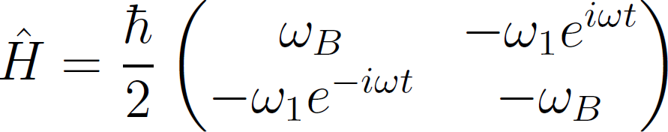
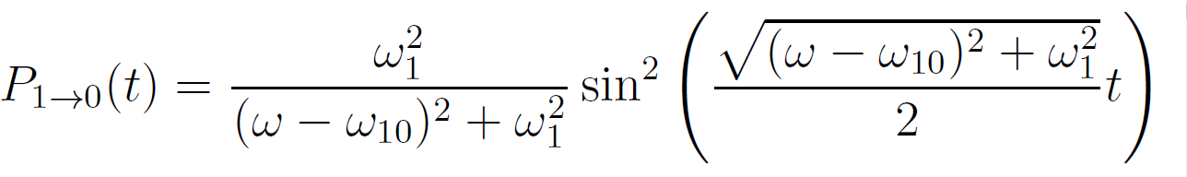
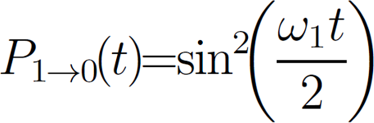
Rabi oscillations
Theory
total Hamiltonian:
for ω₁<< ω_{B}, perturbation theory yields:
Rabi’s formula
in resonance: ω=ω₁₀ →

Slide 9
Bloch sphere
Theory
Image of rotations on bloch sphere

Slide 10
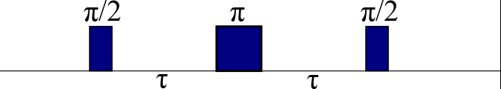
Dynamical Decoupling sequences
Theory
Hahn Echo
1st spin echo experiment
Measurement of T₂

Slide 11
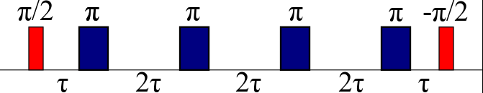
Dynamical Decoupling sequences
Theory
CPMG
multiple π rotations around single axis
higher decoupling efficiency than Hahn Echo

Slide 12
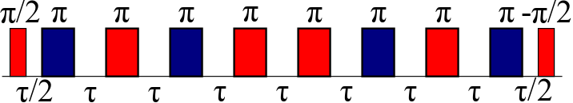
Dynamical Decoupling sequences
Theory
XY
CPMG pulse spacing
π rotations around 2 axes → 3D decoupling

Slide 13
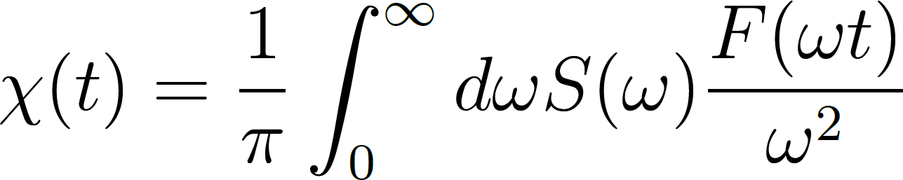
Spectral decomposition
Theory
In general: loss of coherence obeys C(t)=e^{-Χ(t)}
with
S(ω): spectral density function
F(ωt): filter function

Slide 14
Setup

Slide 15
Measurements

Slide 16
Conclusion and Outlook
successful implementation of DD protocols
CPMG: improvement of factor 50 in nanodiamond and 200 in bulk → 60 μs
CPMG outperforms XY
Spectral density in good agreement with other experiments
error sources: BPG (pulse errors), MW splitter, AOM
future
better time and phase control
Implementation of other decoupling protocols

