Slide 1

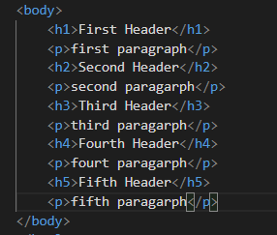
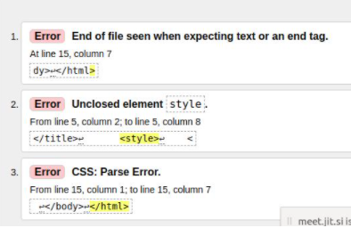
HTML5 | Basic exercises
Exercise 1:
using the basic elements
Exercise 2:
Create an error, use W3C validator

Slide 2
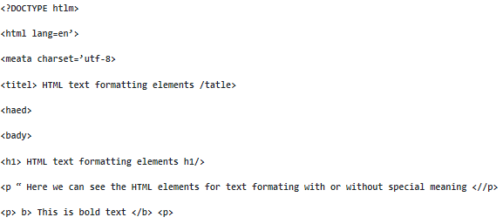
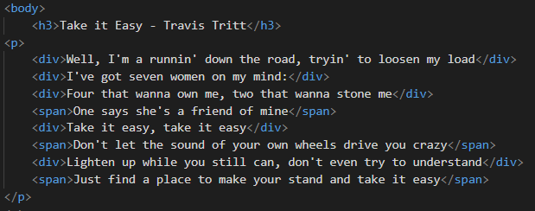
HTML5 | Basic exercises
Exercise 3:
- Fixing bugs, add new text formatting elements
Exercise 4:
Create Lyrics,
using <div> and <span>

Slide 3
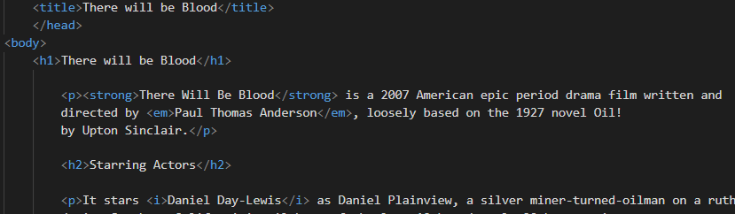
HTML5 | Basic exercises
Exercise 5:
create a web page for your favorite movie,
using paragraphs, headings and text formatting elements

Slide 4
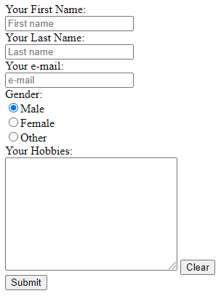
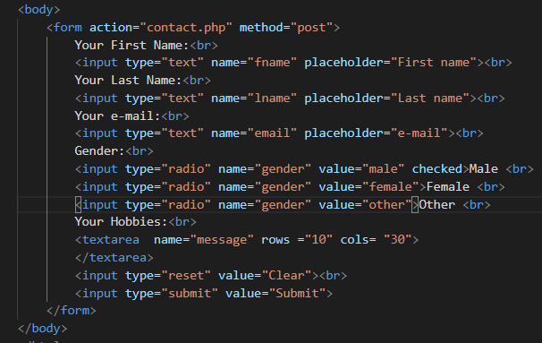
HTML5 | Intermediate exercises
Contact form:

Slide 5
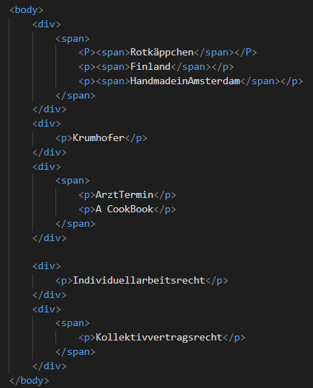
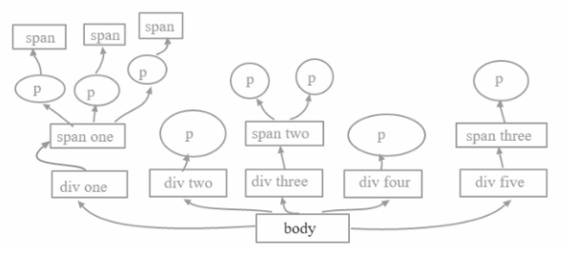
HTML5 | Intermediate exercises
Recreate the structure:

Slide 6
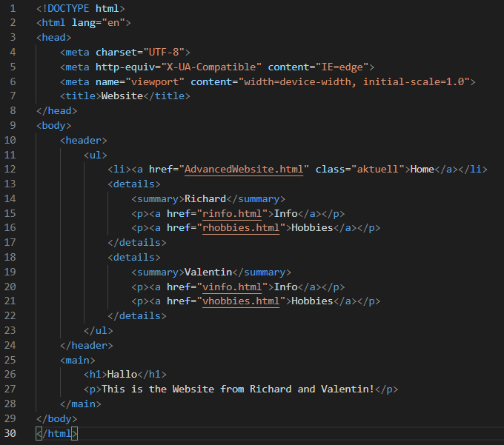
HTML5 | Advanced Exercise
Website:
5 HTML pages
Linked in <header>

Slide 7
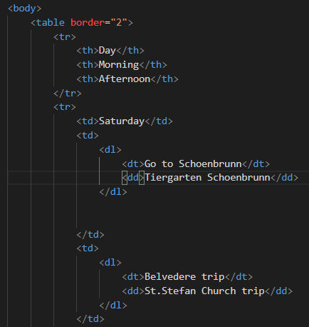
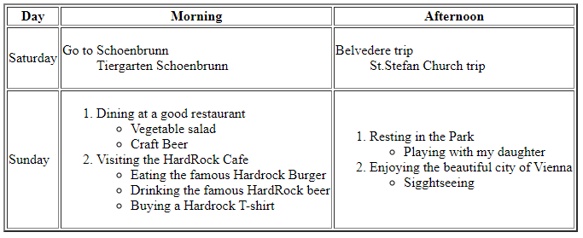
HTML5 | Advanced Exercise
Nested Elements:

