Slide 1
Graphs
Intro to Graphs
Graph implementations
Adjacency lists
Adjacency matrix
Graph traversals
Breadth First Search
Depth First Search
(probably more information in these slides than we will cover in detail… let’s see how things go…)

Slide 2
What is a Graph?
A graph is a set of nodes joined by a set of edges (lines or arrows).
1
3
1
2
3
2
4
5
6
4
5
6

Slide 3
A directed graph, also called a digraph, G is a pair (V, E), where V is a finite set of vertices (nodes) and E is a set of edges on V. Each edge in E is a binary relation on V : An edge e from node a to node b is denoted by the ordered pair e = (a, b).
Directed Graph
Self loop
1
2
3
7
Isolated node
V = { 1, 2, 3, 4, 5, 6, 7 } |V | = 7
4
5
6
E = { (1,2), (2,2), (2,4), (4,5),
(4,1), (5,4),(6,3) } | E | = 7

Slide 4
An undirected graph G = (V, E) , where V is a finite set of vertices and E is a set of edges on V. Each edge in E is an unordered pair of vertices in V.
Undirected Graph
Notation: (a, b) refers to a directed edge from node a to node b {a, b} denotes an undirected edge between node a to node b (some also use (a, b) for undirected edges… not 100% uniform).
V = { A, B, C, D, E, F } |V | = 6
A
B
C
E = { {A, B}, {A,E}, {B,E}, {C,F} }
|E | = 4
D
E
F

Slide 5
What Can Graphs Model?
Cost of wiring electronic components together.
Shortest route between two cities.
Finding the shortest distance between all pairs of cities in a road atlas.
Flow of material (liquid flowing through pipes, current through electrical networks, information through communication networks, parts through an assembly line, …).
State of a machine.
Used in Operating Systems to model resource handling (deadlock detection problem – wait-for graph).
Used in compilers for parsing and optimizing the code.
Social networks (facebook), WWW links…

Slide 6
In an undirected graph, the degree of a vertex is the number of edges incident on it.
Degree, Out-Degree, In-Degree of a Node
In a directed graph , the out-degree of a vertex is the number of edges leaving it and the in-degree is the number of edges entering it.
A
B
C
1
2
Self-loop
D
4
5
E
F
The degree of B is 2.
The in-degree of 2 is 2 and the out-degree of 2 is 3.

Slide 7
Simple Graphs
Simple graphs are graphs without multiple (directed in same direction or undirected) edges connecting a single pair of vertices, or self-loops.
We will consider only simple graphs for this course.

Slide 8
A weighted graph is a graph for which each edge has an associated weight, usually given by a weight function w: E → R.
Weighted Graphs
1.2
2
1
2
3
1
2
3
.2
.5
1.5
5
3
.3
1
4
5
6
4
5
6
.5
The weight has different meanings in different applications, but usually reflects how strongly or closely the corresponding nodes are related.
Notes:
Discussion point for weights: probability from u to v in traffic flow, similarity between two nodes in document clustering, co-occurrences between to words in word clustering (topic analysis), etc.

Slide 9
Paths
A path is a sequence of vertices such that there is an edge from each vertex to its successor.
A path is simple if all vertices on it are distinct, i.e., it never passes through the same vertex more than once.
A path from a vertex to itself is called a cycle
Example: v₁ → v₂ → v₄ → v₁
If a graph contains a cycle, it is a cyclic
graph. Otherwise, it is an acyclic graph.
1
2
4
3

Slide 10
s-t Connectivity
s-t connectivity problem: Given two nodes s and t, is there a path between s and t?
s-t shortest path problem: Given two nodes s and t, what is the length of the shortest path between s and t?
Notes:
Six Degrees of Kevin Bacon is a parlor game based on the "six degrees of separation" concept, which posits that any two people on Earth are, on average, about six acquaintance links apart. That idea eventually morphed into this parlor game, wherein movie buffs challenge each other to find the shortest path between an arbitrary actor and veteran Hollywood character actor Kevin Bacon. It rests on the assumption that any individual involved in the Hollywood, California film industry can be linked through his or her film roles to Kevin Bacon within six steps.

Slide 11
Connectivity
An undirected graph is connected if any two nodes are connected by a path.
A directed graph is strongly connected if there is a directed path from any node to any other node.
A graph is sparse if | E | ≈ | V |.
A graph is dense if | E | ≈ | V |².

Slide 12
A Complete graph is an undirected/directed graph in which every pair of vertices is adjacent.
Complete Graph
If (u, v) is an edge in a graph G, we say that vertex v is adjacent to vertex u.
A
A
B
B
E
D
D
4 nodes and (4*3)/2 edges
|V| nodes and |V|*(|V| – 1)/2 edges
Note: if self loops are allowed |V|²/2
3 nodes and 3*2 edges
|V| nodes and |V|*(|V| – 1) edges
Note: if self loops are allowed |V|² edges

Slide 13
Data Structures for Graphs
What do you think?!

Slide 14
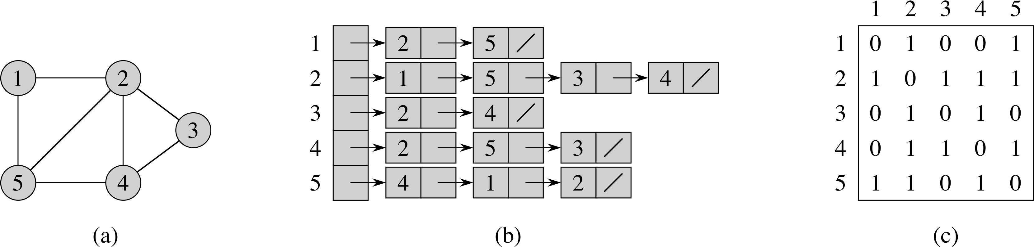
Graph Implementation: Adjacency-List Representation
Adjacency-list representation of a graph G = (V, E) consists of an array adj of |V | lists, one for each vertex in V. For each u ∈ V , adj[u] points to all its adjacent vertices.

Slide 15
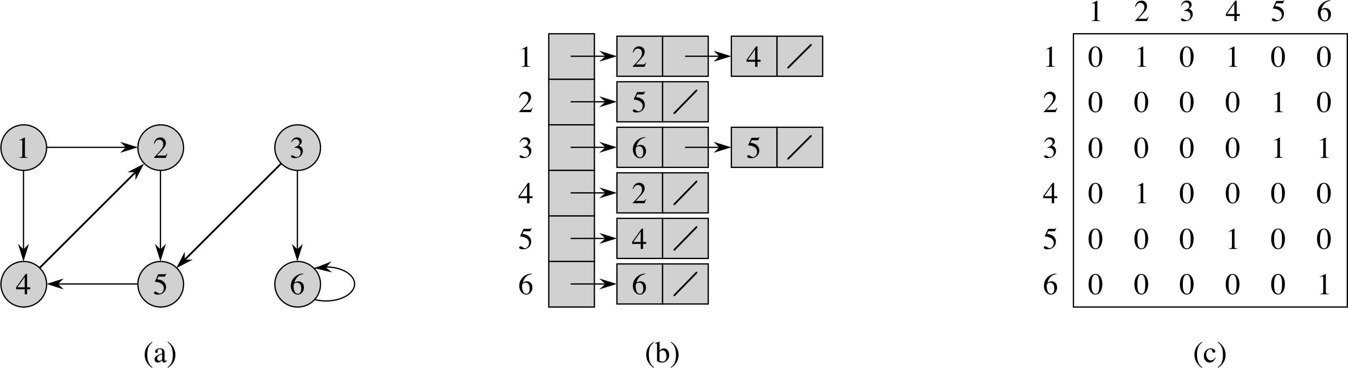
Adjacency-list Representation for Directed Graph
Adjacency-list representation of a directed graph G = (V, E) consists of an array adj of |V | lists, one for each vertex in V. For each u ∈ V , adj[u] points to all its adjacent vertices. In a digraph, v is adjacent to u if (u, v) ∈ E.
Variation: Can keep a second list of edges coming into a vertex.

Slide 16
Pros and Cons of Adjacency List
Advantages:
Saves space for sparse graphs. Most graphs are sparse.
“Visit” edges that start at v
Only need to traverse linked list of v
Size of linked list of v is degree(v)
Θ(degree(v)) time
Disadvantages:
Check for existence of an edge (v, u)
Must traverse linked list of v
Size of linked list of v is degree(v)
O(degree(v)) time

Slide 17
Adjacency List
Storage
We need V pointers to linked lists.
For a directed graph the number of nodes (or edges) contained (referenced) in all the linked lists is
➔ So we need Θ(|V | + | E |) storage space.
For an undirected graph the number of nodes is
➔ Also Θ(|V | + | E |) for storage space.

Slide 18
Adjacency-matrix-representation of a graph G = (V, E) is a |V | × |V | matrix A such that a_{ij} = 1 if (i, j) ∈E and 0 otherwise.
Adjacency-Matrix-Representation (1)
For undirected graph:

Slide 19
Adjacency-matrix-representation of a graph G = (V, E) is a |V | × |V | matrix A such that a_{ij} = 1 if (i, j) ∈E and 0 otherwise.
Adjacency-Matrix-Representation (2)
For directed graph:

Slide 20
Adjacency Matrix Representation (3)
Advantage:
Save space on pointers for dense graphs.
Check for existence of an edge (i, j)
Just check if A[i, j] = 1?
So Θ(1).
Disadvantage:
“Visit” all the edges that start at v
Row v of the matrix must be traversed.
So Θ(|V |).

Slide 21
Graph Traversals
Some applications involving graph G:
Is G connected?
Does G contain a cycle?
Is G a tree?
Is G bipartite?
Find connected components.
Topological sorting
Is directed G strongly connected?

Slide 22
Breadth First Search (BFS): Basic Idea
Given an unweighted graph G = (V, E) and a source vertex s, BFS systematically explores the edges of G to “discover” (visit) each node of G reachable from s.
Basic ideas: It discovers all vertices at distance k from s before discovering any vertices at distance k + 1 from s.
In the search process, it expands the frontier between already discovered and undiscovered vertices one step at a time.
Use a First-In-First-Out (FIFO) queue to implement the Frontier.
Need O(1) time to update

Slide 23
Breadth First Search: Output
The algorithm also computes the shortest distance (dist) from s to any reachable node.
It also produces a breadth first tree with root s that contains all the reachable vertices from s.
To get O(|V| + |E|) running time, we use an adjacency list representation.
If we used an adjacency matrix, the running time would be O(|V|²).

Slide 24
BFS: Coloring the Nodes
For illustration, we use colors (white, gray and black) to denote the state of the node during the search.
A node is white if it has not been reached (discovered) yet.
Discovered nodes are gray or black.
Gray nodes are at the frontier of the search.
Black nodes are fully explored nodes.
A node is considered fully explored if all of its adjacent nodes have been examined (discovered or fully explored).
All nodes change color in order: white → gray → black.

Slide 25
BFS: Algorithm Part 1 - Initialize
BFS(G, s) // start the search from node s in graph G
for each vertex u ∈ G.V – {s}
u.color = white
u.d = ∞ // u.d to hold the distance from s to u
u.π = NIL // u.π denotes the predecessor of u in BS-tree
s.color = gray
s.d = 0 // distance to itself is 0
s.π = NIL
Q = φ // Q is a FIFO queue and it is initially empty
Enqueue(Q, s)

Slide 26
BFS: Algorithm Part 2 - Main
while ( Q ≠ φ )
u = Dequeue(Q) // removes the “last” element of the Q
for each v in adj[u]
if (v.color == white) // v has not been discovered
// from another path
v.color = gray
v.d = u.d +1
v.π = u // make u the predecessor or parent
// of v in the breadth first tree
Enqueue(Q, v)
u.color = black // u is now fully explored

Slide 27
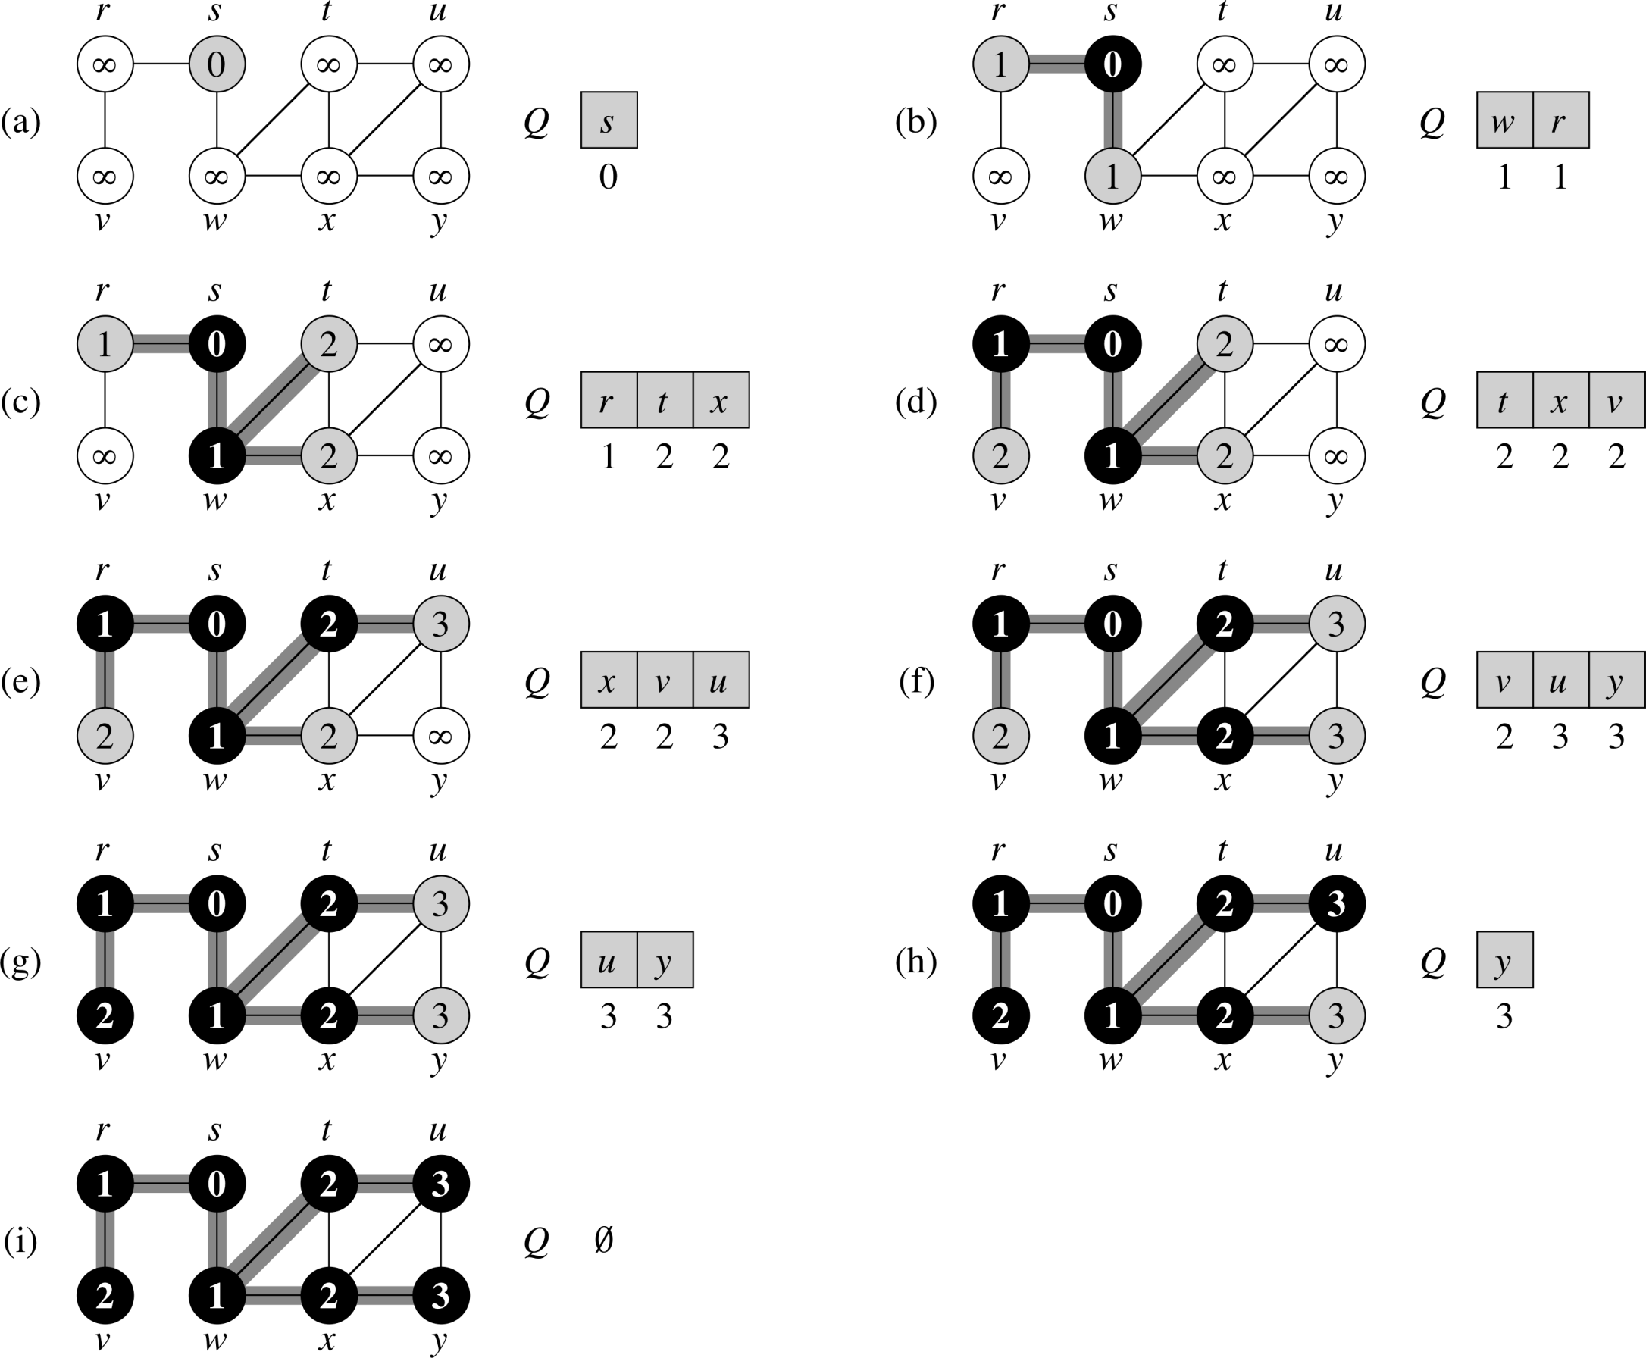
BFS: Example

Slide 28

BFS: Example (continued)
The shaded edges are edges of the breadth first tree.

Slide 29
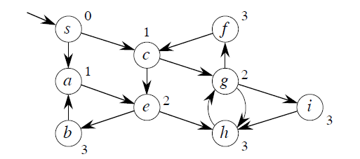
BFS: Another Example
The algorithm also works for directed graphs.

Slide 30
BFS: Analysis
Initialization is Θ(|V |) due to the for loop.
Each node can be added to the queue at most once (it needs to be white), and its adjacency list is searched only once.
If graph is undirected each edge is reached twice
if u is in the adjacency list of v, then v is also in the adjacency list of u
so the body of for loop in the main procedure executes ≤ 2|E | times.
If graph is directed, each edge is reached exactly once. So the body of the for loop is executed at most |E | times.
➔ Worst case time of BFS is O(|V |+| E |)
BFS may fail to reach all nodes for directed or unconnected graphs.

Slide 31
Depth First Search (DFS): Basic Idea
Goal: Explore every vertex and edge of G.
Basic idea: Go “deeper” whenever possible.

Slide 32
Depth First Search (DFS)
The DFS algorithm described here does not require a pre-specified source node.
Idea: Until there are no more undiscovered nodes…
Pick an undiscovered node and start a depth first search from it.
The search proceeds from the most recently discovered node to discover new nodes.
When the last discovered node v is fully explored, backtrack to the node used to discover v. Eventually, the start node is fully explored.
The output varies depending on the order in which the nodes are considered.

Slide 33
DFS: Node Coloring Scheme
Same coloring method as the one used for BFS.
White for un-discovered nodes
Gray for discovered but not fully explored nodes
Black for fully explored nodes.
A node is considered fully explored if all of its descendant nodes have been examined (discovered or fully explored).

Slide 34
Depth First Search: Some Features
The algorithm can discover all nodes regardless of whether the graph is directed, undirected, or even not connected.
The algorithm saves:
A depth first forest composed of several depth first trees.
Two timestamps for each node u
u.d is its discovery time – the time when it is first discovered
u.f is its finishing time – the time when it is fully explored.
Use adjacency list representation to get Θ(|V |+|E |) running time.
If we used an adjacency matrix, the running time → Θ(|V |²).

Slide 35
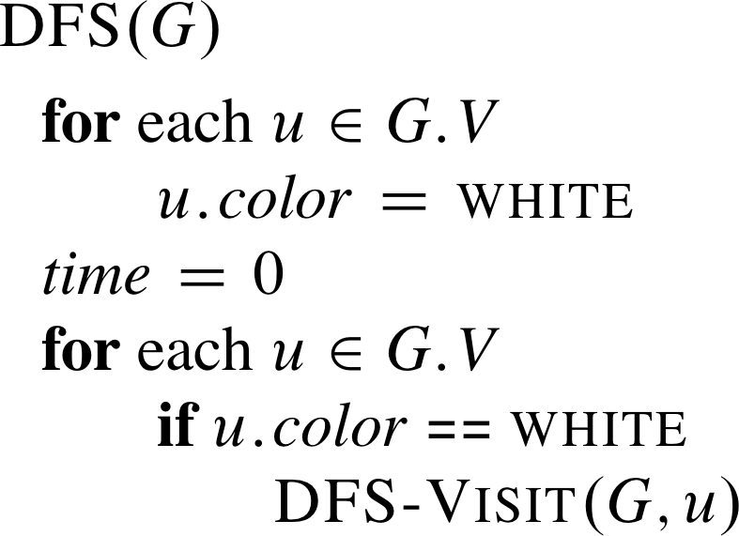
DFS: Algorithm
.π = NIL
// no parent or predecessor initially
Each time DFS-Visit(G, u) is called here, u becomes the
root of a new depth first tree in the depth first forest.

Slide 36
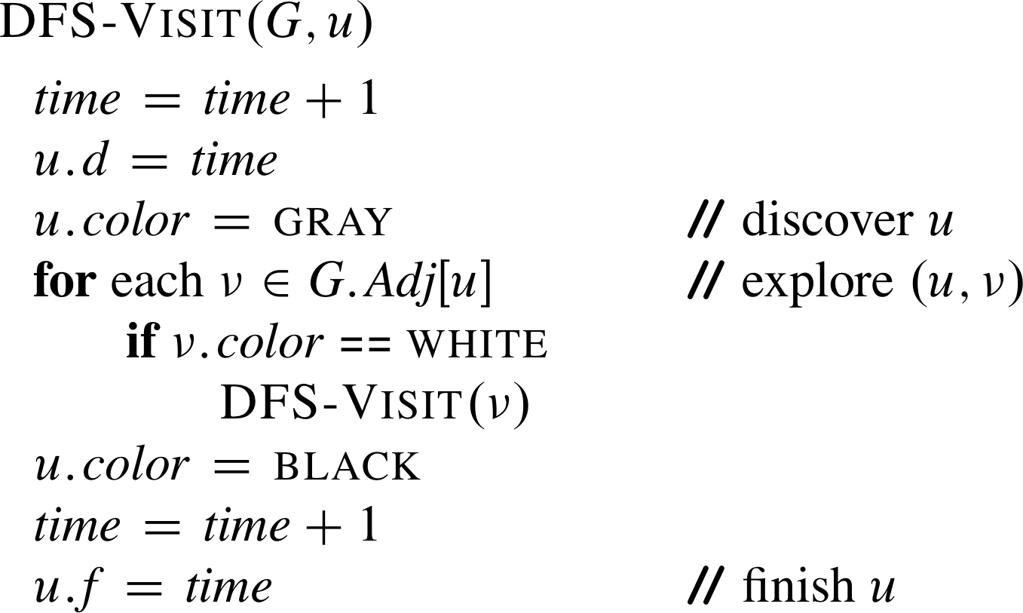
Procedure DFS-Visit(u)
π =
// create an edge for the current DF tree

Slide 37
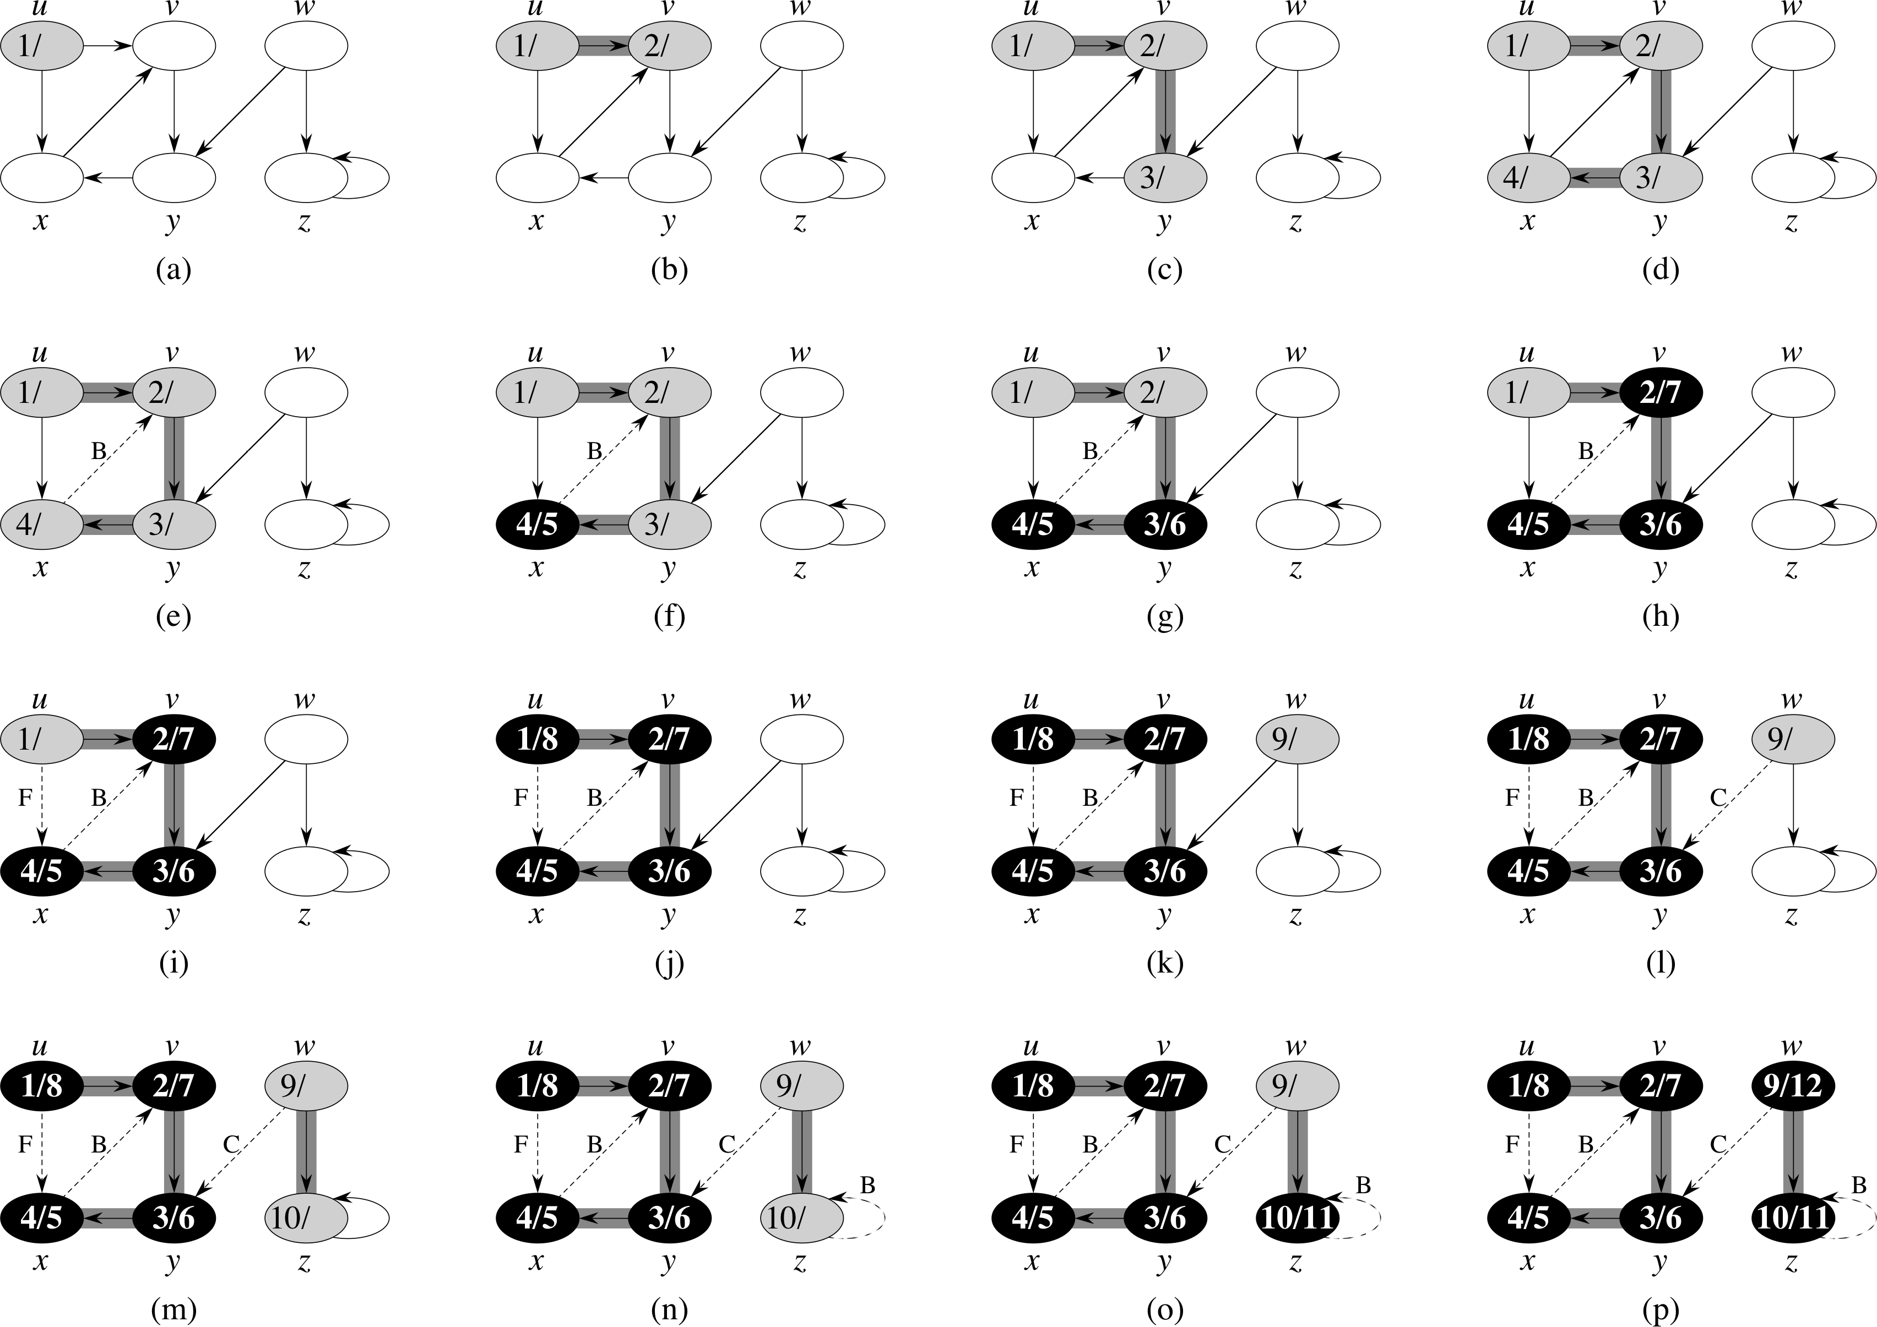
DFS: Example (1)

Slide 38
DFS: Example (2)

Slide 39
DFS: Example (3)

Slide 40
DFS: Example (4)

Slide 41
DFS: Analysis
DFS is Θ(|V |) (excluding the time
taken by the DFS-Visit).
DFS-Visit is called once for each
node v and its for loop is executed
|adj(v)| times. The DFS-Visit calls
for all the adjacent nodes take
time.
➔ Worst case running time is
Θ(|V |+| E |).
.π = NIL
π =

Slide 42
Depth-First Forest & Depth-First Trees
DFS produces a depth-first forest comprised of depth-first trees.
Each depth-first tree is made of edges (u, v) such that u is gray and v is white when (u, v) is explored.
See the DFS example.

Slide 43
DFS: Classification of Edges (1)
Tree edges – edges belonging to the depth-first forest.
Back edges – non-tree edges from a node to an ancestor in a depth first tree.
See the edges labeled B in the previous slide.
Forward edges – non-tree edges from a node to a descendant in a depth first tree.
See the edge labeled F in the previous slide.
Cross edges – the rest of the edges, can be within a single depth-first tree or between two depth-first trees.
See the edge labeled C in the previous slide.

Slide 44
DFS: Classification of Edges (2)
The type of some edges can be determined when the edges are encountered during DFS.
When edge (u, v) is first explored, the color of node v determines the type of (u, v):
It’s a tree edge if v is white.
It’s a back edge if v is gray.
It’s a forward or cross edge if v is black.

Slide 45
DFS: Classification of Edges (3)
Note that for an undirected graph, edge (u, v) is the same as edge (v, u).
In this case, we classify the edge according to whichever of (u, v) or (v, u) is first encountered by DFS.
Theorem 1: When a graph is undirected, its edges are either tree edges or back edges.
Example: Treat the graph below as an undirected graph.
Edge (x, u) would be encountered
before (u, x), making the edge a
back edge.
Edge (y, w) would be encountered
before (w, y), making the edge a
tree edge.

Slide 46
DFS: Applications (1)
Is undirected graph G connected?
Change DFS to call DFS-Visit(G, v) only once
Then check if there are still white nodes.
If no white nodes left, G is connected
Otherwise, it is not connected.
Running time: O(|V | + | E |)
Find connected components.
Call DFS.
The nodes discovered in each call to DFS-Visit(G, v) belong to a single connected component.
Running time: Θ(|V | + | E |)

Slide 47
DFS: Applications (2)
Does a directed graph G contain a directed cycle?
Run DFS. If there are back edges, then yes; otherwise, no.
Running time: O(|V | + | E |).
Does an undirected graph G contain a cycle?
Same as directed graph.
If G is a tree or a forest, it can have at most |V | – 1 edges.
Running time is O(|V |) since we encounter at most |V | edges (if (u, v) and (v, u) are counted as one edge), before cycle is found.
Is an undirected graph G a tree?
DFS with one call to DFS-Visit(G, v). If all vertices are reached and no back edges, then G is a tree. If |V | edges are encountered, then G is not a tree.
Running time: O(|V |).

