Slide 1
Outline
Heap
Heapsort
O(n lg n) worst case running time—like Merge-sort.
Sorts in place—like Insertion-sort.
Combines the best of both algorithms.
A sorting algorithm that uses a data structure (i.e., heap) to perform sorting.
Priority Queue

Slide 2
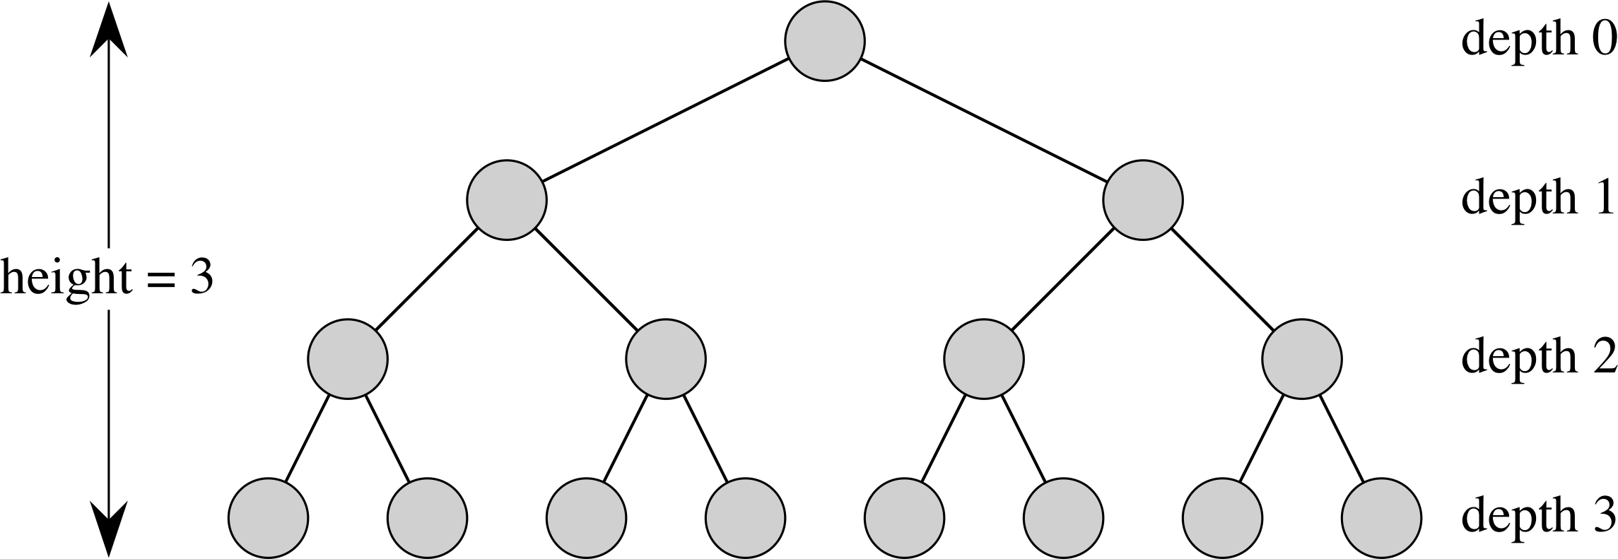
Recall: Complete Binary Tree (1)
A complete binary tree of depth d is a binary tree that satisfies the following two conditions:
It has all possible nodes down to a depth of d – 1.
The nodes with depth d are filled from the left up to a point.

Slide 3
Important Property
The height of a complete binary tree is
O(lg N)

Slide 4
Heap Data Structure
A (binary) heap is a complete binary tree such that:
The values stored at the nodes come from an ordered set.
The value stored at each node satisfies a certain heap property.
Two types of heap properties:
Max-heap property: the value stored at each node is ≥ the values stored at its child nodes.
the largest value is stored at the root node
Min-heap property: the value stored at each node is ≤ the values stored at its child nodes.
the smallest value is stored at the root node

Slide 5
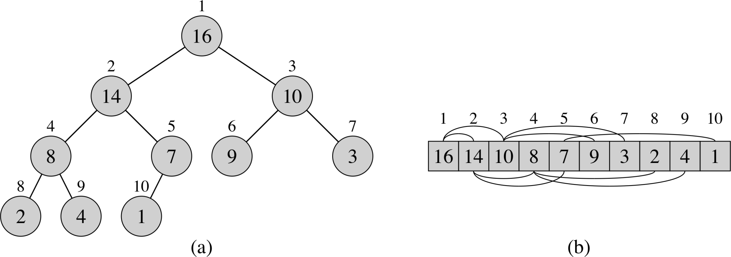
Heap Data Structure (continued)
Two types of heaps:
max-heap satisfies max-heap property
min-heap satisfies min-heap property
An example of a max-heap
Numbers outside
the circles are index
numbers of the nodes
when the heap is stored
in an array.
Numbers inside the
circles are the values
or keys of each node.

Slide 6
Array Implementation of Heap
A heap can be stored as an array A.
Root of tree is A[1].
Left child of A[i] = A[2i].
Right child of A[i] = A[2i + 1].
Parent of A[i] = A[ ⎣i/2⎦ ].
In C++ Root is at A[0]
left child A[2i+1], right child at A[2i+2]]
With this array implementation, basic operations such as finding the parent, the left child or the right child of a node can be performed very quickly (in constant, or O(1), time).
Notes:
Finding left child can be done by shifting the binary representation of i left by one position and finding right child can be done by shifting the binary representation of i left by one position and then adding a 1 at the lowest bit.

Slide 7
Array Implementation (continued)
An array implemented max-heap
Arcs go between parents
and children.

Slide 8
Basic Heap Procedures
Max-Heapify: a key procedure for maintaining max-heap property; it runs in O(lg n) time.
Build-Max-Heap: a procedure for building a max-heap from an unordered input array; it runs in Θ(n) time.
Heapsort: sorts an array in place with running time of:
O(n lg n).
Max-Heap-Insert, Heap-Extract-Max, Heap-Increase-Key, and Heap-Maximum

Slide 9
Maintaining Heap Property
Max-Heapify is used to maintain the max-heap property.
Before Max-Heapify: A[i], may be smaller than its child node(s).
Condition: The left and right subtrees of i are already max-heaps.
After Max-Heapify: the subtree rooted at i is a max-heap.
Main Idea:
Compare A[i], A[Left(i)], and A[Right(i)].
If necessary, swap A[i] with the larger of the two child nodes.
Continue this process of comparing and swapping down the heap, until the subtree rooted at i is a max-heap.

Slide 10
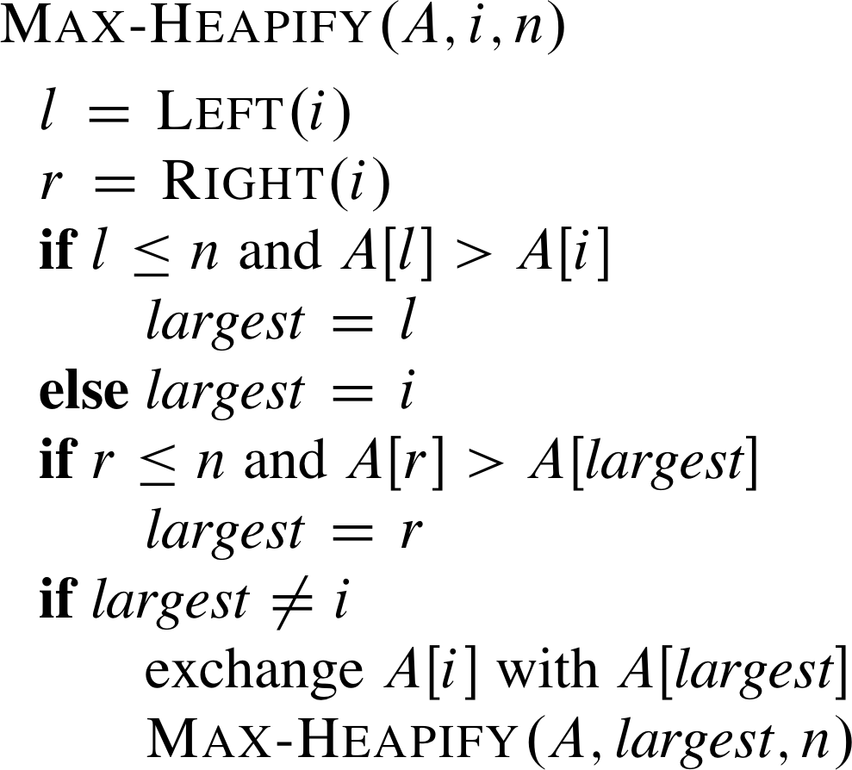
Algorithm Max-Heapify
Running time:
The height of the tree is lg n and moving A[i] one level down takes a constant number of operations.
O(lg n)

Slide 11
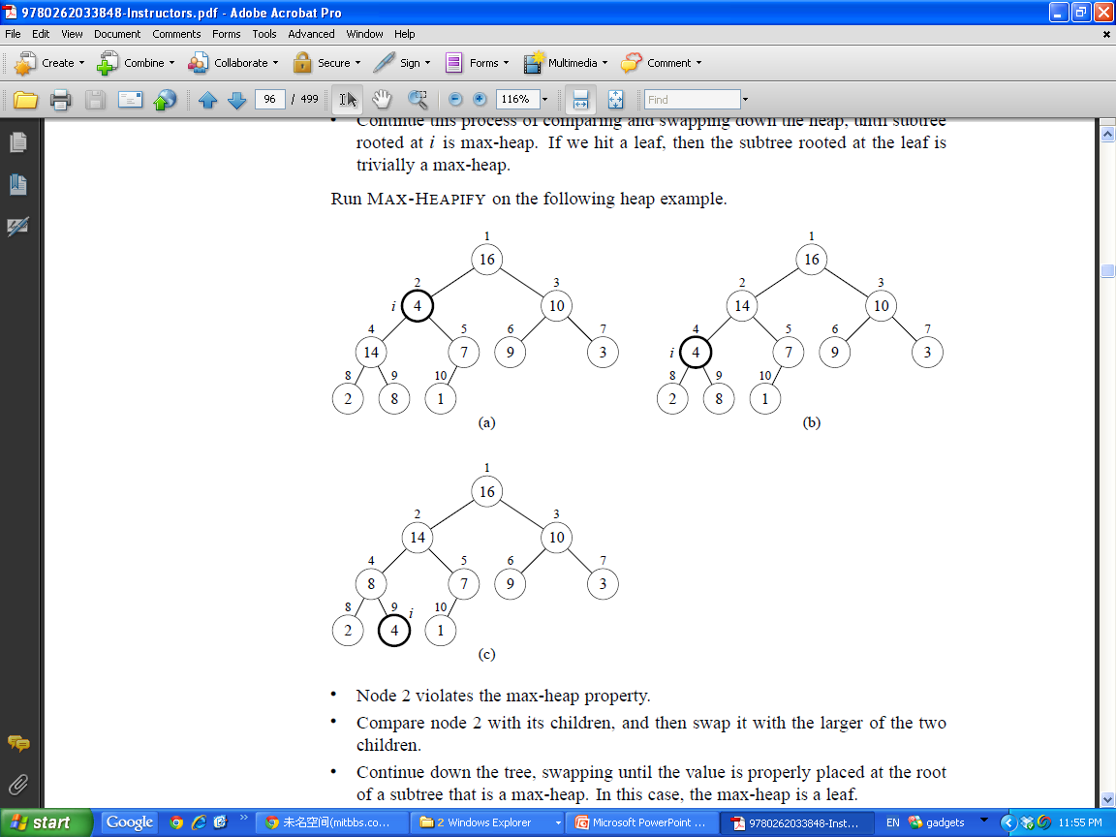
Illustrating Max-Heapify
Node 2 violates the max-heap property.
Compare node 2 with its child nodes, and then swap it with the larger of the two child nodes.
Continue down the tree, swapping until the value is properly placed at the root of a subtree that is a max-heap. In this case, the max-heap is a leaf.

Slide 12
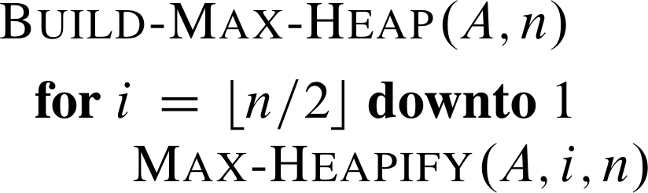
Building a Heap
The following bottom-up procedure, given an unordered array A, will produce a max-heap.

Slide 13
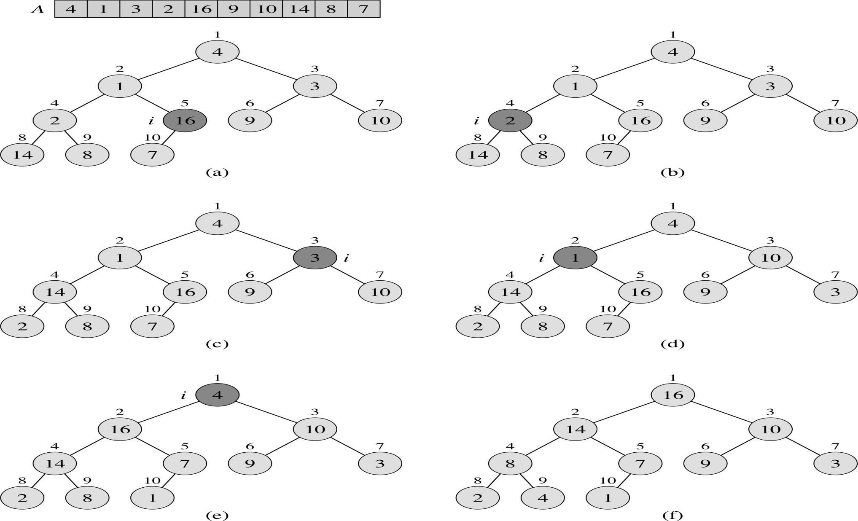
Build-Max-Heap: Example

Slide 14
Heap Sort
Any ideas?

Slide 15
Heapsort Algorithm: Idea
Given an input array, the Heapsort algorithm acts as follows:
Builds a max-heap from the array.
Starting with the root (which has the maximum value), the algorithm places the maximum value into the correct place in the array by swapping it with the element in the last position in the array.
“Discard” this last node (knowing that it is already in its correct place) by decreasing the heap size, and calling Max-Heapify on the new (possibly incorrectly-placed) root.
Repeat this “discarding” process until only one node (the smallest value) remains, and therefore is in the correct place in the array.

Slide 16
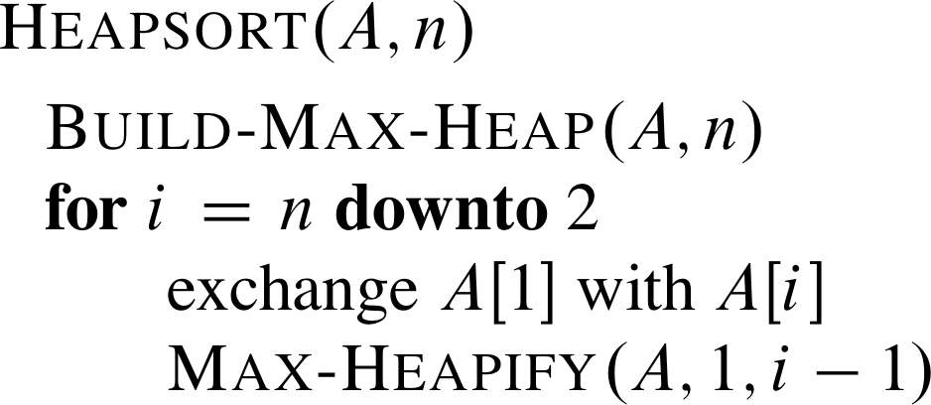
Heapsort Algorithm: Pseudocode

Slide 17
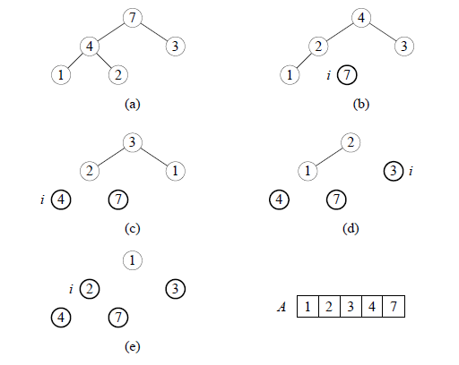
Heapsort Algorithm: Example
Initial array:
A 7 4 3 1 2
Sorted array:

Slide 18
Heapsort Algorithm: Analysis
Build-Max-Heap: O(n)
for loop: n – 1 times
exchange values: O(1)
Max-Heapify: O(lg n)
Total time: O(n lg n)
The same as Merge-Sort but it sorts in place.

Slide 19
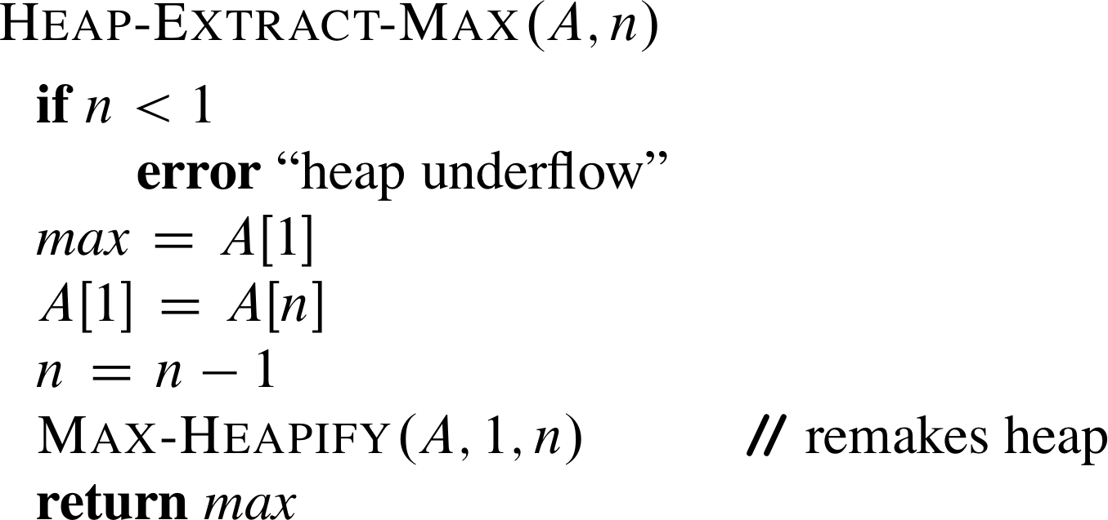
Heap-Extract-Max
Given the array A:
Make sure heap is not empty.
Make a copy of the maximum element (the root).
Make the last node in the tree the new root.
Re-heapify the heap, with one fewer node.
Return the copy of the maximum element.
Running time:
Constant-time assignments plus time for Max-Heapify: Θ(lg n).

Slide 20
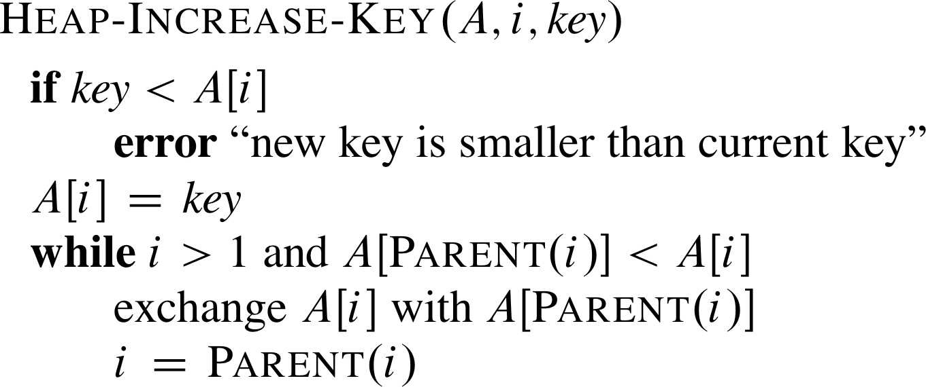
Heap-Increase-Key
Given array A, element A[i], and new key value key:
Make sure key ≥ A[i].
Update A[i]’s key value to key.
Traverse the tree upward comparing A[i] to its parent and swapping keys if necessary, until A[i]’s key is smaller than its parent’s key.
Running time:
Upward path
from node i has length O(lg n)
in an n-element heap: O(lg n).

Slide 21
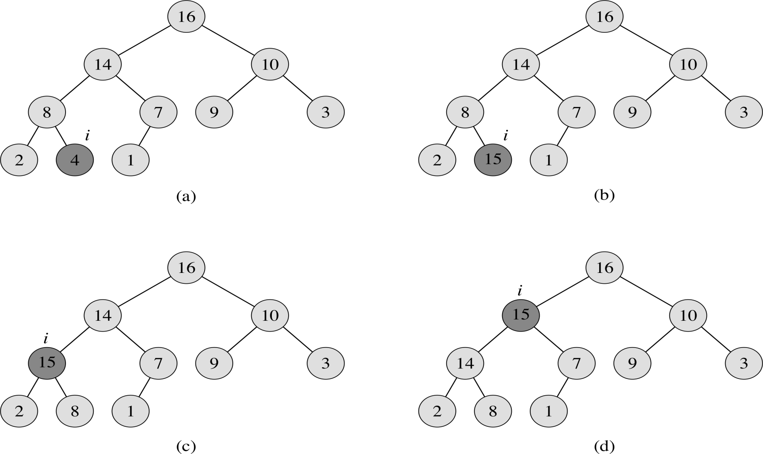
Heap-Increase-Key: An Example
Heap-Increase-Key(A, i, 15)

Slide 22
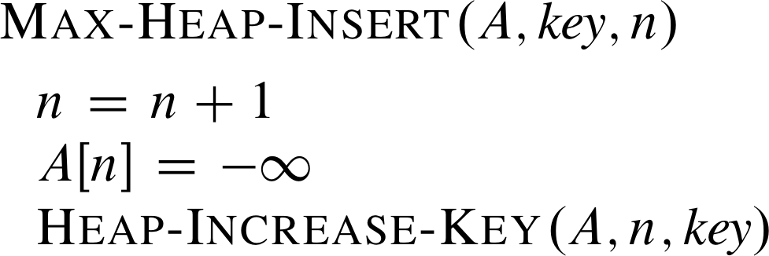
Max-Heap-Insert
Given a key key to insert into the heap:
Increment the heap size.
Insert a new node in the last position in the heap, with key – ∞.
Increase the – ∞ key to key using the Heap-Increase-Key procedure defined earlier.
Running time:
Constant time
assignments + time for
Heap-Increase-Key: O(lg n).

