Slide 1
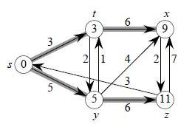
Single-Source Shortest Path Problem
Given a weighted directed graph G(V, E), a source vertex s ∈ V, find a shortest path from s to each vertex v ∈ V.
Example: The shortest paths from s to different vertices.
Solutions are not unique.

Slide 2
Other Variants of the Problem
Single-source: Find shortest paths from a given source vertex s ∈ V to every vertex v ∈ V.
Single-destination: Find shortest paths to a given destination vertex t from each vertex v.
Single-pair: Find shortest path from vertex u to vertex v.
No way known that is better in worst case than solving the single-source problem.
All-pairs: Find shortest path from u to v for all u, v ∈ V.

Slide 3
Shortest Path Properties
Let δ(u, v) denote the weight of a shortest path from u to v for a given directed, weighted graph.
Shortest paths satisfy the triangle inequality:
δ(u, v) ≤ δ(u, x) + δ(x, v), for any vertex x.
x
u
v
The shortest path cannot be longer than any other path.

Slide 4
Shortest Path Properties
Shortest paths cannot contain cycles.
If a cycle has a positive weight, omitting it makes the path shorter.
If a cycle has a negative weight, containing it creates paths with arbitrarily low (negative) weights
Why?
< 0
u
v

Slide 5
Shortest Path Representation
Given a graph G = (V, E), maintain for each vertex v ∈ V a predecessor v.π that is either another vertex or NIL.
A shortest path from s to v can be represented as a chain of predecessors originating from v running backwards to s.
Of course, not all possible predecessor chains from v to s are shortest paths from s to v.
Let G_{π} = (V_{π}, E_{π}) be the subgraph (the predecessor subgraph) induced by the π values, where
V_{π} = {u ∈V | u.π ≠ NIL} ∪ { s }, and
E_{π} = {(u.π, u)∈E | u ∈ V_{π} – { s }}.
The algorithms here will produce G_{π} as a shortest-paths tree, containing a shortest path from s to each node reachable from s.

Slide 6
What do we know already?
Recall BFS and DFS
Unweighted graphs
Which one solves the shortest path problem, if we assign each edge a weight of 1?
Can we run that traversal algorithm as is to solve the shortest path problem for weighted graphs?

Slide 7
Any good ideas!?
Maybe spend time in groups, if there’s time (?)

Slide 8
Shortest-Paths Tree
A shortest-paths tree (SPT) is similar to a breadth-first tree (BFT)
SPT contains shortest paths from a source in terms of edge weights.
BFT contains shortest paths from a source in terms of the number of edges.
More formally, an SPT rooted at s is a directed subgraph G* = (V*, E*), V* ⊆ V and E* ⊆ E, such that
V* is the set of vertices reachable from s,
G* forms a rooted tree with root s, and
for each v ∈V*, the unique simple path from s to v in G* is a shortest path from s to v in G.

Slide 9
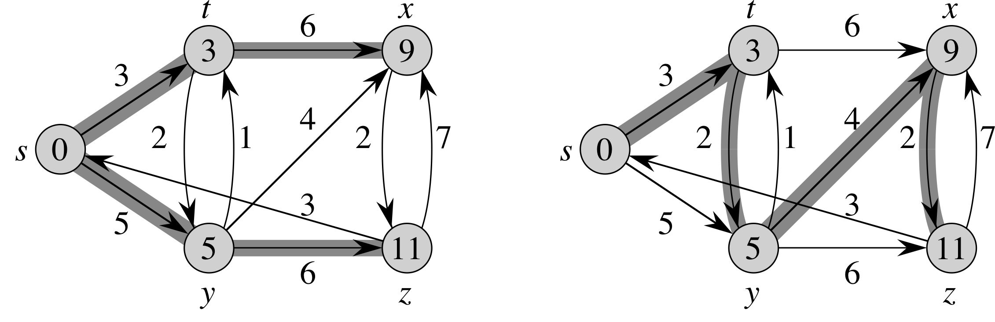
SPT Example
For a weighted, directed graph, there may be more than one shortest-paths tree.
Two SPTs of a weighted, directed graph.

Slide 10
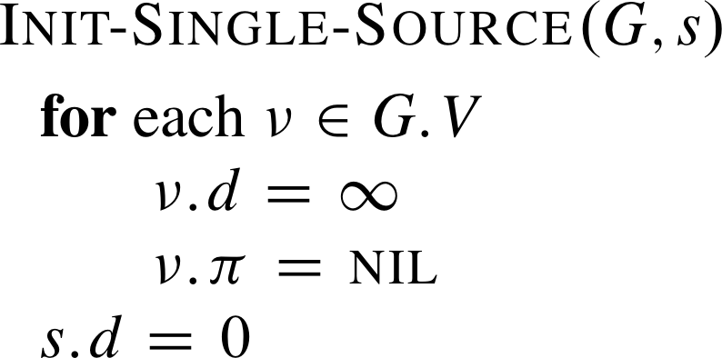
Relaxation
A key technique in shortest-path algorithms is relaxation.
Idea: for each v, maintain an upper bound v.d on δ(s, v):
that is, v.d ≥ δ(s, v)
v.d is called a shortest-path estimate.
Initially, for each vertex other than the source, its shortest-path estimate is set to ∞ (0 for the source) and its predecessor is set to NIL.

Slide 11
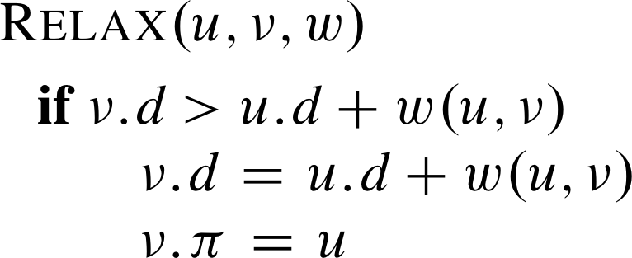
Edge Relaxation
Relaxation consists of relaxing edges.
When relaxing edge (u, v), we check whether we can improve the shortest path to v found so far by going through u. If so, update v.d and v.π.
// w is the weight on (u, v)

Slide 12
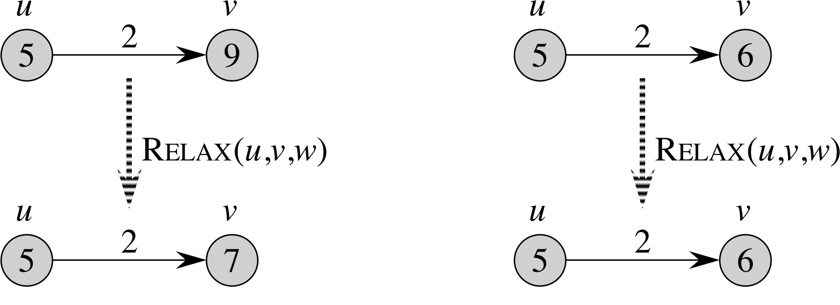
Edge Relaxation Example
Estimate improved
Estimate not improved

Slide 13
Shortest-Path Algorithms
Several algorithms to find single-source shortest paths.
They all start by calling Init-Single-Source( ) first and then repeatedly relax edges.
Bellman-Ford algorithm relaxes each edge |V| – 1 times.
Dijkstra’s algorithm relaxes each edge exactly once.

Slide 14
Dijkstra’s Algorithm: Basic Idea
It is for graphs with no negative-weight edges.
Similar to breadth-first search – a weighted version of BFS.
Grow a tree gradually, advancing from vertices taken from a queue.
Instead of a FIFO queue, it uses a priority queue with keys being the shortest-path weights (v.d).
Have two sets of vertices:
S = vertices whose final shortest-path weights have been determined
Q = priority queue = V – S.

Slide 15
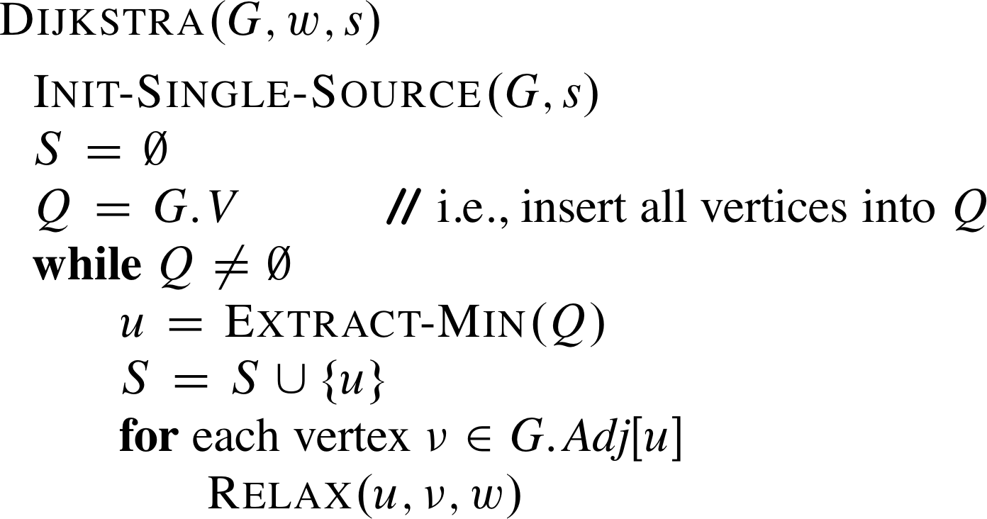
Dijkstra’s Algorithm: Pseudocode
// imply a Decrease-Key( )
It is a “greedy algorithm”: always choose the “closest” vertex in V – S to add to S.

Slide 16
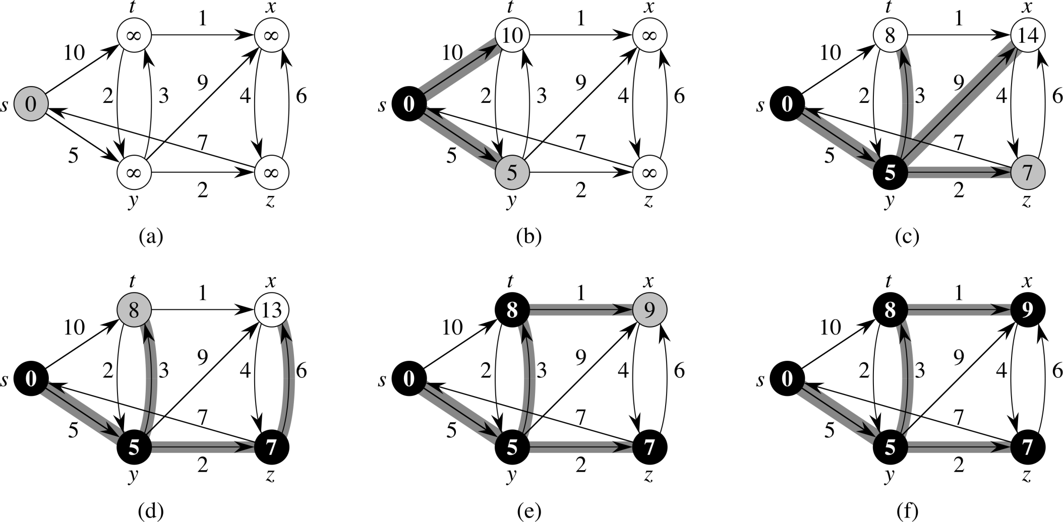
Dijkstra’s Algorithm: Example

Slide 17

Dijkstra’s Algorithm: Running-Time
Running time: O(|E| lg |V|) if binary heap is used for Q
// Essentially Decrease-Key( )
Initialization part: O(|V|)
While loop: O(|V|)
Each Extract-Min( ): O(lg|V|)
For loop (total number of iterations for entire While loop): O(|E|)
Each Relax (Decrease-Key): lg |V|
The total for the For loop: O(|E| lg |V|)
Together: O(|V| lg |V|)

