Slide 1
Stock Selection and Portfolio Construction in Emerging Markets Using Quantitative Models: A Focus on the Chinese Market
Richard Lu (fl1403)

Slide 2

Emerging Markets
Emerging markets refer to economies or countries that are experiencing rapid growth and industrialization but have not yet reached the status of developed markets.
High volatility, high risk-adjusted returns potential
Examples: BRICS (Brazil, Russia, India, China, South Africa), Mexico, Indonesia, Turkey, Vietnam

Slide 3

Project Objectives
Discovering a systematic, quantitative approach to investing in EMs
Focusing on the Chinese market (CSI 300 Index)
Integrating machine learning in the stock selection process

Slide 4
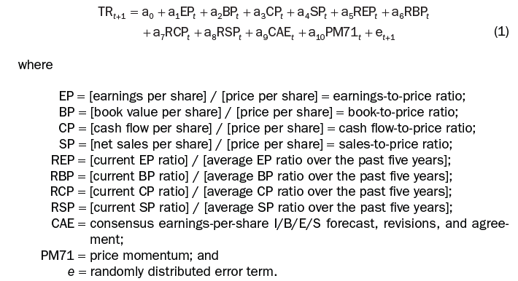
Literature Review
Guerard, Gillam, and Beheshti (2022): Stock Selection Modeling and Portfolio Selection in Emerging Markets

Slide 5
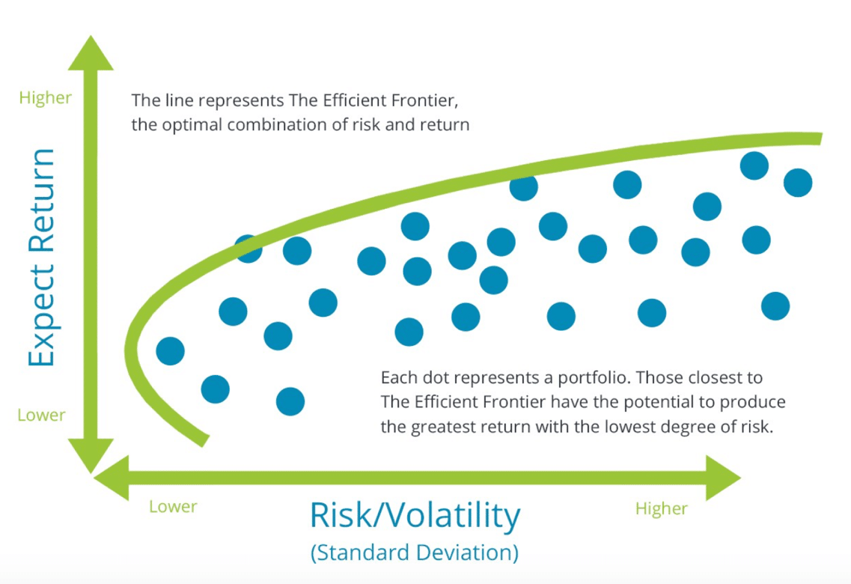
Markowitz: Modern Portfolio Theory (MPT)
Investors can construct an "optimal" portfolio that maximizes expected return for a given level of risk, or alternatively, minimizes risk for a given level of expected return by carefully selecting and combining assets.

Slide 6
Relevant Advancements
Advances in EM stock selection (e.g., Harvey 1995, Haugen & Baker 1996).
Recent applications of nonlinear models for stock selection, such as XGBoost (Zhang & Li 2020)

Slide 7

Research Framework
This project aims to integrate both fundamental and technical analysis for the Chinese market portfolio construction.
Stocks are selected quarterly based on predicted quarterly returns according to fundamental data, and each quarter’s portfolio either (1) assigns equal weights to all selected stocks for the whole quarter or (2) is dynamically optimized on a weekly basis via technical analysis
Comparisons to the CSI 300 index are made in the end to determine each method’s performance

Slide 8

Data Preprocessing & Feature Engineering
Fundamental data source: Bloomberg Terminal
Technical data: generated from daily stock closing prices by TA-Lib
Fundamental features: book value per share, earnings per share, revenue per share, etc.
Technical features: TRIX, RSI, PPO, MOM, etc
Data preprocessing steps: handling missing values, winsorizing outliers, standardization

Slide 9
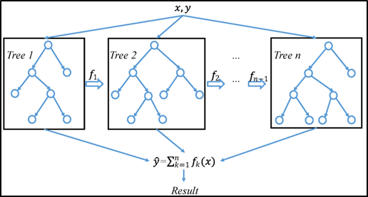
XGBoost
Gradient boosting: each new model (decision tree in this case) attempts to correct the errors made by previous models by minimizing an objective function, improving overall accuracy
Regularization: XGBoost includes L1 (Lasso) and L2 (Ridge) regularization terms in its objective function, which helps prevent overfitting and makes it more robust
Non-linear relationship is captured

Slide 10
Stock Return Prediction with XGBoost
Features: either fundamental features (quarterly) or technical features (weekly)
Training period: 2001-2020
Testing period: 2020-2024
Regression: XGBRegressor
Loss: MSE, MAPE, etc

Slide 11
Portfolio Construction Strategies
Quarterly Rebalanced Equal-Weighted Portfolio
Selects stocks with predicted quarterly returns in the top 25% percentile
Every stock has the same weight in the portfolio for the whole quarter
Ensures transparency and simplicity
Weekly Rebalanced Non-Equal-Weighted Portfolio
Still includes the same stocks in the above portfolio
Uses technical features and XGBoost to predict next week’s returns for each stock
Applies Markowitz mean-variance analysis in Riskfolio-Lib to find the efficient portfolio with the minimum risk for next week

Slide 12
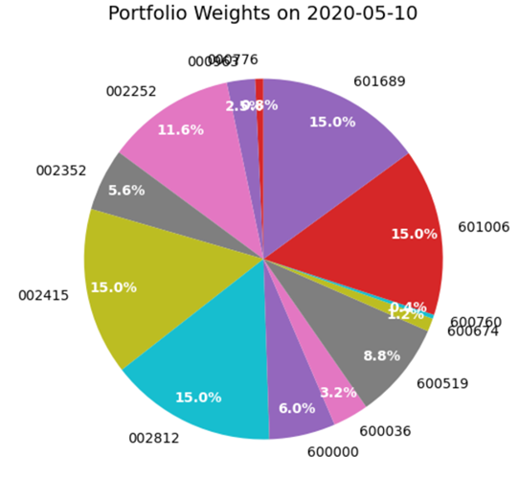
Riskfolio-Lib
An open-source Python library designed to simplify the process of portfolio optimization and risk management
15% cap on individual stock weights
Full capital allocation (sum of weights=1)
No shorting

Slide 13
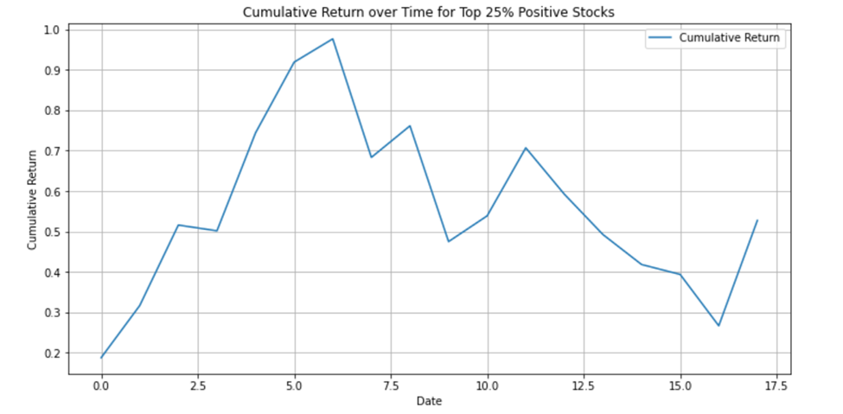
Portfolio Performance
Equal-weighted portfolio cumulative return:

Slide 14
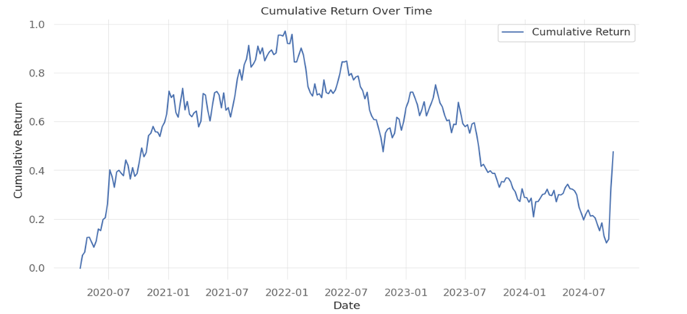
Portfolio Performance
Weekly-optimized portfolio cumulative return:

Slide 15
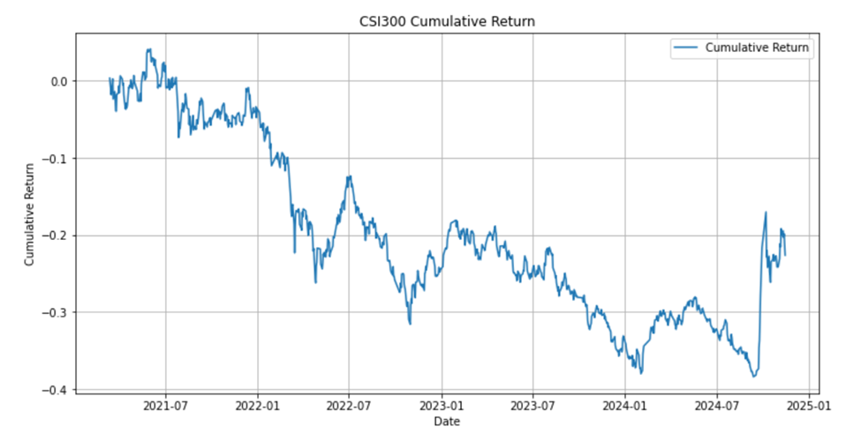
Benchmark
CSI 300 cumulative return:

Slide 16
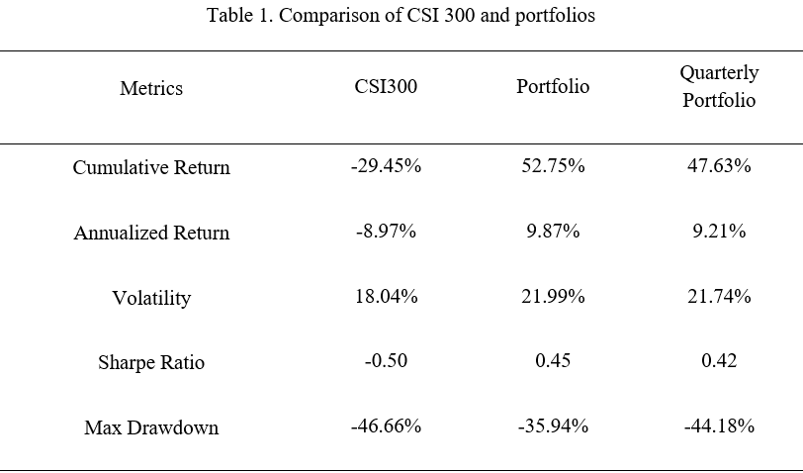
Portfolio Performance Stats

Slide 17

Insights from the Results
Both strategies outperform CSI 300 benchmark
Equal-weighted strategy is simpler, fundamental-driven and has competitive performance
Minimum-risk strategy is dynamic; it yields marginal improvements (lower volatility) but is more complex and costly to implement

Slide 18

Key Findings and Practical Implications
In emerging markets like China, fundamental analysis still holds significant value
Dynamic rebalancing with technical indicators offers limited additional benefit in this context
Practical implications for portfolio managers focusing on EMs

Slide 19
Conclusion and Future Research
Importance of fundamentals in the Chinese equity market
Complex technical-based optimization may not always lead to superior results
Potential areas for future research: exploring other EMs, fine tuning parameters through gridsearch, applying deep learning models, further analyzing the role of technical indicators.

Slide 20


