Slide 1
LoRa
Fedir, Richard, Jian

Slide 2
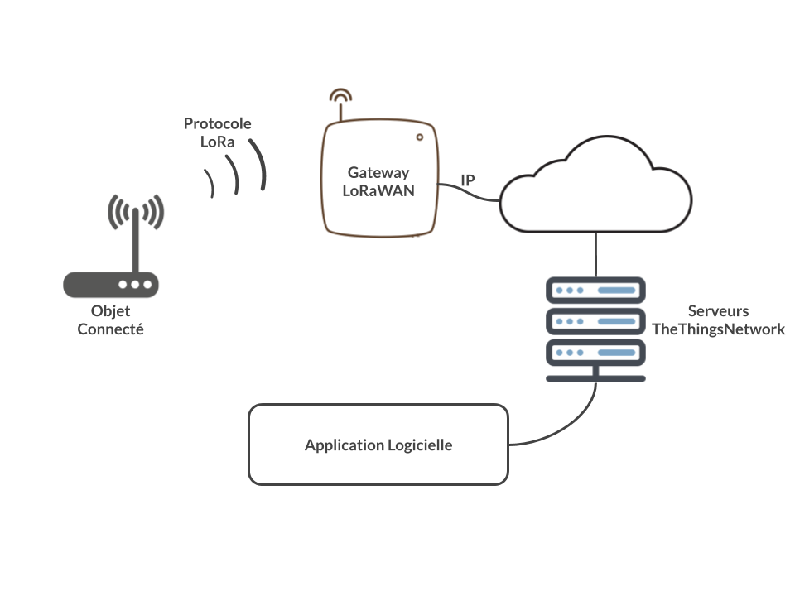
What is LoRa
LoRa, short for Long Range, is a wireless communication technology designed for long-range, low-power communication between IoT (Internet of Things) devices. It operates on unlicensed radio frequencies and is characterized by its long-range capabilities, low power consumption, and ability to penetrate obstacles.

Slide 3
Benefits of LoRa
Long Range: LoRa can provide communication over distances of several kilometers in urban environments and even tens of kilometers in rural areas, depending on the line-of-sight conditions and terrain.
Low Power Consumption: LoRa devices are designed to operate on battery power for extended periods, making them suitable for IoT applications where power efficiency is crucial.
Low Data Rates: LoRa supports relatively low data rates compared to other wireless technologies like Wi-Fi or cellular. This trade-off enables longer-range communication while conserving battery life.

Slide 4
Comparison between LoRa and ESP8266
Range:
LoRa: LoRa technology provides long-range communication, typically several kilometers in urban environments and even tens of kilometers in rural areas, with line-of-sight conditions.
ESP8266: ESP8266 provides local area network (LAN) connectivity through Wi-Fi, typically limited to indoor or local outdoor environments within the range of a Wi-Fi router.
Data Rates:
LoRa: LoRa supports relatively low data rates compared to other wireless technologies like Wi-Fi or cellular. This trade-off enables longer-range communication while conserving battery life.
ESP8266: ESP8266 supports higher data rates compared to LoRa, making it suitable for applications requiring higher throughput or real-time communication over Wi-Fi networks.
Use Cases:
LoRa: LoRa is commonly used in IoT applications where long-range communication is required, such as smart cities, agriculture, environmental monitoring, and asset tracking.
ESP8266: ESP8266 is widely used in IoT projects for connecting devices to Wi-Fi networks and the internet. It is used in applications such as home automation, smart devices, IoT sensors, and Wi-Fi-enabled gadgets.

