Slide 1
Evaluation of Virtual Reality based Mesh Saliency Maps
Abschlussvortrag zur Masterarbeit
Vortragender: Richard Metzler
Aufgabensteller: Prof. Dr. Dieter Kranzlmüller
Betreuer: Markus Wiedemann
Datum des Vortrags: 18.09.2017

Slide 2
Outline
Goal of this work
Difference analysis of automatically computed, and through user selections determined important parts of 3D objects
Discussion of results as well as possible influences of immersive virtual reality environments
Background
Automated complexity reduction of 3D objects for real-time rendering
Maintain perceived quality and detail as much as possible
Antrittsvortrag Richard Metzler
1/12

Slide 3
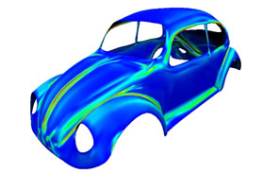
Introduction
Terms
Mesh Saliency
  Prominence of surface points of objects in 3D space
  Measure of perceived importance, based on fundamentals of human cognition¹
Immersive Virtual Reality environments
  Virtual scene is perceived as real, actual stimuli are overshadowed
http://www.digitaleng.news/de/polygonal-mesh-library-for-postprocessing-3d-scan-data/
- visited 07-06-2017
Spatial indexing structures
  Allow efficient operations on 3D data
  Quad- and Octrees, R-trees...
¹ Itti, Laurent, Christof Koch, and Ernst Niebur. "A model of saliency-based visual attention for rapid scene analysis." IEEE Transactions on pattern analysis and machine intelligence 20.11 (1998): 1254-1259.
Antrittsvortrag Richard Metzler
1/12

Slide 4
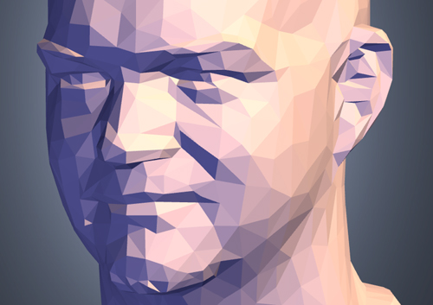

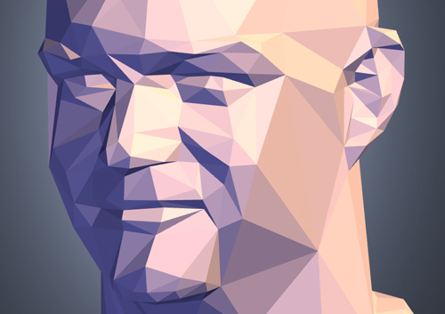
Related work
Mesh Saliency
Compare vertices to their surrounding
  Critical value: curvature
  Scalable via radius determining the surrounding
Relevant for automatic complexity reduction (number of vertices and polygons) in the context of real-time rendering
Chang Ha Lee, Amitabh Varshney, and David W Jacobs. Mesh saliency. In ACM transactions on graphics (TOG), volume 24, pages 659–666. ACM, 2005.
Antrittsvortrag Richard Metzler
1/12

Slide 5
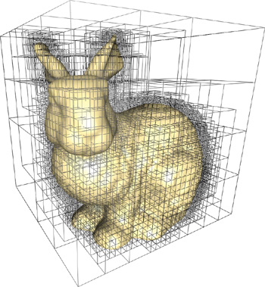
Concept
Major tasks
Implement Selection Application
  Quick, recursive indexing of loaded 3D data
  Selection functionality
Conduct User study to collect data
  Users select interesting regions via selection application
  Selections logged and used as “user saliency” values
Difference analysis
  Gather data from user study
  Compare mesh saliency and user saliency values
  Conceptualize measure of difference
http://http.developer.nvidia.com/GPUGems2/gpugems2_chapter37.html - visited 07-06-17
¹ http://assimp.sourceforge.net/
Antrittsvortrag Richard Metzler
1/12

Slide 6
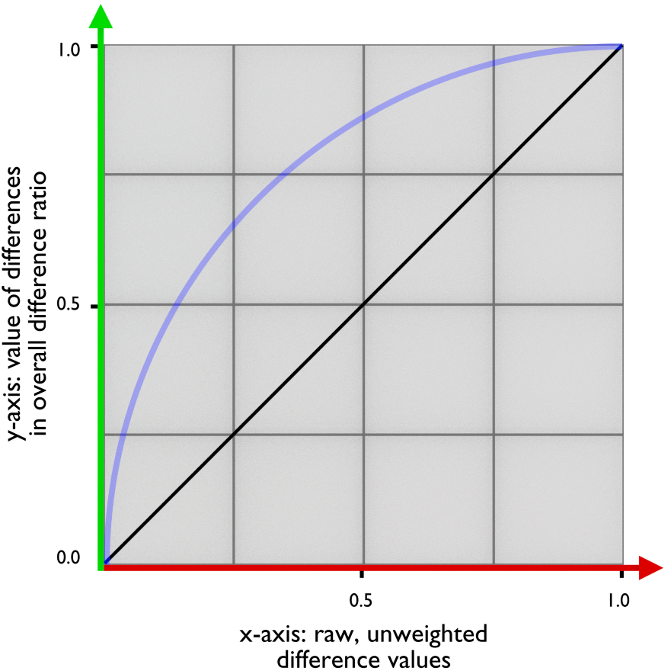
Concept
Measure of difference
SM(vi) = calculated mesh saliency value for vertex vi
SU(vi) = average user saliency value for vertex vi
|SM(vi) – SU(vi)| = (unweighted) difference for vertex vi
Sum over differences = measure of difference
All values are normalized to range [0.0, 1.0]
Some differences more interesting
    Mesh saliency values for surrounding vertices of vj high ->
    |SM(vj) – SU(vj)| gets weighted
Goal: First, quick and easy measure of differences
Antrittsvortrag Richard Metzler
1/12

Slide 7
Implementation
High-level tasks
Spatial index structure as basis
  Octree
  Implementation in C++
Selection functionality
  Select & deselect vertices
  Save selections in logfiles
Adjust application for usage at V2C
  Synchronised, multi-threaded architecture
  Server- and projector-programs
Antrittsvortrag Richard Metzler
1/12

Slide 8
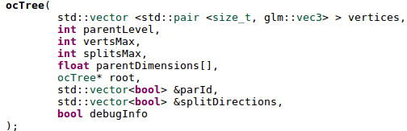

Implementation
Octree
Load objects via ASSIMP¹
Spatial indexing of loaded 3D data via octree
  Public root constructor: 3 essential parameters
  Each subtree is a leaf until maximumVertsPerLeaf is exceeded
  Split() function creates 8 new subtrees
  0.0001 margin for root borders
¹ http://assimp.sourceforge.net/
Antrittsvortrag Richard Metzler
1/12

Slide 9
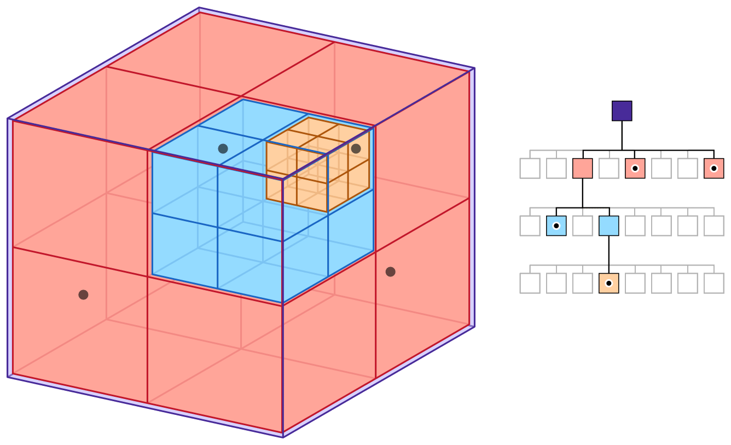
Implementation
Octree
Apple Developer Documentation https://developer.apple.com/documentation/gameplaykit/gkoctree - visited 08-12-17

Slide 10
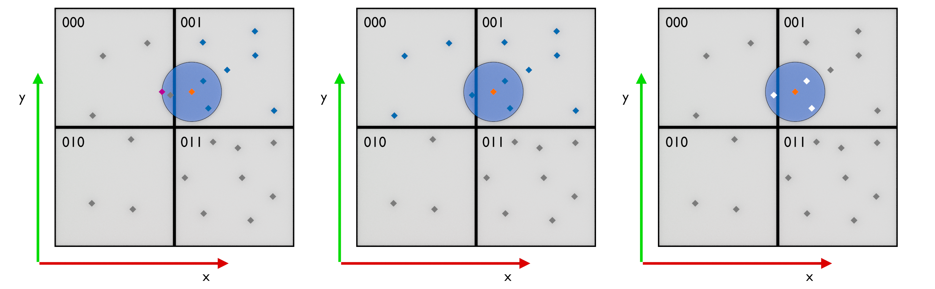
Implementation
Octree
Vertex selection
Add vertices to selection & remove them
Next-neighbor queries and possible follow-up queries
  Determine target subtree of original query
  Determine set of vertices to check
  Determine crossed borders of target subtree
  Update set of vertices to check accordingly

Slide 11
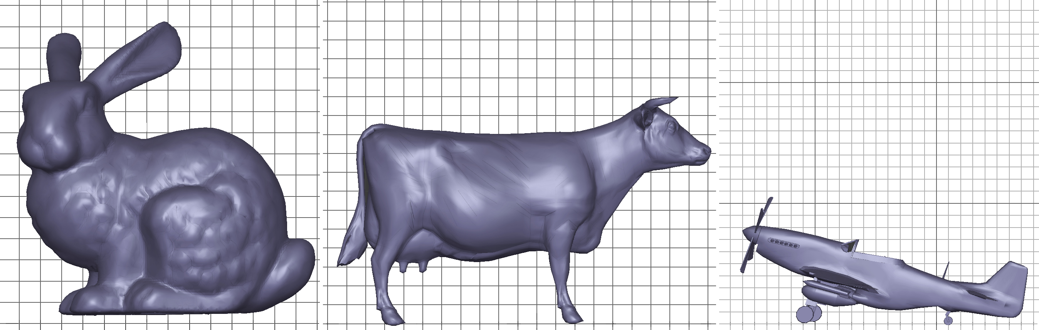
User study
Users select parts of objects considered “interesting”
Use selection application & available navigation (immersive VR)
Selection-radius around wand (95% of smallest possible subtree)
“interresting” as interpreted subjectively. Suggested hints:
  “Parts which are geometrically interesting or important”
  “Parts which intuitively attract attention”
  “Parts and regions which are characteristic for the object”
Objects
68.754 Vertices 69.648 Vertices 51.708 Vertices

Slide 12
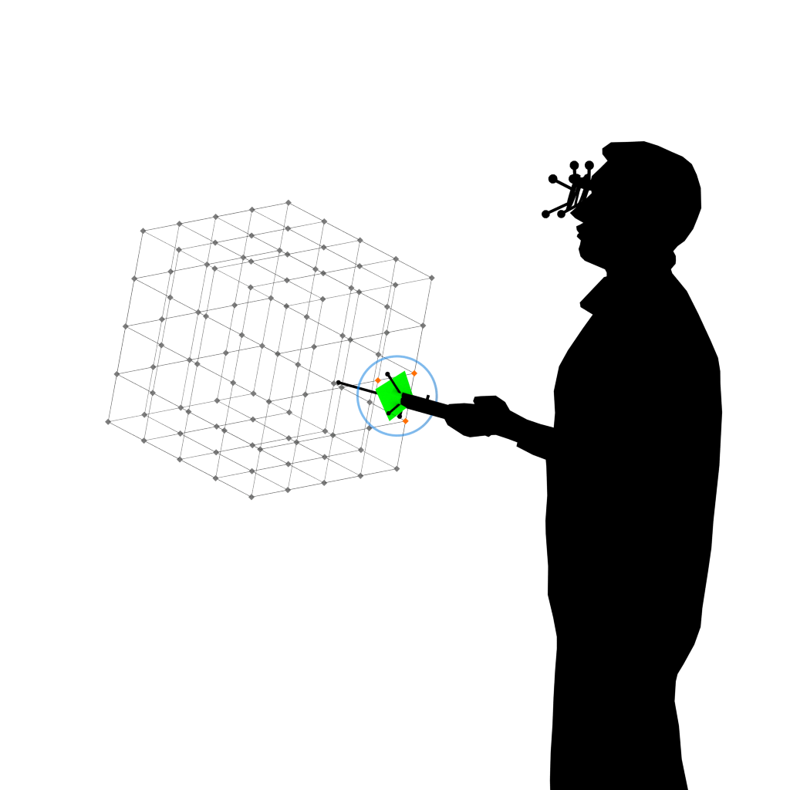
User study
Instructions
Take time to get familiar with the application
5 Minutes maximum for each one of 3 objects, premature
termination by user possible
Consider symmetry in selection
Select as precise as desired
No “correct” or “incorrect”
selection
Clue at beginning of the last minute
Questionnaire
  Demographic information
  Interests and feedback on the application

Slide 13
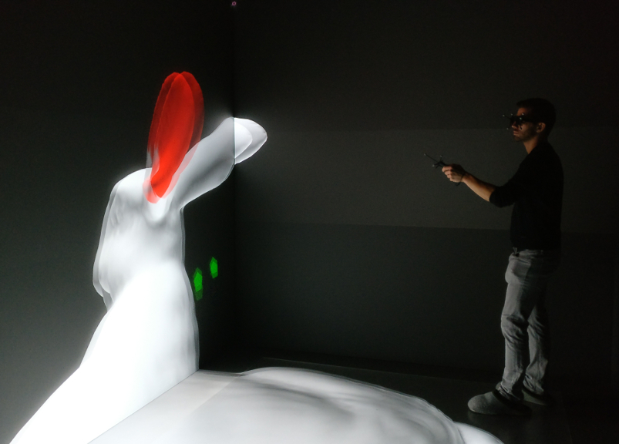
User study
Goal
3 User-selections per user
  Vertex-ID & Timestamp logged
  Saved to logfile
Get “User saliency” values
Basis for analyzing differences between computed mesh saliency maps and average user selections

Slide 14
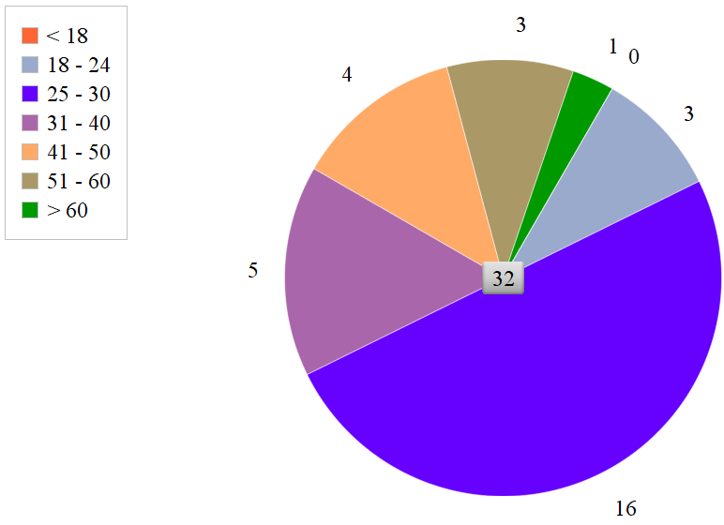
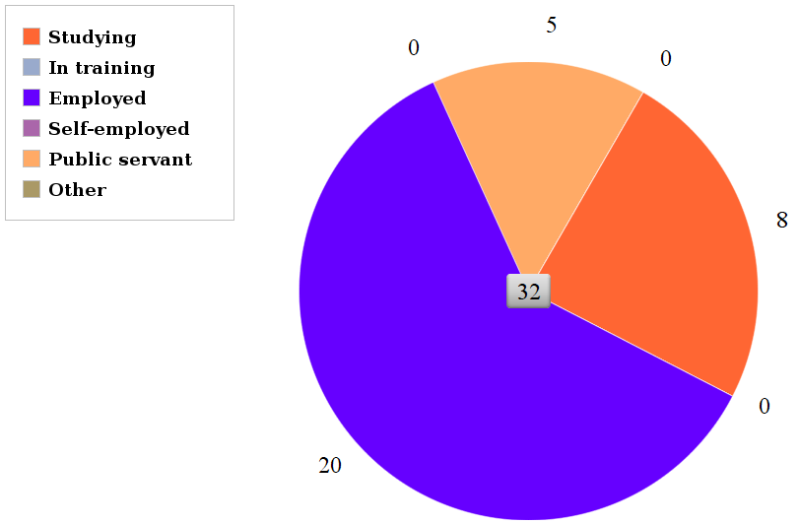
Results
Demographie
32 participants total, 50/50 male/ female
14 users with prior experience with VR; 18 users with none
No strong impairments of vision
29 right-, 3 left-handed
Age groups Working situation

Slide 15
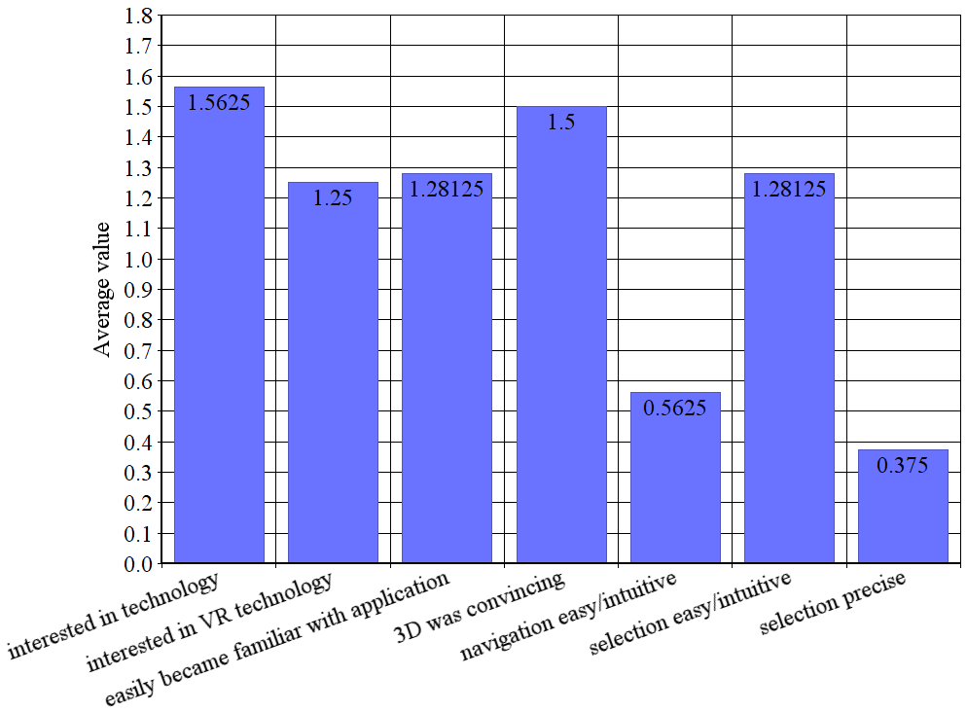
Results
Feedback on application
Average value scores:
Likert-Scale
2 = “strongly agree”
1 = “agree”
0 = “no statement”
-1 = “do not agree”
-2 = “strongly disagree”

Slide 16
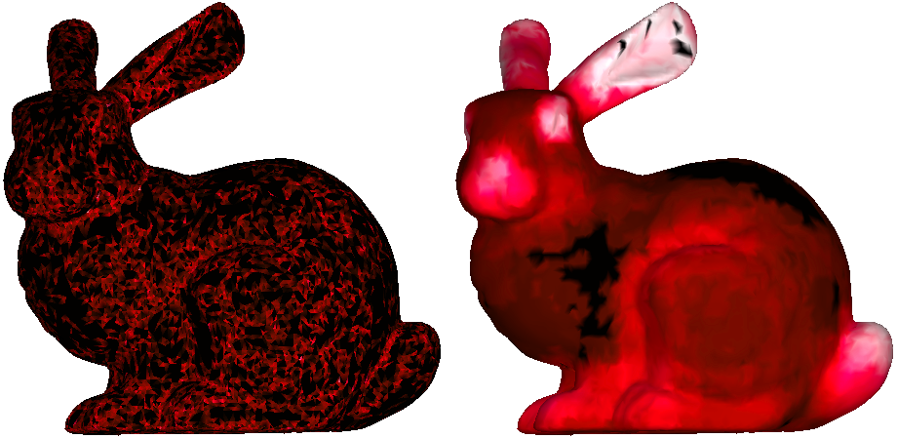
Results
Model “bunny”
Mesh Saliency Average User Saliency
Scale
0.0 0.5 1.0

Slide 17
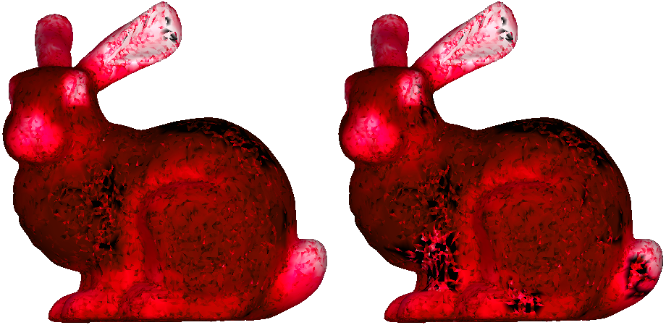
Results
Model “bunny”
Difference overall (unweighted): 0.23435
Difference overall (weighted): 0.23455
Vertices total: 68.754
Vertices weighted: 2667
Differences unweighted Differences weighted
Scale
0.0 0.5 1.0

Slide 18
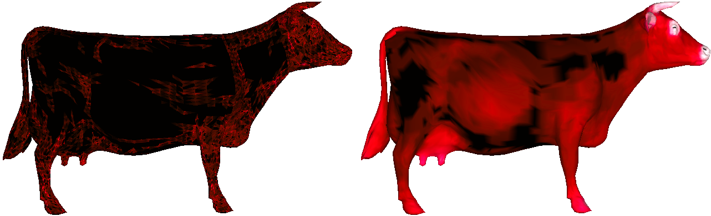
Results
Model “cow”
Differences unweighted Differences weighted
Scale
0.0 0.5 1.0

Slide 19
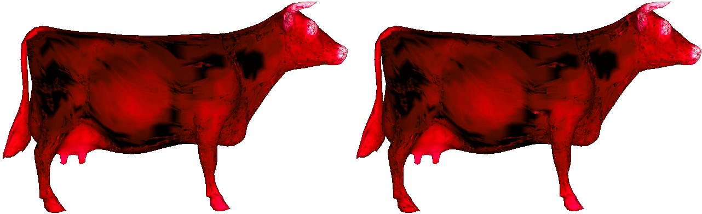
Results
Model “cow”
Difference overall (unweighted): 0.27431
Difference overall (weighted): 0.26904
Vertices total: 69.648
Vertices weighted: 3200
Mesh Saliency Average User Saliency
Scale
0.0 0.5 1.0

Slide 20
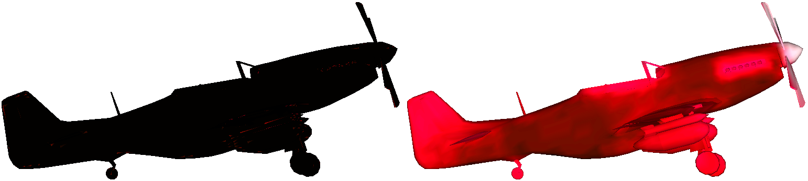
Results
Model “P51”
Mesh Saliency Average User Saliency
Scale
0.0 0.5 1.0

Slide 21
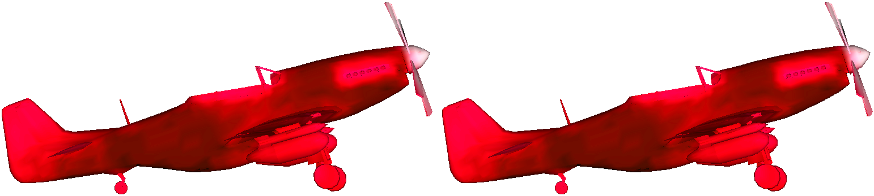
Results
Model “P51”
Difference overall (unweighted): 0.38002
Difference overall (weighted): 0.38002
Vertices total: 51.708
Vertices weighted: 0
Differences unweighted Differences weighted
Scale
0.0 0.5 1.0

Slide 22
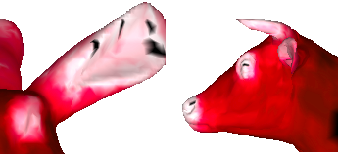
Results
Discussion
Measure of difference
Overall differences between ~0.23 and ~0.38
Low difference, as expected but
  Many very low values “water” overall result
  Very basic measure of difference
Observations
Seemingly zero-values in the middle of highly “popular” regions
  Possible faults in implementation
  Visual feedback not clear enough
Stronger variation in user saliency values
More clearly distinct patches in user saliency values
Noticeable patches of more commonly selected vertices
Clearer values for both mesh and user saliency values for non-mechanical objects

Slide 23
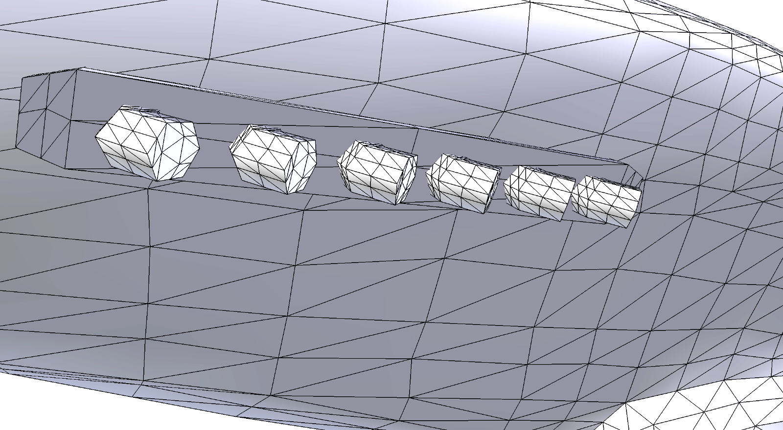
Results
Discussion
Mesh saliency with mechanical objects
Normalizing saliency values to the highest one
  Very few, extremely high values
  Almost all values are very low
Weakness of difference measure

Slide 24
Future Work
Mesh saliency with mechanical objects
Other values for variables
  Selection radius
  Object size
  Time
Further develop measure of difference
  No normalizing of values
  Multiple figures expressing differences
More extensive user study
  More users
  Other kinds of immersive VR
Use additional data collected
  Determine influences of VR (feedback)
  Use logged time

Slide 25
References
Chang Ha Lee, Amitabh Varshney, and David W Jacobs. Mesh saliency. In ACM transactions on graphics (TOG), volume 24, pages 659–666. ACM, 2005.
De Ladurantaye, Vincent, Jacques Vanden-Abeele, and Jean Rouat. Models of information processing in the visual cortex. INTECH Open Access Publisher, 2012.
http://http.developer.nvidia.com/GPUGems2/gpugems2_chapter37.html - visited 07-06-17
https://developer.apple.com/documentation/gameplaykit/gkoctree - visited 08-12-17
Antrittsvortrag Richard Metzler
12/12

