Slide 1
Evaluation of Virtual Reality based Mesh Saliency Maps
Abschlussvortrag zur Masterarbeit
Vortragender: Richard Metzler
Aufgabensteller: Prof. Dr. Dieter Kranzlmüller
Betreuer: Markus Wiedemann
Datum des Vortrags: 18.09.2017

Slide 2
Outline
Goal of this work
Evaluation of differences between automatically computed and through user selections determined important parts of 3D objects
Gathering data and discussing differences
Background
Automated complexity reduction of 3D objects for real-time rendering
Maintain perceived quality and detail as much as possible
Abschlussvortrag Richard Metzler
1/19

Slide 3
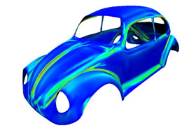
Introduction
Terms
Spatial indexing structures
  Allow efficient operations on 3D data
  Quad- and Octrees, R-trees...
Immersive Virtual Reality environments
  Virtual scene is perceived as real, actual stimuli are overshadowed
Mesh Saliency
  Prominence of surface points of objects in 3D space
  Measure of perceived importance, based on fundamentals of human cognition¹
http://www.digitaleng.news/de/polygonal-mesh-library-for-postprocessing-3d-scan-data/
- visited 07-06-2017
¹ Itti, Laurent, Christof Koch, and Ernst Niebur. "A model of saliency-based visual attention for rapid scene analysis." IEEE Transactions on pattern analysis and machine intelligence 20.11 (1998): 1254-1259.
Abschlussvortrag Richard Metzler
2/19

Slide 4
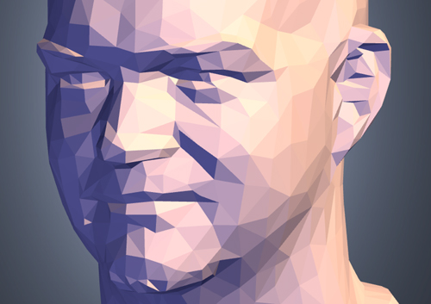

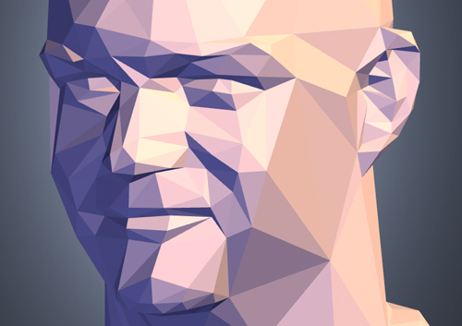
Related work
Mesh Saliency
Comparison of vertices to their surrounding to determine their perceived importance
  Critical value: curvature
  Scalable via radius determining the surrounding
Relevant for automatic complexity reduction (number of vertices and polygons) in the context of real-time rendering
Chang Ha Lee, Amitabh Varshney, and David W Jacobs. Mesh saliency. In ACM transactions on graphics (TOG), volume 24, pages 659–666. ACM, 2005.
Abschlussvortrag Richard Metzler
3/19

Slide 5
Concept
Major tasks
Implement Selection Application
  Loading and indexing of 3D data
  Selection functionality
Conduct User study to collect data
  Users select interesting regions via selection application
  Selections logged and used as “user saliency” values
Difference evaluation
  Use mesh saliency to compute mesh saliency values
  Gather data from user study
  Compare mesh saliency and user saliency values
  Qualify a measure of difference
¹ http://assimp.sourceforge.net/
Abschlussvortrag Richard Metzler
4/19

Slide 6
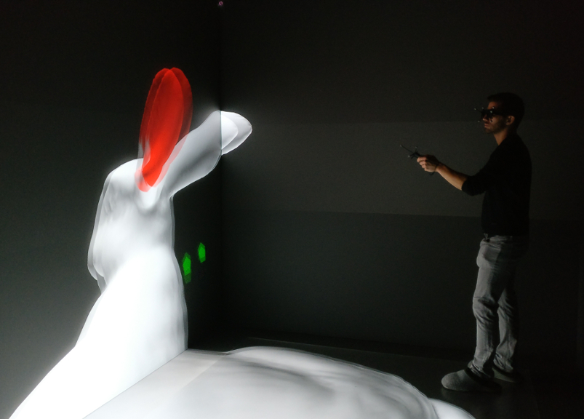
Implementation
High-level tasks
Spatial index structure as basis
  Octree, implemented in C++
  Load and render objects
  Render selection target
Selection functionality
  Select & deselect vertices
  Visual feedback on where operations take place
  Visual feedback on what is currently selected
  Log user selections & provide export function
Adjust application for usage at V2C
  Distributed rendering via graphics cluster
  Ensure synchronized rendering
http://assimp.sourceforge.net/
Abschlussvortrag Richard Metzler
5/19

Slide 7
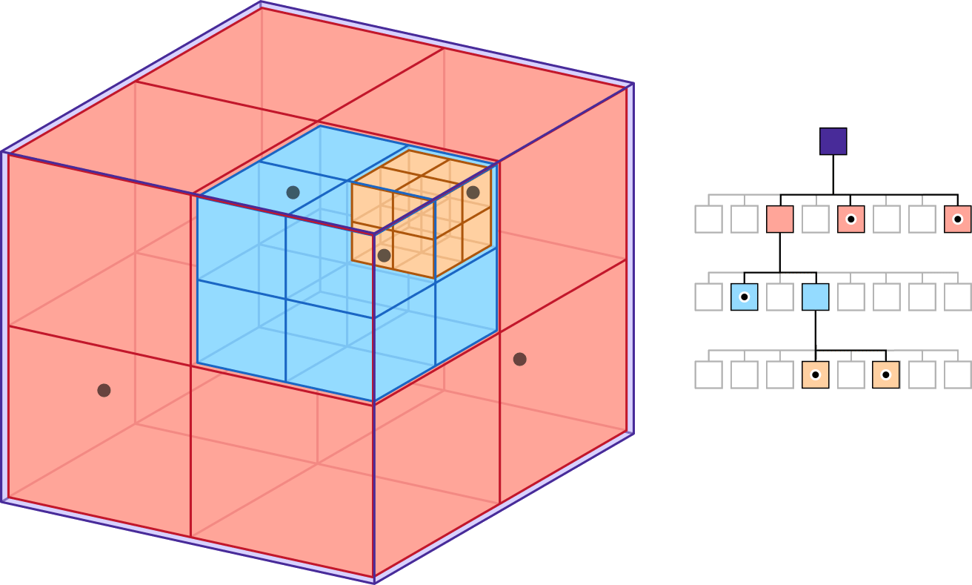
Implementation
Octree
Load objects via ASSIMP¹
Spatial indexing of loaded 3D data
Basis for fast interaction
https://developer.apple.com/documentation/gameplaykit/gkoctree - visited 08-12-17
¹ http://assimp.sourceforge.net/
Abschlussvortrag Richard Metzler
6/19

Slide 8
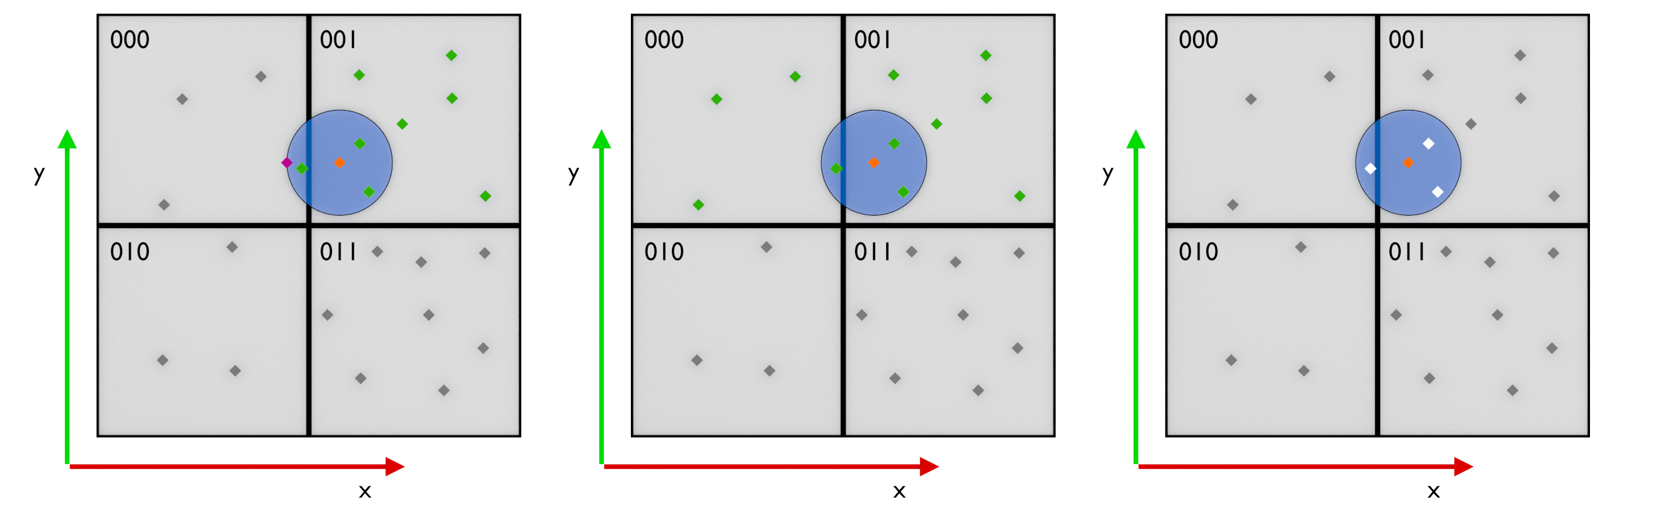
Implementation
Octree
Vertex selection
Add vertices to selection & remove them
Next-neighbor queries and possible follow-up queries
  Determine target subtree of original query
  Determine set of vertices to check
  Determine crossed borders of target subtree (radius: 95% of smallest possible subtree)
  Update set of vertices to check accordingly
Abschlussvortrag Richard Metzler
7/19

Slide 9
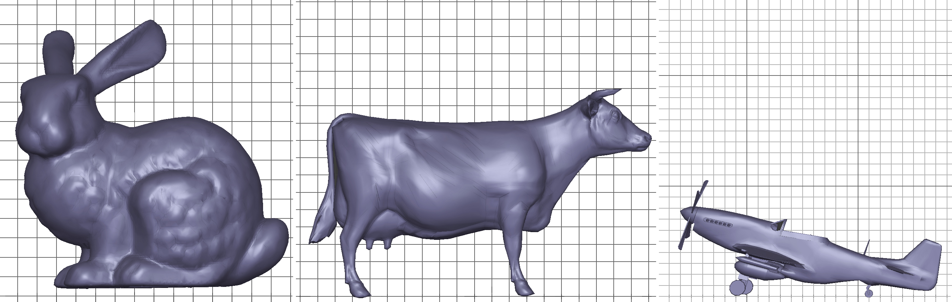
User study
Users select parts of objects considered “interesting”
“interesting” as interpreted subjectively. Suggested hints:
  “Parts which are geometrically interesting or important”
  “Parts which intuitively attract attention”
  “Parts and regions which are characteristic for the object”
Objects
68.754 Vertices 69.648 Vertices 51.708 Vertices
Abschlussvortrag Richard Metzler
8/19

Slide 10
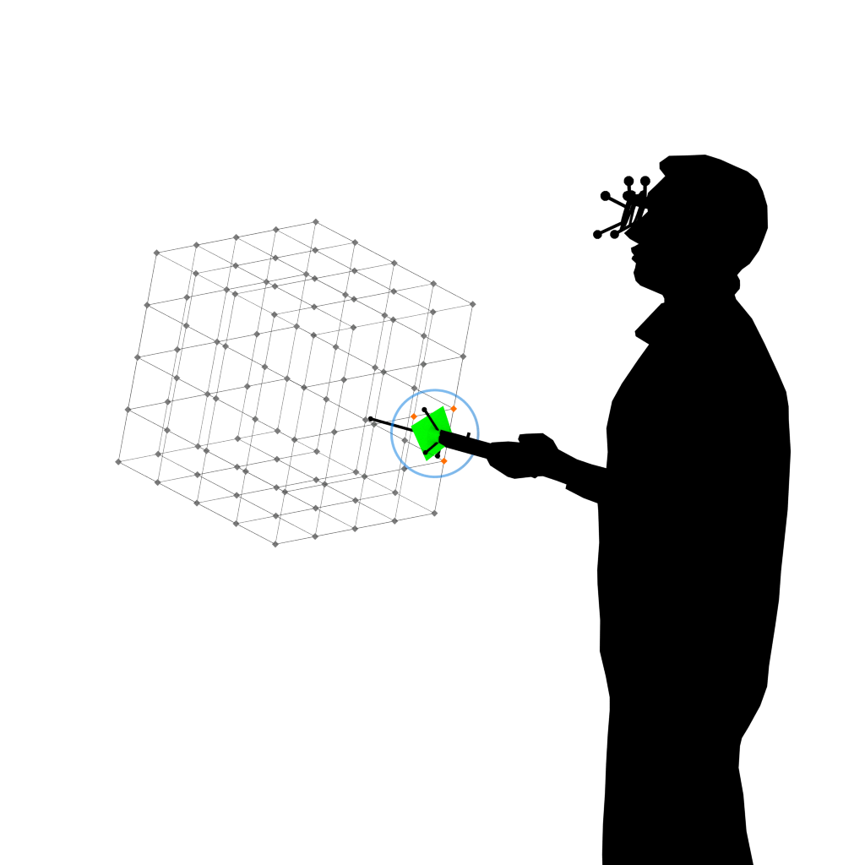
User Study
Instructions
Take time to get familiar with the application
5 Minutes maximum for each one of 3 objects, premature
termination by user possible
Consider symmetry in selection
Select as precise as desired
No “correct” or “incorrect”
selection
Clue at beginning of the last minute
Questionnaire
  Demographic information
  Interests and feedback on the application
Abschlussvortrag Richard Metzler
9/19

Slide 11
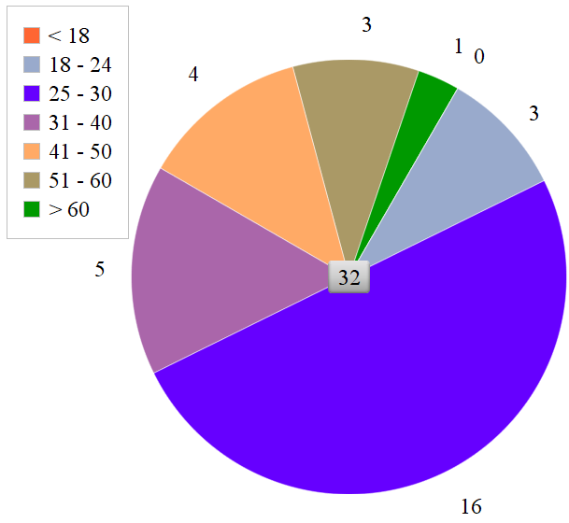
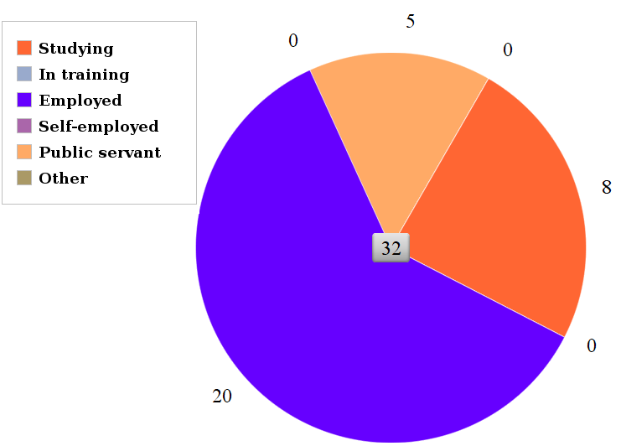
Results
Demography
32 participants total, 50/50 male/ female
14 users with prior experience with VR; 18 users with none
No strong impairments of vision
29 right-, 3 left-handed
Age groups Working situation
Abschlussvortrag Richard Metzler
10/19

Slide 12
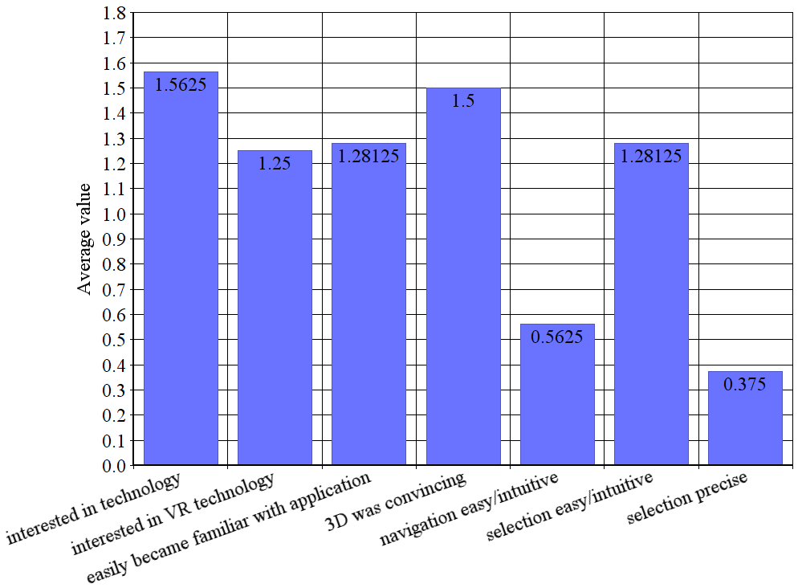
Results
Feedback on application
Average value scores:
Likert-Scale
2 = “strongly agree”
1 = “agree”
0 = “no statement”
-1 = “do not agree”
-2 = “strongly disagree”
Abschlussvortrag Richard Metzler
11/19

Slide 13
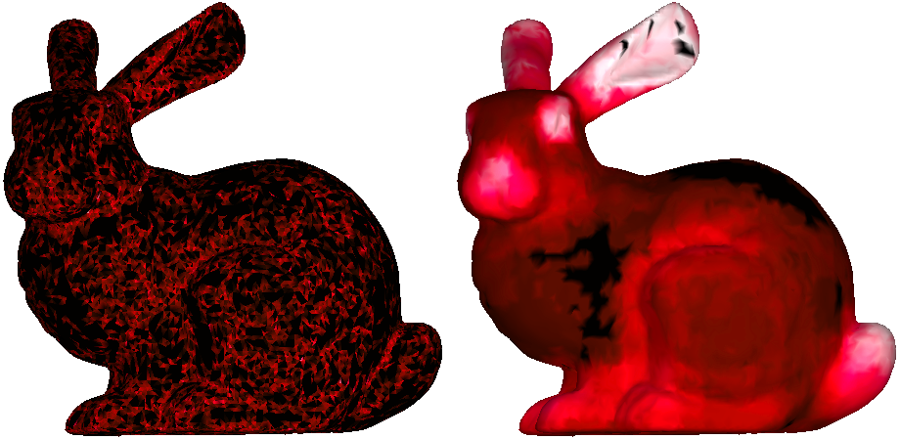
Results
Model “bunny”
Mesh Saliency Average User Saliency
Scale
0.0 0.5 1.0
Abschlussvortrag Richard Metzler
12/19

Slide 14
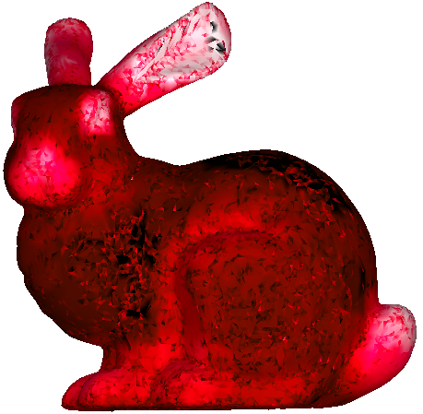
Results
Model “bunny”
Difference overall: 0.23435
Scale
0.0 0.5 1.0
Abschlussvortrag Richard Metzler
13/19

Slide 15
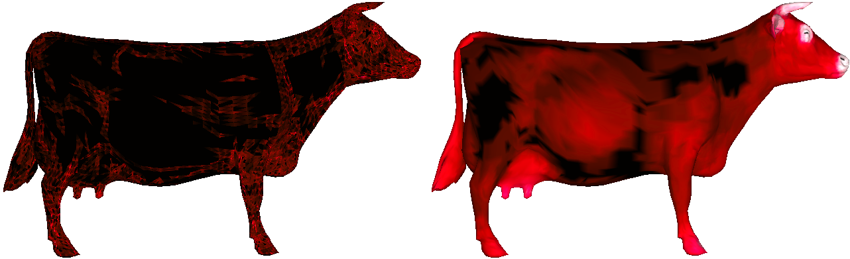
Results
Model “cow”
Mesh Saliency Average User Saliency
Scale
0.0 0.5 1.0
Abschlussvortrag Richard Metzler
14/19

Slide 16
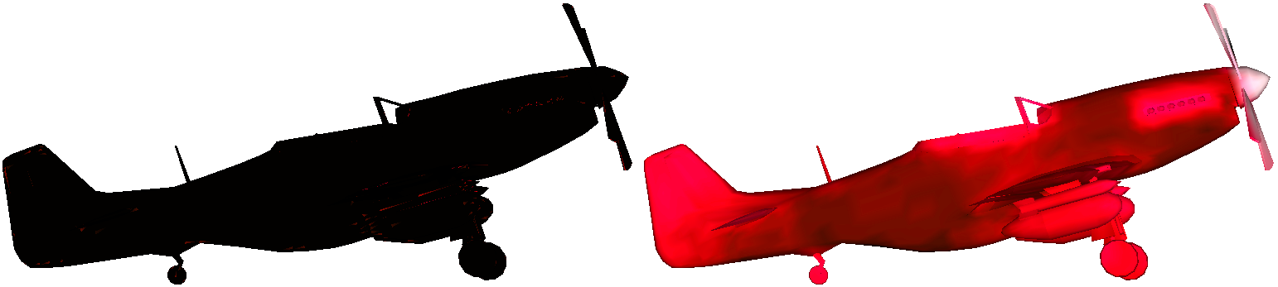
Results
Model “P51”
Mesh Saliency Average User Saliency
Scale
0.0 0.5 1.0
Abschlussvortrag Richard Metzler
15/19

Slide 17
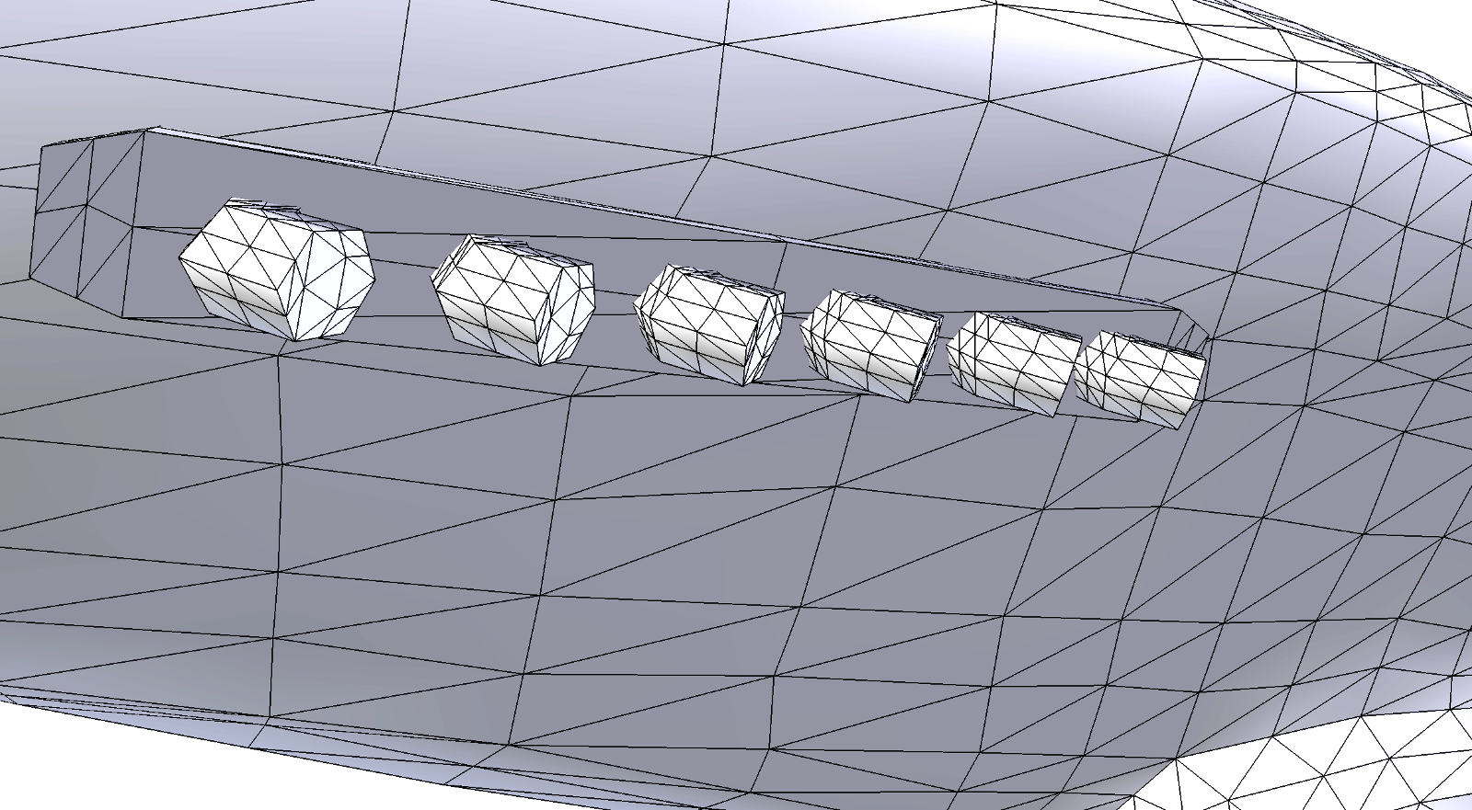
Results
Discussion
Mesh saliency with mechanical objects
Normalizing saliency values to the highest one
  Very few, extremely high values
  Almost all values are very low
Weakness of difference measure
Abschlussvortrag Richard Metzler
17/19

Slide 18
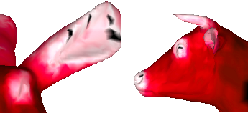
Results
Discussion
Measure of difference
Overall differences between ~0.23 and ~0.38
Low difference, as expected but
Many very low values “water” overall result
Observations
Seemingly zero-values in the middle of highly “popular” regions
Possible faults in implementation
Stronger variation in user saliency values
More clearly distinct patches in user saliency values
Clearer values for both mesh and user saliency values for non-mechanical objects
Abschlussvortrag Richard Metzler
16/19

Slide 19
Future Work
Further develop measure of difference
  No normalizing of values
  Multiple figures expressing differences
Other values for variables
  Selection radius
  Object size
  Time
More extensive user study
  More users
  Other kinds of immersive VR
Abschlussvortrag Richard Metzler
18/19

Slide 20
References
Chang Ha Lee, Amitabh Varshney, and David W Jacobs. Mesh saliency. In ACM transactions on graphics (TOG), volume 24, pages 659–666. ACM, 2005.
De Ladurantaye, Vincent, Jacques Vanden-Abeele, and Jean Rouat. Models of information processing in the visual cortex. INTECH Open Access Publisher, 2012.
Pausch, Randy, Dennis Proffitt, and George Williams. "Quantifying immersion in virtual reality." Proceedings of the 24th annual conference on Computer graphics and interactive techniques. ACM Press/Addison-Wesley Publishing Co., 1997.
Rodrigo Barni Munaretti. Perceptual guidance in mesh processing and rendering using mesh saliency. 2007.
Paul Atchley and Arthur F Kramer. Attentional control within 3 -d space.
Gabriel Taubin. Estimating the tensor of curvature of a surface from a polyhedral approximation. In Computer Vision, 1995. Proceedings., Fifth International Conference on, pages 902–907. IEEE, 1995.
Garland, Michael, and Paul S. Heckbert. "Surface simplification using quadric error metrics." Proceedings of the 24th annual conference on Computer graphics and interactive techniques. ACM Press/Addison-Wesley Publishing Co., 1997.
Taubin, Gabriel. "Estimating the tensor of curvature of a surface from a polyhedral approximation." Computer Vision, 1995. Proceedings., Fifth International Conference on. IEEE, 1995.
https://github.com/alecjacobson/qslim
http://assimp.sourceforge.net/
https://developer.apple.com/documentation/gameplaykit/gkoctree - visited 08-12-17
http://http.developer.nvidia.com/GPUGems2/gpugems2_chapter37.html - visited 07-06-17
Abschlussvortrag Richard Metzler
19/19

Slide 21
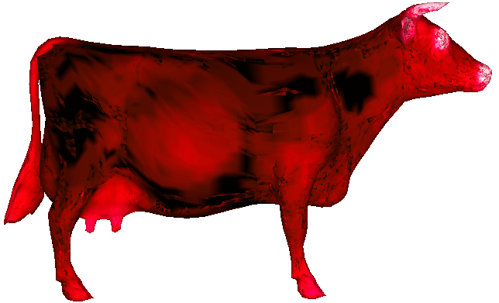
Results
Model “cow”
Difference overall: 0.27431
Scale
0.0 0.5 1.0
Abschlussvortrag Richard Metzler
17/23

Slide 22
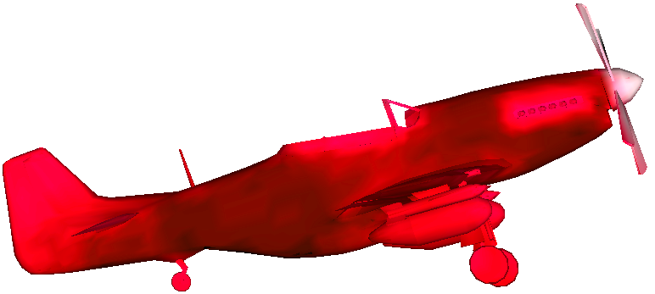
Results
Model “P51”
Difference overall: 0.38002
Scale
0.0 0.5 1.0
Abschlussvortrag Richard Metzler
19/23

